Slide 1













Teen behaviour analysis
By: Asmaa Mohamed Ali

Slide 2
Agenda
01
02
03
04
storytelling
explaining my data
my quistions
what I gained?

Slide 3

Storytelling
One day, I was sitting with my father, who is an educational psychologist. He provided me with some data and asked me to analyse it for him, as he needed it for a study.
He needed to study the behaviour of teenagers in different situations.
Even though he left me alone and didn't tell me what the problem was, I turned to him for every question I had.

Slide 4

ID
Name
Age
Gender
Location
Anxiety_Level
Depression_Level
Addiction_Level
Self-Esteem
School Grade
Academic Performance
Sleep_Hours
Exercise_Hours
Parental_Control
My Data
Family_Communication
Social_Interactions
Exploring
Daily_Usage_Hours
Phone_Usage_Purpose
Weekend_Usage_Hours
Apps_Used_Daily
Phone_Checks_Per_Day
Screen_Time_Before_Bed
Time_on_Social_Media
Time_on_Gaming
Time_on_Education

Slide 5
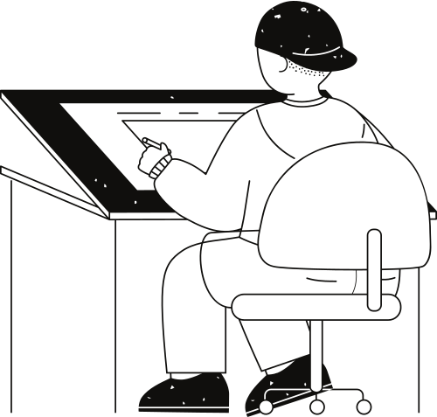
Questions

Slide 6

01.
Can behaviors differ by gender?
my visual:
What do I gain?
There’s no big difference.

Slide 7
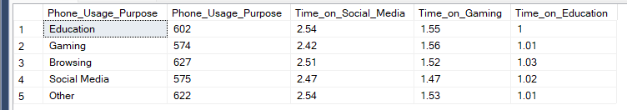
02.
Are the average hours spent learning, playing, and using social media on the phone equivalent to the purpose?
my visual:
What do I gain?
Social media actually dominates for all groups (approximately 2.4-2.5 hours).
Gaming comes in second (1.4-1.5 hours).
Education is almost the least needed (≈1 hour only).

Slide 8

03.
Is the academic performance affected by whether it is a girl or a boy?
my visual:
What do I gain?
There is no difference.

Slide 9
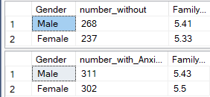
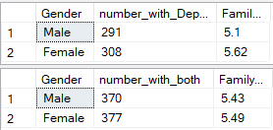
04.
Does the average amount of communication with family differ between genders? Is this affected by depression and anxiety?
my visual:
What do I gain?
Gender generally doesn't make a significant difference in family communication when the psychological state is stable or during anxiety.
However, in cases of depression only:
🔹 Males' communication with family declines significantly (5.1).
🔹 Females, on the contrary, increase their communication (5.62).

Slide 10
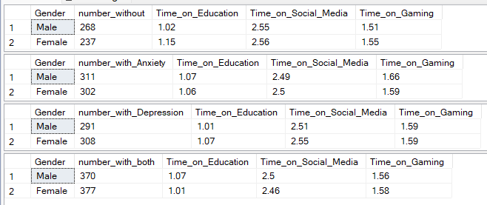
05.
Does the average time spent learning vary with increased anxiety and depression for both genders?
my visual:
my visual:
What do I gain?
Education time is very short and almost constant (≈ 1 hour), regardless of psychological state or gender.
Gaming time increases with anxiety (possibly as an escape mechanism).
Social media time is always highest (≈ 2.5 hours) → whether anxiety/depression is present or not.
The differences between boys and girls are not significant.

