Slide 1


Financial Transactions Fraud Detection

Slide 2
Overview
This analysis explores customer financial transaction data with the objective of:
- Understanding customer profiles and behaviors
- Detecting potential fraud indicators
- Providing actionable insights for risk reduction

Slide 3
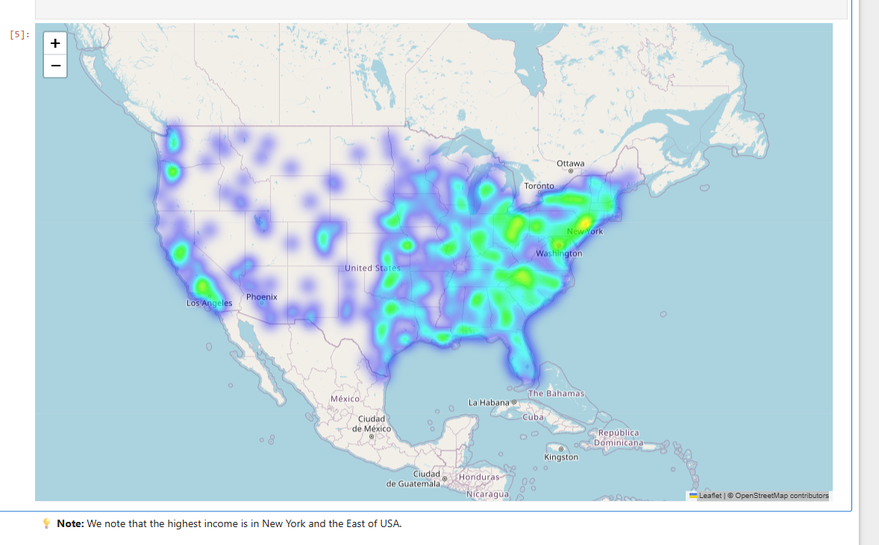
the highest income

Slide 4
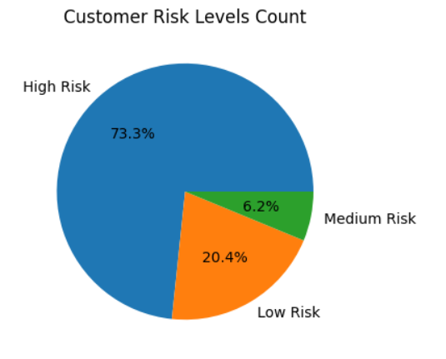
Customer Risk Levels Count

Slide 5
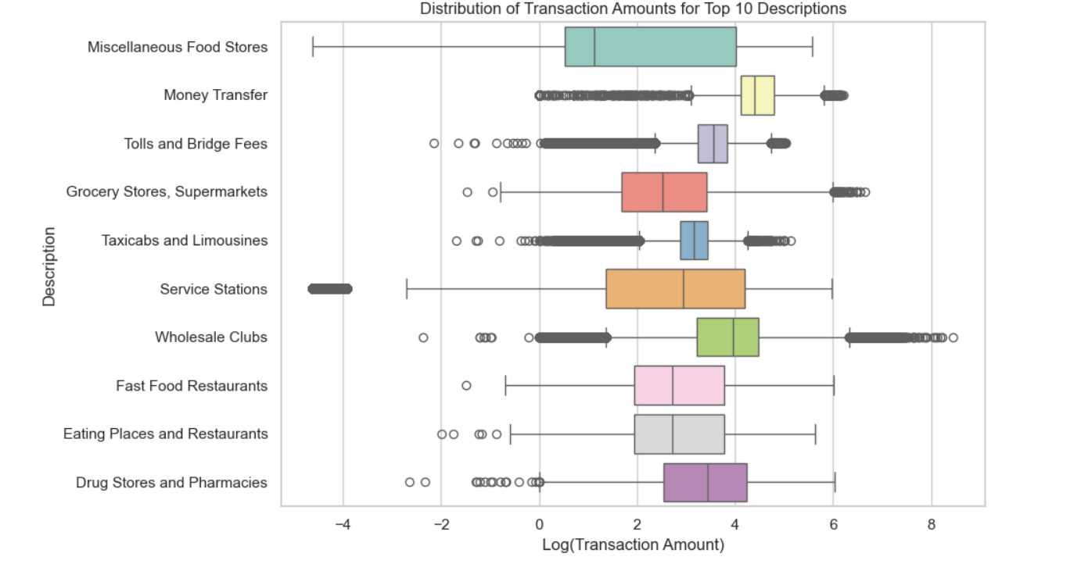
Distribution of Transaction Amounts for Top 10 Descriptions
.

Slide 6
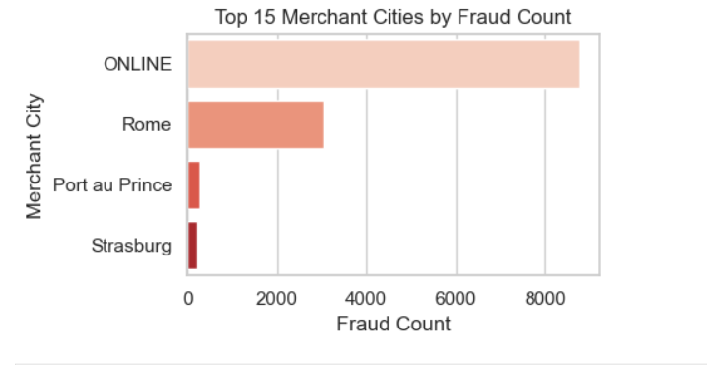
Executive Top 4 Merchant Cities by Fraud Count
Recommendations focus on stronger monitoring, proactive alerts, and fraud prevention strategies

Slide 7
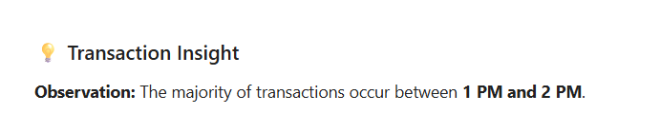
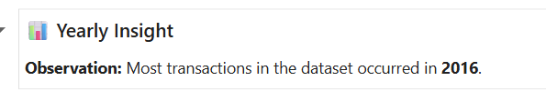
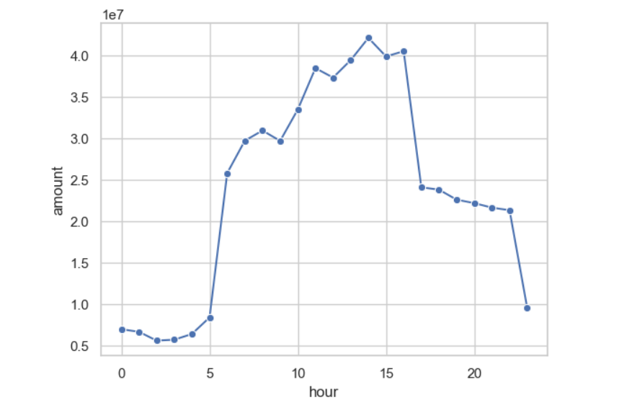
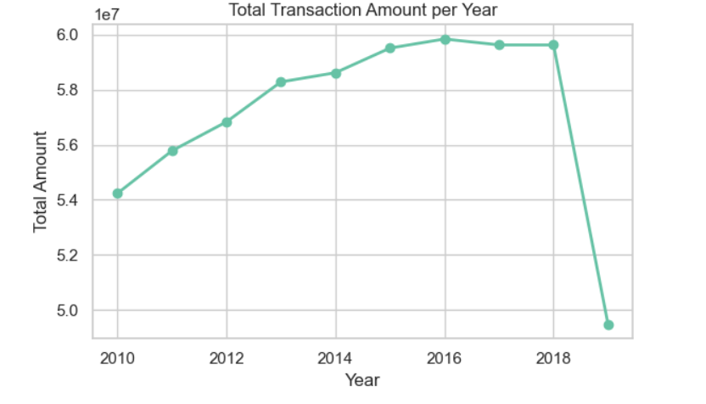

Slide 8
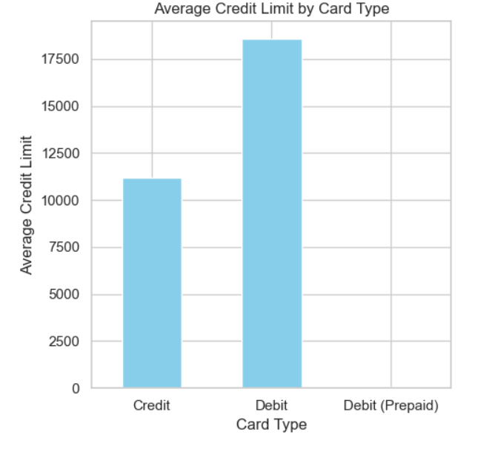
Average Credit Limit by Card Type"

Slide 9
Key Insights & Recommendations
Key Insights:
- Certain customer groups show higher fraud risk.
- Credit scores are correlated with higher debt exposure.
Recommendations:
- Strengthen monitoring for high-risk credit profiles.
- Enhance verification processes for exposed customers.
- Introduce proactive alerts for unusual card activity.

