Slide 1
Data science
sec6

Slide 2
tensorflow
Building a machine learning model in TensorFlow typically involves the following steps:
Step 1: Define the Model
Create a model by specifying the layers, activation functions, and output layers.
Choose an optimizer, loss function, and evaluation metric.
Step 2: Prepare the Data
Load, preprocess, and split the dataset into training, validation, and test sets.
Data preprocessing might include normalization, reshaping, and encoding categorical variables.

Slide 3
tensorflow
Step 3: Train the Model
Feed the training data into the model and perform forward and backward passes.
Use optimization algorithms such as stochastic gradient descent (SGD) or Adam to minimize the loss function.
Step 4: Evaluate the Model
After training, evaluate the model’s performance on the validation and test sets to assess its generalization ability.
Step 5: Deploy the Model
Once the model is trained and evaluated, deploy it to a production environment using TensorFlow Serving, TensorFlow Lite, or other deployment tools.

Slide 4
tensorflow
Building a Simple Model with TensorFlow
Let’s learn how to create and train a simple neural network with TensorFlow using the steps discussed above.
Here, we have loaded the MNIST Dataset and processed the image. Then, we have built a simple neural network using TensorFlow’s Sequential API with two layers:
dense layer with ReLU activation
an output layer with softmax activation function
At last we compiled the model using Adam Optimizer and Sparse Categorical Crossentropy, and trained the model for 5 epochs.

Slide 5
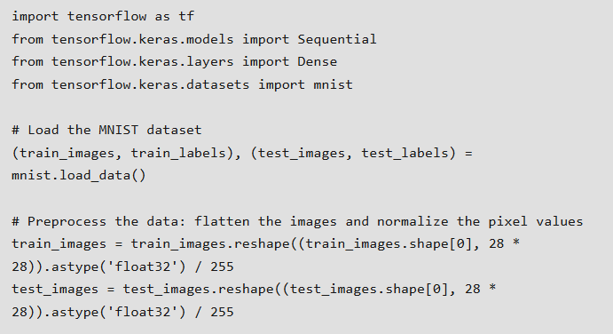
tensorflow

Slide 6
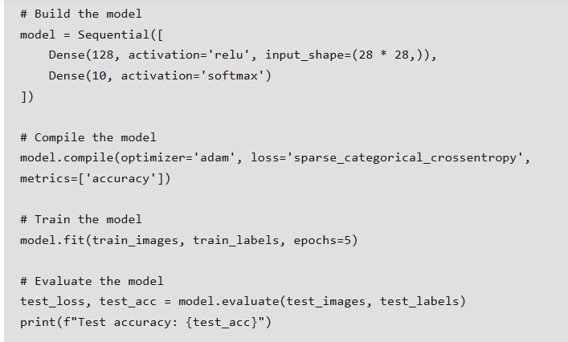
tensorflow

Slide 7
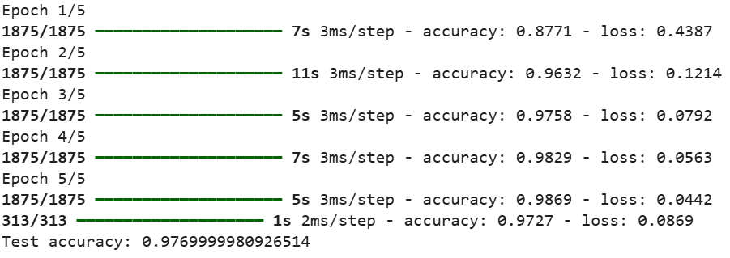
Tenserflow

Slide 8
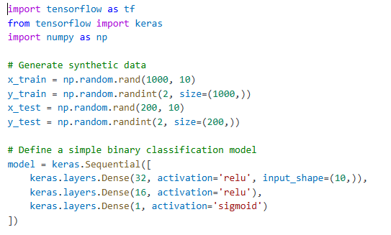
Example 1

Slide 9
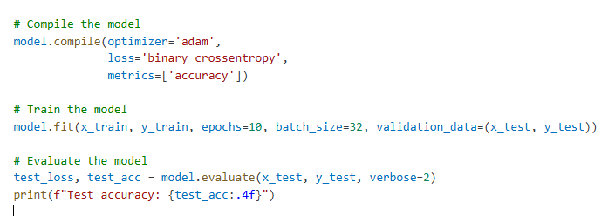
Example 1

Slide 10
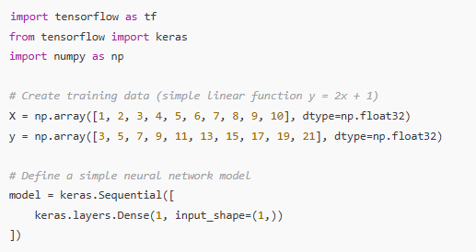
Example2

Slide 11
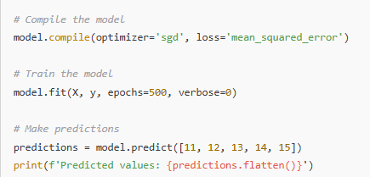
Example2

