Slide 1
Natural Language processing
Section 6

Slide 2
LSTM
Long Short-Term Memory (LSTM) is an enhanced version of the Recurrent Neural Network (RNN) , designed to solve the vanishing gradient problem.
LSTMs have special gates to control the flow of information:
Input Gate: Decides what new information to store.
Forget Gate: Chooses what information to remove.
Output Gate: Decides what information to pass on.

Slide 3
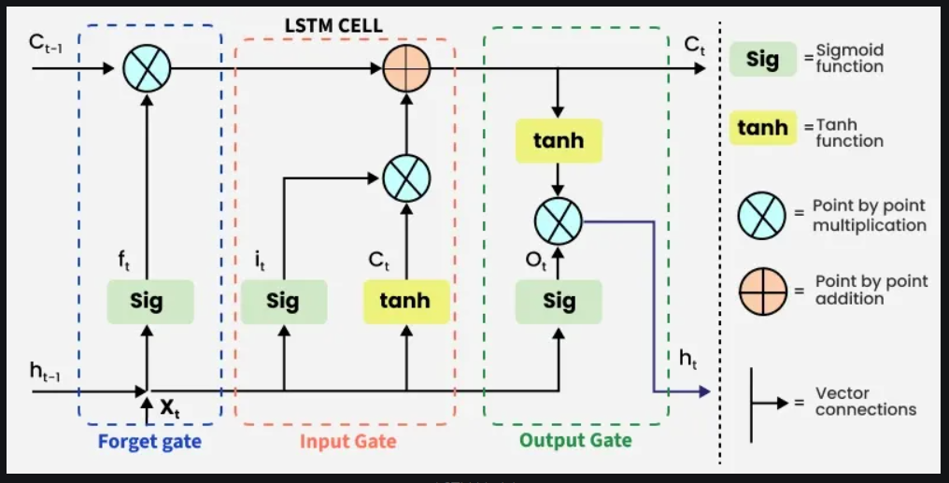

Slide 4
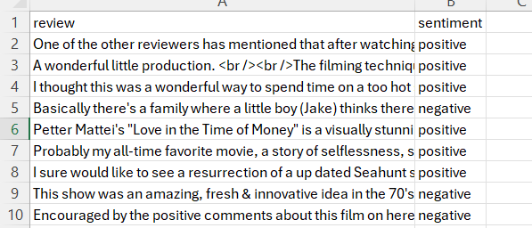
Dataset
IMDB Dataset of 50K Movie Reviews from Kaggle.
https://www.kaggle.com/datasets/lakshmi25npathi/imdb-dataset-of-50k-movie-reviews
This is a dataset for binary sentiment classification with 2 labels positive and negative

Slide 5
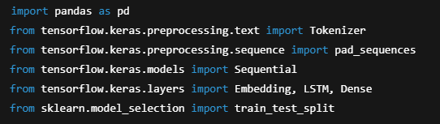
1-Import necessary libraries

Slide 6
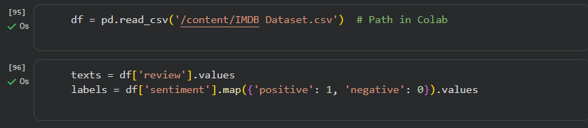
2- Load & Prepare Data

Slide 7
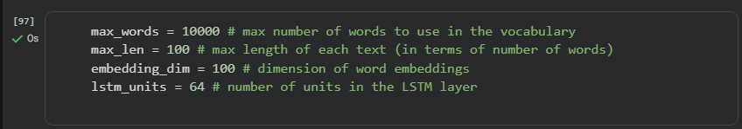
3- Model Parameters

Slide 8
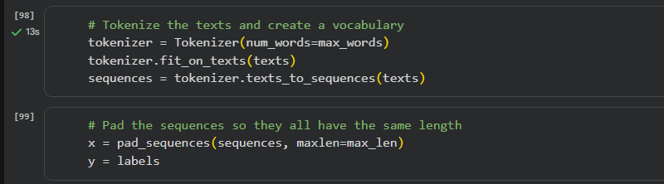
4- Tokenization & Padding

Slide 9
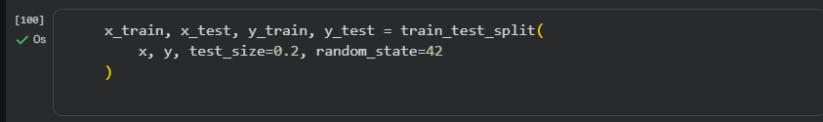
5- Train-Test Split

Slide 10
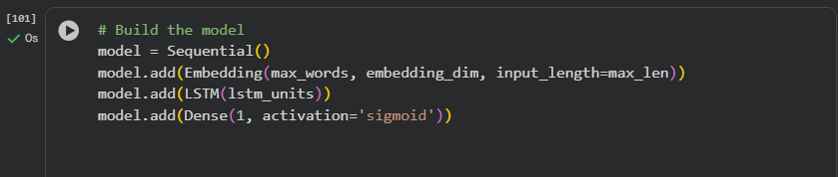
6- Build LSTM Model

Slide 11
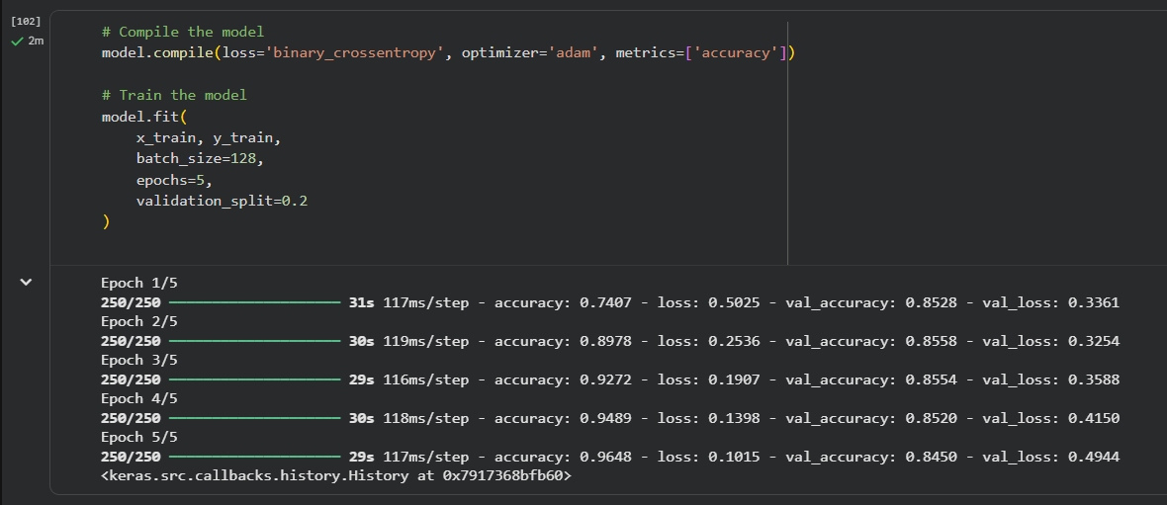
7-Compile & Train the model

Slide 12
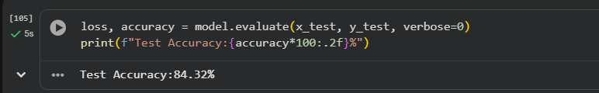
8-Test accuracy and predicting

Slide 13
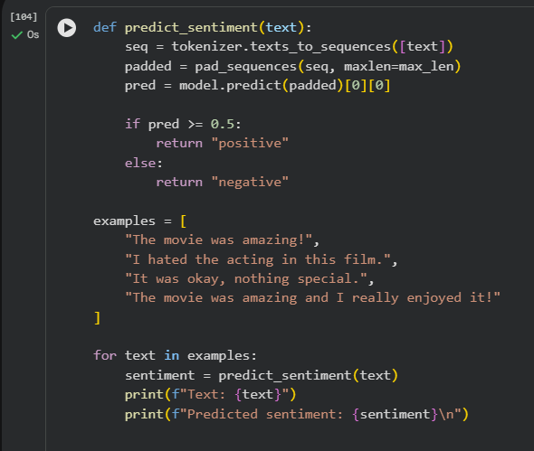
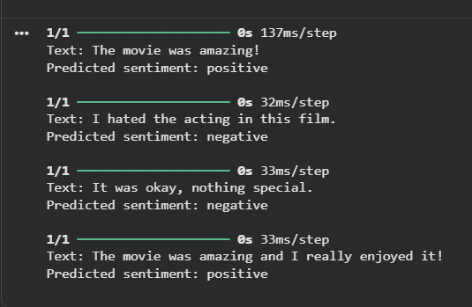

Slide 14
See you soon

