Slide 1

Employee’s Attrition Prediction Watson Healthcare
Asmaa Chraibi

Slide 2

Scope
Develop a model to predict employee's attrition in a healthcare facility

Slide 3
Data source
https://www.kaggle.com/datasets/jpmiller/employee-attrition-for-healthcare/code
Limited Dataset : 1600 records
35 features

Slide 4
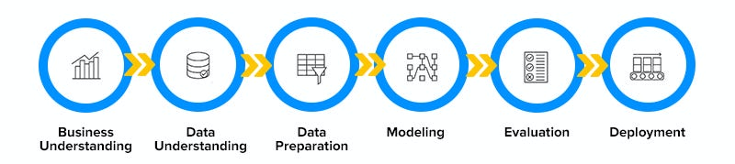
Process
https://medium.com/@zuhailinasir_26370/data-science-proces

Slide 5
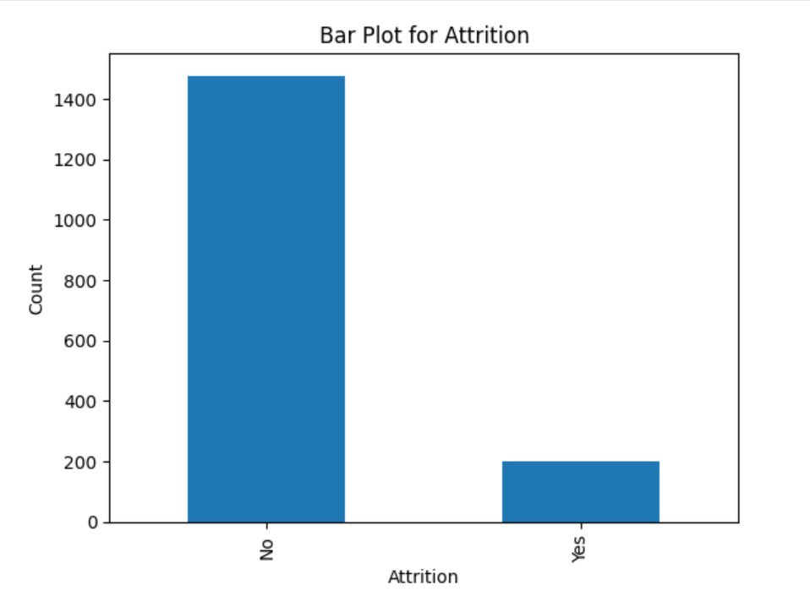
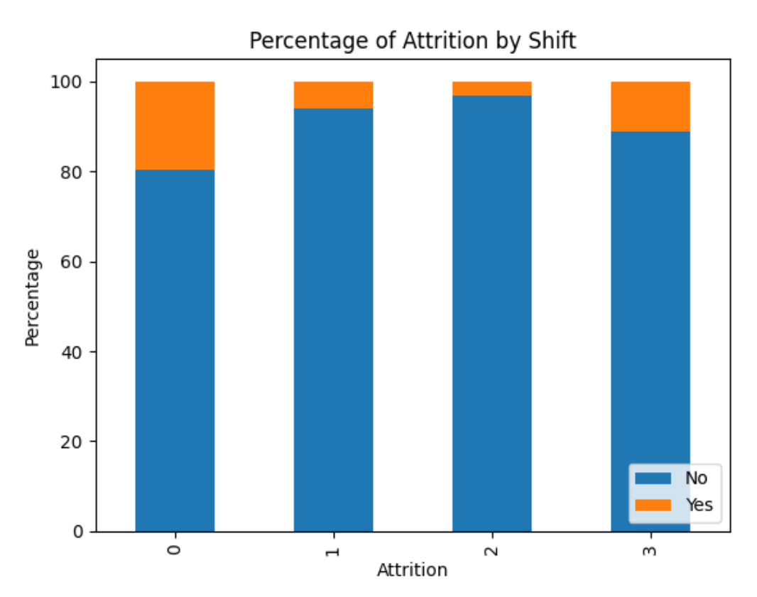
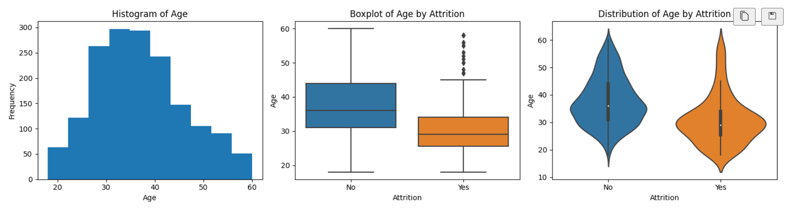
EDA snapshot

Slide 6
Features engineering
Balancing the data – SMOTE
EDA:
Dropping some features
Grouping some feature classes
Hot encoding categorical Features
Scaling using standard scaler
Features score based on studied models
Used 6 features sets including PCA

Slide 7
Classification algorithms with Grid Search CV
Logistic regression
Random Forrest
SVC
XGB Classifier
Gradient Boosting Classifier
Ada Booster Classifier
Ensemble
NN

Slide 8
Model Selection
Models

Slide 9
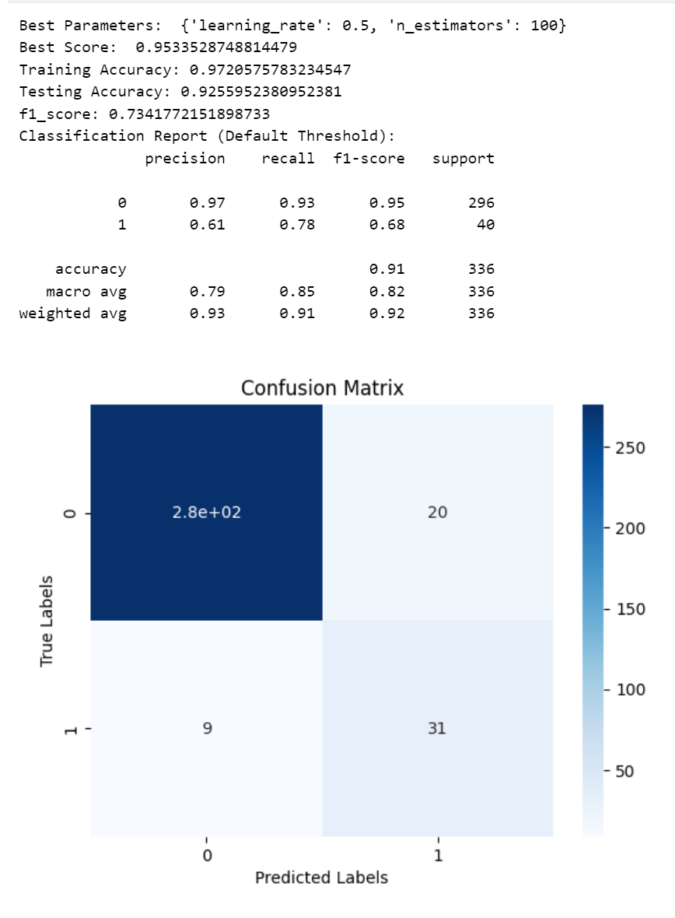
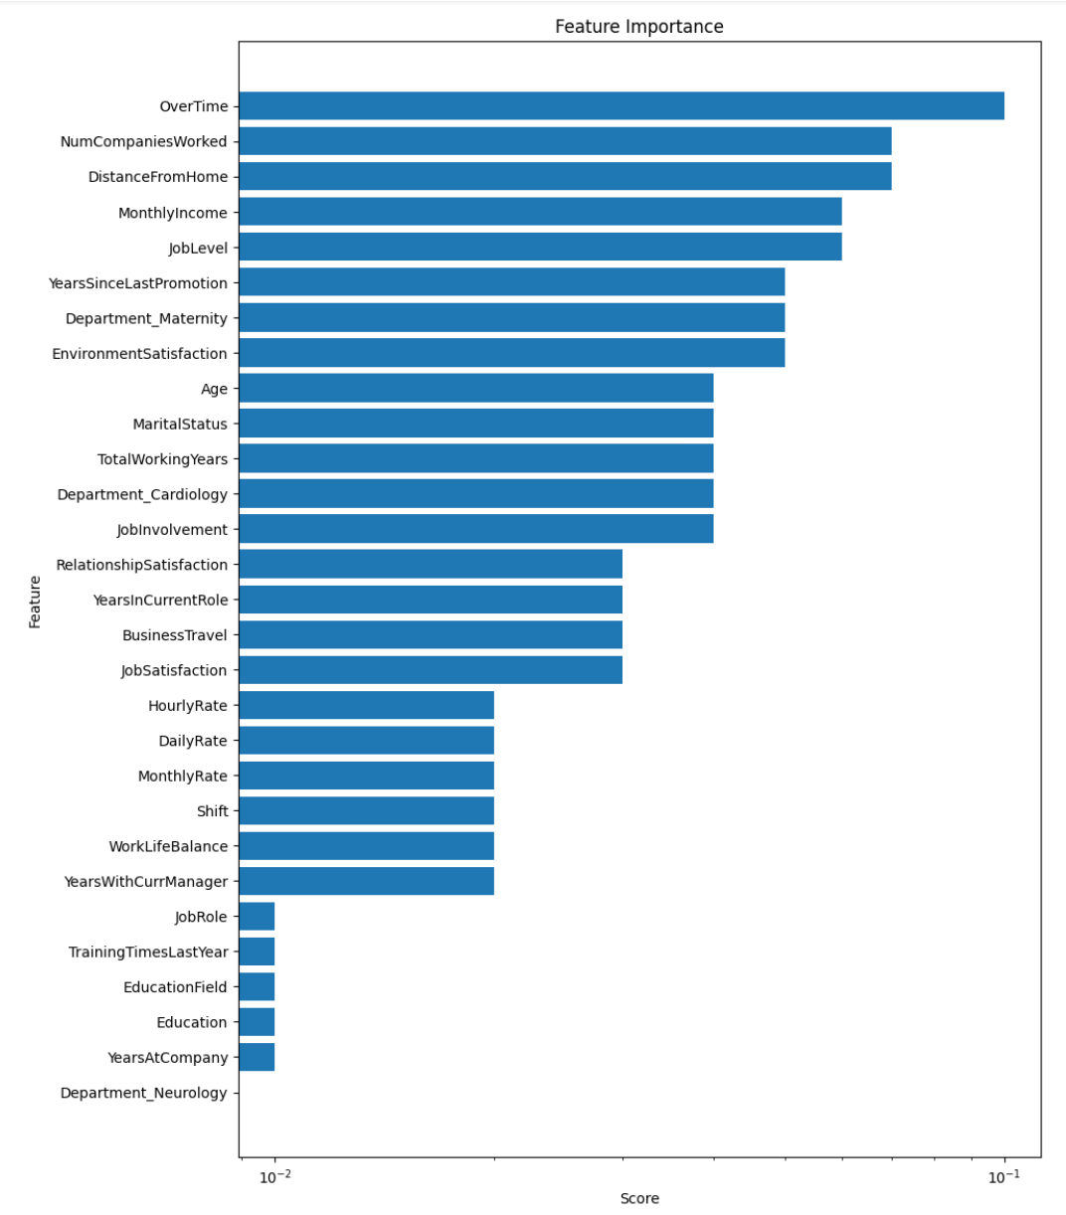
Best Models results
'Gender','Over18','PercentSalaryHike','PerformanceRating'

Slide 10
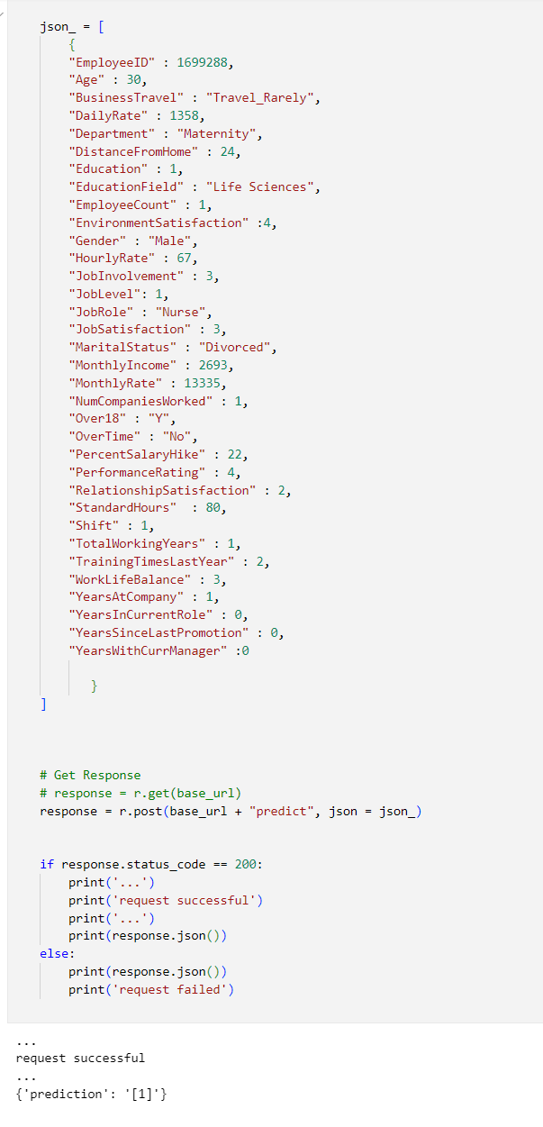
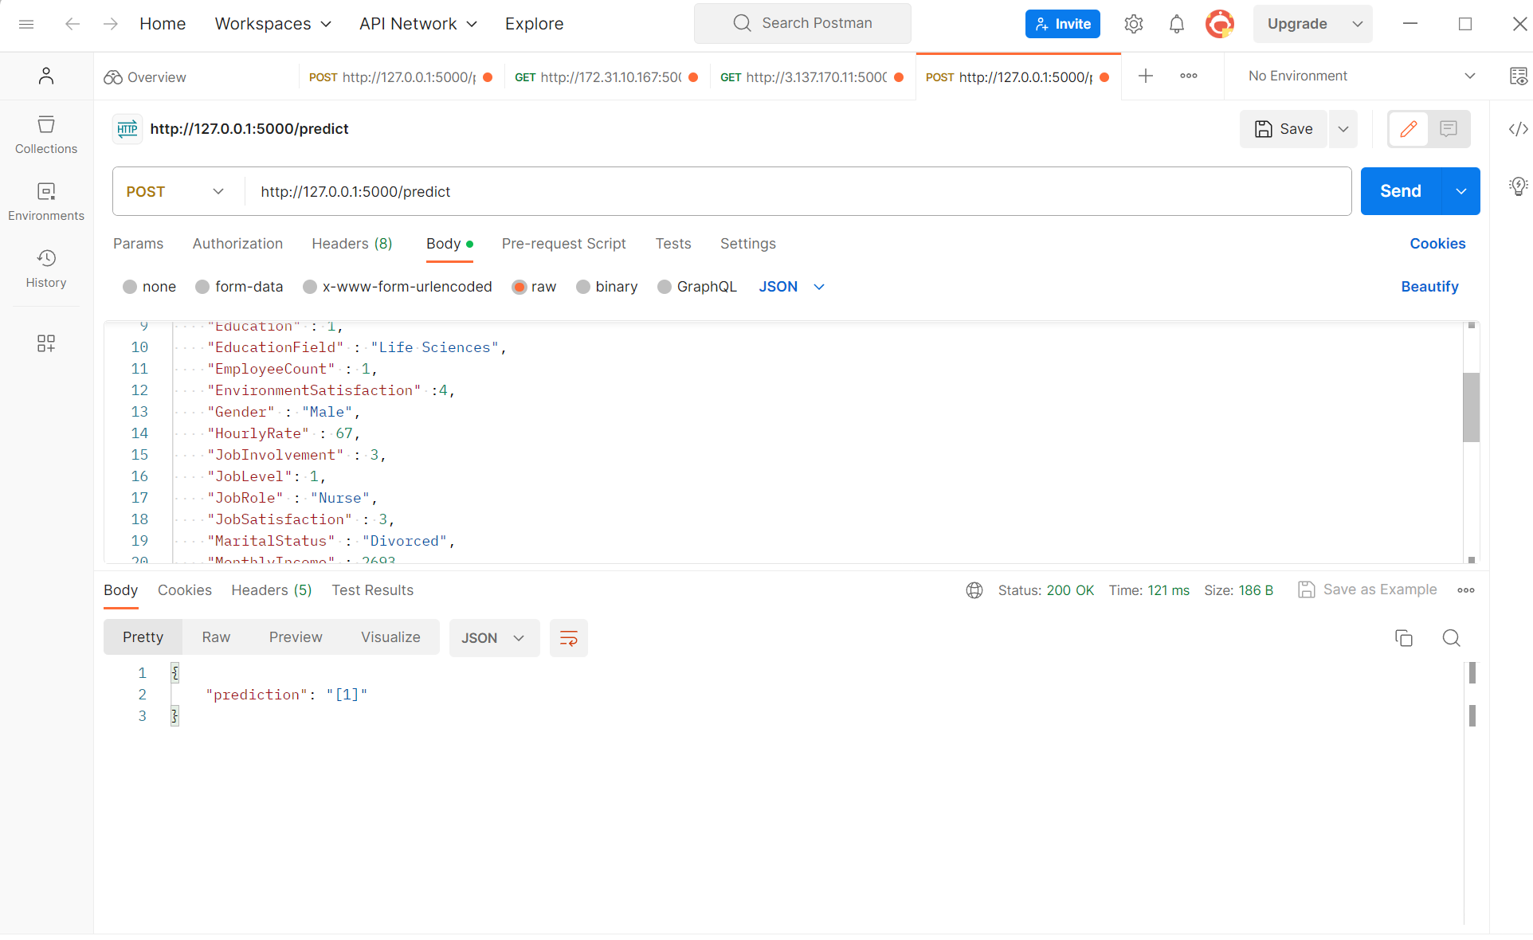
Deployment

Slide 11
Future Steps
More Features Engineering
More Data:
Data Augmentation
Local Healthcare Facility
Different scaler and balancing functions
Test and Evaluate the model in other industry

Slide 12
THANK YOU

