Slide 1
Team
Asma
Nina
Zackline

Slide 2
Project(Deysda)
Description- start up company we chose to do our project on
Will be in Saudi Arabia
Provide Services
Offer online courses

Slide 3
Service Types
Emergency management
Emergency operational plan
Business continuity plan
Continuous operation plan
Just to name but a few

Slide 4
Service Beneficiaries
Schools, hospitals,
Civil defense and service
Saudi Red Crescent Authority
Private Sectors

Slide 5
Courses to offer
CERT(Community emergency response training
Disaster life support
Counter terrorism procedures

Slide 6
Course beneficiaries
Civil defense workers.
Saudi Red Crescent Authority workers.
Saudi Humanitarian Emergency Aid and Response Team (Saudi HEART) workers.
EMTs and Paramedics.

Slide 7
DB requirement
We have 9 entities
Each entity has attributes
Entities are related according to our specifications e.g, 1-1, 1-M, M-N

Slide 8
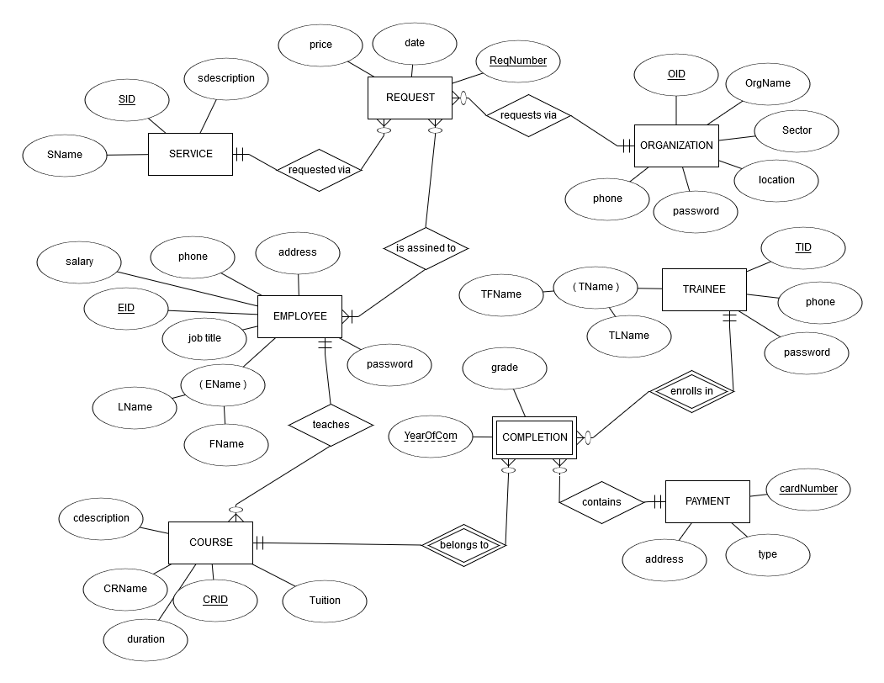
Er diagram

Slide 9
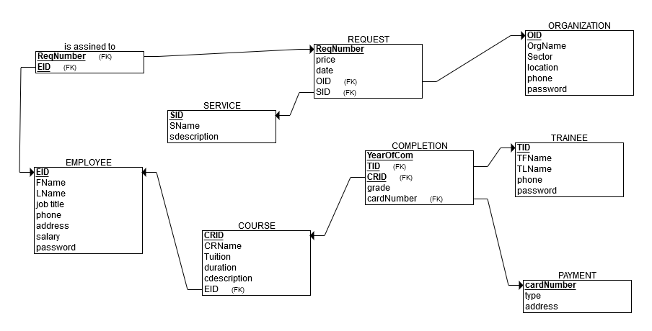
Relational model

Slide 10
Types of queries DB supports
Insert
Update
Delete
Create
select

Slide 11
Queries users can run
Select
Insert
update

Slide 12
Referential integrety and FD
We identified the referential integrity in our relations and made sure we abide by them
We have full key dependency, we avoided the use of partial and transitive dependency
Our relations are in 3rd normal form

Slide 13
Indexing
Since we are a start up company, we do not have huge amount of data yet
Our queries are running fast enough
Indexes are expensive and takes time to maintain, we will use them only if need be.

Slide 14
User interface
Although data access is with the use of sql select statement, our users wont be writing the code
We created user interface for our 3 types of users(employees, trainee and organization)
Created registration forms for new users to register and we keep track of their info in our relations
When registered next visit they will just login

Slide 15
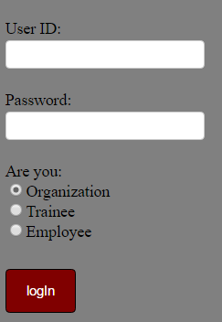
Cont.(home)

Slide 16
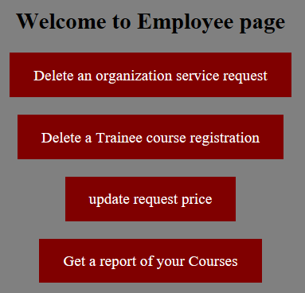
Employee interface

Slide 17
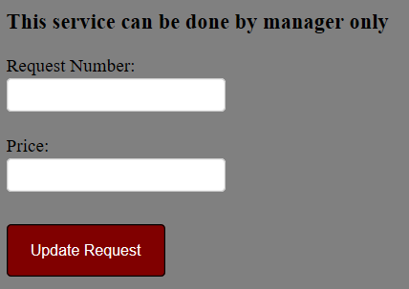
Update service price

Slide 18
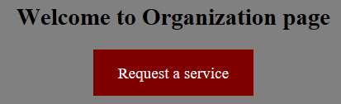
organization interface

Slide 19
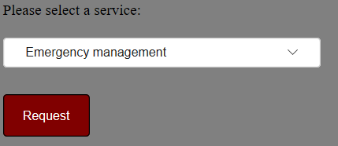
Service request

Slide 20
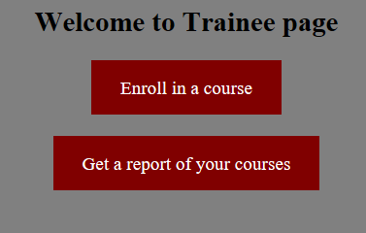
Trainee interface

Slide 21
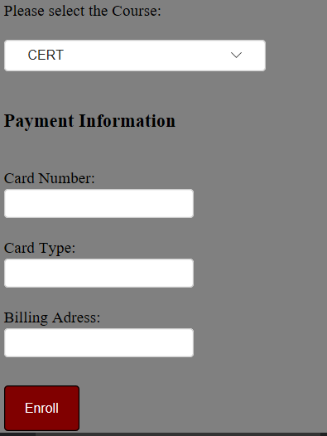
Enroll in a course

Slide 22
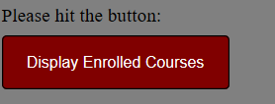
Courses registered in

Slide 23
improvement
We will like to improve our design in the future, time permitting to include more functionalities.

