Slide 1
Project Name: Dayesda
Asma
Nina
Zackline

Slide 2
Dayesda
Dayesda is a start up company we chose to do our project on.
It provides emergency management services and courses.
Provides services for organizations.
Offers courses for individuals(trainees).

Slide 3
Service Examples
Emergency operation plan.
Business continuity plan.
Walk in security assessment.
Infrastructure protection evaluation.

Slide 4
Service beneficiaries
Schools, hospitals, industries.
Civil defense.
Red Crescent Authority.
Private Sectors.

Slide 5
Course examples
CERT(Community emergency response training).
Disaster life support.
Counter terrorism procedures.
FEMA courses.

Slide 6
Course beneficiaries
Civil defense workers.
Saudi Red Crescent Authority workers.
Saudi Humanitarian Emergency Aid and Response Team (Saudi HEART) workers.
EMTs and Paramedics.

Slide 7
DB requirement
We have 9 relations in our DB.
Each relation has many attributes( columns), PK and some relations have FKs.
Entities are related according to our specifications e.g. 1-1, 1-M, M-N.

Slide 8
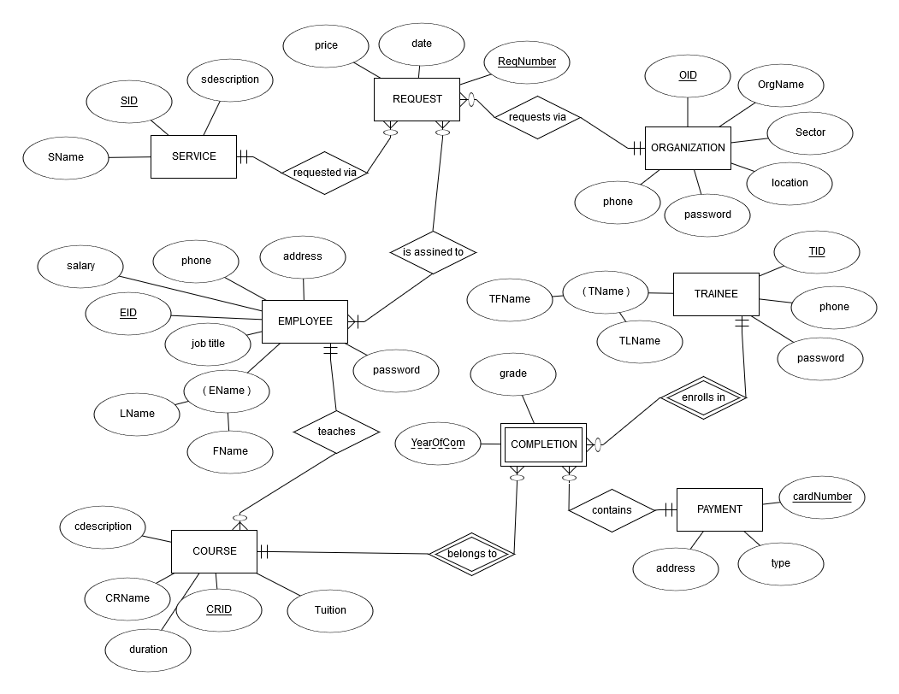
ERD

Slide 9
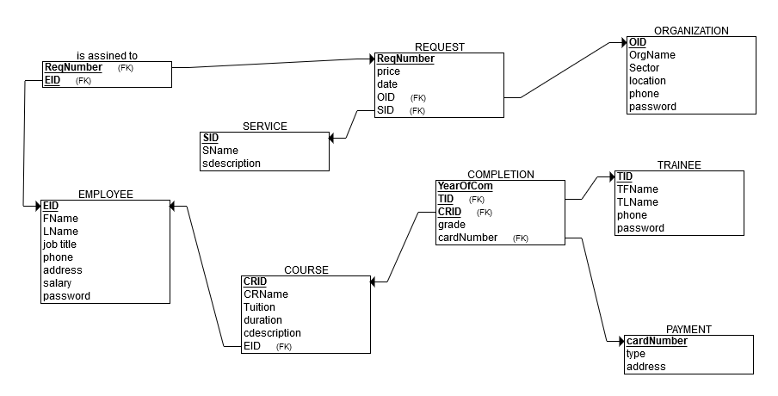
Relational model

Slide 10
Query types
Query in our DB | Query users can run
Create Insert Update Delete Select | Insert Update Delete Select

Slide 11
Referential integrity and FD
We identified the referential integrity in our relations and made sure we abide by them.
We have full key dependency, we don't use the partial and transitive dependency.
Our relations are in 3rd normal form.

Slide 12
Indexing
Since we are a start up company, we do not have huge amount of data yet.
Our queries are running fast enough, and most depends on PKs and FKs.
Indexes are expensive and take time to maintain, we will use them only if need be.

Slide 13
User interfaces
Although data access is done with SQL select statements, our users won’t be writing the code.
We created user interface for our 3 types of users(employees, trainees and organizations)
Created registration forms for new users to register and we keep track of their info in our relations.
When registered next visit they will just login.

Slide 14
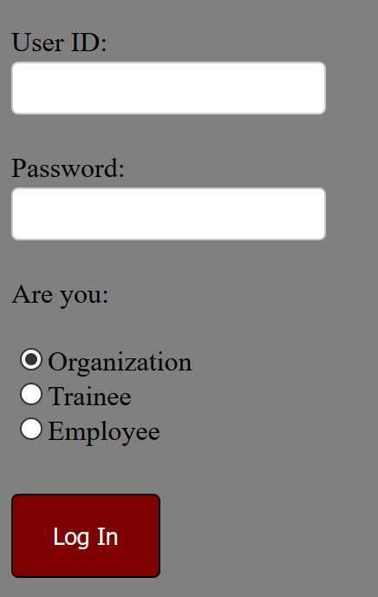
Log in interface

Slide 15
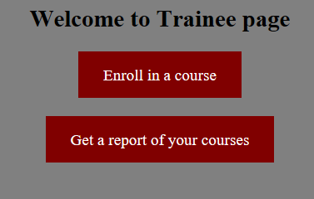
Trainee interface

Slide 16
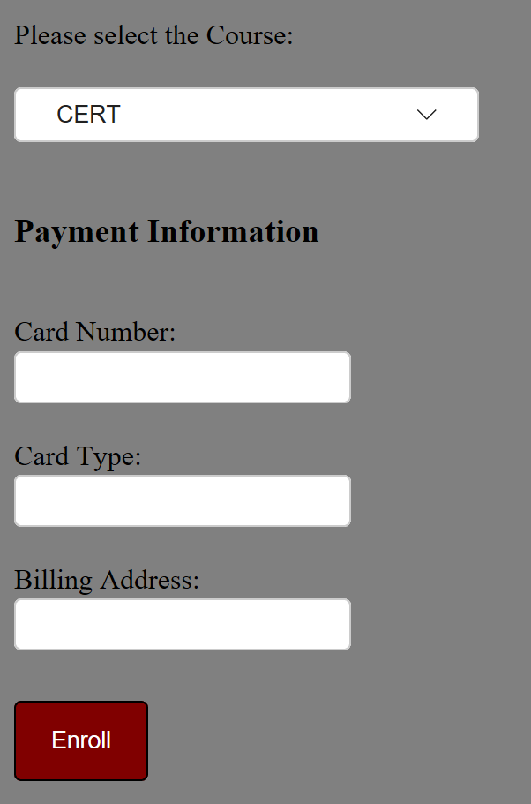
Enroll in a course (Insert)

Slide 17
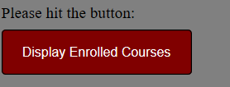
Courses Enrolled in (Select)

Slide 18
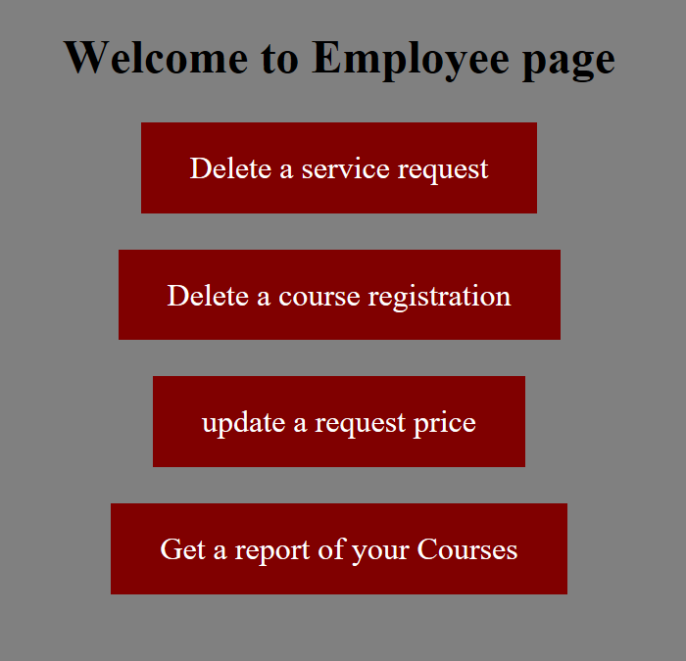
Employee interface

Slide 19
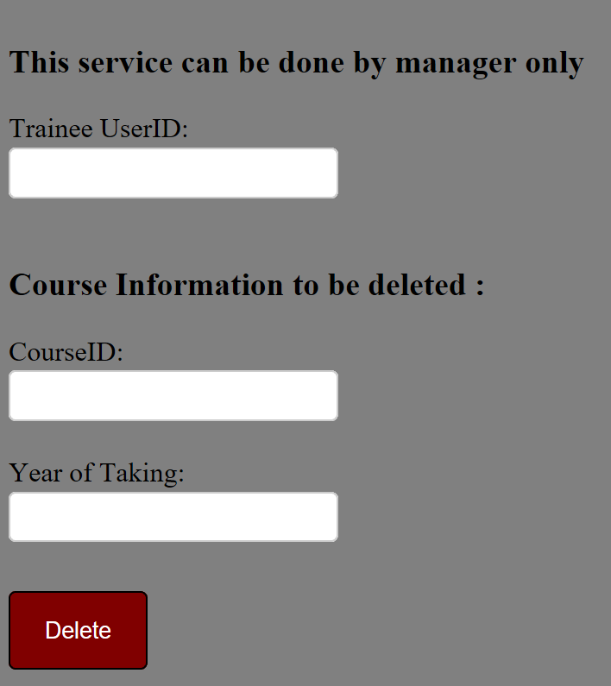
Delete a course registration.

Slide 20
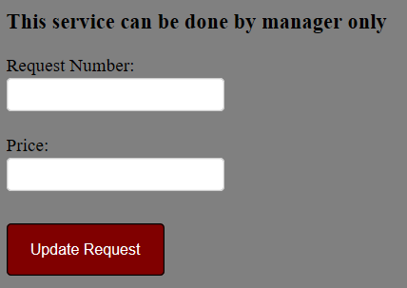
Update a service request price

Slide 21
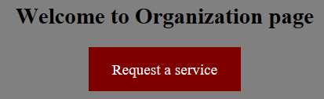
Organization interface

Slide 22
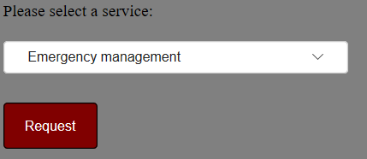
Service request (Insert)

Slide 23
Improvements
We would like to improve our design in the future, time permitting, to include more functionalities.

