Slide 1
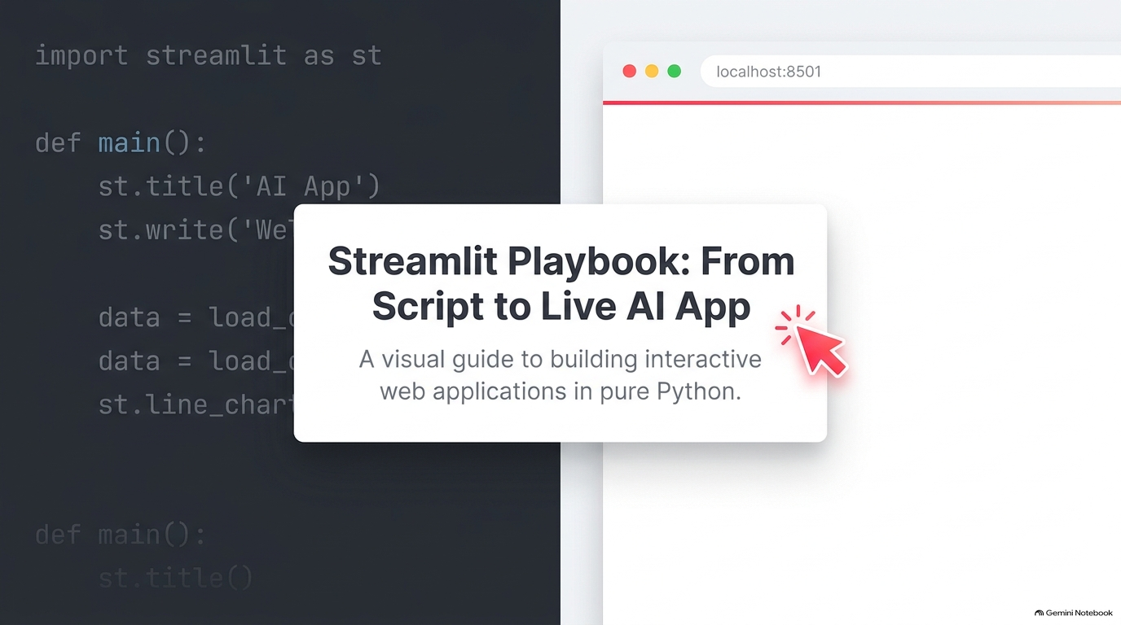

Slide 2
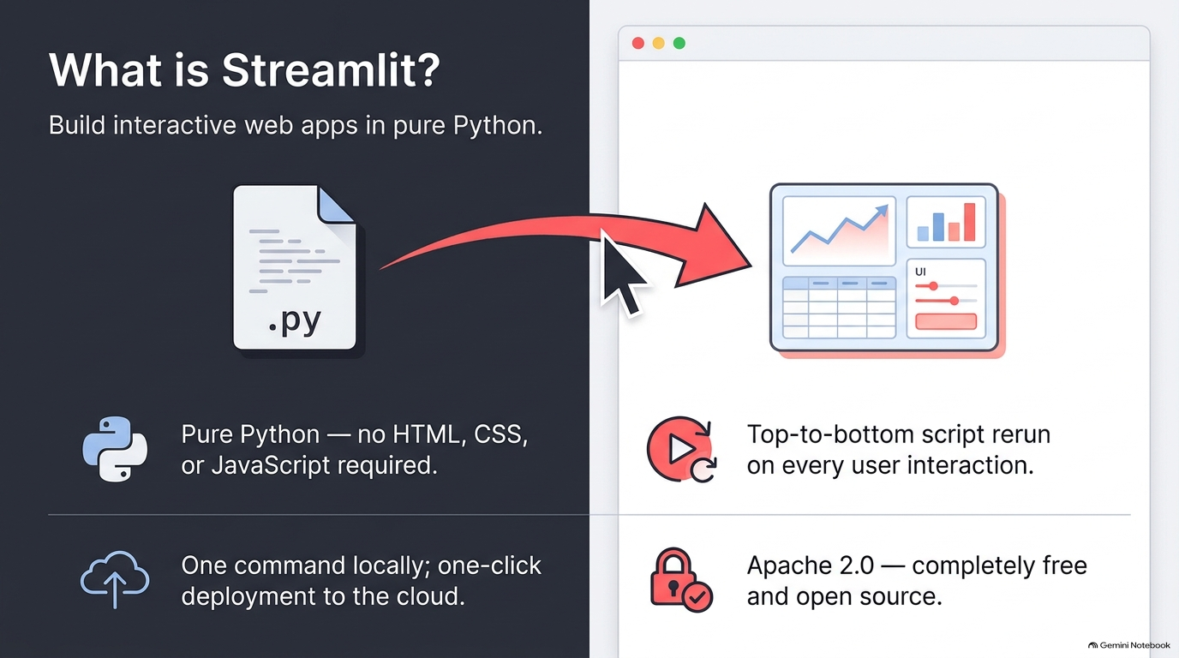

Slide 3
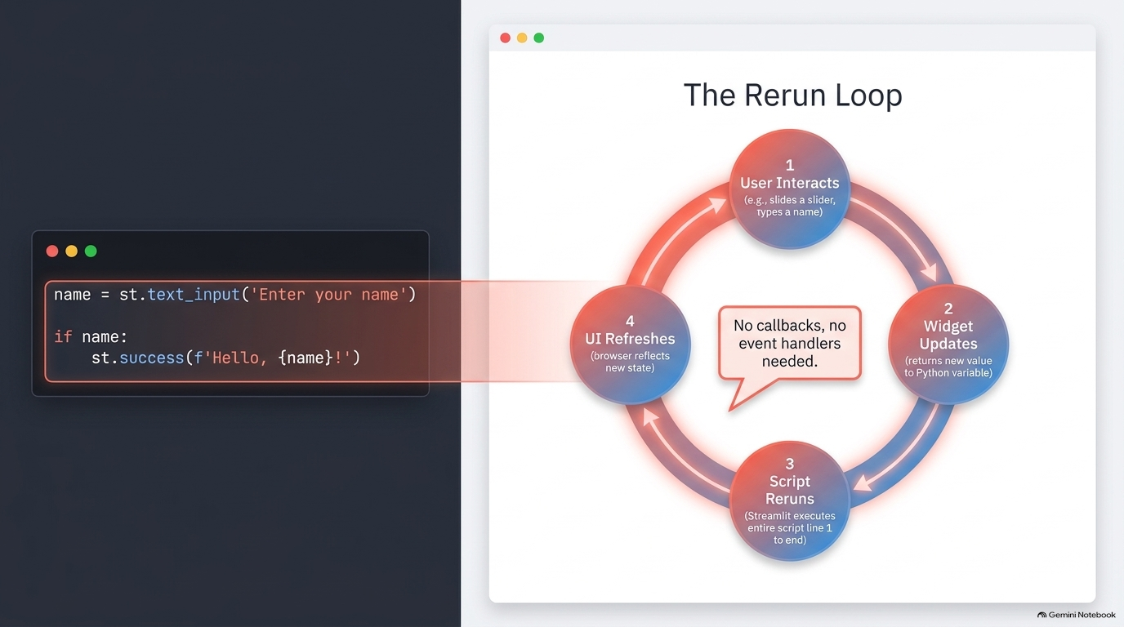

Slide 4
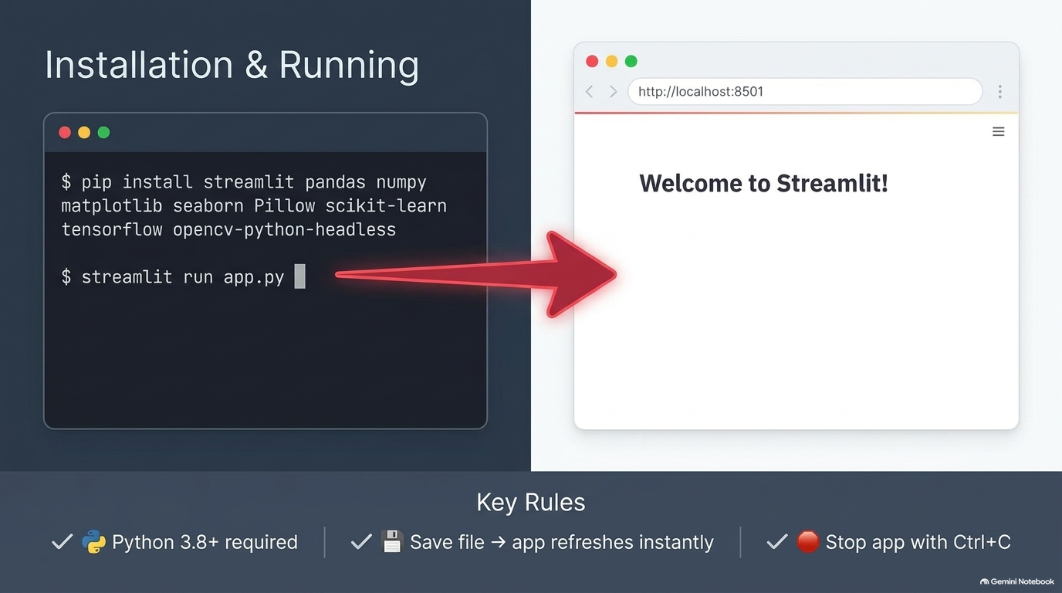

Slide 5
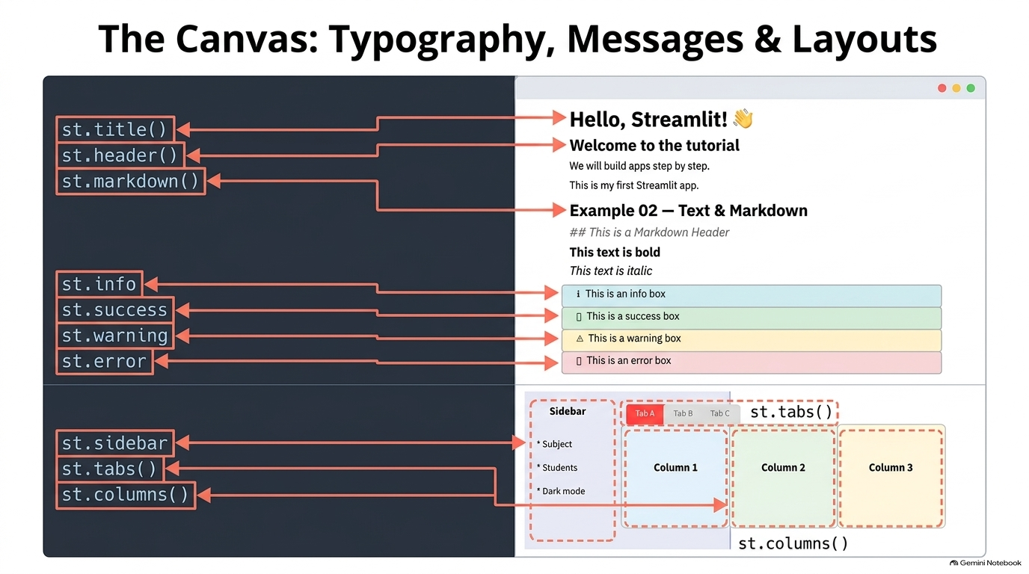

Slide 6
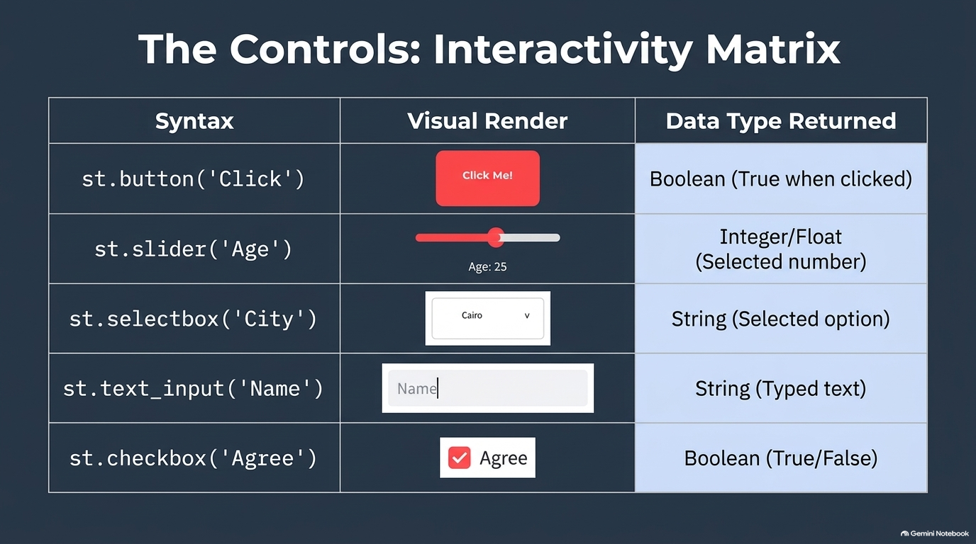

Slide 7
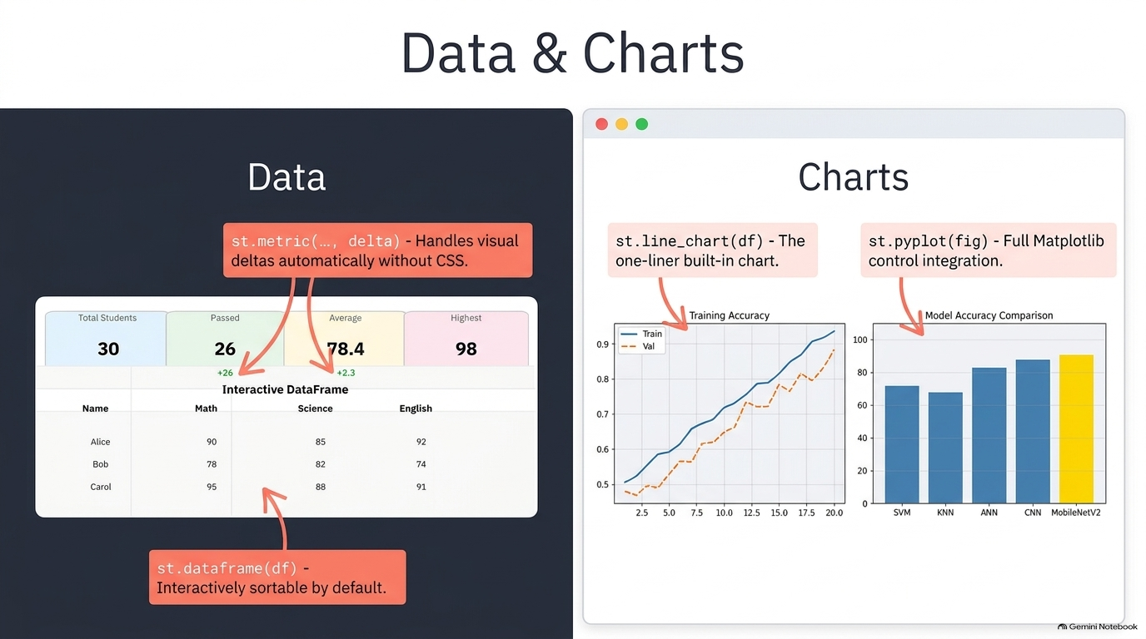

Slide 8
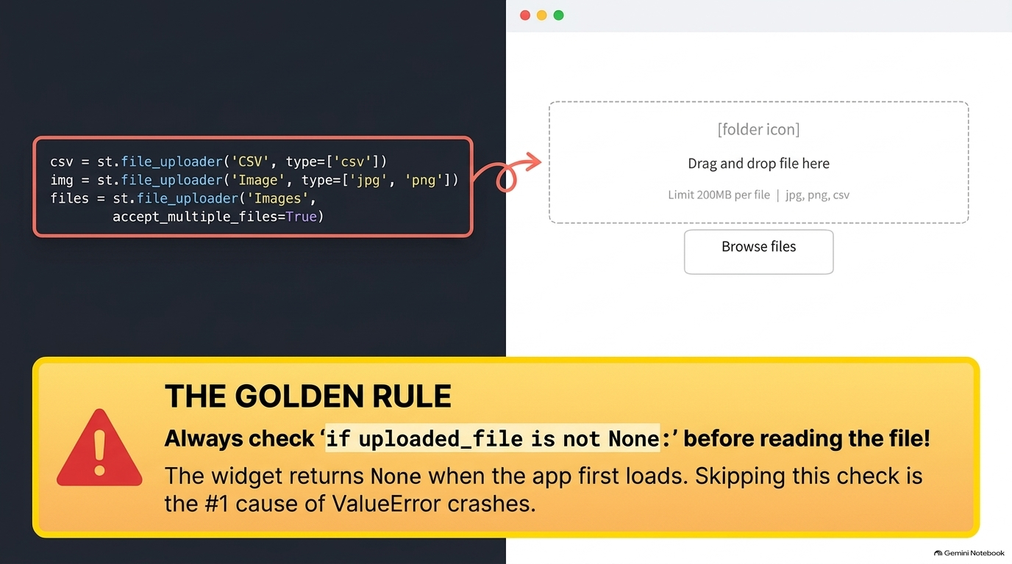

Slide 9
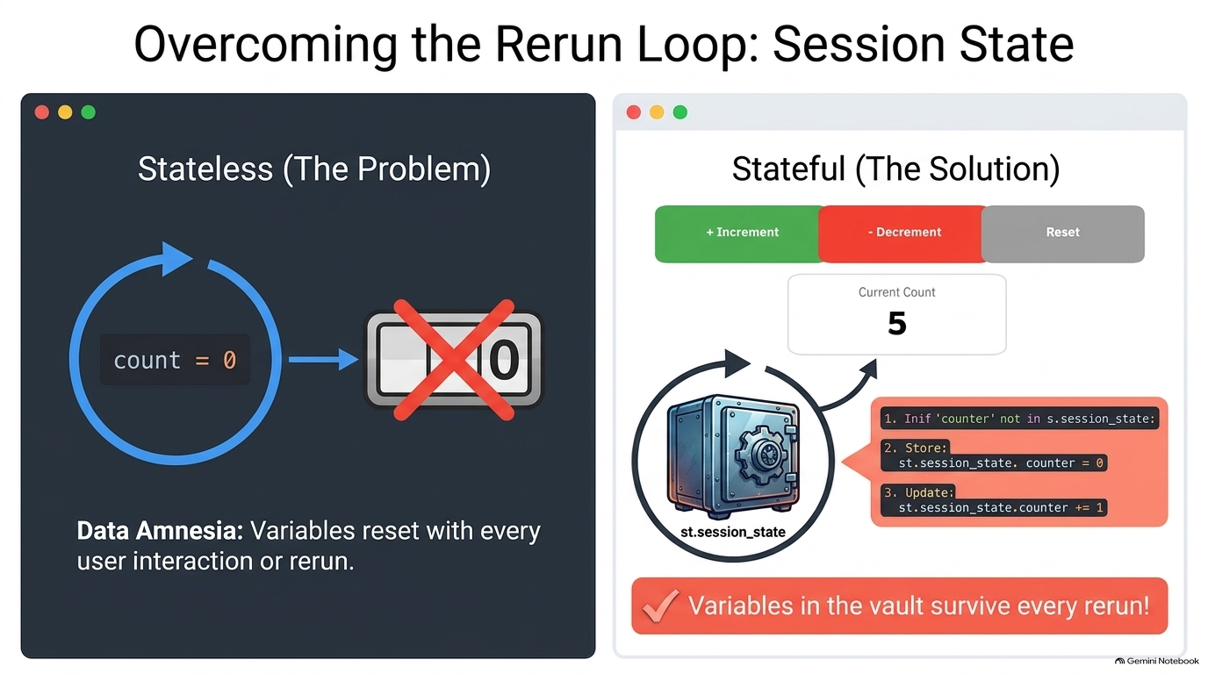

Slide 10
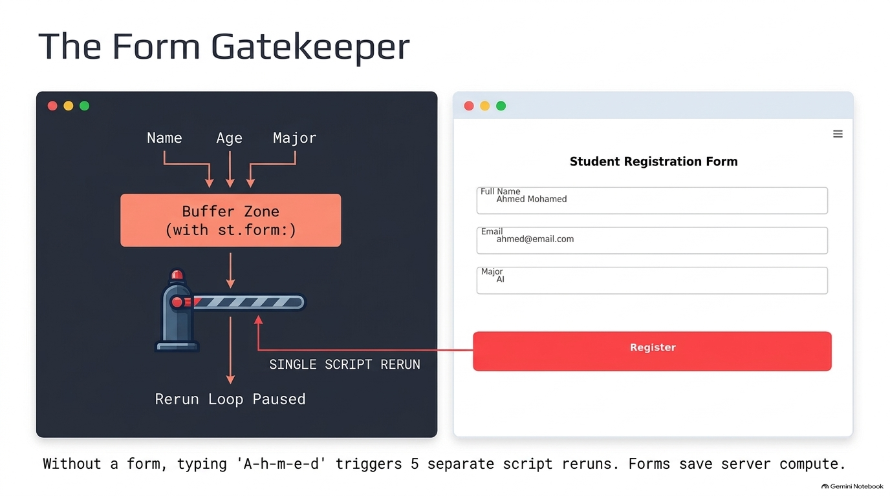

Slide 11
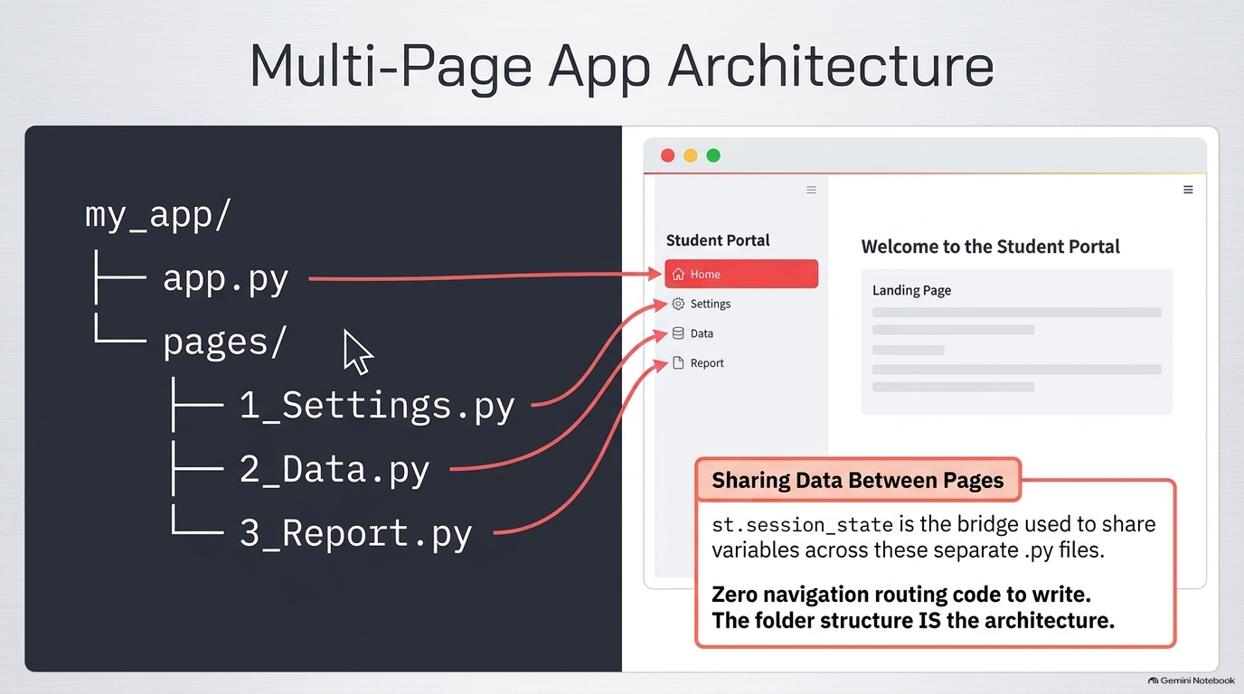

Slide 12
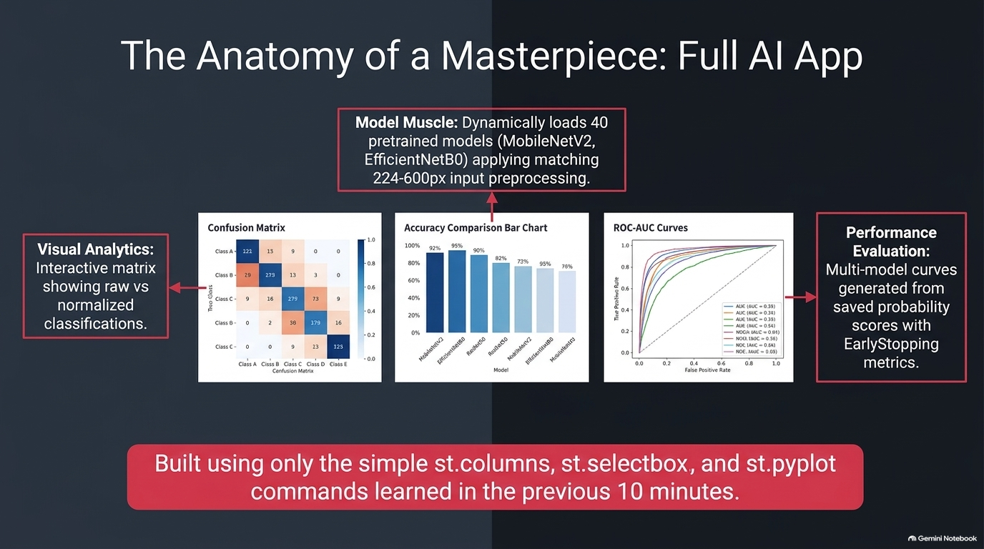

Slide 13
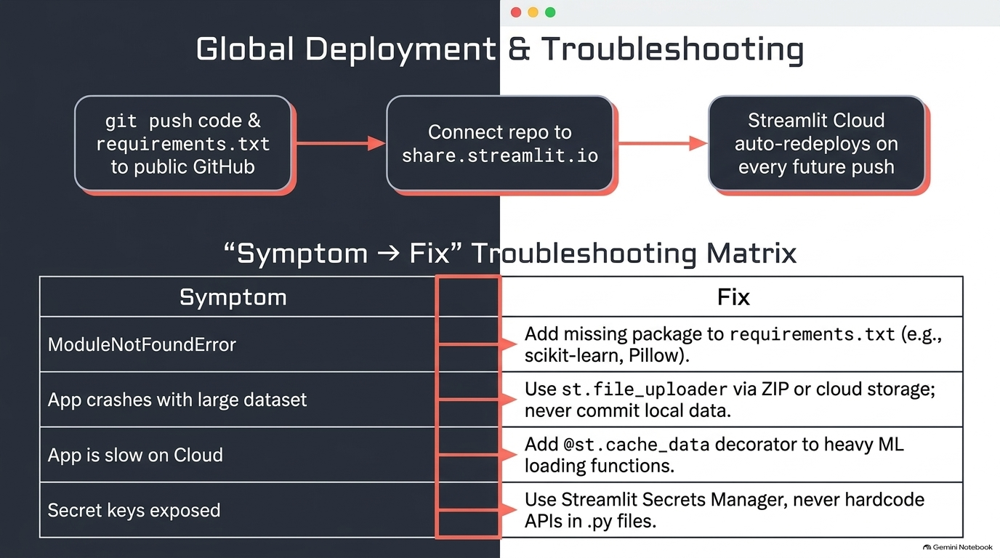

Slide 14
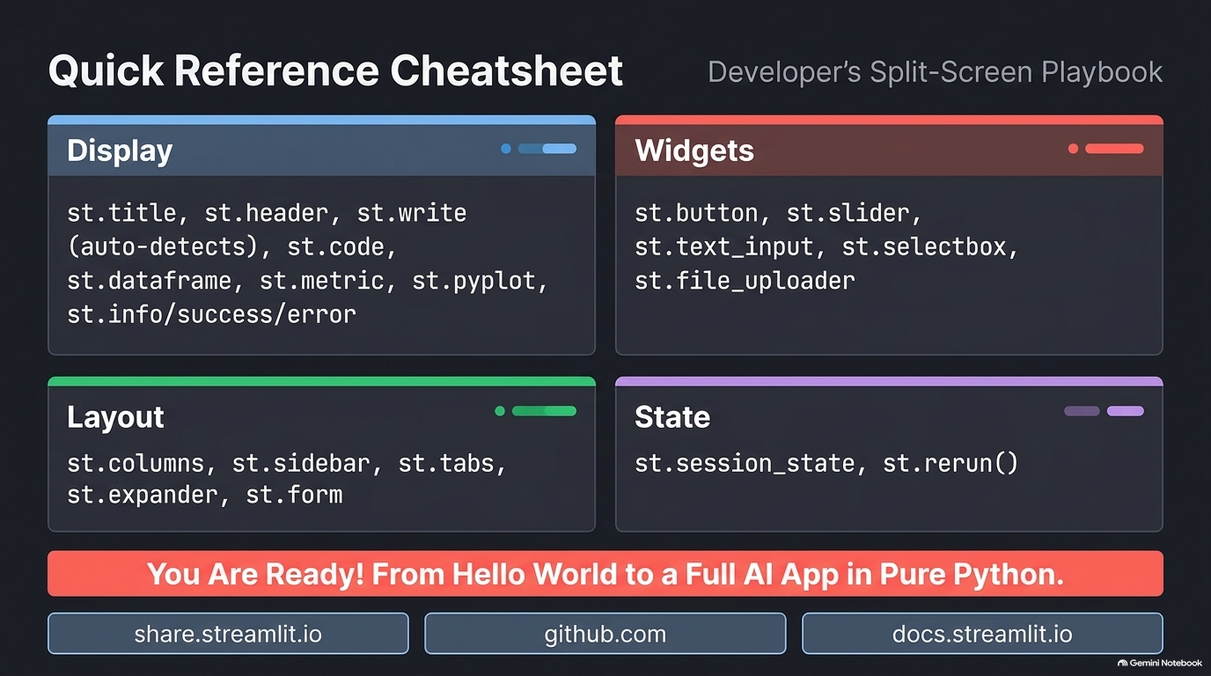

Slide 15
Streamlit Tutorial Series
A Complete Guide for Students
From Hello World to Full Image Classification App
Examples 01–12
Keras Integration
GitHub Deployment
Streamlit Cloud
Notes:
Welcome slide. Introduce the full tutorial series covering 12 examples from Hello World to a complete image classification app.

Slide 16
Agenda — What We Will Cover
01 What is Streamlit & Installation
02 Examples 01–06: Display, Widgets, Layout, Data, Charts, Upload
03 Examples 07–10: Session State, Forms, Multi-Page Apps
04 Examples 11–12: Image Display & Full Classification App
05 Deploying on GitHub & Streamlit Cloud
06 Quick Reference Cheatsheet
Notes:
Overview of all 12 examples and topics covered in this tutorial.

Slide 17
01
What is Streamlit?
Build interactive web apps in pure Python
Notes:
Section: What is Streamlit?

Slide 18
What is Streamlit?
Streamlit is a free, open-source Python library that turns a plain .py script into a fully interactive web application — without any HTML, CSS, or JavaScript.
Key Fact | Details
Language | Pure Python — no web development knowledge needed
Execution | Script reruns top-to-bottom on every user interaction
Deploy | One command locally • One click to deploy to the cloud
License | Apache 2.0 — completely free and open source
Ideal for | Data scientists, ML engineers, researchers, students

Slide 19
How Streamlit Works — The Rerun Model
Every time the user interacts with the app (clicks, slides, types), Streamlit reruns the ENTIRE Python script from top to bottom. Variables get their values from widgets automatically.
import streamlit as st
# This reruns on every interaction
name = st.text_input("Enter your name")
if name:
st.success(f"Hello, {name}!")
Write your app like a normal Python script
Every widget returns its current value
Use if statements to react to widget values
No callbacks, no event handlers needed
Use st.session_state to remember values

Slide 20
Installation & Setup
# Install Streamlit
pip install streamlit
# Install everything for this tutorial
pip install streamlit pandas numpy matplotlib
pip install seaborn Pillow scikit-learn tensorflow
pip install opencv-python-headless
# Create app.py, then run it:
streamlit run app.py
# App opens automatically at:
# http://localhost:8501
Python 3.8 or higher required
pip comes with Python automatically
VS Code is the recommended editor
Browser opens automatically at port 8501
Save the file → app refreshes instantly
Stop the app with Ctrl + C in terminal

Slide 21
02
Examples 01–06
Display • Widgets • Layout • Data • Charts • File Upload
Notes:
Section: Examples 01–06

Slide 22
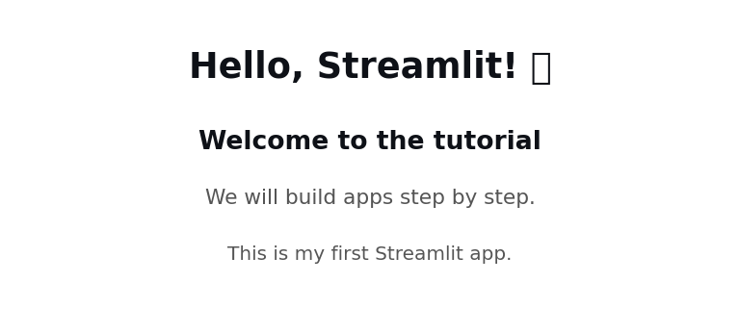
Example 01 — Hello Streamlit
import streamlit as st
# Biggest heading on the page
st.title("Hello, Streamlit!")
# Section heading
st.header("Welcome to the tutorial")
# Smaller heading
st.subheader("Step by step.")
# General-purpose display
st.write("This is my first Streamlit app.")
Function | Output
st.title() | Biggest heading
st.header() | Section heading
st.subheader() | Smaller heading
st.write() | Auto-detect: text, data, chart

Slide 23
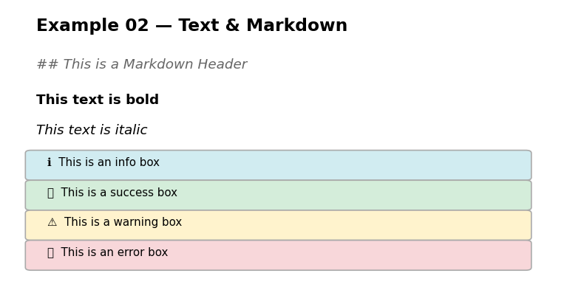
Example 02 — Text & Markdown
import streamlit as st
st.markdown("**Bold text**")
st.markdown("*Italic text*")
st.markdown("## Heading")
# Colored text with HTML
st.markdown(
"<p style='color:red'>Red</p>",
unsafe_allow_html=True)
st.code("x = 1 + 1", language="python")
# Message boxes
st.info("Info box")
st.success("Success box")
st.warning("Warning box")
st.error("Error box")

Slide 24
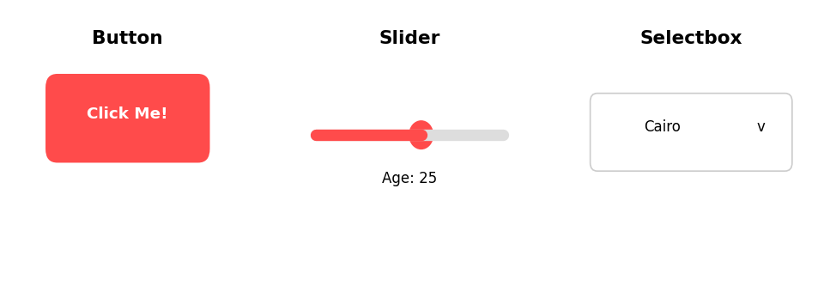
Example 03 — Widgets Basics
# Button
if st.button("Click Me!"):
st.success("Clicked!")
# Slider
age = st.slider("Age", 0, 100, 25)
# Text input
name = st.text_input("Your name")
# Checkbox
agree = st.checkbox("I agree")
# Radio
choice = st.radio("Subject",
["Math","Science","CS"])
# Selectbox (dropdown)
city = st.selectbox("City",
["Cairo","Dubai","London"])
Widget | Returns
st.button() | True when clicked
st.slider() | Selected number
st.text_input() | Typed string
st.checkbox() | True / False
st.radio() | Selected option
st.selectbox() | Selected option

Slide 25
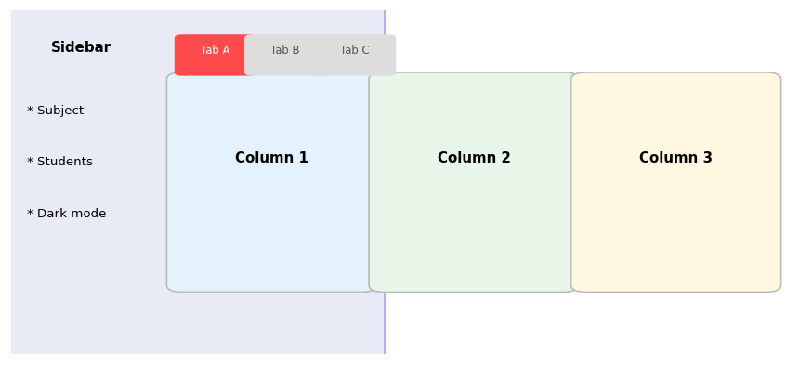
Example 04 — Layout
# Side-by-side columns
col1, col2 = st.columns(2)
with col1:
st.metric("Students", 120)
with col2:
st.metric("Average", "87.5")
# Sidebar panel
with st.sidebar:
subject = st.selectbox("Subject",
["Math","Science"])
# Tabs
tab1, tab2 = st.tabs(["A","B"])
with tab1:
st.write("Tab A content")
# Expander (collapsible)
with st.expander("Click to expand"):
st.write("Hidden content")

Slide 26
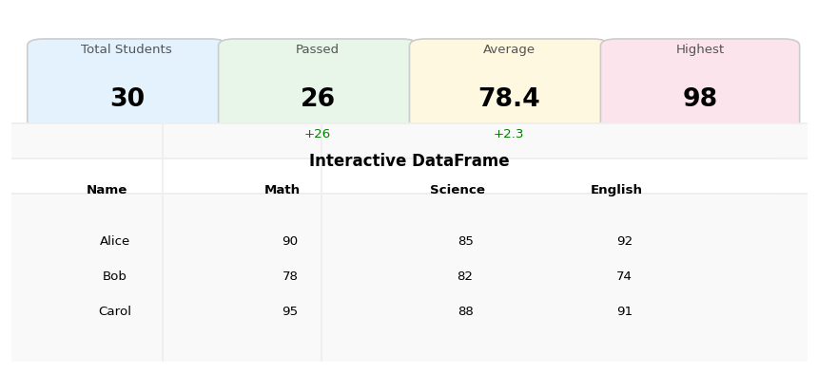
Example 05 — Displaying Data
import pandas as pd
# Interactive sortable table
st.dataframe(df, use_container_width=True)
# Metric cards
col1, col2, col3 = st.columns(3)
with col1:
st.metric("Total", len(df))
with col2:
st.metric("Avg", df["Math"].mean())
with col3:
st.metric("Top", df["Math"].max())
# Filter interactively
grades = st.multiselect("Grade",
["A","B","C"], default=["A","B"])
filtered = df[df["Grade"].isin(grades)]
st.dataframe(filtered)

Slide 27
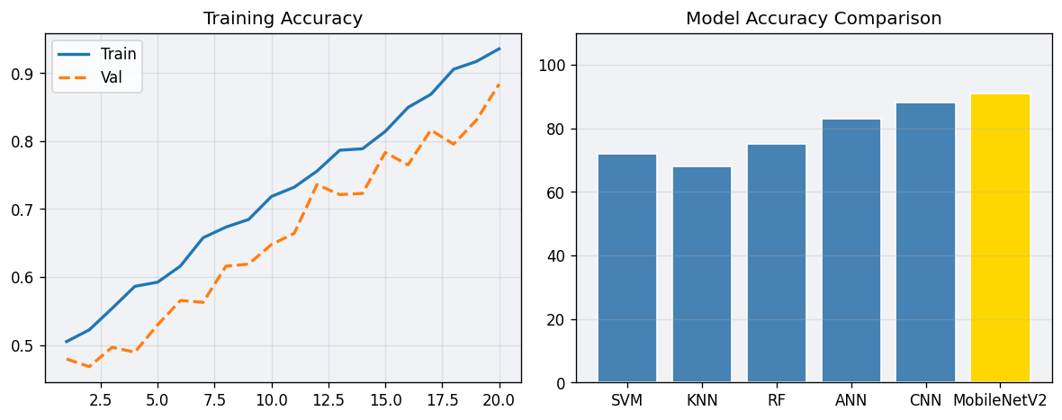
Example 06 — Charts & Plots
import matplotlib.pyplot as plt
# Built-in line chart (one line!)
st.line_chart(history_df)
# Matplotlib (full control)
fig, ax = plt.subplots(figsize=(8,4))
ax.bar(models, accuracies,
color="steelblue")
ax.set_title("Model Comparison")
ax.set_ylim(0, 110)
ax.grid(axis="y", alpha=0.3)
plt.tight_layout()
# Show in Streamlit
st.pyplot(fig)

Slide 28
03
Examples 07–10
File Upload • Session State • Forms • Multi-Page Apps
Notes:
Section: Examples 07–10

Slide 29
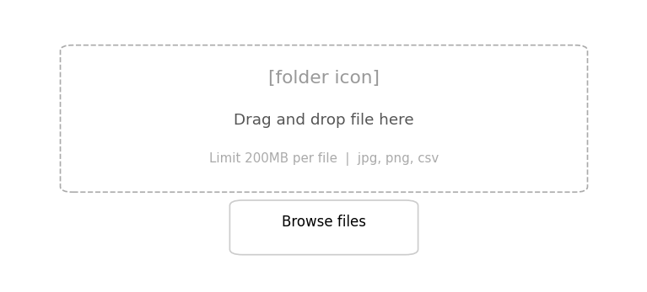
Example 07 — File Upload
from PIL import Image
import pandas as pd
# Upload a CSV file
csv = st.file_uploader("CSV", type=["csv"])
if csv is not None:
df = pd.read_csv(csv)
st.dataframe(df.head())
# Upload an image
img_file = st.file_uploader("Image",
type=["jpg","jpeg","png"])
if img_file is not None:
image = Image.open(img_file)
st.image(image, width=300)
# Multiple files
files = st.file_uploader("Images",
accept_multiple_files=True)
Key Rule: Always check if uploaded_file is not None: before reading the file. The widget returns None when nothing is uploaded yet.

Slide 30
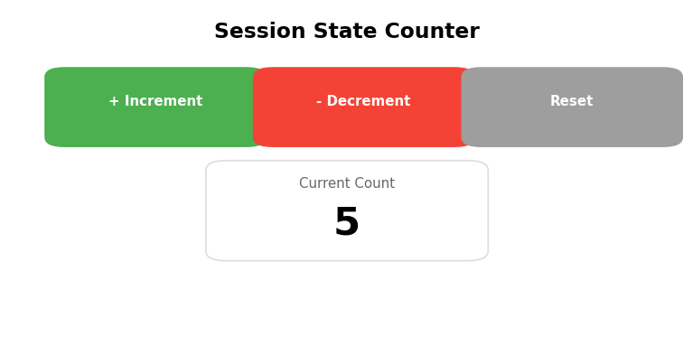
Example 08 — Session State
# PROBLEM: variables reset every rerun!
count = 0 # always resets to 0
# SOLUTION: use session state
if "counter" not in st.session_state:
st.session_state.counter = 0
# Update on button click
col1, col2, col3 = st.columns(3)
with col1:
if st.button("+ Increment"):
st.session_state.counter += 1
with col2:
if st.button("- Decrement"):
st.session_state.counter -= 1
with col3:
if st.button("Reset"):
st.session_state.counter = 0
# Display — survives reruns!
st.metric("Count", st.session_state.counter)
Pattern | Meaning
if "key" not in st.session_state: | Initialize once
st.session_state.key = value | Store / update
st.session_state.key | Read stored value
st.rerun() | Force immediate rerun

Slide 31
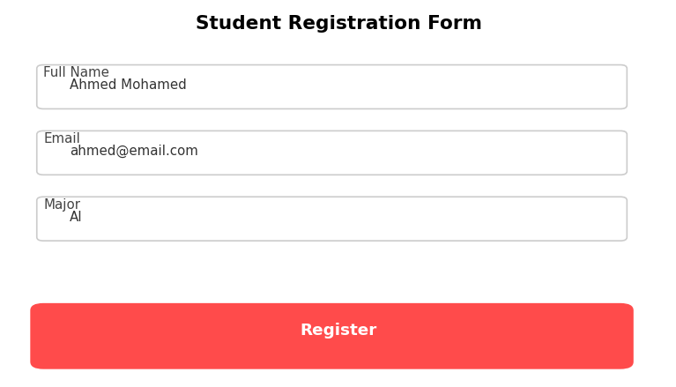
Example 09 — Forms
# Form: no rerun until Submit is clicked
with st.form("registration_form"):
name = st.text_input("Full Name")
age = st.number_input("Age", 15, 60, 20)
major = st.selectbox("Major",
["AI","CS","Engineering"])
agree = st.checkbox("I agree to terms")
# Submit button — must be inside form
submitted = st.form_submit_button("Register")
# Handle result OUTSIDE the form
if submitted:
if not name.strip():
st.error("Enter your name!")
elif not agree:
st.error("Please agree to terms")
else:
st.success(f"Welcome, {name}!")
Without a form, the app reruns while the user is still typing. A form collects all inputs and only submits when the button is clicked.

Slide 32
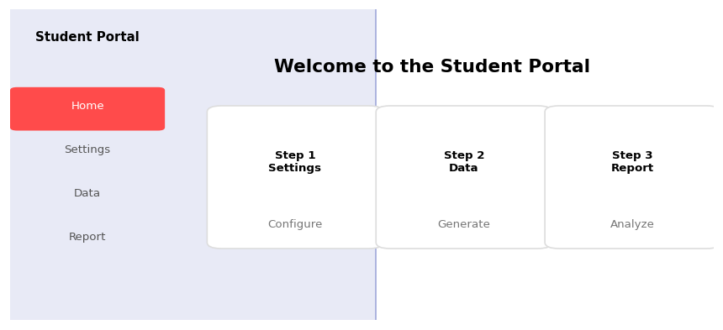
Example 10 — Multi-Page App
Streamlit automatically creates sidebar navigation for every .py file inside a pages/ folder. No navigation code needed — just the right folder structure.
my_app/
|-- app.py <- run this file
`-- pages/
|-- 1_Settings.py
|-- 2_Data.py
`-- 3_Report.py
# Sharing data between pages
# In Settings page:
st.session_state.subject = subject
# In Data page (reads it):
subject = st.session_state.subject
Notes:
Pages folder + session state are the two key concepts for multi-page apps.

Slide 33
04
Examples 11–12
Image Display • Full Image Classification App
Notes:
Section: Examples 11–12

Slide 34
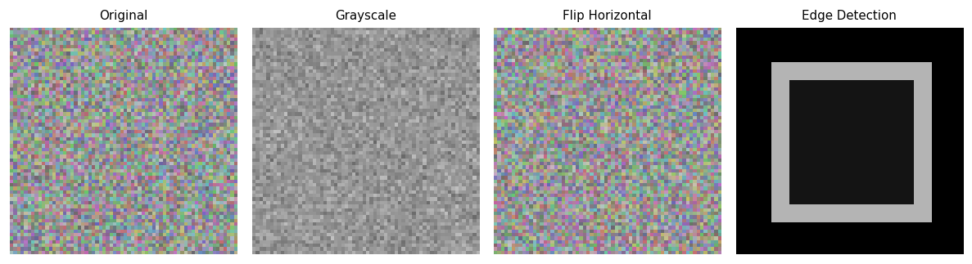
Example 11 — Image Display
from PIL import Image, ImageFilter, ImageOps
# Display from URL
st.image("https://upload.wikimedia.org/...",
caption="Cat", width=300)
# Upload and display
uploaded = st.file_uploader("Image",
type=["jpg","png"])
if uploaded:
image = Image.open(uploaded).convert("RGB")
arr = np.array(image)
st.image(image, width=400)
# Apply operation
op = st.selectbox("Operation",
["Grayscale","Flip","Blur","Edges"])
result = ImageOps.grayscale(image)
col1, col2 = st.columns(2)
col1.image(image, caption="Original")
col2.image(result, caption=op)

Slide 35
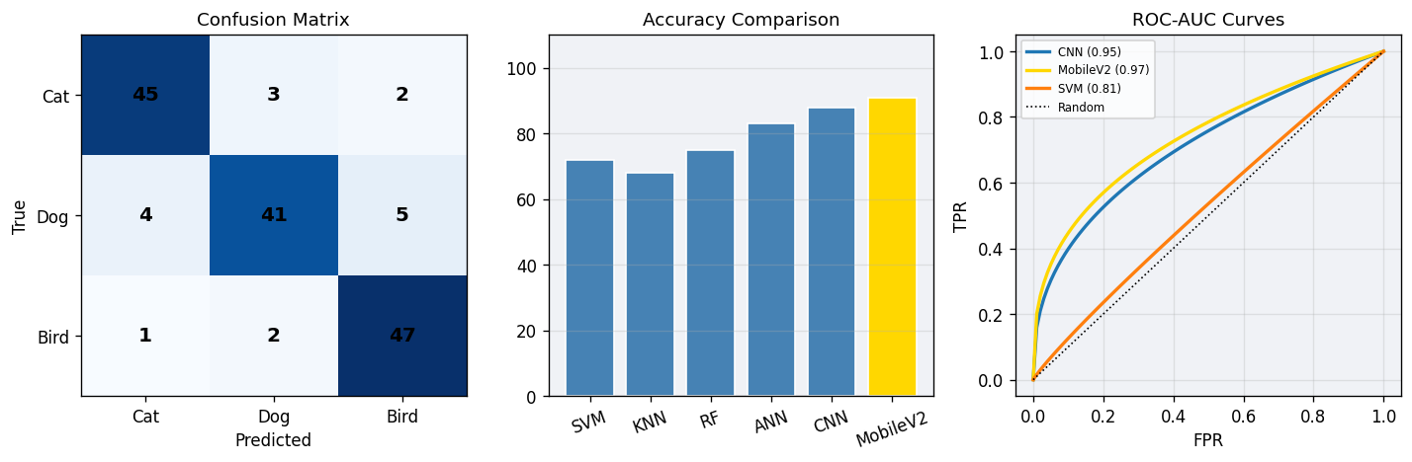
Example 12 — Full Image Classification App
The final app connects all previous examples: ZIP upload, model training, prediction, and full evaluation with 10 result figures.
Page | What it does
app.py (Home) | Upload dataset as ZIP file, configure image size
1_Upload_Predict.py | Upload one image → prediction with confidence chart
2_Train_Models.py | Train all 6+ models, show accuracy for each
3_Results.py | Confusion matrix, ROC-AUC, PR curves, heatmap, summary

Slide 36
Example 12 — Models Included
Category | Models
Classical ML | SVM (kernel=rbf) • KNN (k=5) • Random Forest (100 trees)
Neural Networks | ANN (Dense 256→128→output) • CNN (3 Conv blocks + augmentation)
Pretrained (40) | MobileNetV2, EfficientNetB0–B7, EfficientNetV2, ResNet50/101/152, VGG16/19, InceptionV3, Xception, DenseNet, NASNet, ConvNeXt
Students choose pretrained models via multiselect. Each model uses its correct input size (224–600px) and matching preprocess_input function — loaded dynamically.
All 40 pretrained models shown in a reference table with size, MB, and ImageNet accuracy
Default recommendation: MobileNetV2 (fast) + EfficientNetB0 (accurate)
Each model trains in 10 epochs with EarlyStopping
Probability scores saved for ROC/PR curve generation in Results page

Slide 37
Example 12 — Results Page (10 Sections)
Section | Visualization
1. Accuracy Cards | Metric card per model with delta vs best
2. Accuracy Bar Chart | All models ranked, average line highlighted
3. Confusion Matrix | Interactive: raw counts or normalized %
4. All Confusion Matrices | Grid of all models in one expander
5. ROC-AUC Curves | Per-class + macro average, all models compared
6. Precision-Recall Curves | Per-class AP, mean AP bar chart
7. Per-Class Metrics | Grouped bar: Precision / Recall / F1
8. Metrics Heatmap | All models × 8 metrics color-coded
9. Error Analysis | Misclassification rate, confused pairs, distribution
10. Final Summary Table | Accuracy, F1, ROC-AUC, mAP, Kappa, MCC ranked

Slide 38
05
GitHub & Streamlit Cloud
Deploy your app for free in minutes
Notes:
Section: GitHub & Streamlit Cloud

Slide 39
Deployment — Step by Step
1
Create GitHub account at github.com and install Git
2
Create a new PUBLIC repository on GitHub
3
Add requirements.txt listing every package your app imports
4
Push your code: git init → git add . → git commit → git push
5
Go to share.streamlit.io → Sign in with GitHub → New app
6
Select your repo, set Main file path (e.g. app.py) → Deploy
7
App is live! Streamlit Cloud auto-redeploys on every git push

Slide 40
Deployment — Key Files
requirements.txt
.gitignore
streamlit
pandas
numpy
matplotlib
seaborn
Pillow
scikit-learn
tensorflow
opencv-python-headless
# Never upload dataset to GitHub
dataset/
*.zip
*.h5
*.keras
__pycache__/
*.pyc
.env
RULE: Every library you import must be in requirements.txt. If you see ModuleNotFoundError on Streamlit Cloud — add the missing package and git push again.

Slide 41
Deployment — Common Issues & Fixes
Error / Problem | Fix
ModuleNotFoundError | Add the missing package to requirements.txt and git push
Pages not showing in sidebar | Ensure pages/ folder is next to app.py in the repo
App crashes with large dataset | Use st.file_uploader — never hardcode a local path
Works locally but not on Cloud | Check requirements.txt has every import you use
App is slow on Cloud | Add @st.cache_data decorator to heavy functions
Secret keys exposed in code | Use Streamlit Secrets Manager — never hardcode keys
Dataset too large for GitHub | Upload via ZIP inside the app — never commit data
Local vs Cloud: pip install = requirements.txt | local folder = st.file_uploader | persists = use cloud storage | GPU = CPU only on free tier

Slide 42
06
Quick Reference Cheatsheet
All functions at a glance
Notes:
Section: Quick Reference Cheatsheet

Slide 43
Cheatsheet — Display Functions
Function | What it shows
st.title("text") | Biggest heading on the page
st.header("text") | Section heading
st.write("text or data") | Auto-detect: text, number, DataFrame, chart
st.markdown("**bold**") | Formatted Markdown text
st.code("x=1", language="python") | Syntax-highlighted code block
st.info / success / warning / error | Colored alert boxes
st.image(img, width=300) | Display image (URL, PIL, NumPy)
st.dataframe(df) | Interactive sortable table
st.metric("label", val) | Dashboard number card with delta
st.pyplot(fig) | Display Matplotlib / Seaborn figure

Slide 44
Cheatsheet — Widgets & Layout
Widgets
Layout & State
Function | Returns
st.button("label") | True when clicked
st.slider("label", min, max) | Number by dragging
st.text_input("label") | Typed string
st.checkbox("label") | True / False
st.radio("label", [opts]) | Pick one option
st.selectbox("label", [opts]) | Dropdown menu
st.file_uploader("label") | File object or None
Function | What it does
st.columns(n) | Side-by-side layout
st.sidebar | Left control panel
st.tabs(["A","B"]) | Clickable tabs
st.expander("label") | Collapsible section
st.form("name") | Group inputs, submit once
st.session_state.key | Persistent value across reruns
st.rerun() | Force immediate rerun

Slide 45
You Are Ready!
You now have everything needed to build and deploy professional Streamlit apps.
12 Examples
40 Pretrained Models
Complete Evaluation
Free Deployment
Hello World → Full AI App
MobileNet, EfficientNet, ResNet ...
ROC, PR, Confusion Matrix, Heatmap
GitHub + Streamlit Cloud
share.streamlit.io • github.com • docs.streamlit.io
Notes:
Thank the students and point them to the resources listed.

