Slide 1


Glamour
ASMA HAMAD ALNASER

Slide 2
•Problem statement
•Problem statement
لان التصميم والازياء مهم في حياتنا حبيت اسوي مشروع يضم مصممين الأزياء الغير مشهورين حتى يكون لهم اسمهم..
Design and fashion are important in our lives I wanted to make a project that includes the fashion designers who are not famous so that they have their name..

Slide 3
•Brief about the project
مشروعي يتكلم بشكل عام عن مصممين الأزياء الجدد ,يعني أي مصمم عنده الهوايه هذي يقدر يسجل بياناته وينضم للصفحه الرئيسيه وبكذا ينشهر عند الناس ..
My project generally speaks of new fashion designers, which means that any designer with this hobby can record his chart and join the main page and thus become famous to the people .

Slide 4
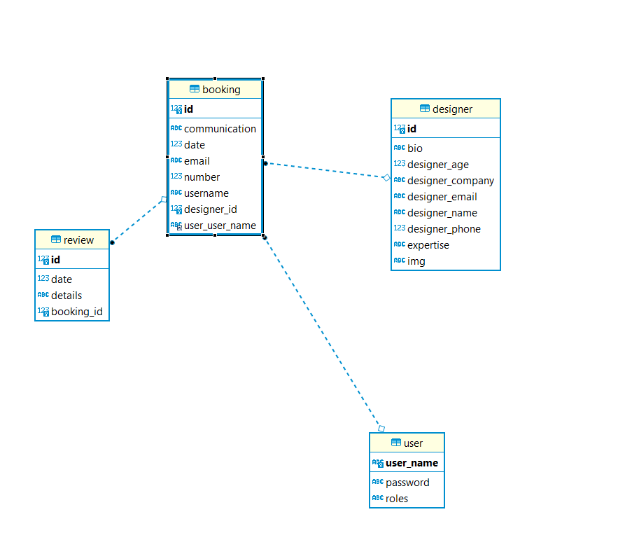

Slide 5
•Demo of the project
FRONT END : REACT AND CSS
BACK END : SQL AND INTILIJI AND BOSTMAN AND SPRING POOT

Slide 6
REGISTER DESIGNER
LOGIN

Slide 7
What was the most difficult part of the project
اصعب جزء بالمشروع كان الربط بين العلاقات
The hardest part of the project was the connection between relationships..

Slide 8
What was your favorite part of the project
افضل جزء بالمشروع كان وجود الوقت الكافي والكثير له The best part of the project was having enough time and a lot for it ..

Slide 9
What are the new things you learned creating this application
تعلمت أشياء كثيره بالمشروع مثل الربط بين العلاقات واستخدام الكثير من تطبيقات البرمجه ..
I learned a lot of things in the project like linking relationships and using a lot of programming applications..

Slide 10


