Slide 1


Predicting Diabetes Risk from Clinical and Demographic Data
A Comparative Machine Learning Study
CBIO313: Machine Learning & Data Mining
Presented by: Asmaa Mohamed Mansour | ID: 221001928
Supervised by: Dr. Muhammed Elsayeh
Notes:
1

Slide 2
INTRODUCTION
Why HbA1c matters for diabetes prediction
Chronic, global burden
HbA1c as a biomarker
The ML question
Diabetes affects millions worldwide, risking cardiovascular disease, kidney failure, nerve damage and vision loss if undiagnosed.
Glycated hemoglobin reflects average blood glucose over 2–3 months — a more stable signal than a single glucose reading.
How well do HbA1c and related clinical/demographic features predict diabetes status across different model families?
2
Notes:
2

Slide 3
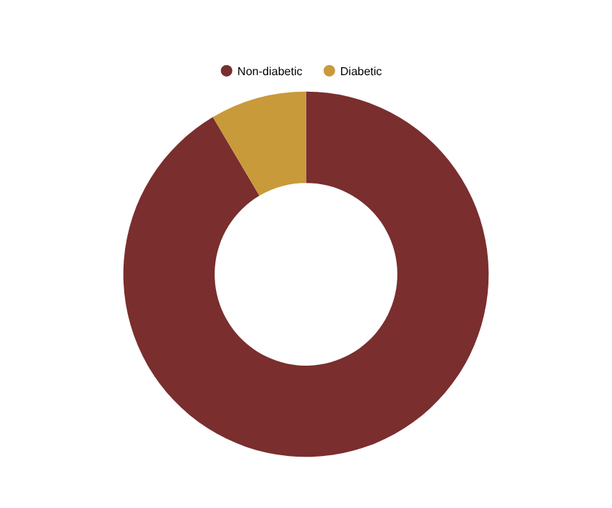
METHODOLOGY
Dataset & Preprocessing
100,000 patient records — 16 columns: age, gender, BMI, HbA1c level, blood glucose, smoking history, hypertension, heart disease, diabetes (target)
Class Balance (test set, n = 19,994)
No missing values; 14 duplicate rows identified
Encoded gender & smoking_history as numeric categories
StandardScaler applied to age, bmi, hbA1c_level, blood_glucose_level
80% / 20% train–test split
3
Notes:
3

Slide 4
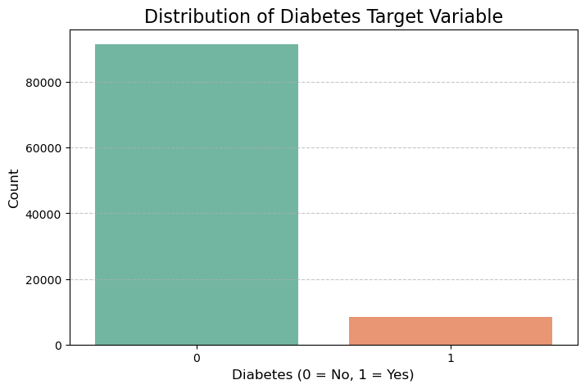
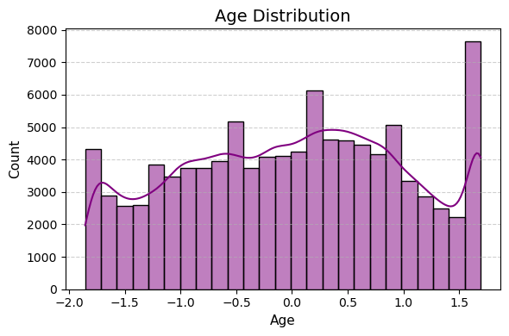
EXPLORATORY DATA ANALYSIS
Target distribution & age profile
~91.5% non-diabetic vs ~8.5% diabetic — a strongly imbalanced target.
Age spans the adult range with a spike near the upper bound.
4
Notes:
4

Slide 5
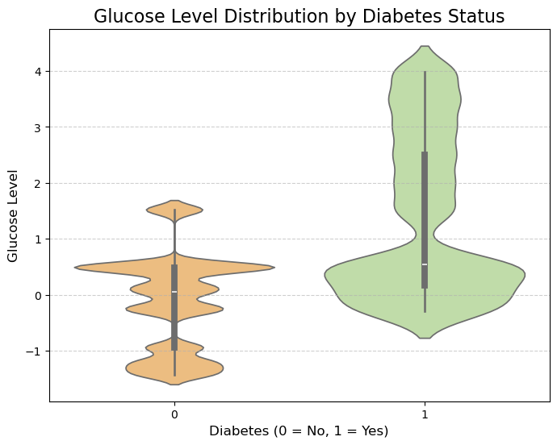
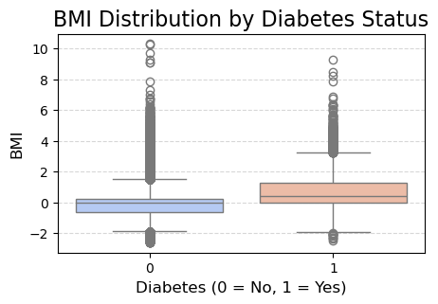
EXPLORATORY DATA ANALYSIS
Clinical markers by diabetes status
Diabetic patients trend toward higher BMI.
Blood glucose shows a clear rightward shift for diabetic patients.
5
Notes:
5

Slide 6
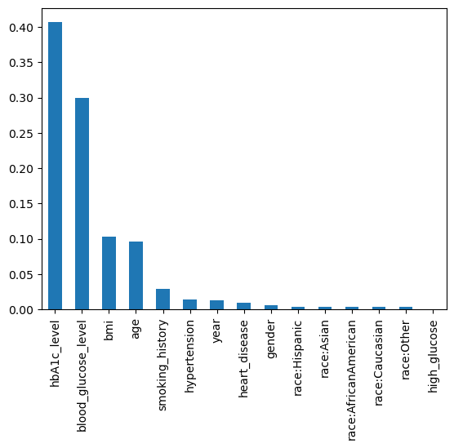
FEATURE ENGINEERING & SELECTION
HbA1c and glucose dominate feature importance
Top 5 selected features (Random Forest importances)
Feature | Importance
hbA1c_level | 0.390
blood_glucose_level | 0.317
bmi | 0.104
age | 0.094
smoking_history | 0.029
Together, HbA1c and glucose account for ~70% of predictive weight — confirming their clinical significance.
6
Notes:
6

Slide 7
METHODOLOGY
Six models, one evaluation framework
Random Forest
XGBoost
Logistic Regression
K-Nearest Neighbors
Decision Tree
Naive Bayes
Evaluated on: Accuracy · Precision · Recall · F1 Score · Confusion Matrix · ROC-AUC
7
Notes:
7

Slide 8
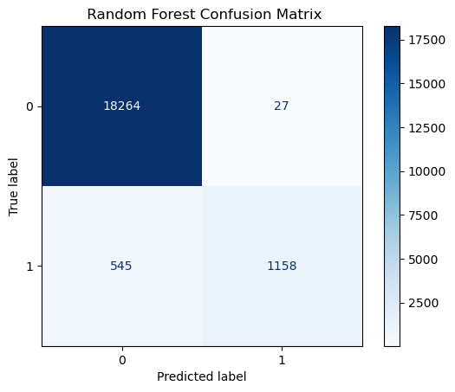
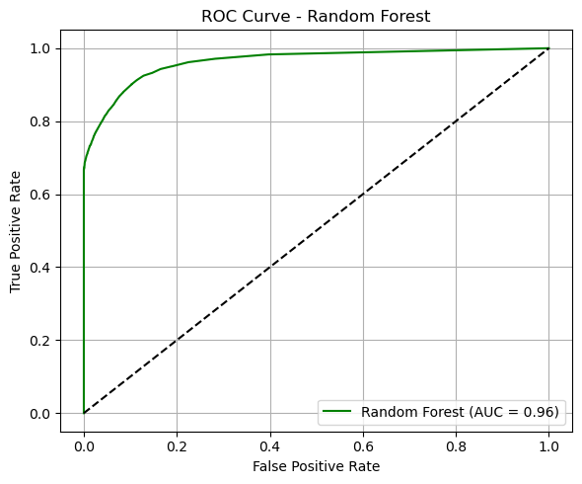
MODEL RESULTS
Random Forest
0.97
Accuracy
0.98
Precision
0.68
Recall
0.80
F1 Score
0.96
AUC
8
Notes:
8

Slide 9
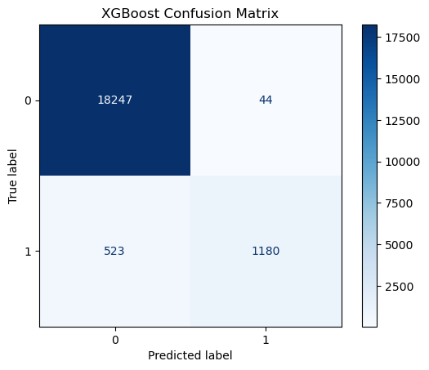
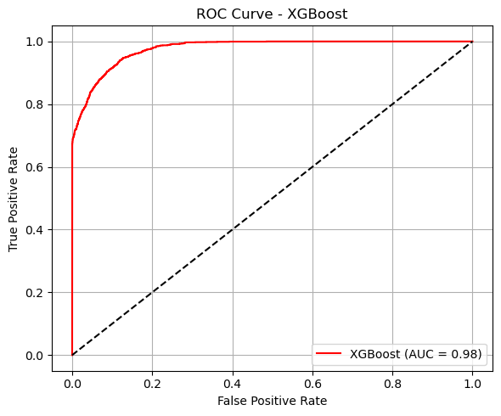
MODEL RESULTS
XGBoost
0.97
Accuracy
0.96
Precision
0.69
Recall
0.81
F1 Score
0.98
AUC
9
Notes:
9

Slide 10
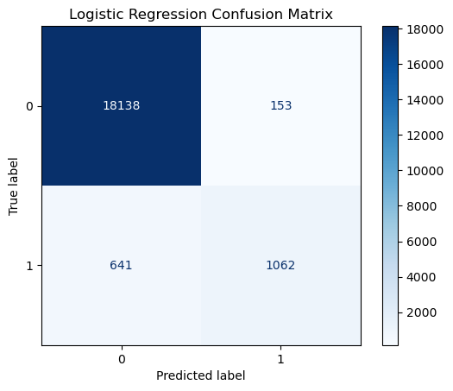
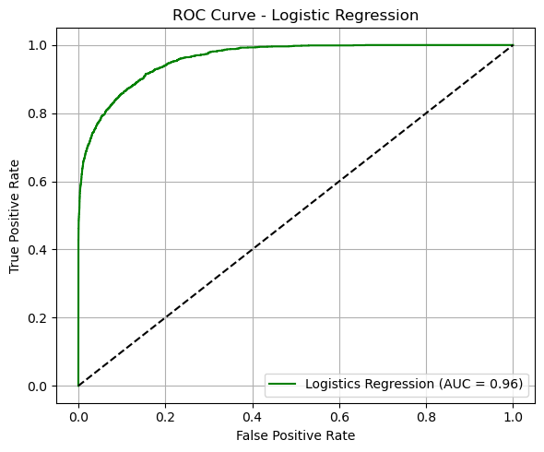
MODEL RESULTS
Logistic Regression
0.96
Accuracy
0.87
Precision
0.62
Recall
0.73
F1 Score
0.96
AUC
10
Notes:
10

Slide 11
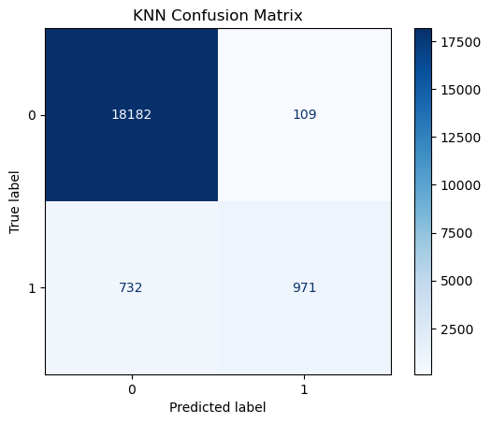
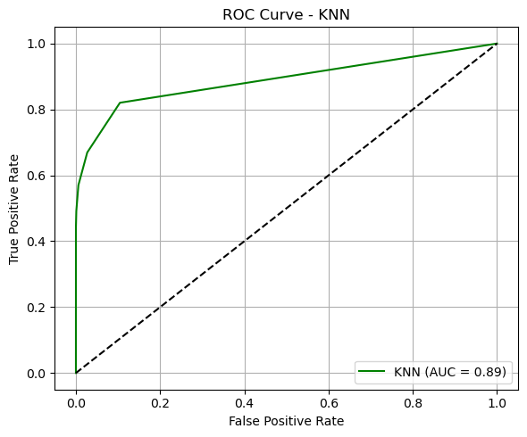
MODEL RESULTS
K-Nearest Neighbors
0.96
Accuracy
0.90
Precision
0.57
Recall
0.70
F1 Score
0.89
AUC
11
Notes:
11

Slide 12

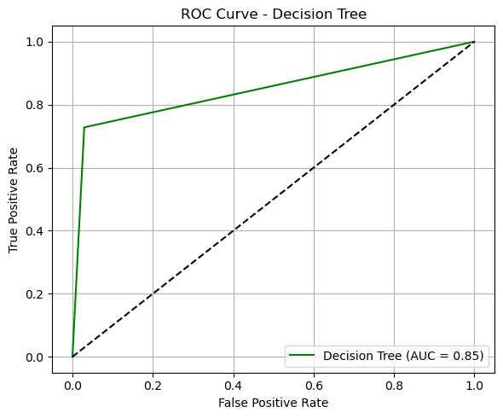
MODEL RESULTS
Decision Tree
0.95
Accuracy
0.70
Precision
0.73
Recall
0.71
F1 Score
0.85
AUC
12
Notes:
12

Slide 13
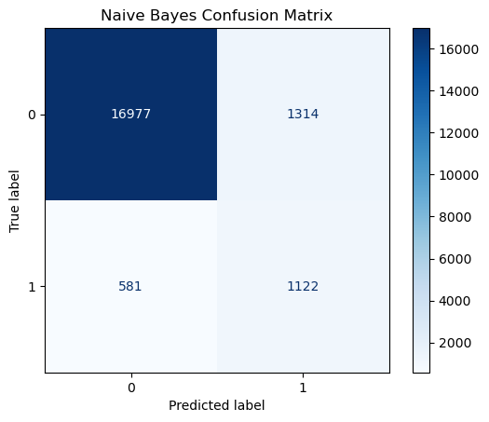
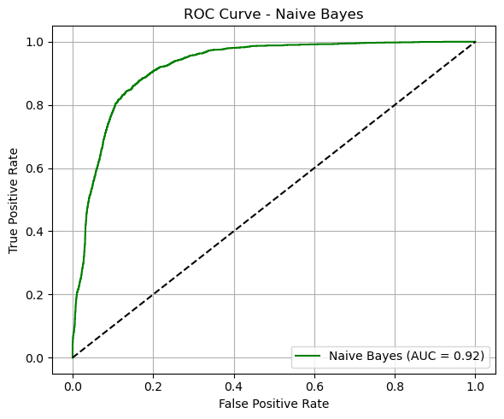
MODEL RESULTS
Naive Bayes
0.91
Accuracy
0.46
Precision
0.66
Recall
0.54
F1 Score
0.92
AUC
13
Notes:
13

Slide 14
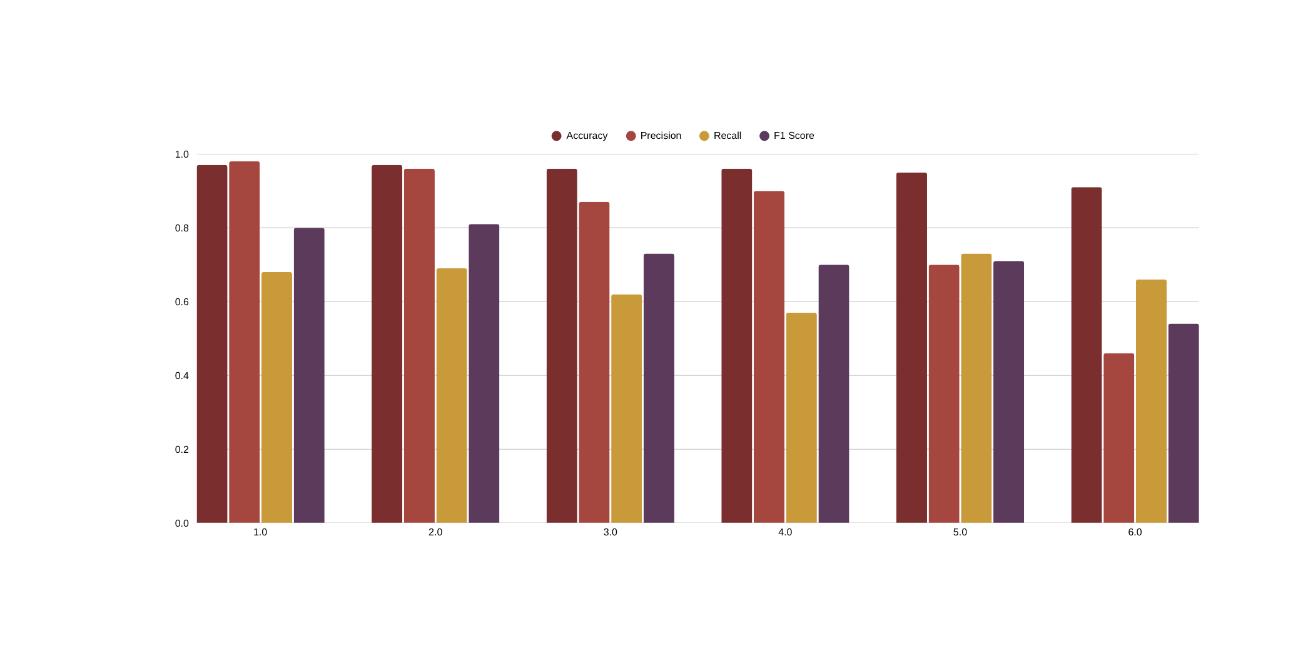
RESULTS & DISCUSSION
Overall performance comparison
14
Notes:
14

Slide 15
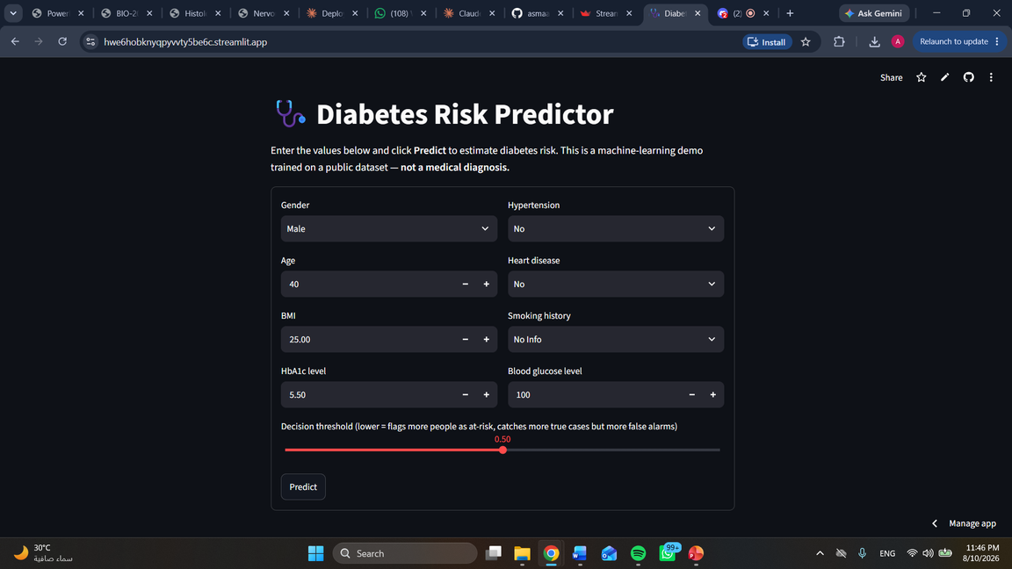
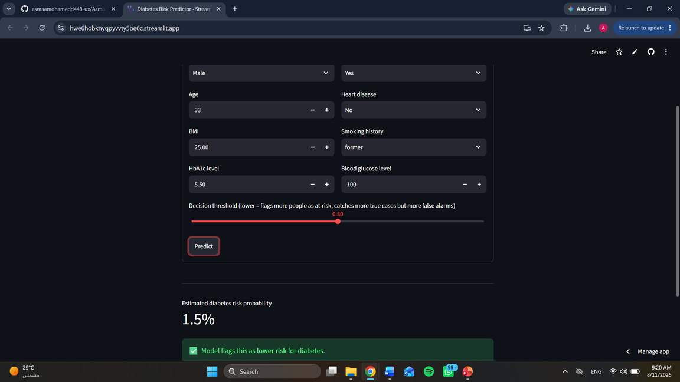
DEPLOYMENT
Diabetes Risk Predictor — live web app
Streamlit app taking gender, age, BMI, HbA1c, glucose & more as input.
Example: 33-year-old male, BMI 25, HbA1c 5.5% → 1.5% estimated risk (lower risk).
15
Notes:
15

Slide 16
CONCLUSION
Key takeaways
Best overall balance
Clinically confirmed predictors
XGBoost (F1 = 0.81, AUC = 0.98) and Random Forest (F1 = 0.80, AUC = 0.96) led the field.
HbA1c level and blood glucose together account for ~70% of feature importance.
Accuracy alone misleads
Next steps
With ~91.5% non-diabetic cases, F1 and recall are far more informative than accuracy.
Address class imbalance (SMOTE), tune ensemble hyperparameters, validate externally, add multi-class staging.
Notes:
16

Slide 17
Thank You
Asmaa Mohamed Mansour | ID: 221001928
CBIO313: Machine Learning & Data Mining · Nile University
Supervised by: Dr. Muhammed Elsayeh
Notes:
17

