Slide 1

GRADUATION CAPSTONE · NATIONAL TECH INITIATIVE
EcoWater Insights
An End-to-End Scalable Climate & Food Production Decision Support System
Presenter Name · Academic Supervisors · National Initiative Logo · Date

Slide 2
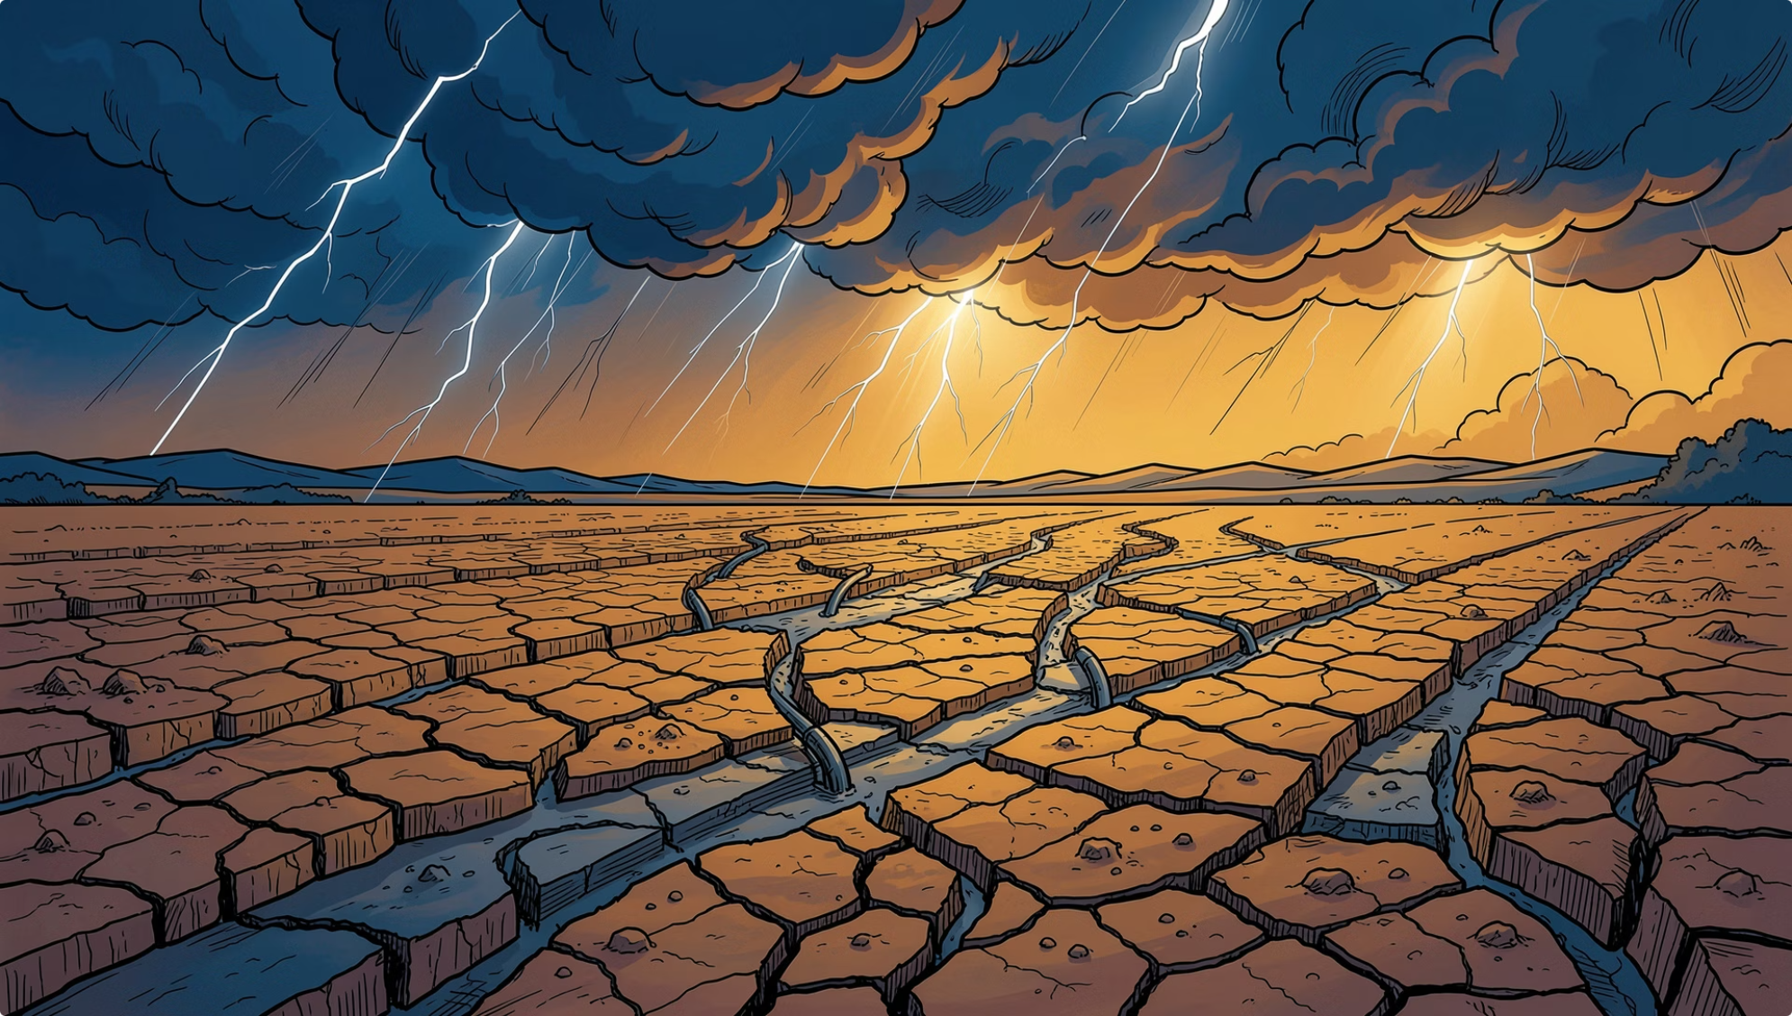

RESEARCH BACKGROUND
The Climate–Water–Food Nexus
Rising regional temperatures trigger hydrological imbalances — accelerated evaporation and soil moisture depletion — driving severe yield volatility across agriculture and aquaculture.
Climate Pressure
Water Stress
Food Security Risk
Temperature anomalies disrupt regional water cycles
Evaporation and soil moisture depletion accelerate
Crop and aquaculture yield volatility intensifies

Slide 3
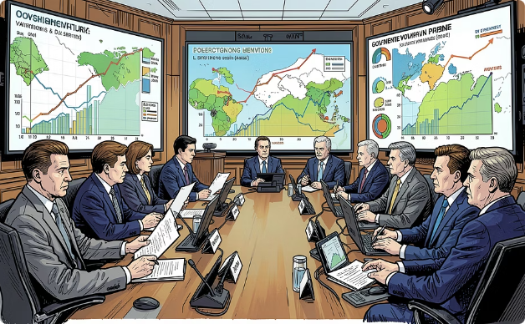
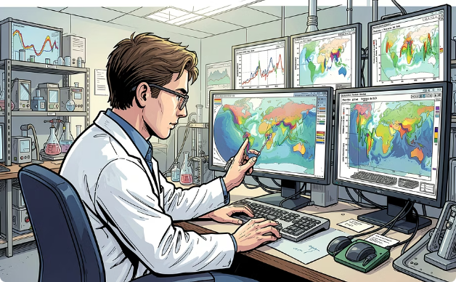

STAKEHOLDER FRAMEWORK
Who Benefits From This System
Policy Makers & Ministries
Academic Researchers & Climatologists
Commercial Agritech & Smart AquaGrid
Agriculture, Water Resources, and Environment ministries leverage long-term resource allocation models aligned with national sustainable development goals.
Advanced climate simulation environments enable hypothesis testing, regional modeling, and peer-reviewed research output at scale.
Real-time risk mitigation and adaptive farming intelligence for aquaculture operators managing yield exposure under climate variability.

Slide 4

DATA ENGINEERING ARCHITECTURE
End-to-End System Architecture & Data Pipelines
Engineering Lifecycle
📎 Asset Placeholder
01
[INSERT SYSTEM ARCHITECTURE / SPARK PIPELINE CLI LOGS IMAGE]
Embed pipeline execution logs, architecture diagram, or Spark job UI screenshot here.
1_data_generator.py
Parameterized stochastic simulation of climate, water, and food production variables across 190+ countries
02
2_global_spark_processing.py
Apache Spark distributed processing — cleaning, transformations, schema enforcement, and pipeline scalability
03
SQL Star Schema Warehouse
OLAP-optimized relational model for sub-second analytical query execution
04
Power BI + Streamlit + Gemini LLM
Unified analytical model, cloud web application, and generative AI inference layer

Slide 5

ANALYTICAL DATA MODELING
Relational Data Modeling — The Star Schema Framework
OLAP Warehouse Architecture
📎 Asset Placeholder
The analytical core is a Star Schema engineered for sub-second query execution and granular cross-filtering across the full nexus.
[INSERT POWER BI STAR SCHEMA RELATIONSHIPS DIAGRAM]
Embed the Power BI model view showing Fact_Global_Nexus connected to Dim_Country and Dim_Time.
Fact_Global_Nexus
Dim_Country
Dim_Time
Central fact table — multi-sector climate, water, and yield metrics
Geographic dimension enabling regional disaggregation and benchmarking
Temporal dimension supporting multi-decadal trend analysis

Slide 6

GLOBAL CLIMATE ANALYTICS
Macro-Level Global Climate & Hydrological Trends
Multi-Decadal Statistical Validation
📎 Asset Placeholder
Global temperature anomalies are correlated with precipitation shifts, evaporation rates, and soil moisture trends — validating the statistical model across 190+ countries.
[Global Water Metrics View — INSERT CHART / DASHBOARD SCREENSHOT]
Embed Power BI line and column chart showing global temperature anomaly vs. water metrics over time.
Temperature Anomaly — upward trajectory (line)
Precipitation, Evaporation & Soil Moisture — corresponding column metrics
Statistical Confidence — multi-decadal correlation patterns confirmed

Slide 7
REGIONAL CASE STUDY · EGYPT
Egypt Hydrological Deep Dive
Geographic Disaggregation
📎 Asset Placeholder
Egypt serves as the primary regional case study — a water-scarce nation where climate-driven hydrological fluctuations directly threaten national food security and aquaculture output.
[Egypt Water Stress Analytics — INSERT DASHBOARD SCREENSHOT]
Embed Egypt-specific Power BI report page showing evaporation anomalies, water stress indices, and hydrological fluctuations.
Water Stress Index
Hydrological Fluctuation
Climate Change Indicators
Localized evaporation anomalies mapped against historical baselines
Soil moisture and precipitation response to regional temperature change
Multi-decadal trend correlation confirming systemic pressure

Slide 8

FOOD SECURITY ANALYTICS · EGYPT
Egypt Food Production & Smart AquaGrid Yield Response
Socio-Economic Impact Quantification
📎 Asset Placeholder
Local temperature anomalies are directly quantified against consolidated yield data — translating climate signals into actionable food security intelligence.
[Egypt Production Analytics — INSERT DASHBOARD SCREENSHOT]
Embed Power BI visualization correlating Egypt's temperature anomalies with Wheat, Tomato, and Smart AquaGrid fish production yields.
🌾 Strategic Crops
🐟 Smart AquaGrid
Wheat and Tomato yield sensitivity modeled against regional temperature anomalies
Aquaculture production dynamics correlated with hydrological stress indicators

Slide 9

UNIFIED DECISION SUPPORT
Consolidated Decision Support System
Unified Executive Intelligence
📎 Asset Placeholder
A single Power BI model enables stakeholders to cross-filter the entire Climate–Water–Food Nexus simultaneously for Egypt — instantly visualizing cause-and-effect patterns across climate drivers, water stress, and food production outcomes.
[Consolidated Executive Nexus View — INSERT DASHBOARD SCREENSHOT]
Embed the full unified Power BI executive dashboard showing all nexus dimensions for Egypt.
Cross-Filter Any Dimension
Cause-and-Effect Visibility
Executive-Ready Output
Country, time period, crop type, or water metric — instantly
Temperature → Water Stress → Yield impact in one view
Policy-grade visualizations for ministry and board-level decisions

Slide 10

SCALABILITY & BENCHMARKING
Platform Agility & International Benchmarking
Enterprise-Grade Architectural Versatility
📎 Asset Placeholder
The data model transitions to cross-country benchmarking with a single click — no re-engineering required. Egypt's climate-production patterns are instantly comparable against international states.
[Global Partners Benchmarking — INSERT DASHBOARD SCREENSHOT]
Embed Power BI cross-country comparison view: Egypt vs. Australia, China, and Brazil climate-production patterns.
🇦🇺 Australia
🇨🇳 China
🇧🇷 Brazil
Arid-zone agricultural stress benchmark
High-density food production under climate pressure
Tropical hydrological variability reference

