Slide 1
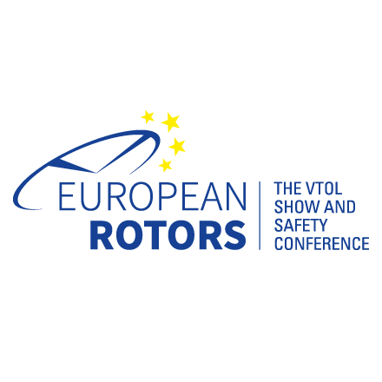



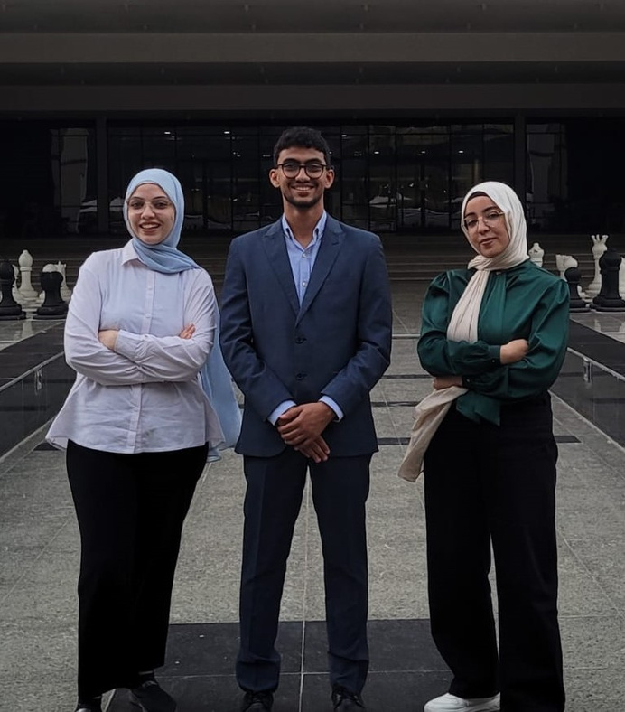
THE
AVALANCHE

Slide 2
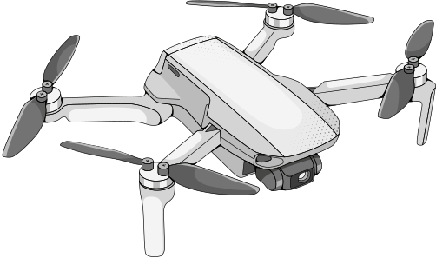
TABLE OF CONTENTS
Research Findings
Project Design
Public Engagement Strategies

Slide 3

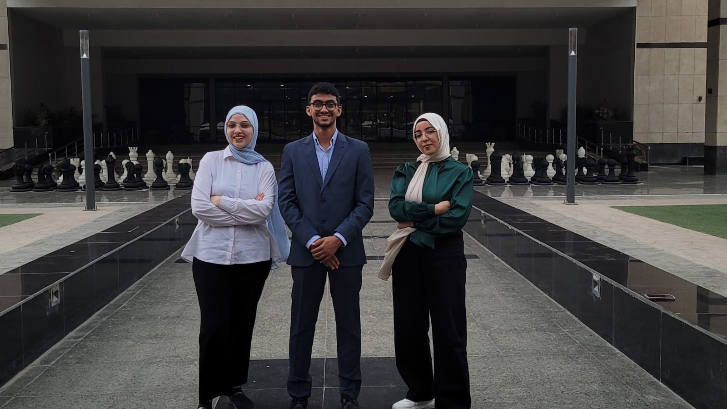
  VISION
ABOUT
US
Partaking in the ROTORTHON challenge, we do not only look forward to enhance our technical skills in the aerospace field, but also improve our problem-solving skills. Through our involvement, our goal is to enhance rotorcraft technology and raise Egypt's position in the international aerospace industry.
Team members
  Yahya Hazem
  Eman Yasser
  Asmaa Sapry
Country
  Egypt
University
  Bsc Aerospace Engineering
  University of Science and Technology in Zewail City
  MISSION
Our team is committed to advancing innovation in unmanned systems while supporting the United Nations Sustainable Development Goals, with a focus on promoting gender equality and increasing women's participation in STEM within aerospace. We aim to address critical safety and privacy issues in the UAV industry, tackle challenges in U-Space integration, and develop solutions that enhance public acceptance, reduce noise, and improve safety. Through our work, we strive to combine sustainability, social responsibility, and technological progress in shaping the future of aerospace.

Slide 4

Drones have become increasingly commonplace among the general population, facilitating enhanced connectivity and intelligence within urban environments. Yet, we seem to face some challenges regarding:
FACTORS INFLUENCING PUBLIC ACCEPTANCE OF UAVS
  Safety protocols
Public concerns about drone safety arise from the risk of crashes and collisions that may result in bodily harm and property damage. These issues highlight the need for strict regulations and public education to address safety fears.
  Privacy concerns
People often oppose drones due to privacy concerns, fearing they may be spied on or recorded without consent. This belief fuels discomfort and resistance to UAVs. Additionally, drones are unwelcome in certain areas, such as military bases, where they may be shot down for national security.
  Noise
Different species react differently to various noise levels and frequencies. Prolonged exposure to sounds above 85 decibels can damage human hearing. While humans hear between 20 and 20,000 Hz, birds can detect sounds beyond human hearing, even in the ultrasonic range. Dogs have sensitive hearing, able to perceive frequencies from 40 Hz to 60,000 Hz, and may feel stressed at noise levels between 60 and 80 dB. Understanding these sensitivities is crucial for protecting animal health and reducing noise pollution's impact.
  Environmental Impact

Slide 5
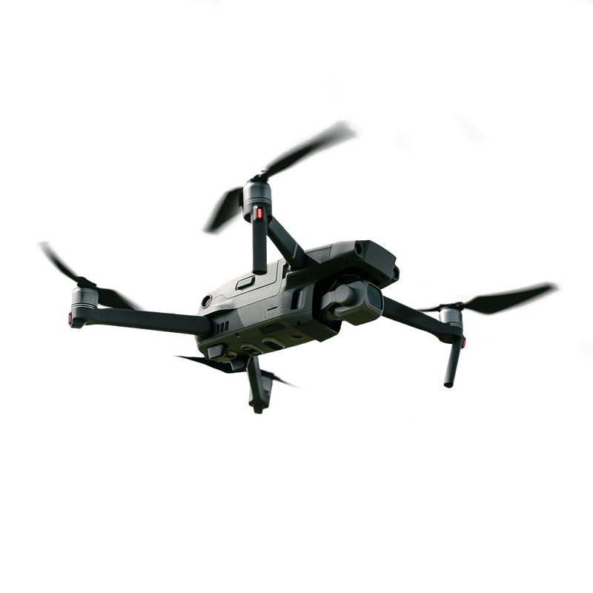
EXISTING U-SPACE PROJECTS
  Convo 5
The Convo 5 Project highlights the potential of U-Space principles to transform urban air mobility. By focusing on safety, efficiency, and community engagement, this initiative has set a precedent for integrating UAVs into urban environments, paving the way for a future where drones coexist harmoniously with traditional air traffic.
  AURA
The AURA (PJ.34) project focuses on integrating the management of very low-level airspace (VLL), also referred to as U-space, with conventional air traffic management (ATM) systems. Its aim is to facilitate smooth operations between U-space and ATM.

Slide 6
IMPLEMENTING
U-SPACE IN A “HYPOTHETICAL CITY”
  Objectives
  Safety Assurance: Establish robust protocols and systems to ensure the safety of both drone operations and the public.
  Privacy Protection: Implement measures to safeguard personal privacy and prevent unauthorized surveillance.
  Noise Mitigation: Develop strategies to reduce the noise generated by UAVs, especially in densely populated areas.
  Environmental Management: Minimize the ecological footprint of drone operations and address potential impacts on local wildlife.
  Regulatory Framework: Create adaptive regulations that support innovation while ensuring public safety and privacy.

Slide 7
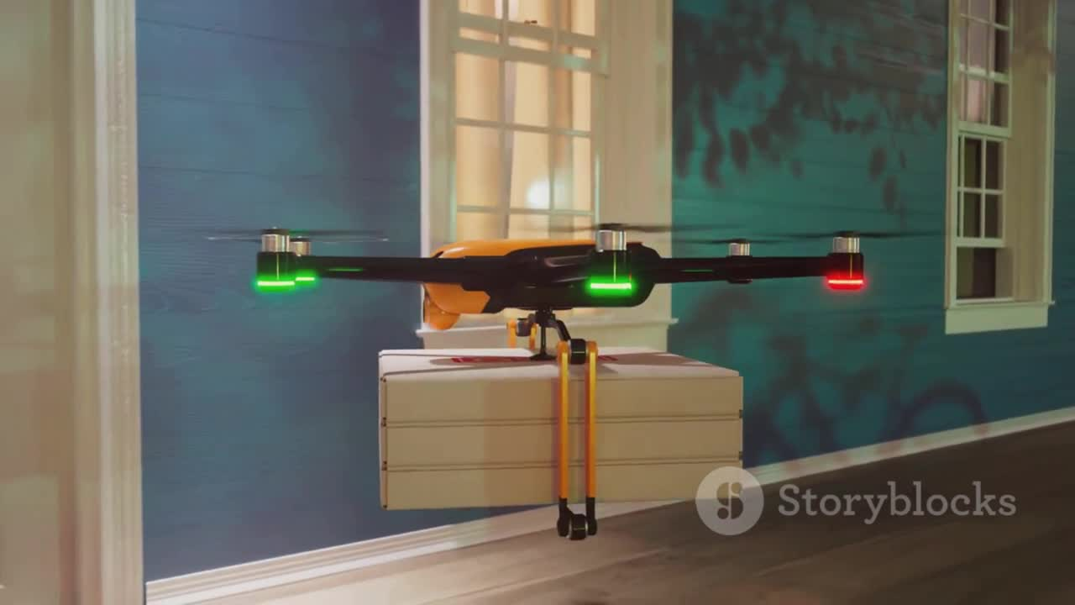

Slide 8
ENHANCED SAFETY MEASURES
  Identification & Tracking
  Collision Avoidance system
Each UAV should have a unique identification number, similar to airplane transponders, which can be transmitted to ground stations using low-energy communication technologies like ADS-B. The UAV's 3D location (x, y, z) and speed will be tracked in real-time using GPS or GNSS, allowing ground stations to monitor its path. Sharing this data is essential for air traffic control and integrated systems to ensure safe distances between drones and people.
To avoid collisions, UAVs should use computer vision and sensors like LiDAR, radar, and cameras to detect and steer clear of other drones. They can share location data through specific communication protocols for better coordination. Additionally, UAVs can integrate with existing air traffic control systems to automatically change course if a manned aircraft is nearby. AI-based algorithms can help adjust flight paths in real-time to prevent collisions..
  Bird Deterrent system
A Bird Deterrent System uses ground-based ultrasonic emitters placed near sensitive areas like airports or wildlife sanctuaries. These devices emit frequencies that safely warn birds to stay away from UAVs, preventing potential collisions without harming them.

Slide 9
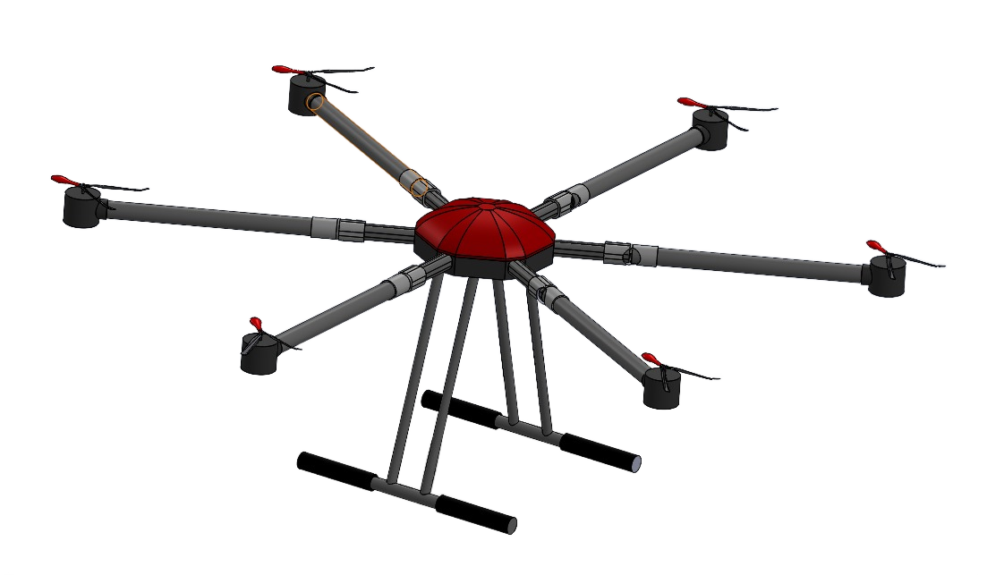
SAFETY BACK-UP SOLUTIONS
  Partial rotor failure
In the case of Hexacopter and Octacopter, the propulsion redundancy mechanism starts, where if a motor or two fail, the drone can safely maintain stability till it reaches the nearest underground drone parking spot for maintenance and for power supply.
  Total rotor failure
In addition, in the event of a total rotor failure, a parachute deployment system (PDS) is activated alongside with a dual purpose float, that performs as both a cushioning on land and a floatation device on water. For ensuring more safety, the use of a flight termination system (FTS), that would force stop the propellers so that the parachute can operate properly, would be beneficial.

Slide 10
MITIGATING PRIVACY CONCERNS
  Dynamic No-Fly Zones: Local governments need a way to create temporary restricted airspace for events or hazards. UAV systems can connect to a centralized airspace management platform to get real-time updates and avoid these zones automatically.
  Route Modification: If a UAV nears restricted airspace, its onboard computer should quickly find a safe detour to avoid the no-fly zone. This can be done using UAV software with pre-installed, real-time updating geofencing.
  Real-Time Monitoring and Editing: Authorities can add or remove restricted areas based on current events, like establishing a temporary no-fly zone over a disaster site.
  Passive Camera Detection system, like RF or millimeter-wave, to check if UAVs have cameras, without interfering with their avionics.

Slide 11
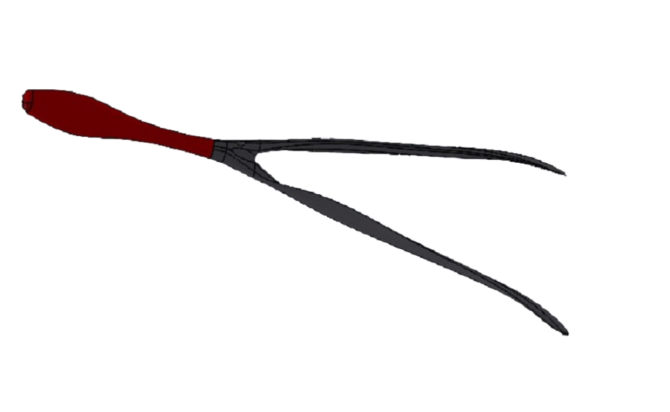

NOISE REDUCTION TECHNOLOGIES
  Propeller Design
Structure
The silent Zipline Propeller with a serrated blade design, which is inspired by owl wings, breaks up the airflow over the blades; therefore, reducing turbulence and noise. While minimizing the turbulence, it’s optimized with efficient airflow and thrust by using a 30-degree blade angle. Furthermore, the asymmetrical blade shape works on reducing drag and improving lift besides the flexibility to absorb mechanical vibrations and even out the airflow, providing a quieter operation. The root of each blade has a wider chord, generating more lift at lower RPMs.
Material
Recycled carbon fibers & fiberglass filled with nylon would give the utmost efficiency as promised by several reputable companies such as ELSA industries

Slide 12
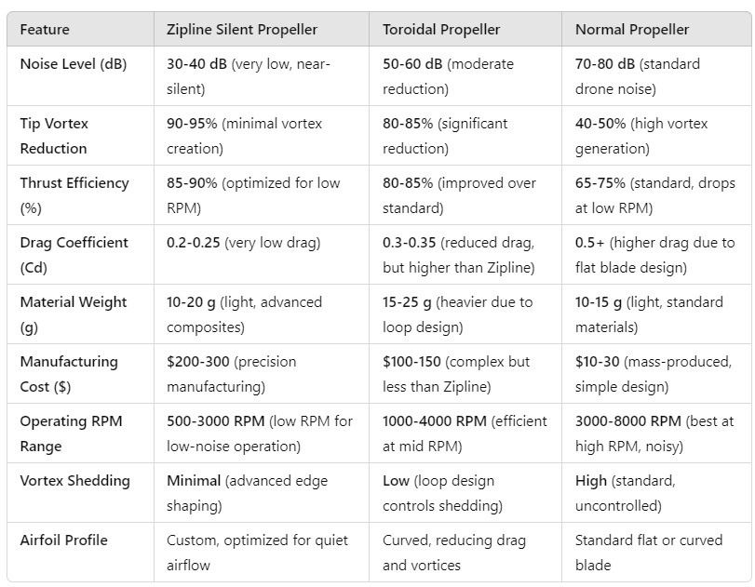
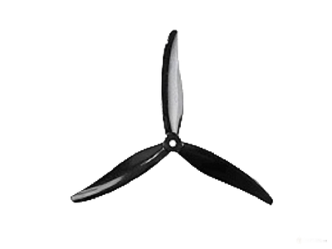
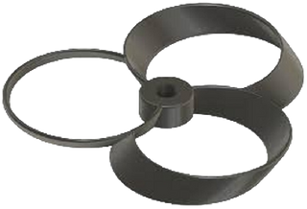
Normal Propeller
Propeller Design
Toroidal
Zipline

Slide 13
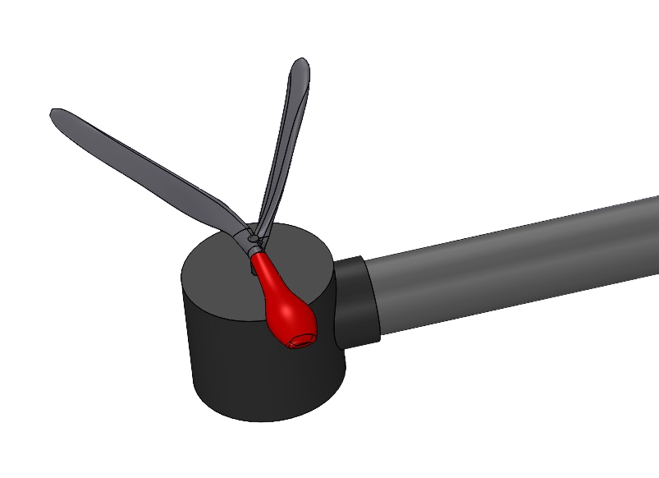
NOISE REDUCTION TECHNOLOGIES
  Noise dampening materials
Polyurethane foam is an effective padding material for drones, as it absorbs noise from motors and propellers while being lightweight for optimal performance. Its durability and versatility allow for targeted noise reduction and vibration damping, enhancing stability. Affordable and easy to shape, it contributes to quieter flights and better acceptance in urban areas.

Slide 14

ENVIRONMENTAL IMPACTS SOLUTIONS
  Power Management System Battery Efficiency it is recommended to Implement an advanced power management system to extend battery life, which is crucial for long-distance flights or missions requiring high energy (e.g., operating sensors).
  Efficient energy distribution among sensors, propulsion, and communication systems will reduce the overall environmental impact.
  Reducing environmental impact and Enhancing Privacy using eco-friendly materials such as recycled carbon fiber & PLA for drone construction to lower the environmental impact. Additionally, ensure the propulsion system is as efficient as possible to reduce emissions (if any).

Slide 15
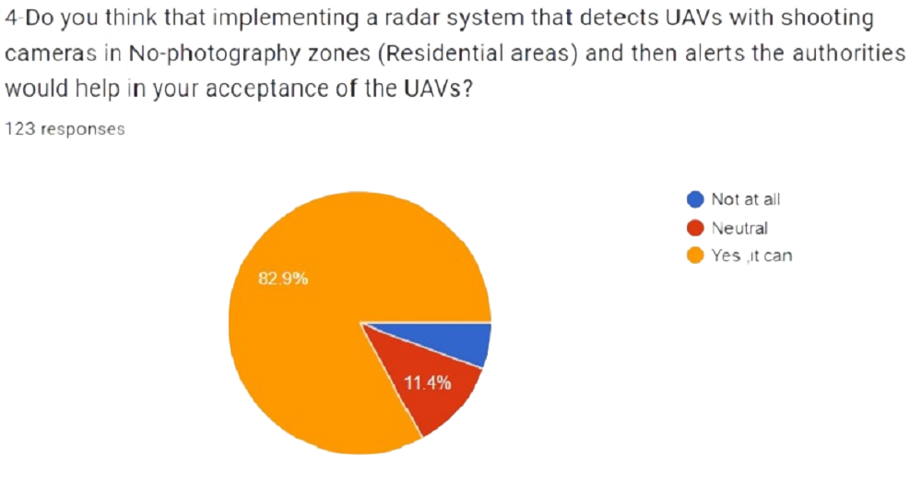
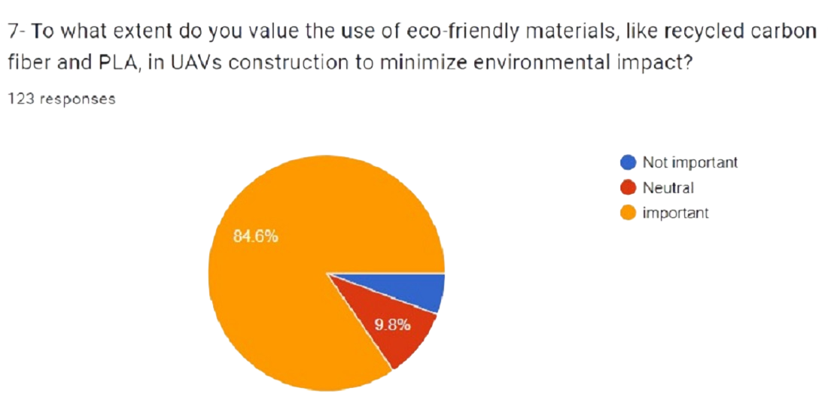
PUBLIC SURVEYS & FEEDBACK
The survey we made after posing the enhanced solutions to the issues at hand were positive so we expect the UAVs to be present in the upcoming future with almost no concerns and with utmost acceptance.

Slide 16
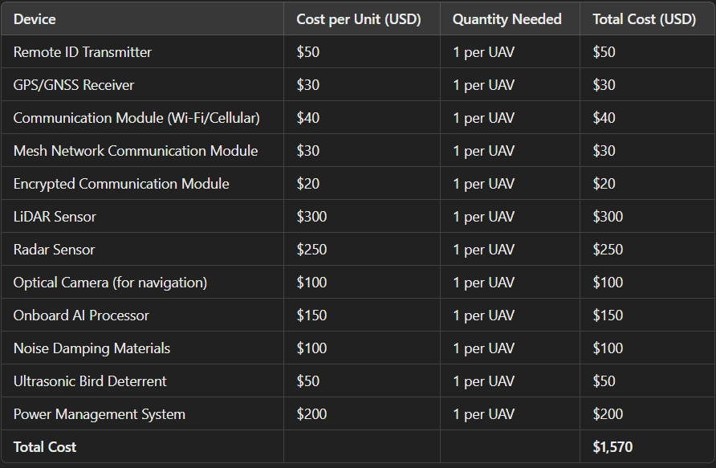
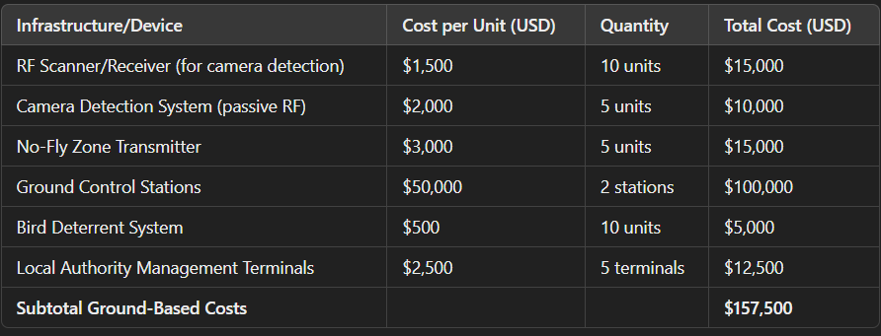
FINANCIAL
Plan
Initial Hardware and Device Costs
Ground-Based Infrastructure Costs

Slide 17
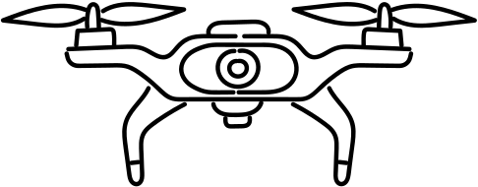
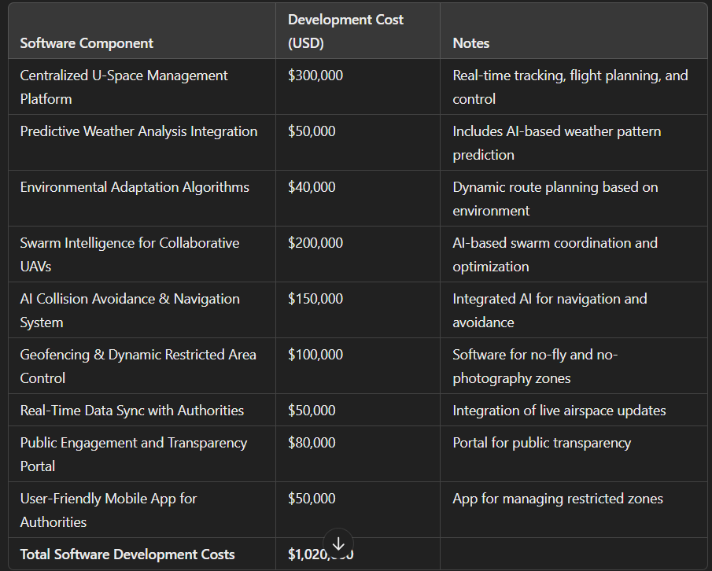
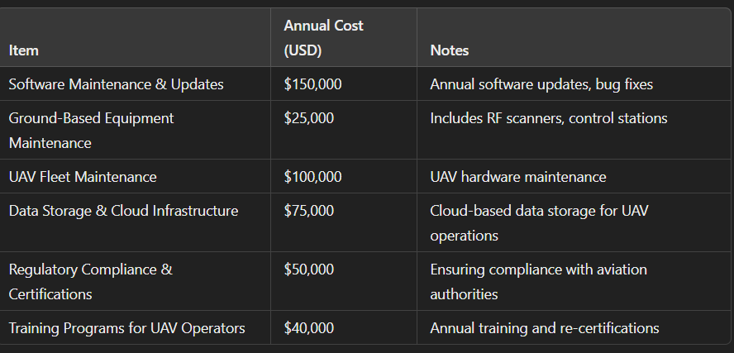
Software Development and Integration
Operational and Maintenance Costs

Slide 18
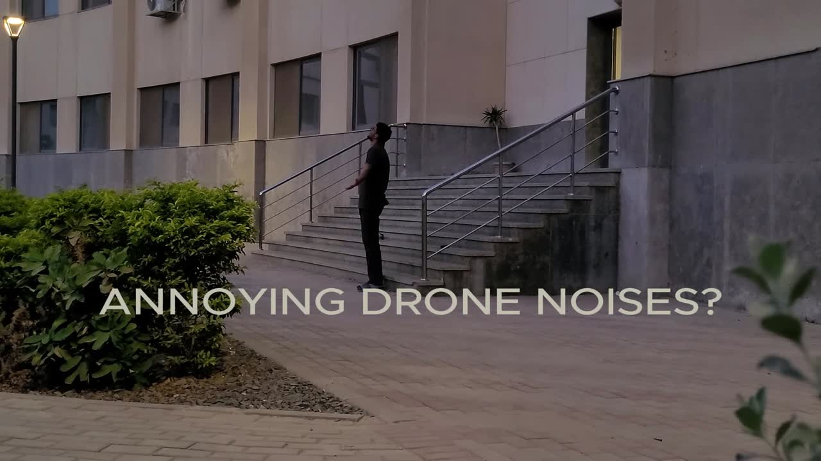

Slide 19
REFERENCES
The new EU regulatory framework for U-space. (n.d.). https://www.ecac-ceac.org/activities/unmanned-aircraft-systems/uas-bulletin/22-uas-bulletin/505-uas-bulletin-2-the-new-eu-regulatory-framework-for-u-space
Kim, T. (2016). Reduction of Tonal Propeller Noise by Means of Uneven Blade Spacing. https://escholarship.org/uc/item/9q75v9t9
What is U-space? (n.d.). https://www.ecac-ceac.org/activities/unmanned-aircraft-systems/uas-bulletin/22-uas-bulletin/504-uas-bulletin-2-what-is-u-space
What is U-space? (n.d.). https://www.ecac-ceac.org/activities/unmanned-aircraft-systems/uas-bulletin/22-uas-bulletin/504-uas-bulletin-2-what-is-u-space
Teja, H. S., Chawan, G., Nilay, S., Eswaraiah, D., & Jyothi, U. (2023). Design and analysis of drone propeller by using aluminium and nylon materials. E3S Web of Conferences, 391, 01032. https://doi.org/10.1051/e3sconf/202339101032

