Slide 1
Cybersecurity

Slide 2
What is Cybersecurity ?
Cybersecurity is the practice of protecting computers, networks, and data from theft, damage, and unauthorized access. It has become critical in our increasingly digital world where sensitive information is often just a click away from cyber threats.
Cybersecurity is essential in today's digital world to protect sensitive data, systems, and privacy.
The digital age has brought immense convenience but also significant risks. As we conduct an increasing amount of our personal, professional, and financial transactions online, the potential for cybercriminals to exploit vulnerabilities and gain unauthorized access to our most sensitive information has grown exponentially.

Slide 3
Cybersecurity is important for several reasons:
Protection of Sensitive Data: In an increasingly digital world, we store a vast amount of sensitive data online, from personal information to financial details. Cybersecurity ensures that this data remains confidential and is not accessed or stolen by cybercriminals.
Financial Security: Cyber-attacks can have severe financial consequences. Businesses can suffer financial losses due to data breaches, and individuals can fall victim to scams and identity theft. Effective cybersecurity measures help protect against these financial risks.
Preserving Privacy: Cybersecurity safeguards individual and organizational privacy. It ensures that private communications, transactions, and personal information remain confidential and are not exploited.
Business Continuity: For organizations, cyber-attacks can disrupt operations, leading to downtime and financial losses. Cybersecurity measures help maintain business continuity and protect the reputation of the organization.

Slide 4
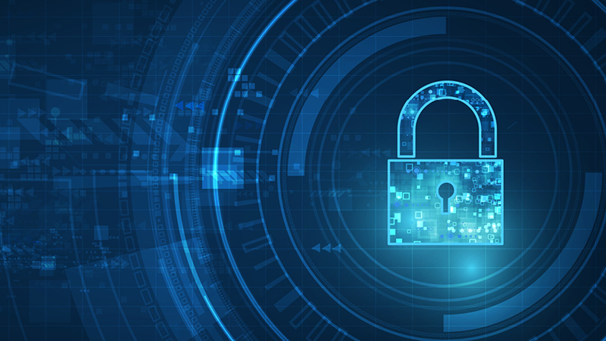
Network Security

Slide 5
Network Security
Network security is the entire set of technologies, processes, and practices dedicated to safeguarding computer networks against unauthorized access and various cyber threats.
It serves as the first line of defense, acting as a digital barrier between a network and the potential threats of the internet. A wide range of procedures are included in network security to guarantee the availability, confidentiality, and integrity of data on the network.
Network security is vital not only for protecting sensitive business information but also for ensuring the privacy and security of individuals who rely on network-connected devices.
Effective network security is a continuous effort that requires staying up-to-date with emerging threats, patching vulnerabilities, and educating users about best practices to prevent breaches.

Slide 6
Common Network Threats:
Network threats come in various forms, including:
  Malware: This umbrella term includes viruses, which can corrupt or destroy data, and ransomware, which encrypts data and demands a ransom for its release. Malware can infiltrate systems through malicious downloads or attachments.
  Phishing Attacks: Cybercriminals impersonate trustworthy sources to deceive individuals into revealing sensitive information, such as passwords or credit card details. Phishing emails often appear legitimate and urge recipients to take urgent actions.
  Distributed Denial of Service (DDoS) Attacks: In a DDoS attack, a network is overwhelmed with a flood of traffic, rendering it inaccessible to legitimate users. Attackers use networks of compromised devices to orchestrate these attacks.

Slide 7
Effective Countermeasures of Network Security:
Firewalls: These are like virtual gatekeepers that monitor incoming and outgoing traffic, allowing or blocking data based on predefined security rules. Firewalls act as the sentinels that decide who can enter and exit the network.
Intrusion Detection Systems (IDS): IDS are like vigilant guards that continuously scan network traffic, looking for signs of suspicious activities or potential threats. When something unusual is detected, the IDS raises an alert.
Encryption: Encryption is the process of converting data into a code to prevent unauthorized access. It ensures that even if someone intercepts the data in transit, they cannot decipher it without the appropriate decryption key.
Data Integrity: Network security measures also include mechanisms for maintaining data integrity. This ensures that data remains unchanged and uncorrupted during transmission.

Slide 8
Cyber Careers
Ethical Hackers:
Role: Ethical hackers are cybersecurity professionals who legally attempt to break into computers, networks, and devices. Their mission is to test an organization's defenses by identifying vulnerabilities and weaknesses before malicious hackers can exploit them.
2. Security Analysts:
Role: Security analysts are the experts responsible for monitoring and maintaining an organization's security infrastructure. They continuously assess security measures, review logs, and respond swiftly to security breaches. They investigate incidents, analyze threats, and implement security improvements to protect the organization's digital assets.
3. Incident Responders:
Role: Incident responders are professionals dedicated to analyzing and mitigating security incidents when they occur. They play a critical role in identifying the scope of an incident, containing it, and preventing further damage. Incident responders work to get systems back on track and develop strategies to avoid similar incidents in the future.

Slide 9
Education Pathways
Certifications
Certifications are targeted credentials that provide in-depth knowledge and validation of expertise in specific areas of cybersecurity. They are often sought after by professionals looking to specialize or upskill in a particular aspect of cybersecurity.
Examples: Some well-regarded certifications include Certified Information Systems Security Professional (CISSP), Certified Ethical Hacker (CEH), CompTIA Security+, and Certified Information Security Manager (CISM).
Degrees
Pursuing a degree in cybersecurity, computer science, or a related field offers a comprehensive and structured education. It equips students with a broad understanding of cybersecurity principles and practices.
Bachelor's Degrees: Many universities offer bachelor's degrees in cybersecurity, computer science, or information technology with a focus on security.
Master's Degrees: For those seeking advanced knowledge, master's programs in cybersecurity or information assurance provide in-depth studies and may include specializations like digital forensics, cyber policy, or network security.

Slide 10
Emerging Threats and Technologies
The world of cybersecurity is in a constant state of change, as cyber threats and technologies evolve. Staying ahead of emerging trends is important to maintaining a strong defense. Some of the most noteworthy emerging trends:
AI-Driven Attacks:
Cybercriminals are increasingly leveraging artificial intelligence (AI) to launch more sophisticated attacks. AI enables attackers to automate and optimize their methods, making them more effective at finding vulnerabilities and breaching systems.
AI-driven attacks can quickly adapt to changing circumstances, making them challenging to detect and defend against. These attacks have the potential to bypass traditional security measures.

Slide 11
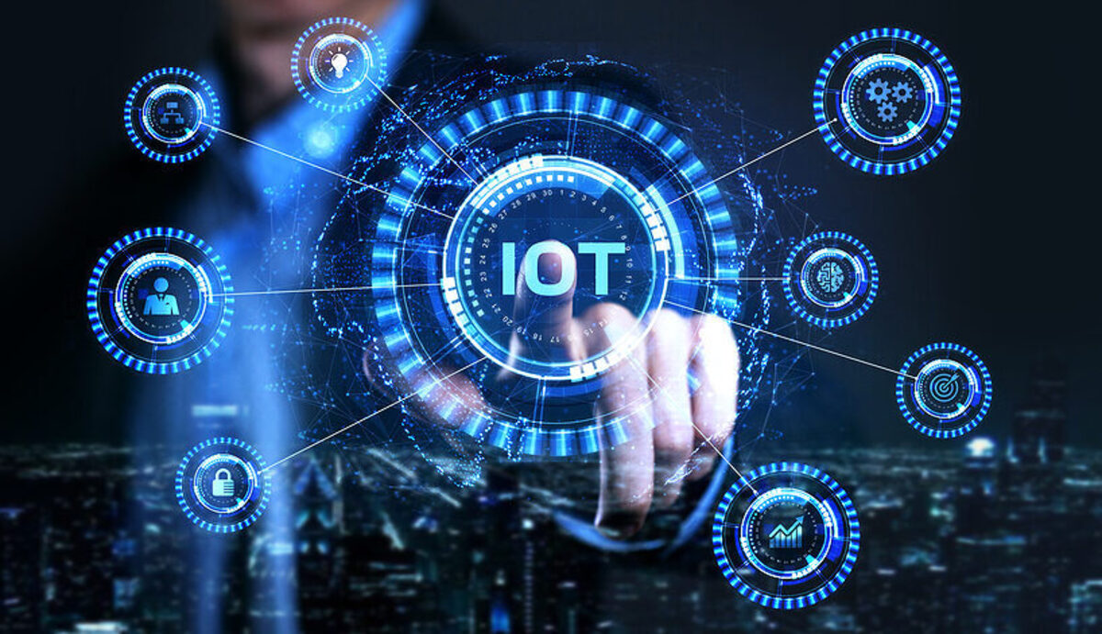
IoT Vulnerabilities:
The Internet of Things (IoT) is the network of interconnected devices and sensors. As more devices, from smart thermostats to industrial machinery, become part of the IoT, they present new potential entry points for hackers.
IoT devices often have limited security features and are more challenging to patch or update. This vulnerability makes them attractive targets for cybercriminals looking to compromise networks and gain unauthorized access.

Slide 12
AI and Blockchain:
Emerging technologies like AI and blockchain are revolutionizing cybersecurity.
AI in Cybersecurity: AI is used to analyze vast datasets, identifying patterns and anomalies that might indicate a threat. It enhances the speed and accuracy of threat detection and response.
Blockchain in Cybersecurity: Blockchain provides an immutable ledger for secure transactions and data storage. It ensures the integrity of data and offers robust protection against tampering or unauthorized access.
AI is a powerful ally in the fight against cyber threats, offering real-time analysis and the ability to predict and prevent attacks. Blockchain ensures the transparency and security of data, making it increasingly relevant for secure transactions and record-keeping.

Slide 13
Cybercrime Expected To Skyrocket in the
Coming Years

