Slide 1

ChronoSales
Revolutionizing Retail Analytics
Team 6
Ikram Mohammed
Asma Irfan
Shivaram
Senthil Kumar
Vaishnavi

Slide 2

Problems
Inefficiencies in current retail operations
Lack of precise sales predictions affecting decision-making
Unforeseen market fluctuations
Inefficient inventory management
Difficulty in making informed decisions due to unreliable forecasts

Slide 3



Commitment to optimizing retail operations
Leveraging technology for actionable insights

Slide 4

DATA! The backbone
Time series of features like Store id,Date, store_nbr, family, sales, onpromotion Holidays and Events, with metadata - date,type,locale,locale_name,description,transferred

Slide 5
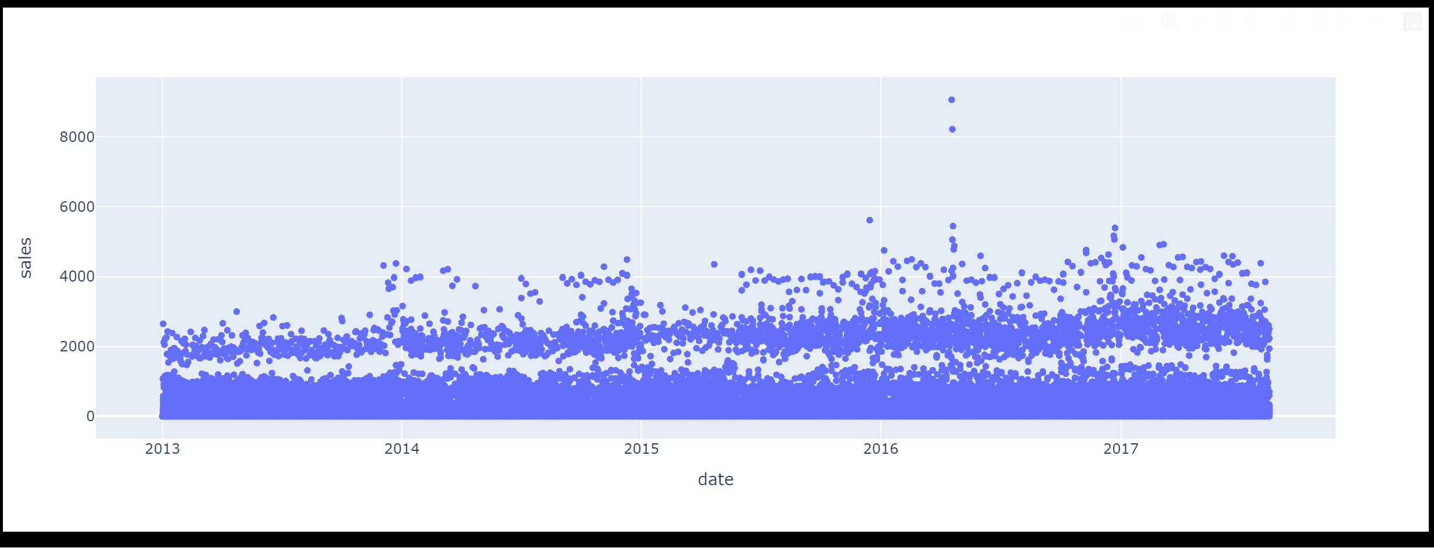
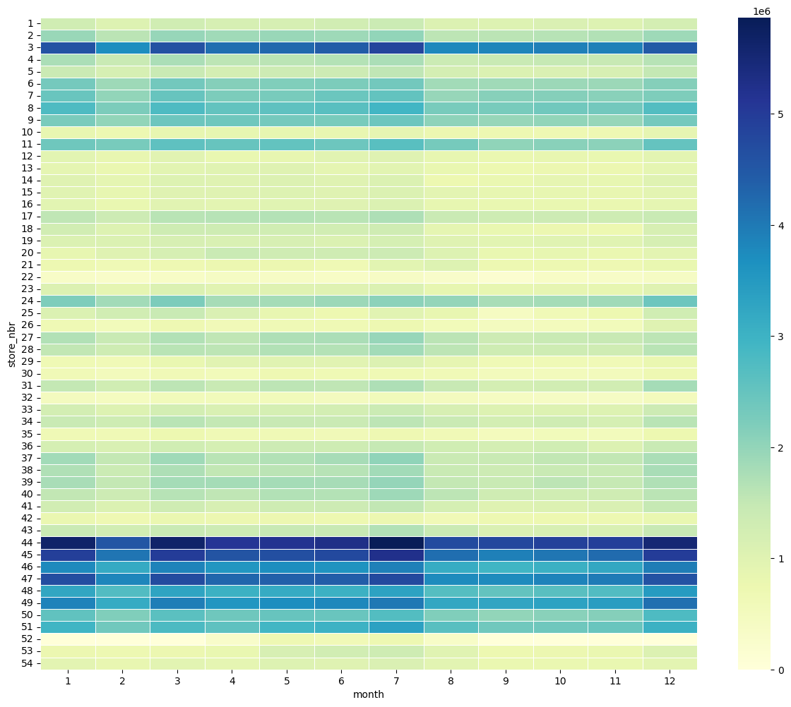
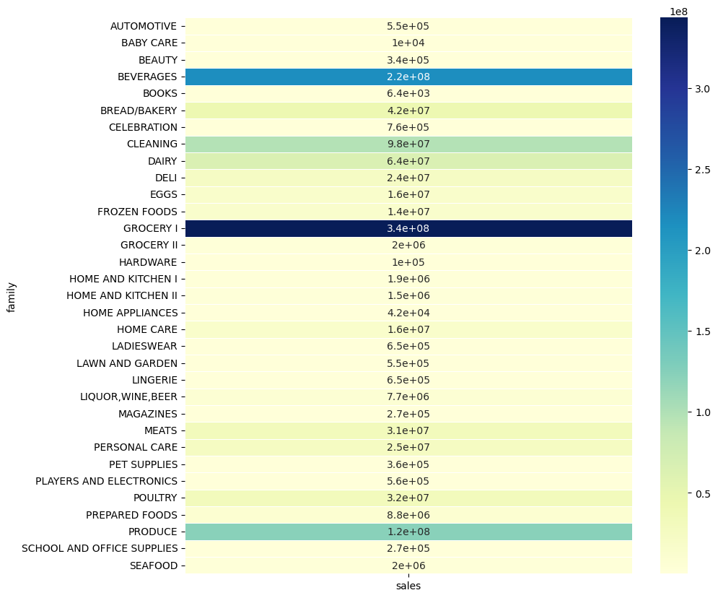

Slide 6

The Engine Behind ChoronoSales
ARIMA : AutoRegressive Integrated Moving Average
LSTM:
Long Short-Term Memory
LSTM identified as the superior model for predictive accur
LSTM identified as the superior model for predictive accuracy

Slide 7
Seq Len = 7
Epochs = 10
p, q, d by AIC
p = Order of AR Model
d = Degree of Differencing
q = Order of MA model
Models
LSTM
ARIMA

Slide 8
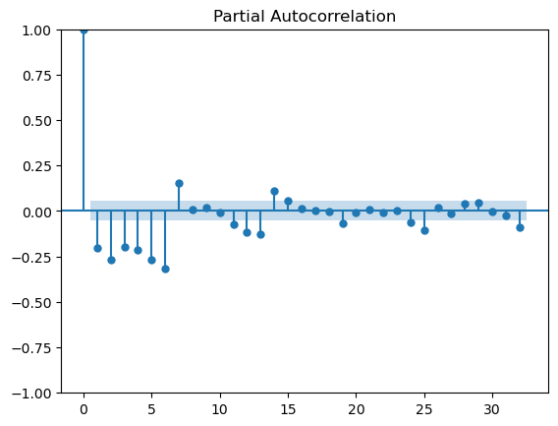
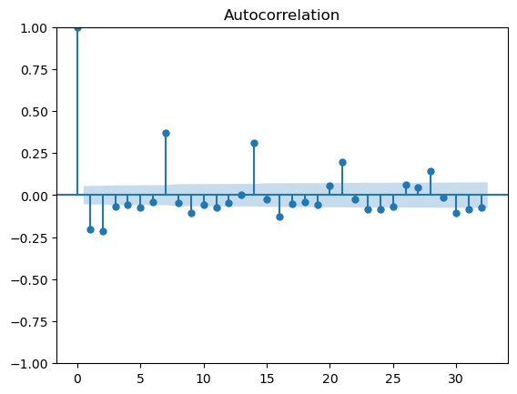
P-Value Determination
Q-Value Determination

Slide 9

TRIUMPHS
Remarkable achievement of RMSE below 0.05
Integration of a user-friendly web application
Improved accessibility for intuitive user experience

