Slide 1
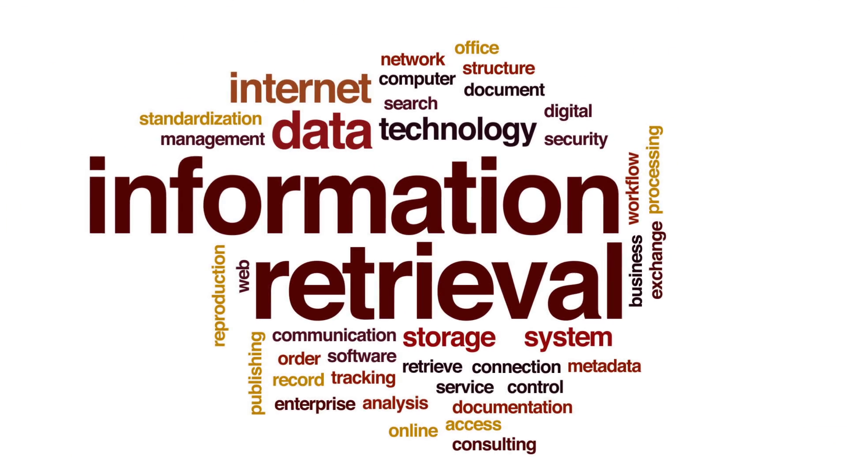

Slide 4
Information Retrieval
Information retrieval (IR) is the process of finding material (usually documents) of an unstructured nature (usually text) that satisfies an information need from within large collections (usually stored on computers).
Information is organized into (a large number of) documents
Large collections of documents from various sources: news articles, research papers, books, digital libraries, Web pages, etc.
Example: Web Search Engines like Google claim to index over 1 Trillion pages

Slide 5
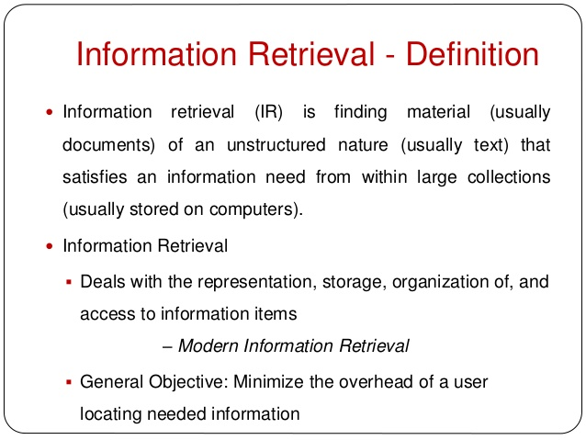

Slide 6
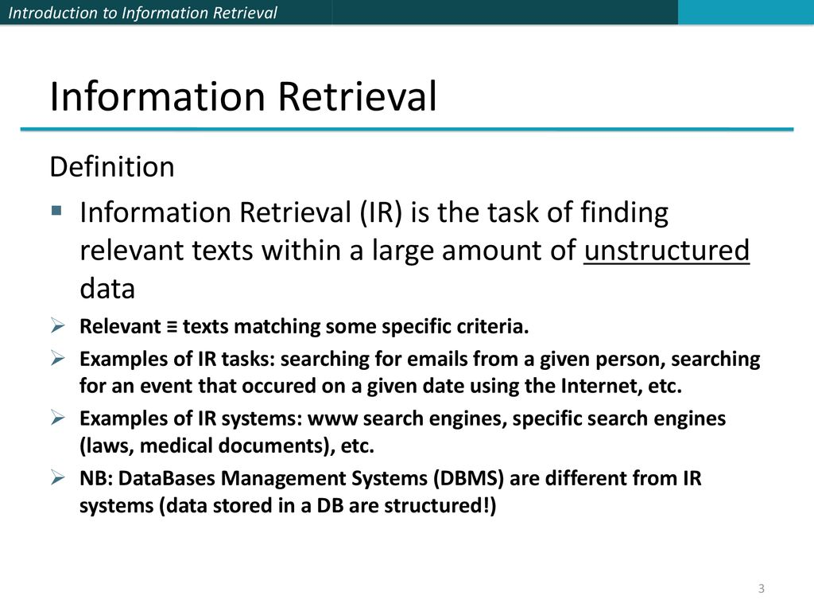

Slide 7
Information Retrieval
Given a query and a corpus, find relevant documents.
query: user’s expression of the information need
corpus: the repository of retrievable items
relevance: satisfaction of the information need

Slide 8
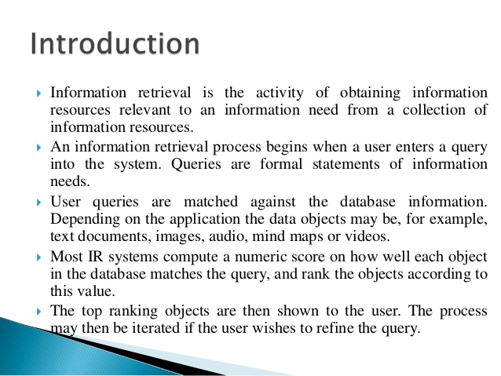

Slide 9
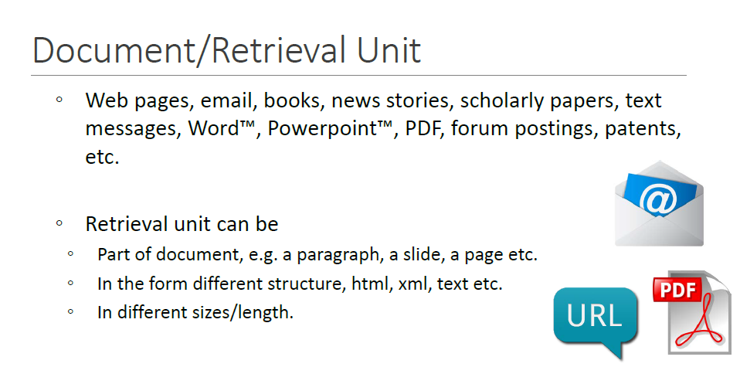

Slide 10
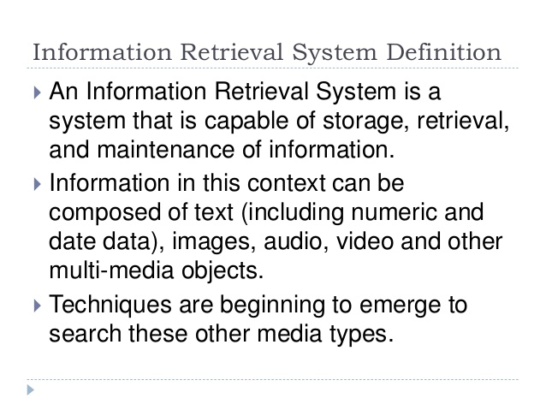

Slide 11
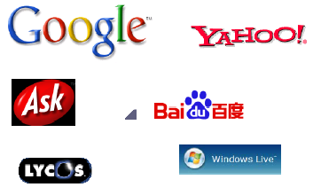
Information Retrieval Systems?
Document (Web page) retrieval in response to a query
Quite effective (at some things)
Commercially successful (some of them)
But what goes on behind the scenes?
How do they work?
What happens beyond the Web?
Web search systems
Lycos, Excite, Yahoo, Google, Live, Northern Light, Teoma, HotBot, Baidu, …

Slide 12
Examples of IR systems
Examples of Information Retrieval Problems Web Search
given a keyword and a web crawl, find relevant URLs.
Examples of Information Retrieval Problems Image Search
given a keyword and image database, find relevant images.
Examples of Information Retrieval Problems Question Answering
given a question and available text, rules, logic, find an answer.

Slide 13
Examples of IR systems
Examples of Information Retrieval Problems Job Search
given a resume and job advertisements, find relevant jobs.
Examples of Information Retrieval Problems Applicant Search
given a advertisement and resumes, find good candidates.

Slide 14
Examples of IR systems
Conventional (library catalog): Search by keyword, title, author, etc.
is a register of all bibliographic items found in a library or group of libraries, such as a network of libraries at several locations
Text-based (Lexis-Nexis, Google, FAST): Search by keywords. Limited search using queries in natural language.
Multimedia (QBIC, WebSeek, SaFe): Search by visual appearance (shapes, colors,… ).
Multimedia Information Retrieval (MIR) is an organic system made up of Text Retrieval (TR); Visual Retrieval (VR); Video Retrieval(VDR); and Audio Retrieval (AR) systems. ... Such an approach is known as the Content Based Information Retrieval (CBIR), and is the core of MIR.

Slide 15
Examples of IR systems
Question answering systems (AskJeeves, Answerbus): Search in (restricted) natural language
Question answering (QA) is a computing discipline within the fields of information retrieval and natural language processing (NLP), which is concerned with building systems that automatically answer questions posed by humans in a natural language

Slide 16
Examples of IR systems
Other:
Cross language information retrieval, (is a subfield of information retrieval dealing with retrieving information written in a language different from the language of the user's query)
Music retrieval(Music information retrieval (MIR) is the interdisciplinary science of retrieving information from music. MIR is a small but growing field of research with many real-world applications.)

Slide 17
General Goal of Information Retrieval
To help users find useful information based on their information needs (with a minimum effort) despite
Increasing complexity of Information
Changing needs of user
Provide immediate random access to the document collection.
Retrieval systems, such as Google, Yahoo, are developed with this aim.

Slide 18
Information Retrieval vs. Data Retrieval
Emphasis of IR is on the retrieval of information, rather than on the retrieval of data
Data retrieval
Consists mainly of determining which documents contain a set of keywords in the user query (which is not enough to satisfy the user information need)
Aims at retrieving all objects that satisfy well defined semantics
a single erroneous object among a thousand retrieved objects implies failure
Information retrieval
Is concerned with retrieving information about a subject or topic than retrieving data which satisfies a given query
semantics is frequently loose: the retrieved objects might be inaccurate
small errors are tolerated

Slide 19
Information Retrieval vs. Data Retrieval
Example of data retrieval system is a relational database
 | Data Retrieval | Info Retrieval
Data organization | Structured | Unstructured
Fields | Clear Semantics (ID, Name, age,…) | No fields (other than text)
Query Language | Artificial (defined, SQL) | Free text (“natural language”), Boolean
Matching | Exact (results are always “correct”) | Partial match, best match
Query specification | Complete | Incomplete
Items wanted | Matching | Relevant
Accuracy | 100% | < 50%
Error response | Sensitive | Insensitive
Ranking None Important

Slide 20
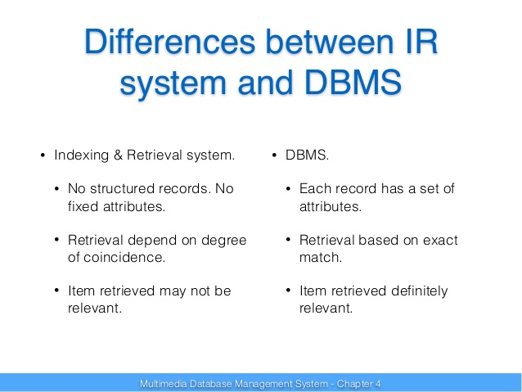

Slide 24
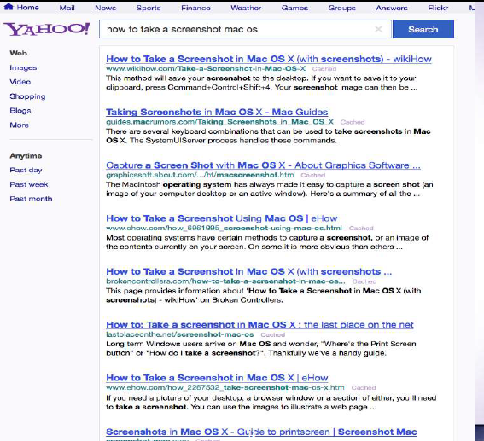

Slide 25
Why is IR so hard?
Traditionnel Information retrieval (IR) Systems attempt to find relevant documents to respond to a user’s request.
Information retrieval problem: locating relevant documents based on user input, such as keywords or example documents
The real problem boils down to matching the language of the query to the language of the document.
Simply matching on words is a very brittle (no elasticity) approach. One word can have different semantic meanings. Consider: Take
“take a place at the table”
“take money to the bank”
“take a picture”

Slide 26
More Problems with IR
You can’t even tell what part of speech a word has:
“I saw her duck”
A query that searches for “pictures of a duck” will find documents that contains:
“I saw her duck away from the ball falling from the sky”
Proper Nouns often use regular old nouns
Consider a document with “a man named Abraham owned a Lincoln”
A word matching query for “Abraham Lincoln” may well find the above document.

Slide 27
Basic Concepts in Information Retrieval:
(i) User Task and (ii) Logical View of documents
The User Task:
two user task – retrieval and browsing
Retrieval
DB
Browsing
USER

Slide 28
The User Task
Retrieval
It is the process of retrieving information whereby the main objective is clearly defined from the onset of searching process.
The user of a retrieval system has to translate his information need into a query in the language provided by the system.
In this context (i.e. by specifying a set of words), the user searches for useful information executing a retrieval task
English Language Statement :
I want a book by J. K Rowling titled The Chamber of Secrets

Slide 29
Browsing
It is the process of retrieving information, whereby the main objective is not clearly defined from the beginning and whose purpose might change during the interaction with the system.
E.g. User might search for documents about ‘car racing’ . Meanwhile he might find interesting documents about ‘car manufacturers’. While reading about car manufacturers in Addis, he might turn his attention to a document providing ‘direction to Addis’, and from this to documents which cover ‘Tourism in Ethiopia’.
In this context, user is said to be browsing in the collection and not searching, since a user may has an interest glancing around

Slide 30
Logical View of Documents
Documents in a collection are frequently represented by a set of index terms or keywords
Such keywords are mostly extracted directly from the text of the document
These representative keywords provide a logical view of the document
Document representation viewed as a continuum, in which logical view of documents might shift from full text to index terms
Docs
Tokenization
stop words
stemming
Indexing
Full text
Index terms

Slide 31
Logical view of documents
If full text :
Each word in the text is a keyword
Most complex form
Expensive
If full text is too large, the set of representative keywords can be reduced through transformation process called text operation
It reduce the complexity of the document representation and allow moving the logical view from that of a full text to a set of index terms

Slide 32
Structure of an IR System
An Information Retrieval System serves as a bridge between the world of authors and the world of readers/users,
That is, writers present a set of ideas in a document using a set of concepts. Then Users seek the IR system for relevant documents that satisfy their information need.
The black box is the information retrieval system.
To be effective in its attempt to satisfy information need of users, the IR system must ‘interpret’ the contents of documents in a collection and rank them according to their degree of relevance to the user query.
Thus the notion of relevance is at the center of IR
The primary goal of an IR system is to retrieve all the documents which are relevant to a user query while retrieving as few non-relevant documents as possible
User
Black box
Documents

Slide 33
Typical IR Task
Given:
A corpus of textual natural-language documents.
A user query in the form of a textual string.
Find:
A ranked set of documents that are relevant to the query.

Slide 34
Typical IR System Architecture
Document
corpus
IR
System
Query String
1. Doc1
2. Doc2
3. Doc3
.
.
Ranked
Documents

Slide 35
Web Search System
Web
Spider
Document
corpus
IR
System
Query String
1. Page1
2. Page2
3. Page3
.
.
Ranked
Documents

Slide 36
What is Information Retrieval ?
A good formal definition of information retrieval is given in Baeze-Yates & Riberio-Neto (1990, p1)
“Information retrieval deals with representation, storage, organization of, and access to information items. The organization and access of information items should provide the user with easy access to the information in which he/she is interested”
The definition incorporates all important features of a good information retrieval system
Representation
Storage
Organization
Access
The focus is on the user information need

Slide 37
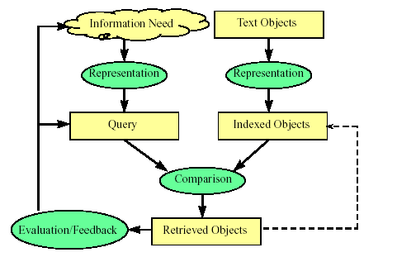
Overview of the Retrieval process

Slide 38
The Retrieval Process
It is necessary to define the text database before any of the retrieval processes are initiated
This is usually done by the manager of the database and includes specifying the following
The documents to be used
The operations to be performed on the text
The text model to be used (the text structure and what elements can be retrieved)
The text operations transform the original documents and the information needs and generate a logical view of them

Slide 39
Retrieval Process ….
Once the logical view of the documents is defined, the database module builds an index of the text
An index is a critical data structure
It allows fast searching over large volumes of data
Different index structures might be used , but the most popular one is the inverted file
Given that the document database is indexed, the retrieval process can be initiated

Slide 40
The Retrieval Process …
The user first specifies a user need which is then parsed and transformed by the same text operation applied to the text
Next the query operations is applied before the actual query, which provides a system representation for the user need, is generated
The query is then processed to obtain the retrieved documents
Before the retrieved documents are sent to the user, the retrieved documents are ranked according to the likelihood of relevance
The user then examines the set of ranked documents in the search for useful information. Two choices for the user:
(i) reformulate query, run on entire collection or (ii) reformulate query, run on result set
At this point, s/he might pinpoint a subset of the documents seen as definitely of interest and initiate a user feedback cycle
In such a cycle, the system uses the documents selected by the user to change the query formulation.
Hopefully, this modified query is a better representation of the real user need

Slide 41
Detail view of the Retrieval Process
User
Interface
Text
User need
Text
Text Operations
logical view
Logical view
DB manager
Module
User feedback
Query Language & Operations
Indexing
Query
Inverted file
Searching
Index
Retrieved docs
Text Database
Ranking
Ranked docs

Slide 42
Issues that arise in IR
Text representation
what makes a “good” representation?
how is a representation generated from text?
what are retrievable objects and how are they organized?
information needs representation
what is an appropriate query language?
how can interactive query formulation and refinement be supported?
Comparing representations (to identify relevant documents)
What weighting scheme and similarity measure to be used?
what is a “good” model of retrieval?
Evaluating effectiveness of retrieval
what are good metrics?
what constitutes a good experimental test bed?

Slide 43
Focus in IR System Design
Our focus during IR system design is:
In improving performance effectiveness of the system
Effectiveness of the system is measured in terms of precision, recall, …
Stemming, stop words, weighting schemes, matching algorithms
In improving performance efficiency
The concern here is storage space usage, access time, searching time, data transfer time …
Concern regarding space – time tradeoffs !!
Use Compression techniques, data/file structures, etc.

Slide 44
Subsystems of an IR system
The two subsystems of an IR system:
Searching: is an online process of finding relevant documents in the index list as per users query
Indexing: is an offline process of organizing documents using keywords extracted from the collection
Indexing and searching: are unavoidably connected
you cannot search what was not first indexed in some manner or other
indexing of documents or objects is done in order to be searchable
there are many ways to do indexing
to index one needs an indexing language
there are many indexing languages
even taking every word in a document is an indexing language
Knowing searching is knowing indexing

Slide 45
Indexing Subsystem
documents
Documents
Assign document identifier
text
document IDs
Tokenize
tokens
Stop list
non-stoplist tokens
Stemming & Normalize
stemmed terms
Term weighting
terms with weights
Index

Slide 46
Searching Subsystem
query
parse query
query tokens
ranked document set
non-stoplist tokens
Stop list
ranking
Stemming & Normalize
relevant document set
stemmed terms
Similarity Measure
Query terms
Term weighting
Index terms
Index

Slide 47
Thank you

