Slide 1


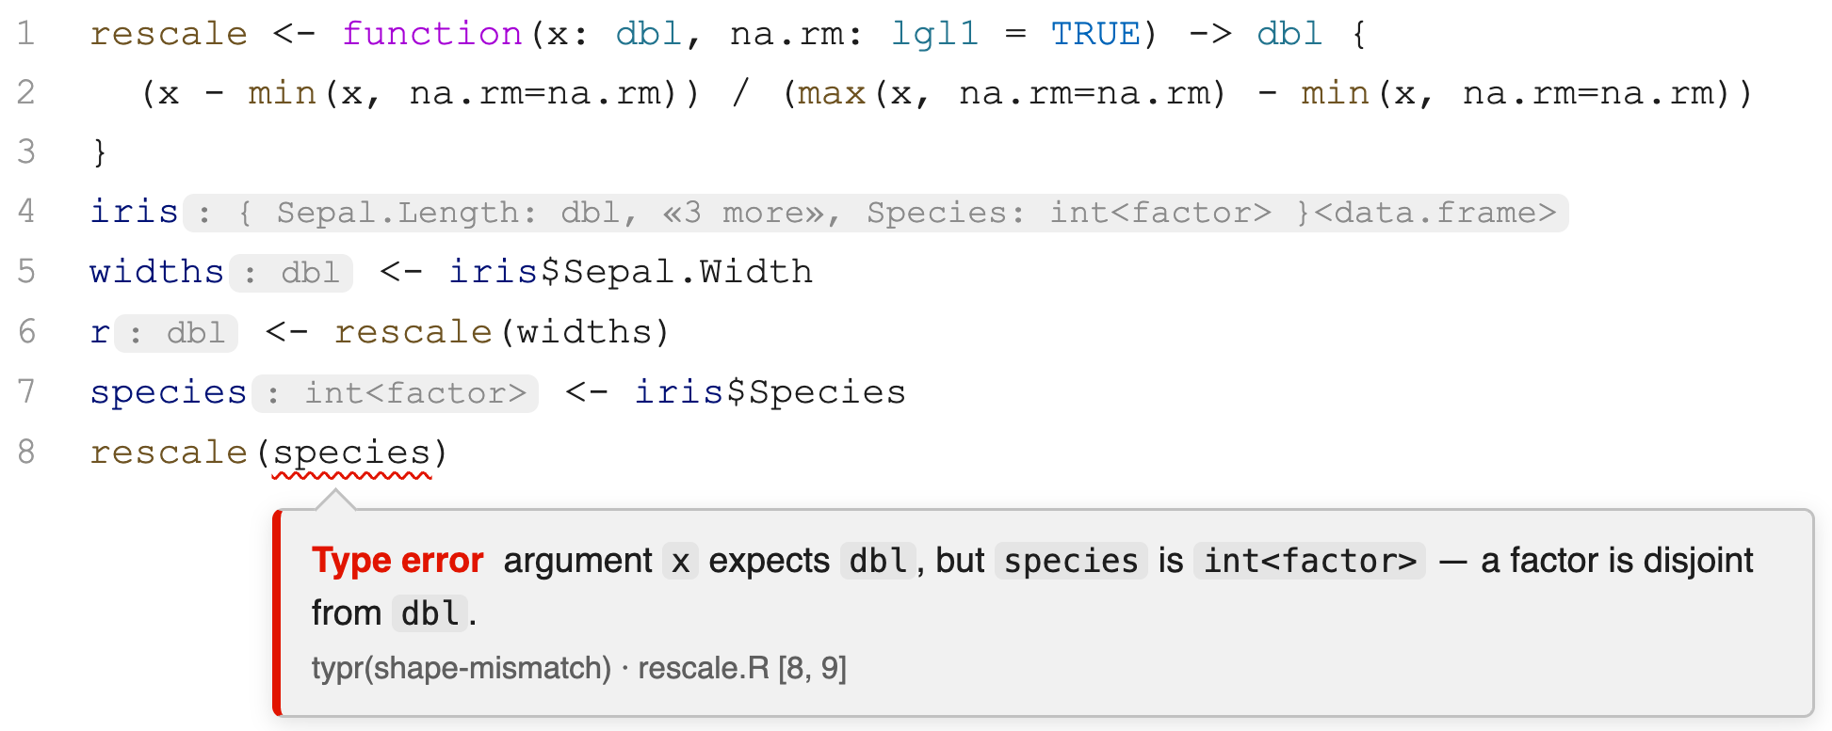








A Type System for the R Language
in progress…
Mickaël Laurent
Pierre Donat-Bouillud
Filip Křikava
Jan Vitek
Motivation
Examples
> x <- c(-1, 4, 9)
> if (x > 0) log(x) else 0
Error in if (x > 0) log(x) else 0 : the condition has length > 1
With types: the guard of `if` requires lgl1 (a scalar), x > 0 has type lgl, rejects the if call
> scores <- factor(c("1", "2", "3"))
> wt <- c(0.2, 0.3, 0.5)
> w <- weighted.mean(scores, wt)
Warning message: In Ops.factor(x, w) : '*' not meaningful for factors
> w
[1] NA
With types: weighted.mean : (x : dbl, w : dbl) -> dbl1 rejects the call, scores is int<factor>
> df <- data.frame(revenue = c(100, 200, 300))
> vat <- df$reveneu * 0.21 # missing column, NULL * 1.2 is numeric(0)
> total <- sum(vat) # silently 0, error surfaces far from the typo
> total
[1] 0
With types: df: { revenue : dbl, ... } has no field `reveneu`, rejects df$reveneu call
R expression | Type | Comment
NULL | null | its own type, distinct from empty vectors
list(1, 2, 3) | { dbl } | homogeneous list of doubles
list(1, "a", TRUE) | { dbl | chr | lgl } | heterogeneous — union element type
list(x = 1, y = 2) | { x : dbl, y : dbl } | record with named fields
list(x = 1, y = "a", 3) | { x : dbl, y : chr, any } | named fields plus anything else
factor(c("a", "b", "a")) | int<factor> | codes are int; class makes it disjoint from dbl
ordered(c("lo", "hi")) | int<ordered, factor ...> | carries two classes at once
matrix(1:6, 2, 3) | int<matrix, array ...> | shape is the type bit R hides
data.frame( id = 1:3, name = c("a","b","c")) | { id : int, name : chr }<data.frame ...> | list shape plus S3 class together
lm(y ~ x) | { coefficients : dbl, residuals : dbl, any}<lm> | a big record with a class
function(x) x + 1 | (x: dbl)->dbl & (x: clx)->clx & (x: clx1)->clx1 | increment function
nrow | (x: vec | <array ...> | <data.frame ...>) -> int | nrow function – can take vectors, arrays, df
df$col | (x: { #col:'a ...}<data.frame ...>, #col) -> 'a | extraction of a dataframe column
Code quality
Lightweight specification and documentation
Safety
Helps to catch bugs that tests miss (tests and type-checking are complementary)
Static feedback: with types, less runtime errors!
Transparency
R hides stuff: a value's storage type (int vs dbl), its shape (scalar vs vector vs matrix), its S3 classes, these are all invisible at the call site.
Types make the invisible bits explicit where needed!
Goal
Types for R
Syntax and semantics for R types
Find the sweet-spot between precision and ergonomics
Type checking
Static type checks - in an editor or command line, before code runs
Runtime type checks - for cases that cannot be statically checked
No more stopifnot(is.character(file) && length(file) == 1)
Type inference
Infer types automatically so user only annotate when needed
this work
Subtyping
future work
Type of c(.,.) | raw | logical | integer | double | complex | character
raw | raw | logical | integer | double | complex | character
logical | logical | logical | integer | double | complex | character
integer | integer | integer | integer | double | complex | character
double | double | double | double | double | complex | character
complex | complex | complex | complex | complex | complex | character
character | character | character | character | character | character | character
future work
Types for R
raw1 < lgl1 < int1 < dbl1 < clx1 < chr1
raw < lgl < int < dbl < clx < chr
Atomic vectors
Vector types (vec): raw | lgl | int | dbl | clx | chr
Scalar types (vec1): raw1 | lgl1 | int1 | dbl1 | clx1 | chr1
Singleton types: 42 | "hello world" | tt | ff | ...
Lists
List of (any number of) double vectors: { dbl }
Exactly two named elements: { x : dbl, y : dbl }
Two named elements and anything else: { x : dbl, y : dbl, any }
S3 classes
Exactly this class: <data.frame>
At least this class: <data.frame ...>
can decorate any type { id : int, name : chr }<data.frame ...>
any boolean combination <matrix, ~array ...>
for simplicity, types do not capture the order of classes
Functions
Types for function parameters and return type: (x: dbl, y: int) -> dbl
Arrow of unions: (x: dbl | int | chr) -> (dbl | chr)
Intersection of arrows: ((x: dbl) -> (dbl)) & ((x: int) -> (dbl)) & ((x: chr) -> (chr))
<
<
<
<
<
<
df : { id:dbl ...}<data.frame ...>
df <- data.frame(id = 1L:3L) # OK, id is int < dbl
df <- data.frame(id = 1:3, name = c("a","b","c")) # OK, type of df allows extra columns
df <- data.frame(id = c("a","b","c")) # NOT OK, id is chr > dbl
Function polymorphism
Overloading (aka ad-hoc polymorphism)
Shape of the type (matters for base operations and typeof)
typeof : ( x : { any } ) -> "list"
typeof : ( x : null ) -> "NULL"
typeof : ( x : lgl ) -> "logical"
rbind : ( ... : <data.frame ...> ) -> <data.frame ...>
rbind : ( ... : <matrix ...> ) -> <matrix ...>
rbind : ( ... : vec<> ) -> <matrix>
Classes of the type (matters for S3 dispatch)
Genericity (aka parametric polymorphism)
identity : (x : 'a) -> 'a
[.] : ({'a}, dbl) -> 'a
[.] : (v('a), dbl) -> v1('a)
(+) : (x : int, y : int) -> int
(+) : (x : dbl, y : dbl) -> dbl
(+) : (x : chr, y : chr) -> chr
Type variables ('a,'b): capture a single type. Row variables (`r): capture a list of types.
Extra parameters (captured by `r) are forwarded
Types are sets
Set-theoretic operations (union, inter, diff): vec \ chr = raw | lgl | int | dbl | clx
Usual set properties (e.g. De Morgan laws): ~(t1 | t2) = ~t1 & ~t2
lapply : (X : v('a), FUN : @(v1('a), ... : `r) -> 'b, ... : `r) -> {'b}
lapply : (X : {'a}, FUN : @( 'a , ... : `r) -> 'b, ... : `r) -> {'b}
Type narrowing
Implementation
Explicit function signature
Typr
Parse R code and native libraries
Resolve dependencies (call graph, etc.)
Call the type-checkers and show results
Rsem
Type-check R top-level definitions
Try to infer types when not annotated
Gradual: some functions can stay untyped
neg <- function(x: null | lgl | dbl) -> null | lgl | dbl {
if (typeof(x) == "NULL") return(NULL)
if (typeof(x) == "logical") return(!x)
return(-x)
}
The rest is typed under the assumption that:
x : ~null
NativeSem
Infer types for exported functions in C
Do not try to catch programming errors,
only to infer the type of library functions
We plan to add support for Fortran libraries
Set-theoretic types
The mathematical foundations we rely on
Support set connectives and polymorphism
Based on recent formal works: [1, 2, 3, 4]
Library: https://e-sh4rk.github.io/MLsem/
Related work
Official syntax for type specifications, but
no official type-checker implementation
Many type-checkers co-exist: MyPy, Pyright, Ty
Mostly incompatible as types are not formalized
No official syntax for types
Standard way is assertions (stopifnot)
Packages providing type annotations checked at runtime: typed, types, rtypes
Statically-typed variant of JS, widely adopted
A new syntax for types on top of JS
Type annotations are erased, yielding valid JS
Started retrofitting gradual types 5 years ago
No type annotations yet, but it is planned
Based on set-theoretic types, as our work!
Supported by the Czech Ministry of Education, Youth and Sports under program ERC-CZ (no. LL2325) and Czech Science Foundation (no. 23-07580X)
[1] Giuseppe Castagna, Programming with union, intersection, and negation types. The French School of Programming
[2] Mickaël Laurent, Jan Vitek.Type Inference for Functional and Imperative Dynamic Languages. OOPSLA 2026
[3] Mickaël Laurent, Kim Nguyen. 2026. Implementing Set-Theoretic Types. under review for OOPSLA 2026
[4] Mickaël Laurent, et. al. Revisiting Row Polymorphism for Set-Theoretic Types. under review for OOPSLA 2026
https://github.com/PRL-PRG/typr

