Slide 1
Introduction on UML for Industrial Systems
Ansgar Radermacher / Asma Smaoui ansgar.radermacher@cea.fr
Acknowledgments – contains material from my CEA colleagues Shuai Li, Jérémie Tatibouët, François Terrier, Sébastien Gérard

Slide 2
Domain specific modeling languages (DSLs)
Recap – abstract syntax, notation, and semantics
What are domain specific languages, what are their objectives?
Text-based DSLs
UML profile mechanisms
Define a simple profile

Slide 3
Abstract Syntax The concepts defined by a language
Subject
Verb
Complement
Language concepts, i.e. set of syntactic elements, their relationships, and their constraints, provided by a language
Plays role of
Is a
Plays role of
Wǒ shì xué shēng
Class
BehavioredClassifier
[0..1] behavioredClassifer
[0..1]
classifierBehavior
Behavior
StateMachine

Slide 4
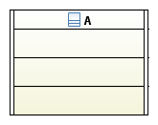
Notation The representation of language concepts
Symbolic representations associated to language concepts (i.e. elements of the abstract syntax)
Subject
Verb
Complement
Plays role of
Is a
Plays role of
是
Map notation symbols to syntactical elements
我
生
我是学生
学
Wǒ shì xué shēng
StateMachine
Class
BehavioredClassifier
[0..1] behavioredClassifer
[0..1]
classifierBehavior
Note: some concepts in a language may not have a representation.
StateMachine
Behavior

Slide 5
The meaning of the concept defined by a language semantics (1/2)
Subject
Verb
Complement
plays role of
is a
plays role of
The semantics of a languages in computer science
Defined by a semantic model
Captures the signification of concepts provided by the syntactical model
Semantic model can be formalized using different approaches
Operational – semantics is defined by a program / algorithm
Axiomatic – semantics is defined as a set of axioms)
Denotational – semantics is defined as a set of denotations
Transformational – semantics is the one defined by the target language
The form of the semantics defines what you can do with it
Execution/reasoning about valid execution traces for a model…
我是学生
Define signification of syntactical elements
我 = me; 是 = to be;
学生 = student
我是学生 = I am a student
Semantic of language, i.e. signification of syntactical elements

Slide 6
The meaning of the concept defined by a language semantics (2/2)
Contained in the fUML semantic model (i.e., the one defining the semantics of classes and activities)
UML semantic model is defined using an operational approach
Object
ObjectActivation
BehavioredClassifier
Class
[0..1] behavioredClassifer
[0..1]
classifierBehavior
Execution
CS_Object
Behavior
StateMachine
StateMachineExecution
Contained in the PSSM semantic model (i.e., the one defining the semantics of state-machines)
Contained in the PSCS semantic model (i.e., the one defining the semantics of composites structures)

Slide 7
Abstract syntax, Notation, and semantics WRAP UP
The abstract syntax
The concepts that are offered by the language
Papyrus: you use it when you create UML elements
The notation
The representation that is attached to language concepts
Papyrus: you use it when creating diagrams and graphical elements
The semantics
The elements capturing the meaning of language concepts
Papyrus: you use it when you execute a model

Slide 8
Domain specific modeling languages (DSLs)
Recap – abstract syntax, notation, and semantics
What are domain specific languages, what are their objectives?
Text-based DSLs
UML profile mechanisms
Define a simple profile

Slide 9
What are domain specific languages (DSLs)?
A language specialized to a particular application domain (contrast to a general-purpose language (GPL), which is broadly applicable across domains).
Wide variety of DSLs, ranging from the quite generic HTML to very specific ones
Can be further subdivided into specification/modeling languages and domain-specific programming languages.
Special-purpose computer languages not new, term "domain-specific language" has become more popular due to the rise of domain-specific modeling.
Separation between general-purpose and domain-specific not always sharp
Language may have features for particular domain but applicable more broadly
Conversely capable of broad application but in practice used primarily for specific domain
Examples: Perl and PostScript

Slide 10
Objectives of DSLs
Use domain specific concepts and vocabular
Small, just the concepts that are required

Slide 11
Domain specific modeling languages (DSLs)
Recap – abstract syntax, notation, and semantics
What are domain specific languages, what are their objectives?
Text-based DSLs
UML profile mechanisms
Define a simple profile

Slide 12


Textual modeling languages
Classical context free grammars
Eclipse
Open-source language tool supporting the Language Server Protocol
written in TypeScript and running in Node.js.

Slide 13
Context free grammars (CFGs)
Grammar = set production rules describing all possible strings of a formal language.
Production rules iof n the form A → α
A – nonterminal symbol, α – string of terminals or non-terminals
“context free” – production rules can be applied regardless of the symbols before/after.
Example : Statement → Id = Expr ;
Terminal

Slide 14
Classical tools
Lex and yacc (free / enhanced variants flex and bison)
Two steps
Lexical analysis
Syntactical analysis (parsing)

Slide 15
Regular epressions
Meta character | Matches
. | any character except newline
* | zero or more copies of the preceding expression
+ | one or more copies of the preceding expression
? | zero or one copy of the preceding expression
a|b | a or b
[] | character class
[A-Za-z0-9]+ at least one alpha numerical character
[A-Za-z][A-Za-z0-9_]* start with a alphabetic character, followed by zero or more alpha numerical characters (+ underscore)

Slide 16
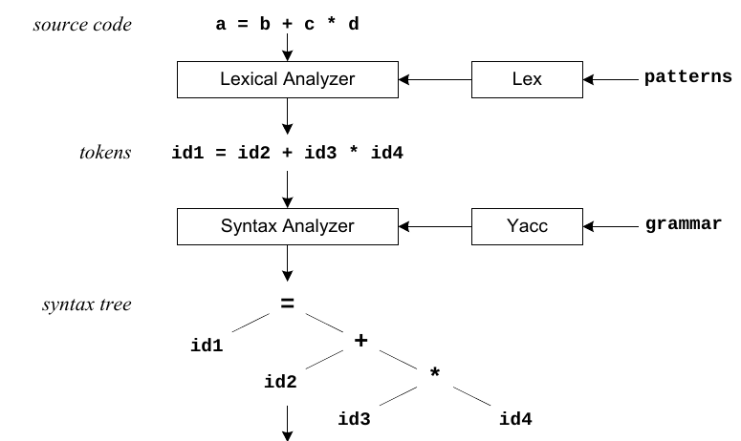
Example

Slide 17
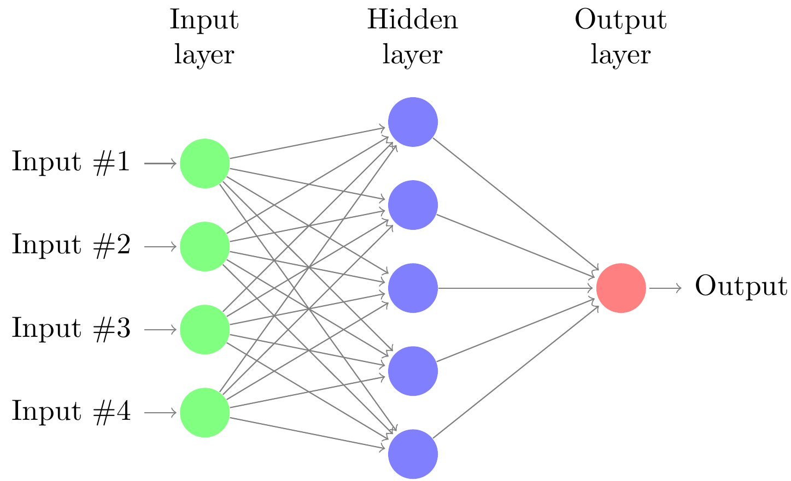
Other example – neural network descripton
Keras https://keras.io/
Python library/framework for describing and executing neural networks
High level API
Goal : Declarative description of neural network
Source: https://texample.net/tikz/examples/neural-network/

Slide 18
Neural network descripton
Different layer types in Keras
Each layer has a set of parameters
Simplification – focus on two layers and a subset of the parameters
Convolutional layer Conv1D
filters: Integer, dimensionality of output space (i.e. number of output filters in the convolution).
kernel_size: An integer specifying the length of 1D convolution window.
LSTM layer (Long Short-Term Memory layer – recurrent layer)
activation: Activation function to use. Two options: tanh - hyperbolic tangent, linear - a(x) = x.
use_bias: Boolean (default True), whether the layer uses a bias vector.

Slide 19
Other example (from neural networks)
Possible textual description
network MyNN {
l1 : Conv (kernel_size = 2)
l2 : LSTM (use_bias = true, activation = tanh)
l3 : LSTM (activation = linear)
}
Howto describe this editor formally?

Slide 20
Use Eclipse xtext
https://www.eclipse.org/Xtext/
“Xtext is a framework for development of programming languages and domain-specific languages. ... define your language using a powerful grammar language. … get parser, linker, typechecker, compiler as well as editing support for Eclipse, any editor that supports the Language Server Protocol and your favorite web browser.”

Slide 21
Xtext formalization
grammar org.xtext.example.mydsl.NNDsl with org.eclipse.xtext.common.Terminals
generate NNDsl "http://www.xtext.org/example/nndsl/NNDsl"
Model:
'network' name=ID '{'
(layers += Layer)*
'}';
Layer:
name=ID ':' (
'Conv' options += COptions |
'LSTM' options += LOptions
);
…
(see in Eclipse editor, exercise)

Slide 22
Domain specific modeling languages (DSLs)
Recap – abstract syntax, notation, and semantics
What are domain specific languages, what are their objectives?
Text-based DSLs
UML profile mechanisms
Define a simple profile

Slide 23
Model and metamodel – conformance relationship
source[1]
Class
operations[*]
Operation
Meta-model level
target[1]
type[1]
Cardinality
Association
Property
upperBound: Integer
lowerBound: Integer
properties[*]
A model conforms to a particular meta-model which describes a modelling language
Model level
Scheduler
Task
tasks [*]
successors [*]
schedule()
execute()
predecessors [*]

Slide 24
Metamodel and meta-meta-model – end of the loop
Entity
[2]
[0..*]
Relationship
Meta-meta-model level
name
name
[1]
A meta-meta-model conforms to itself
[2]
End
isComposite
isNavigable
Attribute
[1]
[0..*]
name
[1]
A meta-model conforms to a particular meta-meta-model which describes a language to design meta-modelling languages
source[1]
operations[*]
Meta-model level
Class
Operation
target[1]
type[1]
Cardinality
Association
Property
upperBound: Integer
lowerBound: Integer
properties[*]

Slide 25
Wrap UP - Model, meta-model and meta-meta-model
M3
Conforms to
Meta-meta-model
M2
Conforms to
Meta-model
Class
Instance of
M1
Conforms to
:Class
classifier
Model
name = Foo
Conforms to
Instance of
M0
Represents
System
:Object

Slide 26
WHERE IS UML ?
M3
M2
Semantics
UML
fUML
PSCS
PSSM
Other
Abstract Syntax
Classes
Activities
Composite
Structures
State
Machines
Sequences, Use cases, components,…
M1
M0

Slide 27
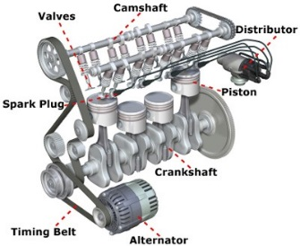
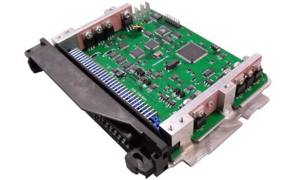
UML – richness & limitations
Formalize structure of a system using different formalisms (statics) Formalize behavior of a system using different formalisms (dynamics) Capture system abstractions and user interactions
Intended to be agnostic of a particular domain
But it is clearly software oriented
Many concepts come from object oriented programming languages
Will you use it as it is to describe the following kind of systems ?
© http://www.driving-test-success.com
© http://www.standaloneenginemanagement.com/
Points of interest: piston diameter, cylinder volume, weight of components, etc.
Points of interest: processor rate, the quantity of memory, energy consumption?

Slide 28





UML extensibility – the profile mechanism
Difficulty to capture concerns of specific domains
….such as mechanics, electronics, avionic, etc.
Extend UML to capture the concerns of these domains
Enable design of UML based domain specific languages
Capitalize on syntax and semantics provided by UML
UML profiles are widely used in industry
Description of real time and embedded systems
System engineering
Profile for system testing
Robotics

Slide 29
How does a profile contribute to UML?
M3
UML
Profile
M2
Extension of UML semantics
Semantics
Semantics
fUML
PSCS
PSSM
Other
Abstract Syntax
Abstract Syntax
Extension of UML syntax
Classes
Activities
Composite
Structures
State
Machines
Sequences, Use cases, components,…
A set of stereotypes + OCL constraints
M1
M0

Slide 30

Profiles - UML meta-model view
Extension = particular kind of association between stereotype and meta-class
A profile is a particular kind of namespace
Stereotype = contained in a profile, inherits from Class
May introduce new representation of extended model element

Slide 31
Example – a profile for requirement engineering
Objective – Capture system requirements
Analysis
In my system I can have
Functional requirements (actions that can be accomplished by the system)
Performance requirements (expected performance for the system)
Structural requirements (Identify the necessary structure of the system)
A base requirements has
An identifier
A text that describes a requirement
A formalization (i.e. an expression given in a formal language)
A general requirement can be refined (clarified) by a set of sub-requirements

Slide 32

Step 1 – define a «Requirement» stereotype
In Papyrus
File – New – Papyrus project
Set the project name
Choose architecture context “Profile”
Start to define your profile
Import the meta-class to be extended
Create a stereotype
Create the extension relationship
The choice of the meta-class that is extended by the stereotype is leaded by its semantics
The meta-class to be extended
«metaclass»
Class
The extension relationship existing between the stereotype and the meta-class
The stereotype extending the meta-class
«stereotype»
Requirement

Slide 33
Step 2 – capture basic properties of a requirement
Realized by adding properties ID and Description to our stereotype
«metaclass»
Class
Formal description of the requirement given using an OpaqueExpression
Model as typed attribute instead of association
«stereotype»
Requirement
+ ID: String[1]
+ Description: String[1]
formalDescription[0..1]
«metaclass»
OpaqueExpression
Simple UML association
Why did we choose OpaqueExpression?
Possibility to choose a formal language to define something
The specification takes the form of a piece of text that is easily accessible

Slide 34

Step 2 – capture basic properties of a requirement
«metaclass»
Class
RequirementKind
+ FUNCTIONAL
+ STRUCTURAL
+ PERFORMANCE
kind[1]
Let the designer to indicate the “kind” of its requirements
«stereotype»
Requirement
Alternatively, use property instead of association (Papyrus bug)
+ ID: String[1]
+ Description: String[1]
+ formalDesc: OpaqueExpression[0..1]
Question
What is missing in the profile to make a requirement “refinable” by another requirement?

Slide 35
Step 3 – Refinement relationship
Objective
Find meta-class that allows the specification of a relationship between two classes
Create a stereotype that apply on this meta-class
Proposal
Dependency (UML 2.5 – p. 36)
Source and target are NamedElements
A model element requires another model element for its specification
«metaclass»
Dependency
No additional properties are required. The stereotype just act as an annotation
Meaning: the source requirement has is clarified by the target requirement.
«stereotype»
Refine

Slide 36
Reduce UML expressiveness – Why and How
Why? We do not need some features when specifying requirements
Class
A class can have operations
A class can have a classifier behavior
A class can be active
Dependency
The source and the target can be NamedElement
How? Via OCL constraints in our profile
Object Constraint Language
OCL is a formal language
Specification of constraints on models (not only UML)
The constraints that can be verified at any time of the model life

Slide 37
Reduce expressiveness – «Requirement» stereotype
«metaclass»
Class
RequirementKind
+ FUNCTIONAL
+ STRUCTURAL
+ PERFORMANCE
kind[1]
«stereotype»
Requirement
+ ID: String[1]
+ Description: String[1]
formalDescription[0..1]
«metaclass»
OpaqueExpression
self.base_Class.ownedOperation->isEmpty()
and
self.base_Class.classifierBehavior.oclIsUndefined()
self.formalDescription.language->size()=1
and
self.formalDescription.language->first()=“OCL”

Slide 38


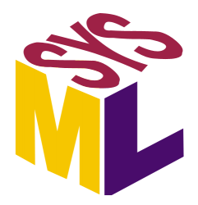
Interest requirement model / related work in SysML
Interest of the requirements model
Capture and organize efficiently the requirements of a system
Link the requirements to the model of the system
What are the part of the system that satisfy the requirements
Link the requirements to the test cases validating the system
What are the test cases that ensure the requirements are verified
SysML
Normative UML profile
Specialization of UML for system modeling
The addition of UML compared to SysML
Component
Deployment
Collaboration
Template
Types
Behaviors
Requirements
Allocation
Blocks
Parametrics

Slide 39
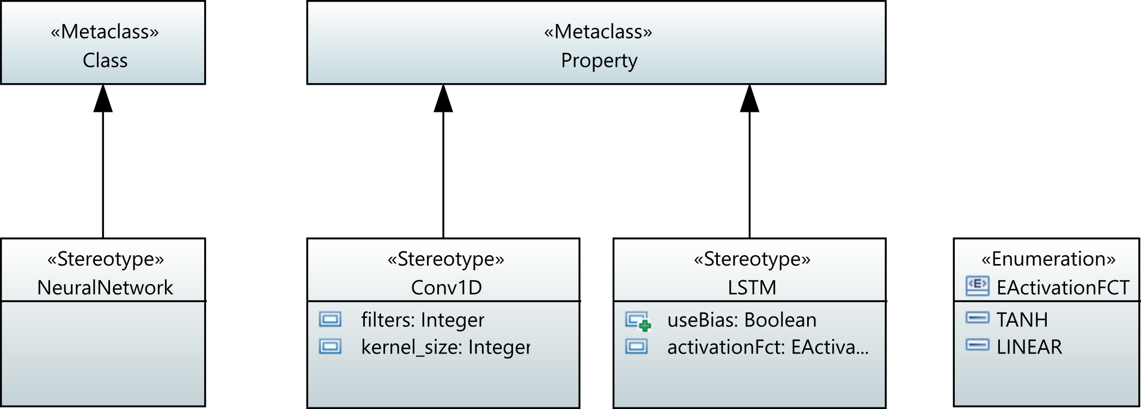
Simple Neural Network profile
UML Meta class
Stereotypes
Extension relationship

Slide 40
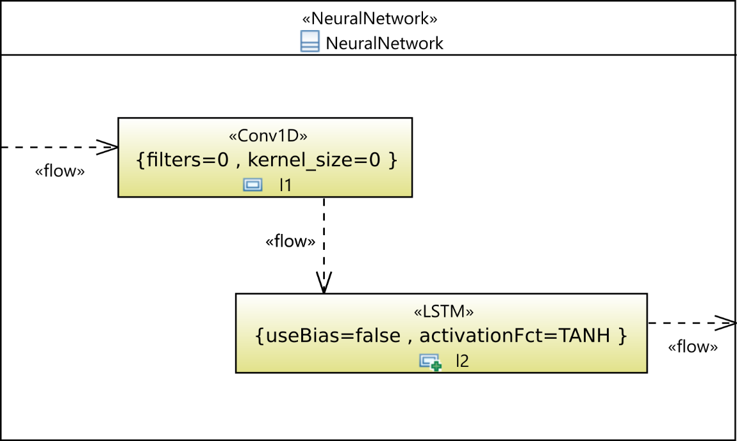
Sample model applying the profile
Composite structure diagram
CSS (style sheet) modifies appearance
Class with stereotype applied
standard UML relationship
“information flow”
Property with stereotype applied

Slide 41
Specify valid models
Restrict UML meta-models having a lot of features
Use OMG OCL (object constraint language)
https://www.omg.org/spec/OCL/
Associate it with stereotypes
OCL access to meta-model or stereotype attributes
Use “.” in expressions for normal attributes, “->” for lists
List operators, e.g. “forAll(attr | …)”, “size()” or “sum(…)”

Slide 42
CSS – Cascading style sheet
Background color of compsite class is white
Class {
fillColor: white;
}
Property {
maskLabel : name;
fillColor: #e0e0a0;
}
Property > Compartment[kind="internalstructure"] {
visible : false;
}
Compartment[type=StereotypeBrace] {
visible : true;
}
Show only name as label (not visibility,type, …)
Hide “internal structure” compartment
Stereotype attributes in Braces { … } after stereotype name

Slide 43
Sample model, constraints
Neural network can have attributes, but no operations
Properties must have no types
Properties have to apply “Layer” stereotype

Slide 44
Add constraints
Navigate to base_Class (extension), use size list operator
Neural networks must not have operations
self.base_Class.ownedOperation->size() = 0
Parts should not be typed
self.base_Property.type = null
Parts should apply either the Conv1D or LSTM stereotype
Introduce (abstract) «Layer» stereotype to facilitate extensibility
self.base_Class.ownedAttribute->forAll(attr | attr.getAppliedSubstereotypes( attr.getApplicableStereotype('SimpleNN::Layer') )->notEmpty())
Attribute of Class Meta-Model element
Each owned attribute must apply abstract «Layer» stereotype

Slide 45
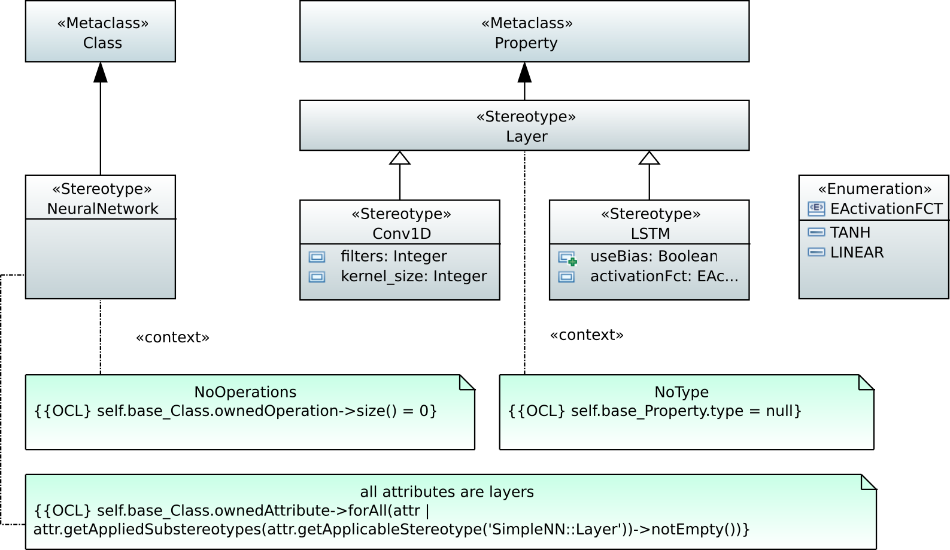
Resulting profile
Should have been abstract stereotype
Context = owner (self)

Slide 46
Useful OCL (list) operations
exists(boolean condition on list element) – true, if at least one element of the list fulfills the condition
forAll(boolean condition on list element) – true, if all elements of the list fulfill the condition
select(boolean condition on list element) – filtered list containing only elements with condition evaluating to true (reject(…) … to false)
collect(attribute of list element) – new list containing a collection of the attribute values
isEmpty(), notEmpty(), size() – checks on list size

Slide 47
Exercise
Create profile with Papyrus
Create a new model, apply the profile and style-sheet
Create the layers and flow

