Slide 1

Subtyping in bladder cancer
Dr Andrew Mason
Lecturer in Cancer Informatics
andrew.mason@york.ac.uk
asmasonomics.github.io

Slide 2
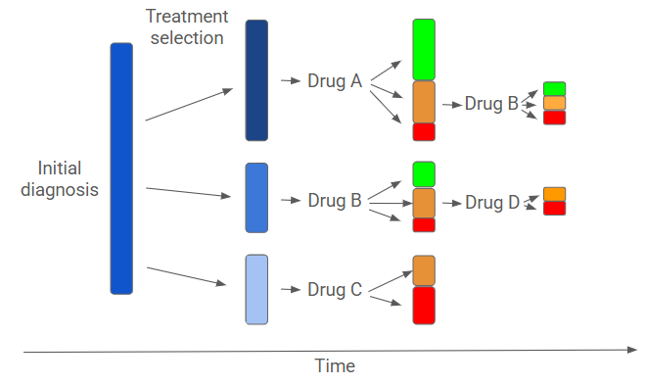
1
Deliver personalised cancer treatment.
We’re currently not very good at doing this first time, and every delay matters to patient outcome.
There are drugs that work – but we need to find ways to specifically identify the right patients

Slide 3
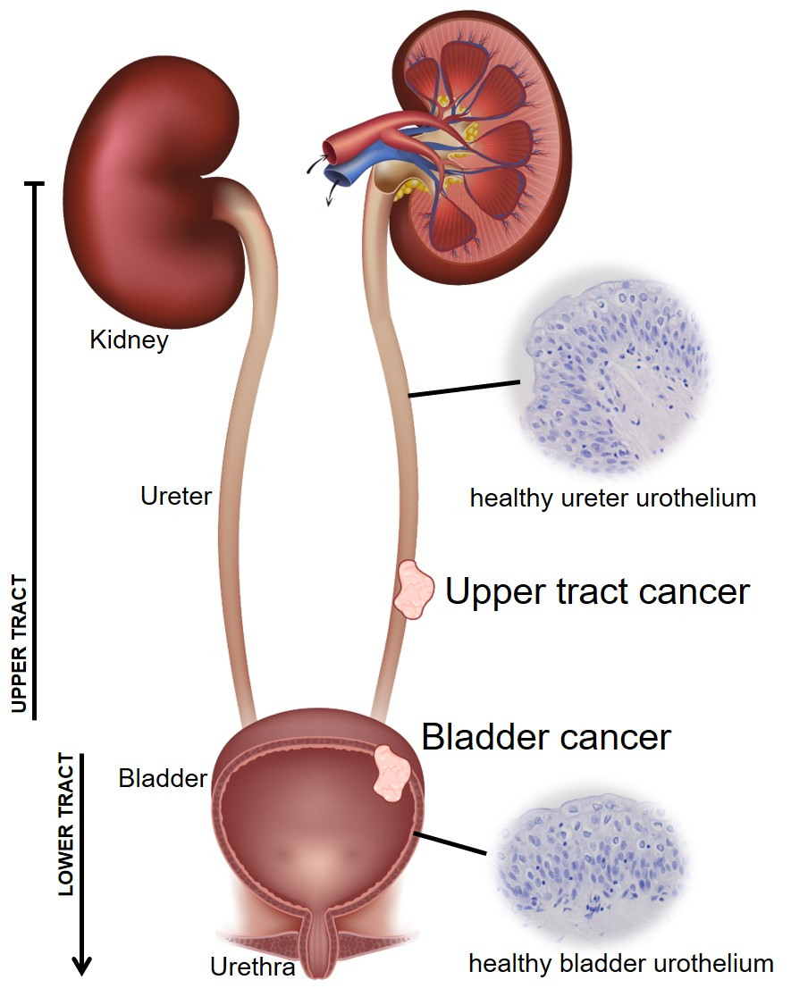
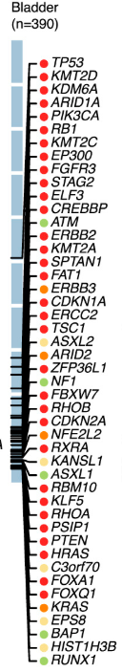
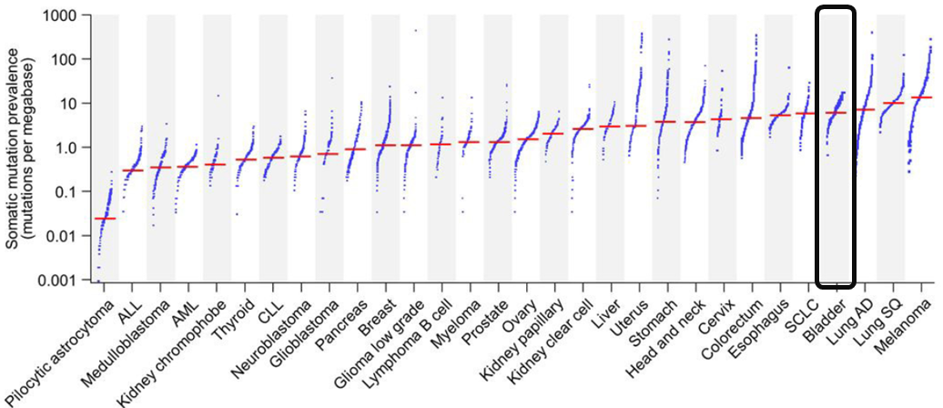
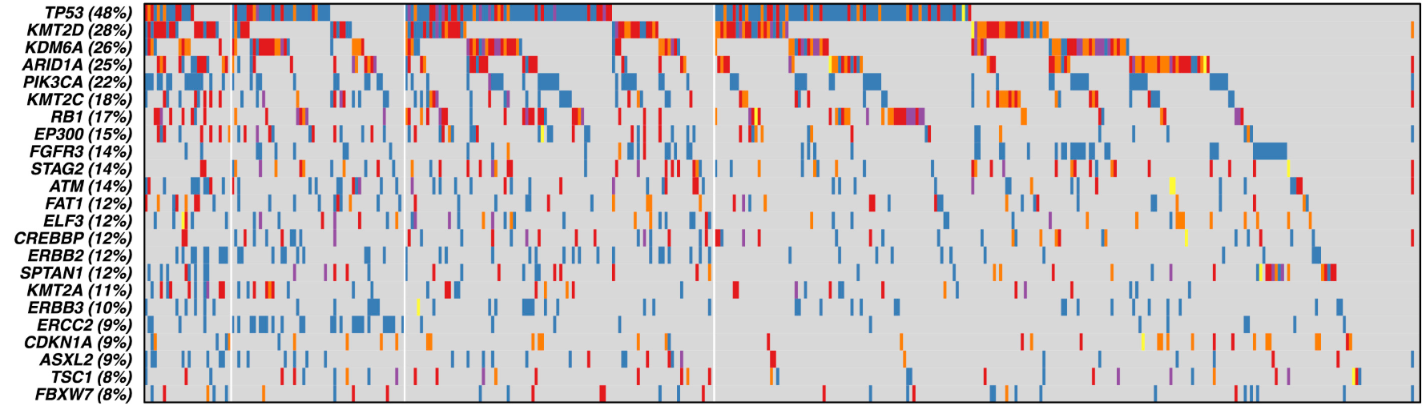
Urothelial carcinoma is a diverse disease without clear subtypes
2
Very high mutational burden (TMB) and diverse driver genes
Lots of driver gene co-occurrence → no clear groups

Slide 4
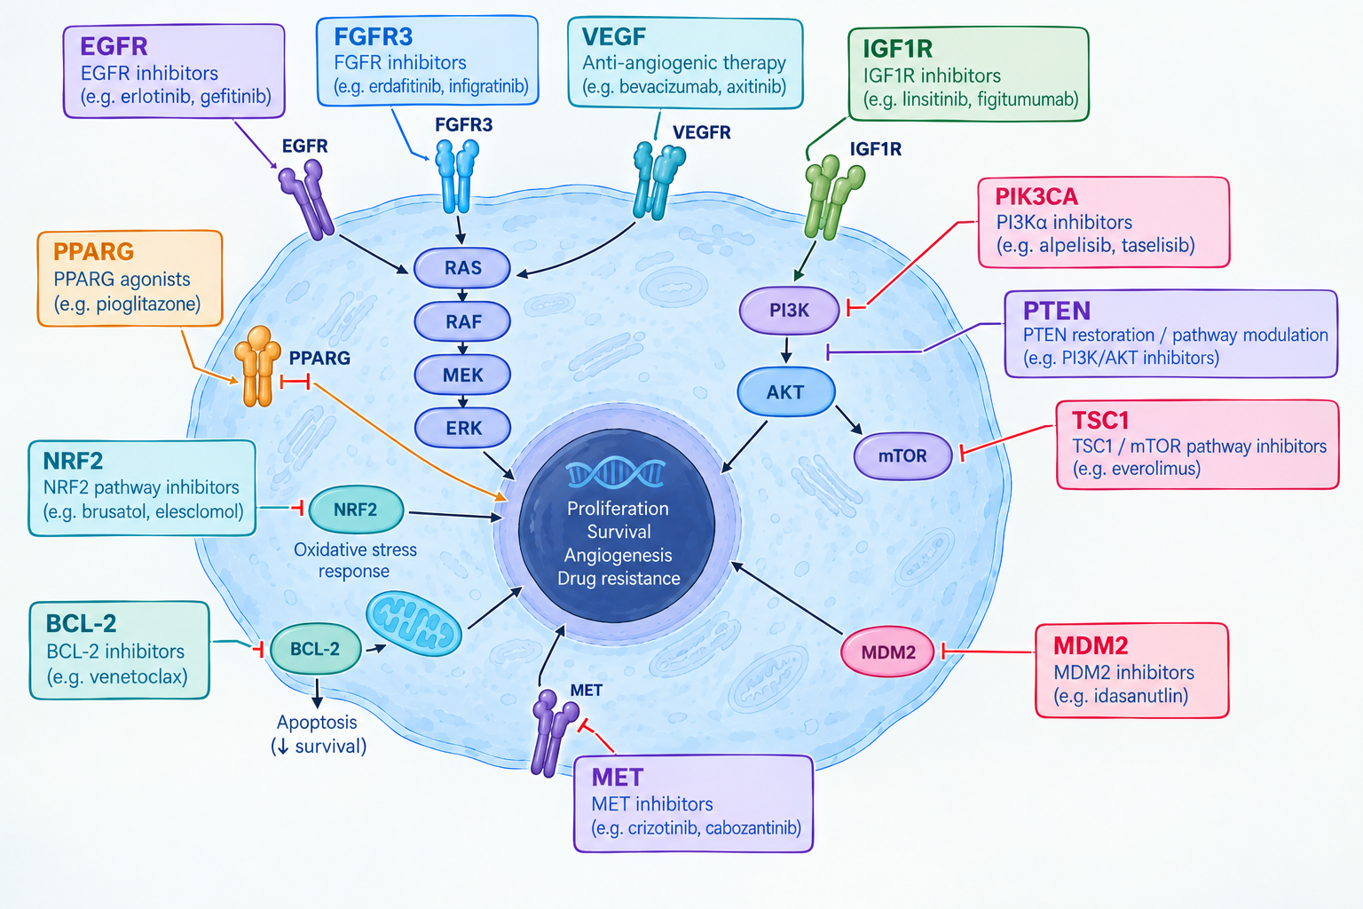
Lots of potential targets, but very few successes
3
Patient selection is a big problem – can we detect subgroups who will respond?

Slide 5
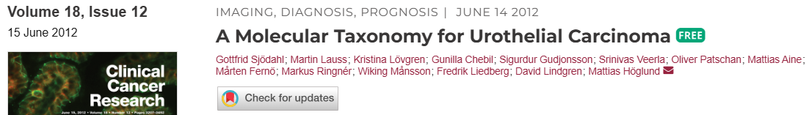
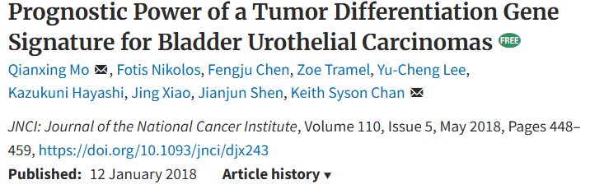
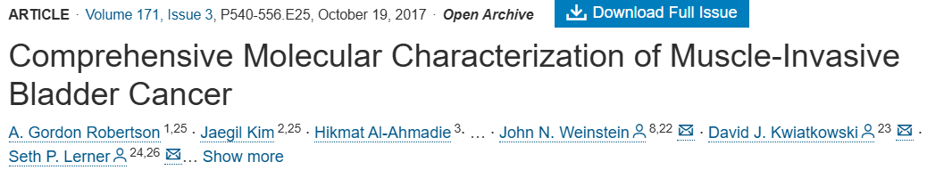
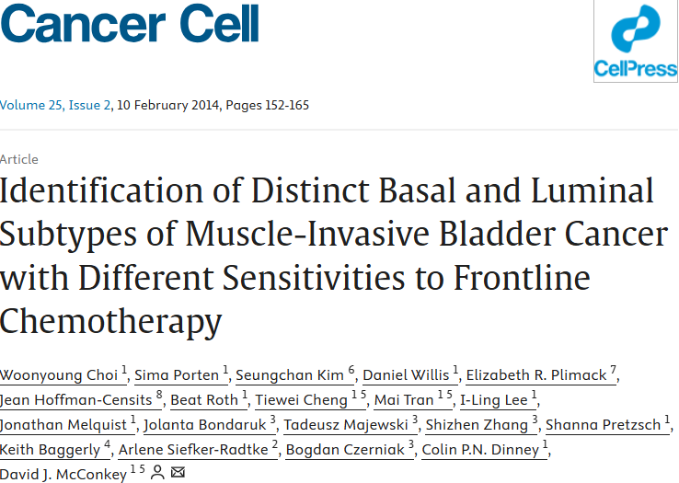
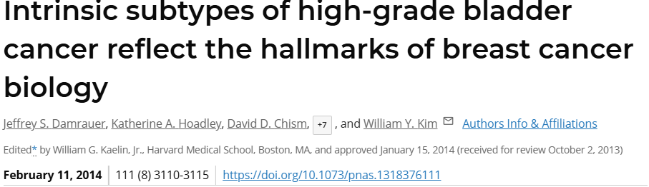
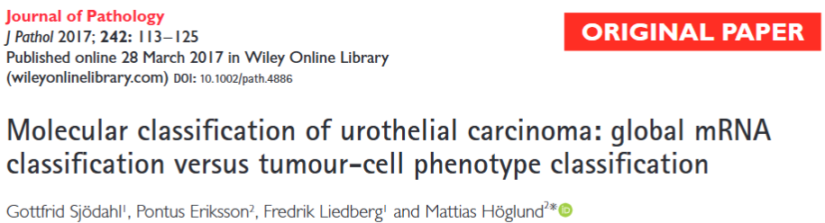
Gene expression subtypes could only describe - the clinical links were weak
4
As with many cancers, BLCA research focused on gene expression profiles in the 2010s
Standard approach → retain “most variable” genes, dimension reduction, most parsimonious number of groups

Slide 6
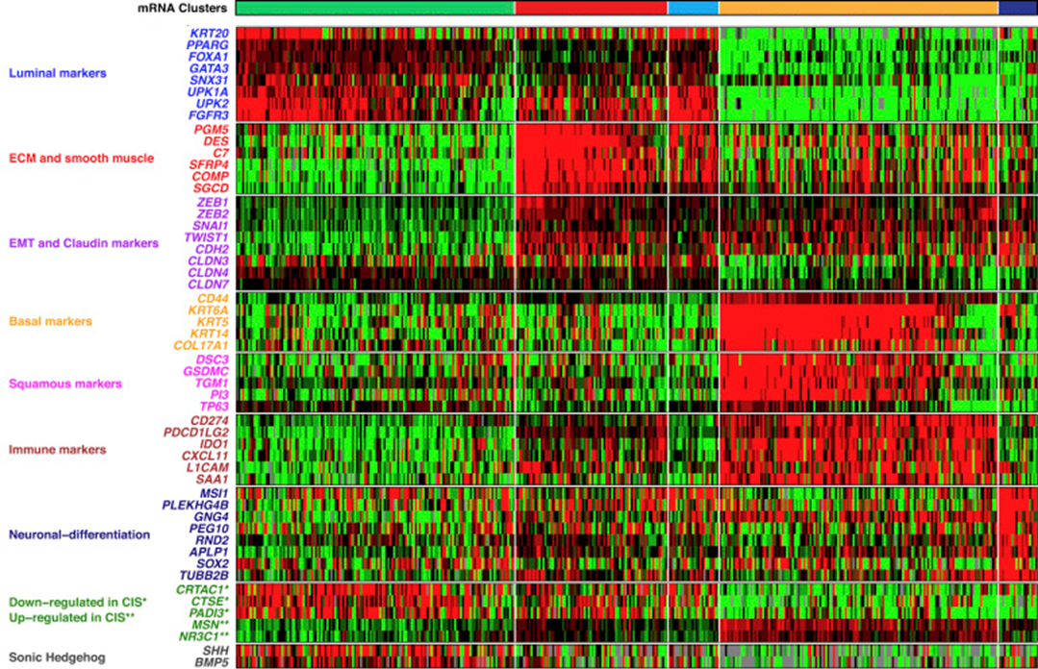
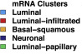

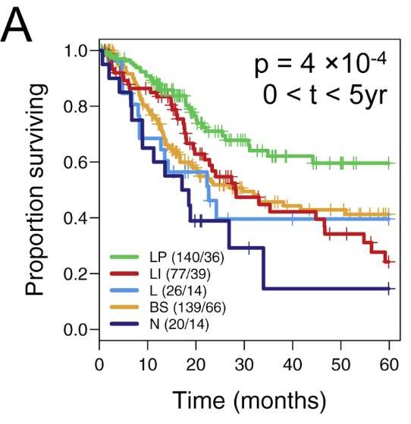
Gene expression subtypes could only describe - the clinical links were weak
5
As with many cancers, BLCA research focused on gene expression profiles in the 2010s
Standard approach → retain “most variable” genes, dimension reduction, most parsimonious number of groups
Biggest single study in The Cancer Genome Atlas (TCGA) included some human “involvement” (Lum group).

Slide 7
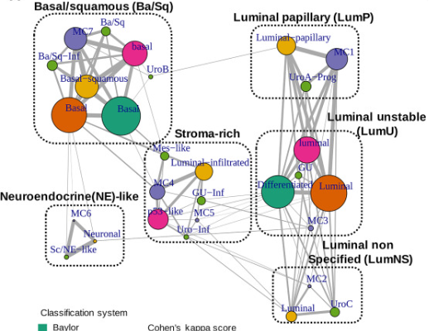

Gene expression subtypes could only describe - the clinical links were weak
6
As with many cancers, BLCA research focused on gene expression profiles in the 2010s
Standard approach → retain “most variable” genes, dimension reduction, most parsimonious number of groups
Biggest single study in The Cancer Genome Atlas (TCGA) included some human “involvement” (Lum group).
Consensus effort harmonised labels, rather than deriving groups from scratch

Slide 8
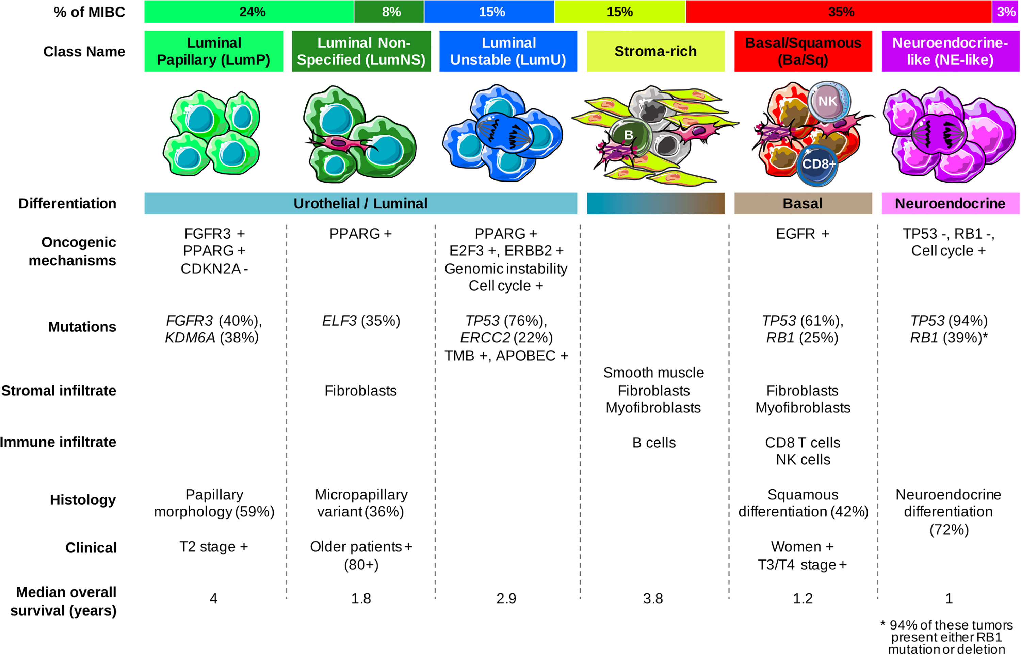
Gene expression subtypes could only describe - the clinical links were weak
7
As with many cancers, BLCA research focused on gene expression profiles in the 2010s
Standard approach → retain “most variable” genes, dimension reduction, most parsimonious number of groups
Biggest single study in The Cancer Genome Atlas (TCGA) included some human “involvement” (Lum group).
Consensus effort harmonised labels, rather than deriving groups from scratch

Slide 9
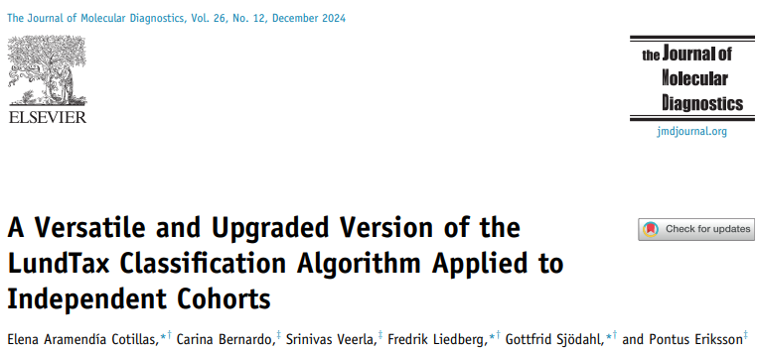
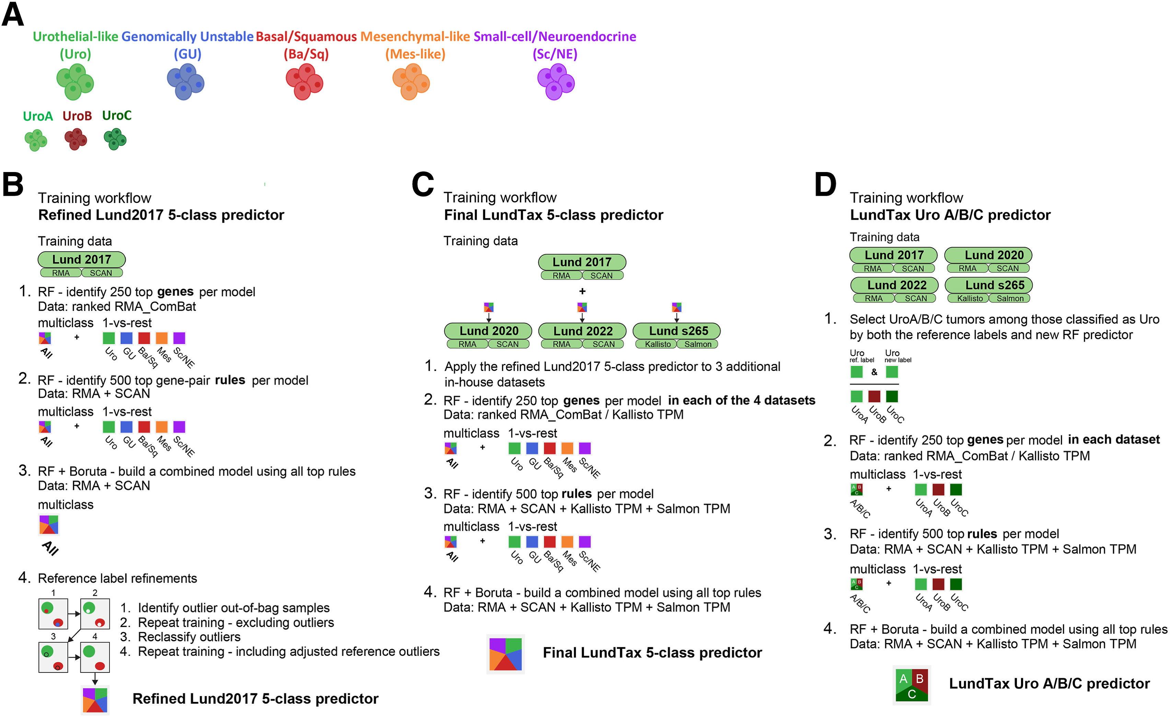
Consensus? You forget we’re academics.
8
#

Slide 10
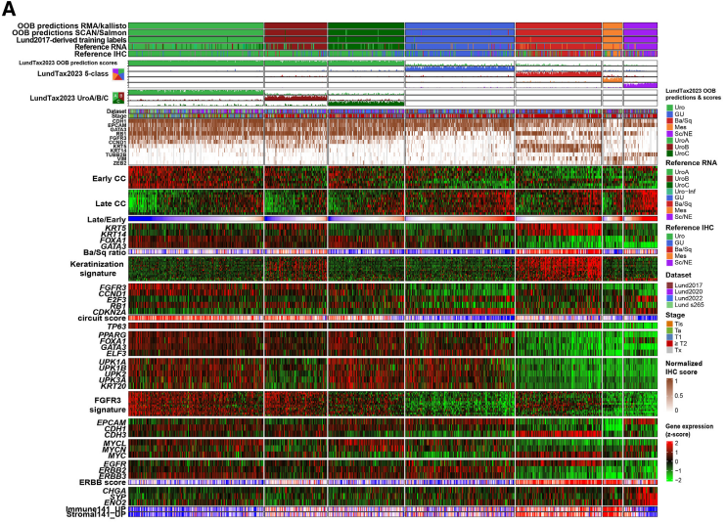
Consensus? You forget we’re academics (ii)
9
Much more honest, shows their working and brings in histological validation, but still poor association with druggable targets or clinical outcomes

Slide 11
--- 2 ---
Has cancer subtyping been made more difficult by focusing on cancer?

Slide 12
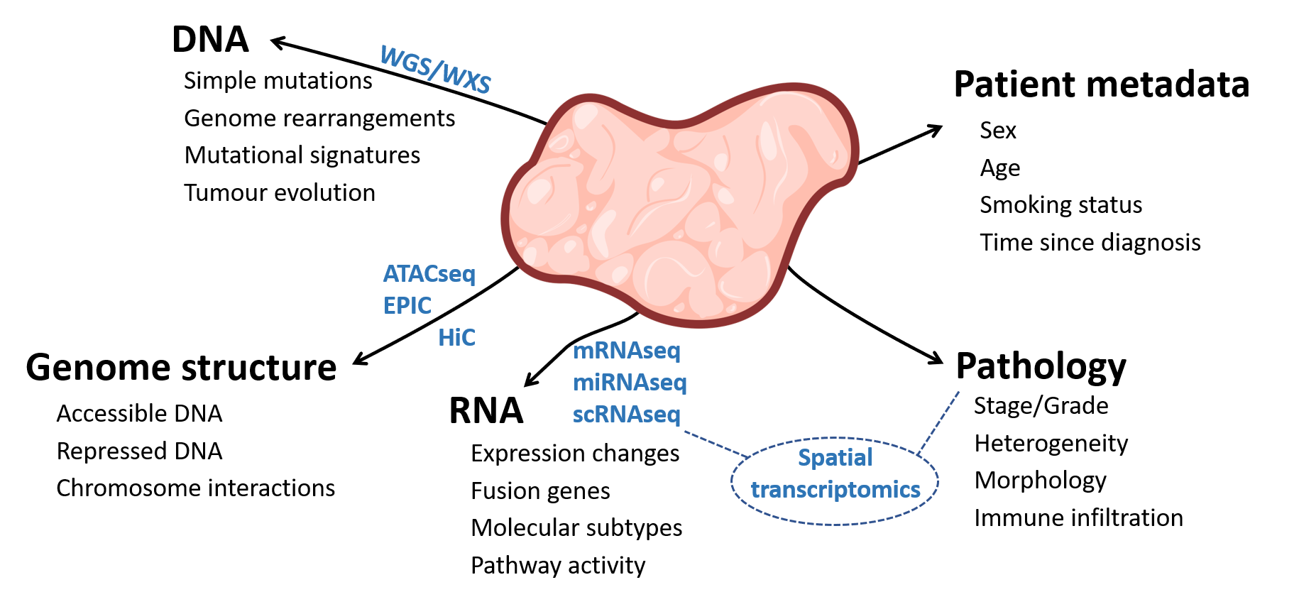
Tumours are very data rich – surely the answer is there?
11
People tend to cluster with one of these and then correlate with these.
In high TMB, high driver diversity cancers like bladder, RNAseq likely most informative

Slide 13
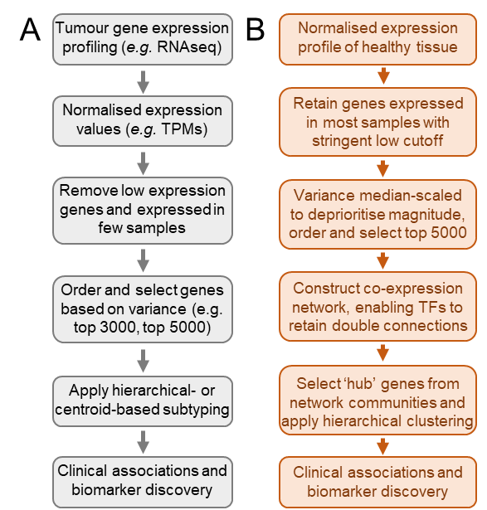
The standard approach for unsupervised stratification of cancer samples
12
This can be done in 15 lines of code

Slide 14
The standard approach for unsupervised stratification of cancer samples
13
Tumour heterogeneity
Sample purity
TME vs neighbouring tissue

Slide 15
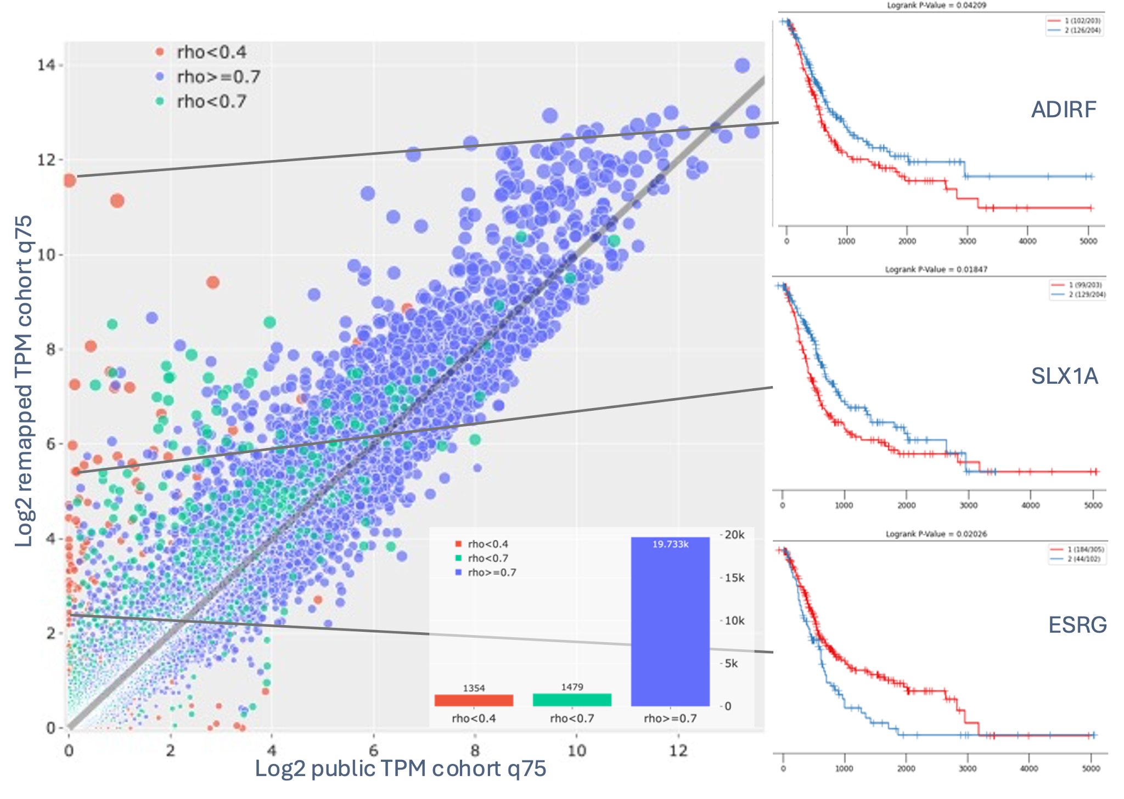
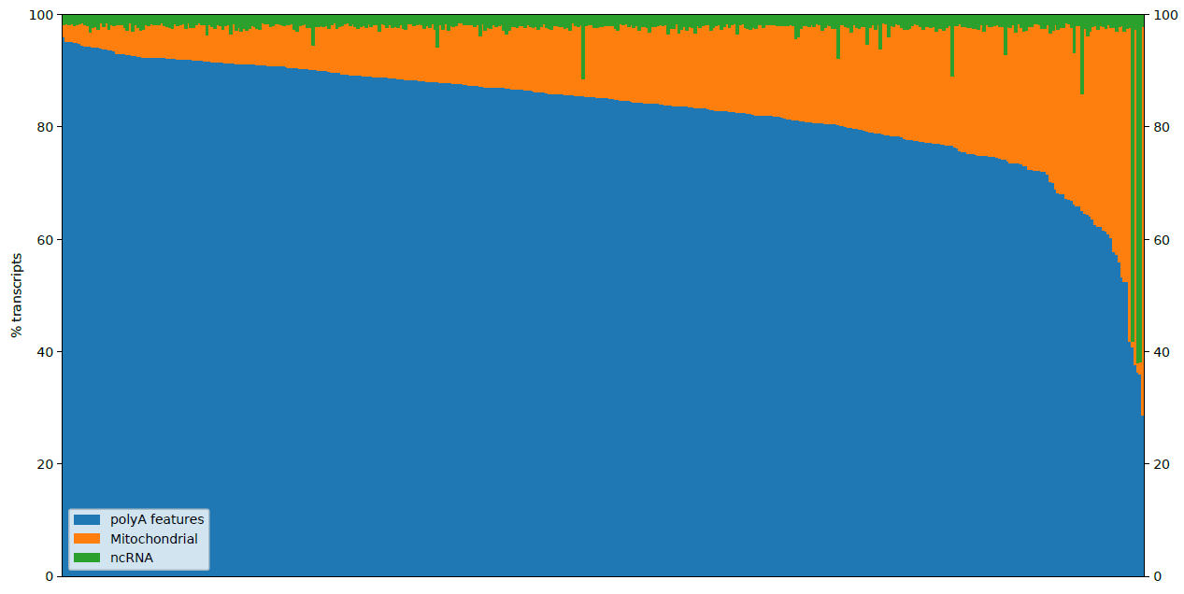
The standard approach for unsupervised stratification of cancer samples
14
Different metrics have different biases
Ensure annotations are up to date

Slide 16
The standard approach for unsupervised stratification of cancer samples
15
Personalised is the goal, but still not attainable, so “precision” applied to groups is usually preferred

Slide 17
The standard approach for unsupervised stratification of cancer samples
16
Genes with high expression will have high variance, even if they are relatively constant in terms of deviation
Gene number is highly arbitrary → justification different in different datasets

Slide 18
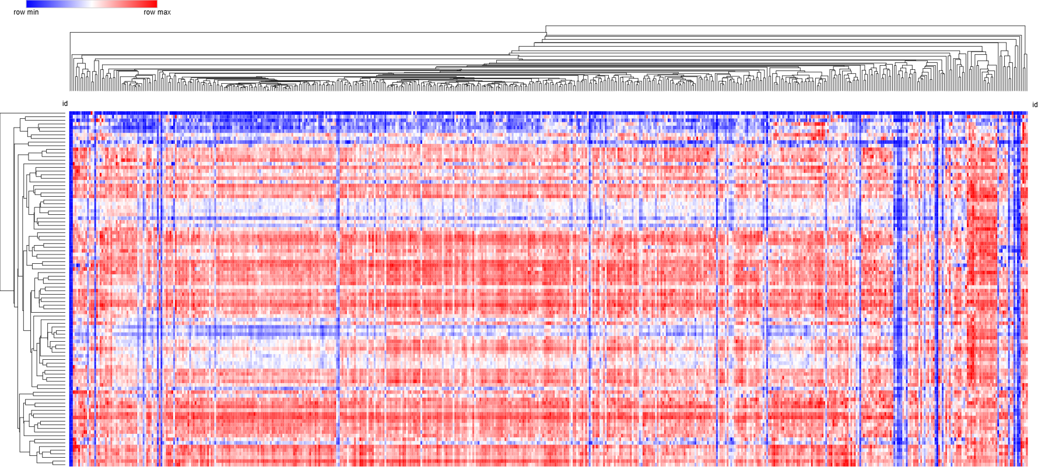
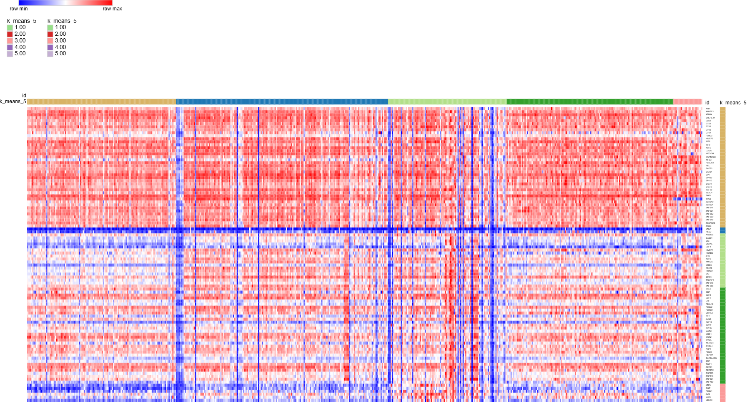
The standard approach for unsupervised stratification of cancer samples
17
Hierarchical Clustering
K=5 kmeans
Model choice has a big effect → centroid likes even groups, hierarchical can be susceptible to outliers

Slide 19
The standard approach for unsupervised stratification of cancer samples
18
Derived groups correlated with other data to get associations or enrichments, links to existing outcomes, biomarkers for diagnosis or treatment etc.

Slide 20
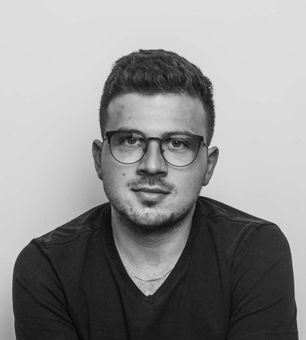
Our novel strategy
19
Few cancers have this option
Genes important at all diff states
Not just genes with high expression (and therefore likely high variance)
Integration of biological knowledge

Slide 21
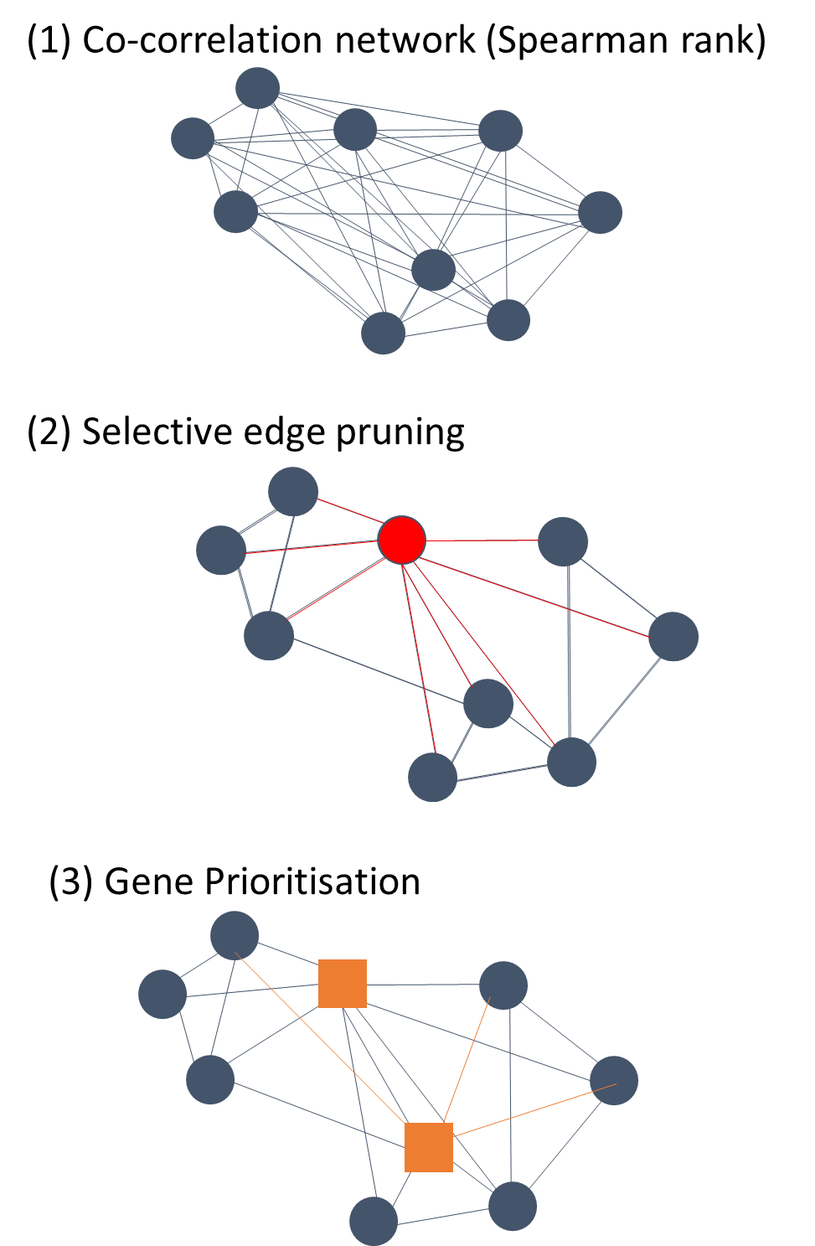
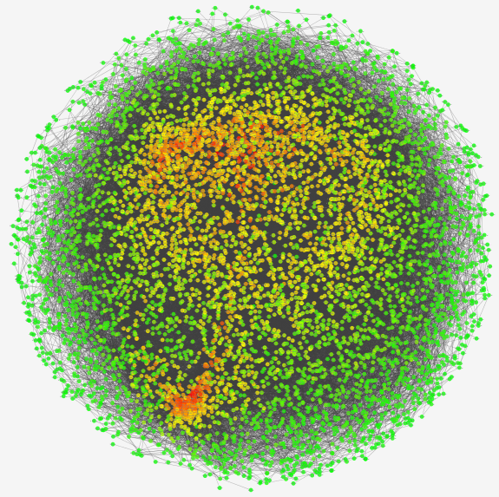
Network construction
20
Nodes → genes
Edges → the correlation values (the lines joining nodes)
All-vs-all correlation networks are enormous
Num network edges = (num nodes * (num nodes - 1))
2
Our network using 5000 genes therefore has >12.5M edges

Slide 22
Network construction (ii)
21

Slide 23
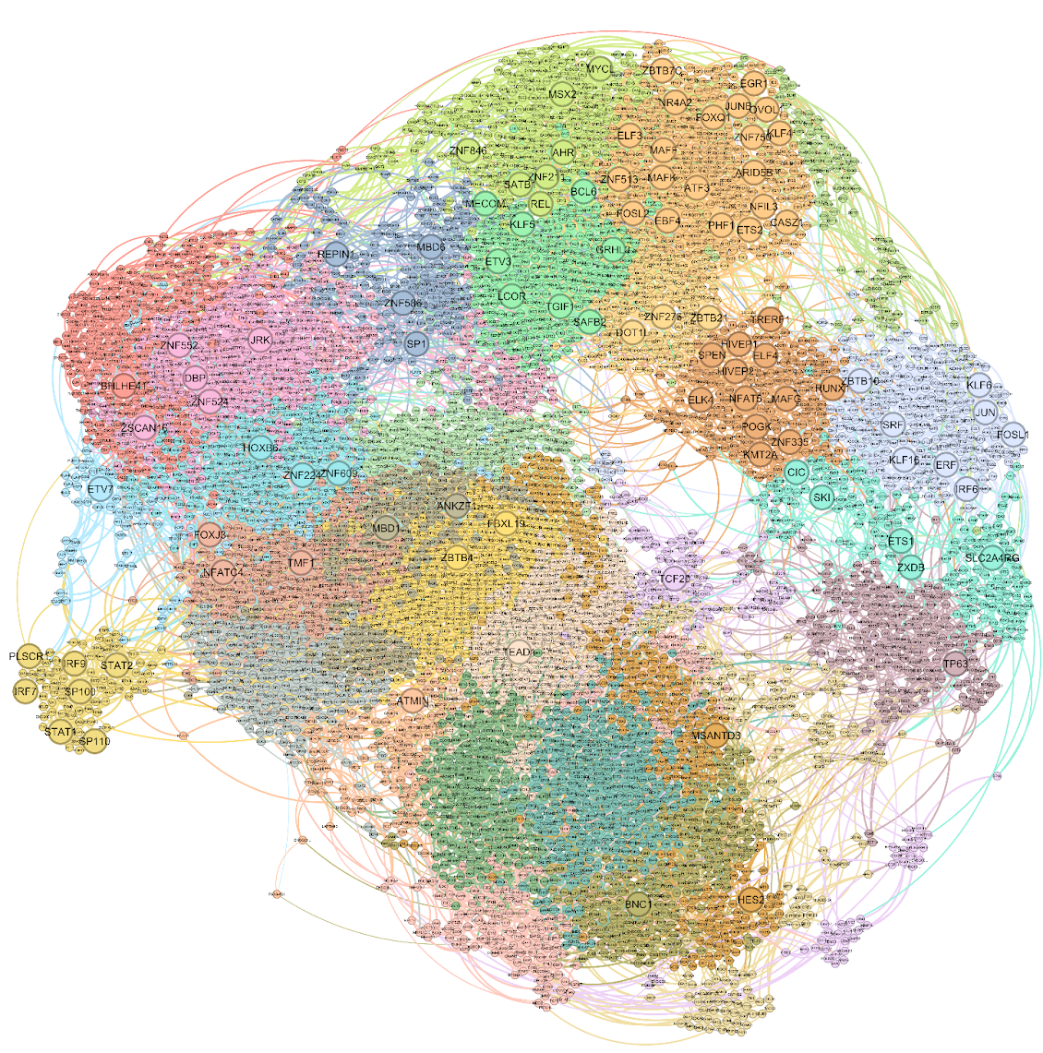
98 naturally emergent TFs define network structure
22

Slide 24
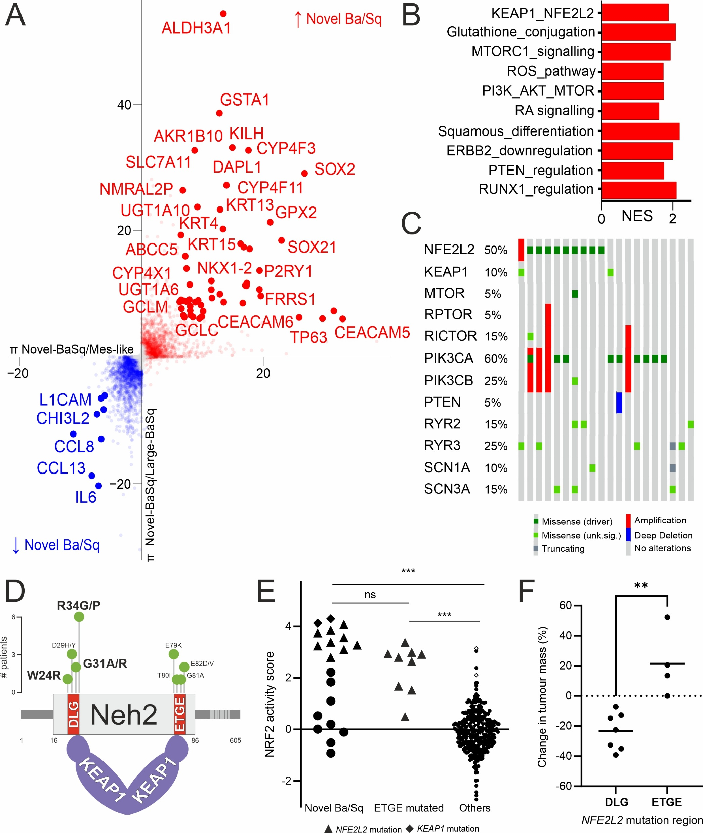
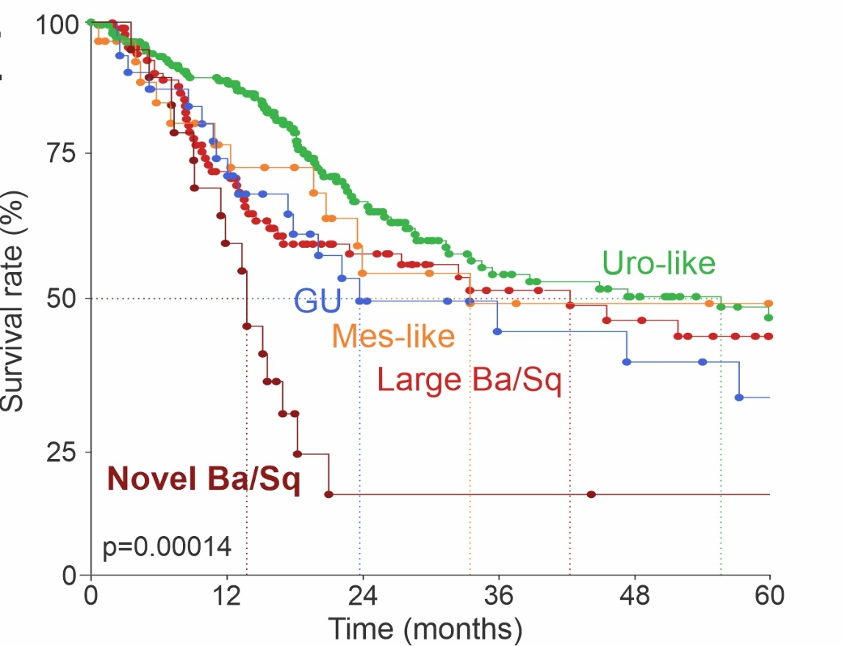
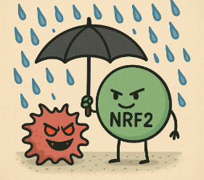

Novel Ba/Sq subdivision had very poor survival and was driven by NRF2
23
There is no ground truth
  Survival is poor for all MIBC patients
  Very poor survival gave a good first indication
DEA showed specific signatures for:
  ROS response
  Drug conjugation
  mTOR signalling
  Retinoid signalling

Slide 25
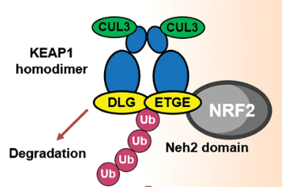
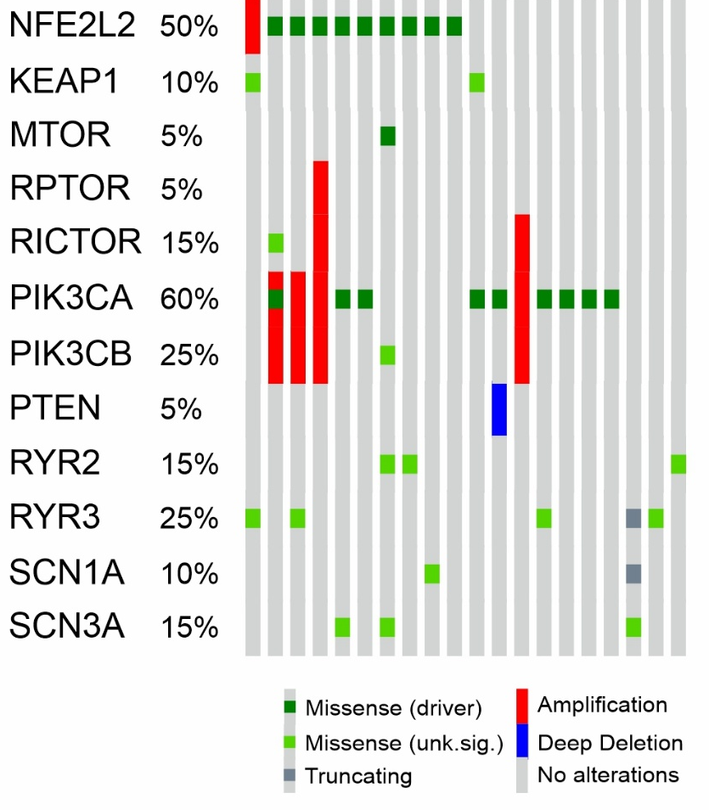
NRF2 overactive group showed mixed, but consistent mutational profile
24
50% of group contained driver NFE2L2 mutations
10% contained potential KEAP1 driver mutations
PI3K pathway alterations seen in 60%
Changes in Ca²⁺ and Na⁺ channels may feed into PI changes
Some NFE2L2 drivers were excluded!
Reanalysis of LUSC sapanisertib (mTORi) trial shows genotype-specific response

Slide 26
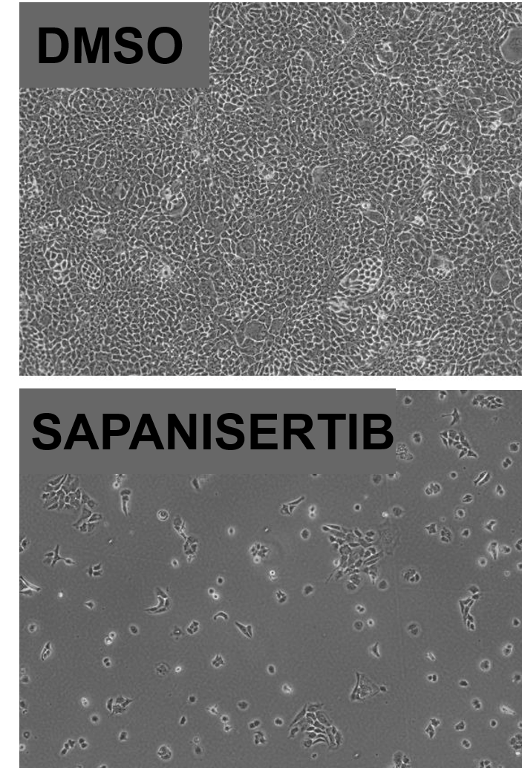
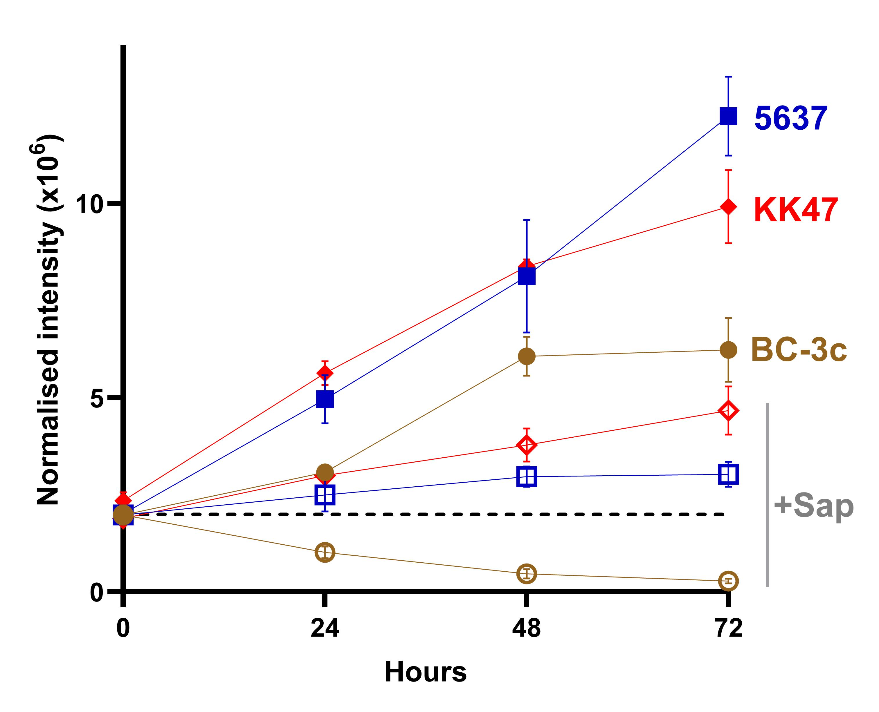
Sapanisertib specifically kills BLCA cells with DLG mutation
25
1µM sapanisertib kills >90% of BC-3c cells (NRF2 R34G)
  mTORi slows growth in other Ba/Sq lines, but cessation allows recovery
  senescence-consistent phenotype common after mTOR inhibition → trying to target these cells
We see consistent changes in LUSC and HNSC lines as well

Slide 27
Focusing on the biology-driven subtyping → moving beyond PoC
26
New/different/subset mRNA datasets
Different modalities – miRNA, LR etc.
Prioritise different gene sets
Integrate different modalities
Stratify different BC stages

Slide 28
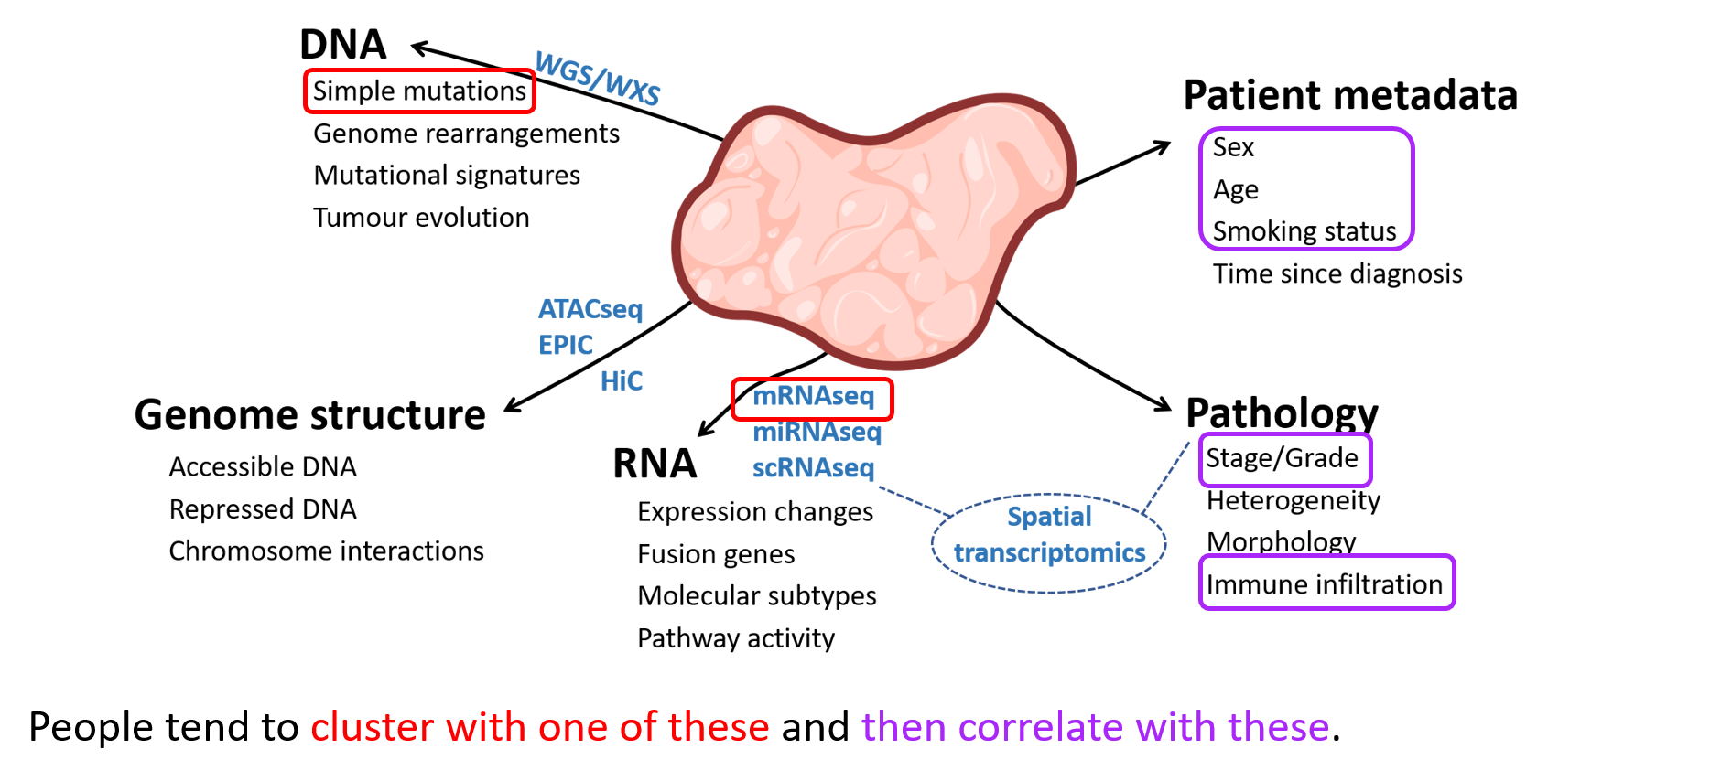
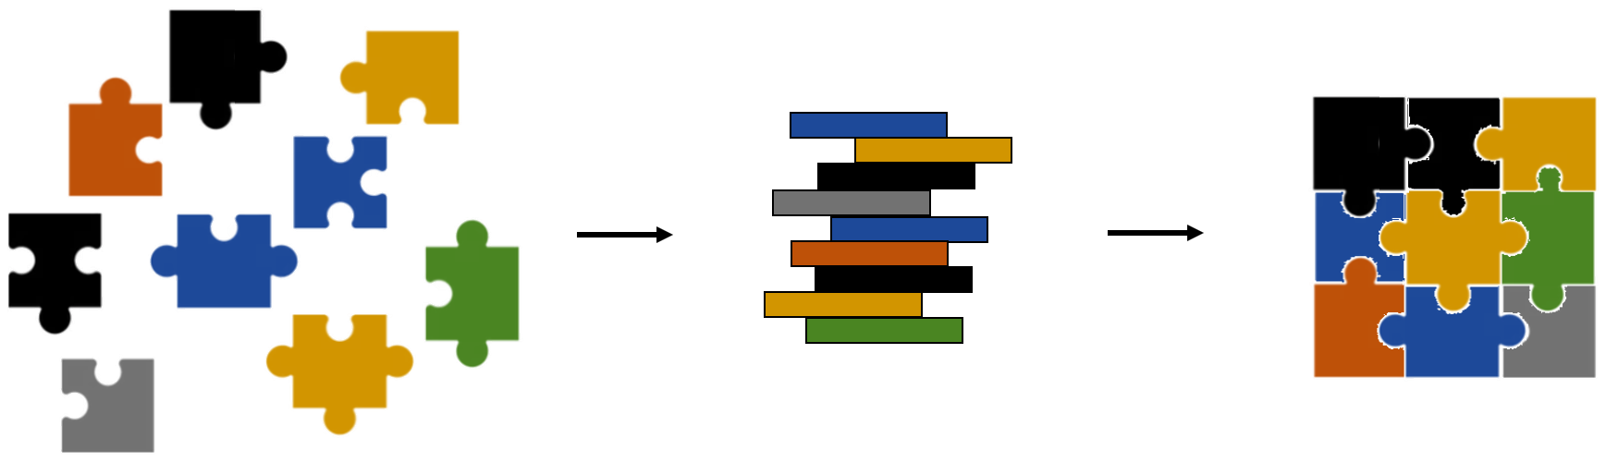
Multiomic integration
27
Multiomic integration often means cluster separately and combine, or combine all data before clustering

Slide 29
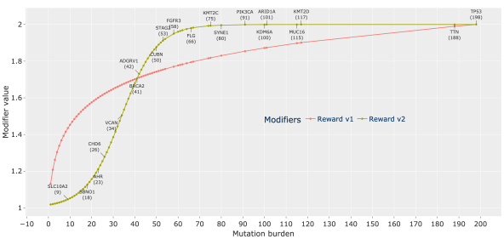
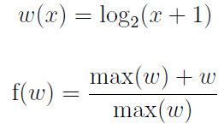

Mutation integration, but doing it our way (i)
28
  Our strategy was to use the geography of the network to integrate mutations

Slide 30
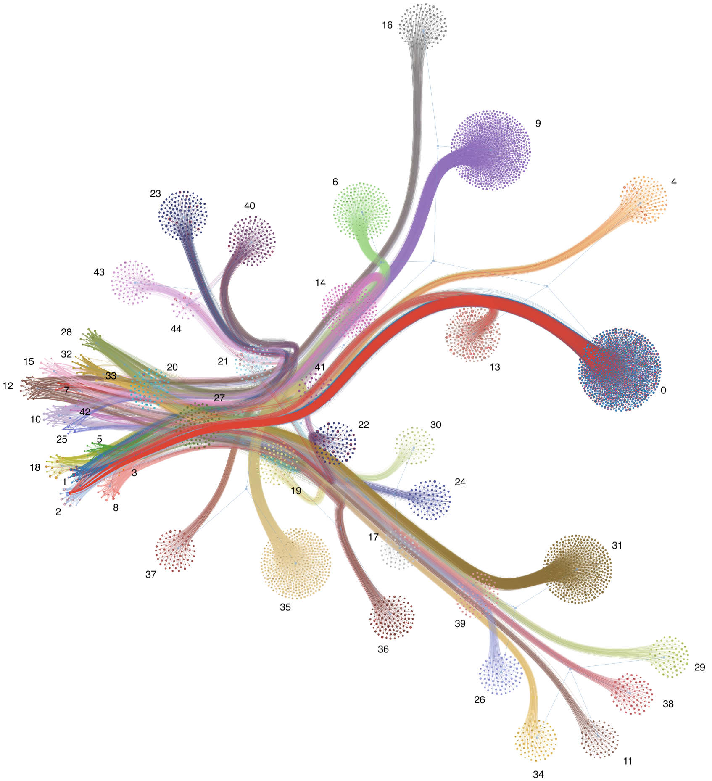
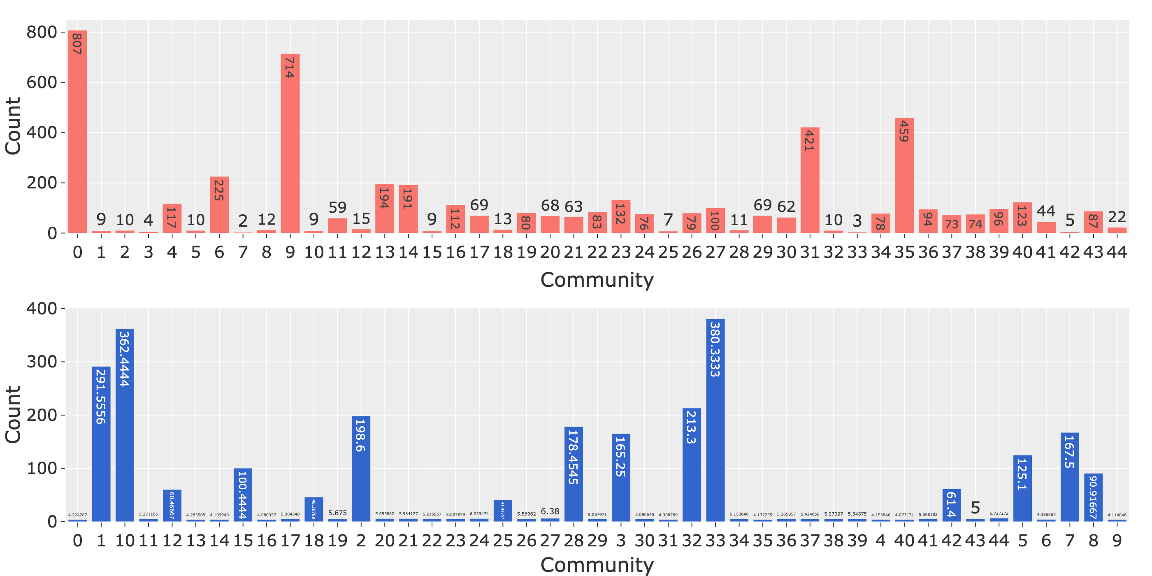
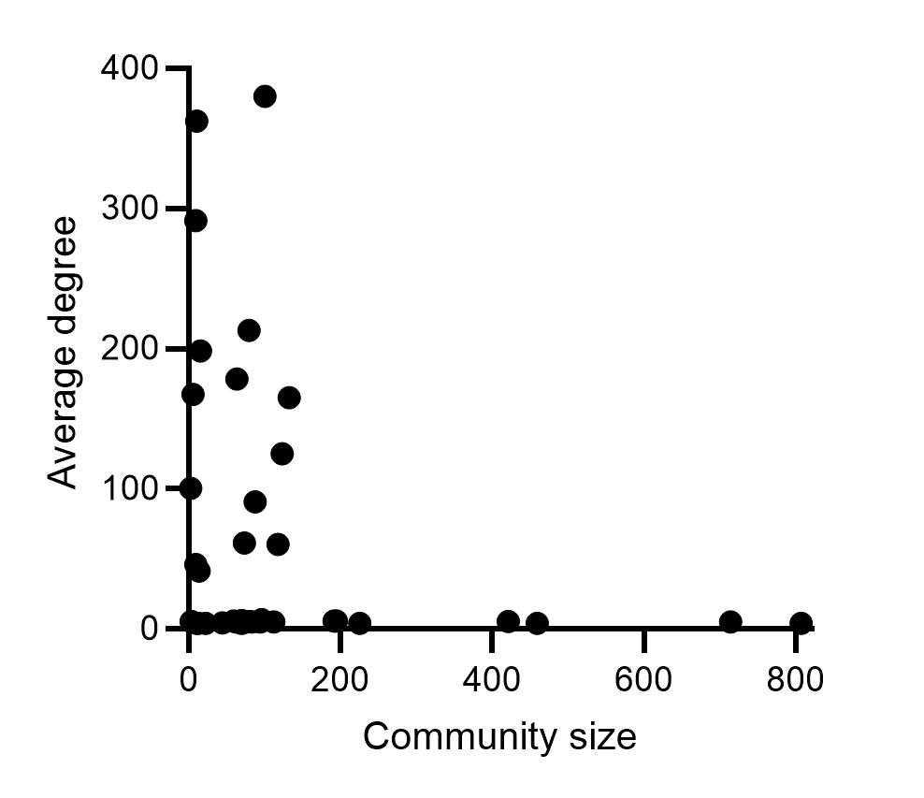
Mutation integration, but doing it our way (ii)
29
  Currently this is very (very) extreme, and makes the networks look heavily biased in terms of connections
  Community membership
  Average degree (i.e. connectivity)

Slide 31
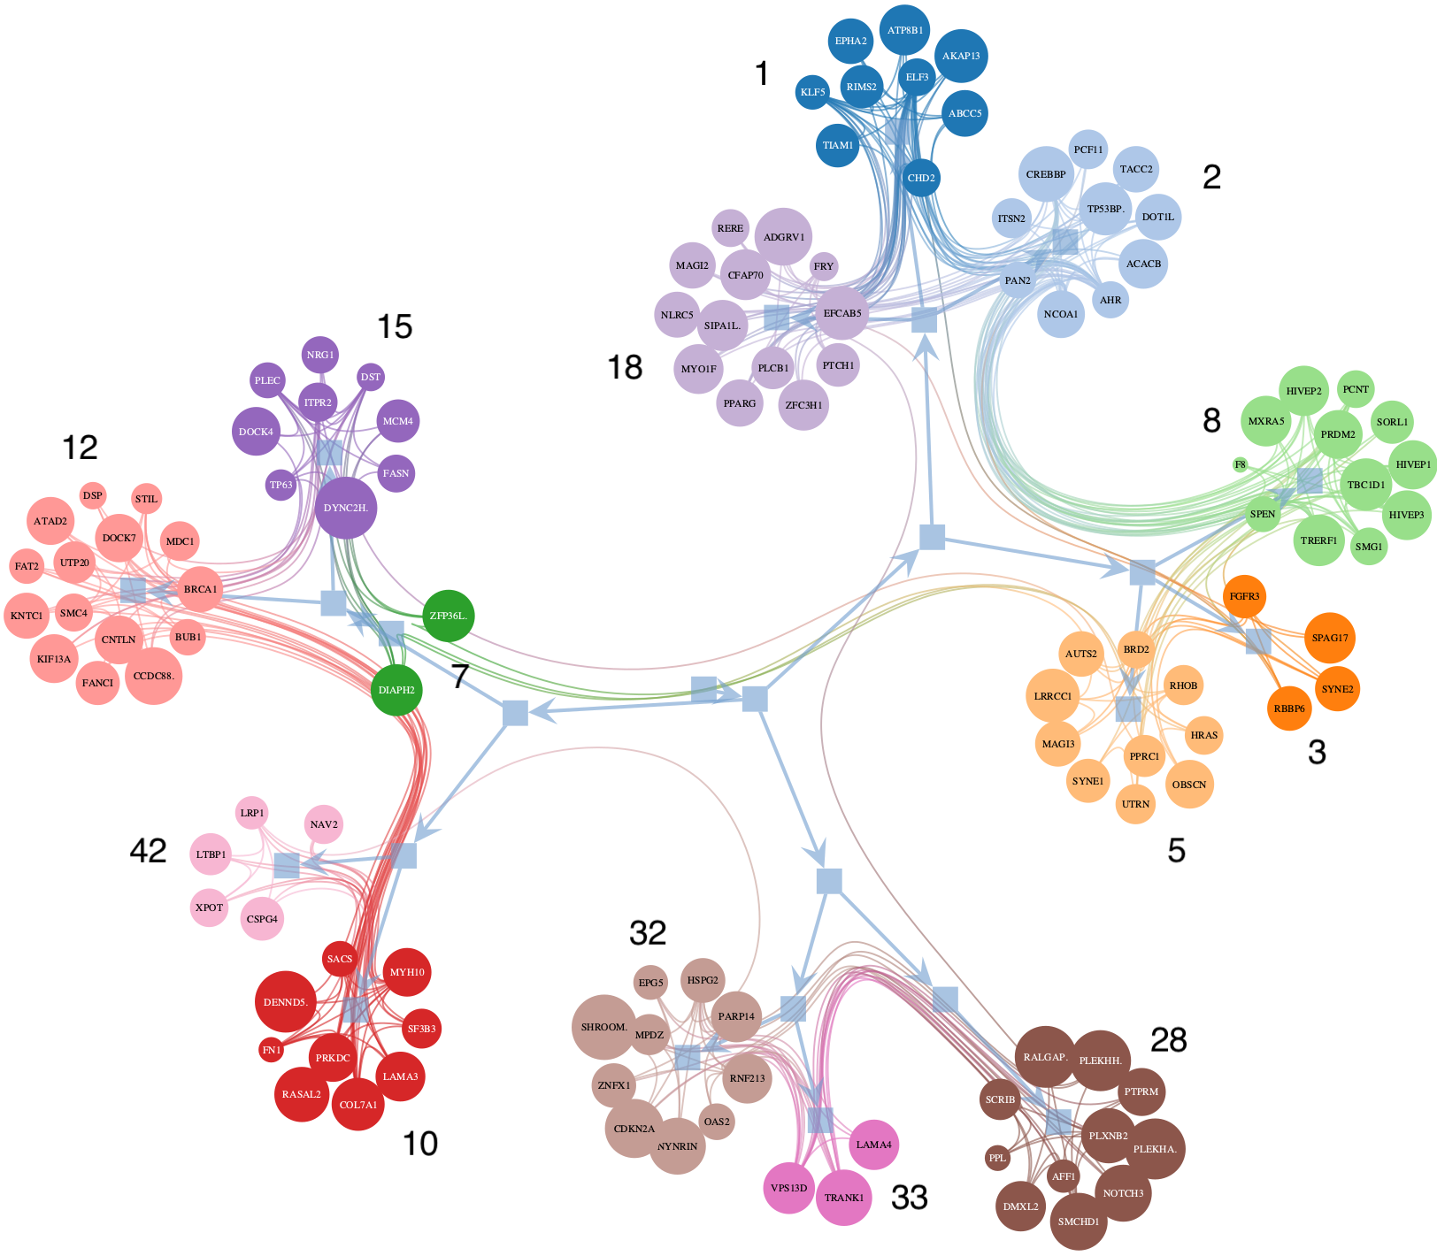
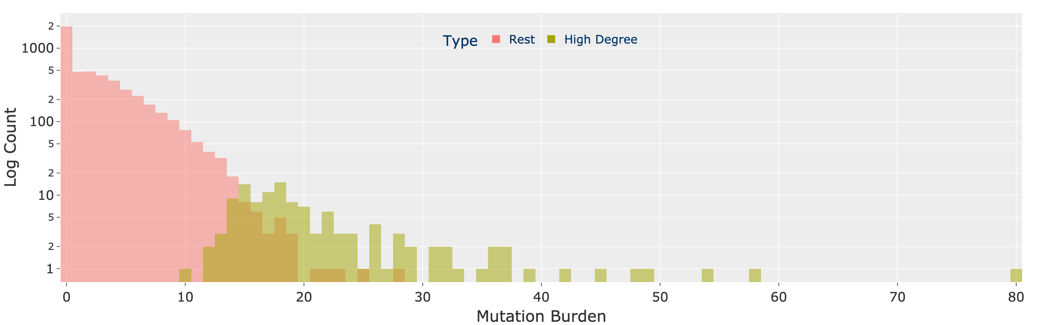
Mutation integration, but doing it our way (iii)
30
  CREBBP
  AHR
  FGFR3
  Focus on the hyperconnected genes (notice that expression remains important – e.g. TP53 not selected, but TP53BP is…)
  Some of selected genes are not heavily mutated

Slide 32
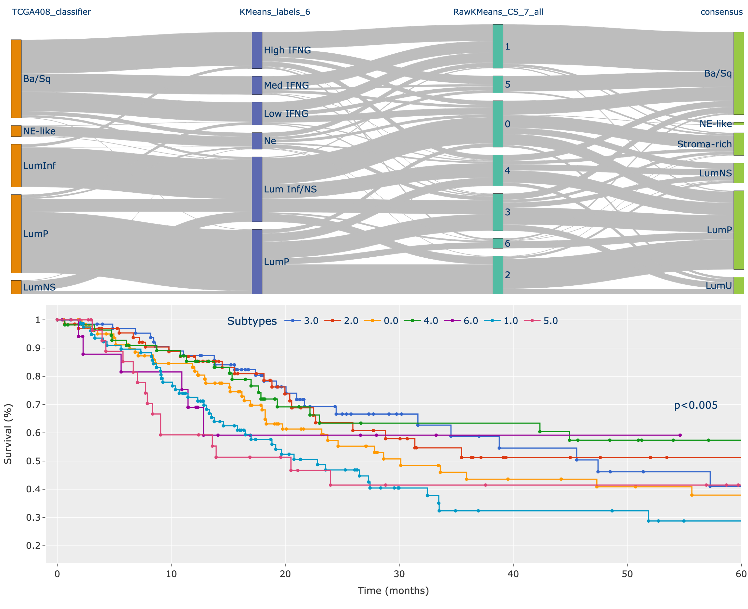
Mutation integration, but doing it our way (iv)
31
  Use the 122 genes to stratify TCGA MIBC → luminal splits!
  Small LumP group with poorest Luminal survival

Slide 33
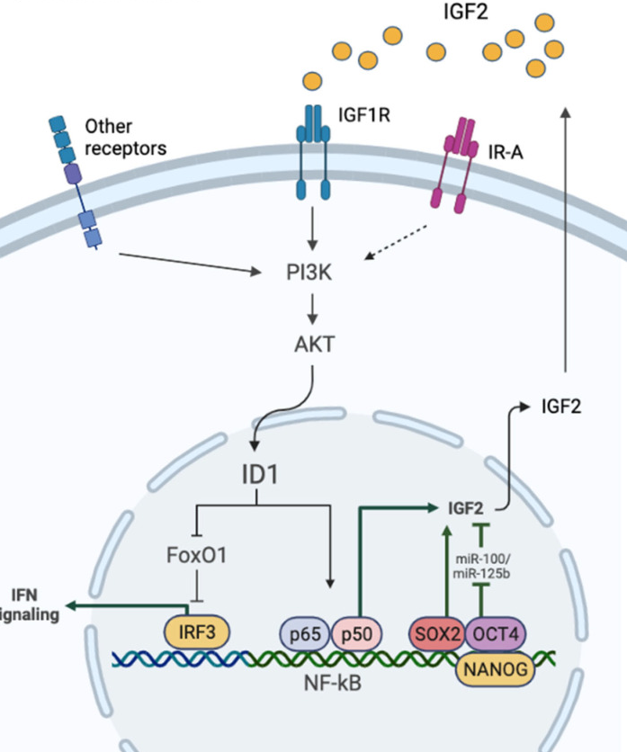
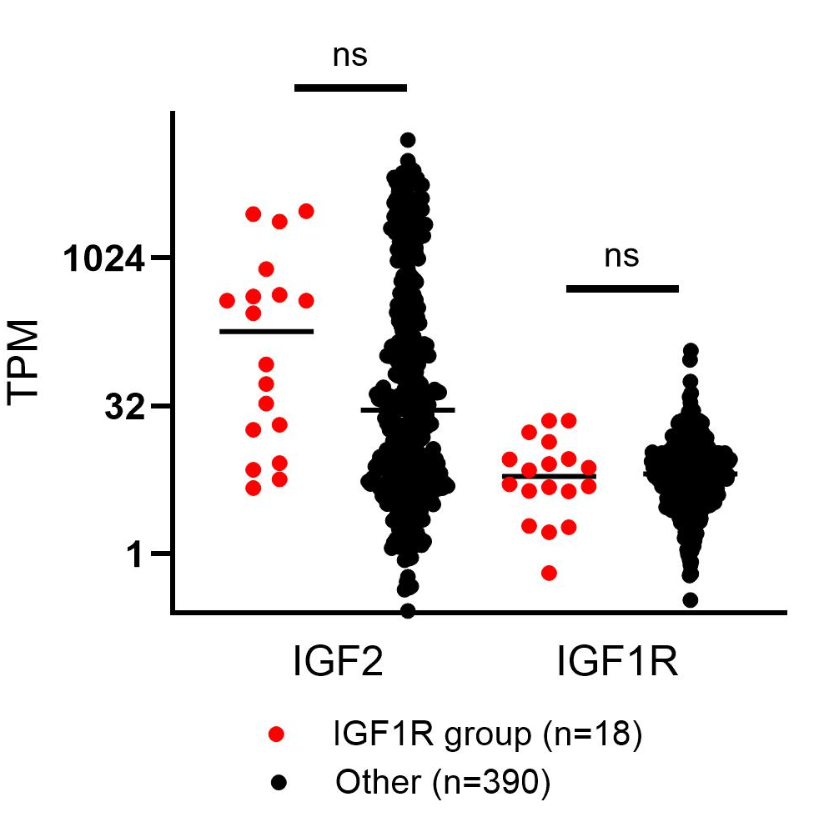
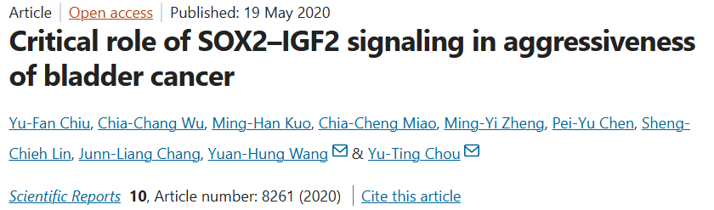

Mutation integration, but doing it our way (v)
32
  Enrichment of IGF1R signalling
  Overrepresentation of KRAS and NRAS mutants
  PI3K overactivity (no overlap with NRF2 group…)
  Slightly elevated IGF2 expression
  DepMap CRISPR Chronos scores (IGF1R)
  UMUC1
  RT112
Phase 2/3 trials with linsitinib (IGF1R inhibitor) had mixed results in lung and prostate adenocarcinoma, Ewing’s sarcoma and even adrenocortical carcinoma, where 90% of patients have IGF2 (IGF1R ligand) overexpression

Slide 34
Addressing the clinical reality
33

Slide 35
Addressing the clinical reality
34
In my view, this is closer to genuine precision oncology
Drug A
Drug B
Drug C
Drug D
Drug E

Slide 36
Addressing the clinical reality
35
In my view, this is closer to genuine precision oncology
Drug A
Drug B
Drug C
Drug D
Drug E
Drug E
Drug F
Iterative improvement, led by biological knowledge.

Slide 37

Biological knowledge vs data brute force
36
https://xkcd.com/1831/
I’m not saying this can’t happen… but…
If you assume c.100 gene/feature lists are the most informative, there are 10^253 combinations of expressed genes, each generating 5-10 clusters of tumours…

Slide 38














Acknowledgements
37
Maggie Knowles
Lars Dyrskjøt
Philippe Lamy
Vlad Ungureanu
Richard Gawne
Marcello Beltrami
Jessie Irvine
Simon Baker
Jenny Baker
Claire Varley
Ros Duke
Jo Pearson
Jennifer Southgate
Jim Catto
Jon Griffin
Lewis Quayle
David McConkey
Steve Smith
David Halliday
Rik Bryan
Pontus Eriksson
Viking
Research Compute Cluster
#25297

