Slide 1

Introduction to cBioPortal
21/03/2024
Course material

Slide 2


Andrew Mason BSc (Hons) PhD AFHEA
Lecturer in Cancer Informatics at The University of York
Run a small bioinformatics-focused research group within the Jack Birch Unit
Work on human urothelial cancers and retroviral cancers in birds
Bioinformatic lead for the bladder cancer group of the 100,000 genomes project
Elixir-UK Data Stewardship Training Fellow
Improve data management, not just analysis, in life sciences
Development of data management training resources

Slide 3
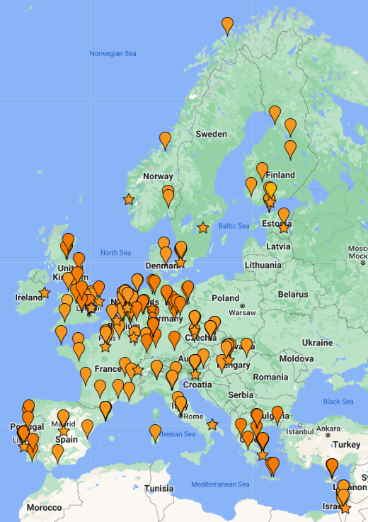

What is Elixir?
“ELIXIR coordinates and develops life science resources across Europe so that researchers can more easily find, analyse and share data, exchange expertise, and implement best practices.”
Improve skills in data management
Improve quality of, and access to, informatics training
Develop and disseminate FAIR data principles in life sciences

Slide 4
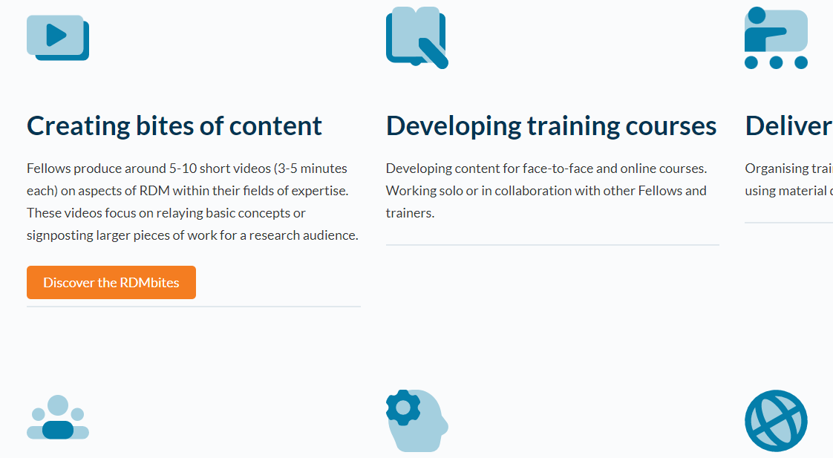

Elixir-UK Data Stewardship Training Fellows
Research Data Management bites
My videos introducing sequencing data
Online training courses, cookbooks and carpentries
Local, in-person training

Slide 5
Introduction and Learning Objectives
4
Introduction to cBioPortal
Course material

Slide 6
Session structure
5
12.35 Introduction and Learning Objectives
12.45 cBioPortal website demonstration
12.55 Problem-solving tasks
13.30 Recap and Further Resources
13.35 Accessing and using underlying cBioPortal data
13.45 Rstudio demo for accessing cBioPortal data
13.55 Summary and final remarks
14.00 Close
Course material

Slide 7
Learning objectives
6
1
Recognise the applications and utility of cBioPortal for cancer research
2
Operate and explore the cBioPortal website to identify cancer data of interest
3
Complete two cancer biology problem-solving tasks using cBioPortal
4
Recognise the process for accessing and analysing cBioPortal data
Course material

Slide 8





What is cBioPortal?
7
Public website for exploratory analysis, visualisation and download of large cancer omics datasets, with clinical metadata
cbioportal.org
Data derived from large consortia, as well as highlighted studies
Data annotated by external reference databases
Depending on the dataset, includes mutations, CNA, gene expression, methylation data etc.
Course material
When using cBioPortal, cite the following papers, plus the reference papers for datasets used: Cerami et al. 2012, Gao et al. 2013

Slide 9
Why use cBioPortal?
8
Access to the largest, publicly available cancer sequencing studies, all in one place
cbioportal.org
Explore broader relevance of laboratory/animal studies across cancer types
Hypothesis generation, including student projects
Data visualisation
Exploration of clinical data
Course material
When using cBioPortal, cite the following papers, plus the reference papers for datasets used: Cerami et al. 2012, Gao et al. 2013

Slide 10
cBioPortal website demo
9
Introduction to cBioPortal
Course material

Slide 11

Problem-solving tasks
10
Your turn!
Course material
Google Form for questions

Slide 12
Recap and Further Resources
11
Introduction to cBioPortal

Slide 13
12
1
Recognise the applications and utility of cBioPortal for cancer research
2
Operate and explore the cBioPortal website to identify cancer data of interest
3
Complete two cancer biology problem-solving tasks using cBioPortal
4
Recognise the process for accessing and analysing cBioPortal data

Slide 14
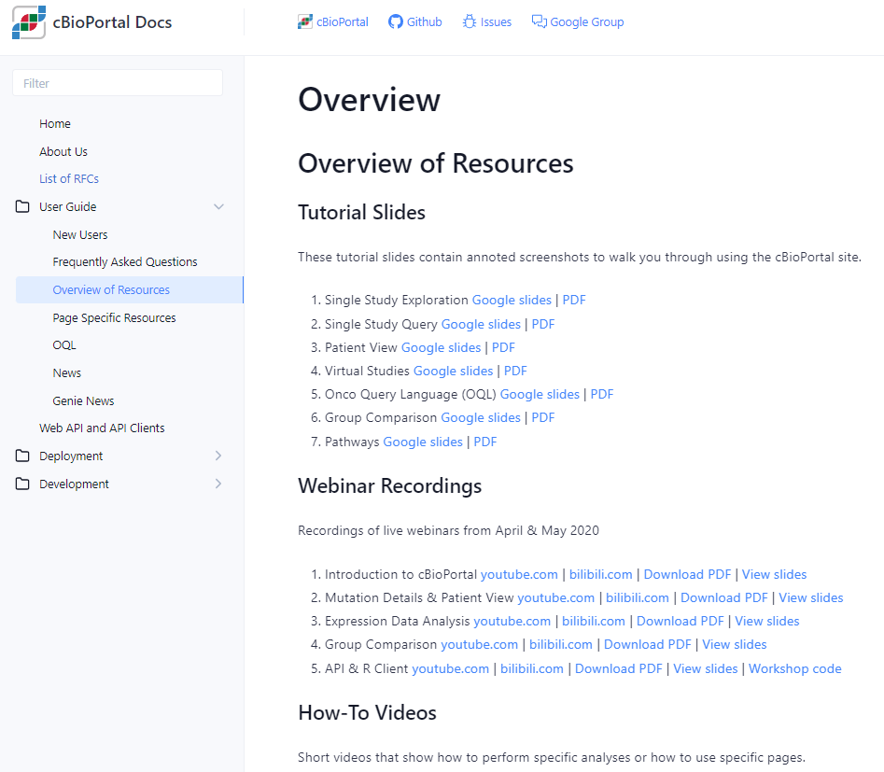


Further training resources
13
Direct link
cBioPortal FAQs

Slide 15
Accessing and using underlying cBioPortal data
14
Introduction to cBioPortal

Slide 16
15
4
Recognise the process for accessing and analysing cBioPortal data
Why bother?
“under-the-hood” dataset has more information than displayed publicly
analyse lists of genes quickly
“improve” the plot quality
perform more advanced statistical testing (e.g. DEA, GSEA)

Slide 17
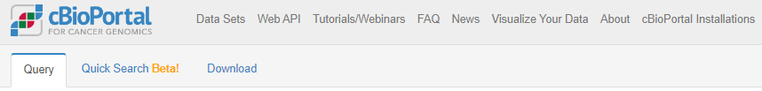
Downloading data
16
Unhelpful starting point.

Slide 18
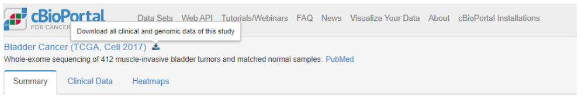
Downloading data
17
Explore your dataset first, and then download.
Download will start and give a .tar.gz file

Slide 19
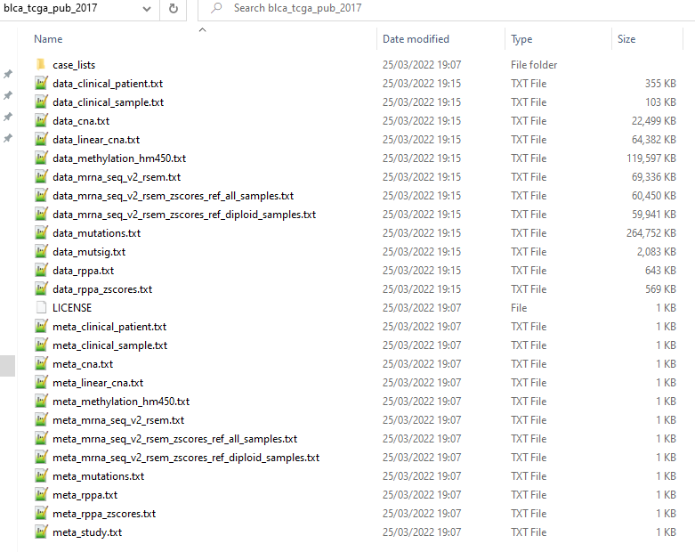
Downloading data
18
For each assay, 1 data file and 1 metadata/information file

Slide 20
Understanding the data
19
TSV – feature x patient ID (many missing values, cancer-specific features)
Patient information
Sex, height, weight, race, ethnicity, diagnosis age, survival status
Occupation history, smoking status, family history
Tumour information
Stage, grade, disease codes, metastasis status
Tumour-specific categories (e.g. for bladder, rate of prostate cancer)

Slide 21
Understanding the data
20
tumour x gene using GISTIC scale (TSV)
-2 homozygous “deep” deletion
-1 shallow deletion (anything that isn’t total loss)
0 diploid
1 gain (“a few” extra copies)
2 amplification (often in focal sets)

Slide 22
Understanding the data
21
tumour x gene, normalised gene expression data (TSV)
Normalised counts
Can feed into differential expression pipelines (DESeq2 etc), if careful!
Good for comparisons of one gene across samples
Harder to compare expression between genes of same sample

Slide 23
Understanding the data
22
TSV – list of all mutations, sorted by tumour ID
Includes synonymous mutations as well as non-synonymous
Data structure is rubbish, requires lots of parsing to find hotspots etc.

Slide 24



Working with the data
23
Existing UG training and extensive core bioinformatic support
Specific cBioPortal REST API for programmatic access
Python support available too – pandas package is versatile
Doable…! But. Memory intensive, and watch delimiters when importing.

Slide 25
cBioPortal API demonstration using RStudio
24
Introduction to cBioPortal
Course material
Google Form for questions

Slide 26

Working with the data… final thoughts
25
The data is not always complete
Inconsistent column usage between datasets
Watch ‘whitespace’ vs ‘tab space’ vs comma delimiters
Biological vs Statistical significance
Limited by previous bioinformatic analysis pipelines, genome version etc.
More advanced questions can go back to the raw data

Slide 27
26
Course complete!

