Slide 1

Introduction to cBioPortal
Welcome!
Course material

Slide 2



Andrew Mason BSc (Hons) PhD AFHEA
Lecturer in Cancer Informatics at The University of York
Run a small bioinformatics-focused research group within the Jack Birch Unit
Work on human urothelial cancers and retroviral cancers in birds
Bioinformatic lead for the bladder cancer group of the 100,000 genomes project
Just started my undergraduate teaching role
Elixir-UK Data Stewardship Training Fellow
Improve data management, not just analysis, in life sciences
Development of data management training resources
Course material
Feedback form

Slide 3
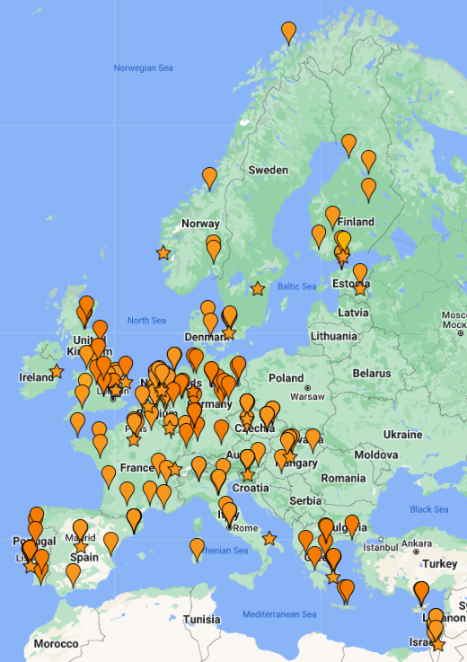

What is Elixir?
“ELIXIR coordinates and develops life science resources across Europe so that researchers can more easily find, analyse and share data, exchange expertise, and implement best practices.”
Improve skills in data management
Improve quality of, and access to, informatics training
Develop and disseminate FAIR data principles in life sciences
Course material
Feedback form

Slide 4
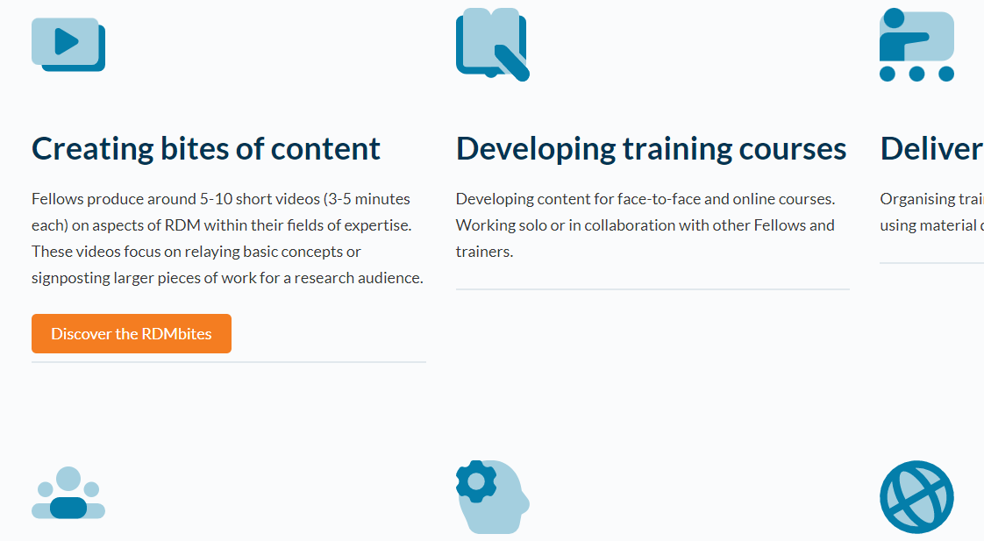

Elixir-UK Data Stewardship Training Fellows
Research Data Management bites
My videos introducing sequencing data
Online training courses, cookbooks and carpentries
Local, in-person training
Course material
Feedback form

Slide 5
Introduction and Learning Objectives
Introduction to cBioPortal
Course material
Feedback form

Slide 6
Session structure
12.00 Introduction and Learning Objectives
12.10 cBioPortal website demonstration
12.20 Problem-solving tasks
12.45 Recap and Further Resources
12.50 Accessing and using underlying cBioPortal data
13.00 Close
Course material
Feedback form

Slide 7
Learning objectives
1
Recognise the applications and utility of cBioPortal for cancer research
2
Operate and explore the cBioPortal website to identify cancer data of interest
3
Complete two cancer biology problem-solving tasks using cBioPortal
4
Recognise the process for accessing and analysing cBioPortal data
Course material
Feedback form

Slide 8





What is cBioPortal?
Public website for exploratory analysis, visualisation and download of large cancer omics datasets, with clinical metadata
cbioportal.org
Data derived from large consortia, as well as highlighted studies
Data annotated by external reference databases
Depending on the dataset, includes mutations, CNA, gene expression, methylation data etc.
Course material
Feedback form
When using cBioPortal, cite the following papers, plus the reference papers for datasets used: Cerami et al. 2012, Gao et al. 2013

Slide 9
Why use cBioPortal?
Access to the largest, publicly available cancer sequencing studies, all in one place
cbioportal.org
Explore broader relevance of laboratory/animal studies across cancer types
Hypothesis generation, including student projects
Data visualisation
Exploration of clinical data
Course material
Feedback form
When using cBioPortal, cite the following papers, plus the reference papers for datasets used: Cerami et al. 2012, Gao et al. 2013

Slide 10
cBioPortal website demo
Introduction to cBioPortal
Course material

Slide 11
Problem-solving tasks
Introduction to cBioPortal
Course material
Feedback form

Slide 12
Task 1 – Exploration of the METABRIC breast cancer dataset
Task 2 – Exploration of two AML datasets
Task 3 – Exploration and comparison of two kidney cancers
Course material
Feedback form

Slide 13
Recap and Further Resources
Introduction to cBioPortal
Course material
Feedback form

Slide 14
1
Recognise the applications and utility of cBioPortal for cancer research
2
Operate and explore the cBioPortal website to identify cancer data of interest
3
Complete two cancer biology problem-solving tasks using cBioPortal
4
Recognise the process for accessing and analysing cBioPortal data
Course material
Feedback form

Slide 15
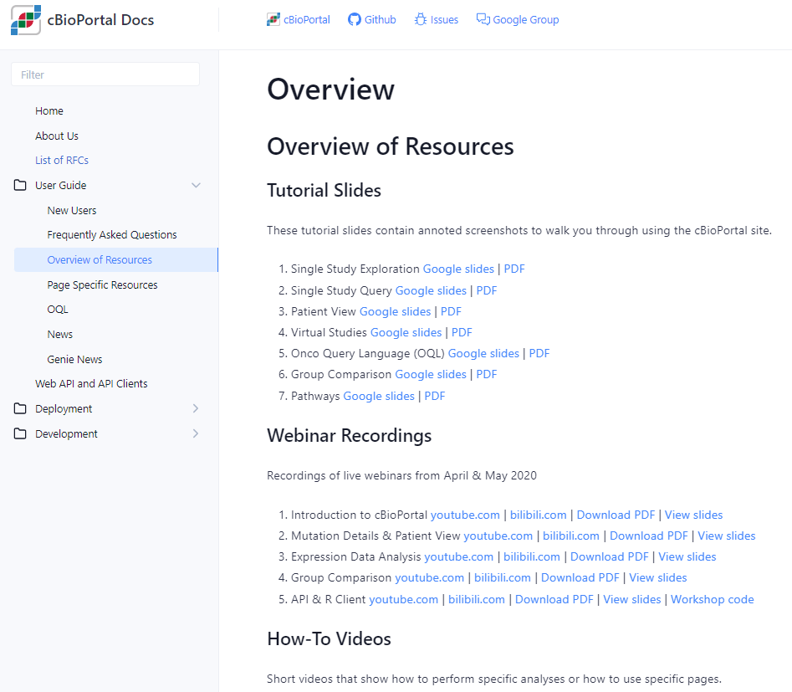


Further training resources
Direct link
cBioPortal FAQs
Course material
Feedback form

Slide 16
Accessing and using underlying cBioPortal data
Introduction to cBioPortal
Course material
Feedback form

Slide 17
4
Recognise the process for accessing and analysing cBioPortal data
Why bother?
“under-the-hood” dataset has more information than displayed publicly
analyse lists of genes quickly
“improve” the plot quality
perform more advanced statistical testing (e.g. DEA, GSEA)
Course material
Feedback form

Slide 18
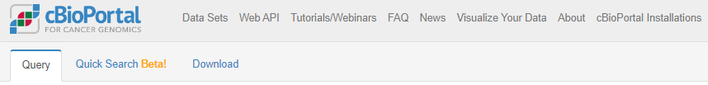
Downloading data
Unhelpful starting point.
Course material
Feedback form

Slide 19
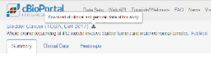
Downloading data
Explore your dataset first, and then download.
Download will start and give a .tar.gz file
Course material
Feedback form

Slide 20
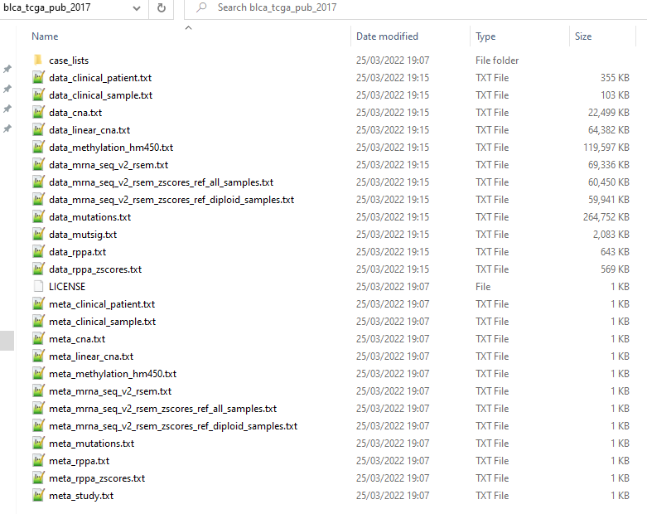
Downloading data
For each assay, 1 data file and 1 metadata/information file
Course material
Feedback form

Slide 21
Downloading data
For each assay, 1 data file and 1 metadata/information file
Course material
Feedback form

Slide 22
Understanding the data
TSV – feature x patient ID (many missing values, cancer-specific features)
Patient information
Sex, height, weight, race, ethnicity, diagnosis age, survival status
Occupation history, smoking status, family history
Tumour information
Stage, grade, disease codes, metastasis status
Tumour-specific categories (e.g. for bladder, rate of prostate cancer)
Course material
Feedback form

Slide 23
Understanding the data
tumour x gene using GISTIC scale (TSV)
-2 homozygous “deep” deletion
-1 shallow deletion (anything that isn’t total loss)
0 diploid
1 gain (“a few” extra copies)
2 amplification (often in focal sets)
Course material
Feedback form

Slide 24
Understanding the data
tumour x gene, normalised gene expression data (TSV)
Normalised counts
Can feed into differential expression pipelines (DESeq2 etc), if careful!
Good for comparisons of one gene across samples
Harder to compare expression between genes of same sample
Course material
Feedback form

Slide 25
Understanding the data
TSV – list of all mutations, sorted by tumour ID
Includes synonymous mutations as well as non-synonymous
Data structure is rubbish, requires lots of parsing to find hotspots etc.
Course material
Feedback form

Slide 26



Working with the data
Existing UG training and extensive core bioinformatic support
Specific cBioPortal REST API for programmatic access
Python support available too – pandas package is versatile
Doable…! But. Memory intensive, and watch delimiters when importing.
Course material
Feedback form

Slide 27

Working with the data… final thoughts
The data is not always complete
Inconsistent column usage between datasets
Watch ‘whitespace’ vs ‘tab space’ vs comma delimiters
Biological vs Statistical significance
Limited by previous bioinformatic analysis pipelines, genome version etc.
More advanced questions can go back to the raw data
Course material
Feedback form

Slide 28
Introduction to cBioPortal
Course complete!
Feedback form

