Slide 1
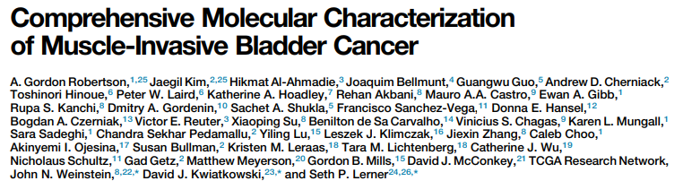

28H Journal Club
Andrew Mason

Slide 2
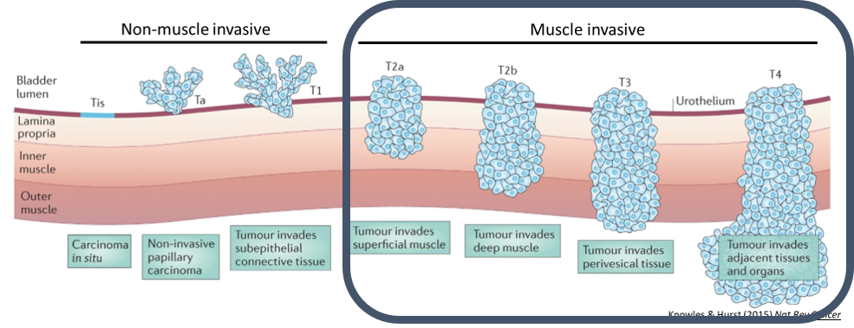
RELEVANT INTRODUCTION
The Cancer Genome Atlas (TCGA) Muscle Invasive Bladder Cancer (MIBC) cohort, n=408/412/404/396…..
Some cohort caveats
Treatment naïve (i.e. all primary tumours)
Tumours had to be large (more aggressive and later stages represented)
Patients had to be cystectomy-eligible (perhaps younger and in better health)
Study favoured more affluent, white Americans close to large hospital centres

Slide 3
Current (and upcoming) standards of care for MIBC
3
MIBC Diagnosis (T2+ N0 M0)
Fit for cystectomy
Unfit for / refuses cystectomy
Cisplatin eligible
Cisplatin ineligible
Neoadjuvant Gemcitabine + Cisplatin
Radical cystectomy
Radical cystectomy possible adjuvant IO
Maximum TURBT & TMT
Adjuvant IO (Nivolumab) for HR

Slide 4
Study aims
Perform multiomic characterisation of muscle invasive bladder cancer at scale for the first time
Large cohort
WXS, CNA, RNAseq, miRNAseq, RPPA, methylation
Extensive clinical data (and follow up)
Validate the subset results from 2014
Determine clinically-relevant molecular subtypes which could be used to guide treatment

Slide 5
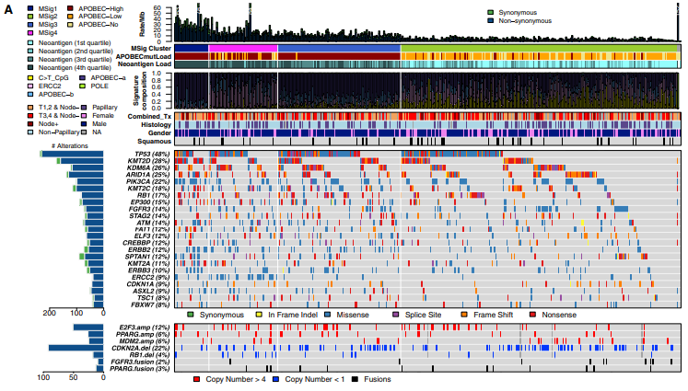
RESULTS
Figure 1 – Mutational profiling (WXS and CNA arrays)
Comments
No clear group subdivision

Slide 6
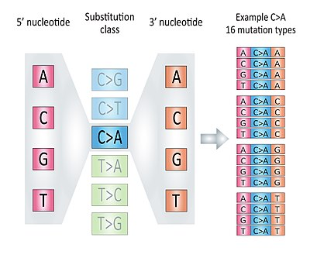
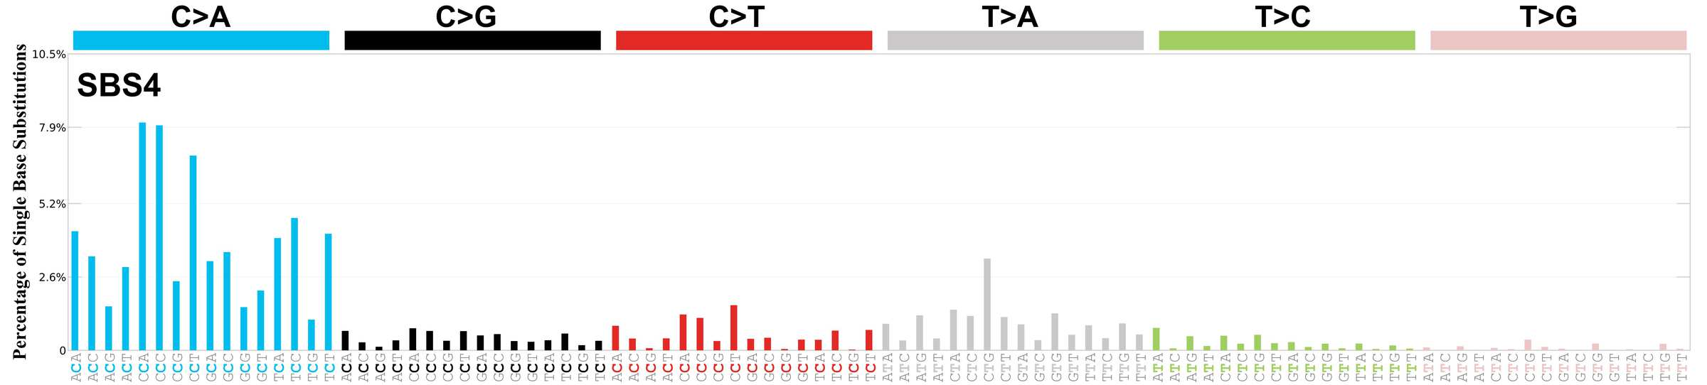
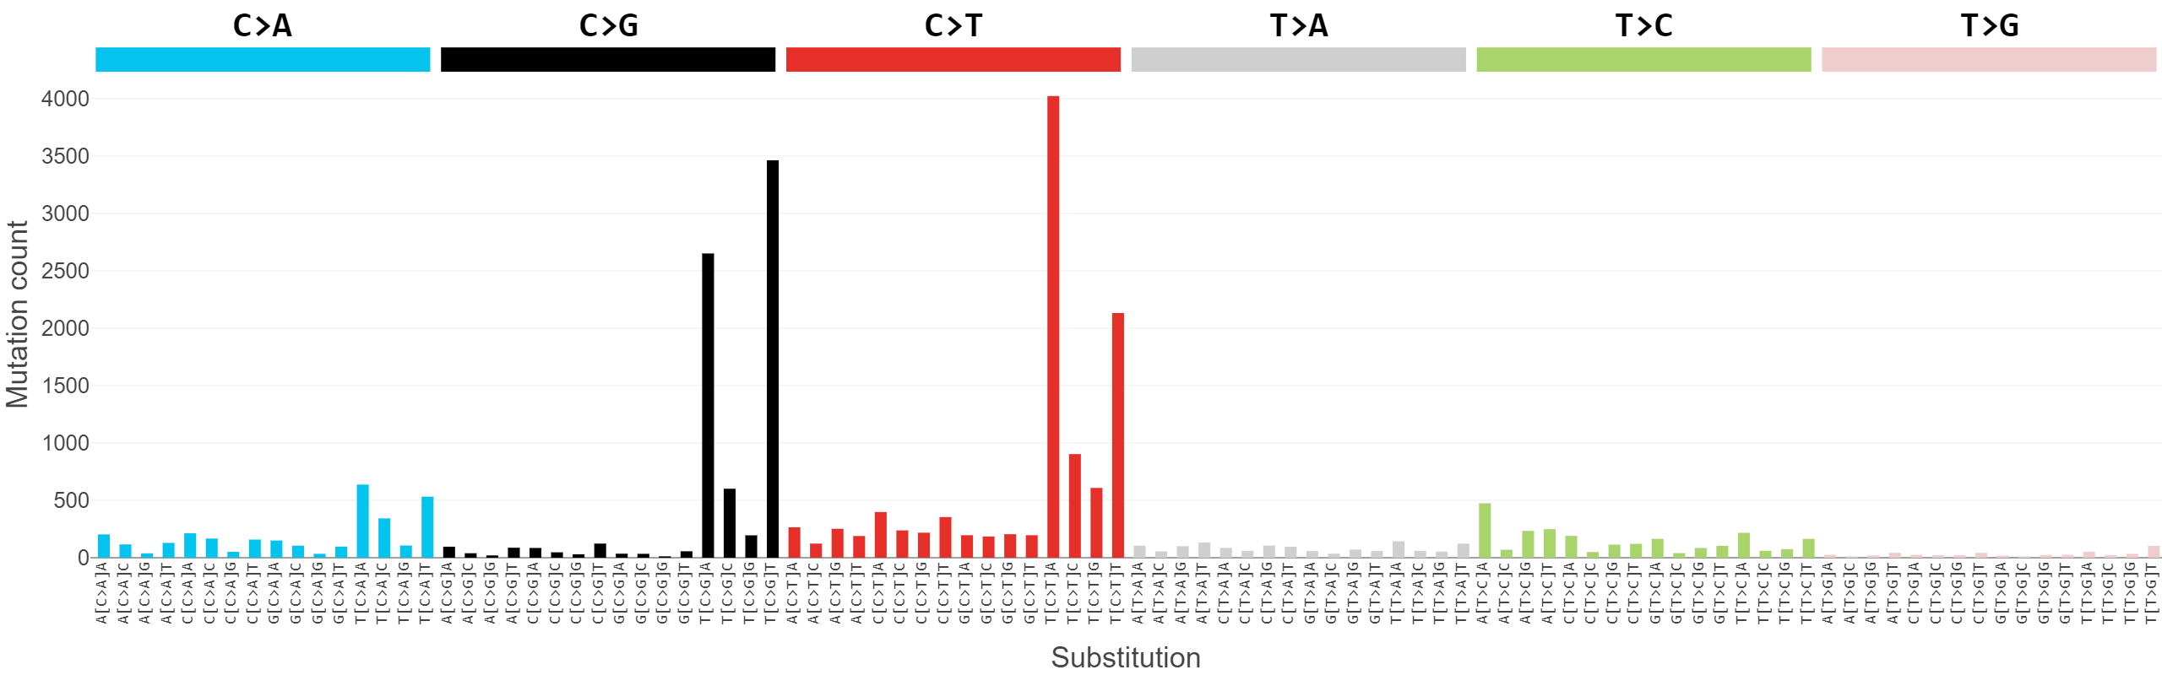
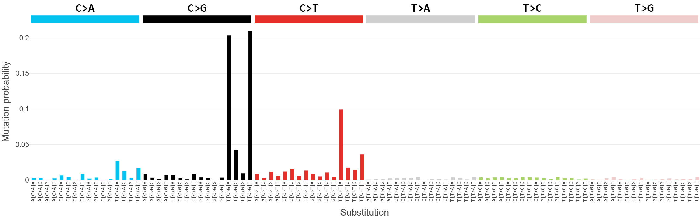
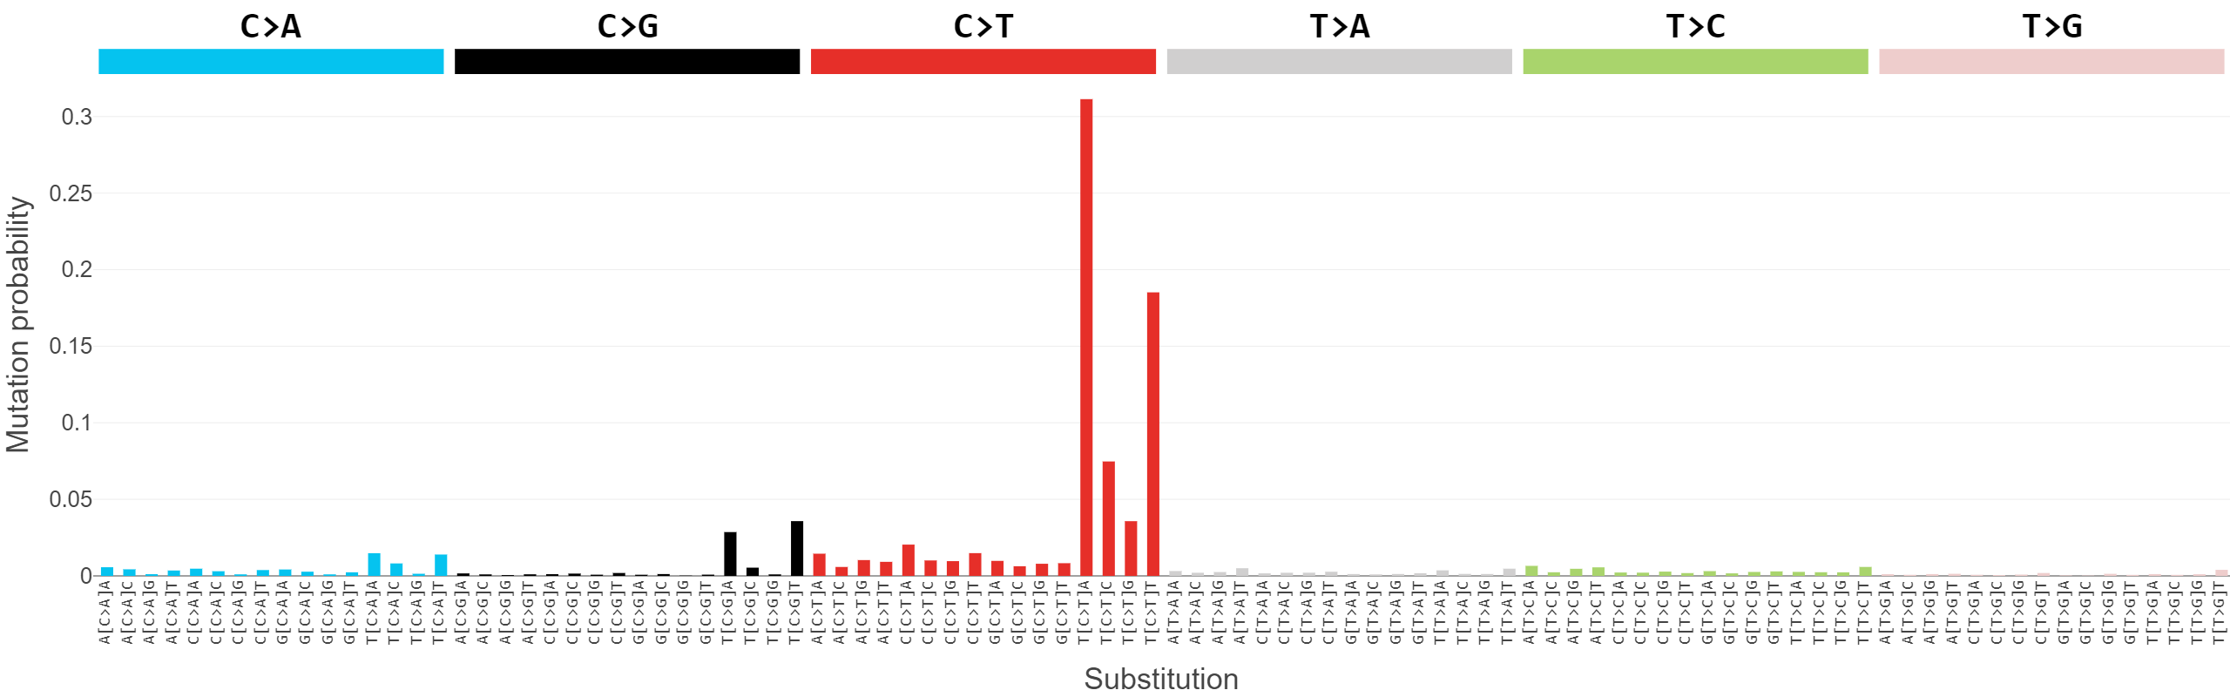
What makes a mutational signature??
Smoking signature characteristic in lung cancer
Typical bladder cancer mutational signature
APOBEC mutagenesis
SBS13
SBS2

Slide 7
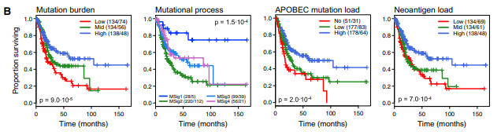
RESULTS
Figure 1 – Mutational profiling (WXS and CNA arrays)
Comments
MSig1 associated strongly with APOBEC

Slide 8
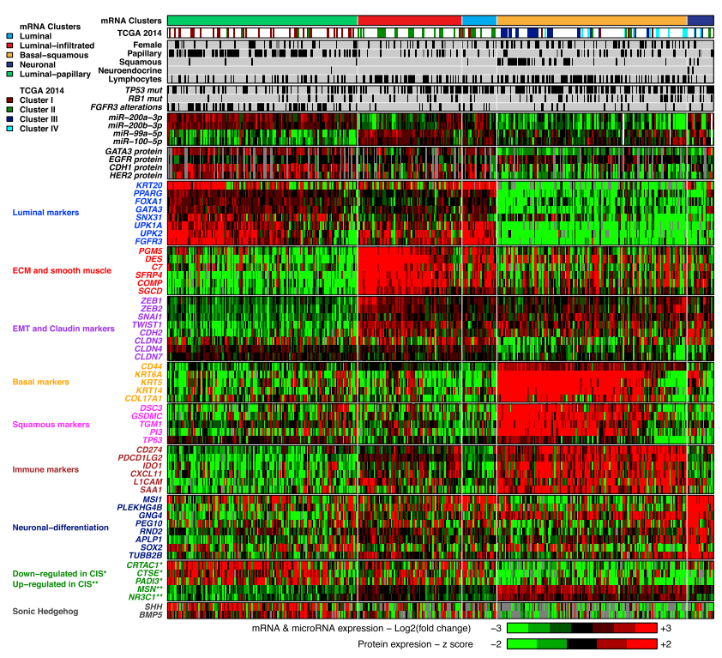
RESULTS
Figure 2 – Gene expression subtyping
Comments
Manual tweaking of k value
Indicative genes in heatmap not necessarily the most representative
Naming carries a lot of power

Slide 9
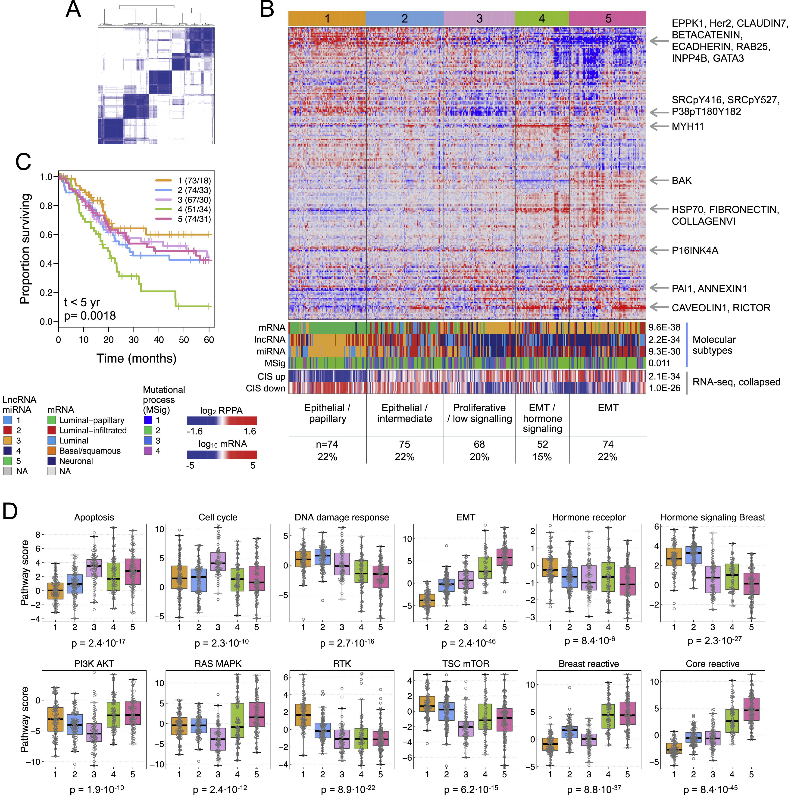
RESULTS
Figure S6 – protein (but not really proteomics)
Comments
RPPA is an antibody-based array
Not all tumours assayed (c.320)

Slide 10
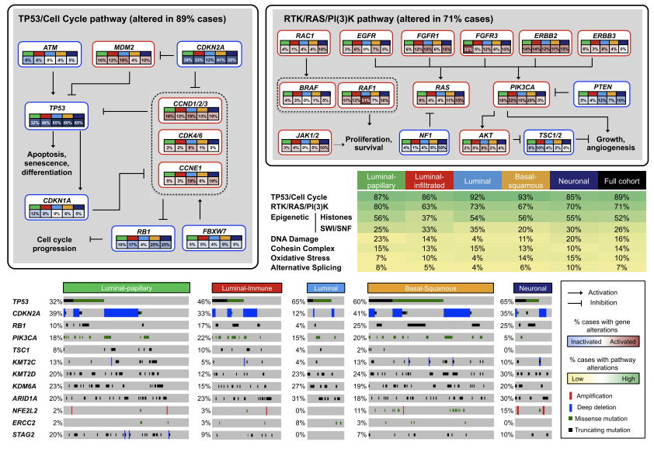
RESULTS
Figure 3 – Mutations and pathway alterations by subtype
Comments
Associations are non-exclusive
Differences for the pathways in different contexts?

Slide 11
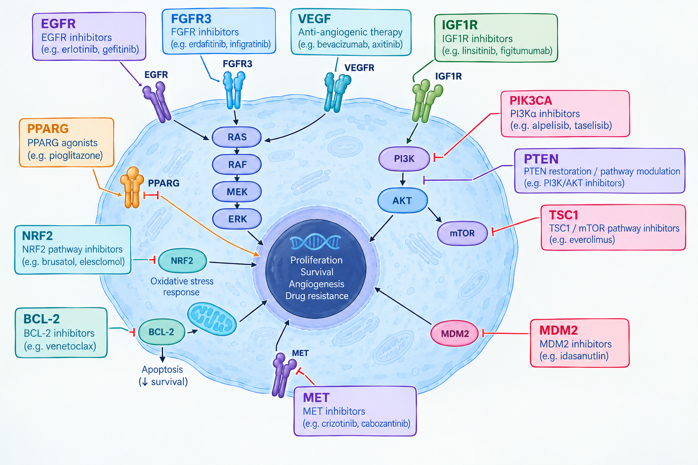
Useful context – pathways and failures

Slide 12
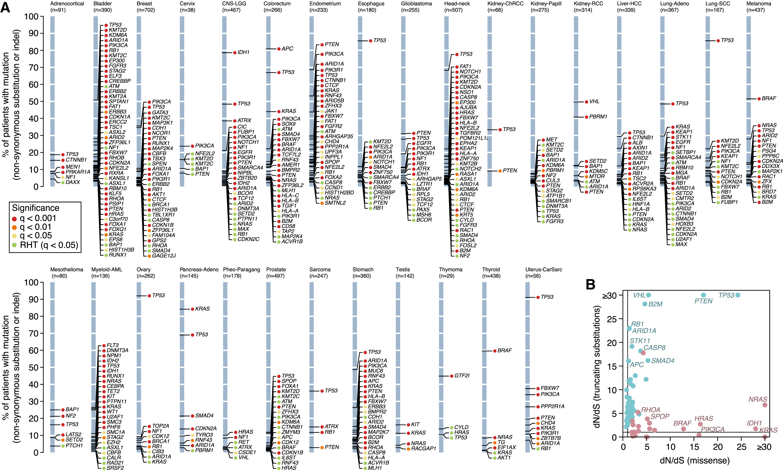
Driver genes → Martincorena et al 2017 paper

Slide 13
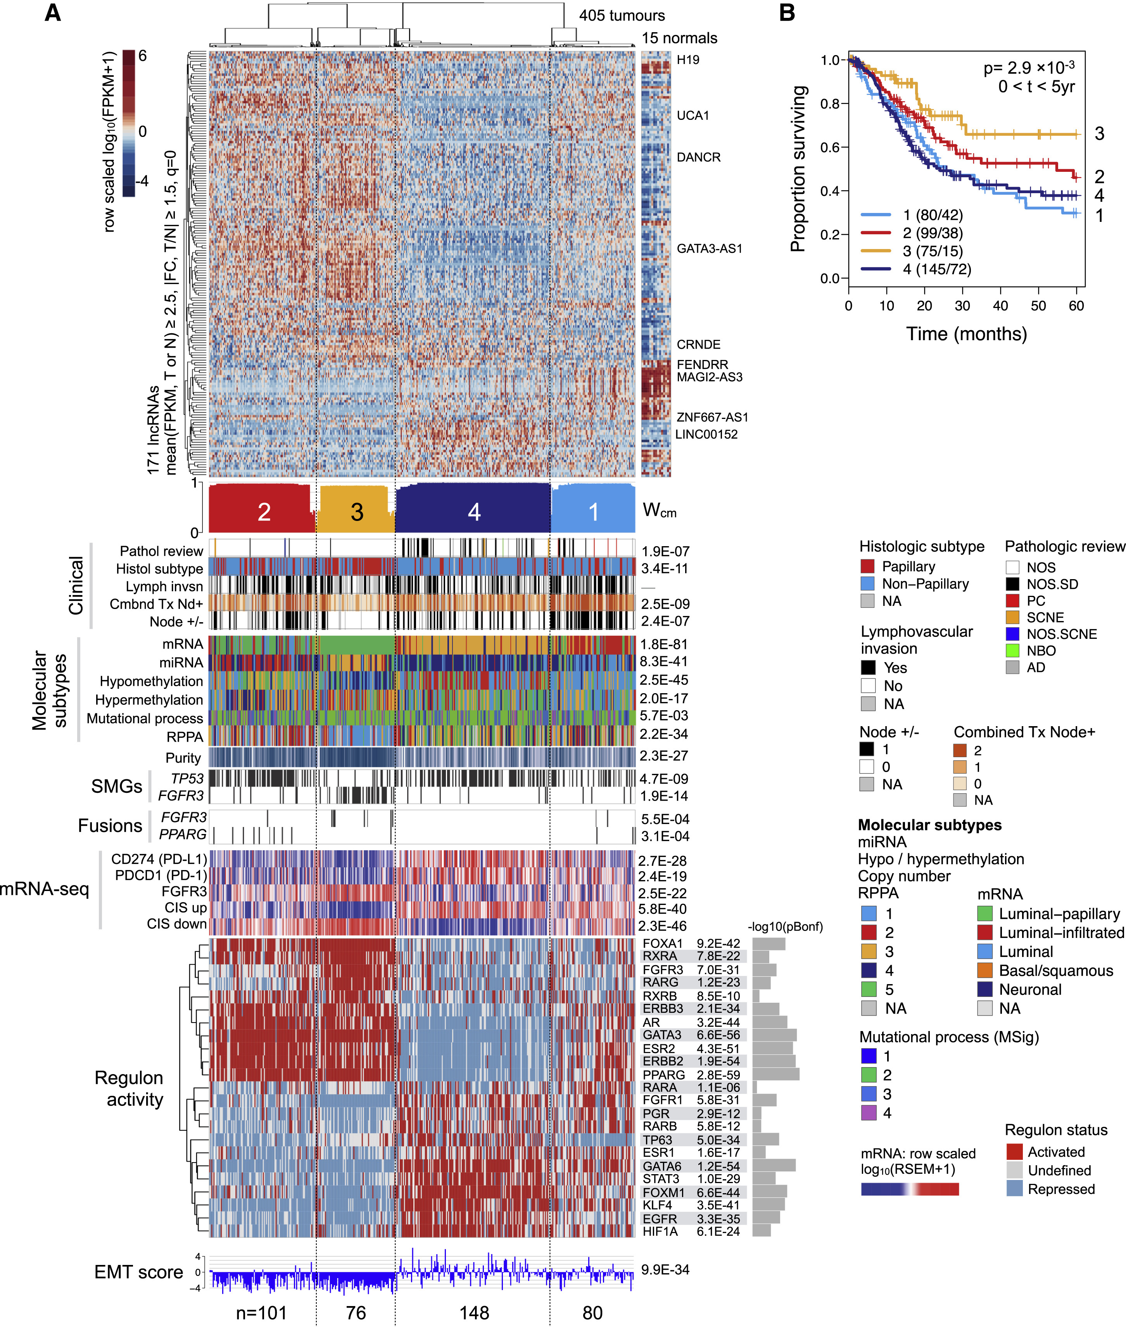
RESULTS
Figure 4 – lncRNA
Comments
Tree does suggest much greater separation
Normals not included in the tree clustering itself

Slide 14
RESULTS
Figure 4 – lncRNA
Comments
Does this simply reinforce the mRNA?

Slide 15
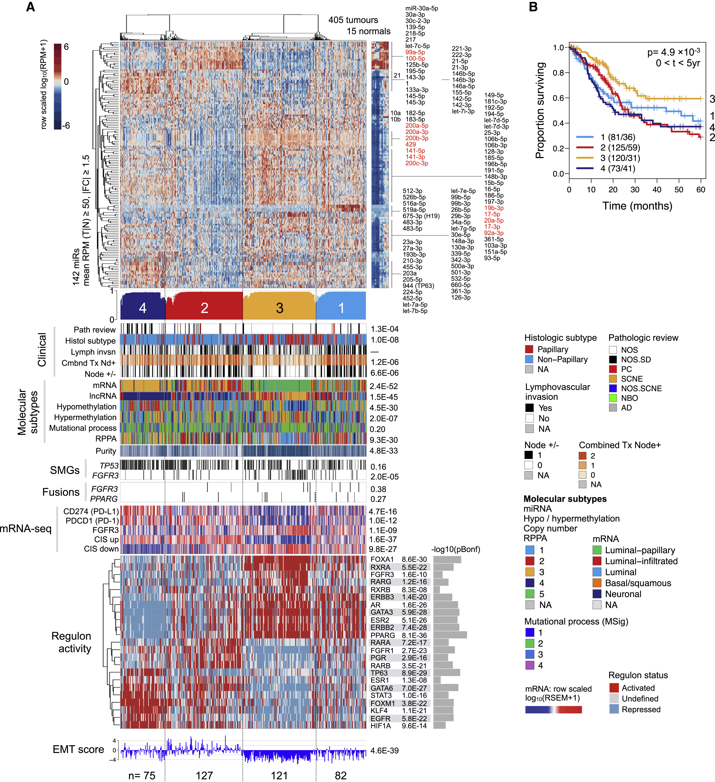
RESULTS
Figure 5 – miRNA
Comments
Similar mRNA reinforcement – but perhaps more mechanistic?

Slide 16
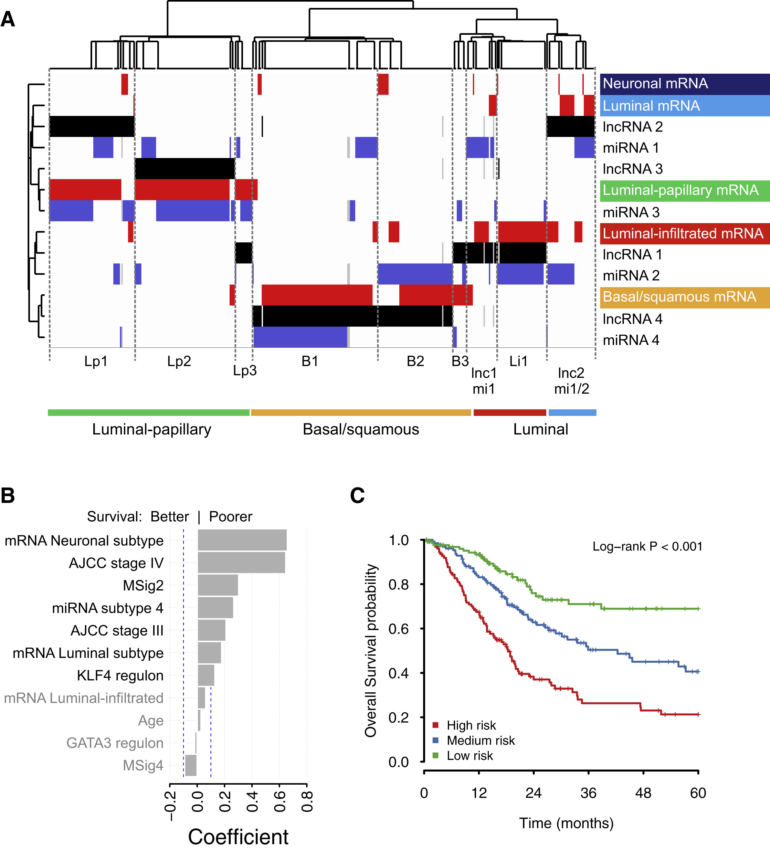
RESULTS
Figure 6 – Integrated data analysis?
Comments
Cluster of cluster assignment (COCA)

Slide 17
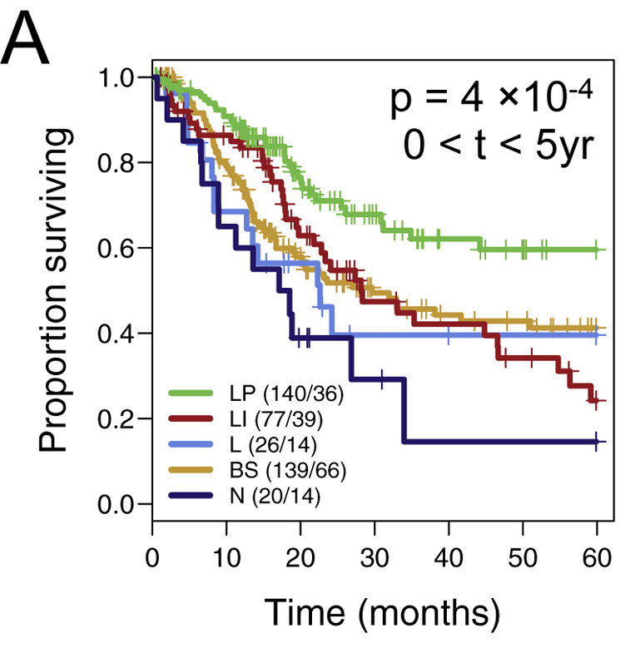
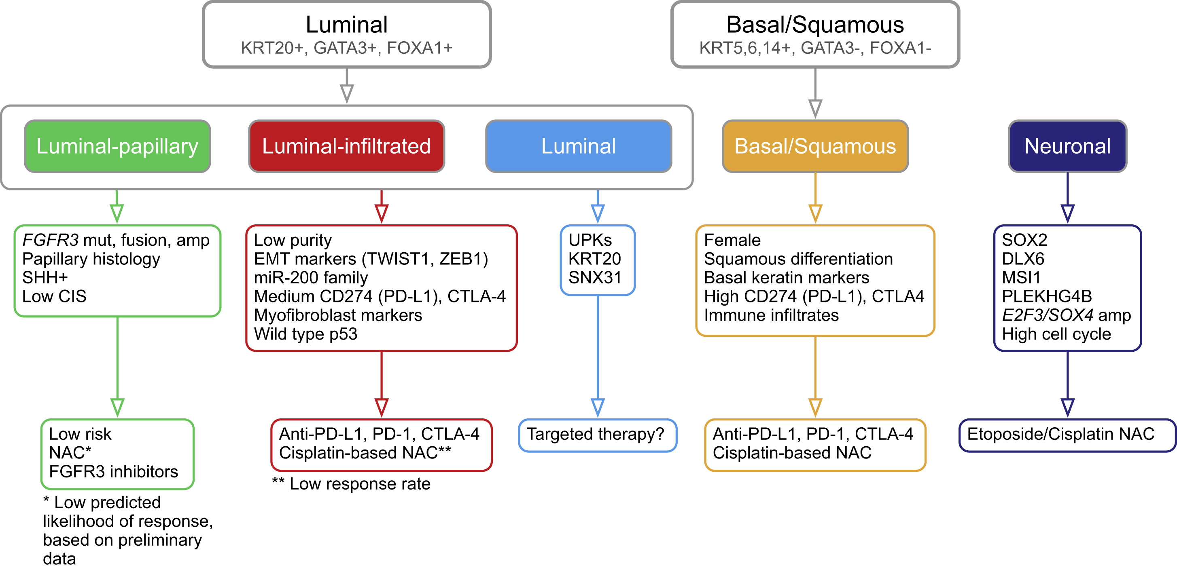
Key conclusions: routes to clinic
These data suggest a tendency/propensity towards certain treatments, rather than specific associations

Slide 18
Key conclusions
Clinical associations were correlations at best, with the study highlighting huge diversity
Molecular subtyping did not reveal groups de novo which the researchers were happy with, given the known biology
Not all data types were equally informative
For us
This is a huge dataset where we can test hypotheses!

