Slide 1
Introduction to Workshop 4: RNAseq
Genomics - BIO00087H
Workshop 4: RNAseq

Slide 2
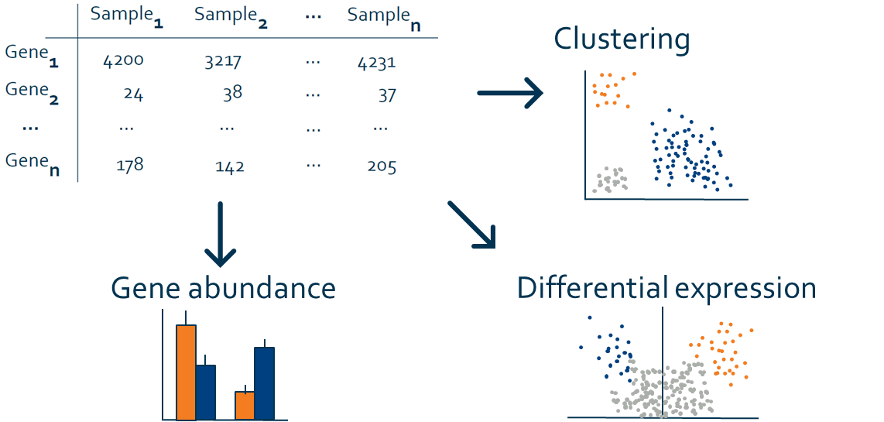
Transcriptomics – a brief lecture reminder
Bulk mRNAseq
What most people think of when they say RNAseq
Workshop 4: RNAseq

Slide 3
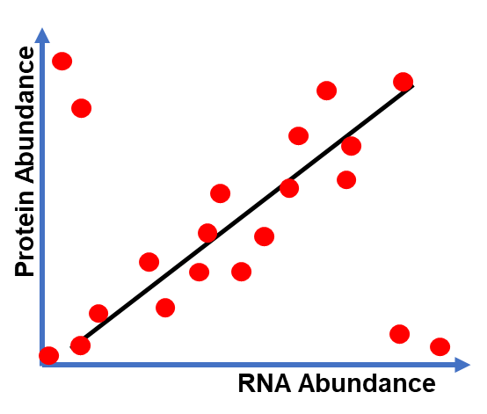
Transcriptomics – a brief lecture reminder
Bulk mRNAseq
What most people think of when they say RNAseq
Functional molecules in cells are hard to measure directly
RNA is easy and cheap to sequence and mostly indicative of phenotype
Workshop 4: RNAseq

Slide 4
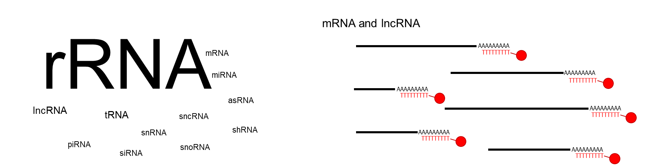
Transcriptomics – a brief lecture reminder
Bulk mRNAseq
What most people think of when they say RNAseq
Functional molecules in cells are hard to measure directly
RNA is easy and is mostly indicative of cellular phenotype
Combination of mRNA and lncRNA (both polyA)
Other RNAs still left in your library are technical noise
If you want to study other RNAs you need a different library prep (i.e. ribodep, sRNA)
Workshop 4: RNAseq

Slide 5
Workshop 4 – the plan
Quality check our sequencing data
(Pseudo)align our reads to a reference human transcriptome
Merge individual transcript expression to the gene-level
Differential expression analysis (DEA) of control and treatment groups
Gene set enrichment analysis (GSEA) to look at changing pathways
Workshop 4: RNAseq

Slide 6
Workshop 4 – the plan
Quality check our sequencing data
(Pseudo)align our reads to a reference human transcriptome
Merge individual transcript expression to the gene-level
Differential expression analysis (DEA) of control and treatment groups
Gene set enrichment analysis (GSEA) to look at changing pathways
Workshop 4: RNAseq

Slide 7
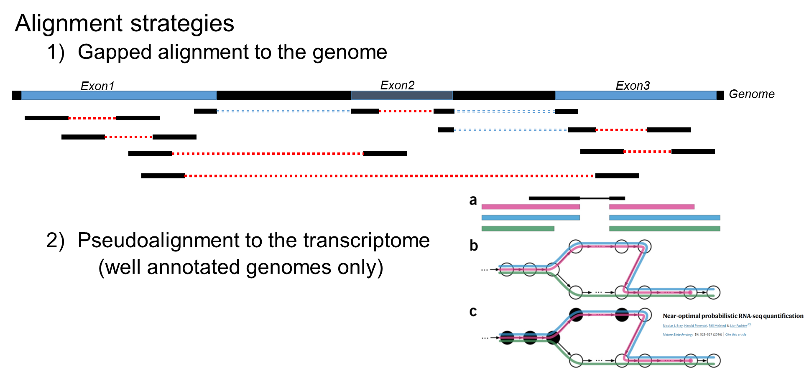
Pseudoalignment and transcript-level data
Very rapid and accurate mapping strategy → requires very well annotated genome
Workshop 4: RNAseq

Slide 8
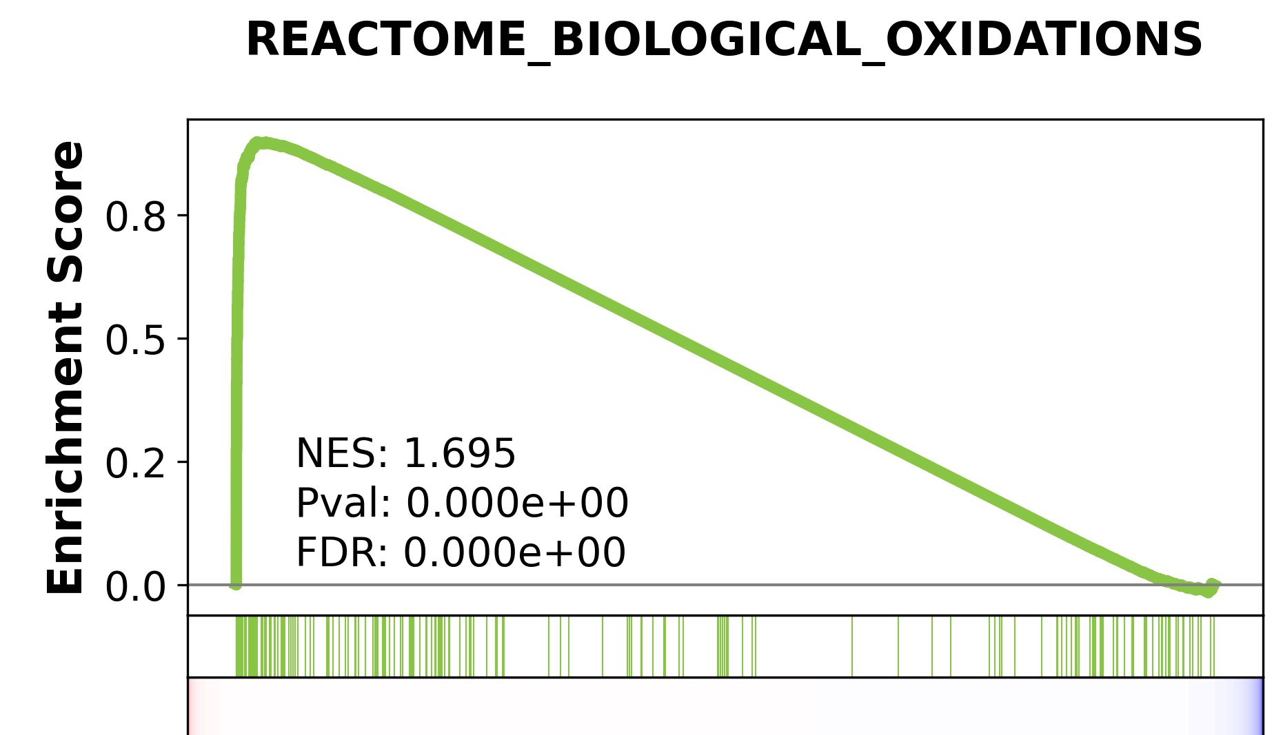
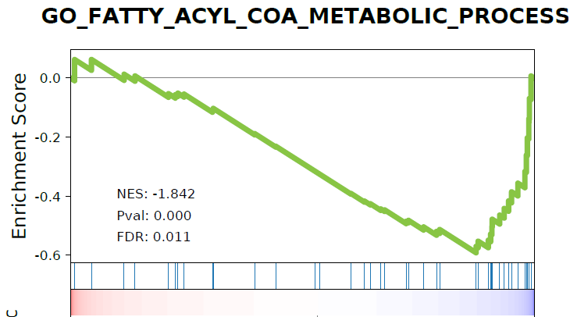
Gene Set Enrichment Analysis (GSEA)
Rather than googling every gene which is different between your groups, GSEA looks for “functional” groups of genes which are changing significantly
This saves a lot of time (but can be misleading)
The plots can be “a bit” gross
Workshop 4: RNAseq

Slide 9
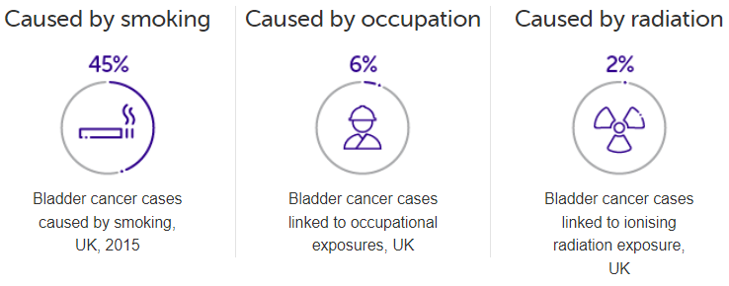
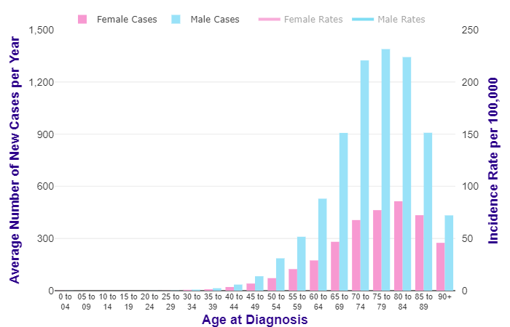

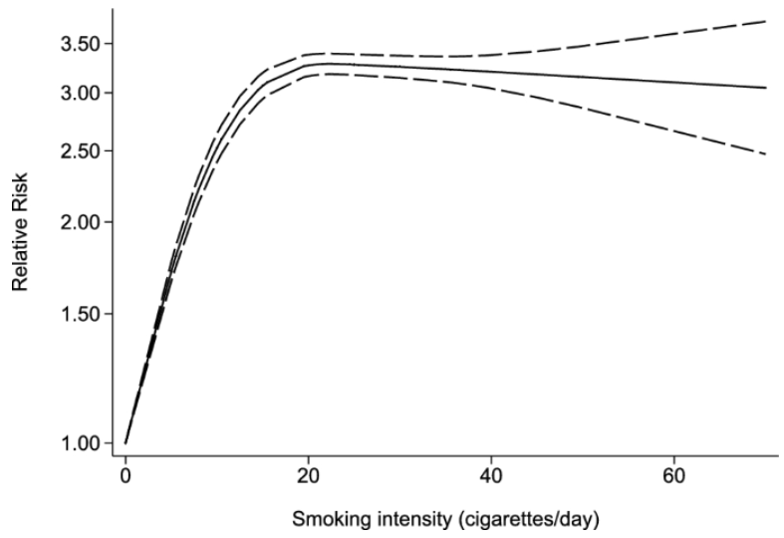
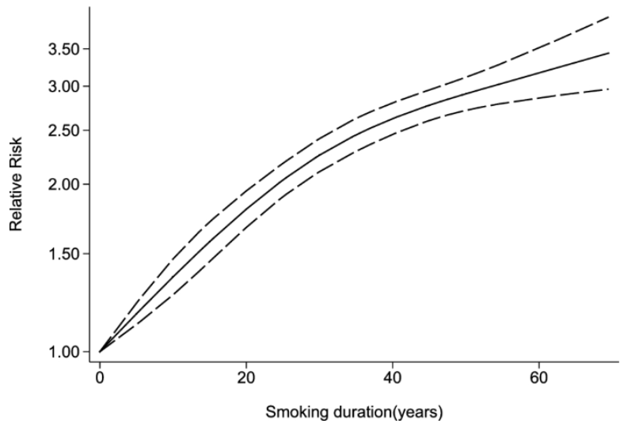
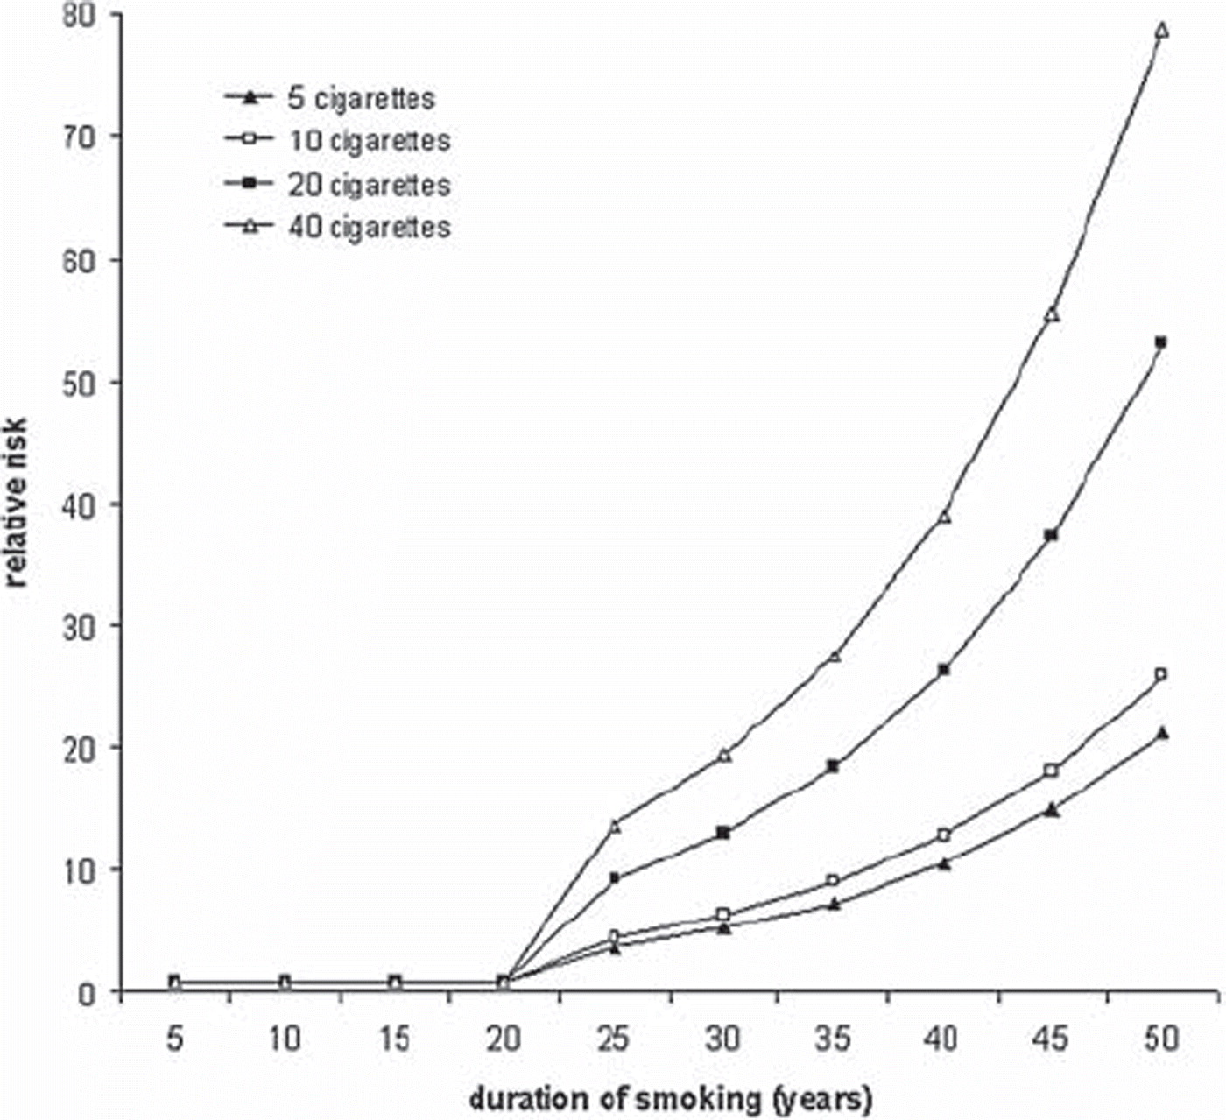
Workshop 4 – the question
Zhao et al (2022) meta-analysis in bladder cancer
PMID:35332429
Question – what causes bladder cancer?
Didkowska et al (2011; PMID:20553096) from data in Simonata et al (2001; PMID:11275995)
Smoking relationship different in lung cancer
Workshop 4: RNAseq

Slide 10
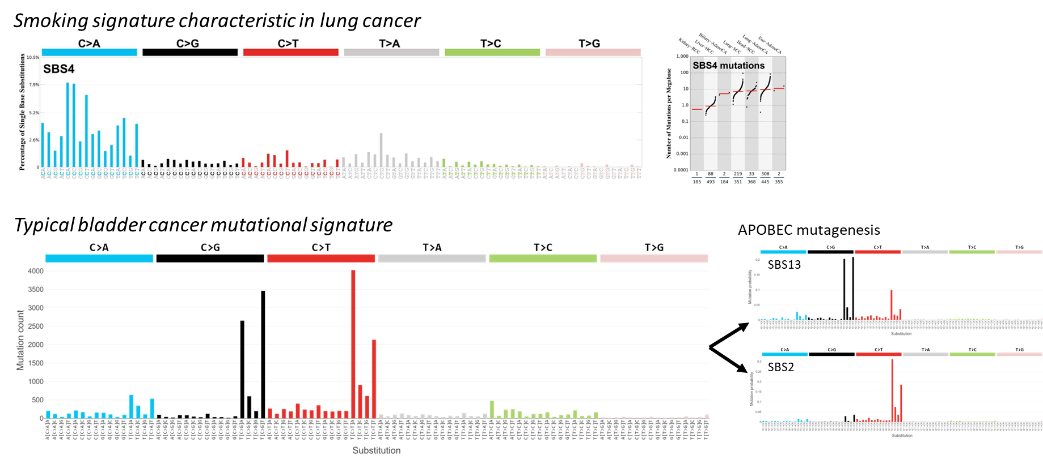
Workshop 4 – the question
Question – what causes bladder cancer?
Workshop 4: RNAseq

Slide 11
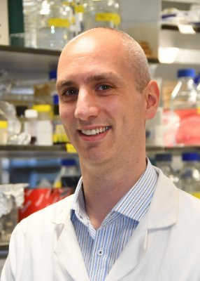

Workshop 4 – the question
Baker lab (York) – hypothesized a causative virus could be BK Polyomavirus (BKPyV)
A key issue here is that bladder cancers do not contain virus
HPV driven cancers do have bits of virus in them
BKPyV can infect human urothelial cells (bladder lining – originating cells in bladder cancer). BKPyV will kill the cells, but treating with IFNɣ can protect the cells (i.e. an innate immune response). BKPyV can be cleared from cells.
But what has BKPyV done to the remaining cells? Are they now pre-cancerous?
We did RNAseq to investigate this → what does infection do to the cells?
This is what you will investigate in today’s workshop.
Workshop 4: RNAseq

Slide 12
Choosing this workshop for your report
There are some helpful tips at the bottom of the workshop webpage.
Do not analyse the BKPyV dataset for your report!
I have provided a dataset from healthy human urothelial cells grown in hypoxic (low oxygen) or normoxic conditions.
You can find your own dataset if you want to.
Make sure you have permission. You shouldn’t use the dataset from your BSc capstone project. You could choose anything, but stick with human data – we have provided the necessary reference datasets for human, but not anything else.
How do I get the excellence criteria?
Extend your analysis beyond what we’ve given you. Think critically. Think biologically. Do something interesting!
Workshop 4: RNAseq

Slide 13
Get started!
Reboot into Linux if you haven’t already
Follow the guide carefully (check where you are and check for typos)
Think about the biology and ask us questions!
Workshop 4: RNAseq

