Slide 1
Introduction to Workshop 5: scRNAseq
Genomics - BIO00087H
Workshop 5: scRNAseq

Slide 2
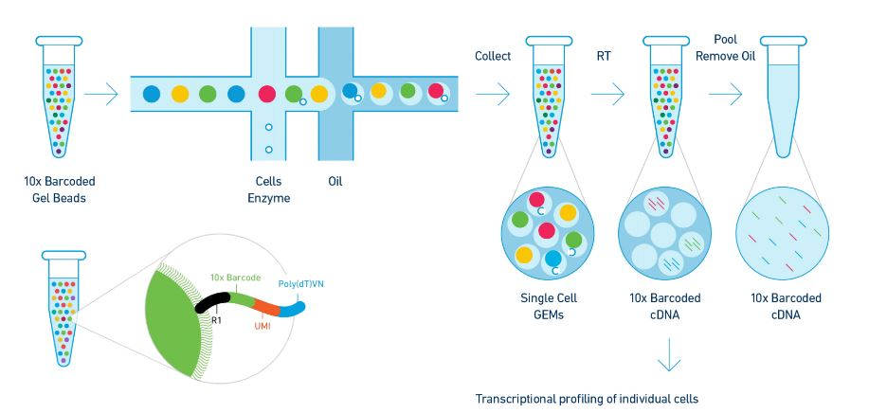
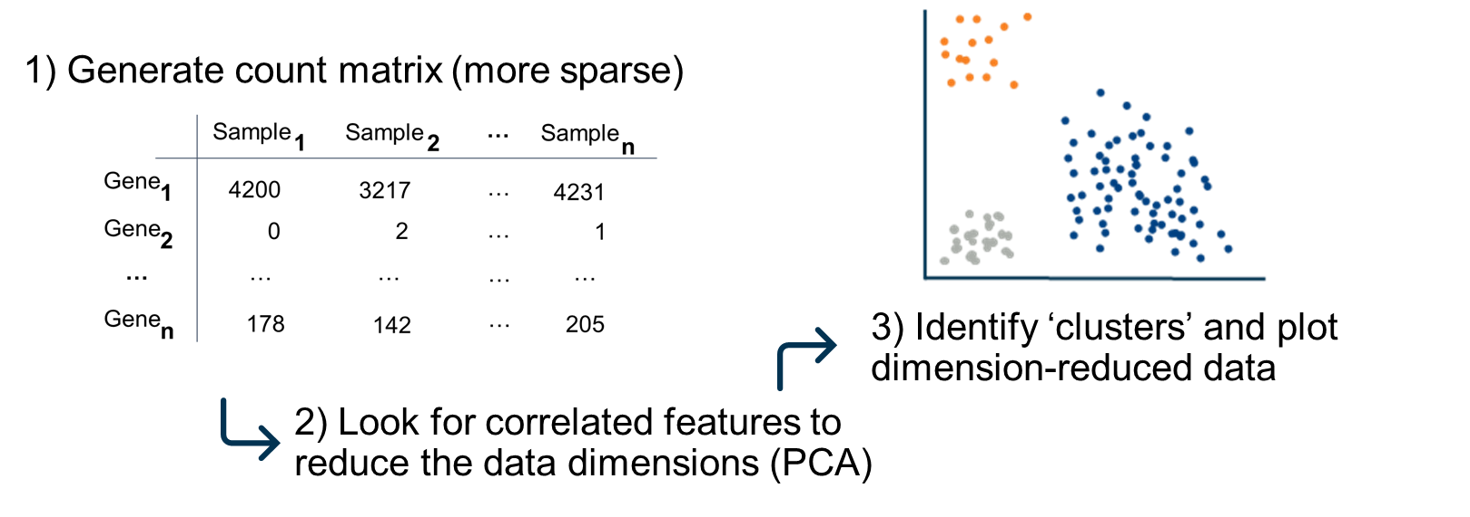
scRNAseq – lecture reminders
Rather than taking an average of a cell population, we profile individual cells
distinguish cells in a mixed population
distinguish differential cell states in a mixed population
10x Genomics – oil droplet library preparation
Workshop 5: scRNAseq

Slide 3
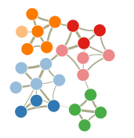
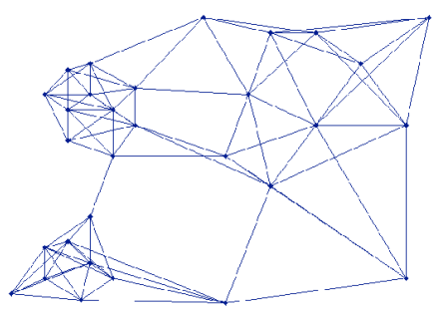
scRNAseq – lecture reminders
After QC, we look for shared features (i.e. expression patterns) in individual cells and use that to form cell ‘communities’ or ‘clusters’
The space between clusters is (largely) arbitrary – we space them out so they look nice
Detection algorithms require you to know guess how many clusters you have, and then you need to annotate them.
Workshop 5: scRNAseq

Slide 4
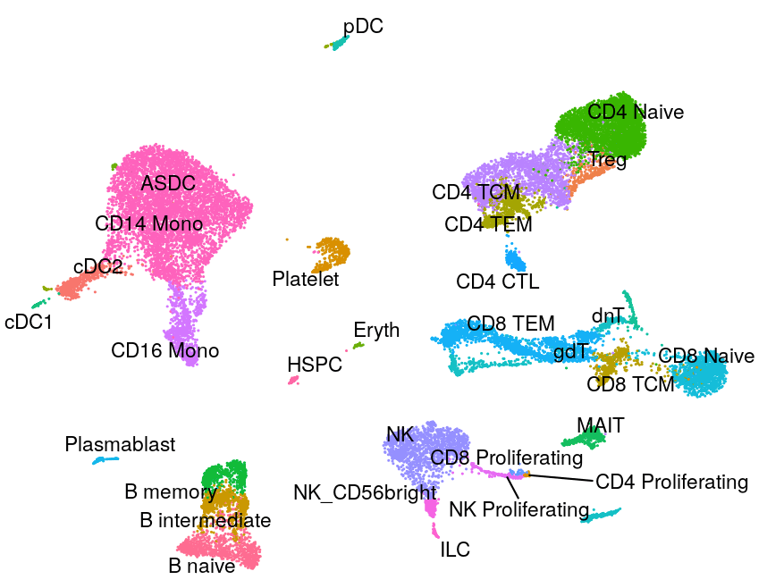
scRNAseq – lecture reminders
Annotation requires a lot of domain-specific knowledge, and very careful curation
Very well characterised PBMCs (Human/Mouse)
Workshop 5: scRNAseq

Slide 5
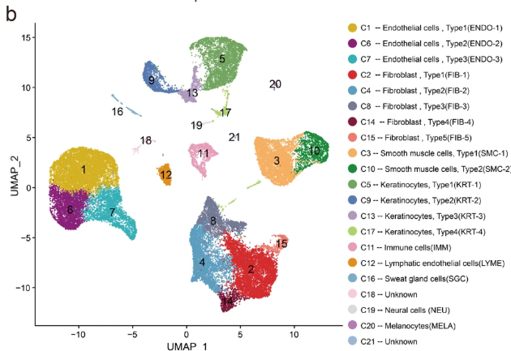
scRNAseq – lecture reminders
Annotation requires a lot of domain-specific knowledge, and very careful curation
Very well characterised PBMCs (Human/Mouse)
Defensible/reproducible sub-clusters??
Smooth muscle
Endothelial cells
Fibroblasts
Think about narrative and over-interpretation!
Workshop 5: scRNAseq

Slide 6
Workshop 5 – the plan
Prepare your Linux directory structure, but then launch RStudio
Load, quality check and filter your dataset
Integrate the two datasets together, find informative genes
Find and annotate cell communities
Understand cell cycle state of all cells
Compare the epithelial cancer cell transcriptomes between samples
Workshop 5: scRNAseq

Slide 7
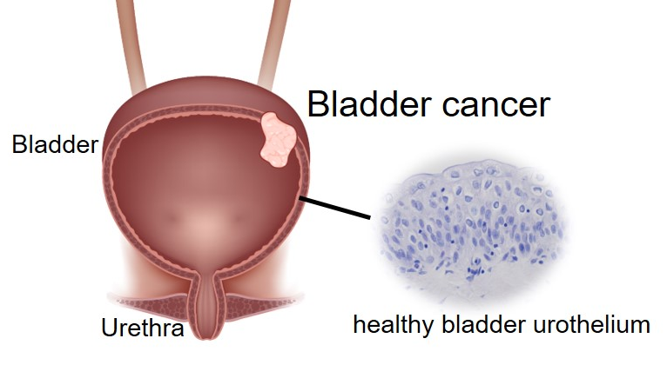
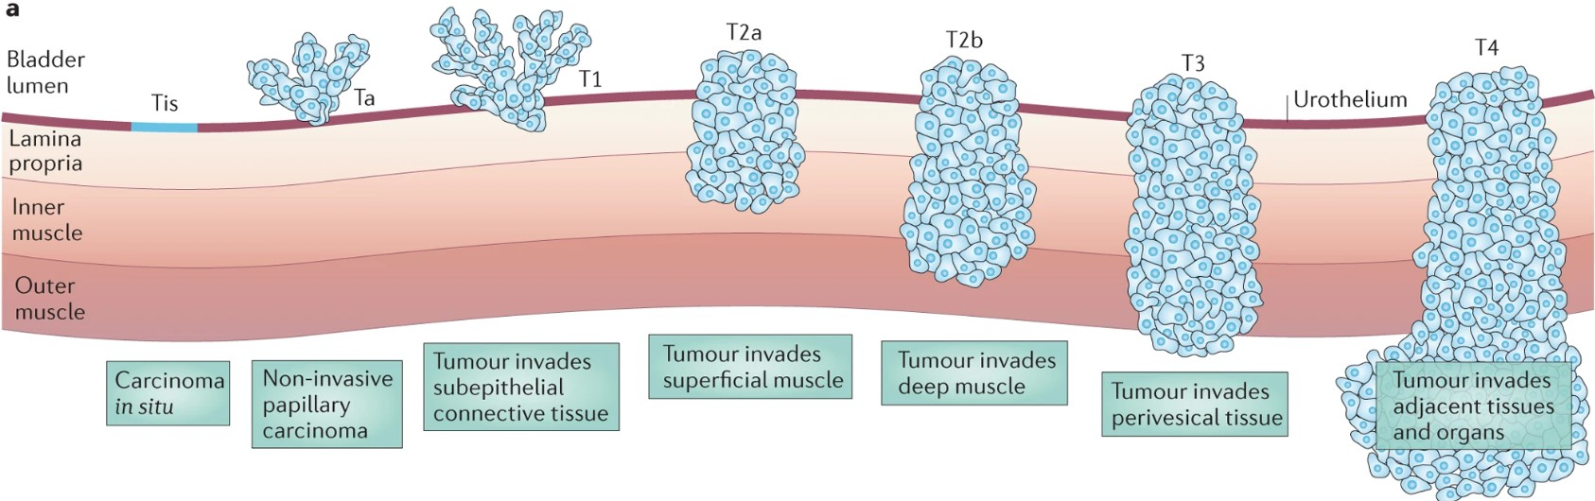
Workshop 5 – the question
Location and stages of bladder cancer
80% BLCA are Ta/T1 at initial presentation
>50% recur and ~10% progress to T2+
Workshop 5: scRNAseq

Slide 8
Workshop 5 – the question
Location and stages of bladder cancer
80% BLCA are Ta/T1 at initial presentation
>50% recur and ~10% progress to T2+
Today we will compare T1 and T3 tumours – trigger to muscle-invasive disease (remember this is n=1…)
Workshop 5: scRNAseq

Slide 9
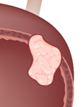
Workshop 5 – the question
Some (biological) thoughts/considerations:
Extrapolating from 1 sample to a whole disease state
Tissue sampling bias vs biological differences
What other information might we need?
Limits of detection
If a gene is not detectable, is it absent?
Tissue/disease heterogeneity
Site 1
low tumour purity
adjacent tissue included
unclear origin of non-epi cells
Site 2
high tumour purity
infiltrating cells are really infiltrating
Sometimes you simply cannot address these issues in your analysis. That’s ok! (if you don’t over-interpret in your results & discussion)
Site 3
different subclone contributions to site 2?
Workshop 5: scRNAseq

Slide 10
Choosing this workshop for your report
There are some helpful tips at the bottom of the workshop webpage.
Do not analyse the workshop BC2 vs BC5 dataset for your report!
I have provided four datasets, each able to address different questions in bladder cancer. You can analyse multiple sets, and you can compare with today’s workshop results, but analyse them separately and then compare – don’t try to combine within Seurat.
You can find your own dataset if you want to.
Make sure you have permission. You shouldn’t use the dataset from your BSc capstone or MBiol group project. You could choose anything, be careful about gene names (e.g. PPARG vs Pparg in human vs mouse), and availability of reference datasets (GSEA etc.)
How do I get the excellence criteria?
Extend your analysis beyond what we’ve given you. Think critically. Think biologically. Do something interesting!
Workshop 5: scRNAseq

Slide 11
Get started!
Reboot into Linux if you haven’t already
Follow the guide carefully (check where you are and check for typos)
Think about the biology and ask us questions!
Workshop 5: scRNAseq

