Slide 1
USAFRICOM COVID-19 Trends for Selected Countries June 4, 2021 The overall classification of this briefing is: UNCLASSIFIED
Point of Contact: DTRA Operations and Integration Department
703-995-3063

Slide 2
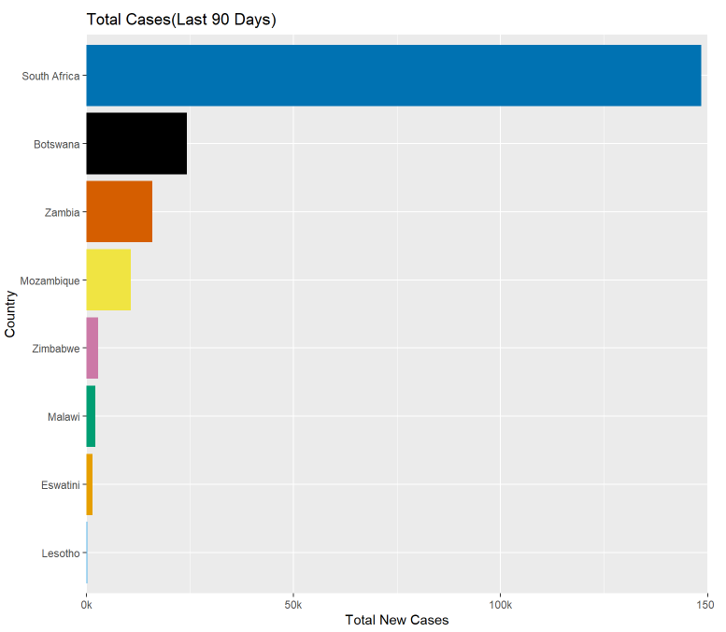
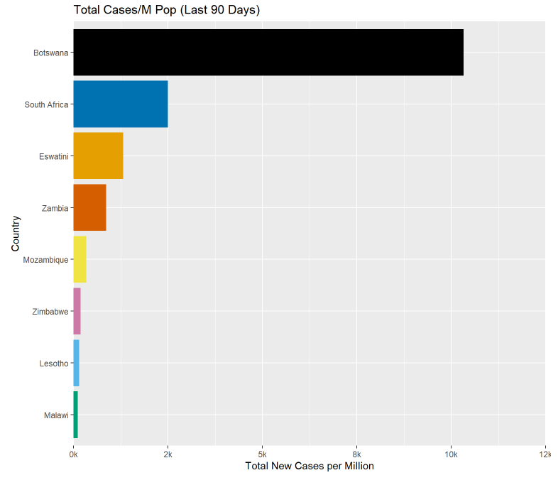
USAFRICOM Metrics (Selected Countries)
Summary:
South Africa’s new cases have fallen this week, but have generally been rising. South Africa, Zambia, and Botswana are at risk of a third wave, with cases creeping up recently. Positive test rates have been rising in South Africa, Zambia, and Mozambique. South Africa’s rising test positivity, coupled with falling numbers of new cases, could indicate better targeted testing of people who are actually showing symptoms.
Country | New Cases | New Cases /1M Pop
South Africa | 148,386 | 2,502
Botswana | 24,291 | 10,329
Zambia | 15,979 | 869
Mozambique | 10,714 | 343
Zimbabwe | 2,831 | 190
Malawi | 2,243 | 117
Eswatini | 1,527 | 1,316
Lesotho | 324 | 151
Data from: https://ourworldindata.org/coronavirus

Slide 3
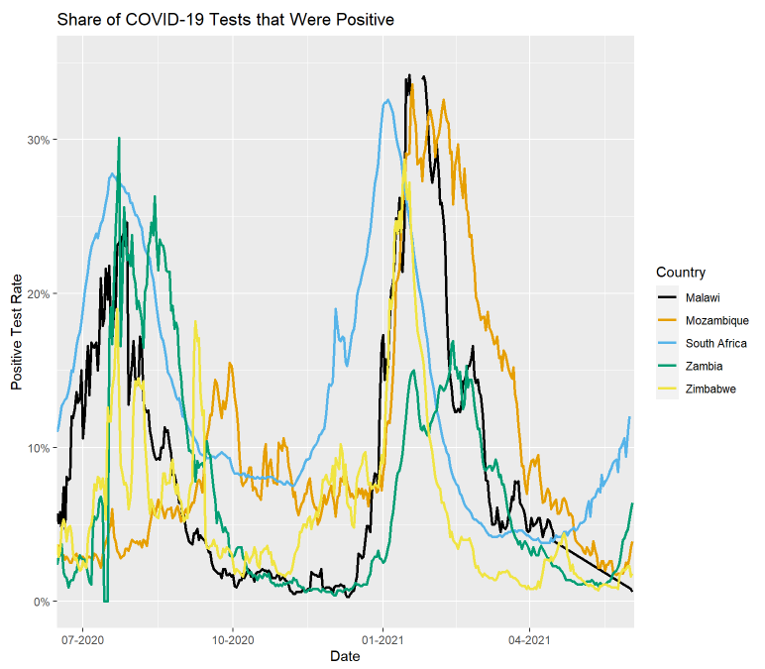
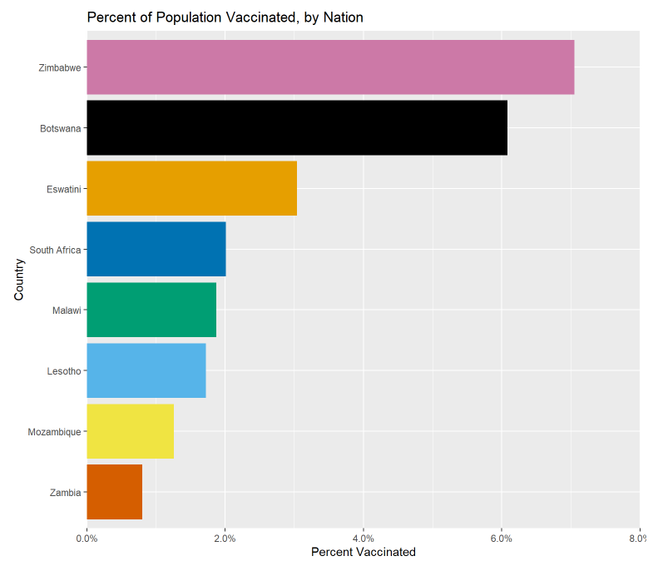
USAFRICOM Vaccinations, Positivity, and Deaths (Selected Countries)
Country | Total Deaths | Total Deaths /1M Pop
South Africa | 56,601 | 954
Zimbabwe | 1,604 | 108
Zambia | 1,288 | 70
Malawi | 1,156 | 60
Botswana | 866 | 368
Mozambique | 837 | 27
Eswatini | 673 | 580
Lesotho | 326 | 152
Data from: https://ourworldindata.org/coronavirus

Slide 4
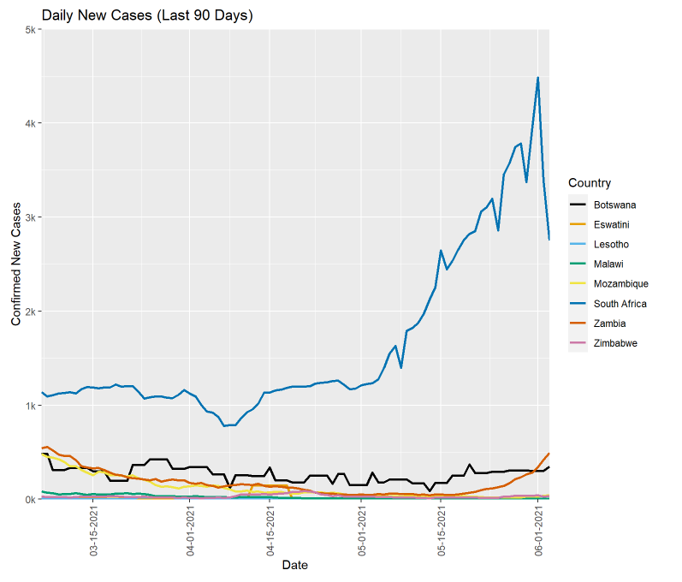
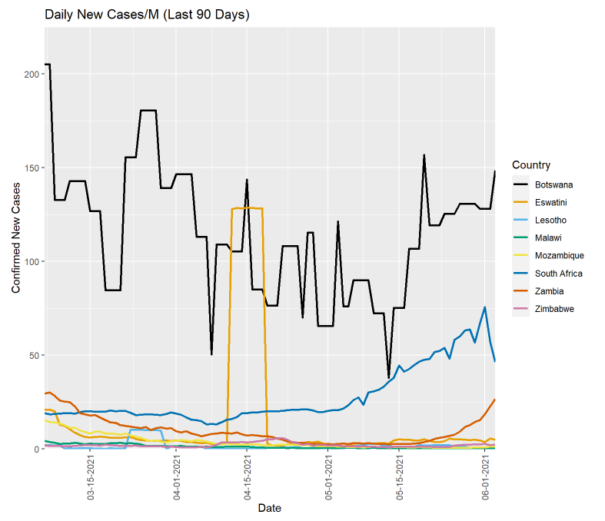
USAFRICOM 90 Days in Cases (Selected Countries)

Slide 5
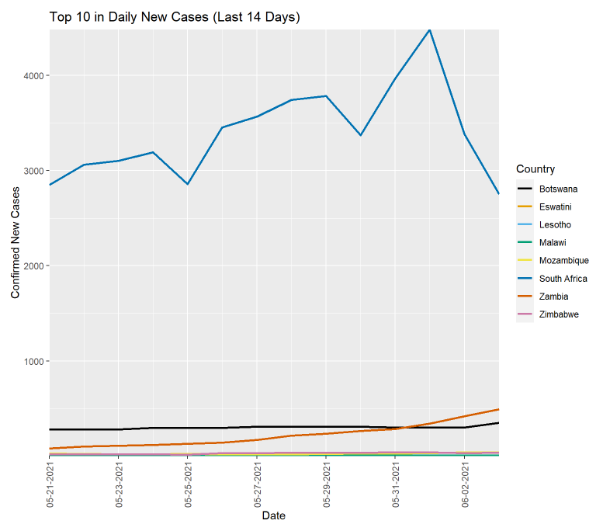
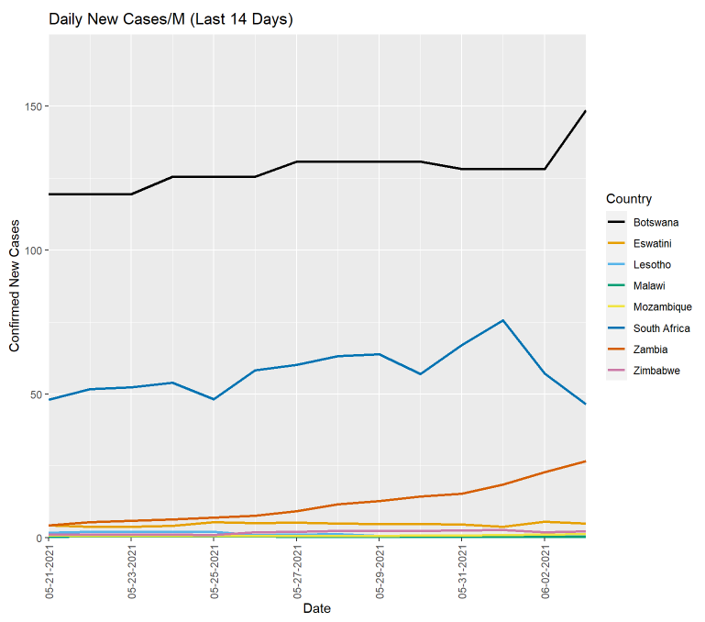
USAFRICOM 14 Days in Cases (Selected Countries)

