Slide 1

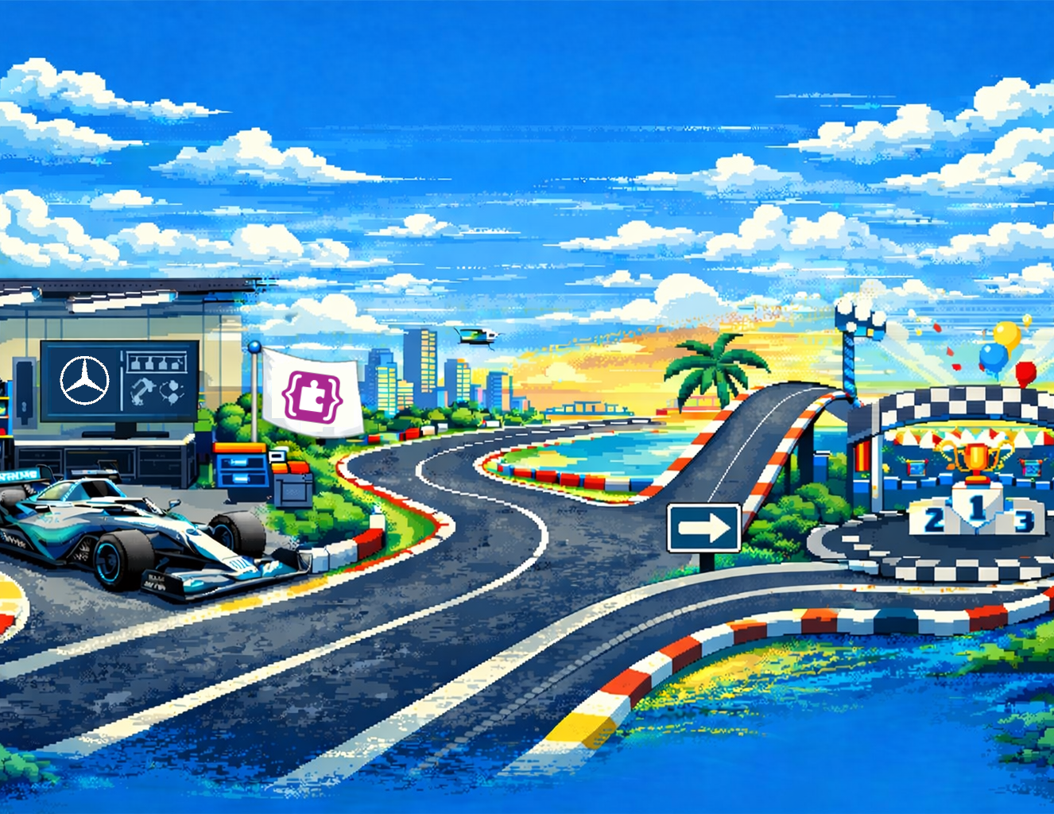



Certificate of Completion
This certificate is proudly awarded to
for completing the Driven by STEM MakeCode Arcade Experience and demonstrating creativity, problem-solving, engineering thinking, and persistence through design, testing, and iteration.
Awarded to:
Avery, Casey, Drew, Jordan, Kai, Morgan, Riley, Sam, and Taylor
Your Driven by STEM Guide Team

