Slide 1

clipsmith
Where creators build careers, not just followings.
AI-native short-form video, creator-first economics, professional editing in your pocket.
$3.5M seed
18-month runway
iOS launch Q3 2026
Confidential investor materials · prepared April 2026

Slide 2
01 · The problem
Short-form video became a billboard for ads, not a career for creators.
Opaque payouts
Toy-grade editing
No path to revenue
TikTok's Creator Fund pays $0.02–$0.04 per 1,000 views. Most creators have no idea what they will be paid until the cheque clears.
In-app editors stop at trim + filters. Anyone serious exports to CapCut, Premiere, or Final Cut. The market splits the value.
Sub-100k creators can't tip, can't sub, can't sell. Brand-deal matching is a Discord DM, not a marketplace.
#1
#2
#3
clipsmith · seed round · confidential
2 / 10

Slide 3
02 · Solution
An AI-native, creator-first video platform — built end-to-end, not bolted on.
Pro editor in 90s
Transparent 70/30
Discovery you can read
Multi-track timeline, AI captions, scene detection, voice de-noise, BG removal, chroma-key — all on-device or server-side, no export.
Tipping (Stripe), subscriptions (Apple IAP), brand-deals, premium content. Creators see exactly which signal earned them what.
Algorithm exposes the four feature scores per video — interest, virality, freshness, community — so creators can optimise without guessing.
30k LOC backend · 14k LOC frontend · 90 SQL tables · 498 unit + 10 e2e tests · 5 architectural contracts · all CI green
clipsmith · seed round · confidential
3 / 10

Slide 4
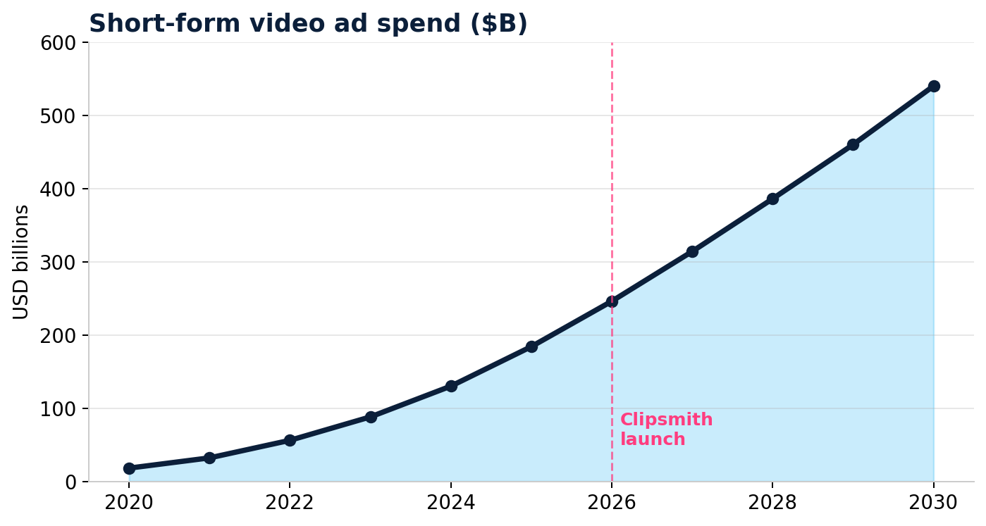
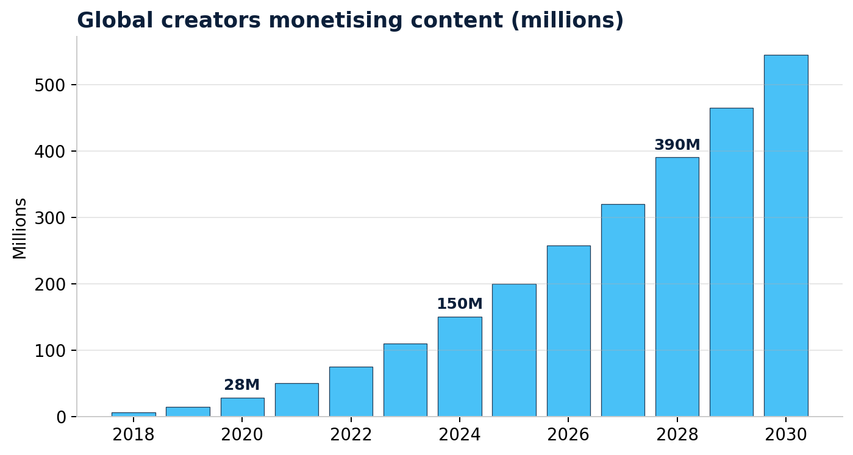
03 · Why now
The market just hit the inflection. Bottoms-up, every signal points the same way.
$540B
short-form ad spend by 2030
545M
creators monetising by 2030
17%
TikTok-share at risk to creator-revolt
9-10mo
to ship full-stack vs. legacy 24mo
clipsmith · seed round · confidential
4 / 10

Slide 5
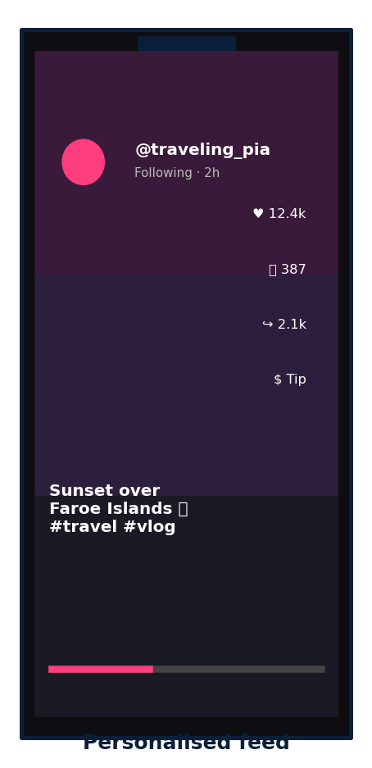
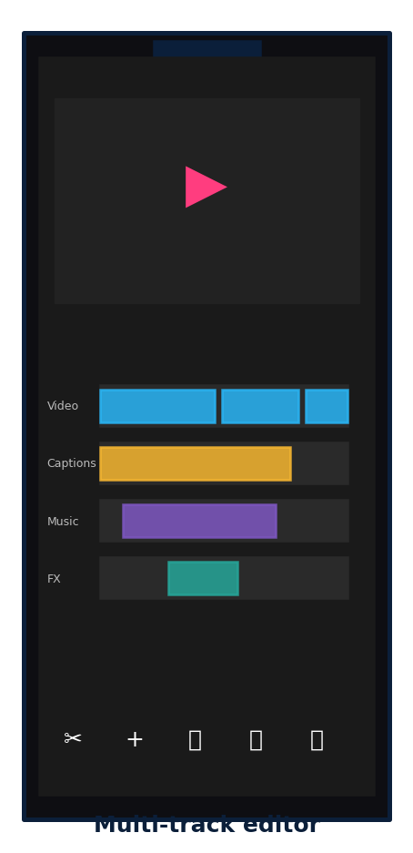
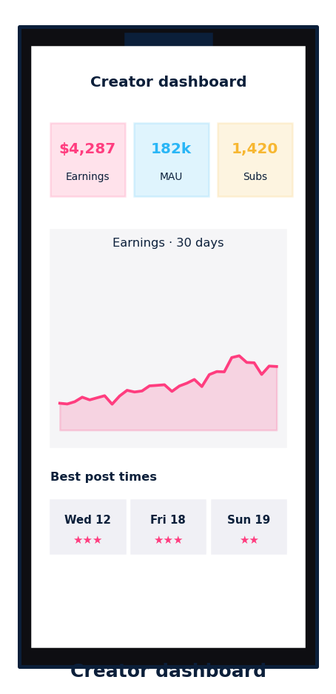
04 · Product
Three surfaces, one codebase — feed, edit, monetise.
Feed
Editor
Dashboard
clipsmith · seed round · confidential
5 / 10

Slide 6
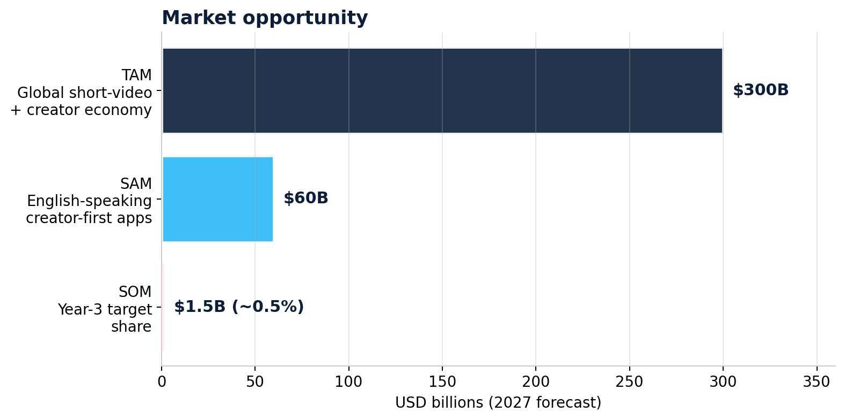
05 · Market
$300B TAM. $60B SAM. We need 0.5% to be a unicorn.
How we scale into it
Year 1
iOS launch, EN markets, niche-down to one creator vertical (lifestyle / cooking).
Year 2
Android + Web, Spanish + Portuguese localisation. Brand marketplace GA.
Year 3
International — Europe + LATAM. Creator Fund 2.0 at scale, ~$100M paid out.
clipsmith · seed round · confidential
6 / 10

Slide 7
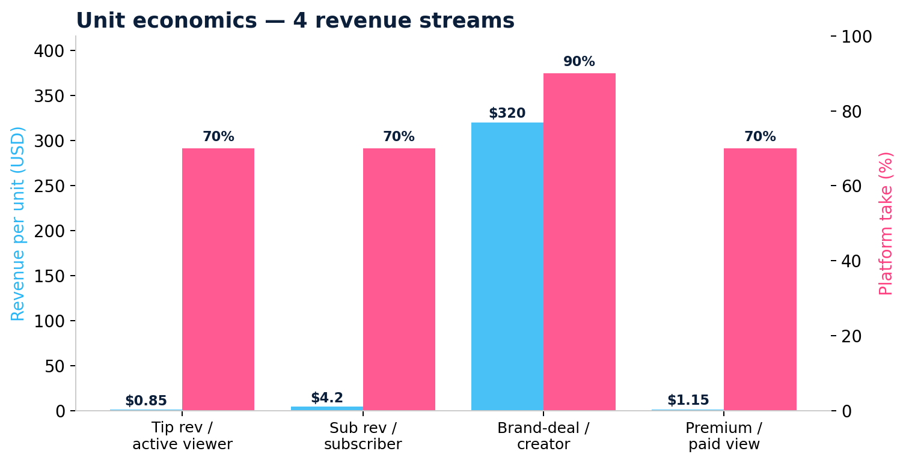
06 · Business model
Four revenue streams. Diversified by design.
Take rates
Tipping
30%
Stripe Connect, identifiable humans
Subscriptions
30% (Apple); 5% (web)
Apple IAP for iOS, Stripe for web
Brand deals
10%
Marketplace fee, escrow
Premium content
30% (Apple); 15% (web)
Same routing as subs
clipsmith · seed round · confidential
7 / 10

Slide 8
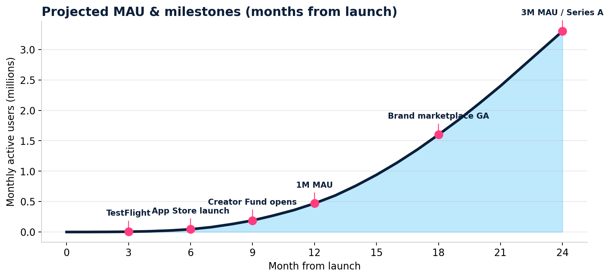
07 · Traction & roadmap
Code-complete. 6 architectural phases shipped. CI green. Month 0 = today.
Phases 0-6 ✓
498 unit tests ✓
import-linter ✓
FFmpeg pipeline ✓
Stripe + IAP ✓
Live + duets ✓
clipsmith · seed round · confidential
8 / 10

Slide 9
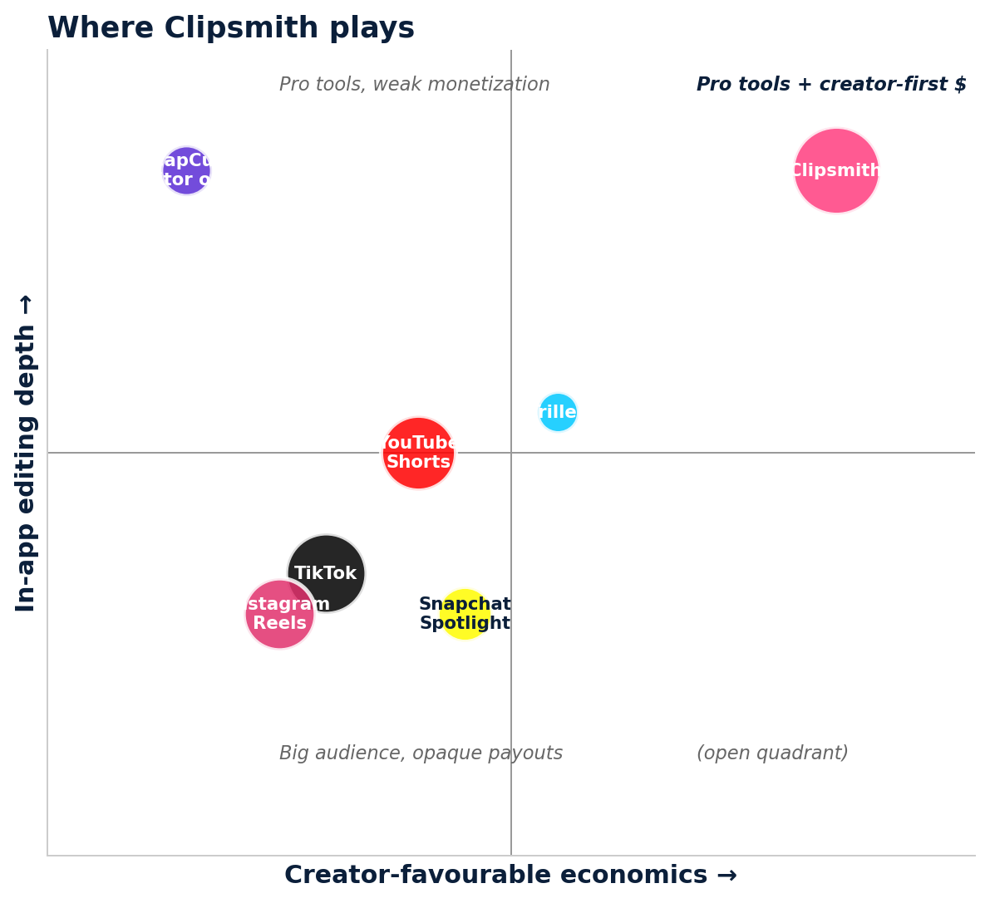
08 · Competition
Pro tools live in editor apps. Creator economics live in walled gardens. We bring them together.
What's defensible
Architecture lead
Clean DDD + 5 layer contracts. Adding creator features faster than incumbent monoliths.
Editor + feed coupling
Pro tools pre-installed. CapCut + TikTok with one auth, one wallet, one analytic surface.
Transparent algo
First major platform to expose Discovery Score features. Wins creator trust = wins creators.
Solo execution proof
9–10mo to feature-complete vs. typical 18–24mo. Capital efficient.
clipsmith · seed round · confidential
9 / 10

Slide 10
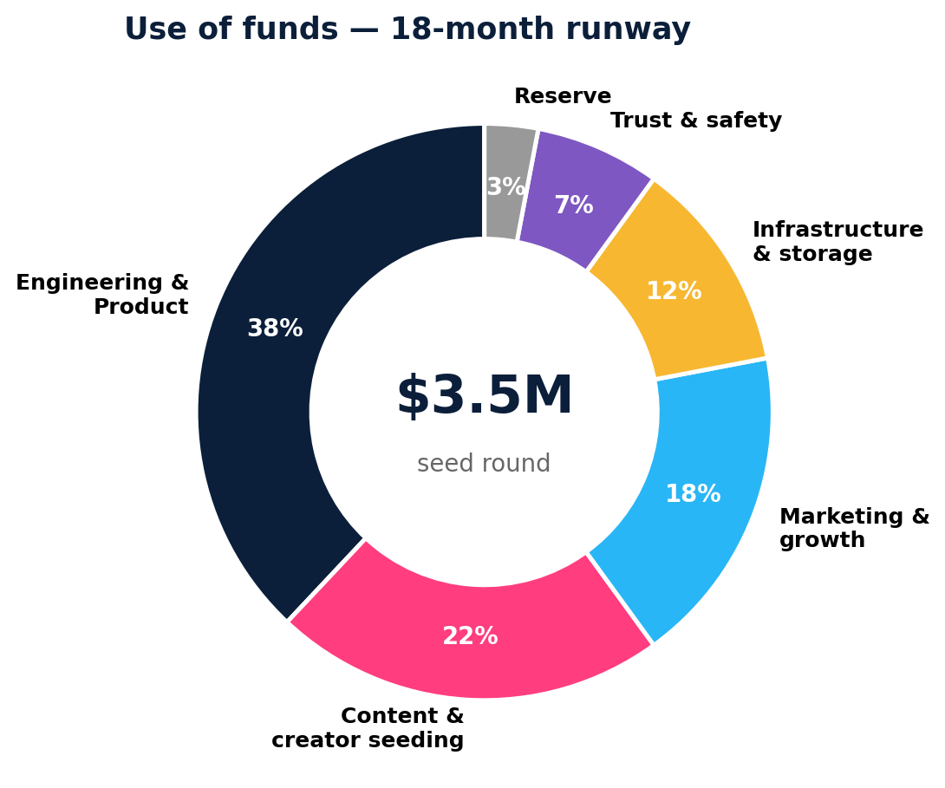
09 · The ask
$3.5M seed for 18 months of runway and one verified revenue ramp.
Round terms
Raise
$3.5M
Instrument
SAFE, post-money cap $20M
Lead check
$1.0–1.5M
Use period
18 months
Next milestone
1M MAU @ month 12
Series A trigger
$3M ARR
Investor seats
1 board observer
Founder commits
100% time, 4-yr vest, 1-yr cliff
Founder · asmeyatsky@hotmail.com · clipsmith.app

