Slide 1
Wipro Data Science Challenge
Asmerom Tesfamichael
20 June 2018

Slide 2
Contents
Data Exploration
Feature Engineering
Modeling
Conclusion

Slide 3
Data Exploration
Data size: 33000 rows and 2 columns
Data type: object data type
Data size by class: 90.9 % is for sentiment = 0 and 9.1% is for sentiment = 0

Slide 4
Feature Engineering
By using label encoder changed the sentiment column to numerical categorical data.
Data cleaning process
Changing to lower case
Removing special characters
Removing stop words
Transforming using CountVectorizer
Transforming using TF-IDF

Slide 5
Feature Engineering
Handling imbalanced data
9.1% of the sentiments were 1 and 90.9% were 0
To handle this issue the parameter class_weight was set to balanced.
Splitting data
70% of data were assigned to train and the remaining 30% to test
Handling imbalanced data
8.5% of authorization attempt were accepted and 11.5% were declined
Downsampling technique were used to downsample majority (accepted) class to balance the data
# accepted attempt = # declined attempt = 93396.
Upsampling the minority (declined) class were used to balance the data. But it had the same result as downsampling at the end.
Splitting data
80% of data were assigned to train and the remaining 20% to test

Slide 6
Modelling
Prototyped three different models to classify each transaction
Random Forest was used as a baseline model
SVM and neural network were used as a more complex models

Slide 7
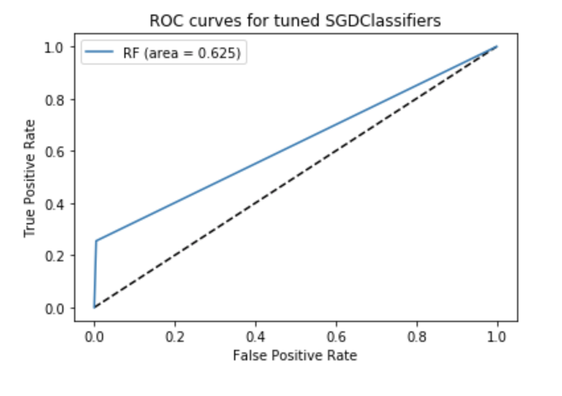
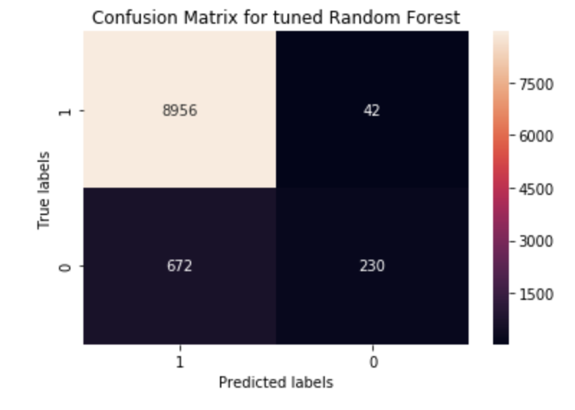
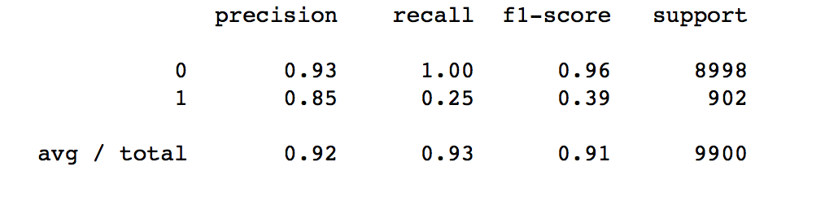
Modelling
Random Forest Method
With default parameters, the accuracy = 92.8%. However, accuracy is not a good metric for unbalanced dataset, we need to look onto other metrics like recall, precession and f-1 score.
After Model was tuned, the accuracy = 93.5% and here are some of the other metrics.
Deep Learning Method
Keras package with tensor flow backend
Upsampling were used, since deep learning performs for large dataset
4 hidden layers were used with relu activation function and Layers = softmax
Hyperparameters:
Cost_function = binary_crossentropy
batch_size = 128
metrics = accuracy
Epochs = 50
Accuracy ~ 89%

Slide 8
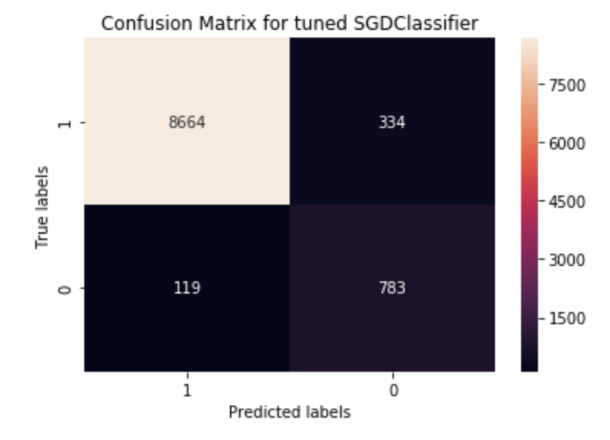
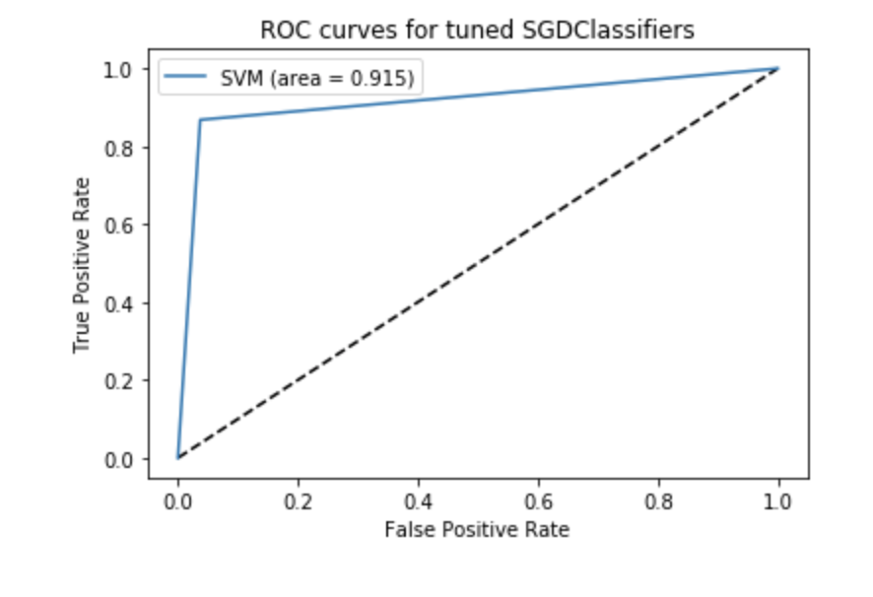
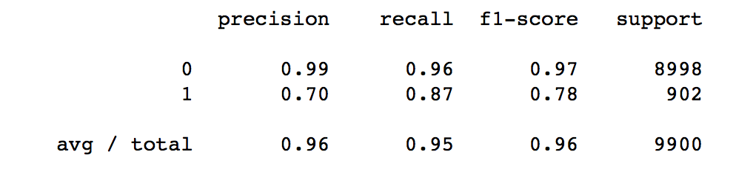
Modelling
Support Vector Machine
With default parameters, the accuracy = 95.4%. However, accuracy is not a good metric for unbalanced dataset, we need to look onto other metrics like recall, precession and f-1 score.
After Model was tuned, the accuracy = 96.2% and here are some of the other metrics.
Deep Learning Method
Keras package with tensor flow backend
Upsampling were used, since deep learning performs for large dataset
4 hidden layers were used with relu activation function and Layers = softmax
Hyperparameters:
Cost_function = binary_crossentropy
batch_size = 128
metrics = accuracy
Epochs = 50
Accuracy ~ 89%

Slide 9
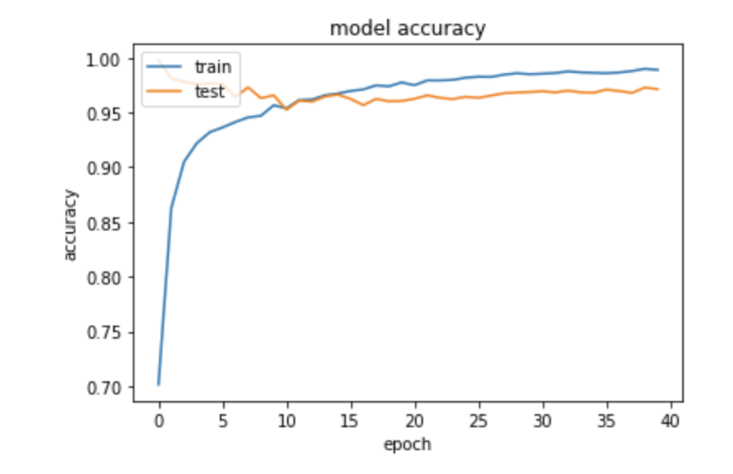
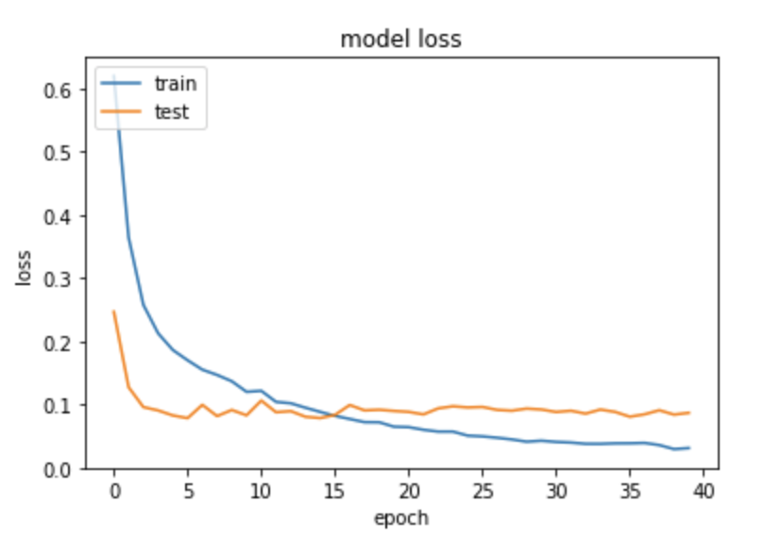
Modelling
Deep Learning Method
Keras package with tensor flow backend
3 hidden layers with relu activation function in the hidden layers and softmax on the outer layer.
Hyperparameters:
Cost_function = binary_crossentropy,batch_size = 128, Epochs = 50
metrics = accuracy
Accuracy ~ 97%
Deep Learning Method
Keras package with tensor flow backend
Upsampling were used, since deep learning performs for large dataset
4 hidden layers were used with relu activation function and Layers = softmax
Hyperparameters:
Cost_function = binary_crossentropy
batch_size = 128
metrics = accuracy
Epochs = 50
Accuracy ~ 89%

Slide 10
Conclusion
SVM performs better than random forest in terms of accuracy as well as other metrics. Which means when using SVM it classify the contents as 1 or 0 better than random forest.
When comparing neural network with SVM. From the accuracy and the loss plots, the accuracy and error of the train and test datasets merges when epoch increase. Hence it Clearly justifies that Neural network is a good algorithm.
Different models also created using pyspark using databricks notebook. However they are not better than neural network and SVM.
Neural network is used as a final model. SVM though a good model

