Slide 1
Customer Shopping Behavior Analysis
How can the company use shopping data to improve engagement, marketing and product strategy?
Python · MySQL · Power BI

Slide 2
Data and approach
1 Python
3,900
18
Clean, engineer age groups and purchase frequency, load to MySQL
purchase records
columns, 50 US states
2 SQL
10 business queries on segments, loyalty and purchase drivers
37
$233K
3 Power BI
missing ratings filled by category median
total revenue, avg $59.76
Interactive dashboard with KPI cards, charts and slicers
A redundant promo-code column (identical to discount applied) was removed.

Slide 3
Who is buying: men, young adults, clothing
$157,890
Male revenue, 68% of total
$75,191
Female revenue, 32%: an under-served segment
Clothing drives 44.73% of revenue. Young Adults lead at 26.66%, though age groups are close.

Slide 4
Loyalty and subscriptions
80% Loyal
3,116 of 3,900 customers
27% subscribe
$62,645 vs $170,436 revenue
$59.49 vs $59.87
avg spend: subscribers vs non-subscribers
Only 958 of 3,476 repeat buyers (over 5 purchases) are subscribed.

Slide 5
What drives purchases
43%
up to 50%
of purchases used a discount. 200 discount users still spent above average.
discount rate on Hat, Sneakers, Coat, Sweater, Pants
$60.48 vs $58.46
3.84 to 3.86
Express vs Standard shipping: a small $2 uplift
top ratings: Gloves, Sandals, Boots, Hat, Handbag

Slide 6
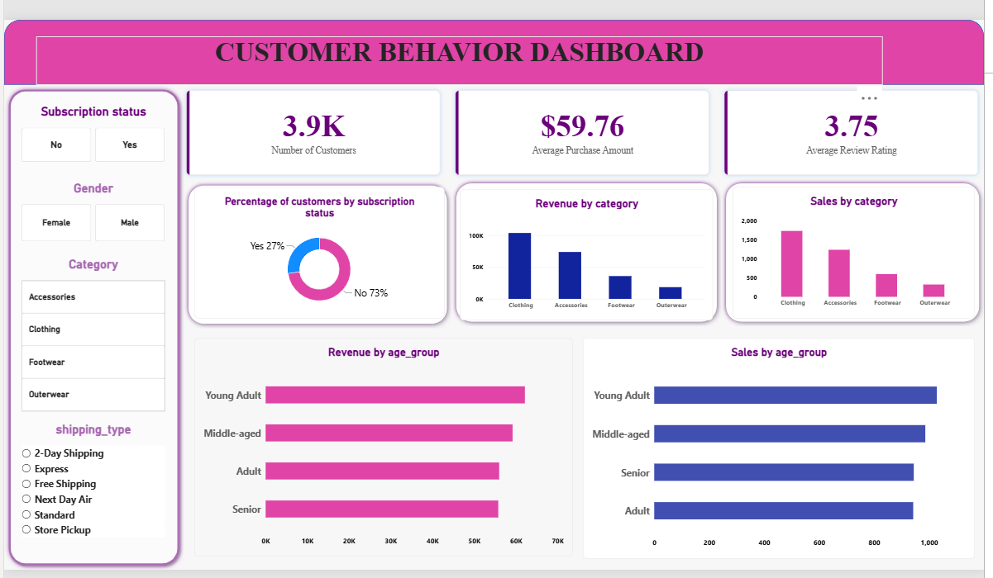
Interactive Power BI dashboard
Slicers: subscription, gender, category, shipping type
KPIs: 3.9K customers, $59.76 avg purchase, 3.75 avg rating
Charts: revenue and sales by category and age group

Slide 7
Recommendations
Grow subscriptions
Reward the loyal base
73% are non-subscribers. Sell it as a loyalty benefit, since spend per order is the same.
80% are Loyal. Add tiered rewards and a welcome offer to lift the 83 new customers.
Target the right segments
Discount selectively
Focus on Young Adults and Clothing; grow female customers (32% of revenue).
Cut blanket offers on heavily discounted items; use discounts on slower products.
Promote Express shipping
Express carries a higher average order; offer upgrade incentives.
Limits: no purchase dates or online/offline channel in the data, so trends and channels were not analysed.

