Slide 1

WIPRO NGA Program – 25SUB4529_WiproNGA_CPPE.net
Capstone Project Presentation – 12th Feb & 13th Feb 2026
Vehicle Service & Customer Management System
Presented by – Asmit Pratap Singh
www.rpsconsulting.in

Slide 2
Vehicle Service & Customer Management System
ASP.NET Core MVC Project
Entity Framework Core + SQL Server
Developed By: Asmit Pratap Singh

Slide 3
Project Overview
Manages Customers, Vehicles and Services
CRUD Operations
Implement Code-First Approach using EF
Tracks Pending & Completed Services
Dashboard with Analytics
Unit Testing using NUnit

Slide 4
Technology Stack
Frontend – Razor Views
Backend – ASP.NET Core
ORM – Entity Framework Core
Database – SQL Server
Testing – NUnit Testing Framework

Slide 5
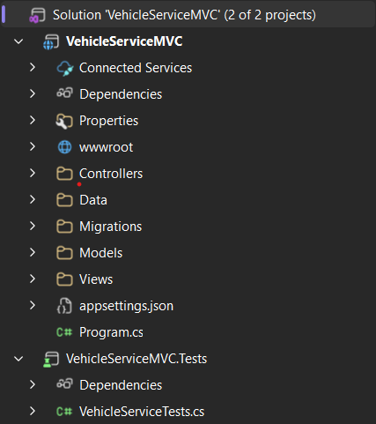
Project Architecture
Models
Controller (MVC)
Data-AppDbContext (EF Core)
Views
SQL Server Database
Nunit Tests

Slide 6
Database Schema -Customer
CustomerId (PK)
Name
Email
Phone
IsActive

Slide 7
Database Schema - Vehicle
VehicleId (PK)
RegistrationNumber
Model
Brand
Year
CustomerId (FK)

Slide 8
Database Schema - Service
ServiceId (PK)
ServiceDate
ServiceType
Cost
IsCompleted
VehicleId (FK)

Slide 9
Entity Relationships
One Customer → Many Vehicles
One Vehicle → Many Services
Foreign Keys enforce relationships

Slide 10
CRUD Operations
Add / Edit / Delete Customer
Add / Edit / Delete Vehicles
Add / Edit / Delete Services
Mark Service as Completed

Slide 11
Advanced Features
Search vehicle by Registration Number
Filter vehicles by Customer
Filter Pending Services
Sort Services by Cost
Group Services by Vehicle
Calculate Total Service Cost per Customer

Slide 12
End-to-End MVC Request Flow
Browser
↓
Routing
↓
HomeController → Index()
↓
DbContext → SQL Server
↓
Data Passed
↓
Index.cshtml
↓
HTML Render
↓
Browser

Slide 13
Internal MVC Lifecycle
User clicks URL
↓
Routing identifies Controller & Action
↓
Controller executes
↓
Data prepared
↓
ViewResult created
↓
View engine finds correct .cshtml file
↓
Model passed
↓
HTML generated
↓
Browser renders page

Slide 14
NUnit Test Cases Implemented
Unit testing implemented using InMemoryDatabase for isolation.
AddCustomer_ShouldAddCustomer
AddVehicle_ShouldAssignToCustomer
AddService_ShouldCreateServiceRecord
CompleteService_ShouldMarkCompleted
PendingServices_ShouldReturnOnlyIncompleteServices

Slide 15
Challenges Faced
Foreign Key Relationships
Migration Errors
CRUD Debugging Issues
Database Connection Setup

Slide 16
Project Outcome
Successfully implemented MVC project
Proper Database Connectivity
Working CRUD Operations

Slide 17
Thank You

