Slide 1
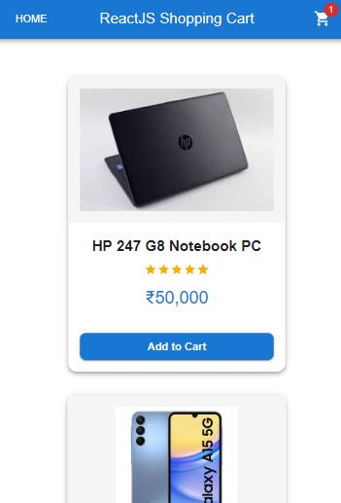
React Shopping Cart Application
Streamlining E-commerce with React. This application targets small businesses and online retailers, offering responsive design and easy customization.

Slide 2
Technology Stack
ReactJS
A JavaScript library for building user interfaces with a declarative, component-based approach and a virtual DOM for efficient updates.
Material-UI
A React UI framework implementing Google's Material Design, offering pre-built components for consistent design and responsive, customizable themes.
Redux
Centralized state management

Slide 3
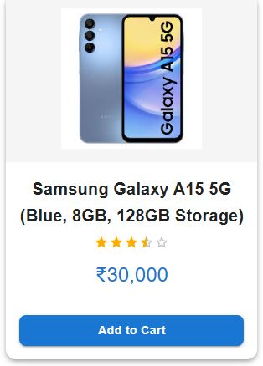
Key Features
1
Product Listing
2
Cart Management
Display products with images, descriptions, and prices, with filtering, sorting, and search functionality.
Add/remove products, update quantities, and display subtotal, taxes, and total price.
3
Checkout
Secure checkout process with payment gateway integration, order confirmation, and tracking.

Slide 4
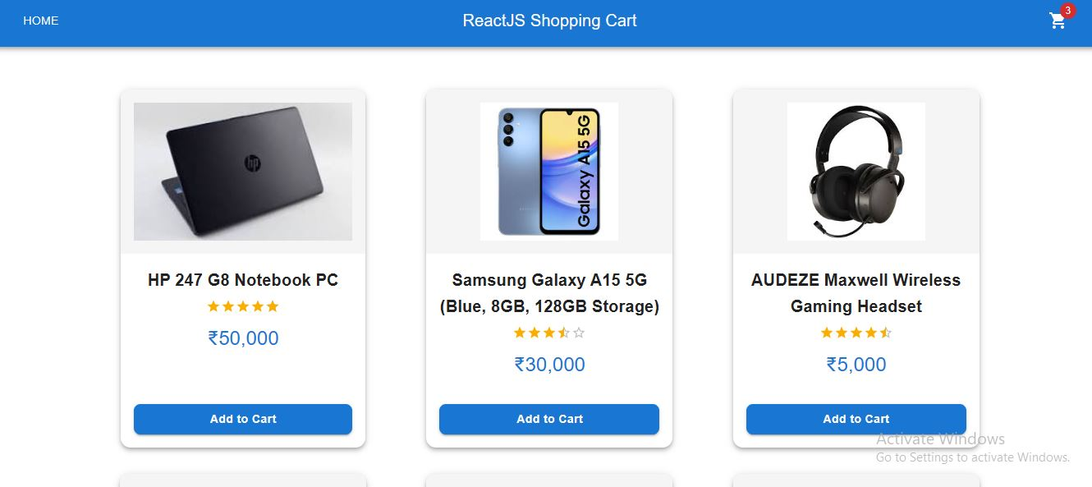
Shopping Cart UI
Key UI Elements
UI Design Highlights
Product images, quantity selectors, "Remove" buttons, subtotal display, "Checkout" button.
Clear visual hierarchy, intuitive navigation, and responsive layout.

Slide 5
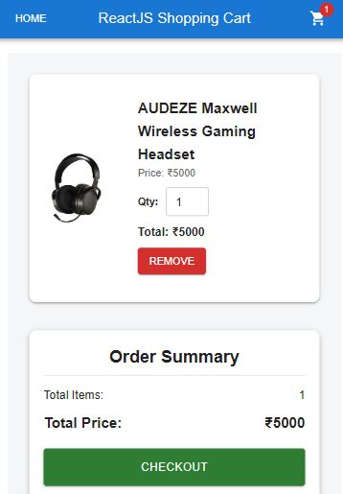




Checkout Process
Checkout
Clear Cart
Message Prompt
Redirecting To the Home Page

Slide 6
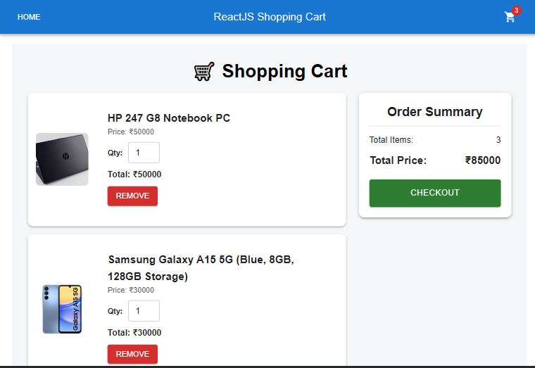



UI/UX Design
Intuitive Navigation
Clear Calls to Action
Mobile Responsiveness

Slide 7

Challenges and Solutions
Challenge 1: State Management
Solution: Implementation of Redux.
Challenge 2: UI Performance
Solution: Optimized React components and lazy loading for images.
Summary of key features, technologies, and benefits.

