Slide 1
CUSTOMER CHURN PREDICTION
Group 5
Asmita bhardwaj OPD2021005
Joji John OPD2021009
Amalraj Irudayasamy OPD2021025

Slide 2
Motivation and Literature Review
Customers are the most valuable assets of any organization.Banks are no exception to this rule.
The competitive atmosphere in various banks when providing the service increases the need for customer loyalty.
Many flaws may occur as customers :
Do not receive easy-to-understand information about a product
Have poor means of communication,
Experiencing the lack of feedback or delayed feedback to queries.
Loyal customers may not feel good for not getting as many bonuses as new customers.
Customers’ experiences reveals the brand perception and influences various services they use.
This project aims to resolve the above shortcomings faced by any potential customers by assessing their propensity of risk to churn.
According to Sharma and Panigrahi (2011), churning refers to customers leaving one company to join another company.
Customer churn introduces not only some loss of income but also other negative effects on the operation of companies (Chen et al. 2014).
Some of the techniques commonly used to achieve this are neural networks, Decision Trees (DT), Random Forests, Support Vector Machines (SVM) and Logistic Regression (Miguéis et al. 2012).
Guo-en and Wei-dong (2008) focused on building a customer churn prediction model using SVM in the telecommunication industry. They compared this method with other techniques such as DT, Artificial Neural Networks, Naïve Bayesian (NB) and Logistic Regression.

Slide 3
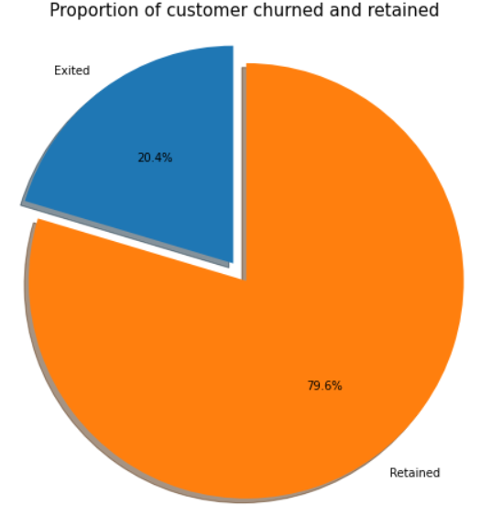
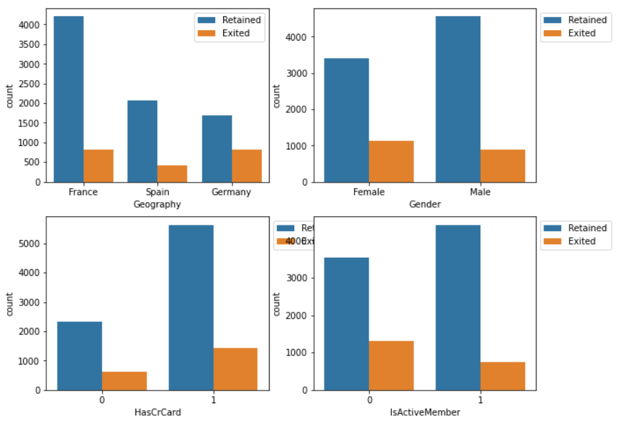
Dataset Description and Preprocessing
Source dataset is in .csv format.
Dataset source is from kaggle website. (kaggle dataset)
Dataset contains 14 features and 10000 records.
There are no missing values in the given dataset.
The variable that tells whether the customer is churning or not i.e. “Exited”.
About 20% of the customers have churned. So the baseline model could be to predict that 20% of the customers will churn.

Slide 4
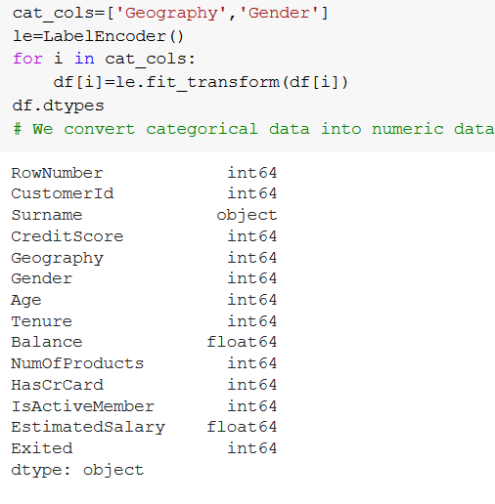
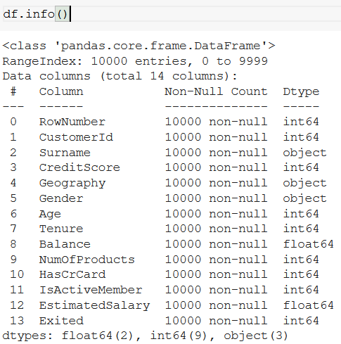
Methodology
EDA(Exploratory data analysis) : dataset consists of 14 variable in all .
Few are continuous and rest are categorical. Control variable is customer.
Model building includes
Defining the purpose of the model
Building the model
Creating an interface of the model and
Exporting the model
Evaluating machine learning algorithms is essential part in this project

Slide 5
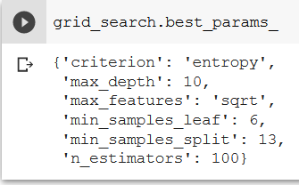
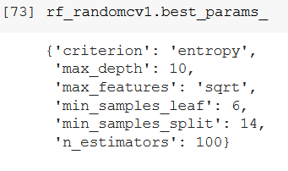
Hyperparameter tuning
As models have many hyperparameters and we have implemented for some set of parameters to determine that accuracy and recall rate is improved so we are finding the best combination of parameters using these search techniques.
1. Grid search CV
2.Randomised search CV

Slide 6
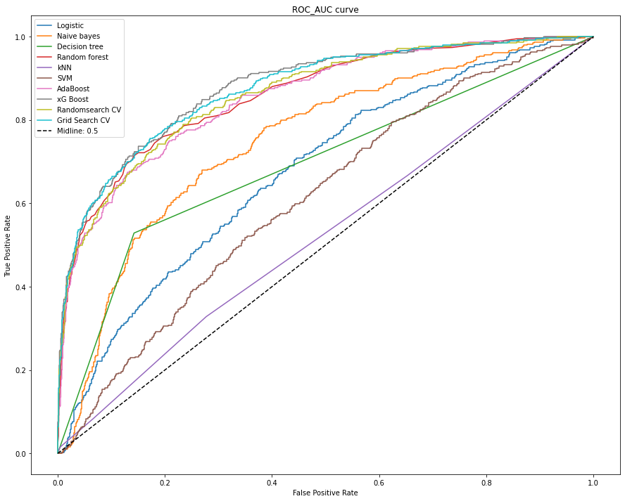
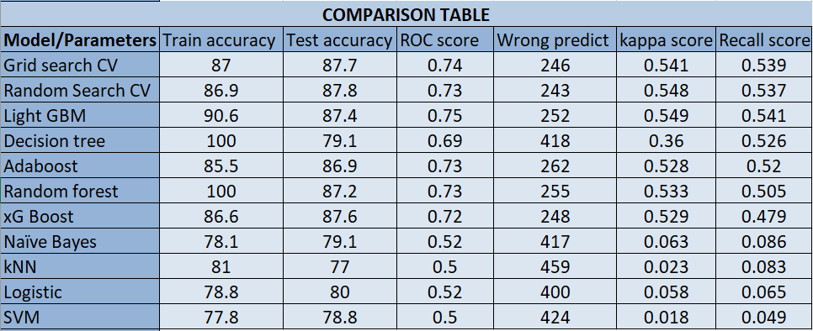
Results and Analysis
We can see that Grid search CV(RF classifier & xG Boost) is giving better performance among all other model and getting accuracy of 87.7% with a recall score of 0.53 on 1’s , the model is able to highlight 53% of all those who churned.

Slide 7
References
[1] V. Kavitha, G. Hemanth Kumar, M. Harish, “Churn Prediction of Customer in Telecom Industry using Machine Learning Algorithms”, International Journal of Engineering Research & Technology (IJERT), Volume 9, May-2020.
[2] Praveen Asthana, "A comparison of machine learning techniques for customer churn prediction ", International Journal of Pure and Applied Mathematic, Page-1149-1169, Volume 119, Issue 10, 2018.
[3] De Caigny, A., Coussement, K., De Bock, K.W., “A new hybrid classification algorithm for customer churn prediction based on logistic regression and decision trees”,Eur. J. Oper. Res., pg- 760–772, Volume 1, Issue 1, April-2018.
[4] Sharma A, Panigrahi PK (2011) A neural network based approach for predicting customer churn in cellular network services. Int. J Computer Application 27(11):26–31
[5] Hadden J, Tiwaria A, Roy R, Ruta D (2005) Computer assisted customer churn management: State-of-the-art and future trends. Comput Oper Res 34:2902–2917

