Slide 1

Customer Churning Prediction using Machine Learning
Project Members :
Asmita Bhardwaj OPD2021005
Joji John OPD2021009
Amalraj Irudayasamy OPD2021025

Slide 2
MOTIVATION & LITERATURE REVIEW
Customers are the most valuable assets of any organization.Banks are no exception to this rule.
The competitive atmosphere in various banks when providing the service increases the need for customer loyalty.
Many flaws may occur as customers :
Do not receive easy-to-understand information about a product
Have poor means of communication,
Experiencing the lack of feedback or delayed feedback to queries.
Loyal customers may not feel good for not getting as many bonuses as new customers.
Customers’ experiences reveals the brand perception and influences various services they use.
This project aims to resolve the above shortcomings faced by any potential customers by assessing their propensity of risk to churn.
According to Sharma and Panigrahi (2011), churning refers to customers leaving one company to join another company.
Customer churn introduces not only some loss of income but also other negative effects on the operation of companies (Chen et al. 2014).
Some of the techniques commonly used to achieve this are neural networks, Decision Trees (DT), Random Forests, Support Vector Machines (SVM) and Logistic Regression (Miguéis et al. 2012).
Guo-en and Wei-dong (2008) focused on building a customer churn prediction model using SVM in the telecommunication industry. They compared this method with other techniques such as DT, Artificial Neural Networks, Naïve Bayesian (NB) and Logistic Regression.

Slide 3
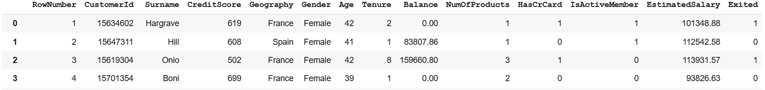
DATASET DESCRIPTION
Source dataset is in .csv format.
Dataset source is from kaggle website. (kaggle dataset)
Dataset contains 14 features and 10000 records.
There are no missing values in the given dataset.
The variable that tells whether the customer is churning or not i.e. “Exited”.
DATASET

Slide 4
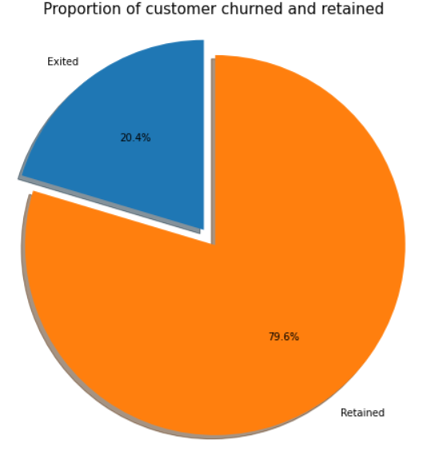
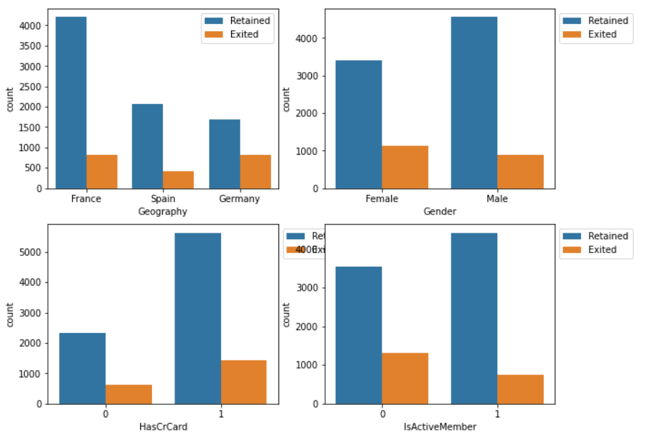
DATASET DESCRIPTION
About 20% of the customers have churned. So the baseline model could be to predict that 20% of the customers will churn.
Notes:
Given 20% is a small number, we need to ensure that the chosen model does predict with great accuracy this 20% as it is of interest to the bank to identify and keep this bunch as opposed to accurately predicting the customers that are retained.

Slide 5
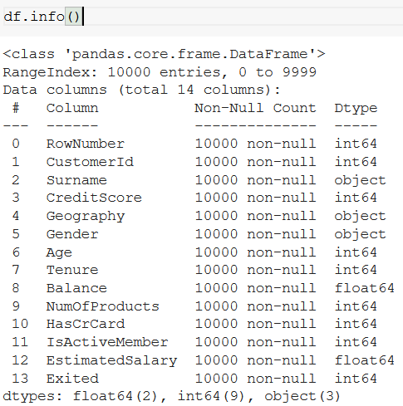
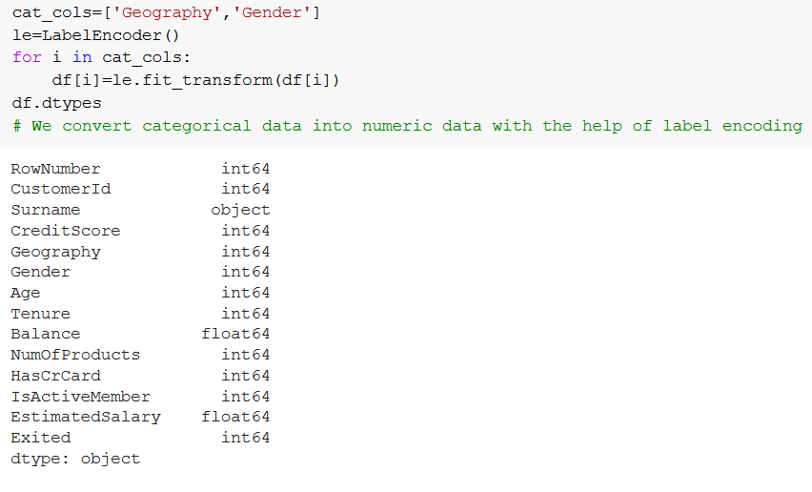
METHODOLOGY & PRE-PROCESSING
EDA(Exploratory data analysis) : dataset consists of 14 variable in all .
Few are continuous and rest are categorical. Control variable is customer.
Model building includes
Defining the purpose of the model
Building the model
Creating an interface of the model and
Exporting the model
Evaluating machine learning algorithms is essential part in this project
Notes:
Identify and visualize which factors contribute to customer churn:
Build a prediction model that will perform the following:
Classify if a customer is going to churn or not
Preferably and based on model performance, choose a model that will attach a probability to the churn to make it easier for customer service to target low hanging fruits in their efforts to prevent churn

Slide 6
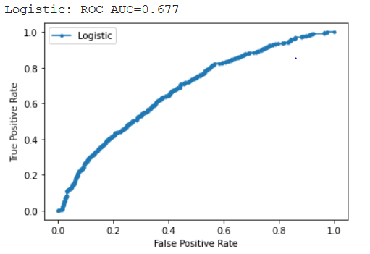

RESULTS AND FUTURE TASKS
Implemented Logistic regression on the model to predict and getting accuracy of 80% on testing dataset.
In the next phase , we are planning to implement Naive Bayes, Decision Tree, kNN, SVM, Random Forest and Grid Search Cross Validation on the dataset and determine which model is giving best accuracy.
With the help of all these models, we will predict the churn rate of customers.

Slide 7
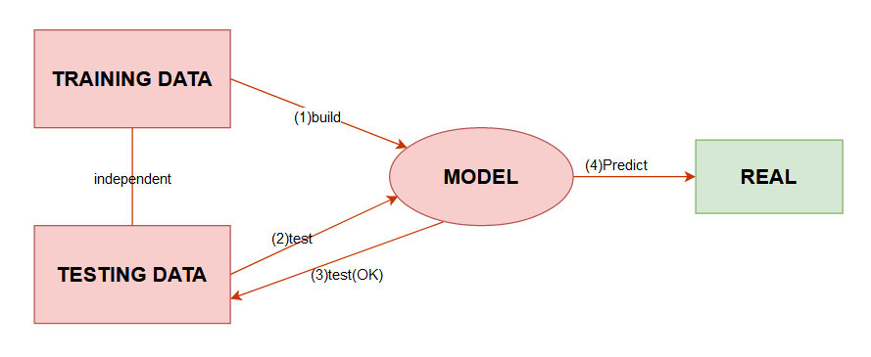
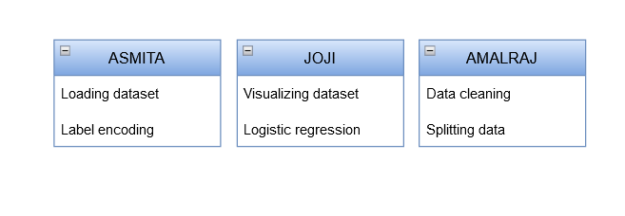

PREDICTION MODEL & INDIVIDUAL TASKS

Slide 8
