Slide 1

SMART OFFICE

Slide 2
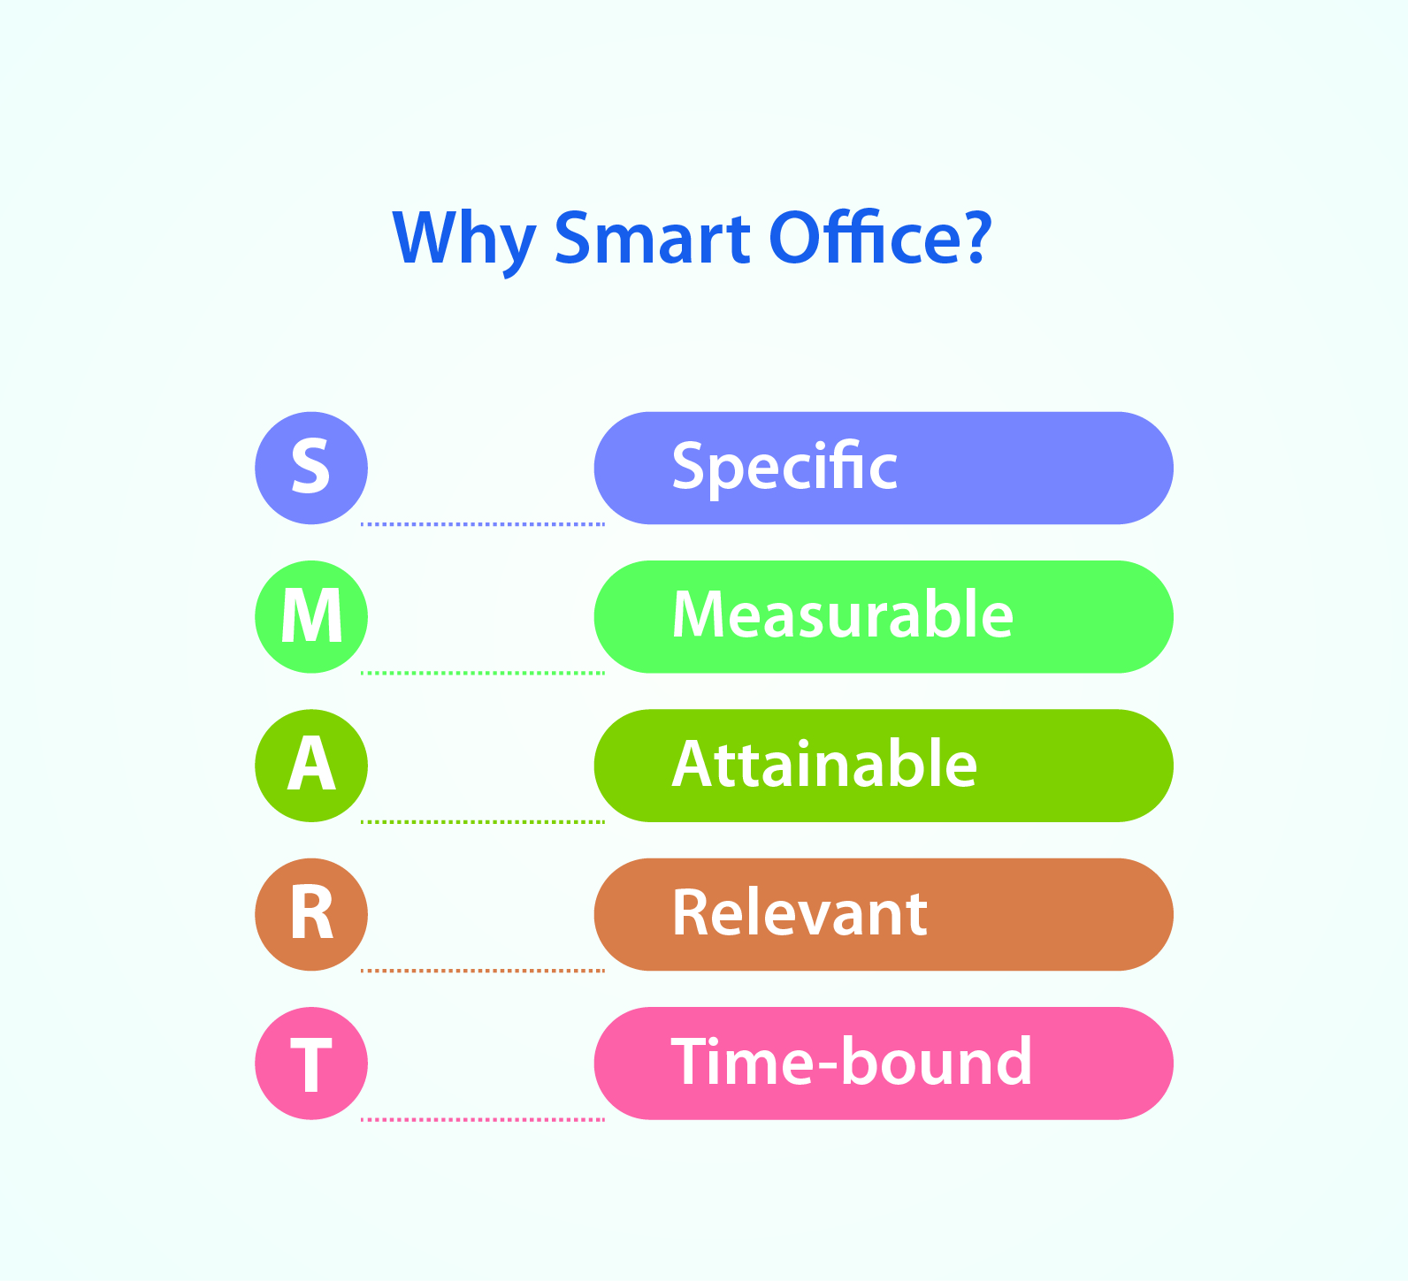
WHY SMART OFFICE ?

Slide 3
INTRODUCTION
Sensors, digital devices, and people with the help of eminent service providers enabling smarter tech in an innovative style to save time, resources, and energy.
There is an increasing demand for smart offices, where appliances react automatically to the changing environmental and can be easily controlled through one common device and security of the office can’t be breached.
This project presents a possible solution whereby the user controls devices by using their existing mobile phone, where control is communicated to the microcontroller from laptop using hardware components and visual basic.

Slide 4
WHAT WE INCLUDED IN PROJECT ?
MUSIC SYSTEM
AUTOMATIC LIGHTNING SYSTEM
SMART PARKING
PASSWORD PROTECTED LOCKING SYSTEM
LIGHT BRIGHTNESS

Slide 5
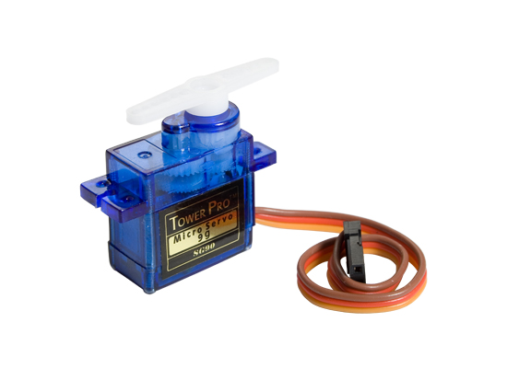
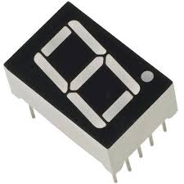
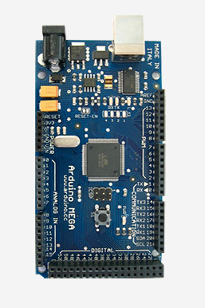
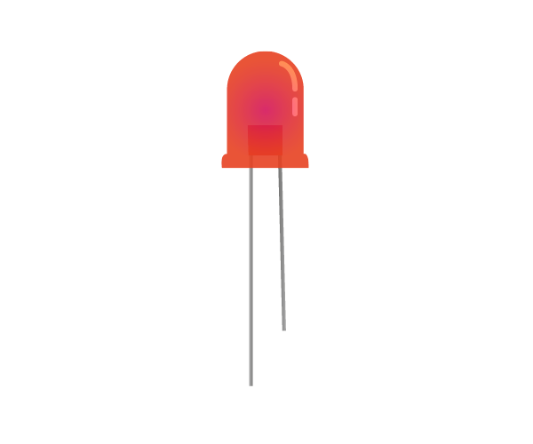
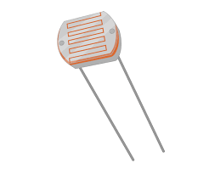
COMPONENTS USED
MICROCONTROLLER-ARDUINO MEGA
LIGHT DEPENDENT RESISTOR
LEDs
7 SEGMENT DISPLAY
SERVO MOTOR
USB CABLE

Slide 6
APPLICATIONS
SMART OFFICE- this project can be used to control various office appliances.
Faster operation and efficient .
We can control device from long distance, thus it gives ease of access .
No need to separate remote or any other controlling unit.

Slide 7

CONCLUSION

Slide 8
THANK YOU

