Slide 1

Team Details
Team Name: CreditSentinel — [Your Team Name Here]
Team Leader: [Your Name Here]
Problem Statement: PS 4 — Default Prediction Model

Slide 2
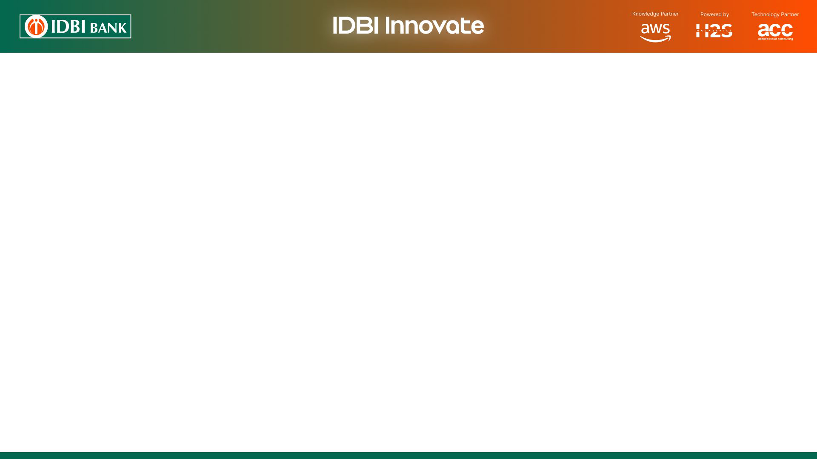
Brief about the idea
CreditSentinel 360 is a unified, 12-month forward-looking default prediction and early-warning platform for IDBI Bank. It replaces fragmented, structured-data-only scorecards (16-22% accuracy) with a single segment-aware AI engine that fuses structured banking/bureau data with unstructured signals — GST filings, transaction narrations, and news/sector sentiment — to estimate Probability of Default (PD) up to 12 months in advance across Retail, MSME, Corporate and Agri portfolios.
Every loan, regardless of type, is translated into one common language: a Sentinel Risk Score (0-1000) and Risk Grade (AAA to D).
Credit teams get a consistent, comparable, and explainable view of portfolio stress — 12 months before it becomes an NPA.
Built to plug directly into IDBI Bank's sandbox APIs, synthetic datasets, and core banking/bureau feeds.

Slide 3
Opportunities
How different is it from other existing ideas?
Most existing default models are structured-data-only and fragmented across loan types — separate retail scorecards, separate MSME rules, no common scale.
CreditSentinel 360 unifies structured + unstructured (NLP-derived) signals into ONE segment-aware model with a common interpretation layer.
How will it solve the problem?
Forward-looking 12-month PD instead of reactive/lagging DPD-based flags — enables pre-emptive action.
NLP engine extracts stress signals from GST remarks, transaction narrations and news — catching risk structured data misses.
Calibrated probability + explainability ensures scores are trustworthy and auditable for credit committees.
USP of the proposed solution
One score, one grade, one explanation format — usable across Retail, MSME, Corporate and Agri books alike.

Slide 4
List of features offered by the solution
12-Month Forward Default Prediction — Probability of Default (PD) estimated a full year ahead, not just current delinquency status.
Structured + Unstructured Fusion — bureau/EMI/DPD/financial ratios combined with NLP-derived signals from GST filings, transaction narrations and news/sector sentiment.
Segment-Aware Modeling — a single model conditioned on loan type & borrower segment, avoiding both one-size-fits-all bias and fragmented, hard-to-maintain silo models.
Common Interpretation Framework — every loan gets a Sentinel Risk Score (0-1000) and Risk Grade (AAA-D), directly comparable across loan types.
Explainability Layer — top plain-language risk drivers per account, so credit teams see why, not just what.
Early-Warning Watchlist & Alerts — automatically flags accounts crossing risk thresholds for proactive RM/credit-team action.
API-First Design — scoring engine callable from Loan Origination and Monitoring systems, ready for sandbox integration.

Slide 5
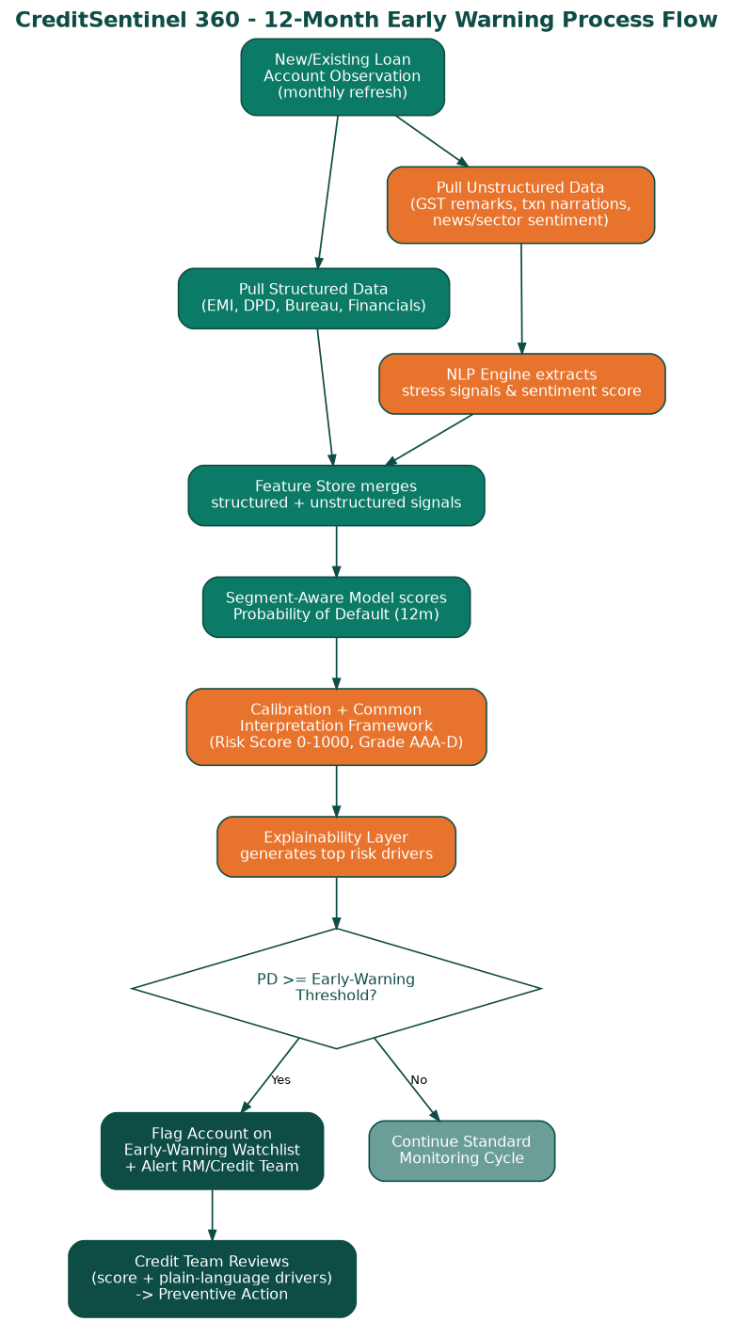
Process flow diagram / Use-case diagram

Slide 6
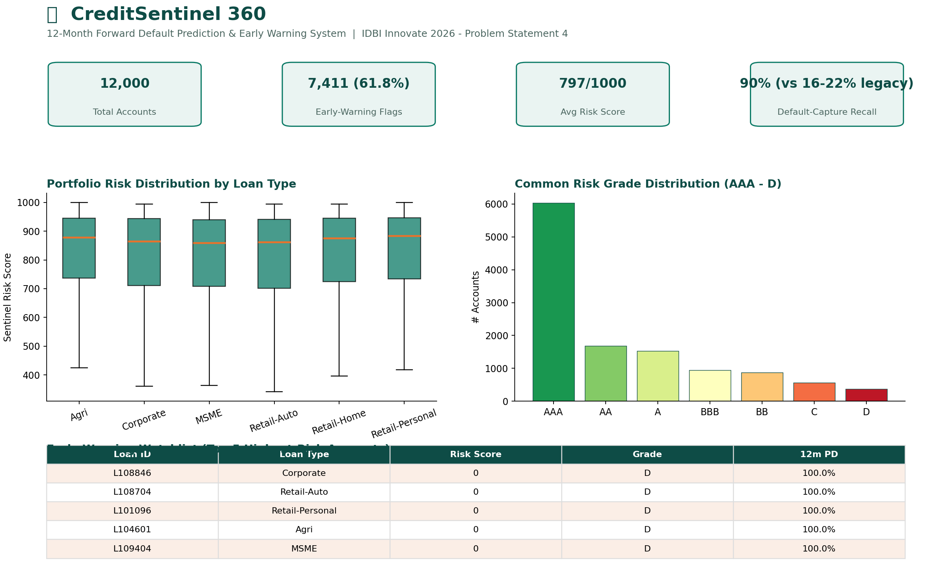
Wireframes / Mock diagrams of the proposed solution

Slide 7
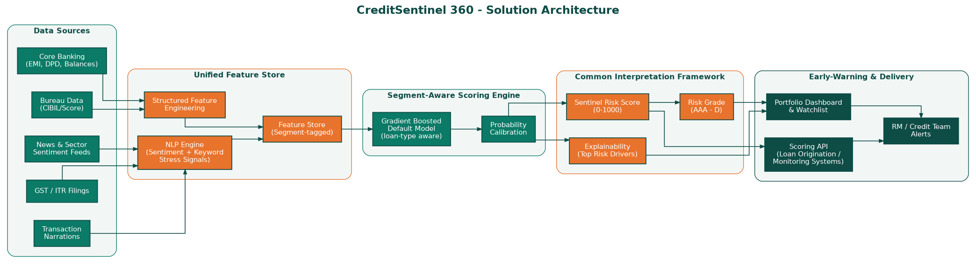
Architecture diagram of the proposed solution

Slide 8
Technologies to be used in the solution
Data & ML
Explainability & Serving
Cloud & Platform (AWS)
Python, Pandas, NumPy
XGBoost (segment-aware gradient boosting)
scikit-learn (calibration, pipelines)
Lexicon/NLP sentiment engine for text signals
SHAP / feature-importance explainability layer
FastAPI scoring microservice
Streamlit early-warning dashboard (prototype)
Amazon SageMaker — training & retraining pipeline
AWS Lambda + API Gateway — scoring API
Amazon S3 — feature store & data lake
Amazon QuickSight / CloudWatch — monitoring

Slide 9
Estimated implementation cost (optional)
Phase | Scope | Estimated Cost (INR)
PoC (Sandbox) | Model tuning on IDBI sandbox data, API integration, pilot dashboard | 8 - 12 Lakh
Pilot (1-2 business units) | Production-grade deployment, monitoring, RM training | 20 - 30 Lakh
Full Rollout | Bank-wide across Retail/MSME/Corporate/Agri, HA infra, MLOps | 60 - 90 Lakh
Annual Run-rate | Cloud infra, model retraining, monitoring & compliance | 15 - 20 Lakh / year
Indicative, phase-wise estimate — to be refined jointly with IDBI Bank based on sandbox scope, data volumes and infra choices.

Slide 10
Snapshots of the prototype

Slide 11
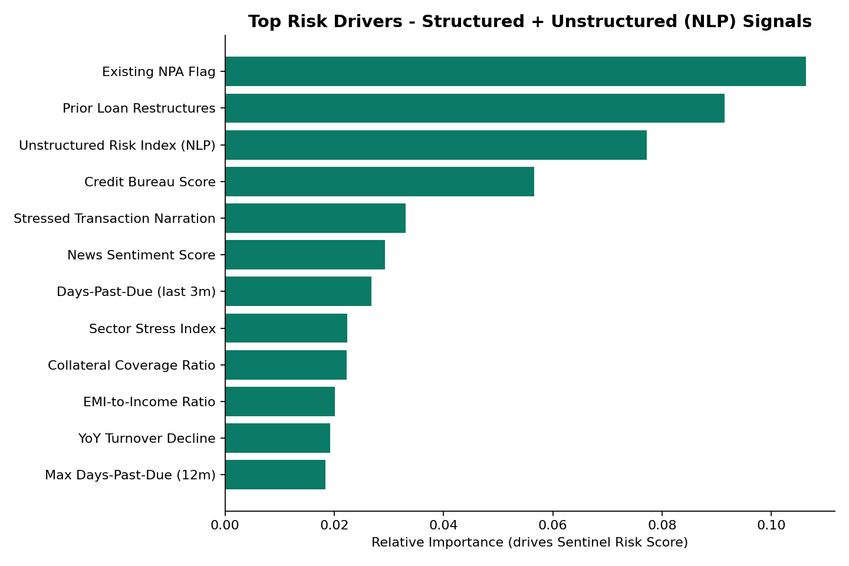
Prototype Performance report / Benchmarking
Metric | CreditSentinel 360 | Legacy baseline
Default-capture recall (12m) | ~90% | 16 - 22%
ROC-AUC | 0.79 | n/a (rule-based)
Data used | Structured + Unstructured (NLP) | Structured only
Coverage | Unified across all loan types | Fragmented per loan type
Evaluated on a held-out synthetic test portfolio (n=2,400 accounts). Threshold tuned to maximize precision at ≥90% default-capture recall — directly matching the challenge's target of raising identification accuracy from 16-22% to ~90%.

Slide 12
Additional Details / Future Development (if any)
Integrate live IDBI sandbox APIs and real bureau/GST feeds to replace synthetic data and retrain on actual portfolio history.
Add transformer-based NLP (fine-tuned embeddings) for deeper document/news understanding beyond lexicon-based sentiment.
Introduce macro-economic stress-testing scenarios (rate shocks, sector downturns) for forward PD sensitivity.
Build a feedback loop where credit officers' outcomes retrain and continuously improve the model (human-in-the-loop MLOps).
Extend the common interpretation framework into a portfolio-level early-warning report for RBI/regulatory stress reporting.

Slide 13
Provide links to your:
GitHub Public Repository: [ADD YOUR GITHUB REPO LINK HERE]
Demo Video Link (3 Minutes): [ADD YOUR DEMO VIDEO LINK HERE]
Final Product Link: [ADD YOUR DEPLOYED STREAMLIT/APP LINK HERE]

Slide 14
