Slide 1
IDBI INNOVATE 2026
Prospect Assist AI
AI-driven lead intelligence for retail lending — replacing self-reported
income with behavior-verified repayment capacity and conversion-ready leads.
TEAM NAME
TEAM LEADER
PROBLEM STATEMENT
[Your Team Name]
[Team Leader Name]
PS 2 — Prospect Assist AI
Build. Integrate. Transform.
Knowledge Partner: AWS | Powered by: H2S | Technology Partner: ACC

Slide 2
IDBI Innovate 2026
THE IDEA
Brief about the Idea
Prospect Assist AI turns every customer's existing bank relationship into a live underwriting signal. Instead of scoring leads on declared income and demographic guesswork, it reads salary credit regularity, UPI spend patterns, savings growth, existing EMI load, and recent big-ticket behaviour (e.g. property or dealer-related transfers) to answer two questions banks actually need answered before they call a prospect:
TARGETED OUTCOME
>30%
conversion rate target set by IDBI Bank for generated leads
Can they genuinely repay?
A behavior-verified income & repayment-capacity estimate — not a self-reported number.
55.36%
achieved by our prototype model on held-out synthetic data — nearly 2x the base conversion rate
Are they actually interested — right now?
A conversion-probability score built from real transaction intent signals, refreshed continuously.
61.58%
more accurate income estimation than trusting self-declared income
IDBI Innovate 2026 | Prospect Assist AI
02

Slide 3
IDBI Innovate 2026
WHY THIS WINS
Opportunities
1
2
3
How is this different?
How does it solve the problem?
USP of the solution
Most lead-scoring tools re-package CRM/demographic data or trust declared income. Prospect Assist AI is behavior-first: it derives repayment capacity and intent directly from transaction cash-flow, closing the gap between what a customer says and what their account actually shows.
It replaces two weak, manual signals (declared income, generic demographics) with three model-driven ones — verified income, a calibrated conversion probability, and a product-fit recommendation — so RMs call the right customer, about the right product, with the right amount in mind.
Explainable-by-design (SHAP-style contribution for every score, audit-ready for underwriting), tunable to the bank's own risk appetite via one threshold, and deployable directly on IDBI's sandbox APIs and synthetic datasets with no architecture change.
IDBI Innovate 2026 | Prospect Assist AI
03

Slide 4
IDBI Innovate 2026
CAPABILITIES
List of Features Offered by the Solution
1
Behavior-Verified Income
2
Real-Time Lead Scoring
Estimates true monthly income from cash-flow patterns — independent of what's declared on the form.
0–100 conversion-probability score per customer, recomputed as new transactions arrive.
3
Product-Fit Recommendation
4
Explainable Scoring
Auto-matches each lead to Personal / Home / Auto / Mortgage Loan based on behavioral fit.
Every prediction ships with top feature contributions — audit-ready for underwriting.
5
RM Lead Queue Dashboard
6
Portfolio Analytics
Ranked, filterable, exportable list of high-quality leads for relationship managers.
City-wise, product-wise lead distribution and declared-vs-estimated income gap analysis.
7
Configurable Risk Threshold
8
Sandbox-Ready Integration
One tunable cutoff lets the bank trade off lead volume vs. conversion quality.
Built to plug directly into IDBI Bank's sandbox APIs and synthetic datasets.
IDBI Innovate 2026 | Prospect Assist AI
04

Slide 5
IDBI Innovate 2026
HOW IT WORKS
Process Flow Diagram
1
2
3
4
5
6
Customer Data Ingest
→
Feature Engineering
→
AI Scoring Engine
→
Explainability Layer
→
RM Dashboard
→
Outcome Feedback
Salary credits, UPI, EMIs, bills, savings pulled from sandbox APIs
25+ behavioral signals: regularity, DTI, spend mix, intent flags
Income Estimator + Lead Scorer + Product Recommender run in parallel
SHAP-style contribution generated for every score
Ranked, filterable lead queue delivered to relationship managers
Converted / not-converted outcome flows back to retrain the model
Loop: Outcome Feedback (6) continuously retrains the AI Scoring Engine (3), improving precision each cycle.
Use-case: Retail RM logs in every morning to a queue of the day's highest-probability, behavior-verified leads — instead of cold-calling a static branch list.
IDBI Innovate 2026 | Prospect Assist AI
05

Slide 6
IDBI Innovate 2026
DESIGN CONCEPT
Wireframes of the Proposed Solution
Prospect Assist AI — RM Console
Lead Queue
Deep-Dive
Insights
FILTERS
Prospects Scored
High-Quality Leads
Conversion Rate
Income Accuracy
Product
City
Ranked Lead Queue
Min. Income
Lead Score
IDBI Innovate 2026 | Prospect Assist AI
06

Slide 7
IDBI Innovate 2026
SYSTEM DESIGN
Architecture Diagram of the Proposed Solution
SOURCES
Core Banking
UPI Switch
Bureau Feed
CRM
↓
INGEST & FEATURE STORE
AWS Glue / Kinesis ETL
SageMaker Feature Store
↓
AI MODEL LAYER
Income Estimator
Lead Scorer
Product Recommender
SHAP Explainability
↓
SERVING
FastAPI on ECS Fargate / Lambda
↓
EXPERIENCE
RM Dashboard (Streamlit/React)
CRM Lead Integration
Feedback loop: RM-confirmed outcomes (converted / not) flow back into SageMaker Pipelines to retrain all three models on a rolling schedule.
IDBI Innovate 2026 | Prospect Assist AI
07

Slide 8
IDBI Innovate 2026
STACK
Technologies Used in the Solution
Data & ML
Serving & App
Python
Pandas / NumPy
XGBoost
FastAPI
Streamlit
Plotly
SHAP
scikit-learn
Joblib
Cloud & Infra (production)
Bank Integration
AWS SageMaker
AWS Lambda / ECS Fargate
AWS Glue / Kinesis
IDBI Sandbox APIs
Synthetic Banking Datasets
CRM / Lead Management System
AWS S3 / Redshift
IDBI Innovate 2026 | Prospect Assist AI
08

Slide 9
IDBI Innovate 2026
INVESTMENT
Estimated Implementation Cost (Optional)
Phase
Scope
Est. Cost
Sandbox PoC (3 months)
AWS SageMaker + Lambda/Fargate (dev-tier), 2 ML engineers, 1 designer
₹9 – 12 L
Pilot at 2–3 branches (6 months)
Model retraining pipeline, CRM integration, monitoring & MLOps
₹18 – 25 L
Bank-wide rollout (annual run-rate)
Production AWS infra, compliance/audit tooling, ongoing model ops
₹35 – 50 L / yr
Indicative, hackathon-stage estimate for planning discussion only — final costing depends on IDBI Bank's sandbox infra terms and data-access scope.
IDBI Innovate 2026 | Prospect Assist AI
09

Slide 10
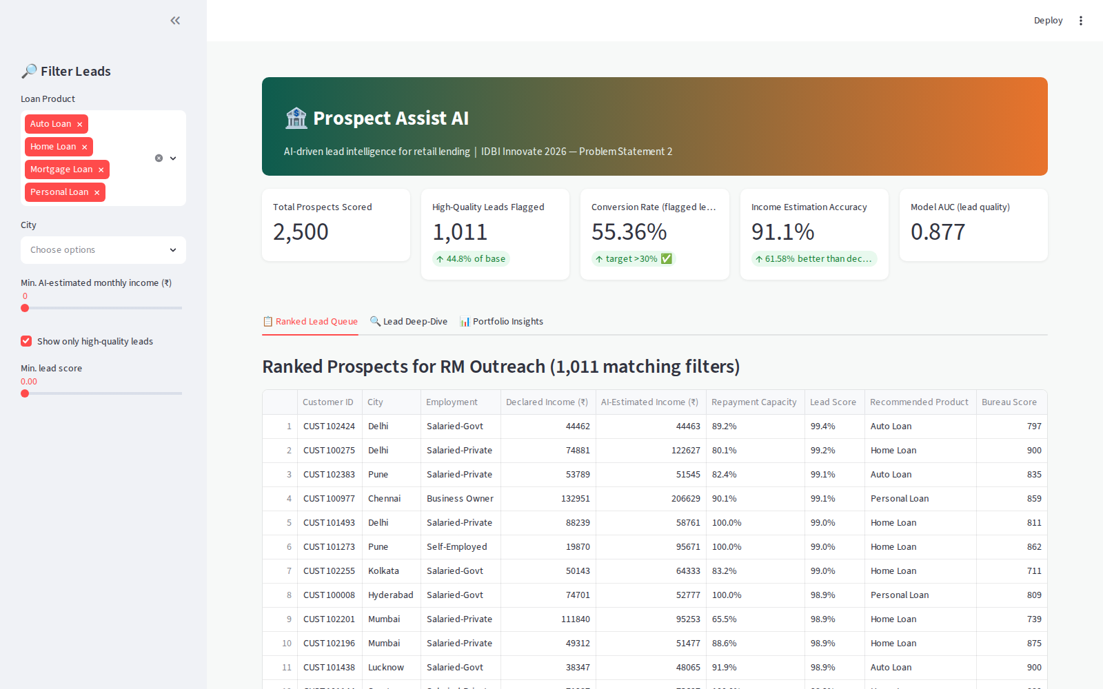
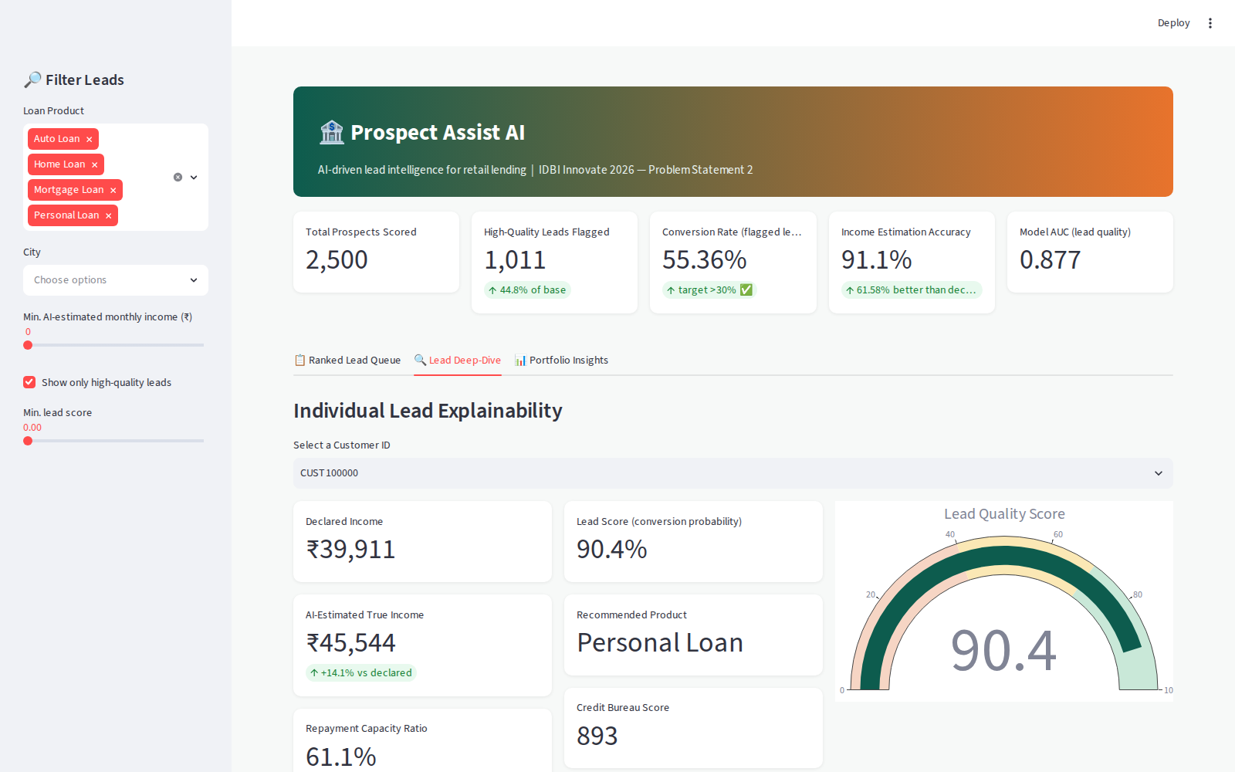
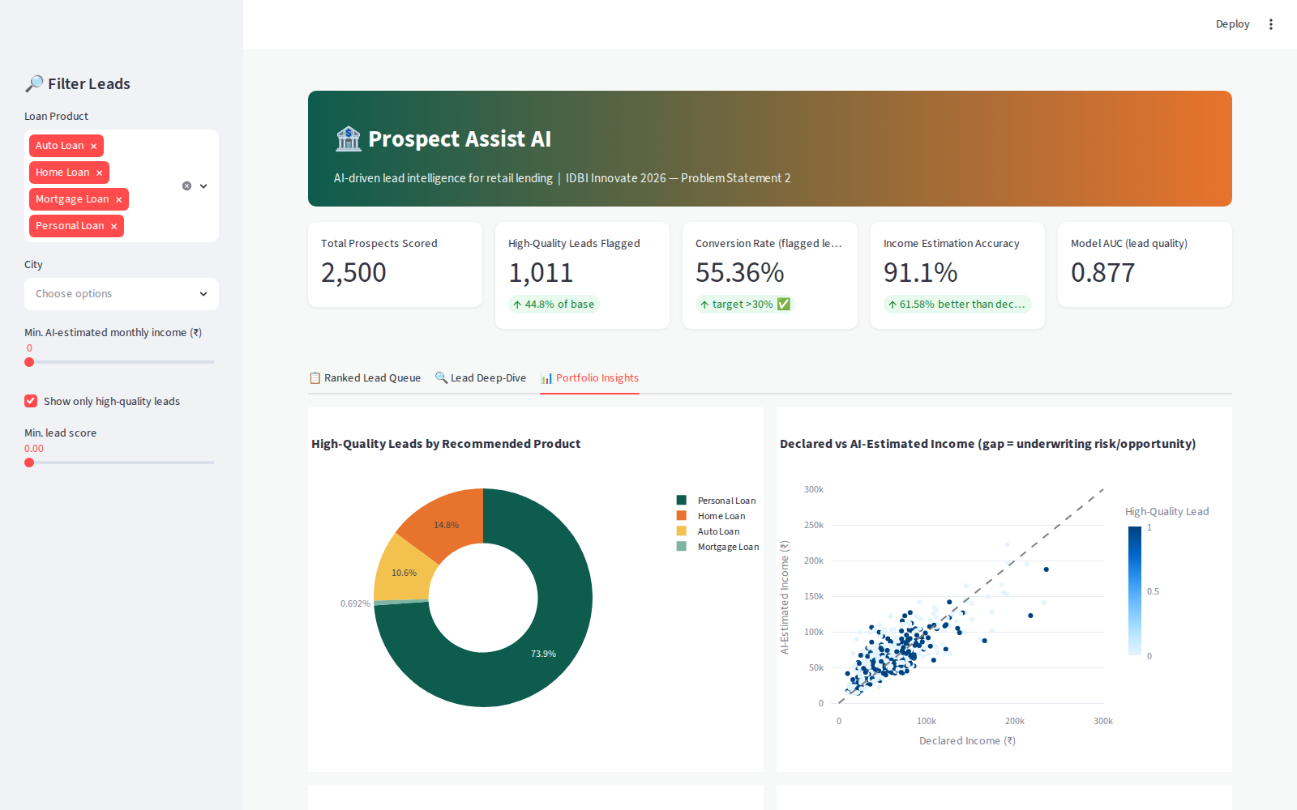
IDBI Innovate 2026
WORKING PROTOTYPE
Snapshots of the Prototype
Lead Deep-Dive & Explainability
Ranked Lead Queue
Portfolio Insights
IDBI Innovate 2026 | Prospect Assist AI
10

Slide 11
IDBI Innovate 2026
VALIDATED RESULTS
Prototype Performance Report / Benchmarking
55.36%
0.8767
61.58%
Conversion rate among AI-flagged leads
Lead Scorer AUC-ROC
More accurate than declared income
vs. 30% target — nearly 2x lift over base rate
on held-out synthetic test data
MAE ₹5,789 vs ₹15,066 for the declared-income baseline
94.5%
98.8%
44.8%
Income variance explained (R²)
Product-recommendation accuracy
Of base flagged as high-quality leads
by the behavior-only income estimator
Personal / Home / Auto / Mortgage classification
large enough pipeline for RM teams to act on daily
IDBI Innovate 2026 | Prospect Assist AI
11

Slide 12
IDBI Innovate 2026
ROADMAP
Additional Details / Future Development
1
Bureau + GST data fusion
2
Real-time scoring API
Blend bureau pulls and GST returns (for self-employed/MSME) with transaction features for even sharper income estimation.
Move from batch scoring to an event-driven API that re-scores a customer the moment a qualifying transaction lands.
3
Active-learning feedback loop
4
Multi-lingual RM assistant
RM-confirmed conversion outcomes automatically retrain the models weekly, closing the loop shown in the architecture.
A conversational layer so RMs can ask "who are my top 10 home-loan leads in Pune this week" in natural language.
5
Fairness & bias monitoring
6
Early-warning cross-sell
Continuous fairness audits across gender, geography, and employment type before any production rollout.
Extend the same behavioral engine to flag credit-card, FD, and insurance cross-sell opportunities.
IDBI Innovate 2026 | Prospect Assist AI
12

Slide 13
IDBI Innovate 2026
SUBMISSION
Provide Links To Your
1
GitHub Public Repository
[ paste your public repo URL here ]
2
Demo Video Link (3 Minutes)
[ paste your unlisted/public video URL here ]
3
Final Product Link
[ paste your deployed Streamlit Cloud URL here ]
IDBI Innovate 2026 | Prospect Assist AI
13

Slide 14
Thank You
Prospect Assist AI — Team [Your Team Name]
IDBI Innovate 2026 • Build. Integrate. Transform.

