Slide 1

FHE applications for future systems
Asmita PaL
Advisor: Prof. Joshua San Miguel

Slide 2
Outline
Risk of Outsourced Computation
Fully Homomorphic Encryption
Challenges in designing FHE systems
Privacy pitfalls in FHE systems
Experimental Setup and Results

Slide 3
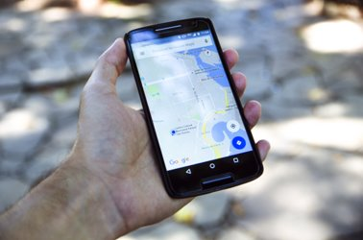
Risk of Outsourced Computation
“Ok Google, find some coffee shops near me”​
What Google knows?​
You’re looking for a coffee shop​
Your location​
When you performed this search​
The probability of how often you do this query​

Slide 4
Wait…There’s More?
The server knows what answer was given to you. ​
How do you search without sharing this information with third parties?​
Do we even care about the data exposed for our caffeine fix?​
Notes:
Recent advances in cloud computing have facilitated a paradigm shift in data storage on third party servers. Though cloud storage is convenient and cost-effective, sensitive data, such as medical or financial records, can be compromised in such environments.
Of course we don’t really care if google figures out our caffeine fix but it becomes a serious threat when the search involves exchanging some Medical financial records

Slide 5





Fully Homomorphic Encryption(FHE)
Client has data x
Secret Key
Encrypted data = E(x)
f(x) needed by client
f(E(x)) given by server
Server computes some function f
Secret Key
Notes:
demonstrates a scenario of querying a record, where the client needs to compute a function f on some private data x. In order to securely do this, the client sends an encrypted version of x, (E(x)), to the server. The server then computes f (E(x)) over the encrypted data, and sends the result to the client. The client possesses the secret key used for decrypting the result. This process ensures that x is never compromised even when being sent to the server.

Slide 6
Various FHE Schemes
Boolean circuits | Exact Arithmetic | Approximate Arithmetic
Gentry-Sahai-Waters (GSW) | Brakerski-Vaikunthanathan (BV) | Cheon-Kim-Kim-Song (CKKS)
Fastest Homomorphic Encryption in the West (FHEW) | Brakerski-Gentry-Vaikunthanathan (BGV)
Fast Fully Homomorphic Encryption over the Torus (TFHE) | Brakerski/Fan-Vercauteren (B/FV)
🟪 Word-wise approach
🟧 Bit-wise approach
For the rest of the talk, we will focus on word-wise approaches

Slide 7
Fully Homomorphic Encryption(FHE)
Client
Server
Client has data x
Secret Key
Encrypted data = E(x)
f(x) needed by client
f(E(x)) given by server
Server computes some function f
Secret Key
Responsible for Encryption, Decryption
Responsible for Homomorphic Addition, Multiplication and other Ciphertext Maintenance Operations

Slide 8
FHE - Encryption
Plaintext vectors are encrypted as ciphertext, pair of polynomials
Plaintext message
m₁
m₂
m_{N/2}
a₁
a₂
a_{N}
Encrypt
Random Noise
b₁
b₂
b_{N}
+e₁
e₂
e_{z}
Ciphertext
Secret Key
Problem : Each ciphertext coefficient can be upto ~2000 bits wide

Slide 9
FHE - Encryption
Computation with wide coefficients (~2000 bits) costs a lot
RNS can represent a wide polynomial (modulo Q) as L polynomials each module a smaller q_{i,} such that q₁ q₂... q_{L} = Q
Solution : Residue Number System
a₁ % q₀
…
a_{N} % q₀
a₁ % q₁
a₁
a₂
a_{N}
…
a₁ % q_{L}
…
a_{N} % q_{L}

Slide 10
Fully Homomorphic Encryption(FHE)
Client
Server
Client has data x
Secret Key
Encrypted data = E(x)
f(x) needed by client
f(E(x)) given by server
Server computes some function f
Secret Key
Responsible for Encryption, Decryption
Responsible for Homomorphic Addition, Multiplication and other Ciphertext Maintenance Operations

Slide 11
FHE Operations - Mult
Homomorphic addition, multiplication and rotation between large ciphertexts is complex
x.a₁
x.a₂
x.a₃
x.a₄
X
+
x
xy
x.b₁
x.b₂
x.b₃
x.b₄
X
+
+
y.a₁
y.a₂
y.a₃
y.a₄
X
y
Key Switching Algorithm
y.b₁
y.b₂
y.b₃
y.b₄
X
Key Switching Hints
Problem : Expensive polynomial multiplication, O(N²) complexity

Slide 12
FHE Operations - Mult
Polynomial multiplication is Convolution followed by polynomial reduction - O(N²) operational complexity
NTT can be performed in O(N log N) complexity by using FFT.
⊗ - Convolution
⊙ - Element wise multiplication
Solution : Number Theoretic Transform
x ⊗ y
xy = NTT⁻¹ (NTT(x) ⊙ (y))
NTT
High Compute Overhead

Slide 13
FHE Operations - Rotate
Ciphertext rotation by k positions, implemented using automorphism
For any index i, automorphism is denoted by :
newindex_{k}(i) = i.5^{k} mod N for i=0, … N-1
For example, if k = 2, N = 1024
newindex_{k}(205) = 205.5² mod 1024 = 5, which means during a rotate operation a₂₀₅ goes to a₅
Ciphertext
Automorphism
Key Switching
Rotated Ciphertext
Key Switching Hints

Slide 14
Fully Homomorphic Encryption(FHE)
Client
Server
Client has data x
Secret Key
Encrypted data = E(x)
What are ciphertext maintenance operations?
f(x) needed by client
f(E(x)) given by server
Server computes some function f
Secret Key
Responsible for Encryption, Decryption
Responsible for Homomorphic Addition, Multiplication and other Ciphertext Maintenance Operations

Slide 15
FHE Operations - KeySwitch
Both multiply and rotate operations produce intermediate polynomials not decryptable with original secret key
Size of public key is larger than ciphertext
Rotation requires a separate key for each k
Multiplication or Rotation
Ciphertext
Intermediate Ciphertext
Final Ciphertext
Public Key
X
High Memory Overhead

Slide 16
FHE Operations – Modulus Switching
Used to control proportion of noise in the ciphertext.
As simple as the name – modulus Q is reduced
L is multiplicative depth
Good for shallow computations
a₁ % q₀
…
a_{N} % q₀
L + 1
a₁ % q₁
…
a₁ % q_{L}
…
a_{N} % q_{L}
The last row is discarded after every multiplication
How to handle deeper computations?

Slide 17
FHE operations - Bootstrapping
Refreshing ciphertext to enable unlimited computation – recover multiplicative depth
Bootstrapping consists of :
Modulus switching – this time extend modulus Q
Linear operations – Homomorphic evaluation of DFT on encrypted data
Non-linear operations – Polynomial approximation followed by an exponentiation
Most of the time is spent multiplication and rotation
Needs evaluation key for every multiplication and rotation
Reuse of this key is very low
Size of key is huge – multiple keys cannot fit on-chip
High Memory Overhead

Slide 18
Fully Homomorphic Encryption
Allows computation on encrypted data.
Very secure against mathematical cryptanalysis.
Adds noise to ciphertext generation.
Bootstrapping was introduced to control noise.

Slide 19
Outline
Risk of Outsourced Computation
Fully Homomorphic Encryption
Challenges in designing FHE systems
Privacy pitfalls in FHE systems
Experimental Setup and Results

Slide 20
Challenges of FHE systems
All primitive homomorphic operations rely on big polynomial arithmetic - which is complex
Ciphertext maintenance operations such as key-switching and bootstrapping
Many computations
Limited by on-chip memory resources or off-chip memory bandwidth
Consumes >80% of execution time
How to accelerate NTT?
How to accelerate ciphertext maintenance operations?

Slide 21
Accelerating NTT
High Computation Complexity
Intensive Memory Access
Limited generality
Execute multiple polynomials concurrently
Use HBM or SRAM
Generate some parameters on the fly
Hardware software co-design
Notes:
Resource constrained on hardware side. Residue polynomial-level parallelism

Slide 22
Accelerating Key Switching
Key switching consists of both fast basis conversion (mult and add) and NTT
Residue polynomial level parallelism is achieved by distributing multiple residue polynomials to different processors – better for fast basis
Coefficient level parallelism – multiple processors collaboratively execute operations for single residue polynomial – better for NTT
Cannot be generalized. We need further application characterization to determine which one to choose
Which one is better?

Slide 23
Accelerating Bootstrapping
It consumes a high percentage of multiplicative depth L which lead to a increase in size of modulus and degree of polynomial
Consequently increasing the size of ciphertext and keys
High computational overhead in homomorphic rotations
Prior work^{[3]} proposed specialized units to tweak parameters
Employ coefficient level parallelism

Slide 24
Prior FHE techniques
Technique | Hardware | Type of FHE | Bootstrappable
cuHE,cuFHE | GPU | TFHE | ✓
nuFHE | GPU | TFHE | ✓
HEAT | FPGA | TFHE | ╳
HEAX | FPGA | BFV,BGV | ╳
HEXL | CPU | CKKS | ╳
HEXL-FPGA | FPGA | BFV, BGV, CKKS | ╳
100X | GPU | BFV, BGV, CKKS | ✓
Cheetah | CPU | BFV,BGV | ╳
F1 | ASIC | BFV, BGV, CKKS | Limited
CraterLake | ASIC | BFV, BGV, CKKS | ✓
BTS | ASIC | BFV, BGV, CKKS | ✓
ARK | ASIC | BFV, BGV, CKKS | ✓
Poseidon | FPGA | BFV, BGV, CKKS | ✓
FAB | FPGA | BFV, BGV, CKKS | ✓
TensorFHE | GPU | BFV, BGV, CKKS | ✓
MAD | Agnostic | BFV, BGV, CKKS | ✓

Slide 25
Discussion
Both compute and memory continue to be a bottleneck for FHE-encrypted applications
Application driven design approaches can benefit some specific applications immensely, like ML inference
Support for both word-wise and bit-wise FHE schemes
Enhanced hardware software co-design, use of better compilers
Connecting multiple FHE accelerators and enabling network co-design

Slide 26
Outline
Risk of Outsourced Computation
Fully Homomorphic Encryption
Challenges in designing FHE systems
Privacy pitfalls in FHE systems
Experimental Setup and Results

Slide 27
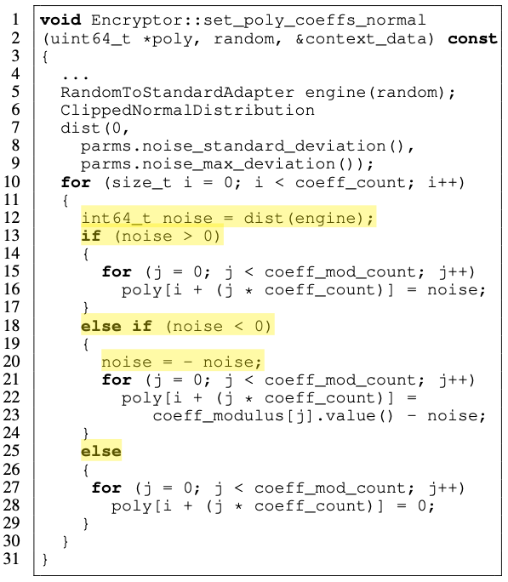
Privacy problem
FHE is airtight
Are there any possible side channels?
Prior work targets SEAL’s Gaussian sampling operation
Branch operations (line 13)
Non-uniform value assignment (line 12)
Negation operation for negative sampled value (line 20)
Reduces plaintext encryption security level from

Slide 28

Characterizing memory side channels in FHE Applications
In Collaboration with : KarthiK V Swaminathan AND SUBHANKAR PAL
IBM Research

Slide 29
Memory Access Patterns as Side Channels
Use case : Database query Application
Server knows memory layout of database.
Analyse memory traces from operations on encrypted data.
Detect any obvious patterns unique to each query.
Can we recover secret key from FHE encrypted memory traces?
No. But what else can the attacker do?

Slide 30
Notion of Trace Distinguishability
Can adversary distinguish between
Unique queries from the database – i.e., query(Q1) != query(Q2)?
For example, query : capital of (Spain) vs capital of (Mexico)
Queries found in the database vs queries non-existent in database?
Distinguishing patterns act as side-channel information to the actual query.
We use ML-based classifiers as the adversary.
Adversary trains on probing with synthetic queries and then distinguishes actual user query.

Slide 31
Experimental Setup - Trace
HELib framework with BGV FHE scheme enabled.
Trace Structure : {Program Counter, Is Branch, Branch Taken, Destination Register, Source Register, Destination Memory, Source Memory}
We look at destination and source memory addresses only.
Traces collected using PINtool, hence only virtual addresses are considered.
Spatial spread is assessed by clustering addresses at a block level granularity.
Three regions of memory detected with >60% accesses for one region.
Temporal distribution is generated for majority spatial region.

Slide 32
Flamegraph of database search
Flamegraph data obtained by attaching perf to the search.
Flamegraph obtained for multiple queries.
Maximum time is spent in power, rotate and product operations.

Slide 33
Comparative Flamegraphs
Query not in DB - Mexico
Query in DB - Estonia
Time spent in each operation is similar.
Hence different mode of vulnerability, aka, memory access patterns.

Slide 34
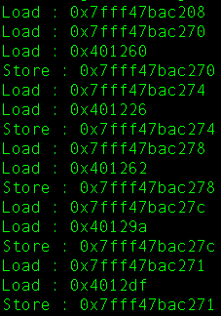
Vulnerability of memory access patterns - AES
Let, sbox base address = 0x401220.
offset[0] = 0x40
offset[1] = 0x06
offset[2] = 0x42
offset[3] = 0x7A
PT[0] = 0x6b PT[1] = 0xc1
PT[2] = 0xbe PT[3] = 0xe2
XOR with offset
KEY[0] = 0x2b KEY[1] = 0x28
KEY[2] = 0xab KEY[3] = 0x09
Locate base address (BA) of sbox from trace and calculate offset as address - BA. (Example: 0x401260 - 0x401220 = 0x40)
Memory Access Sequence in a trace from sbox function
Attacker identifies reads starting with 401xxx
Attacker has plaintext = 6bc1bee2
Key = Offset[i] ^ Plaintext[i]
Example: 0x40^0x6b = 0x2b
*Attack adapted from [1]

Slide 35
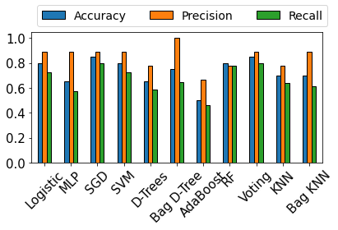
Results – Binary Trace Distinguishability
Adversary – classifying query existent in database or not.
5 existent and non-existent queries each.
20 traces for each such query.
Peak Accuracy = 80%
Peak Precision = 100%
Peak Recall = 75%
Notes:
Put Peak values

Slide 36
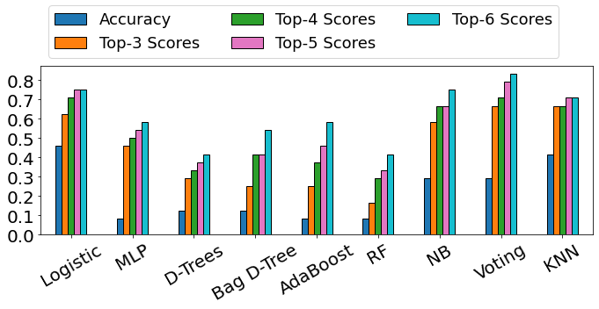
Results – Multiclass Trace Distinguishability
Adversary - classifying traces from 12 unique queries, all existing in the database.
20 traces for each query.
Train:test split – 90:10.
Peak Accuracy - 45%
For 6 labels accuracy can be as high as 80%.
Notes:
Top-k score – How often the predicted class falls in the top-k highest probabilities

Slide 37
Discussion and Future Work
Side channels to FHE implementation are a serious threat to privacy.
Memory access patterns are one such side channel.
Trace-based side channels may be present in other FHE schemes as well.
We are currently extending this to privacy-preserving ML workload for detecting credit card transactions.
Countermeasures need to be developed to thwart for such side-channel leakage.
Notes:
Possible low-overhead obfuscation techniques based on application semantics.

Slide 38

Questions?

Slide 39
References
Osvik, Dag Arne, Adi Shamir, and Eran Tromer. 2006. Cache attacks and countermeasures: the case of aes. In Cryptographers’ track at the rsa conference, 1–20. Springer.
Nikola Samardzic, Axel Feldmann, Aleksandar Krastev, Srinivas Devadas, Ronald G. Dreslinski, Christopher Peikert, Daniel Sánchez: F1: A Fast and Programmable Accelerator for Fully Homomorphic Encryption. MICRO 2021: 238-252
Sangpo Kim, Jongmin Kim, Michael Jaemin Kim, Wonkyung Jung, John Kim, Minsoo Rhu, Jung Ho Ahn: BTS: an accelerator for bootstrappable fully homomorphic encryption. ISCA 2022: 711-725
Nikola Samardzic, Axel Feldmann, Aleksandar Krastev, Nathan Manohar, Nicholas Genise, Srinivas Devadas, Karim Eldefrawy, Chris Peikert, Daniel Sánchez: CraterLake: a hardware accelerator for efficient unbounded computation on encrypted data.ISCA 2022: 173-187
Yinghao Yang, Huaizhi Zhang, Shengyu Fan, Hang Lu, Mingzhe Zhang, Xiaowei Li: Poseidon: Practical Homomorphic Encryption Accelerator. HPCA 2023: 870-881
Jongmin Kim, Gwangho Lee, Sangpyo Kim, Gina Sohn, Minsoo Rhu, John Kim, Jung Ho Ahn: ARK: Fully Homomorphic Encryption Accelerator with Runtime Data Generation and Inter-Operation Key Reuse. MICRO 2022: 1237-1254

Slide 40
Publications and Contact
Characterizing Memory Side Channels in FHE Applications
Email : asmita.pal@wisc.edu

