Slide 1


Camouflage : Utility-Aware Obfuscation for Accurate Simulation of Sensitive Program Traces
Asmita Pal*, Keerthana Desai¶, Rahul Chatterjee☨, Joshua San Miguel*
☨
¶
*
Notes:
Good afternoon everyone. I’m excited to present Camouflage, which is essentially an obfuscation framework for sensitive program traces. This research was conducted at University of Wisconsin-Madison. I look forward to sharing the insights that make this work unique.

Slide 2
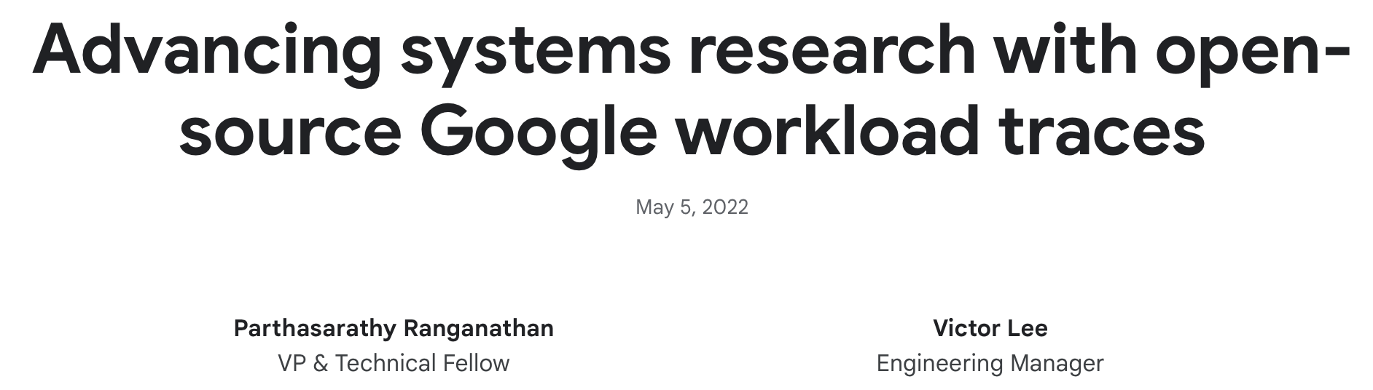
Need for traces?
Benchmark suites capture enough architectural behaviors
Computer Vision
Large Language Models
Need for better hardware
Thorough Design space exploration
Diverse Set of Workloads
High
Performance Computing
Fully Homomorphic Encryption
Notes:
Let's first understand why we need traces. Over the years, we have spent significant effort on developing benchmark suites, which capture enough architectural behaviors to evaluate cache replacement policies and prefetcher performance. However, workload diversity is evolving more rapidly today than ever. Large language models, homomorphic encryption and what not? This facilitates the need for better hardware and more thorough design space exploration. Thus, there has been a growing trend of release and dissemination of traces from real-world workloads.

Slide 3
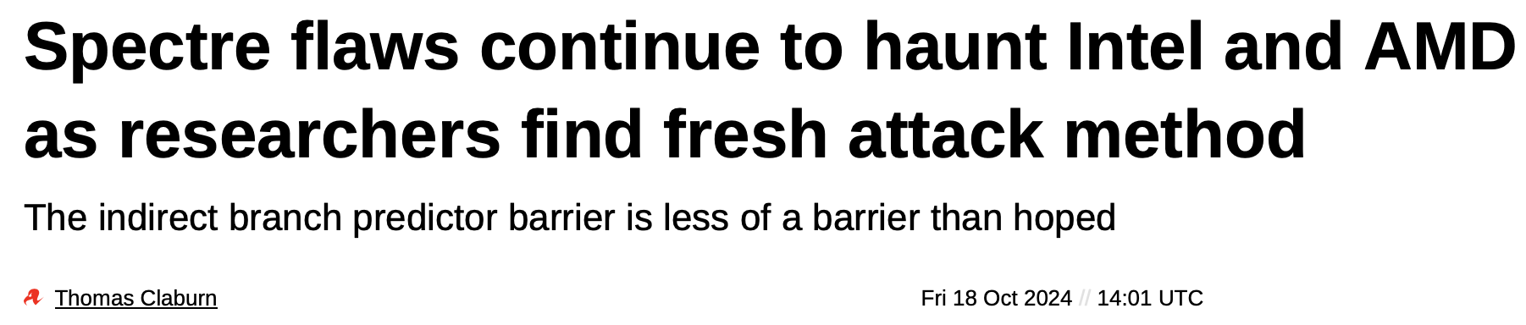
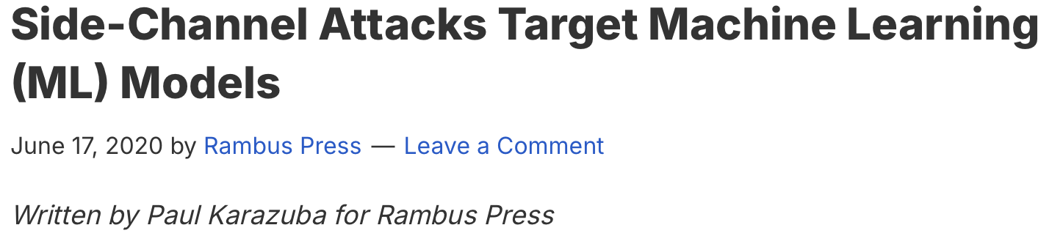
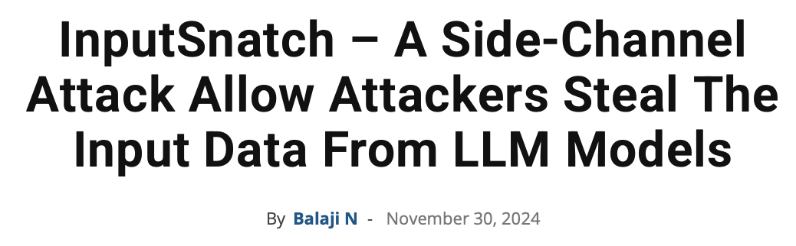
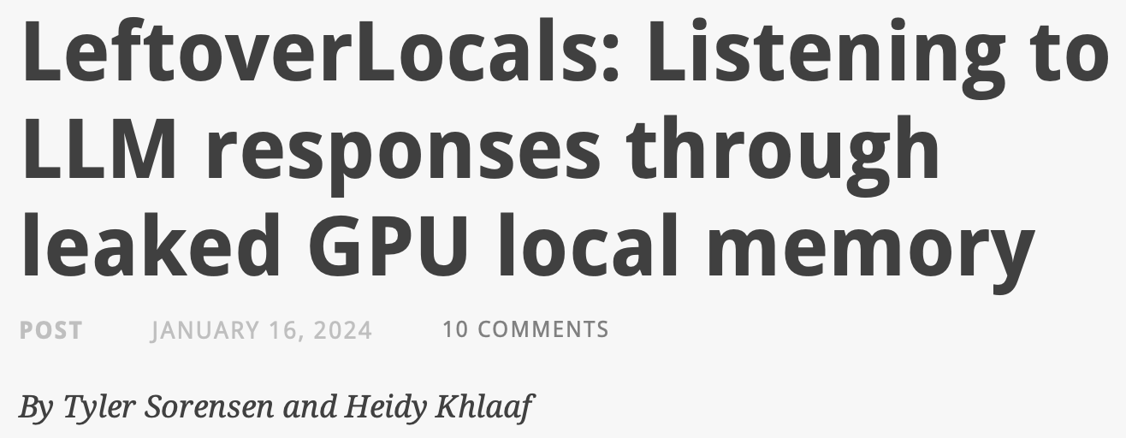
Challenges of Trace Sharing
Leakage of sensitive data from traces
Program input influences path of execution
Notes:
However, trace sharing from real-world applications comes with its own challenges. First being leakage of sensitive program data from traces. This is exacerbated in cases where program input influences the path of execution. We are obviously familiar with the array of side channel attacks that plagues present day caches. Needless to say releasing full traces could be fatal to such proprietary data.

Slide 4





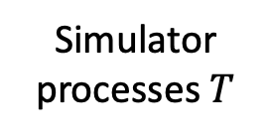

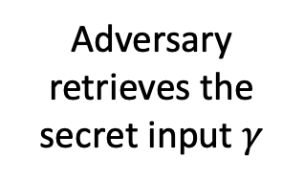

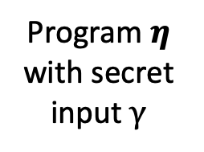
Challenges of Trace Sharing
Programmer - Private access
Public domain
Adversary retrieves the secret input $γ$
Adversary
Published Trace $T$
Program $η$ with secret input $γ$
Trace $T$
Performance System_1 = 1X
System_2 = 5X
System_3 = 3X
Simulator processes $T$
Notes:
Consider a program eta with a secret input gamma to generate a trace T, which is in the safer programmer domain. Now when this trace is released in the public domain, it can be run on a compatible simulator for getting performance numbers. However, an adversary could also have access to it and exploit it to retrieve secret input gamma.

Slide 5
Trace Structure
Trace T is a sequence of memory accesses such that T = {(a₁,v₁,s₁), … ,(a_{n},v_{n},s_{n})}, where
a_{i} ϵ {load/store}
v_{i} = virtual memory address
s_{i} = size of access
Load 0x7fff47bac208 4
Load 0x7fff47bac270 4
Load 0x401260 8
Store 0x7fff47bac270 4
Sample Trace
Can we infer information about 𝛾 from T?
Notes:
This brings us to what trace structure might look like. For this work, trace T is a sequence of memory accesses. where each tuple has the type of operation, virtual memory address and size of the access. This is a sample trace with the structure I just described. Now given this, can we infer information about the input data from trace T?

Slide 6
Exploitable Information in Traces
Not all traces have a secret key(𝛾)
Utility-oriented traces often have large input data – which is proprietary but harder to extract, unlike a key
Information from memory traces :
Absolute address values
Is directly related to input
Might reveal information about underlying system on which trace was generated.
Temporal and spatial patterns which can indirectly lead to input(𝛾)
Notes:
The answer is yes and no. Lets try to look at areas of exploitable information in traces. Not all traces have a secret key. Utility-oriented traces often have large input data - which is proprietary but harder to extract unlike a key. However, memory traces reveal certain things like absolute address values which is directly related to input and might reveal information about underlying system on which trace was generated. And then there are temporal and spatial patterns which can indirectly lead to input data such as occurrence of loops or underlying order of elements stored in databases.

Slide 7
Security vs Utility of traces
Obfuscation
Retain features important for architectural optimization
Hide parts of the trace that may be sensitive
Camouflage
Mocktails^{[3]}
Utility
Architectural Properties
Trace Wringing^{[4]}
Security
Notes:
Security and Utility are on opposite sides of a spectrum, hence its quite challenging to find a sweet spot.
Contemporary approaches impose either too great a burden on the party that wants to share the trace or
undermines the utility of the trace, since it is challenging to obtain both, as you can see here.
But if we can retain features important for optimization, as well as hide parts of the trace that may be sensitive, which is the crux of Camouflage.

Slide 8
Challenges of Trace Sharing
Programmer - Private access
Public domain
Adversary retrieves the secret input $γ$
Adversary
Published Trace $T$
Program $η$ with secret input $γ$
Trace $T$
Performance System_1 = 1X
System_2 = 5X
System_3 = 3X
Simulator processes $T$
Notes:
Lets go back to our previous figure where an adversary was successfully retrieving a secret input.

Slide 9




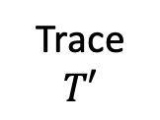
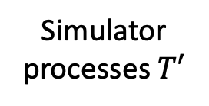
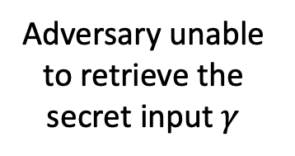

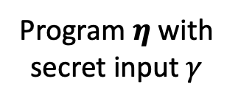
Introducing Camouflage
Programmer - Private access
Public domain
Adversary unable to retrieve the secret input $γ$
Adversary
Trace $T′$
Camouflage
Program $η$ with secret input $γ$
Performance System_1 = 1X
System_2 = 5X
System_3 = 3X
Trace $T$
Trace $T′$
Simulator processes $T′$
Notes:
However with Camouflage in the pipeline now, trace T’ is not exploitable for security violations.

Slide 10
Introducing Camouflage
Security
Programmer - Private access
Public domain
Adversary unable to retrieve the secret input $γ$
Adversary
Trace $T′$
Camouflage
Program $η$ with secret input $γ$
Performance System_1 = 1X
System_2 = 5X
System_3 = 3X
Trace $T$
Trace $T′$
Simulator processes $T′$
Utility
Notes:
As is evident from our discussion so far, we are going to touch upon two aspects of Camouflage which is security and followed by an example of utility-awareness.

Slide 11






Trace Security
Input Indistinguishability
Input $γ$₁
Input $γ$₂
Input $γ$₃
Notes:
How do we define trace security? We use this notion of indistinguishability, which is widely used in cryptography research. And it is exactly what it sounds like. You have three different inputs for the same program, giving three different traces. Now for a normal trace, an attacker can tell this trace belongs to this input and hence is distinguishable.

Slide 12

Trace Security
Input Indistinguishability for camouflaged trace
Input $γ$₁ ?$γ$₂? $γ$₃?
Notes:
What we want to achieve here with a camouflaged trace,
is indistinguishability
for traces generated from different inputs.
So that when an adversary does try to map a trace to an input, they are unable to do so. Now the obvious question here is can they tell exactly what the input is. And the answer is no. Our notion is stronger than that. If the attacker cannot tell which input it was, just by looking at the trace, we can safely assume that it will be hard to learn any non-trivial information about any of the inputs.

Slide 13
What makes a trace useful?
For architectural simulations, such as prefetching, it would be stream of memory accesses.
This depends on program semantics – data structures
For example, non-contiguous data structures such as graphs would be harder to prefetch as opposed to arrays.
Random obfuscation of access patterns jeopardizes the trace utility.
Notes:
Now, lets switch gears a bit and look at what makes a trace useful. Of course it depends on what you intend to accomplish with it. For architectural simulations, such as prefetching, it would be some pattern observed in a stream of memory accesses. Which in turn depends on data structures which generates this stream. Now random obfuscations will diffuse a lot of these patterns and not give desired performance numbers, which inturn jeopardizes trace utility.

Slide 14
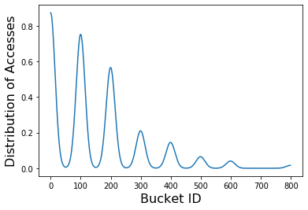
Utility-Aware Trace Obfuscation
For data structures with contiguous memory layout, such as a data-dependent array
Hash function
Keys
Buckets
Pixel 14
00
2710
Pixel 2
01
887
Pixel 7
02
53
Pixel 109
Pixel 1
256
558
Notes:
Lets take a look at one specific example. The paper has more details on the other data structures. Here you see a data-dependent array order of accesses to
the array depend on the input. Here the pixel values of an image are keys and each of them is hashed for storage. And the green box denotes the frequency of accessing a certain bucket. Now the memory sequence seen by the cache is then a function of the distribution of accesses across different buckets. And this is a key architectural property of data-dependent arrays.

Slide 15
Utility-Aware Trace Obfuscation
What we do to mimic a distribution?
Re-map address values
Permute spatial distribution at a cache block granularity (64B)
Mimic temporal distribution of accesses across buckets
Extract samples in 1:1 ratio from both the new distributions
Combine these samples to generate new access distribution for camouflaged trace
Notes:
What we do to mimic a distribution? Re-map address values because that is crucial for security. Following which we Permute spatial distribution at a cache block granularity (64B) and mimic a temporal distribution of accesses across buckets. Extract samples in 1:1 ratio from both the new distributions and Combine these samples to generate new access distribution for camouflaged trace. So, the new distribution looks very very similar to the previous one.

Slide 16
Utility-Aware Trace Obfuscation
Hash function
Hash function
Keys
Buckets
Keys
Buckets
Pixel 14
00
2710
x
00
2710+
Pixel 2
01
887
Camouflage
y
01
887+
Pixel 7
02
53
c
02
53+
Pixel 109
e
Pixel 1
256
558
3
256
558+
Notes:
You can imagine this is what happens. Note that the frequency of the new distribution may not be exactly the same which is why the plus minus. And this is merely a function of statistical modelling.

Slide 17


Camouflage Framework
Original trace
Annotation metadata available?
Automated Data Structure Identification
No
Camouflage
Camouflaged trace
Yes
Annotated Data Structures
List of Data Structures
Sequence of memory accesses
Page-wise remapping
Known Data Structure?
No
Structure-aware memory access remapping
Yes
Notes:
Summing it up, the camouflage framework looks like this where it checks if you already have an annotated trace and goes to either process these annotations and generate the trace. Or we also provide additional support for automatic data structure idntification, which is obviously les accurate. Inside Camouflage, you have the annotations and the memory access sequence. The non annotated parts go to page-wise remapping, which means the number of pages in a trace remain the same and the number of accesses across pages is distributed uniformly. The annotated parts are process uniquely for each data structure.

Slide 18
Experimental Setup
Trace Profiling – PINtool^{[1]} with predefined simulation points from Data Prefetching Championship 3.
Simulator for testing performance – ChampSim^{[2]}
Cache – 512KB 8-way set associative
Benchmarks
SPEC2017
Histogram equalization from PERFECT
GAPBS
Notes:
For trace profiling we use pintool with predefined simulation points from the data prefetching championship 3. The simulator used for testing is champsim. The cache size assumed is 512KB 8-way associative and we test it on a wide range of benchmarks, such as spec, perfect and gapbs.

Slide 19
Experimental Setup
Data structures with contiguous memory layout
Data-independent array
Data-dependent array
Compressed sparse row
Data structures with randomized memory layout
Linked list
Graph
Tree
Notes:
These are some of the common data structures that we cover in our implementation. The paper has more details on what data structures are seen in our benchmarks.

Slide 20
Camouflage-Auto
Although programmers need to do annotation only once, automating this makes it more adaptable.
Camouflage-Auto
Partitioning
Classification
Train a classifier to detect data structures from a trace..
We achieve 82% accuracy on the test set.
Bigger trace dataset will improve this, as we add more workloads.
Notes:
Before we move on to our results, this is how we do the automatic identification of data structures in traces. We adopt a set of partitioning and classification techniques. We first segment the trace into different process sections, such as code, heap, and stack accesses. Each of these are further partitioned according to their memory address values. For each partition we compute the distribution of the differences in consecutive memory accesses. We then create a feature vector to be fed into an MLP classifier, which then gives out labels for data structures. We do split our benchmarks into training and test sets, and achieve an average of 95% and 82% accuracy on the training and test set, respectively. We observe that the mis-classified
test cases primarily belong to graph or CSR, predicted as a data-independent array.

Slide 21
Are camouflaged traces useful?
Prefetcher speedup variation - normalized to a baseline with no prefetching and LRU replacement
Original (OG), Mocktails (MT)^{[3]}, Trace Wringing (TW)^{[4]}, Camouflage (C) and Camouflage-Auto (C-A)
Notes:
Are camouflaged traces actually useful? Looks like we do have some promising numbers. For reporting speedup numbers, we categorize the applications in three broad groups, based on how memory intensive they are, that is misses per kilo instruction (MPKI): (a) low intensity (MPKI ≤ 1): histeq, bc; (b) medium intensity (1 < MPKI < 10): gcc, lbm, x264, xalancbmk; and (c) high intensity (MPKI ≥ 10): deepsjeng, mcf, xz, bfs, cc, pr, sssp, tc.
To maintain trace utility we look at this speedup trend before and after obfuscation. For example, if a prefetcher (𝑓𝐴) performs better than another prefetcher (𝑓𝐵) on the original trace, a good trace modification technique would preserve a similar trend.

Slide 22
Are camouflaged traces secure?
Generate feature vector from a spatial distribution
Normalize memory addresses to n blocks (assuming 64-byte cache blocks)
Compute the fraction of memory addresses accessing each block
Input feature vector to a classifier (D-Tree here)
Output of the classifier is an input label between 1…I, where I is number of unique inputs.
Minimum security loss = equally indistinguishable
For 16 labels its 6.25%
Notes:
The security evaluation involves generating a feature vector from spatial distribution where we normalize memory addresses to n blocks and then compute the fraction of memory addresses accessing each block. We train a classifier, such a decision tree here with these feature vectors and the output of the classifier is an input label based on the number of unique inputs. We frame input indistinguishability as security loss, which means the difference between the achieved classification accuracy and the accuracy of random guessing. For 16 labels equally indistinguishable inputs means a security loss of 6.25%, which is our minimum security loss.

Slide 23
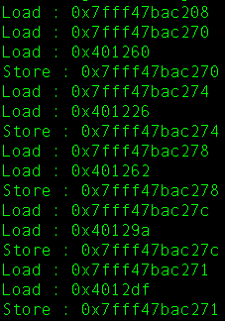
Are camouflaged traces really secure?
Let, sbox base address = 0x401220.
offset[0] = 0x40
offset[1] = 0x06
offset[2] = 0x42
offset[3] = 0x7A
PT[0] = 0x6b PT[1] = 0xc1
PT[2] = 0xbe PT[3] = 0xe2
XOR with offset
KEY[0] = 0x2b KEY[1] = 0x28
KEY[2] = 0xab KEY[3] = 0x09
Locate base address (BA) of sbox from trace and calculate offset as address - BA. (Example: 0x401260 - 0x401220 = 0x40)
Memory Access Sequence in a trace from sbox function
Adversary identifies reads starting with 401xxx
Attacker has plaintext = 6bc1bee2
Key = Offset[i] ^ Plaintext[i]
Example: 0x40^0x6b = 0x2b
*Attack adapted from [5]
Notes:
Are camouflaged traces really that secure? Lets see a snapshot of an AES encryption trace. The adversary goes on to segregate values from the sbox table. Now since the program is public, the plaintext is known to the adversary, so by xoring the offset and the plaintext, an adversary is able to recover bytes of the secret key.

Slide 24
Conclusion
Camouflage can provide guarantees on input recovery and input indistinguishability.
It is designed as security-by-default, hence missed annotations might hamper utility, but no trace security violations.
The automatic approach sacrifices a bit of performance for adaptability.
This framework can be extended to new workloads with user annotations.
Notes:
Camouflage can provide guarantees on input recovery or non-recovery to be specific. As well as input indistinguishability. It is designed as security-by-default, hence missed annotations might hamper utility, but no trace security violations. The automatic approach sacrifices a bit of performance for adaptability. This framework can be extended to new workloads with user annotations. However, its not trivial to adapt for other trace structures, such as those of branch prediction, but the concept is extendable with meticulate characterization of architectural behavior.

Slide 25
References
Luk, Chi-Keung, Robert Cohn, Robert Muth, Harish Patil, Artur Klauser, Geoff Lowney, StevenWallace, Vijay Janapa Reddi, and Kim Hazelwood. 2005. Pin: Building customized program analysis tools with dynamic instrumentation. In Proceedings of the 2005 acm sigplan conference on programming language design and implementation, 190–200. PLDI ’05, New York, NY, USA: ACM
3rd Data Prefetching championship.” 2019. [Online]. Available : https://dpc3.compas.cs.stonybrook.edu/?finalprograms
M. Badr, C. Delconte, I. Edo, R. Jagtap, M. Andreozzi, and N. E. Jerger,“Mocktails: Capturing the memory behaviour of proprietary mobilearchitectures,” in2020 ACM/IEEE 47th Annual International Symposiumon Computer Architecture (ISCA), 2020, pp. 460–472
Deeksha Dangwal, Weilong Cui, Joseph McMahan, and Timothy Sherwood. 2019. Safer Program Behavior Sharing Through Trace Wringing. In Proceedings of the Twenty-Fourth International Conference on Architectural Support for Programming Languages and Operating Systems (ASPLOS '19). Association for Computing Machinery, New York, NY, USA, 1059–1072.
Osvik, Dag Arne, Adi Shamir, and Eran Tromer. 2006. Cache attacks and countermeasures: the case of aes. In Cryptographers’ track at the rsa conference, 1–20. Springer.

