Slide 1
Coding Divas - Women HackTech Team Id # 40 [Health Record System using Hyperledger Composer Blockchain.]

Slide 2
Table of Contents
1 | Use Case
2 | Solution
3 | Technical Design
4 | Innovation
5 | Business Value
6 | Relevance
7 | Reusability
8 | Technology
9 | Value
10 | Savings

Slide 3
Use Case
Health record system, built on blockchain.
Accessibility
With our solution, hospitals and clinic will be able to finally give control of medical records to patients while not only increasing accessibility of records, but also enhancing the security of records through the power of blockchain technology.
Ownership
Our mission is to empower patients through returning ownership of records to the patients through a secure network utilizing blockchain solutions while reducing hospital works.
Secure
The largest problem we came across was one of security. Securing the worlds medical records and making them easily accessible is a difficult challenge. We feel we have combatted that challenge head-on with our hyperledger blockchain implementation

Slide 4

Solution
BUSINESS CHALLENGES
BLOCKCHAIN SOLUTION
Varying Data Standards reduce interoperability because records are not compatible between systems.
Shared data enables near real-time updates across the network to all parties.
Limited Access to Population Health Data, as HIE is one of the few sources of integrated records.
Distributed, secure access to patient longitudinal health data across the distributed ledger.
KEY BENEFITS
Reduced Cost Operational & Transactions cost
Near Real-time
Participants view
Automated
Compliance
Prevent
Fraudulent Transactions

Slide 5


Technical Design
Include a top level Technical Design Diagram
Blockchain API
Hospitals provide services to the patient
Clinical data from a patient interaction is stored in existing system
A standardized set of data with the patient Id is directed to blockchain API
Network permissions validate that the submitter has access to blockchain
A smart contract then process
the incoming transaction for blockchain recording

Slide 6

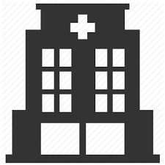
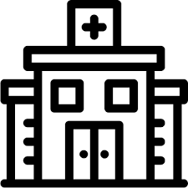

Innovation
CURRENT STATE
Patient A
Organization 1
Cost
- Repetitive checkups
- Multiple report generation
Organization 2
Separate data systems
-
Organization 3
Not secure
not easily accessible
Economic Loss
Data misuse
FUTURE STATE
Patient A
Organization1
Organization2
Organization3
Distributed ledger
Transparent network
No tampering of data
Back-trace

Slide 7
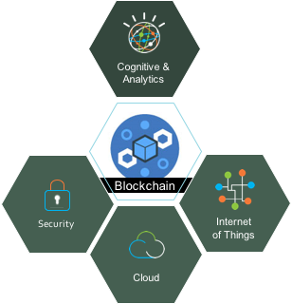
Business Value
Pain Points
Technology Enablers
Transformations in every part of business
Interoperability, accessibility, and data integrity
Privacy and Security
Healthcare delivery models and cost
Fraud and abuse
Process complexity
Customer engagement
Procurement and contracting
Regulation
Revenue leakage
Improving operations & lowering costs
Creating new facilities and making use of them
Improvement in management system

Slide 8
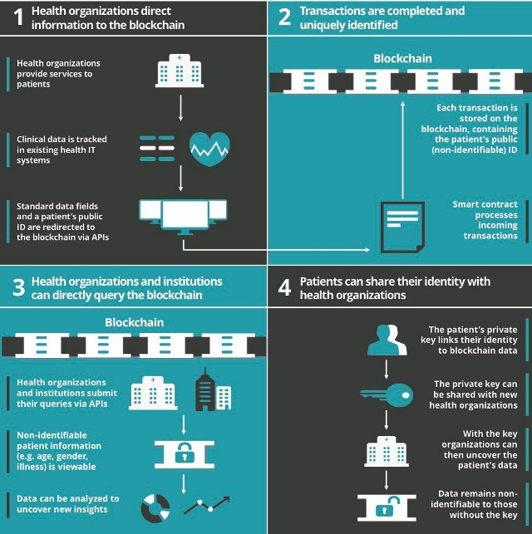
Relevance

Slide 9
Reusability
Blockchain can be used in applications like :-
1.SUPPLY CHAINS:. With modern medicines commanding premium prices, pharmaceuticals are an
attractive prospect for counterfeiters. Although an anti-counterfeiting system based on QR codes already exists in Europe, it has some fallibilities; blockchain could add a further layer of integrity for guaranteeing product integrity.
2. DRUG VERIFICATION: The ability to verify the authenticity of drugs at the point of dispensing, (e.g. community or hospital pharmacy) is an example of cross-sectoral use of blockchains with the pharmaceutical industry.

Slide 10
Technology
One technology mooted as potentially addressing some of the challenges facing data use in healthcare is blockchain.
This is a type of shared distributed digital ledger, which allows every event that a piece of data undergoes - whether it is viewed, used or changed - to be recorded indelibly.
As each event occurs, information on the event is added as a ‘block’ connected - in sequence - to the one recording the previous event.
As the data in the blockchain is recorded on a distributed, peer-to-peer basis, it creates an ever-growing, permanent record that cannot be altered retroactively

Slide 11
Value
potential for value-based healthcare cannot be overstated. The healthcare industry needs an urgent fix to the discrepancies in outcomes and data, which may never occur without a system such as blockchain.
Blockchain will impact Electronic Health Record System, value-based healthcare, precision medicine, medical research and many other areas. Its potential to create a standard, secured mechanism to exchange health data has just started to be realized.

Slide 12
Savings
In traditional systems :
Establishing a Trust Network depends on the intermediary to establish point-to-point sharing and “book-keeping” of what data was exchanged. This becomes costly.
Using Blockchain:
Intermediation of Trust likely would not require an HIE(Health Information Exchange) operator because all participants would have access to the distributed ledger to maintain a secure exchange without complex brokered trust.

Slide 13
Thank You !

