Slide 1

FEASIBILITY CHECKING AND
PERFORMANCE MEASUREMENT OF
NESTJS FRAMEWORK FOR CURRENT
FRAMEWORK MIGRATION
Guided by
Dr Jibi Abraham
Presented by
Asmita Chavan 111603011
Department of Computer Engineering and Information Technology
College of Engineering Pune (COEP)
Forerunners in Technical Education

Slide 2
AGENDA
Introduction
Literature Review
Problem Statement
Objectives
System Requirement Specifications
System Design and Architecture
Pseudo-code and Implementation
Results
Conclusion
Further Scope
References
Department of Computer Engineering and Information Technology
College of Engineering Pune (COEP)
Forerunners in Technical Education

Slide 3
INTRODUCTION
Background
Limitations in current standards and motivation
  Limitation of current backend framework
  Motivation to choose test driven development
Department of Computer Engineering and Information Technology
College of Engineering Pune (COEP)
Forerunners in Technical Education

Slide 4
LITERATURE REVIEW
Challenges in current system
Advantages of typescript over javascript
Expressjs and fastify in NestJS
Department of Computer Engineering and Information Technology
College of Engineering Pune (COEP)
Forerunners in Technical Education

Slide 5
LITERATURE REVIEW
Parameter | Current Framework | NestJS | Review
Community Support Availability | Low | High | Fewer components to maintain
Robustness | Moderate | High | Actively supported. Has 23.8K Github stars
Security | Moderate | High
Dependency Injection | Not applicable | High | Lower learning curve Low coupling
Interceptor Support | Low | High | Extensible
Separation of concerns - MVC | Low | High | Re-use best practices and latest design pattern
Parameter Declaration | Moderate | High | Flexibility
Ease of route versioning | Moderate | High | Flexibility
Department of Computer Engineering and Information Technology
College of Engineering Pune (COEP)
Forerunners in Technical Education

Slide 6
PROBLEM STATEMENT
Current system does not provide static type checking, advanced libraries and
modularity. The current framework was not resilient against product defects.
To overcome these issues, we have proposed migration of current framework
to NestJS [6]. Also, we have studied the performance between two HTTP
underlying server libraries Express.js and Fastify provided by NestJS.
Department of Computer Engineering and Information Technology
College of Engineering Pune (COEP)
Forerunners in Technical Education

Slide 7
OBJECTIVES
Study the limitations of current backend framework
Try to check the feasibility of proposed backend framework
Design a schema to measure performance of Express and Fastify libraries
provided by NestJS.
Implementing the design to further measure the performance of Express
and Fastify
Decide HTTP server library provided by NestJS depending on performance measurement.
Check feasibility of NestJS framework to migrate current framework
based on library support.
Department of Computer Engineering and Information Technology
College of Engineering Pune (COEP)
Forerunners in Technical Education

Slide 8
SYSTEM REQUIREMENT SPECIFICATION
Functional Requirements
  The systems should be able to handle GET, POST, PATCH, DELETE http requests by all browsers
  The systems should be able to fetch, create, update and delete data from database
  The systems should be able to validate incoming data through all the http requests
  Handling of http requests and database should be identical
Non-functional Requirements
  Robust - proper input type checking and error handling
  Independent - The systems functioning should be independent of the development environment
  Data Integrity - The systems should be able to maintain integrity of the data in database
Department of Computer Engineering and Information Technology
College of Engineering Pune (COEP)
Forerunners in Technical Education

Slide 9
SYSTEM REQUIREMENT SPECIFICATION
Software Requirements
  NestJS framework
  Integrated Development Environment (IDE)
  Jest npm library
  Docker
  OS capable to build docker containers [4]
  Auto Cannon npm library - for performance testing
  Web browser - to send request to server
  Postgres database server
  Postman - for API testing
Hardware Requirements
  CPU with at least 4 GB RAM and capable to run mentioned softwares
  Power supply
Department of Computer Engineering and Information Technology
College of Engineering Pune (COEP)
Forerunners in Technical Education

Slide 10
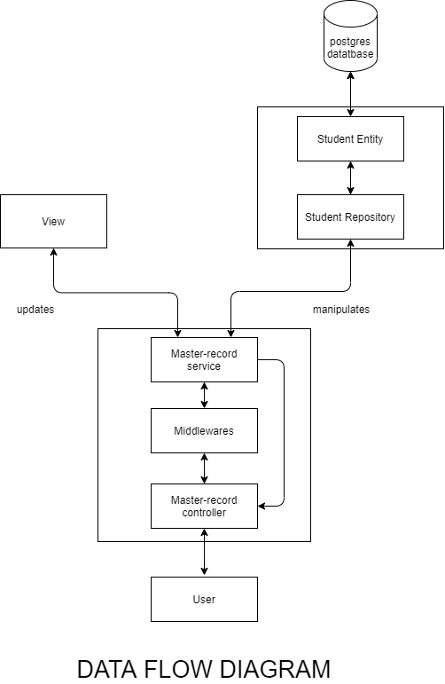
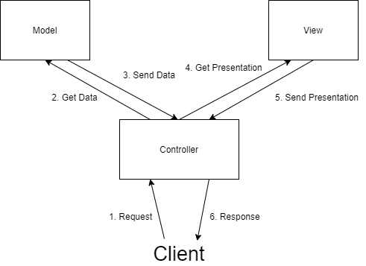
SYSTEM DESIGN AND ARCHITECTURE
ARCHITECTURE DIAGRAM
DATA FLOW DIAGRAM
Department of Computer Engineering and Information Technology
College of Engineering Pune (COEP)
Forerunners in Technical Education
Notes:
abcdefg

Slide 11
PSEUDO-CODE AND IMPLEMENTATION
Pseudo code of main.ts
Import global-validation pipes
Import database configurations
function bootstrap(){
app = http-server() //either express or fastify
@usePipes(global-validation pipes)
initialize database server
app.listen(port, (error) {
print(‘server started successfully!’)
}
}
Department of Computer Engineering and Information Technology
College of Engineering Pune (COEP)
Forerunners in Technical Education

Slide 12
PSEUDO-CODE AND IMPLEMENTATION
Pseudocode for controller
Import MasterRecordService module
@Controller(‘master-record’)
Export class MasterRecordController {
constructor() {
set MasterRecordService module
}
@get() // get request
getMasterRecord(request, response) {
valid_request = middleware(reqest)
if(valid_request)
return this.MasterRecordService
}
}
Department of Computer Engineering and Information Technology
College of Engineering Pune (COEP)
Forerunners in Technical Education

Slide 13
PSEUDO-CODE AND IMPLEMENTATION
Pseudocode for service
Export class MasterRecordService {
student_repository = getStudentRepository()
getMasterRecords() {
data = student_repository.findAll()
return data
}
getMasterRecordById(id){
data = student_repository.find({id})
return data
}
}
Department of Computer Engineering and Information Technology
College of Engineering Pune (COEP)
Forerunners in Technical Education

Slide 14
PSEUDO-CODE AND IMPLEMENTATION
Pseudocode for middleware
Export class MasterRecordDto {
@IsOptional()
id: string
@IsIn([
Approved,
Studying
])
enum: CoeStatusEnum
@IsString()
@IsNotEmpty()
Name: string
}
Department of Computer Engineering and Information Technology
College of Engineering Pune (COEP)
Forerunners in Technical Education

Slide 15
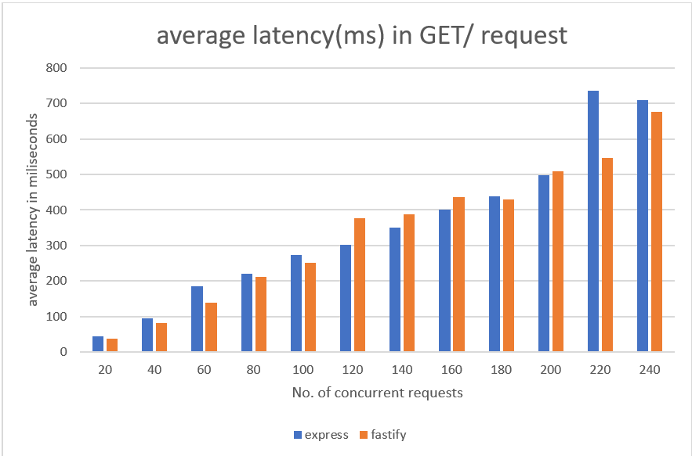
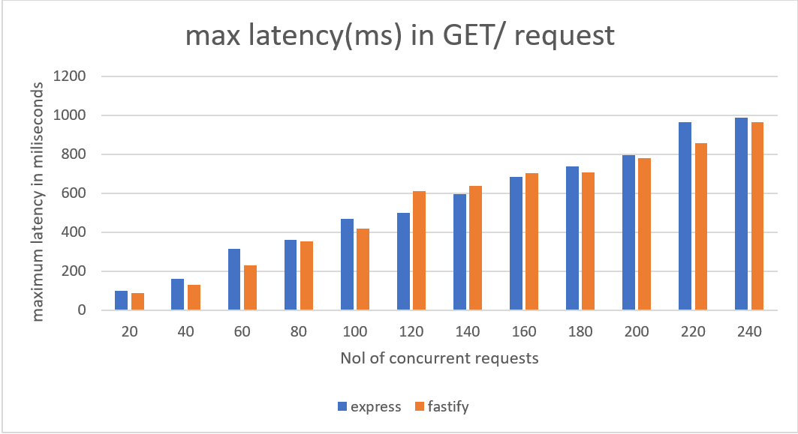
RESULTS
Department of Computer Engineering and Information Technology
College of Engineering Pune (COEP)
Forerunners in Technical Education

Slide 16
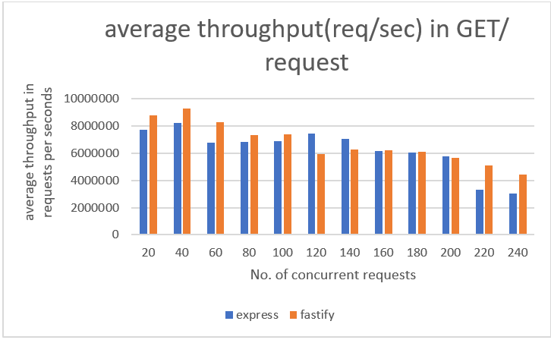
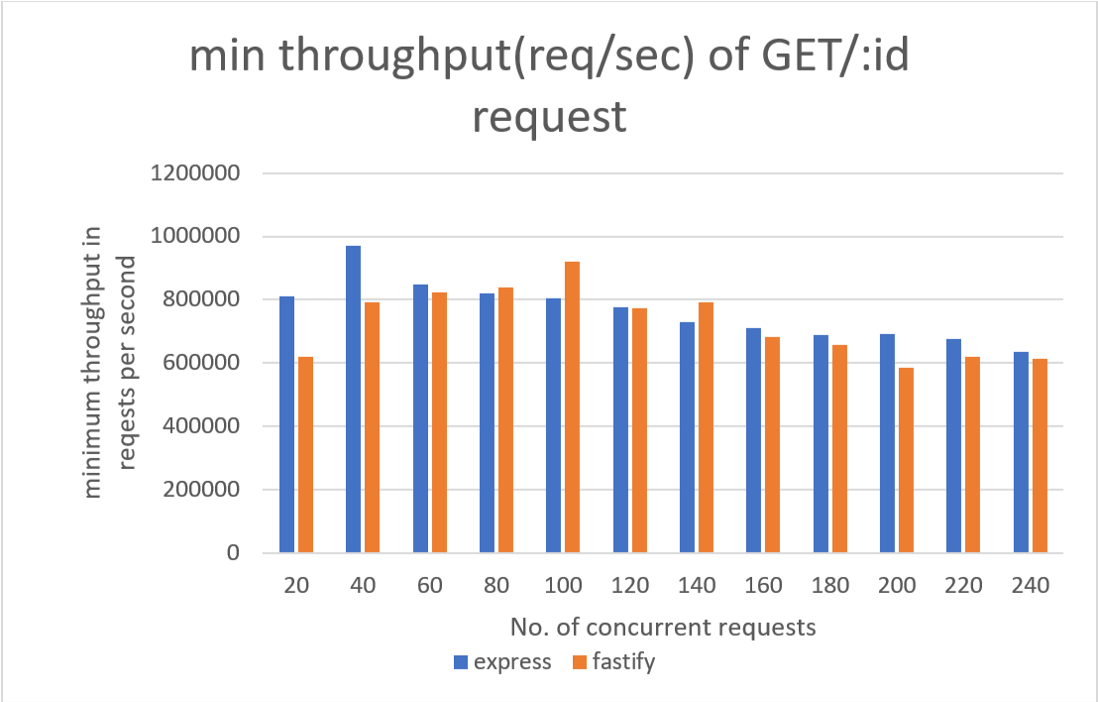
RESULTS
Department of Computer Engineering and Information Technology
College of Engineering Pune (COEP)
Forerunners in Technical Education

Slide 17
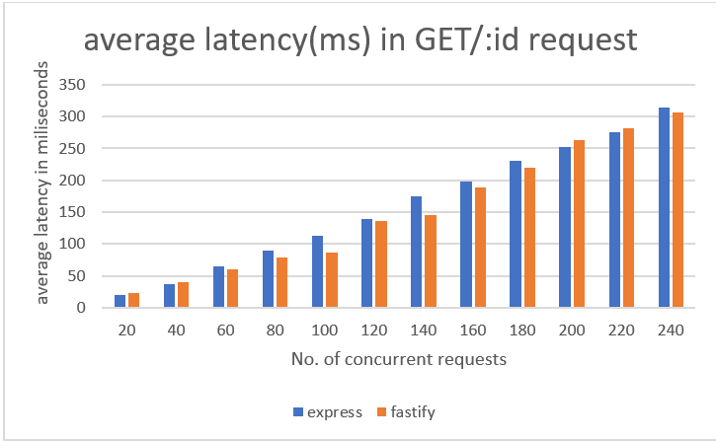
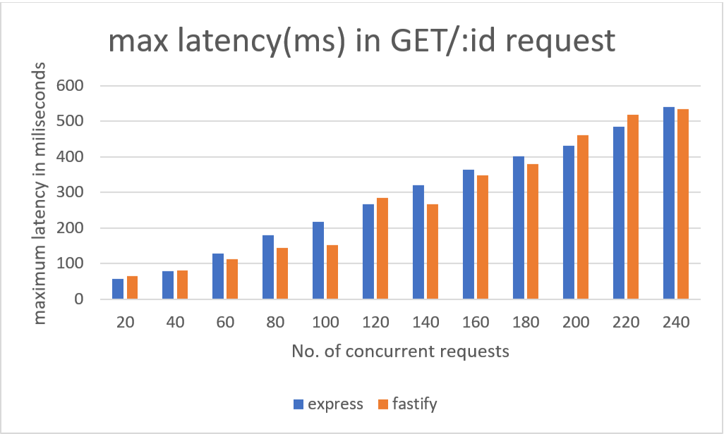
RESULTS
Department of Computer Engineering and Information Technology
College of Engineering Pune (COEP)
Forerunners in Technical Education

Slide 18
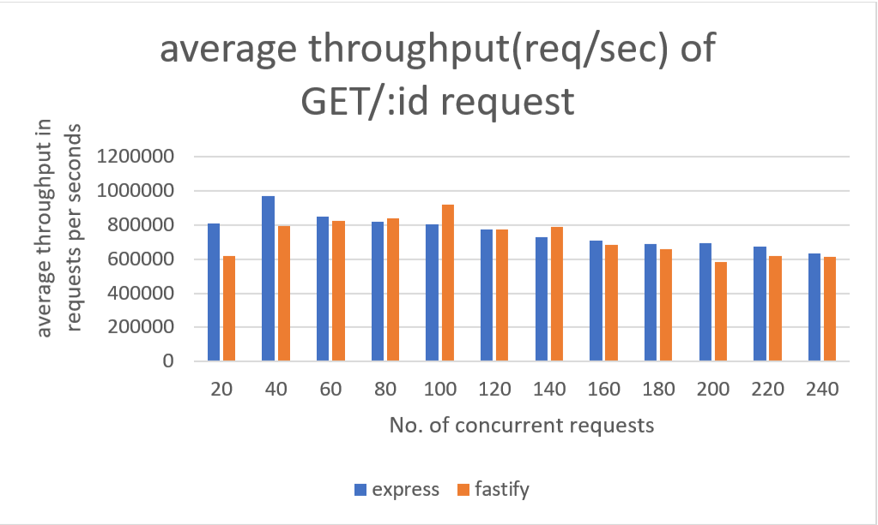
RESULTS
Department of Computer Engineering and Information Technology
College of Engineering Pune (COEP)
Forerunners in Technical Education

Slide 19
CONCLUSION
Fastify and Express both could handle all the incoming requests with proper incoming data validation.
In both the projects, data consistency in database is achieved.
Performance comparison between fastify and express shows that fastify handles incoming requests 5% faster than express also its throughput is nearly 5 % higher than express
Department of Computer Engineering and Information Technology
College of Engineering Pune (COEP)
Forerunners in Technical Education

Slide 20
FURTHER SCOPE
NestJS supports REST, GraphQL, Websockets, gRPC, etc. These features can be considered while developing the application
This framework supports many advanced engineering concepts like Domain Driven Design, Event Sourcing, Microservices Architecture, etc. These concepts can be used for development
Department of Computer Engineering and Information Technology
College of Engineering Pune (COEP)
Forerunners in Technical Education

Slide 21
REFERENCES
[1] Node.js https://nodejs.org/en/
[2] Express.js https://expressjs.com/
[3] Typescript: Typed JavaScript at Any Scale https://www.typescriptlang.org/
[4] Docker documentation https://docs.docker.com/
[5] Benchmarking in Fastify https://www.fastify.io/benchmarks/
[6] NestJS – A progressive Node.js framework https://nestjs.com/
[7] Fastify https://www.fastify.io/
Department of Computer Engineering and Information Technology
College of Engineering Pune (COEP)
Forerunners in Technical Education

Slide 22
Thank You
Department of Computer Engineering and Information Technology
College of Engineering Pune (COEP)
Forerunners in Technical Education

