Slide 1
CAPSTONE PROJECT
SepsisGuard
Clinical Decision Support System
AI-powered early sepsis detection with explainable recommendations
Sujan Dhandapani Murali Balakrishnan · Vishesh Bharuka · Asmita Chetlapalli
XGBoost
SHAP Explainability
RAG Guidelines
Streamlit
Notes:
Good morning everyone. We're presenting SepsisGuard — an AI-powered clinical decision support system for early sepsis detection in ICU patients. Our team is Sujan, Vishesh, and Asmita.

Slide 2
Why does early sepsis detection matter?
1 in 3
1.7M
+7%
US hospital deaths
caused by sepsis
US adults
affected annually
Mortality per hour
of delayed treatment
Sepsis causes 1 in 3 hospital deaths in the US - 1.7 million adults affected annually
Every hour of delayed treatment increases mortality by 7%
Surviving Sepsis Campaign: antibiotics, fluids, and blood cultures within 60 minutes of recognition
Sepsis is hard to recognize early - symptoms overlap with many other conditions
Goal: predict sepsis onset using vital signs and lab values, then explain using published clinical guidelines
⚠ A system that gives both a risk score AND actionable guideline-based recommendations
Notes:
So why sepsis? Sepsis is one of the leading causes of death in hospitals — it causes 1 in 3 hospital deaths in the US, affecting 1.7 million adults annually. The critical challenge is time. Every hour of delayed treatment increases mortality by 7%. The Surviving Sepsis Campaign recommends starting antibiotics, fluids, and blood cultures within 60 minutes of recognition — but the problem is, sepsis is hard to recognize early. Symptoms overlap with many other conditions. Our goal was to build a system that can predict sepsis onset in ICU patients using their vital signs and lab values, and then explain the prediction using published clinical guidelines — so doctors get both a risk score and actionable recommendations.

Slide 3
Three-component system
Data Pipeline
ML Models
RAG Pipeline
Raw PhysioNet .psv files → preprocessing
Handle missing values & engineer temporal features
30-feature matrix per hourly ICU record
XGBoost (primary) - 30 features, Optuna-tuned
Logistic Regression - baseline comparison
Same features & splits for fair evaluation
SSC 2021, 2023 ED, AAFP 2022 → ChromaDB
Retrieves relevant guideline chunks per patient
Gemini generates grounded recommendations
→
→
30 Features
AUROC = 0.81
Evidence-based
Everything surfaces in a Streamlit dashboard: risk score · SHAP explanations · evidence-based recommendations
Notes:
Here's our system architecture. It has three main components. First, the data pipeline — we take raw PhysioNet patient files, preprocess them by handling missing values and engineering temporal features, and produce a 30-feature matrix for each hourly ICU record. Second, the ML models — XGBoost is our primary model using all 30 features, and Logistic Regression serves as the baseline using the same features for fair comparison. Third, the RAG pipeline — we embedded clinical guidelines from three published sources into a ChromaDB vector database. When a patient is assessed, the system retrieves the most relevant guidelines and passes them to Google Gemini, which generates patient-specific recommendations. Everything comes together in a Streamlit dashboard that shows the risk score, SHAP explanations of why that score was given, and evidence-based treatment recommendations.

Slide 4
PhysioNet Dataset
40,336
1.55M
1.8%
De-identified ICU
patient stays
Hourly records
across all stays
Hourly records
labeled sepsis
📋 Dataset features
⚡ Key challenges
14 engineered temporal features - hourly deltas and 3-hour rolling means for 7 vitals, capturing deterioration patterns
26 lab values - measured when clinicians order them
6 demographic features (age, gender, admit time, ICULOS …)
Total: 40 raw columns before feature selection
Only 1.8% of hourly records positive - extreme class imbalance
2,932 sepsis patients out of 40,336 total
Lab missingness: BUN 93%, Glucose 89%, pH 80%+ missing
Model must learn from very few positive examples
Patient-level 80/20 train-test split — no patient appears in both sets (prevents data leakage)
Notes:
We used the PhysioNet Computing in Cardiology Challenge 2019 dataset. This is a real clinical dataset with 40,336 de-identified ICU patient stays — over 1.5 million hourly records. Each record contains 8 vital signs measured hourly, 26 lab values measured when clinicians order them, and 6 demographic features. The key challenge is extreme class imbalance — only 1.8% of hourly records are labeled as sepsis. That's 2,932 sepsis patients out of 40,336 total. This means the model has to learn from very few positive examples while seeing millions of negative ones. We also found that lab values have very high missingness — some features like BUN, Glucose, and pH are 80 to 93% missing because they're only measured when ordered. This significantly influenced our feature selection.

Slide 5
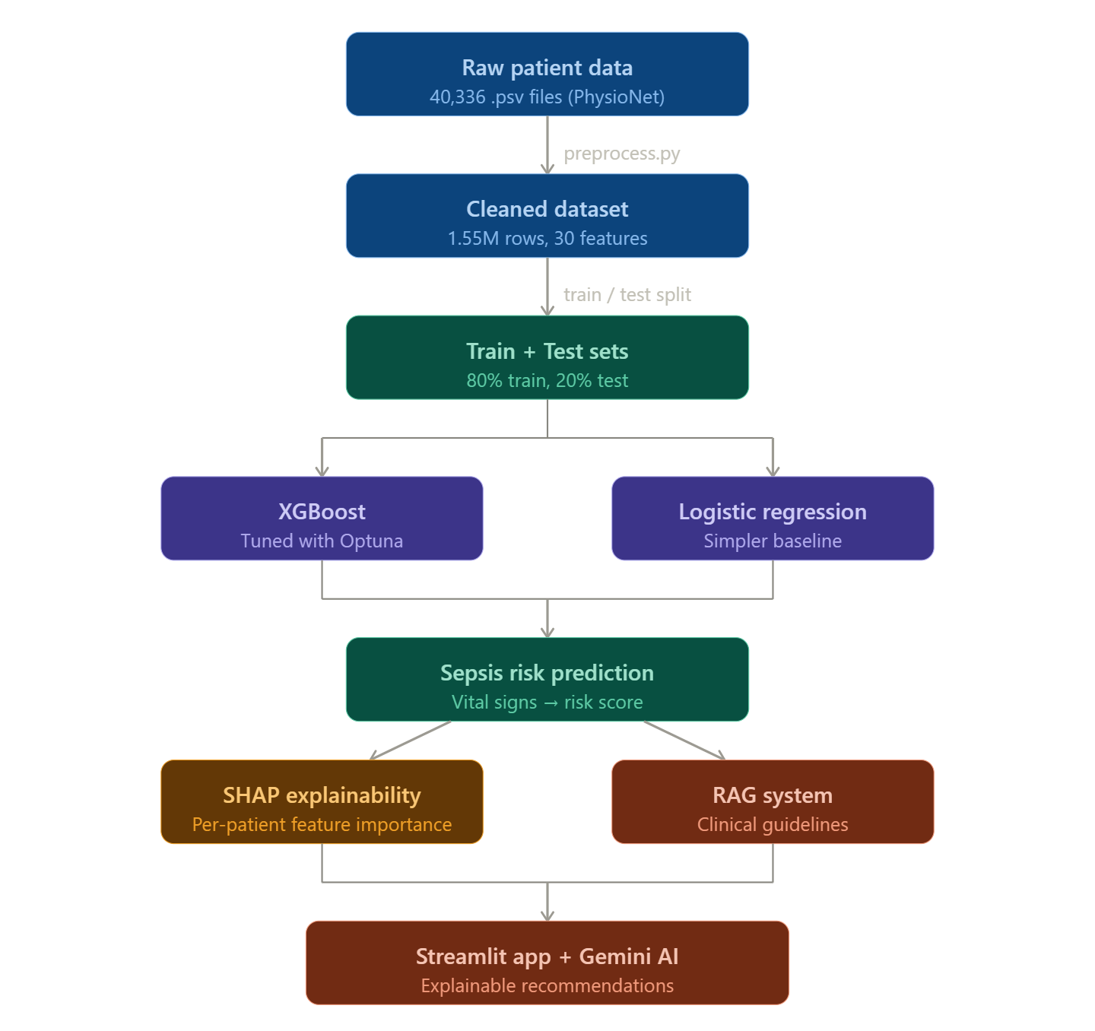

Slide 6
Preprocessing & Feature Engineering
1
2
Missing Value Handling
Feature Selection
Forward-fill vital signs (recorded hourly). Global median imputation for sparse lab values.
Dropped features >80% missing (BUN, Glucose, Hgb, Hct, pH). Kept 16 clean base features.
3
4
Temporal Feature Engineering
Patient-Level Train-Test Split
For each of 7 vital signs: Δ from previous hour + 3-hour rolling mean. Adds 14 temporal features → 30 total.
80% train / 20% test split by patient ID — no data leakage between sets.
Key insight: sepsis isn't just about absolute values — deterioration patterns matter. A HR of 100 rising from 80 is very different from a stable 100.
Notes:
Our preprocessing pipeline has four steps. First, missing value handling. For vital signs, which are recorded hourly, we use forward-fill — carrying the last known value forward. For lab values, which are sparse, we fill with the global median. Second, feature selection. We started with 40 columns but dropped features with more than 80% missing data — BUN, Glucose, Hgb, Hct, and pH — because filling them with medians adds more noise than signal. This left us with 16 clean base features. Third, and this was a key improvement — temporal feature engineering. For each of the 7 vital signs, we computed two additional features: the delta, which is the change from the previous hour, and the 3-hour rolling mean, which captures recent trends. This adds 14 temporal features, giving us 30 total. This was important because sepsis isn't just about absolute values — it's about deterioration patterns. A heart rate of 100 that was 80 an hour ago is very different from one that's been stable at 100. The temporal features capture this. Finally, we used patient-level train-test splits — 80% train, 20% test — to prevent data leakage. We never allow data from the same patient to appear in both sets.

Slide 7
Model Selection
Logistic Regression - Baseline
Reference
Random Forest - Considered
Overfit
✔ Simple & interpretable
✔ Fast training
✘ Linear boundaries only
✘ Can't model feature interactions
✔ Handles non-linearity
✘ Overfit on small initial dataset
✘ Slow on large feature sets
LSTM - Considered
Insufficient data
XGBoost ✓ - Selected
AUROC 0.81
✔ Native time-series support
✘ Only 2,932 sepsis patients
✘ Couldn't learn stable temporal patterns
✔ Native tabular data support
✔ scale_pos_weight for imbalance
✔ Captures Non-linear interactions via tree splits
✔ Works well at moderate dataset size
Both XGBoost and Logistic Regression use the same 30 features and same train-test split for fair comparison
Notes:
We evaluated multiple models for this task. We started with Logistic Regression as our baseline — it's simple, interpretable, and gives us a reference point. We also considered Random Forest, but it overfit on the small initial dataset. We tried LSTM neural networks since ICU data is time-series, but with only 2,932 sepsis patients, it didn't have enough data to learn stable temporal patterns through deep learning. We selected XGBoost as our primary model for several reasons: it handles tabular data natively, has built-in support for class imbalance through scale_pos_weight, can capture non-linear feature interactions through tree splits, and works well even with moderate dataset sizes. For fair comparison, both XGBoost and Logistic Regression use the same 30 features and the same train-test split.

Slide 8
XGBoost Training & Hyperparameter Tuning
Optuna Bayesian Optimization
Best configuration (Optuna)
Ran 50 trials × 3-fold stratified cross-validation
Tuned: n_estimators, max_depth, learning rate
Tuned: scale_pos_weight, subsample, colsample
Tuned: L1 / L2 regularization (alpha, lambda)
Early stopping: halts if val AUC flat for 30 rounds
max_depth
5
learning_rate
0.02
scale_pos_weight
~20
n_estimators
500 (early stop)
⚠ Why scale_pos_weight matters
Without it, the model predicts 'no sepsis' for everything -achieving 98% accuracy while catching zero actual sepsis cases. Class weighting forces the model to pay attention to rare positive cases.
Optuna found max_depth=5 and scale_pos_weight≈20 as the most impactful hyperparameters for this imbalanced clinical dataset
Notes:
For hyperparameter tuning, we used Optuna — a Bayesian optimization framework — running 50 trials with 3-fold stratified cross-validation. The key hyperparameters tuned were: number of estimators, max depth, learning rate, scale_pos_weight for class imbalance, subsample and column sample ratios, and regularization parameters. The best configuration found by Optuna was: max depth of 5, learning rate of 0.02, and scale_pos_weight around 20. We also used early stopping — training stops automatically when the validation AUC doesn't improve for 30 consecutive rounds. One important finding: scale_pos_weight is critical for this problem. Without it, the model would just predict 'no sepsis' for everything and get 98% accuracy — but catch zero actual sepsis cases. The class weighting forces the model to pay attention to the rare positive cases.

Slide 9
Model performance - held-out test set (4,068 patients)
Model | AUROC | Sensitivity | Specificity | PR-AUC | Target Met?
XGBoost (primary) | 0.81 | 71% | 77% | 0.10 | ✅ Yes
Logistic Regression | 0.72 | 55% | 80% | 0.07 | ❌ No
Target | > 0.75 | — | — | — | —
ROC curve: XGBoost AUROC 0.81 vs LR 0.72 - both well above random baseline
PR-AUC 0.10 looks low, but baseline is 0.017 - model is 6× better than random (expected with 1.8% positive rate)
Confusion matrix at threshold 0.14: correctly identifies 3,736 of 5,247 sepsis cases (71% sensitivity)
False alarms trigger a blood test; a missed sepsis case can be fatal - high sensitivity intentionally prioritized
Hospitals can adjust the decision threshold to match their tolerance for false alarms
AUROC 0.81 — 13% relative improvement over Logistic Regression, exceeds clinical utility target of 0.75
Notes:
Here are our results on the held-out test set of about 311,000 records from 4,068 patients. ROC curve: XGBoost achieves AUROC 0.81, significantly outperforming Logistic Regression at 0.72. Both are well above the random baseline. PR-AUC is 0.10, which may look low, but the baseline is only 0.017 — so our model is 6 times better than random. Low PR-AUC is expected with 1.8% positive rate. Confusion matrix at the optimal threshold: We correctly identify 3,736 sepsis cases out of 5,247 — that's 71% sensitivity. We do have false positives, but in clinical practice, a false alarm triggers a blood test while a missed sepsis case can be fatal. High sensitivity is intentionally prioritized. The threshold analysis shows how sensitivity and specificity trade off as we move the decision threshold. At our optimal threshold of 0.14, we get 71% sensitivity and 77% specificity. Hospitals can adjust this threshold based on their tolerance for false alarms.

Slide 10
SHAP explainability - why this prediction?
PER-PATIENT FEATURE CONTRIBUTIONS
WHAT SHAP DOES
Increases risk
Decreases risk
Assigns each feature a contribution score for every individual prediction - not just globally
ICULOS
+0.21
Positive value = pushes the risk score up; negative = pulls it down
Lactate
+0.16
Based on Shapley values from game theory - mathematically fair attribution
Temp
+0.13
Uses TreeExplainer - runs at inference time, no extra model needed
Resp_roll3
+0.11
HR
+0.08
Creatinine
+0.05
WHY THIS MATTERS CLINICALLY
Clinician can see exactly which vitals triggered a HIGH alert
MAP
-0.07
O2Sat
-0.04
ICULOS + Lactate + Temp are the top 3 - all SOFA (Sequential Organ Failure Assessment) score components
SBP
-0.03
Makes the system auditable and trustworthy, not a black box
Key insight: SHAP is computed per patient, per prediction - so two patients with the same risk score may be flagged for completely different reasons

Slide 11
Retrieval Augmented Generation (RAG)
Knowledge
Base
Chunk &
Embed
ChromaDB
Search
Gemini 2.5
Flash
Clinical
Output
SSC 2021, 2023 ED,
AAFP 2022 → 47 chunks
all-MiniLM-L6-v2
384-dim vectors
Cosine similarity
Top-5 chunks
Constrained prompt
No hallucination
Patient-specific
recommendations
Knowledge base: SSC 2021 · 2023 ED Update · AAFP 2022 → 47 semantically coherent chunks
Chunking: Header-aware strategy preserving clinical topic boundaries
Embeddings: all-MiniLM-L6-v2 → ChromaDB cosine similarity search
Query construction: Dynamically assembled from abnormal vitals - e.g. "sepsis management tachycardia hypotension elevated lactate"
Output: 3-5 prioritised, bullet-point recommendations with physician-review disclaimer
Constrained prompt: LLM can ONLY cite retrieved guideline chunks - prevents hallucination of medical advice
Notes:
The third component is our RAG pipeline — Retrieval Augmented Generation — which provides evidence-based treatment recommendations. We embedded clinical guidelines from three published sources: the Surviving Sepsis Campaign 2021, the 2023 Emergency Department Sepsis Update, and the AAFP 2022 Practice Guidelines. These were chunked into 47 sections and embedded using the all-MiniLM-L6-v2 sentence transformer into a ChromaDB vector database. When a patient is assessed, the system detects their abnormal vitals — like tachycardia, hypotension, elevated lactate — and builds a semantic query. ChromaDB retrieves the 5 most relevant guideline chunks. These chunks plus the patient's data are passed to Google Gemini with a constrained prompt — the LLM can only cite the retrieved evidence, preventing hallucination of medical advice. The result is a patient-specific recommendation grounded in published clinical evidence — not generic advice, but targeted guidance based on what's actually wrong with this specific patient.

Slide 12
Clinical Scenario Evaluation
✅
Healthy adult, normal vitals
LOW
✅
Stable post-surgical patient
LOW
Correctly classified
Correctly classified
✅
Early sepsis - tachycardia + fever
MODERATE
⚠
Borderline - mild tachycardia only
MODERATE
Correctly classified
Scored MODERATE at 17.7% - clinically appropriate over-caution
✅
Septic shock - high lactate + hypotension
HIGH
✅
Atypical hypothermic sepsis
HIGH
Correctly classified
Correctly classified
5 of 6 scenarios correctly classified. The one miss is an error toward over-caution - clinically appropriate in ICU settings.
Notes:
Beyond the metrics, we validated the system with 6 clinical scenarios ranging from healthy adults to septic shock. 5 out of 6 scenarios were correctly classified. The one miss was a healthy adult scored as MODERATE at 17.7% — borderline, and the model errs on the side of caution, which is clinically appropriate in an ICU where it's better to over-monitor than to miss early sepsis. The model correctly identified: stable post-surgical patients as LOW risk, early sepsis with tachycardia and fever as MODERATE, and both septic shock and atypical hypothermic sepsis as HIGH risk.

Slide 13
Live Demo
1 Normal patient
Vitals: HR 85 · SpO2 97 · Temp 37.0 · MAP 75 · Resp 16 · Lactate 1.0 · WBC 8 · Creatinine 1.0 · ICULOS 24 · Age 55 · SBP 120 · DBP 70
Expect: LOW risk · no flags · general monitoring
2 Septic shock
Vitals: HR 130 · SpO2 86 · Temp 39.5 · MAP 50 · Resp 32 · Lactate 5.0 · WBC 22 · Creatinine 3.0 · ICULOS 72 · Age 72 · SBP 80 · DBP 40
Expect: HIGH risk · SHAP shows ICULOS + Lactate + Temp · SSC Hour-1 Bundle
Vitals: HR 100 · SpO2 94 · Temp 38.5 · MAP 68 · Resp 24 · Lactate 2.50 · WBC 14 · Creatinine 1.50 · ICULOS 48 · Age 65 · SBP 100 · DBP 55
3 Borderline
Expect: MODERATE risk · flags tachycardia & tachypnea · cautious recommendations
Notes:
Let me show you the system in action. Open http://localhost:8501 Demo 1 — Normal patient (30 sec): Default values — HR 85, SpO2 97, normal temp, normal MAP. Click Assess. The system correctly identifies low risk. No vital sign flags. Recommendations suggest continued monitoring. Demo 2 — High risk patient (1.5 min): Enter HR 130, SpO2 86, Temp 39.5, SBP 80, DBP 40, MAP 50, Resp 32, Age 72, Lactate 5.0, WBC 22, Creatinine 3.0, ICULOS 72. Click Assess. Risk score is HIGH — SHAP explains why: ICULOS, temperature, and lactate are the biggest contributors. Vital sign flags catch tachycardia, hypoxemia, hypotension, tachypnea, elevated lactate, leukocytosis, and renal concern. RAG pulls from SSC 2021 and recommends norepinephrine, crystalloid fluids, and lactate-guided resuscitation. Demo 3 — Borderline patient (1 min): HR 100, SpO2 94, Temp 38.5, MAP 68, Resp 22, Age 65, Lactate 2.5, WBC 14, ICULOS 48. A borderline case — moderate risk. System flags tachycardia and tachypnea but recommendations are more cautious.

Slide 14
Key Findings & Contributions
1
XGBoost with 30 features achieves AUROC 0.81 - exceeds the 0.75 clinical utility threshold set by PhysioNet Challenge
2
Temporal features (deltas + rolling means) significantly improve prediction
3
Dropping ultra-sparse features (>80% missing) improved performance by reducing noise - quality over quantity in feature selection
4
RAG pipeline grounds all recommendations in published clinical evidence: SSC 2021, 2023 ED Update, AAFP 2022 - no hallucination
5
SHAP provides per-patient explanations that make the system transparent, auditable, and trustworthy for clinical use
Notes:
To summarize our key findings: First, XGBoost with 30 features achieves AUROC 0.81, exceeding the 0.75 clinical utility threshold established by the PhysioNet Challenge. Second, temporal features significantly improve prediction — the deltas and rolling means we engineered contribute to the top features by importance. Third, dropping ultra-sparse features with over 80% missing data improved performance by reducing noise. Fourth, the RAG pipeline grounds all recommendations in published clinical evidence — SSC 2021, 2023 ED Update, and AAFP 2022. And fifth, SHAP provides per-patient explanations that make the system transparent and trustworthy for clinical use.

Slide 15
⚠ Current Limitations
🚀 Future Work
EHR integration for real-time continuous monitoring from patient bedside
Expand RAG knowledge base with broader clinical literature
External validation on datasets from different institutions
Prospective clinical trial before any deployment consideration
Trained on PhysioNet only - real deployment needs validation on other hospital data
Dashboard uses single time-point input - temporal features default to zero without live EHR (Electronic Health Records) feed
PR-AUC 0.10 due to extreme class imbalance a known challenge in clinical sepsis prediction
All LLM outputs require physician review before any clinical action
Notes:
Some limitations to acknowledge: The model was trained on a single dataset — PhysioNet 2019. Real-world deployment would require validation on data from other hospitals. The dashboard uses single-timepoint input, so temporal features default to zero. In a real ICU integration, we'd connect to continuous patient monitors for real temporal data. PR-AUC is low at 0.10 due to extreme class imbalance — a known challenge in clinical sepsis prediction. For future work: integrating with hospital EHR systems for real-time continuous monitoring, expanding the RAG knowledge base with more clinical literature, adding patient history tracking over time, and validating on external datasets from different institutions.

Slide 16
Thank You
Target met: AUROC 0.81 - exceeds 0.75 clinical utility threshold
Explainable: SHAP makes every prediction interpretable
Evidence-grounded: RAG cites SSC 2021 guidelines, not hallucinations
End-to-end: Raw PhysioNet files → live Streamlit dashboard
Notes:
That concludes our presentation. The code is available on GitHub. We're happy to take any questions, and we can demo any specific scenario you'd like to see.

Slide 17
References
1. Reyna, M., et al. (2019). Early Prediction of Sepsis from Clinical Data. Critical Care Medicine, 48(2), 210–217.
2. Evans, L., et al. (2021). Surviving Sepsis Campaign: International Guidelines. Intensive Care Medicine, 47(11), 1181–1247.
3. Guarino, M., et al. (2023). 2023 Update on Sepsis Management in the Emergency Department. J Clinical Medicine, 12(9), 3188.
4. Kumar, A., et al. (2006). Duration of hypotension before initiation of effective antimicrobial therapy. Critical Care Medicine, 34(6), 1589–1596.
5. Chen, T., & Guestrin, C. (2016). XGBoost: A Scalable Tree Boosting System. KDD 2016.
6. Lundberg, S., & Lee, S. (2017). A Unified Approach to Interpreting Model Predictions. NeurIPS 2017.
7. CDC. (2021). Sepsis: Data and Reports. https://www.cdc.gov/sepsis

