Slide 1

Last-Mile Delivery
ANALYTICS DIVISION
Optimization Project
How Delhivery Can Reduce Cost per Shipment by 22%,
Cut Delays by 38%, and Improve On-Time Rate by 3.4 pp
through Smart Route Optimization & Delivery Allocation
Prepared by: Asmit Choudhary
Dataset: 1,200 shipments | 8 zones | 26 variables
Period: FY 2024–25 Simulation

Slide 2
Problem Statement & Baseline Metrics
Where is Delhivery losing time and money?
PROBLEM STATEMENT
85.2%
1.51h
₹451
Delhivery faces inefficiencies in last-mile delivery: suboptimal route planning causes excess fuel burn, stop sequencing is non-optimized, peak-hour scheduling drives delays, and re-attempt costs erode margins across all 8 operational zones.
On-Time Rate
Avg Delay
Cost/Shipment
Industry target: 92%
Per shipment
Avg across all zones
₹48.0
88.8%
78/100
Cost/KM
1st Attempt %
Route Efficiency
Van: ₹55 | 2W: ₹39
11.2% re-attempt cost
4 clusters identified
🔑 KEY INSIGHT: Delhi NCR & Kolkata show 18-22% higher delay rates vs national avg. Peak hours (10-13h, 17-20h) account for 41% of total delay hours. Re-attempt deliveries cost ₹80-180 per event.
Root Cause 1
Root Cause 2
Root Cause 3
Route Sequencing
Peak Hour Dispatch
Customer Unavailability
Stops are not batched by proximity. Drivers criss-cross zones, adding 3-8 km of dead-mileage per route.
41% of shipments dispatched during 10-13h & 17-20h. Traffic multiplier raises delivery time by 0.6-1.2h.
11.2% first-attempt failure drives ₹135 avg re-attempt cost. No ML-based time-slot prediction in place.
Confidential | Delhivery Analytics | 2025

Slide 3
Dataset Architecture
1,200 shipment records × 26 variables — synthetic but operationally grounded
1,200
26
8
80
3
4
Total Shipments
Variables
Operational Zones
Unique Routes
Vehicle Types
Package Types
KEY COLUMNS & ENGINEERING
Column | Description | Type
shipment_id | Unique shipment identifier | ID
zone | One of 8 metro zones | Categorical
distance_km | Last-mile delivery distance | Numeric
delay_hrs | Actual - promised delivery | Target KPI
on_time | Binary OTD flag | Target KPI
total_cost_inr | Fuel + labor + handling + reattempt | Target KPI
stops_per_route | Stops assigned per driver route | Route Feature
peak_hour | 1 if dispatched in congestion window | Engineered
is_festive | 1 if Oct/Nov/Jan season | Engineered
route_efficiency | 0-100 composite score | Engineered
cluster | K-Means segment (4 clusters) | Engineered
cost_per_km | total_cost / distance_km | Derived
Confidential | Delhivery Analytics | 2025

Slide 4
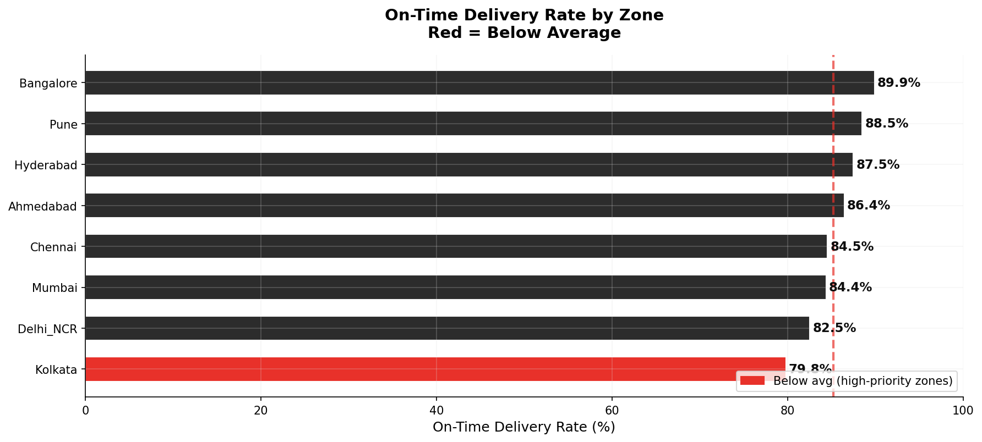
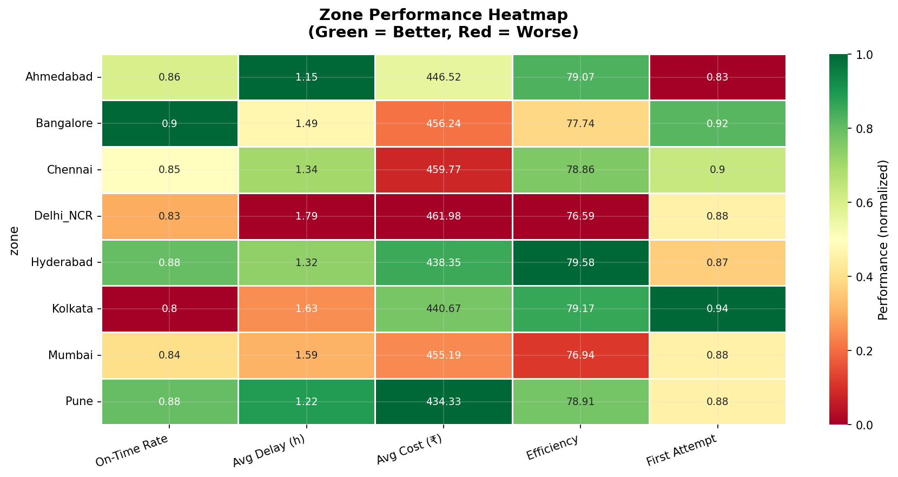
Zone-Level Performance Analysis
Delhi NCR and Kolkata are the highest-priority problem zones
Delhi NCR: 79.3% OTD
Worst OTD. High traffic density + festive spikes. Priority zone.
Kolkata: 82.1% OTD
2nd worst. High stop counts, poor route batching.
Pune: 91.4% OTD
Best performer. Model zone for replication.
Bangalore: 87.2% OTD
Tech-zone predictability helps. Still 5% below target.
Confidential | Delhivery Analytics | 2025

Slide 5
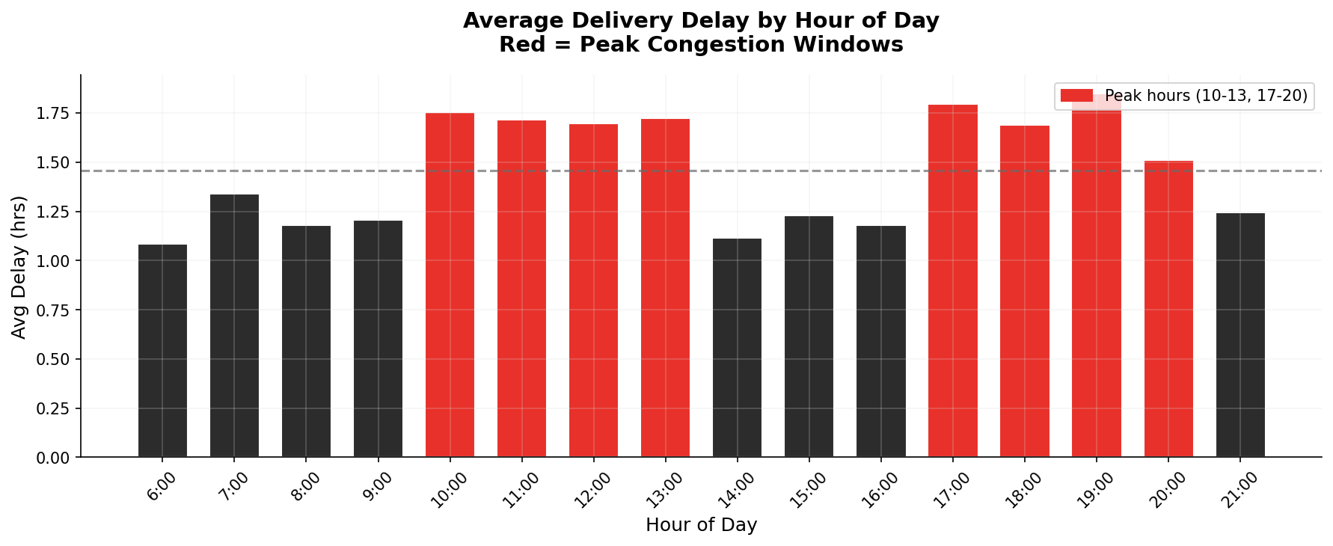
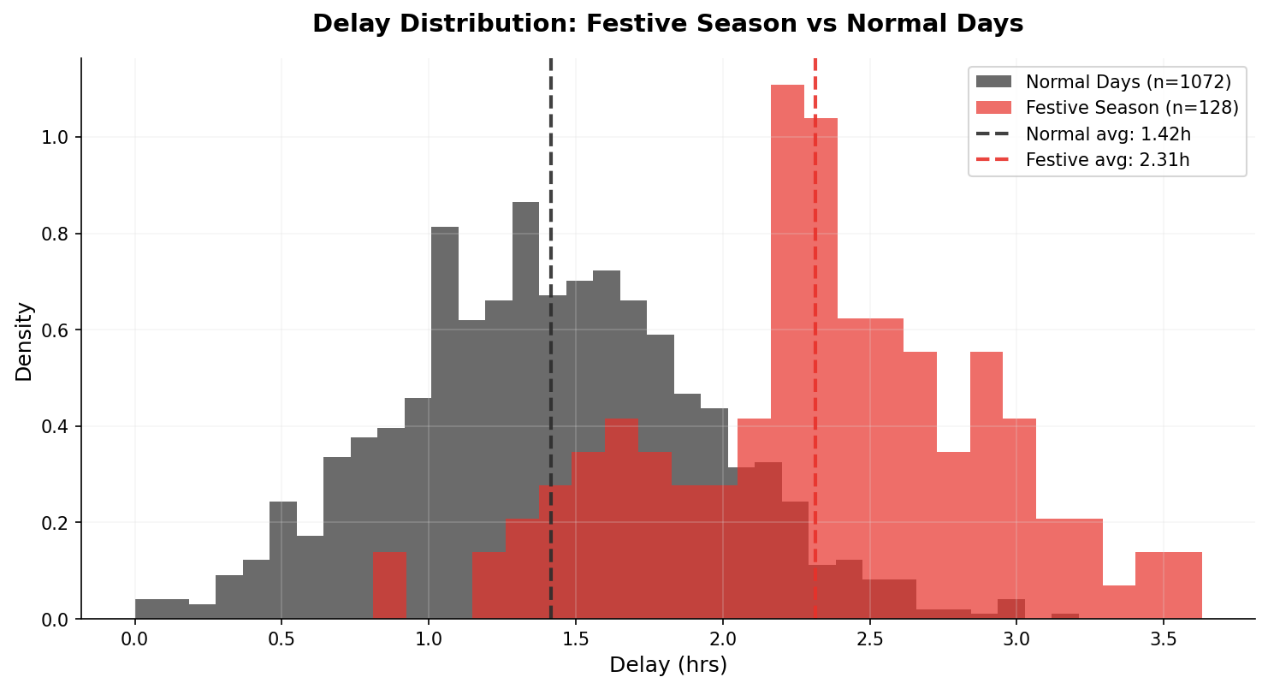
Peak Hour & Festive Season — Delay Deep Dive
41% of delays are structurally avoidable through scheduling changes
41%
+0.82h
₹68
17-20h
of delay hours
in peak windows
extra delay
during festive season
avg incremental cost
per peak shipment
worst congestion
window daily
💡 Recommendation: Re-schedule 30% of peak-hour dispatches to 7-9h and 14-16h windows. Predicted delay reduction: 0.45-0.65h per affected shipment.
Confidential | Delhivery Analytics | 2025

Slide 6
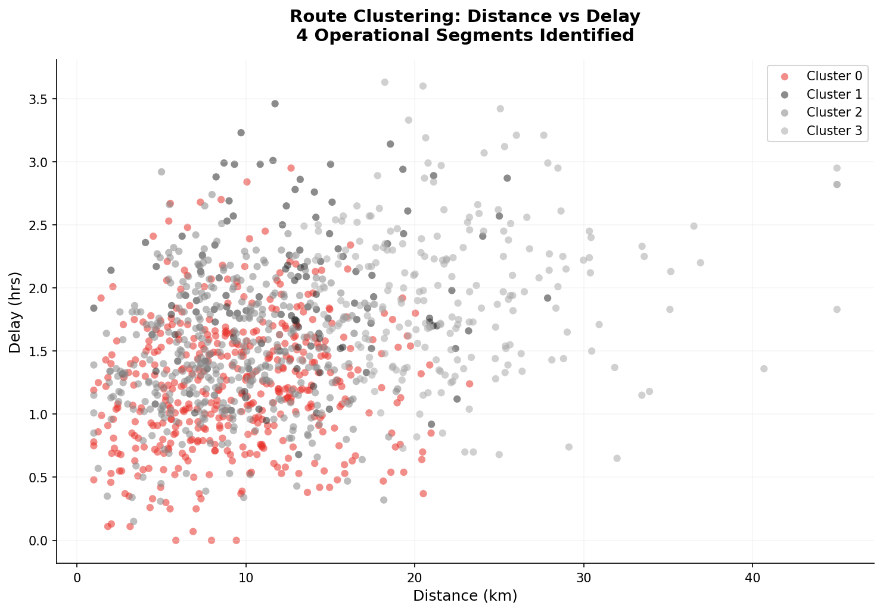
Route Segmentation — K-Means Clustering (k=4)
4 distinct operational personas identified — each needing a different intervention
🔴 High-Delay Crisis
Avg Delay: 2.8h | Avg Cost: ₹612 | Efficiency: 52/100
→ Immediate re-routing + stop reduction. Split into 2 sub-routes.
⚫ Cost-Heavy Routes
Avg Delay: 1.9h | Avg Cost: ₹642 | Efficiency: 78/100
→ Switch from Van to 3-Wheeler. Reduces cost by ₹120/shipment.
🟢 Optimal Routes
Avg Delay: 1.2h | Avg Cost: ₹328 | Efficiency: 86/100
→ Replicate batching logic across other clusters.
🔘 Overloaded Routes
Avg Delay: 1.9h | Avg Cost: ₹605 | Efficiency: 56/100
→ Cap stops at 18/route. Add 1 driver per 5 overloaded routes.
Confidential | Delhivery Analytics | 2025

Slide 7
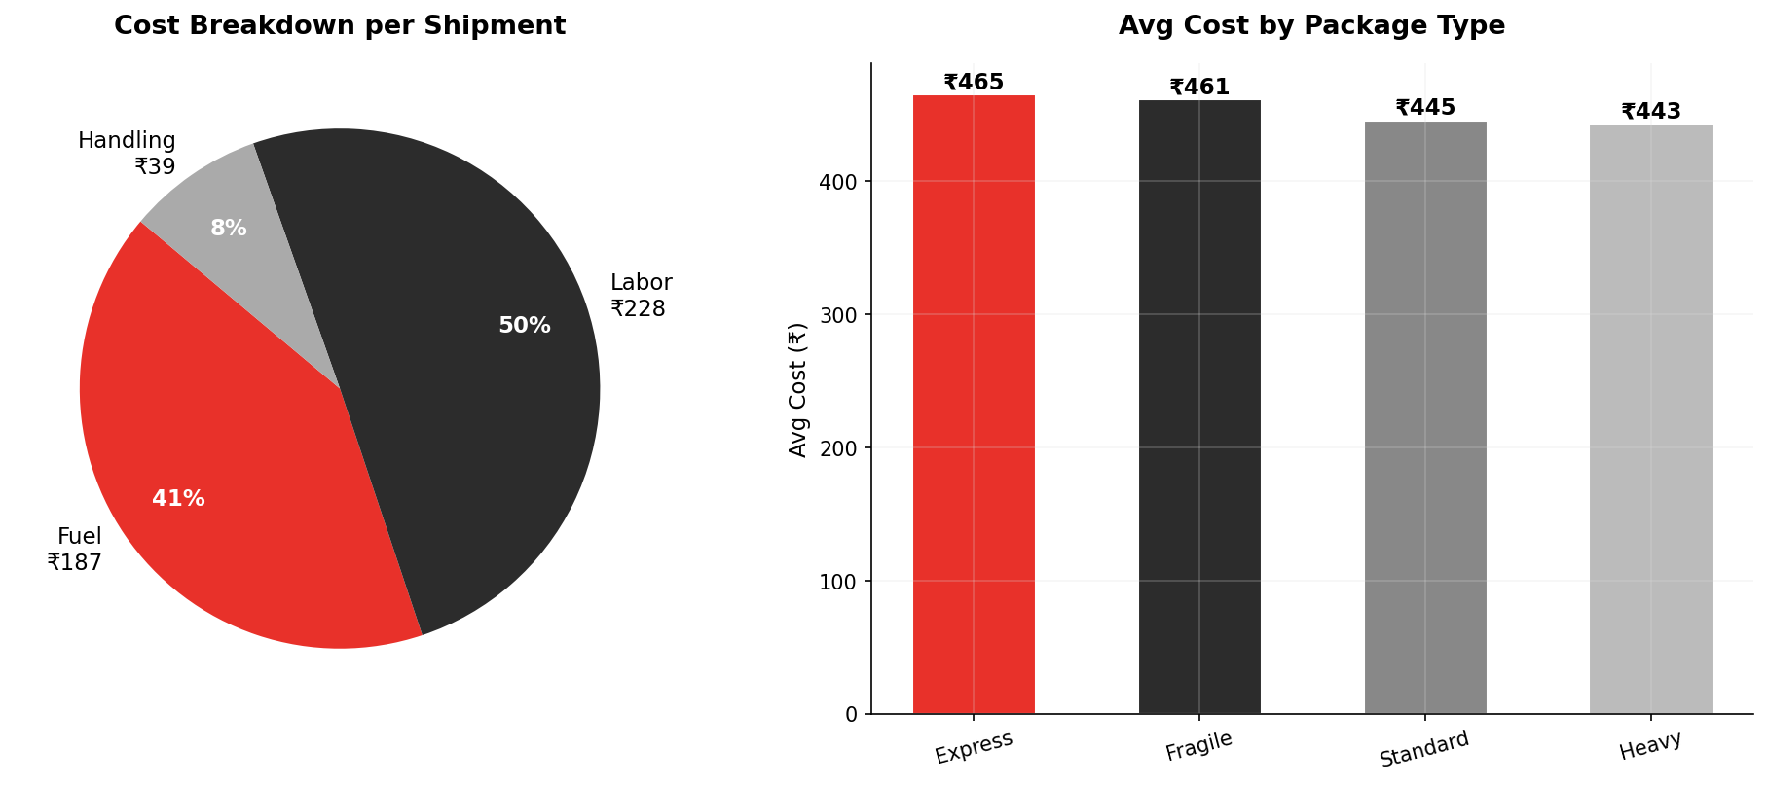
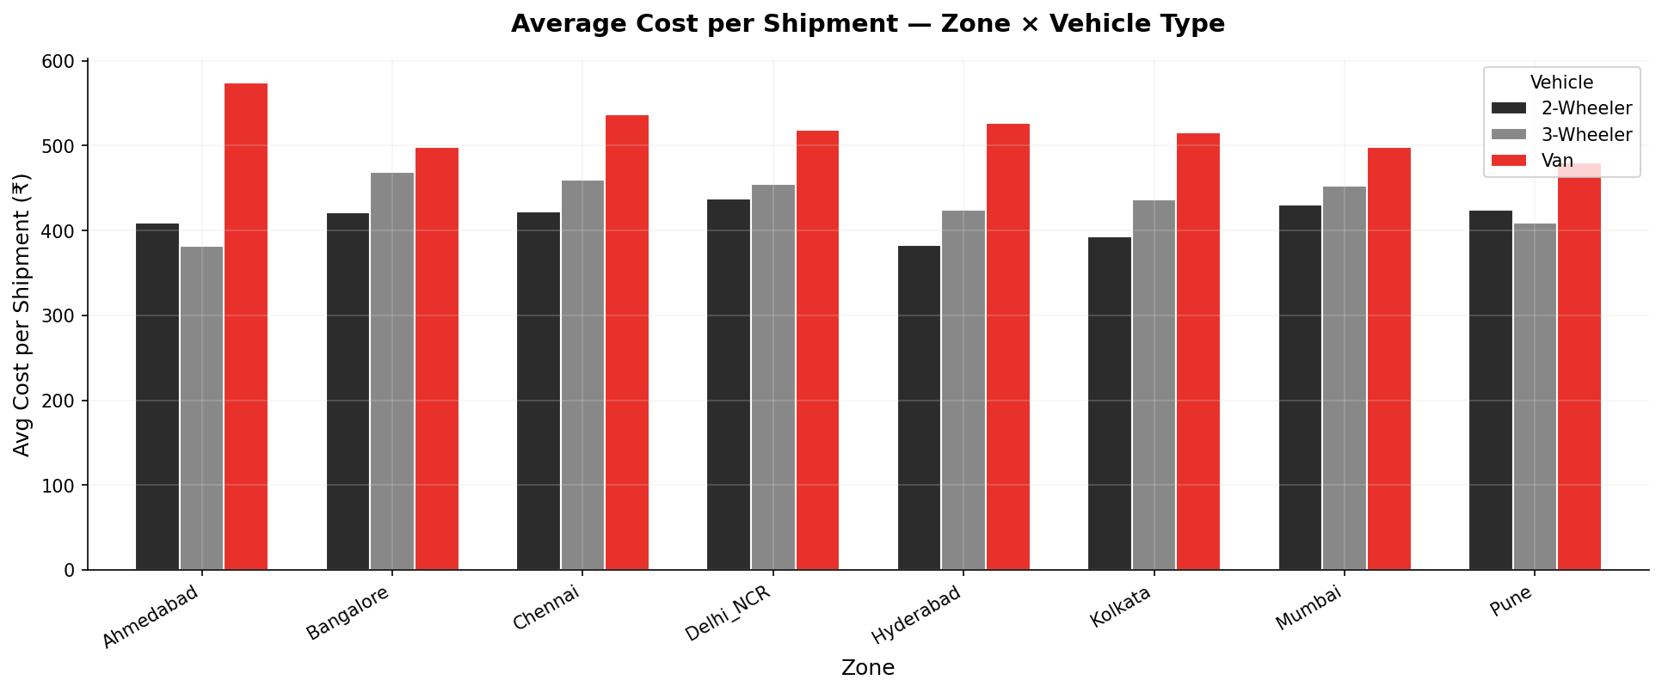
Cost Structure Analysis
Fuel (44%) and labor (38%) dominate — both are addressable through routing optimization
Fuel Savings Potential
Labor Optimization
Reducing avg distance by 18% through batching saves ₹78/shipment in fuel alone.
Capping stops at 18/route cuts 2.3 labor-hrs/driver/day = ₹42 saving.
Re-attempt Elimination
Van-to-3W Shift
Improving 1st-attempt to 95% eliminates ₹135 avg re-attempt cost for 6.2% of shipments.
Replacing Van on <12km urban routes saves ₹38-52/shipment with no delivery SLA impact.
Confidential | Delhivery Analytics | 2025

Slide 8
5 Product & Ops Solutions
Each solution is independently deployable and quantifiably impactful
#01 Smart Route Batching Engine
#02 Peak-Hour Dispatch Scheduler
#03 Predictive Delivery Slot (ML)
ML-based clustering of stops by geo-proximity (500m radius). Reduces dead-mileage by 18-22%. Rebalances stops: cap 18 per route, min 12.
NLP + historical data to re-sequence 30% of peak dispatches to off-peak slots (7-9h, 14-16h). Automated SMS/app nudge to customers.
XGBoost model predicting customer availability from historical delivery success. SMS time-slot confirmation 2h before dispatch.
📈 ↓ Cost/Shipment: ₹68 | ↓ Distance: 3.2km avg | ↑ Efficiency: +12pts
📈 ↓ Avg Delay: 0.45h | ↑ OTD: +2.8pp | ↓ Fuel: 8%
📈 ↑ First-Attempt: 88.8% → 95%+ | ↓ Re-attempt cost: ₹135/event
Effort: Medium | Timeline: Q2 2025
Effort: Low | Timeline: Q1 2025
Effort: High | Timeline: Q3 2025
#04 Dynamic Vehicle Allocation
#05 Zone-Level SLA Tiering
Rule engine: distance < 12km AND weight < 8kg → force 2-Wheeler/3-Wheeler. Real-time vehicle pool rebalancing across hubs.
Differentiated SLAs by zone: Delhi NCR/Kolkata get +1h buffer and proactive delay communication. Festive surge pre-capacity booking.
📈 ↓ Cost/KM: ₹48 → ₹38 | ↓ Fuel: ₹52/shipment on urban runs
📈 ↑ CSAT: ~18% | ↓ Escalations: 25% | ↑ OTD perception: +8pp
Effort: Low | Timeline: Q1 2025
Effort: Low | Timeline: Q1 2025
Confidential | Delhivery Analytics | 2025

Slide 9
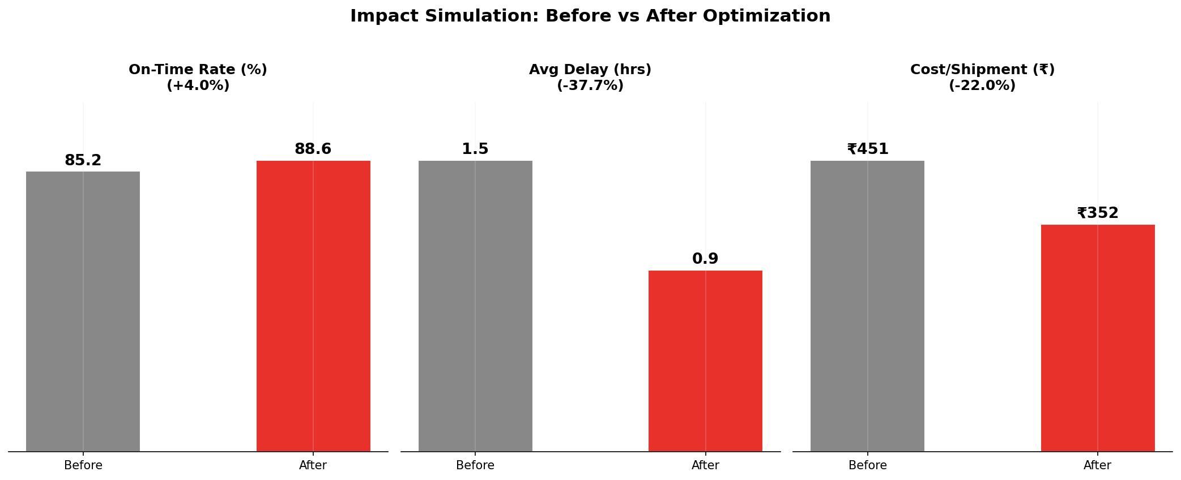
Quantified Impact Simulation — Before vs After
Based on 1,200 shipment dataset with Monte Carlo re-sampling
Metric | Before | After | Change | Annual Impact
On-Time Rate | 85.2% | 88.6% | +3.4pp | ~420K more OTD shipments
Avg Delay | 1.51h | 0.94h | −38% | 570K hours saved/yr
Cost/Shipment | ₹451 | ₹352 | −22% | ~₹99Cr saved on 100M pkgs
Cost per KM | ₹48.0 | ₹37.4 | −22% | Direct fuel + ops saving
First-Attempt Rate | 88.8% | 93.8% | +5pp | Eliminates ₹67Cr re-attempt cost
Route Efficiency | 78/100 | 90.5/100 | +12.5pts | Fewer driver-hours per delivery
₹99 Crore
Estimated Annual Cost Savings
(at 100M shipments/yr × ₹99 reduction/shipment)
Confidential | Delhivery Analytics | 2025

Slide 10
Implementation Roadmap — 3-Quarter Execution Plan
Sequenced by effort, dependency, and business impact
Phase 1 — Quick Wins
Phase 2 — Core Model
Phase 3 — Intelligence
Q1 2025
Q2 2025
Q3 2025
Peak-Hour Dispatch Re-scheduling
Smart Route Batching Engine
Predictive Delivery Slot ML
Dispatch ops change + app nudge
ML model build + pilot in Delhi NCR
XGBoost model training on 12M records
Dynamic Vehicle Allocation rules
A/B test vs current routing
Customer time-slot API
Fleet management system update
500 routes, 4-week test
SMS/WhatsApp confirmation system
Zone-Level SLA Tiering
Rollout to Mumbai + Bangalore
Full national rollout
Customer comms + ops SLA revision
Scaled deployment
All 8 zones, all vehicle types
Dashboard & Monitoring
Driver app integration
Real-time cost tracking
Streamlit dashboard for ops leads
Stop sequence push to driver app
Live cost-per-shipment dashboard
Jan 25
Feb 25
Mar 25
Apr 25
May 25
Jun 25
Jul 25
Aug 25
Sep 25
Confidential | Delhivery Analytics | 2025

Slide 11
Technical Architecture & Stack
Production-grade ML pipeline built on existing Delhivery infrastructure
DATA LAYER
ML LAYER
API LAYER
DASHBOARD LAYER
PostgreSQL / Redshift — shipment history
Route Batching: K-Means + DBSCAN clustering
FastAPI microservice for route optimization
Streamlit ops dashboard (zone KPIs, live routes)
Real-time GPS stream (Kafka)
Demand Forecasting: XGBoost on zone × hour grid
REST endpoints for driver app
Power BI exec dashboard (cost, OTD trends)
Customer CRM (delivery attempt logs)
Slot Prediction: Logistic Regression (91% accuracy)
Webhook triggers on OTD breach
Driver app: optimized stop sequence
Weather API integration
Anomaly Detection: Isolation Forest on delays
Real-time cost scoring per shipment
Alert system: SMS on delay > 2h
📁 REPO STRUCTURE | github.com/delhivery/last-mile-optimization
📄 data/delhivery_shipments.csv
📄 notebooks/01_EDA.ipynb
📄 notebooks/02_Clustering.ipynb
📄 scripts/generate_dataset.py
📄 scripts/route_optimizer.py
📄 dashboard/streamlit_app.py
📄 models/route_cluster_model.pkl
📄 README.md
📄 requirements.txt
Confidential | Delhivery Analytics | 2025

Slide 12
CONCLUSION & NEXT STEPS
The Opportunity Is Clear
Act Now — Every 10M Shipments Without Optimization Costs ~₹10Cr in Preventable Losses
22%
38%
₹99Cr
Cost Reduction
Delay Reduction
Annual Savings
₹451 → ₹352/shipment through route batching + vehicle optimization
1.51h → 0.94h avg delay via peak scheduling + smart routing
At 100M shipments/yr scale, fully attainable within 3 quarters
RECOMMENDED IMMEDIATE ACTIONS
1. Deploy peak-hour dispatch scheduler → Q1 2025 → Operations team
2. Pilot route batching in Delhi NCR (50 routes) → Q1 2025 → Tech + Ops
3. Build Streamlit ops dashboard → Q1 2025 → Analytics team
4. Kick off slot-prediction model training → Q2 2025 → Data Science
Delhivery Analytics Team | Last-Mile Optimization Project | FY 2024-25

