Slide 1

VibraCom: Vibratory Communication in Smart Devices
CSE 597 Project Presentation
Project Members: Asmit De, Shruti Mohanty, Karthikeyan Nagarajan
Professor: Dr. Mahanth Gowda

Slide 2

Outline
Introduction and Problem Statement
Solution Platform
VibraCom Design
Data Transfer Using Vibrations
VibraCom Data Detection & Analysis
Raw Vibration Data
Envelope Application
Clean Output Generation
Encoded Message Extraction
Performance Evaluation
Error Rate
Throughput
Robustness to Multiple Data Patterns
Conclusions
Applications
Limitations
CSE 597 Project
2

Slide 3
Introduction & Problem Statement
Goal: Investigate the possibility of communicating using vibrations, specifically between a user’s finger and a mobile phone.
How: Leverage techniques shown in [1] and [2] to transfer encoded binary data to a receiving smartphone.
Key Challenges:
Low accuracy and reliability due to use of smartphone in-built vibration motors, accelerometers, and microphones.
Low SNR: Detect and extract relevant information from very noisy sensor data.
Design space exploration to improve throughput and accuracy of the system.
Explore data transfer through human bone.
[1] Roy, Nirupam, Mahanth Gowda, and Romit Roy Choudhury. "Ripple: Communicating through physical vibration." 12th {USENIX} Symposium on Networked Systems Design and Implementation ({NSDI} 15). 2015.
[2] Roy, Nirupam, and Romit Roy Choudhury. "Ripple {II}: Faster Communication through Physical Vibration." 13th {USENIX} Symposium on Networked Systems Design and Implementation ({NSDI} 16). 2016.
CSE 597 Project
3

Slide 4

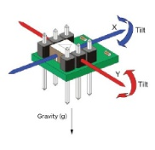
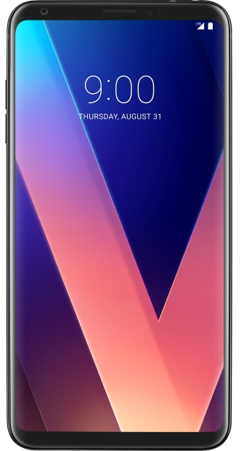
Evaluation Platform
Android OS and sensor APIs
Smartphone haptic motors for transmitting data signals
Smartphone IMUs for receiving encoded data signals
Human body as the communication channel
Smartphone mics for side-channel exploration
CSE 597 Project
4

Slide 5
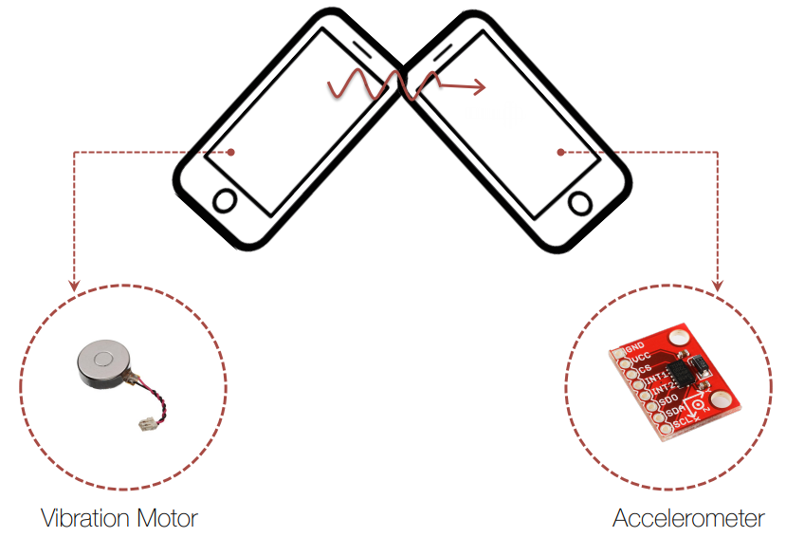
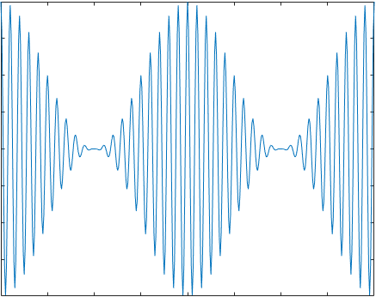
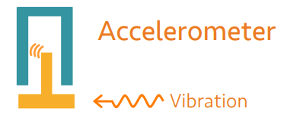
VibraCom Design
Vibration → Change in accelerometer Reading
Three key operations:
Vibration Control
Accelerometer Data Sensing
Data Analysis/Message Extraction
[2]
CSE 597 Project
5

Slide 6

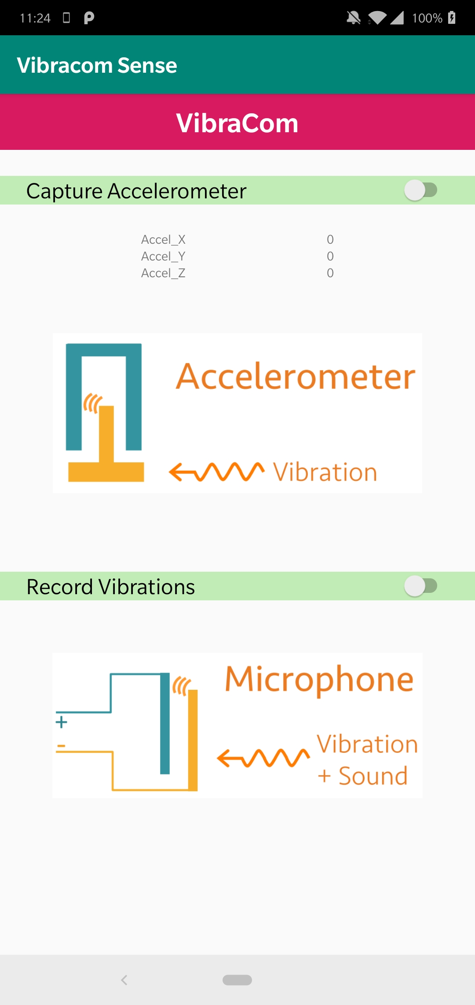

VibraCom Operations
Vibrations
Generated
Vibrations
Sensed
Vibrations
Decoded!
CSE 597 Project
6

Slide 7
Data Analysis of Accelerometer Data
Envelope Function
Sq. Wave Gen.
Message?
1
0
1
0
1
0
1
0
1
0
CSE 597 Project
7

Slide 8
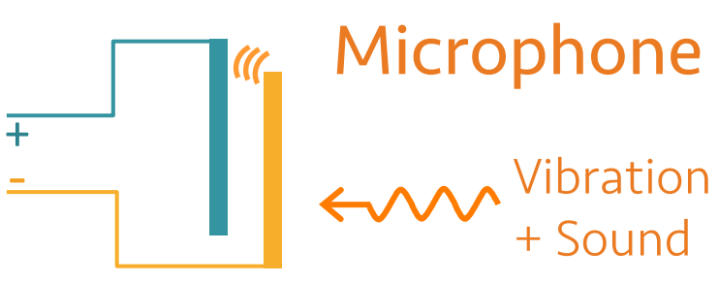
Accelerometer Challenges
Each bit requires ~2 seconds to be sensed accurately.
Noise
Sampling Rate
Bone Conduction
Damping Effect
Low Vibration Amplitude → Low SNR
Solution?
Need for alternate sensing method.
Ripple II [2] uses acoustic sensing of vibration using the smartphone microphone.
CSE 597 Project
8

Slide 9
Data Analysis of Microphone Data
Envelope Function
Sq. Wave Gen.
Message?
1
0
1
0
0
1
0
0
1
0
CSE 597 Project
9

Slide 10
Discussion
Throughput
Accelerometer: 0.5 bps
Microphone: 20 bps
Accelerometer readings depend on the sampling rate
High accuracy provides ~5 samples/s.
Medium accuracy provides ~15 samples/s.
Accelerometer: Unreliable when 1 bit represented by <2s vibration.
Accuracy = 67%
Microphone: ~99% accurate when 1 bit represented in ~0.1s of vibration.
CSE 597 Project
10

Slide 11
Evaluation
Since we are transferring a password, it is essential to minimize the BER.
Transmitting at a higher Bit Rate (BR) might increase the BER.
5
Lab of Green and secure Integrated Circuit Systems (LOGICS)
11
CSE 597 Project

Slide 12
Applications
Vibratory ring worn by user can transfer encoded passwords to smartphones for a secure single factor authentication.
Can be used as a security key for 2-Factor Authentication (2FA).
Can be used in conjunction with PINs for payment authorizations.
Can be used to send data between two on-body smart devices securely via vibrations instead of insecure wireless channels.
CSE 597 Project
12

Slide 13
Conclusions
Low Bit rate for accelerometer-based VibraCom.
On-body vibratory communication was unsuccessful.
Can be mitigated with high amplitude motors or high precision accelerometers.
Microphone-based VibraCom can be used if receiving device is held in hand.
Requires a preamble/header to identify transmission of data.
Ex. We used a 2-bit preamble of ’10’.
Microphone-based VibraCom is limited to <5cm proximity between communicating devices.
Beneficial to prevent acoustic side channels.
CSE 597 Project
13

Slide 14

Thank You!

