Slide 1
Empowering Student Engagement with AI Chatbot Technology
by
ASMIT PATHI
21BRS1538

Slide 2
What is chatbot?
A chatbot is a software application used to conduct online conversation via text or text-to-speech instead of direct contact with a live human agent.
The first chatbot was created by Eliza in 1966.
AI’s efficiency is measured using Turing test.
Benefits:
24/7 Availability
Faster Responses
Cost Savings
Improved Customer Satisfaction
Increased Sales & Leads
Data Collection & Insights
Empowering Student Engagement with AI Chatbot Technology

Slide 3
Brief on ChatBots
A chatbot (originally chatterbot) is a software application or web interface that is designed to mimic human conversation through text or voice interactions. Modern chatbots are typically online and use generative artificial intelligence systems that are capable of maintaining a conversation with a user in natural language and simulating the way a human would behave as a conversational partner. Such chatbots often use deep learning and natural language processing, but simpler chatbots have existed for decades.
In 1950, Alan Turing's famous article "Computing Machinery and Intelligence" was published which proposed what is now called the Turing test as a criterion of intelligence.
The notoriety of Turing's proposed test stimulated great interest in Joseph Weizenbaum's program ELIZA was published in 1966

Slide 4
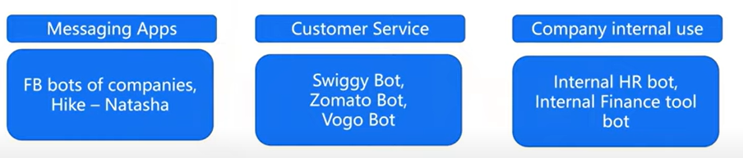
Need for Chatbots
24/7 availability: Customers can get answers to their questions or resolve simple issues anytime, day or night. This is especially helpful for businesses that operate globally or have customers in different time zones.
Increased efficiency: Chatbots can automate many tasks that would otherwise be performed by human employees. This can save businesses time and money.

Slide 5
Types of Chatbots:
Menu-driven chatbots: These are the simplest type of chatbot. They use a series of menus or buttons to guide the user through a conversation. Menu-driven chatbots are a good option for tasks that can be easily broken down into a series of steps, such as ordering food or scheduling an appointment.
Keyword recognition chatbots: These chatbots use keywords to understand what the user is asking. If the user's query matches a keyword in the chatbot's database, the chatbot will provide a predefined response. Keyword recognition chatbots are a good option for answering frequently asked questions (FAQs).
Voice chatbots: These chatbots can interact with users through voice commands. Voice chatbots are a good option for hands-free interaction, such as when a user is driving or cooking. Voice assistants like Siri, Alexa, and Google Assistant are all examples of voice chatbots.
Some other types: Simple chatbots, smart chatbots, hybrid chatbots, social messaging chatbots

Slide 6
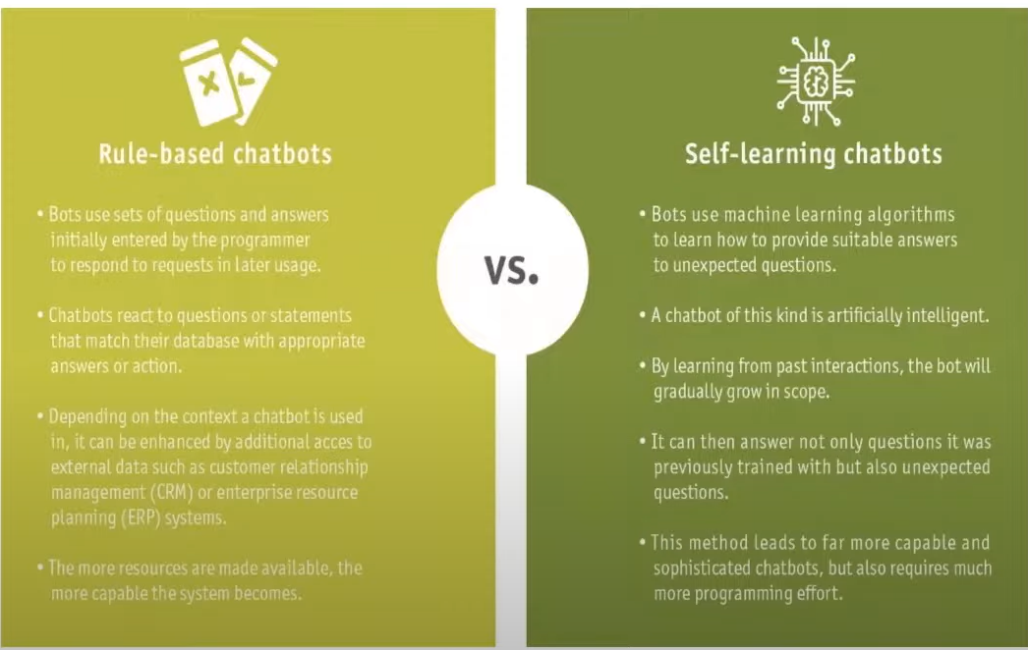
RULE-BASED VS SELF-LEARNING CHATBOTS

Slide 7
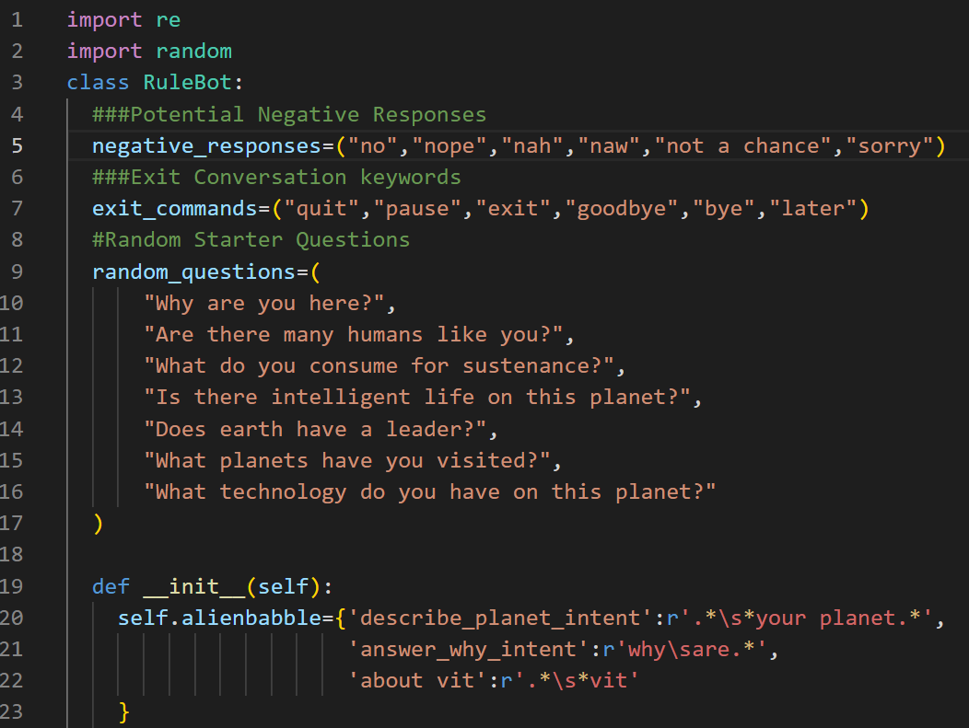
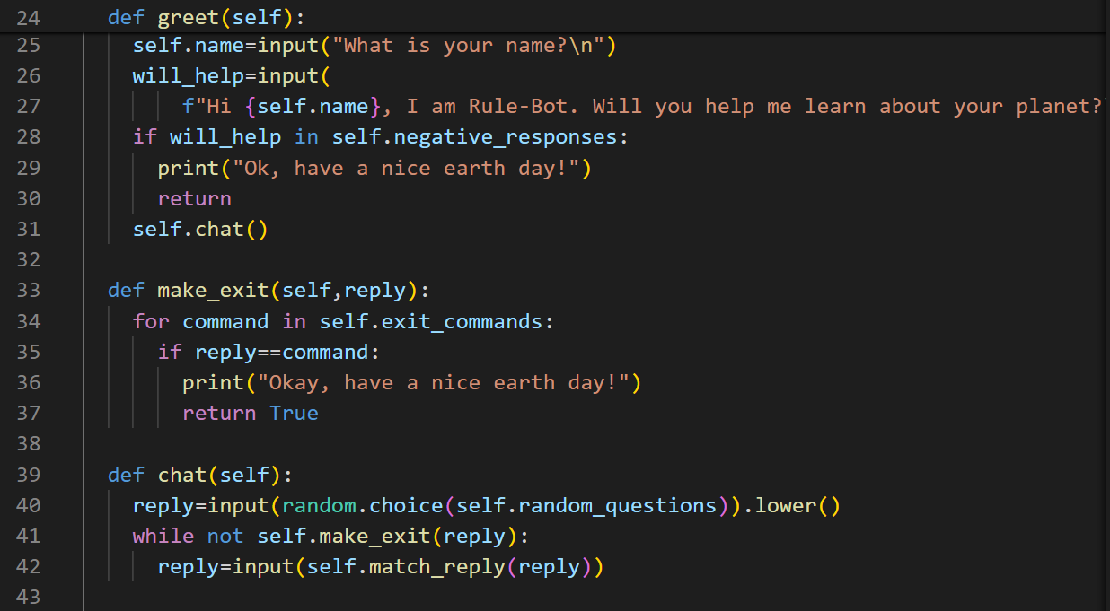
PROJECT 1: RULEBOT

Slide 8
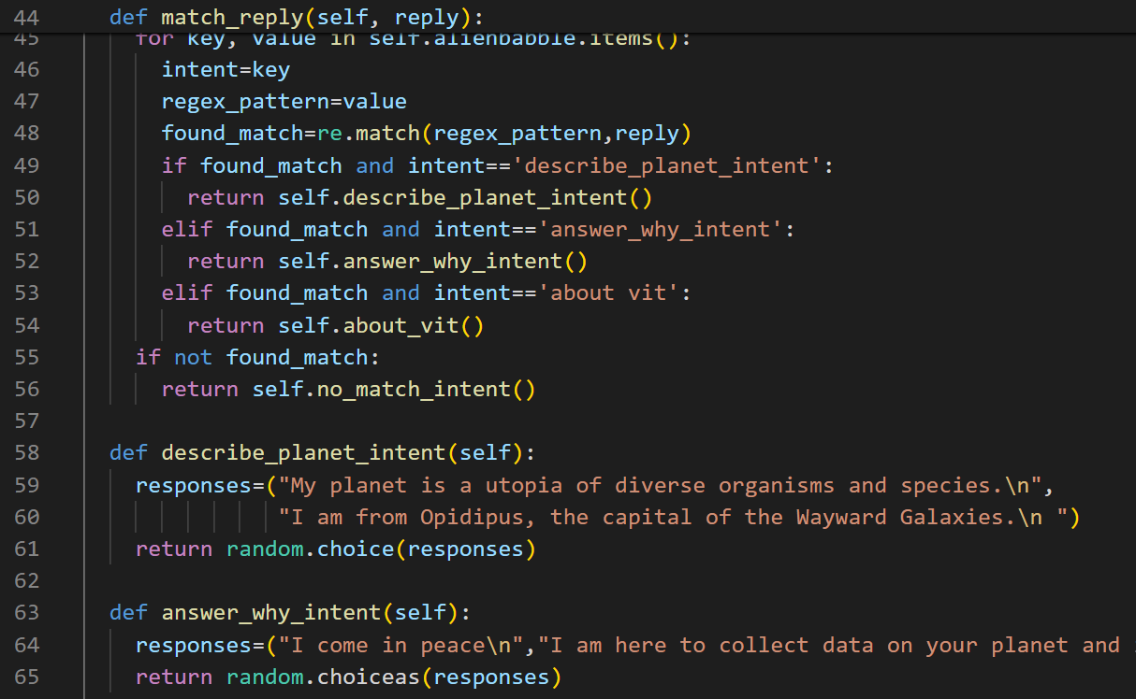
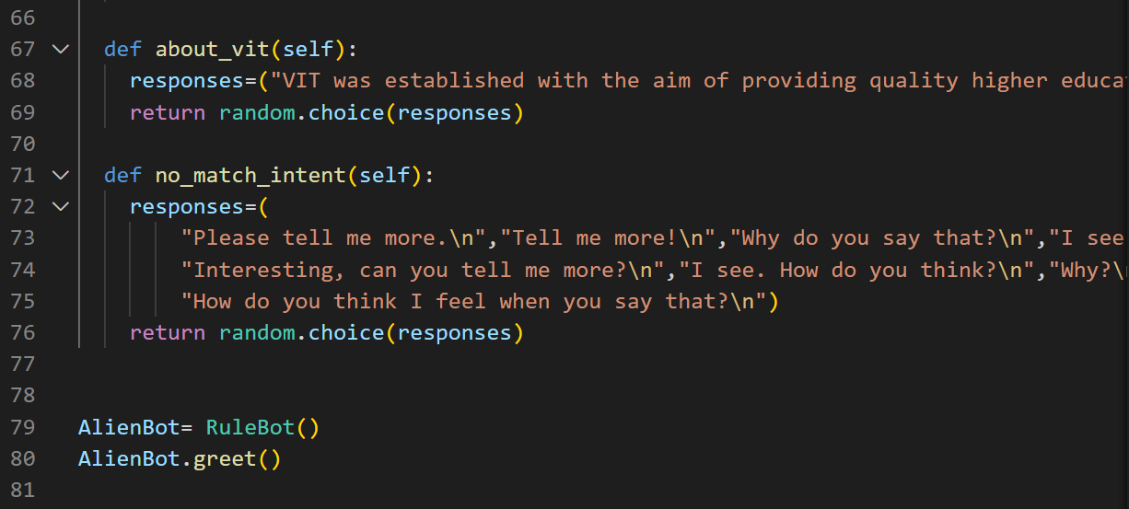

Slide 9
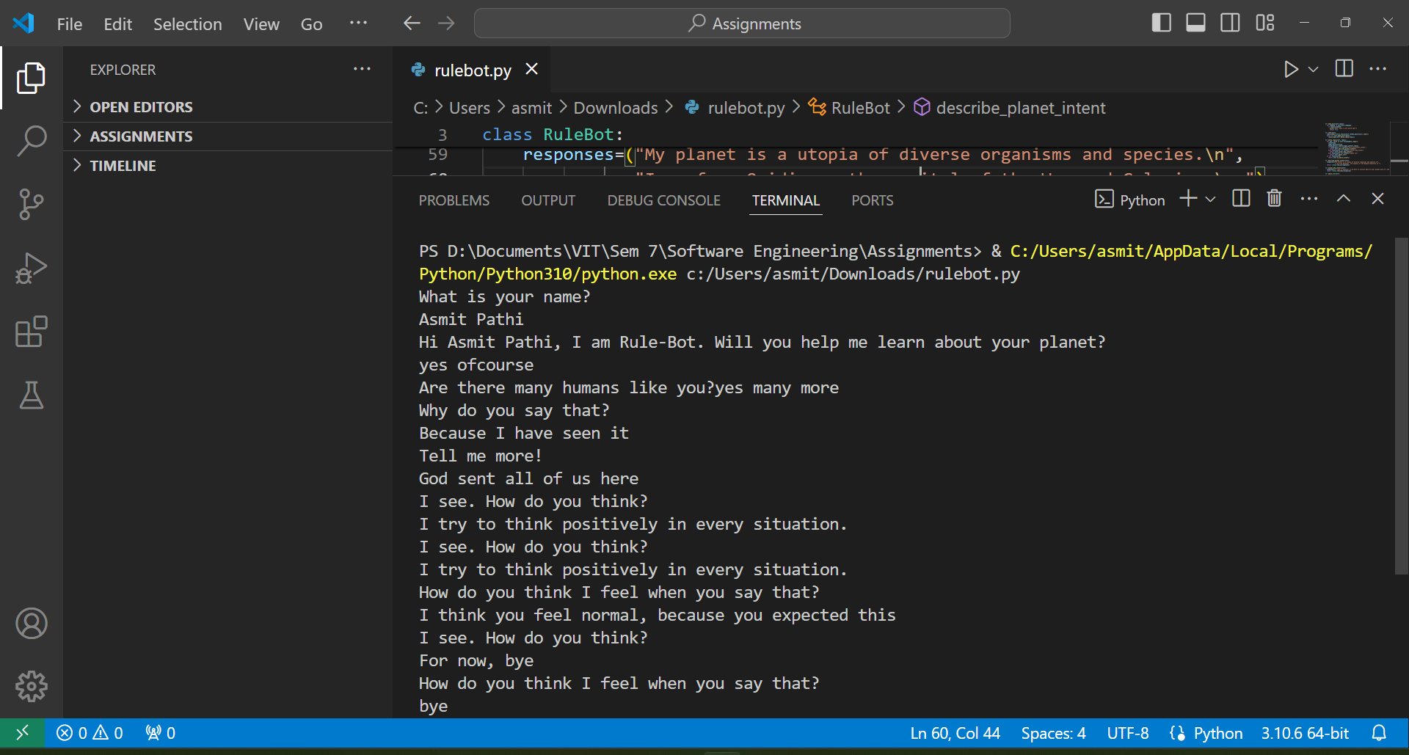
OUTPUT (VS CODE)

Slide 10
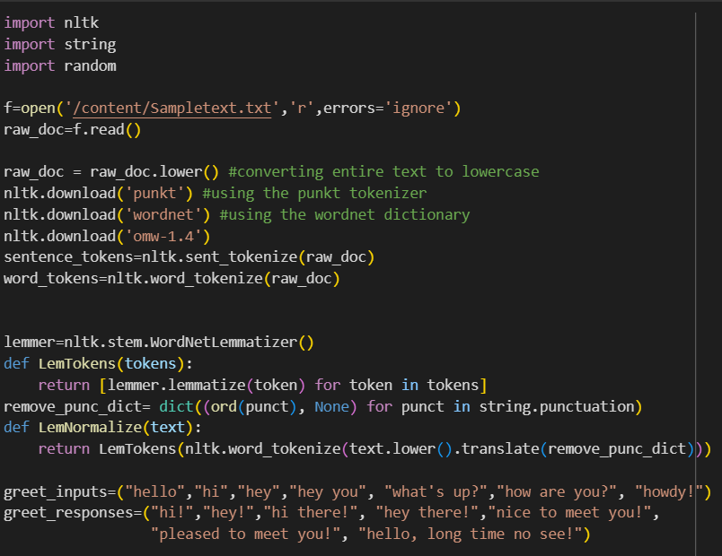
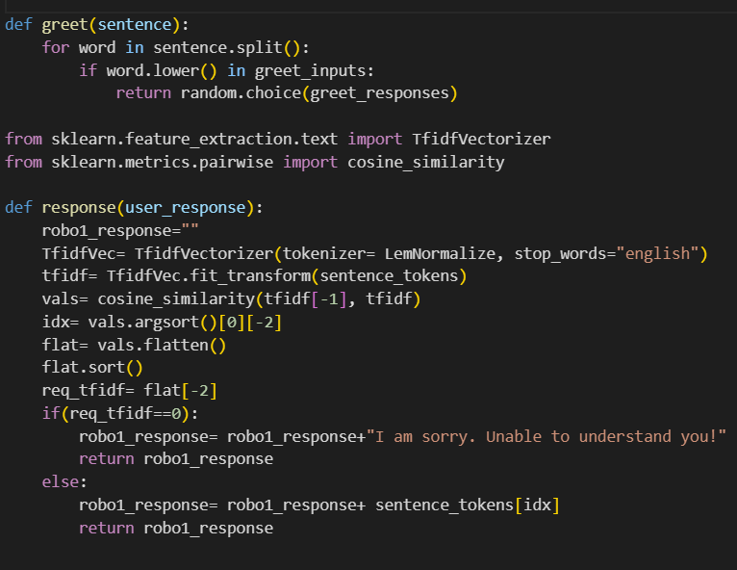
PROJECT 2: SELF-LEARNING CHATBOT

Slide 11
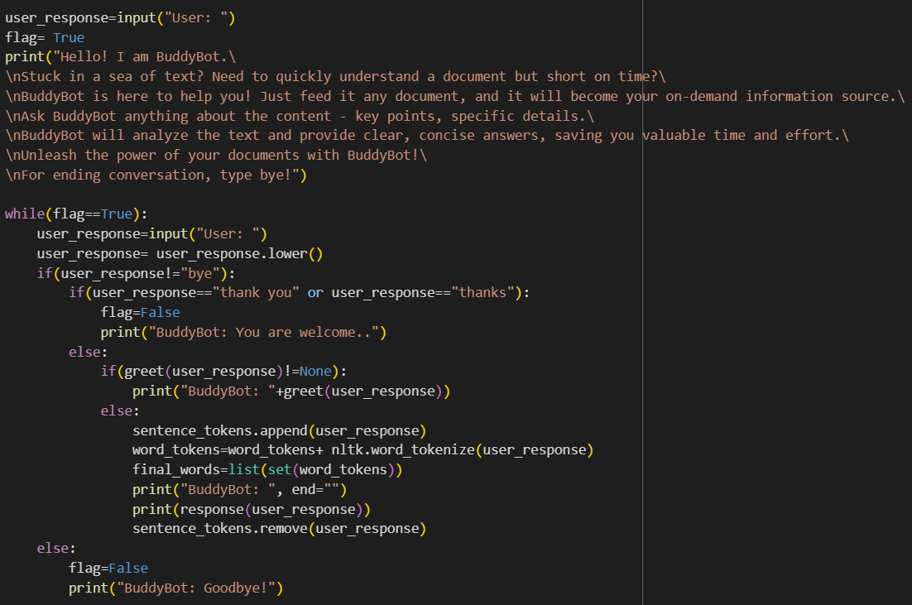

Slide 12
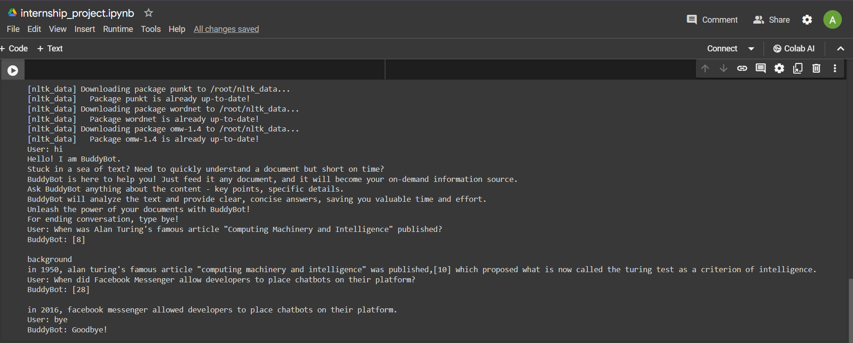
OUTPUT (GOOGLE COLAB)

Slide 13
THANK YOU!

