Slide 1

PORTFOLIO
COMPUTER SCIENCE AND ENGINEERING
Submitted by:
Name: Asmit Raj
Reg. No :12401006
Roll No:RK24CTB69
Section: K24CT
Submitted to: Dr.joshva Raj
DECLARATION
I, Asmit, a student of Bachelor of Technology under CSE discipline at Lovely Professional University,Punjab,hereby declare that all the information furnished in this project report is based on my own work and is genuine.

Slide 2
ASMIT
Registration Number: 12401006
QUORA: https://www.quora.com/profile/Asmit-Raj-82
HACKERRANK: https://www.hackerrank.com/profile/asmitraj9472
LINKEDIN: https://www.linkedin.com/in/asmitraj94/
GITHUB: https://github.com/asmittshah
FIGMA: https://www.figma.com/files/team/1432397687254423052/user/1432397685407132732?fuid=1432397685407132732
GEEKSFORGEEKS: https://www.geeksforgeeks.org/user/asmitratbt5/
STACK OVERFLOW: https://chat.stackoverflow.com/?tab=favorite&sort=active
HACKEREARTH: https://www.hackerearth.com/@asmitraj9472/

Slide 3
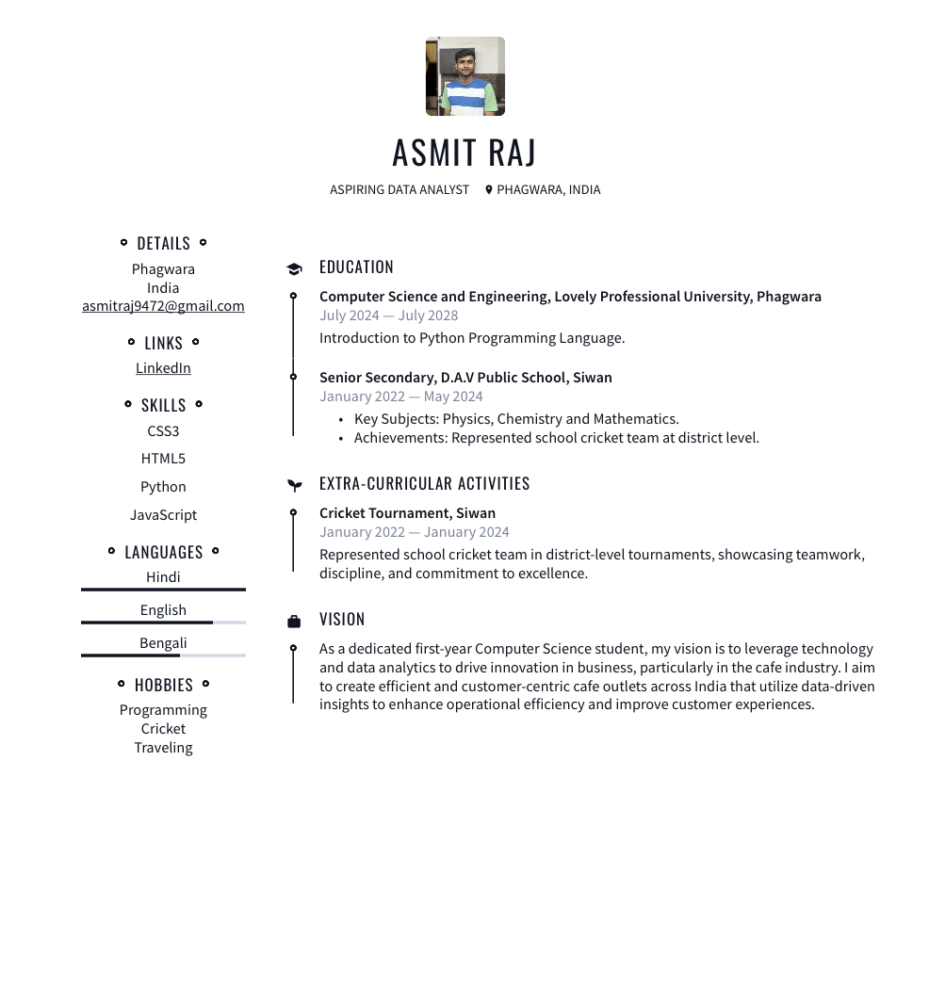
CV:

Slide 4
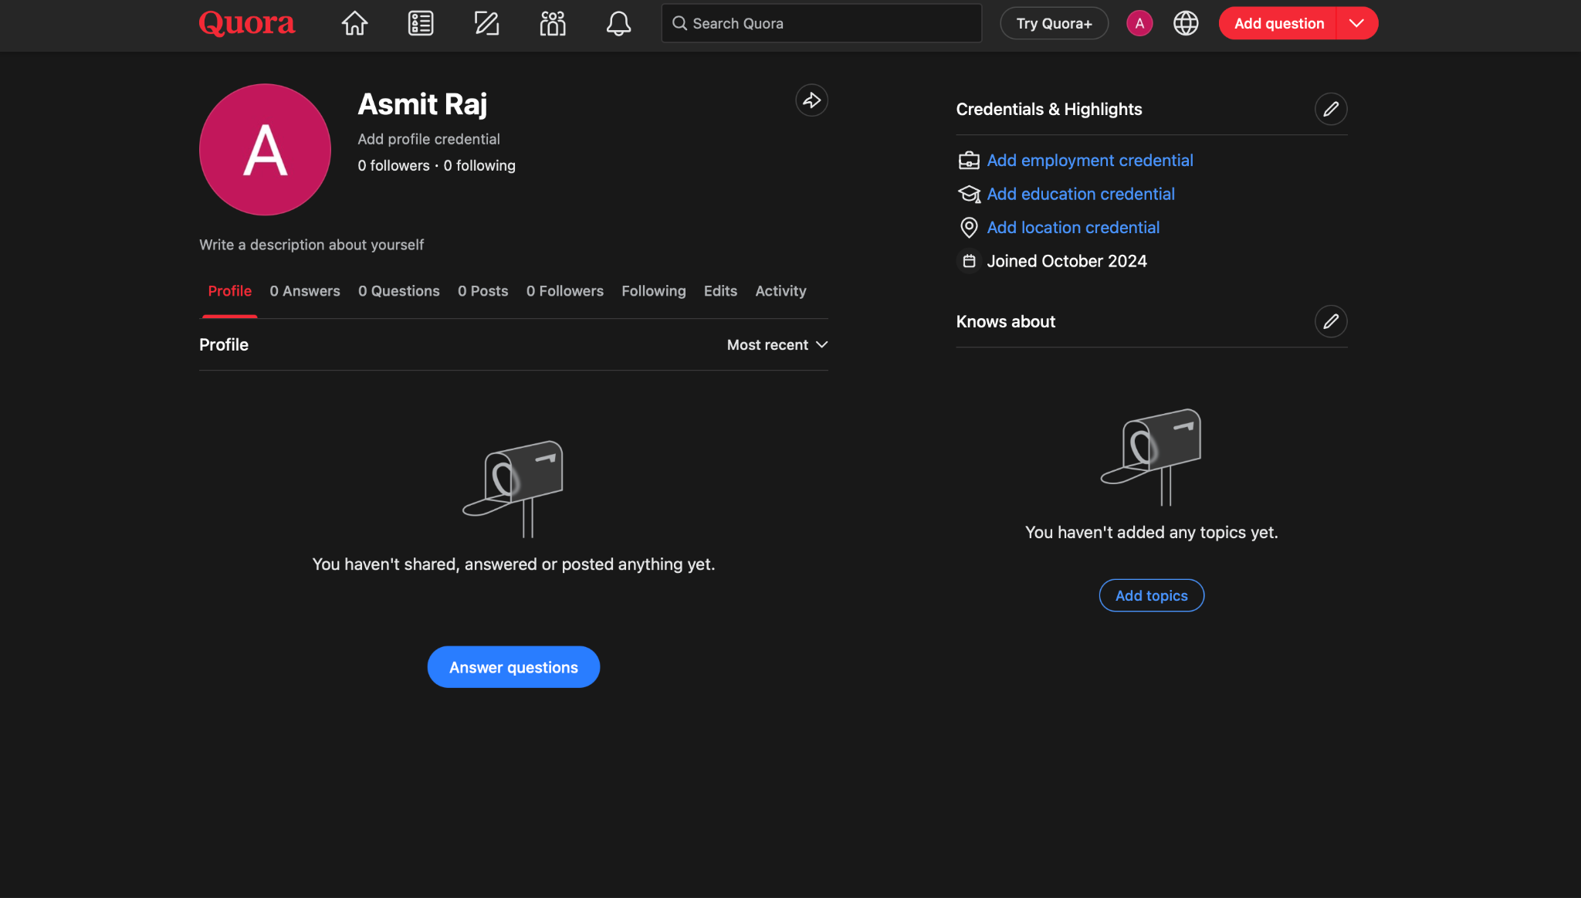
QUORA:

Slide 5
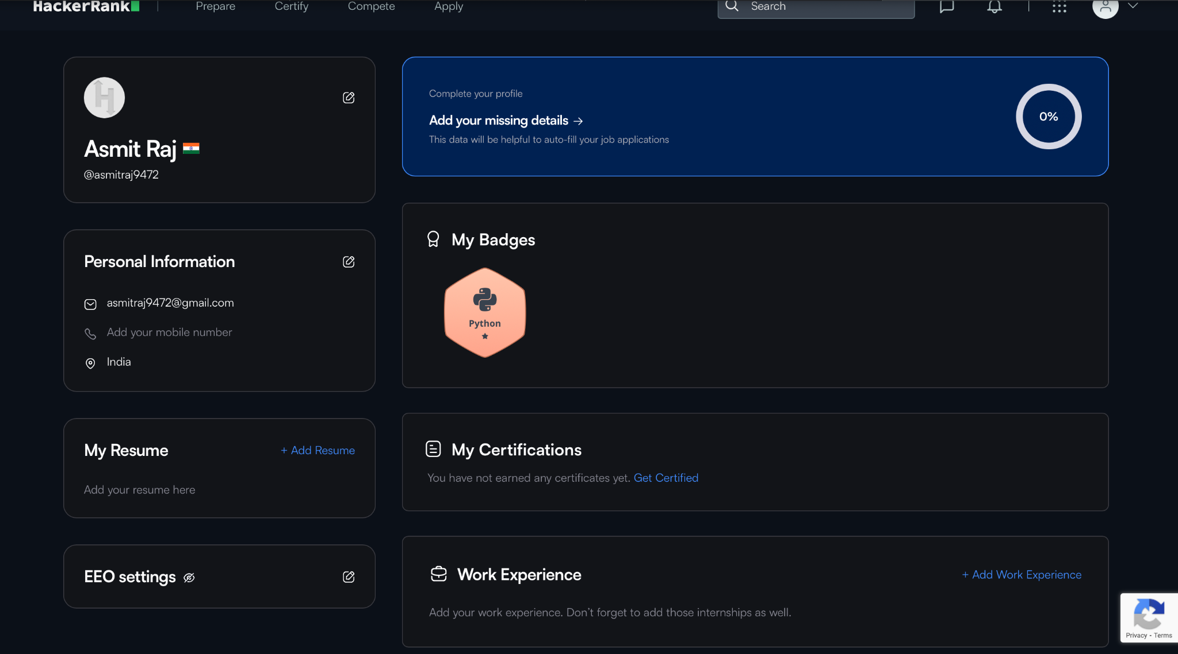
HackerRank:

Slide 6
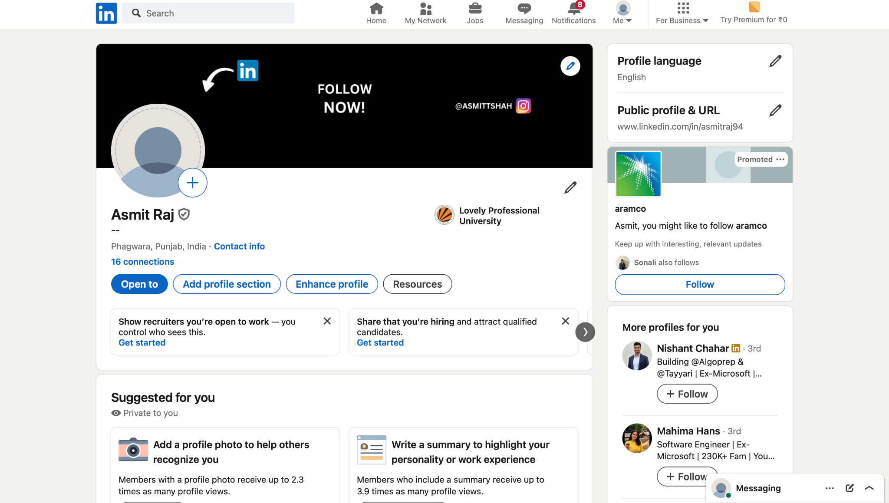
LinkedIn:

Slide 7
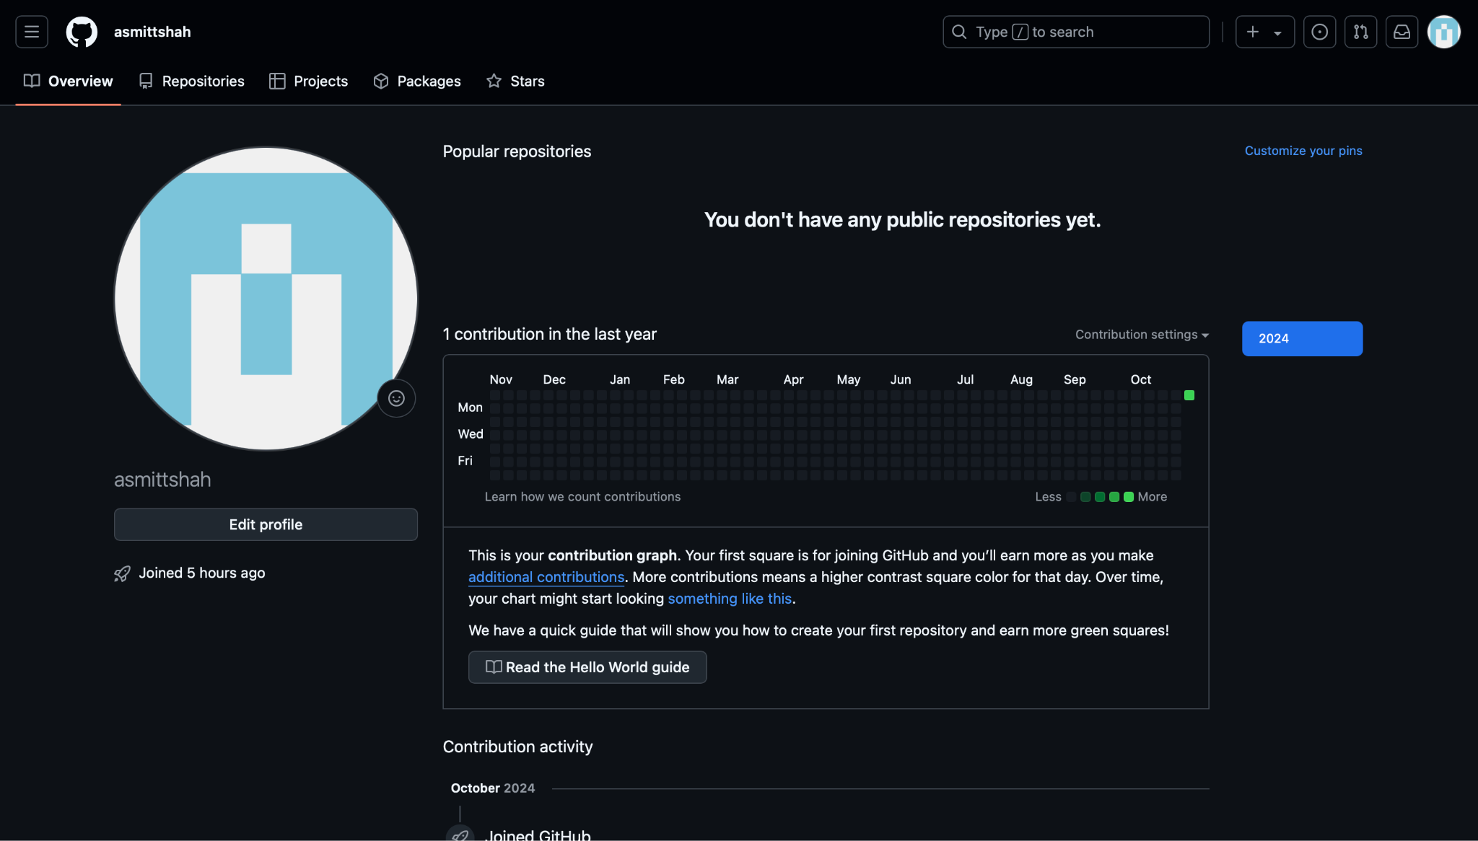
Github:

Slide 8
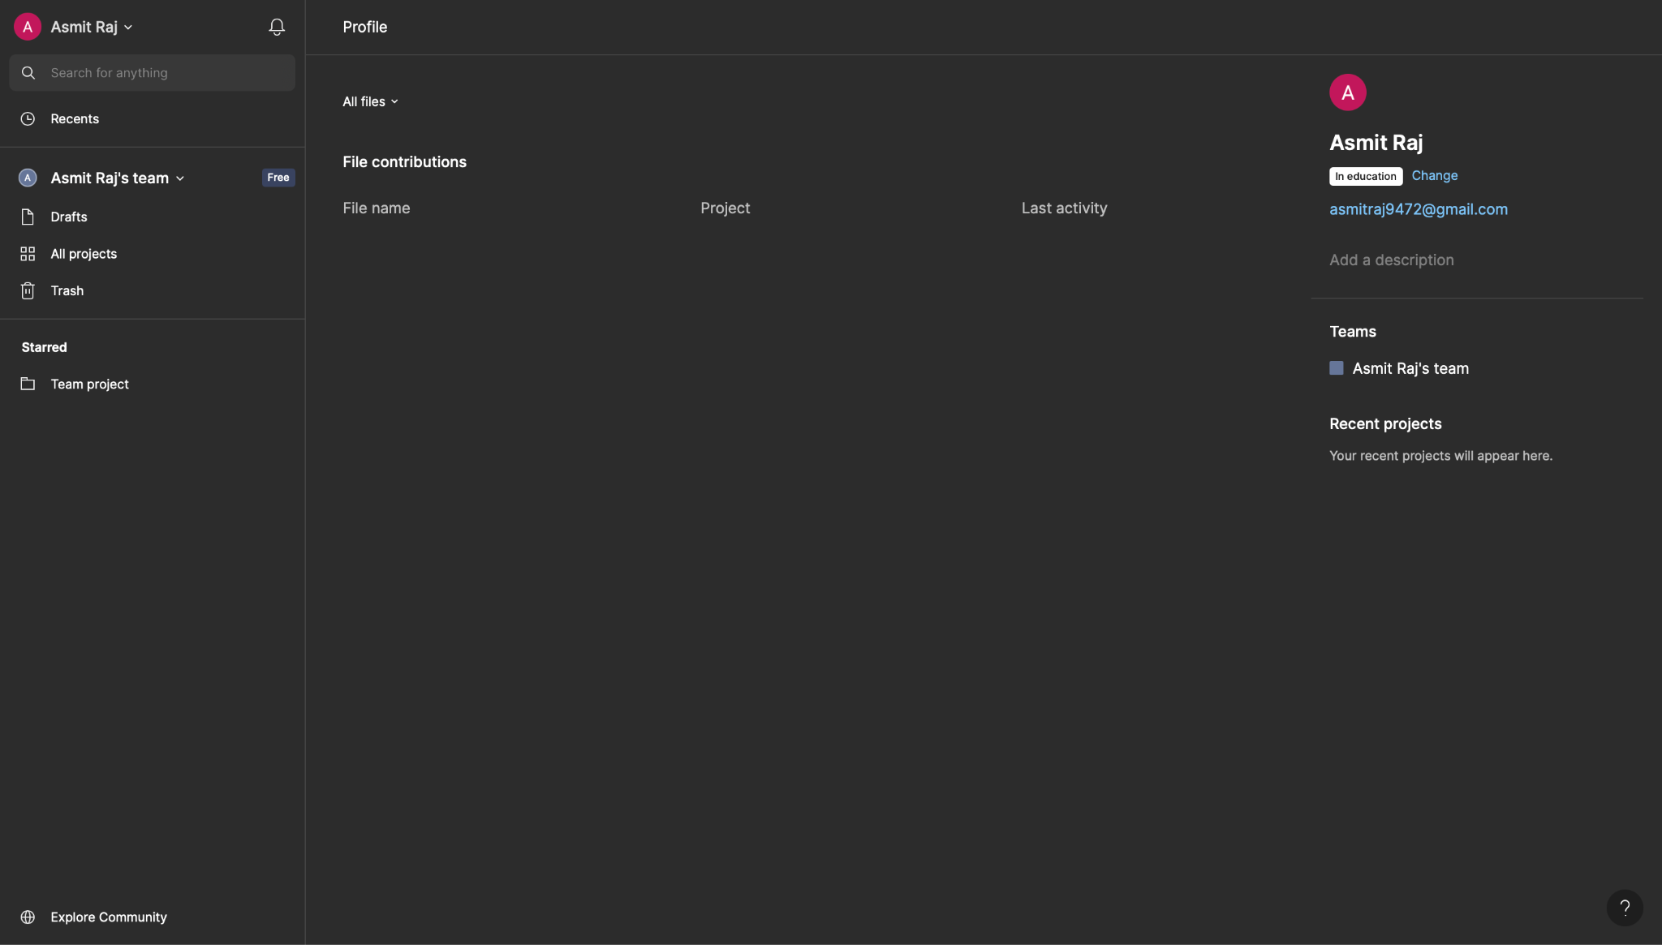
Figma:

Slide 9
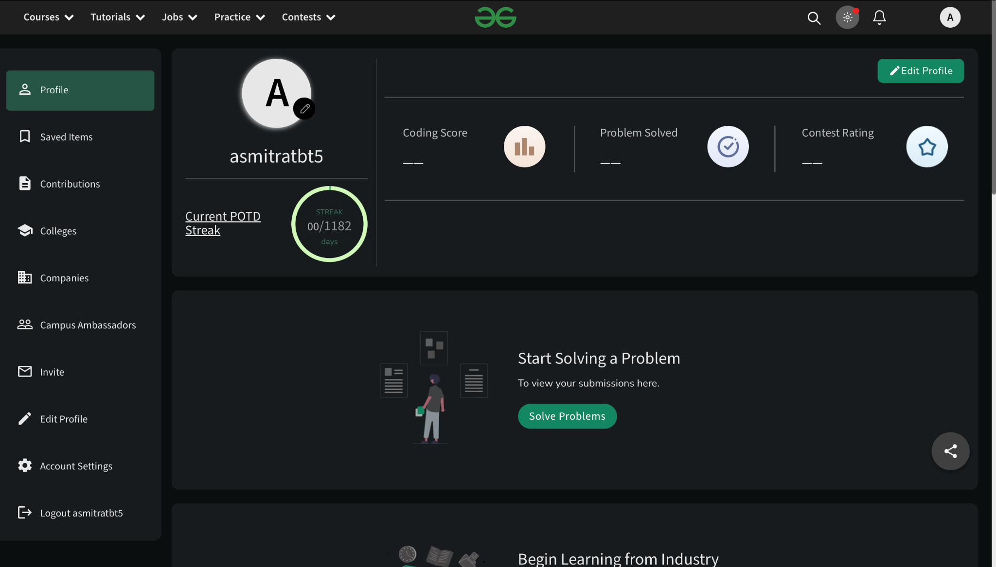
Geeks for Geeks:

Slide 10
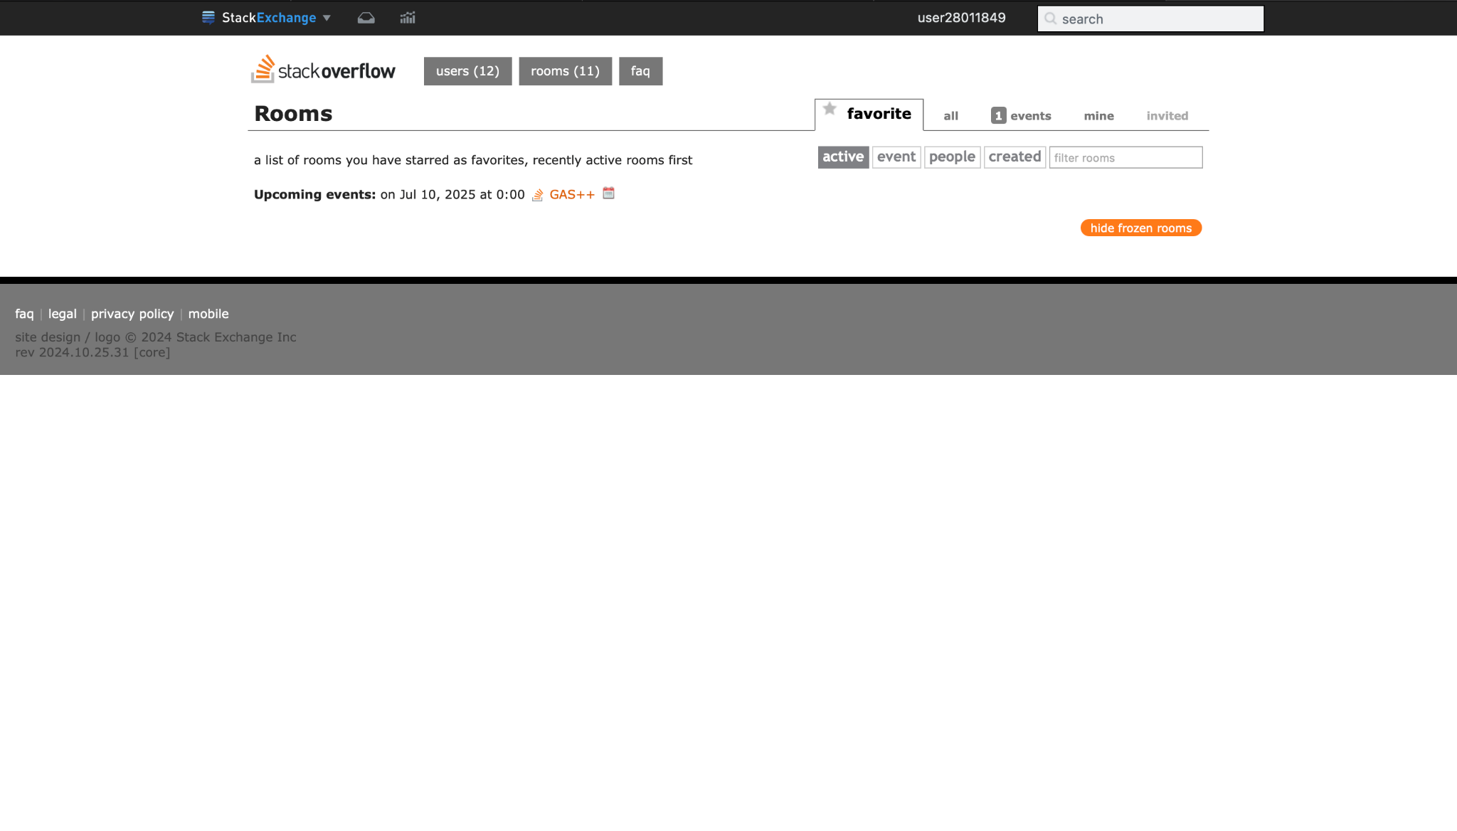
StackOverflow

Slide 11
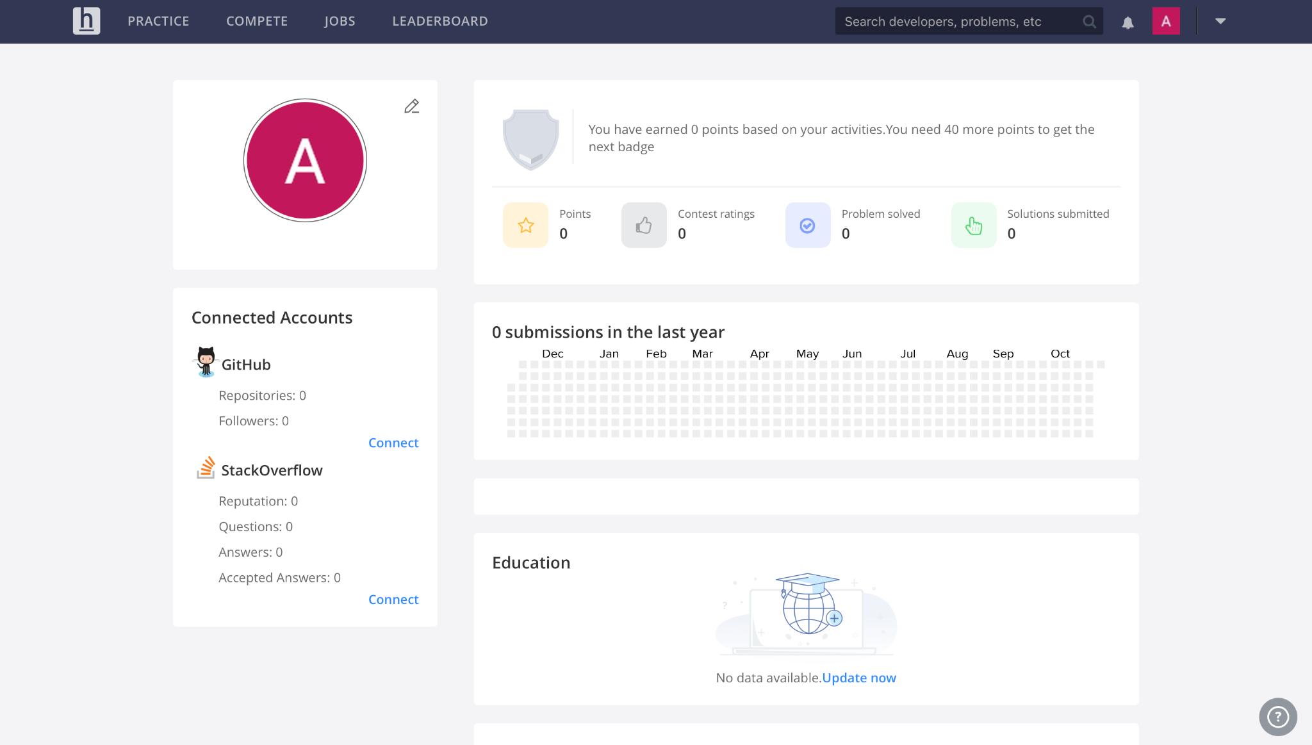
HackerEarth:

