Slide 1
POWER BI PROJECT
Logistics & Delivery Performance Intelligence Dashboard
Analyzing Delivery Performance, Operational Costs & Customer Satisfaction
Presented by
Asmiya Farin
Microsoft Power BI | Microsoft Excel

Slide 2



PROJECT INTRODUCTION
Project Overview
Analyzing logistics and delivery performance using Microsoft Power BI.
Project Objective
Business Problem
To understand delivery performance, identify delays, analyze costs, and monitor customer satisfaction.
Logistics companies need to track delivery delays, operational costs, and service quality to improve their operations.
Project Goals
Analyze delivery performance across partners and regions.
Identify patterns in delivery delays.
Compare delivery costs across vehicles, modes, and package types.
Monitor customer ratings and service quality.
Present insights through an interactive Power BI dashboard.

Slide 3


DATA SOURCE
Dataset Overview
Understanding the data used for delivery performance analysis.
25,000
15
Delivery Records
Columns
Key Data Fields
Delivery Partner
Region
Package Type
Vehicle Type
Delivery Mode
Distance
Delivery Cost
Delivery Rating
Dataset Source
Kaggle — Delivery Logistics Dataset (India – Multi-Partner)
https://www.kaggle.com/datasets/muhammadahmaddaar/delivery-logistics-dataset-india-multi-partner

Slide 4


METHODOLOGY
Tools & Project Workflow
Microsoft Excel
Power BI
Data review and preparation
Measures and dashboards
Project Workflow
01
02
03
04
05
Data Collection
Data Preparation
Data Modeling
Visualization
Analysis
Obtain the dataset from Kaggle.
Review and prepare the data.
Organize fields and create DAX measures.
Build charts, KPI cards and slicers.
Explore delivery performance, costs and ratings.

Slide 5

POWER BI REPORT
Dashboard Overview
The report is organized into five pages to explore different aspects of logistics performance.
01
Executive Overview
Overall delivery KPIs and performance.
02
Delivery Performance Analysis
Delay patterns across partners, regions and delivery categories.
03
Cost & Operations Analysis
Delivery costs across partners, vehicles and modes.
04
Customer & Service Analysis
Customer ratings and service quality.
05
Regional & Package Cost Insights
Cost comparisons across regions and package types.
Interactive visuals and slicers help users explore the data.

Slide 6
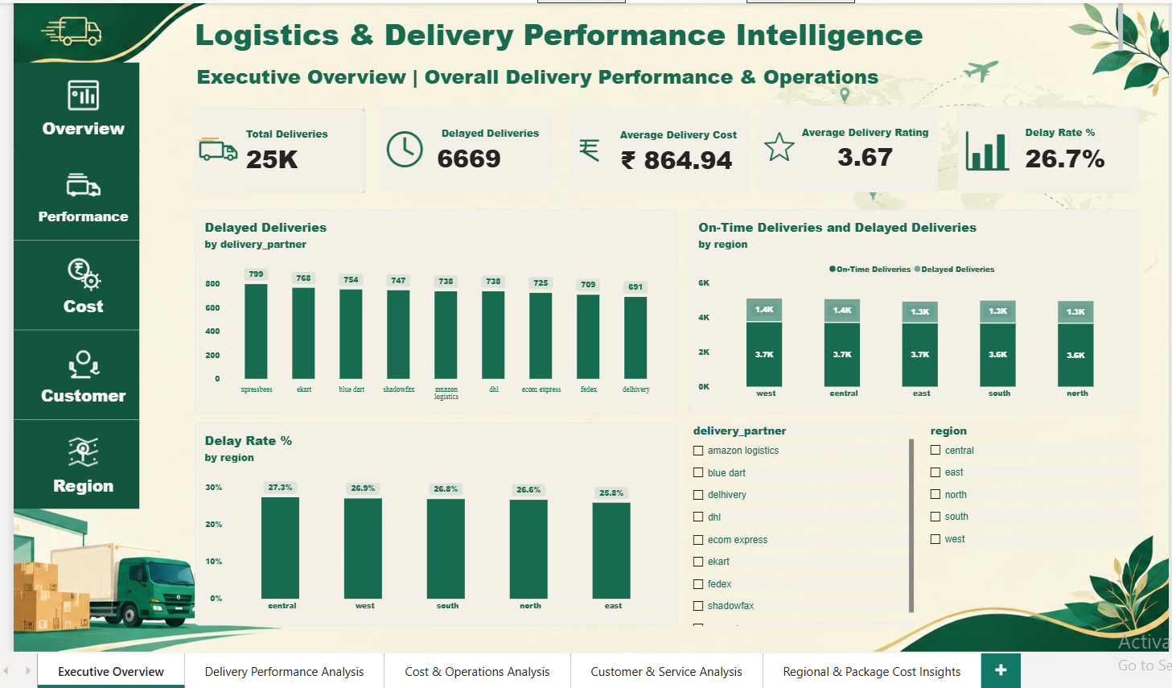
Dashboard Preview | Page 1: Executive Overview

Slide 7
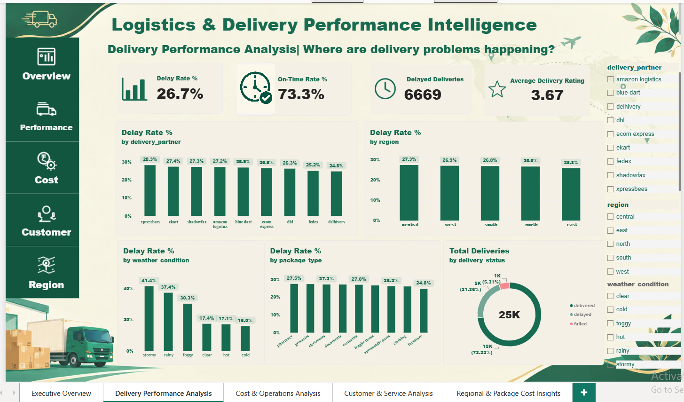
Dashboard Preview | Page 2: Delivery Performance Analysis

Slide 8
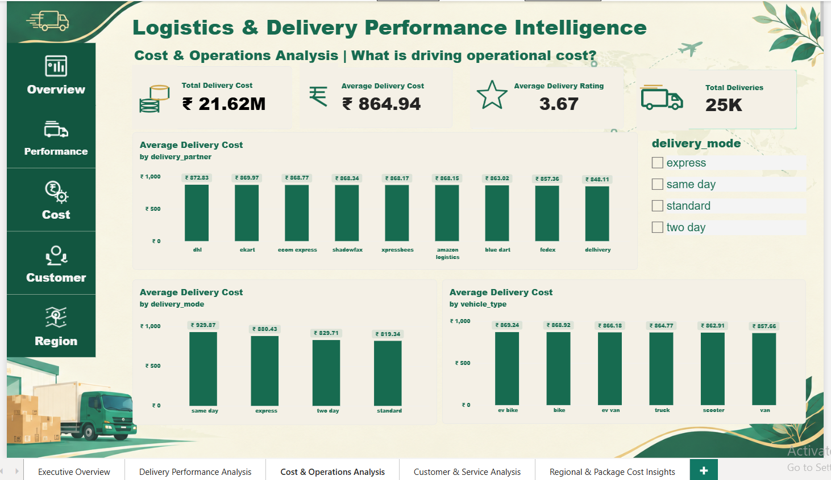
Dashboard Preview | Page 3: Cost & Operations Analysis

Slide 9
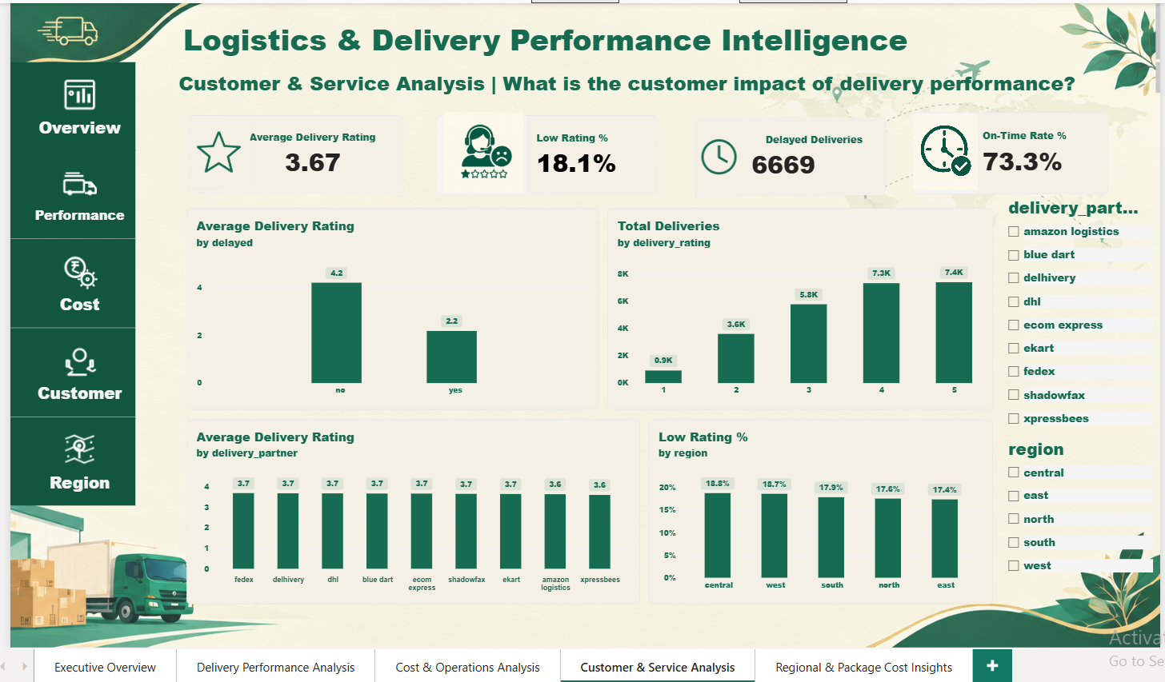
Dashboard Preview | Page 4: Customer & Service Analysis

Slide 10
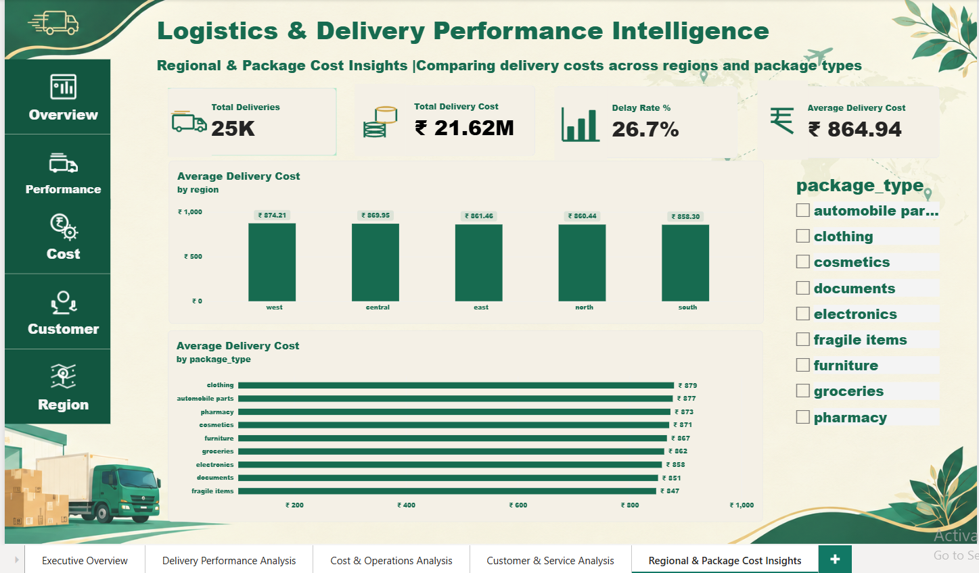
Dashboard Preview | Page 5: Regional & Package Cost Insights

Slide 11
KEY FINDINGS
Key Insights & Findings
A snapshot of delivery performance from the dataset.
25,000
6,669
Total Deliveries
Delayed Deliveries
73.3%
26.7%
On-Time Rate
Delay Rate
₹864.94
3.67 / 5
Average Delivery Cost
Average Delivery Rating
The dashboard summarizes delivery delays, on-time performance, average delivery costs and customer ratings.

Slide 12



BUSINESS APPLICATION
Business Value
How the dashboard can support logistics decisions.
Monitor Delivery Performance
Understand Delivery Costs
Identify partners and regions with higher delay rates.
Compare costs across vehicles, delivery modes and package types.
Track Service Quality
Support Decision-Making
Review customer ratings and identify areas for service improvement.
Use KPIs and interactive reports to explore operational patterns.
A data-driven view of delivery operations, costs and service quality.

Slide 13
PROJECT SUMMARY
Conclusion
This project demonstrates how Microsoft Power BI can be used to analyze logistics delivery performance through interactive dashboards and key performance indicators.
It helped me develop practical skills in data preparation, DAX measures, data visualization and business analysis.
Thank You!
Questions & Discussion
Asmiya Farin

