Slide 1
Amino Acid Interaction Network Prediction using Multi-objective Evolutionary Algorithm
Presented By
Md Shiplu Hawlader
Roll: 1718
Session:2010-11
Supervised By
Dr. Saifuddin Md. Tareeq
Associate Professor,
Department of Computer Science & Engineering,
University of Dhaka

Slide 2
Overview
Introduction
Motivation
Objective
Background Knowledge
Problem Formulation
Proposed Algorithm
Performance Analysis
Conclusion

Slide 3
Introduction
Protein, one of the most important biological macormolecules
Protein performs a vast array of functions
Human Genome Project has identied over 30,000 genes which may encode about 100,000 proteins
Functions of protein are complex and vary from cell to cell
Function of a protein depends on its three dimensional structure
Solution of protein structure finding and prediction, is solution to different diseases and medicine discovery

Slide 4
Motivation
Protein, a amino acid chain of peptide bond
Protein, a network of amino acid in three dimensional space
The Protein Data Bank (PDB) contains all the information about coordinate of amino acid atoms in protein
Distance and torsion angles between amino acid atoms can be computed
Hydrophobicity and Hydrophilicity, two important properties of amino acid and affect the structure of protein

Slide 5
Objective
Predict a network of amino acid atoms
NxN matrix of the graph representing the network
Edges represents the interaction or bonds between amino acid
Interaction depends not only on distance between amino acid atoms in protein but also the angles between them and on the hydrophobic and hydrophilic properties
Evolutionary Optimization Algorithm is used with capability of multi-objective handling instead of using machine learning approaches like ANN, SVM etc.

Slide 6
Experimental method to Protein Structure
X-ray Crystallography
NMR spectography
Electronic micrscopy
Homology modeling (e.g. Swiss model)
Small Angle X-ray Scattering (SAXS)
Small Angle Neutron Scattering (SANS)

Slide 7
Computational approaches to Protein Structure Prediction
Artificial Neural Network (MISMATCH, PHD, NNPREDICT)
Support Vector Machine (SVM)
Nearest Neighbor method
Ab initio protein modeling
Energy and fragment based methods
Evolutionary approach

Slide 8
Protein Structure
Primary Structure
Secondary Structure
Tertiary Structure
Quaternary Structure

Slide 9
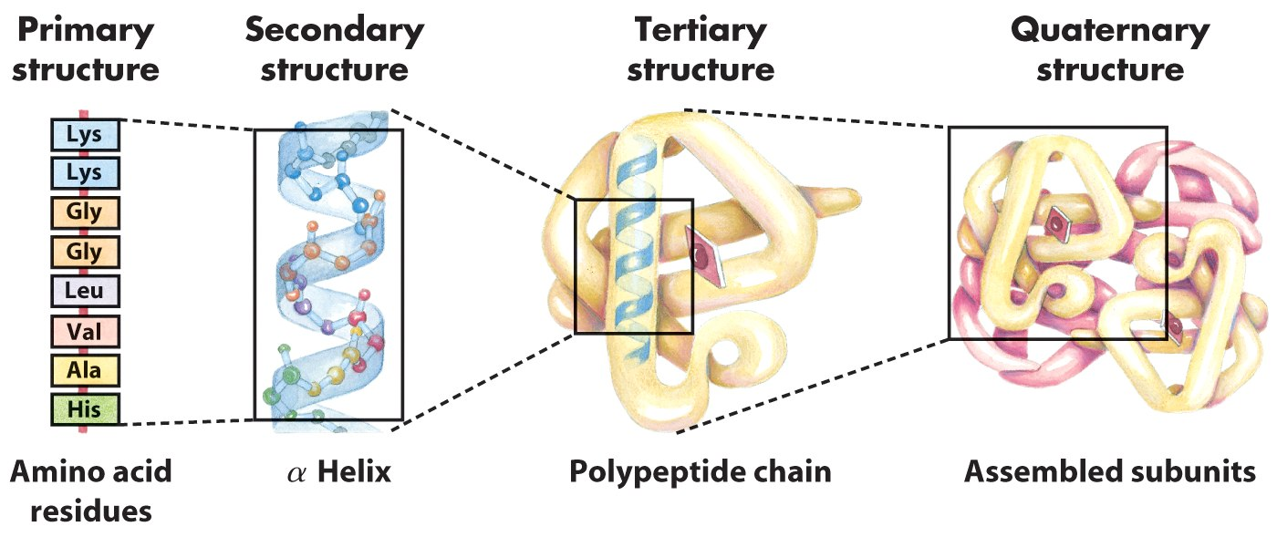
Levels of Protein Structure
Figure 1: Different level of protein structure

Slide 10
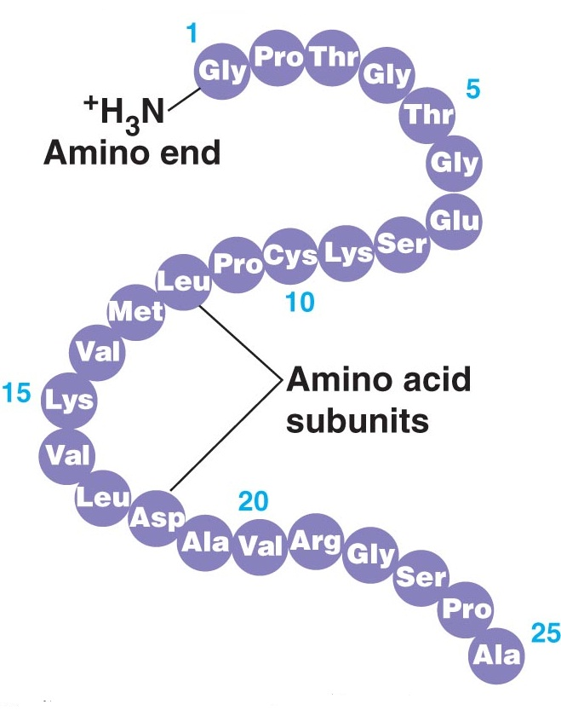
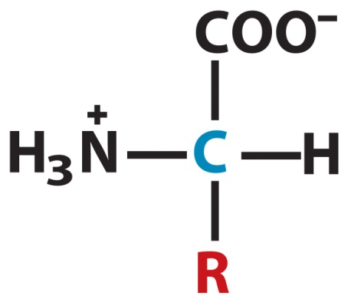
Protein Primary Structure
Sequence of Amino Acids
A peptide bonded chain
(a)
(b)
Figure 2: (a) Amino Acid Structure (b) amino acid chain in polypeptide bond

Slide 11
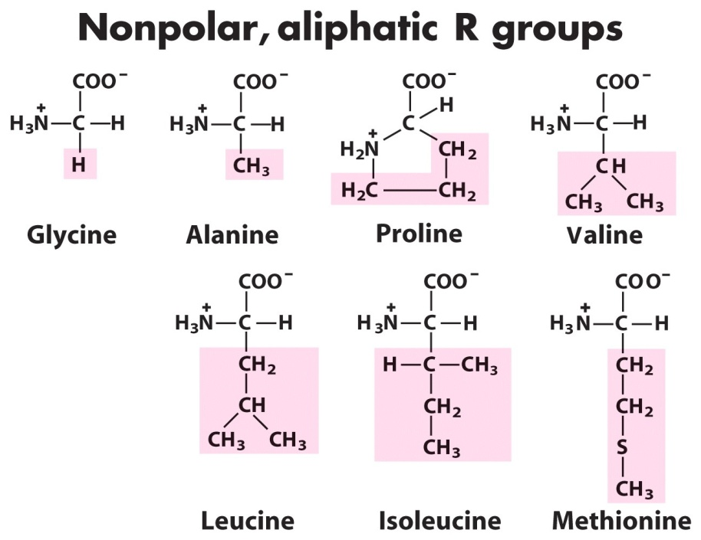
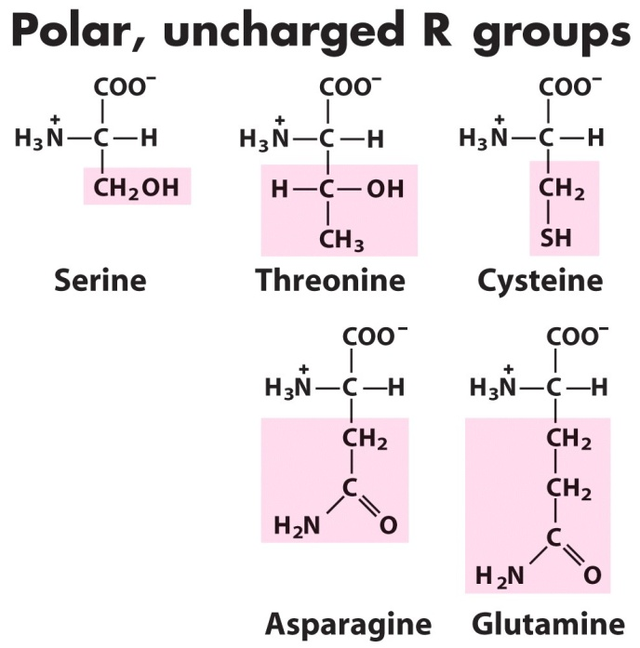
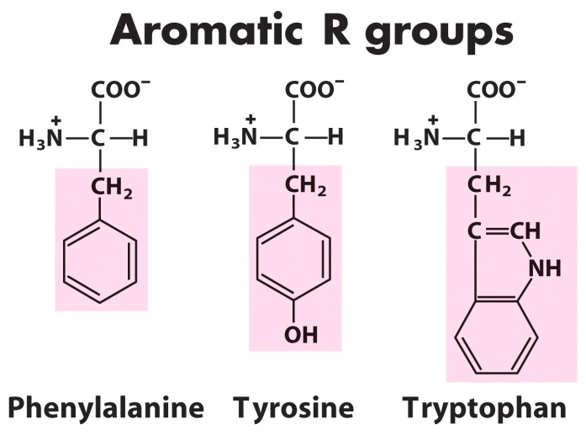
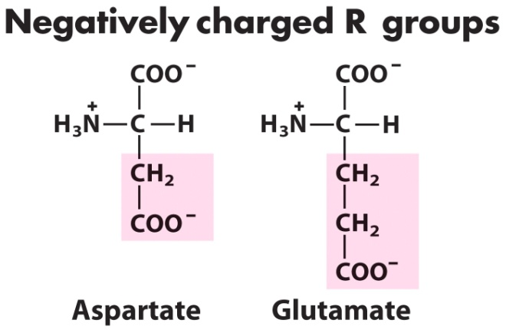
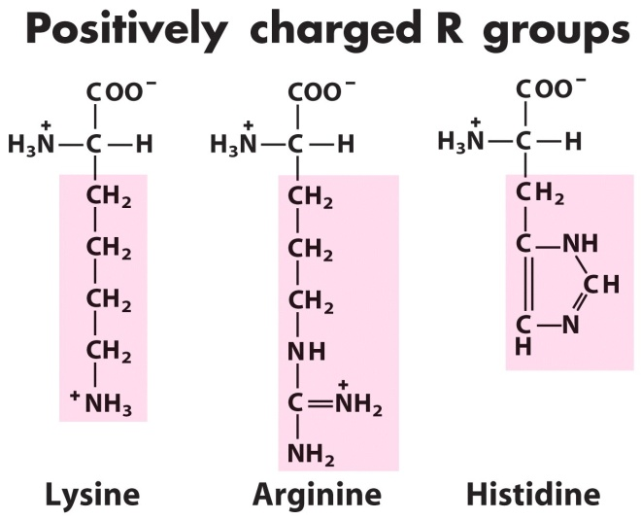
The 20 Amino Acids Found in Protein

Slide 12
Protein Secondary Structure (1/3)
Secondary structures are 3D state of primary structures
Non-adjacent atomic acids may be connected by hydrogen bond
Torsion Angles between amino acids defines secondary structure of protein
Two most important secondary structure
Alpha Helix
Beta Sheet

Slide 13
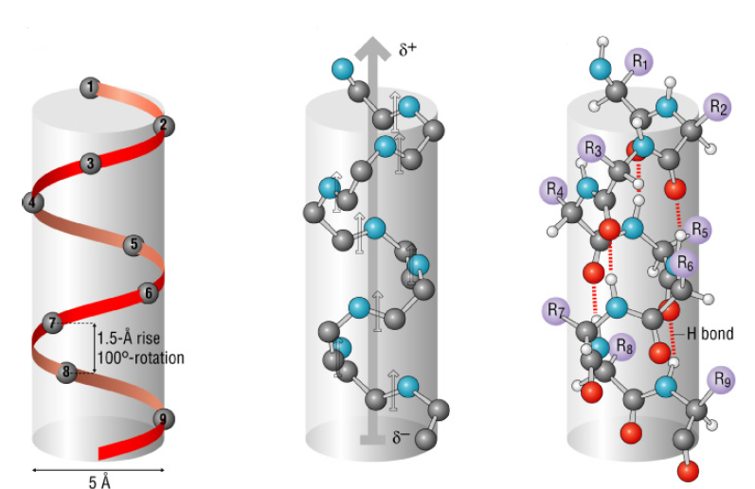
Protein Secondary Structure (2/3)
Figure 3: Alpha Helix

Slide 14
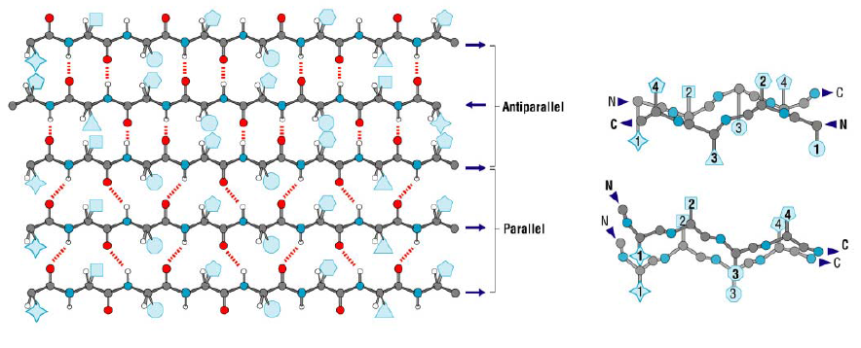
Protein Secondary Structure (3/3)
Figure 4: Beta Sheet

Slide 15
Torsion Angles (1/3)
Defines the rotation of the polypeptide chain around the two bonds on both sides of the Cα atom
Provides the flexibility required for the polypeptide backbone to adopt certain structure
Also called Ramachandran angles
Two torsion angles
Phi (φ) angle - between Nitrogen and alpha Carbon (N-Cα) in amino acid chain
Psi (ψ) angle – between alpha Carbon and Carbon (Cα - C) in amino acid chain

Slide 16
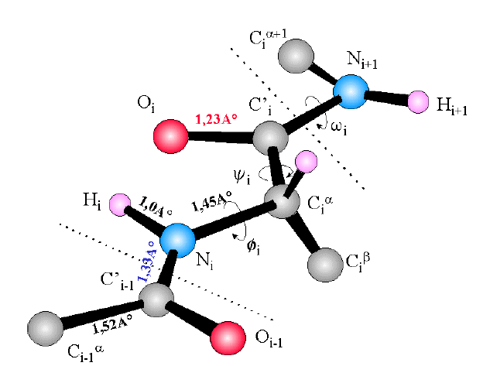
Torsion Angles (2/3)
Figure 5: Part of polypeptide chain marking with Phi and Psi angles

Slide 17
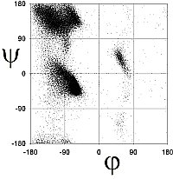
Torsion Angle (3/3)
Ramachandran Plot
Beta Region
Alpha Region
Figure 6: Ramachandra Plot for protein 1E7I

Slide 18
Protein Tertiary Structure (1/2)
Two or more secondary structure folded together to produce tertiary structure
Each of the secondary structure inside a tertiary structure are called Secondary Structure Element (SSE)

Slide 19
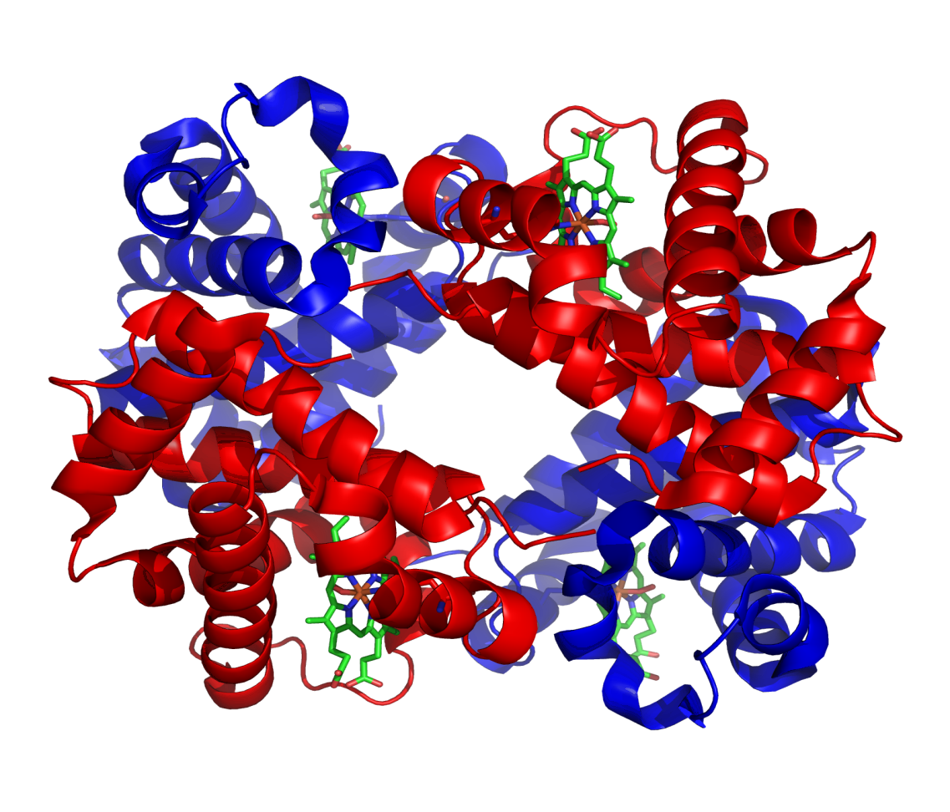
Protein Tertiary Structure (2/2)
Figure 7: Tertiary Structure of Haemoglobin

Slide 20
Problem Formulation (1/5)
We can define the tertiary structure of the amino acid as a network of amino acid atoms
Vertices represent the amino acid atom and edges represent interaction between amino acids or bond between them
But can we distinguish between networks of different proteins structure?

Slide 21

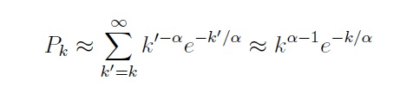
Problem Formulation (2/5)
Random Graph Model
Scale-Free Network
Where, Pk is the probability that a vertex is connected to k other vertices

Slide 22
Problem Formulation (3/5)
Topological Measurement D = Diameter, dG = mean distance, ∂(G) = average density and z = Average mean degree
Protein Family Name | Class | No. of Proteins | D (Å) | dG | ∂(G) | Z
RossmanFold | α β | 2576 | 18.84 | 7.26 | 0.033 | 7.2
Tim Barrel | α β | 1051 | 19.83 | 7.79 | 0.03 | 7.12
Lysozome | Mainly α | 871 | 12.81 | 4.99 | 0.038 | 6.82
Globin-like | All α | 733 | 15.65 | 6.64 | 0.034 | 7.69
TIM β/ α -barrel | α / β | 896 | 20.09 | 7.86 | 0.029 | 7.15
Lysozyme-like | α + β | 819 | 12.85 | 5.03 | 0.042 | 6.81
Table 1: Different Topological measurement of protein

Slide 23
Problem Formulation (4/5)
Properties of Random Graph Model, Scale-Free network and Topological measurement proofs the existence of amino acid interaction network
Two distinct problem to be solved
Predict the SSE-IN, the network of Secondary structure elements (SSE) with connection or interaction between SSE’s
Predict the interaction between intra SSE amino acids

Slide 24
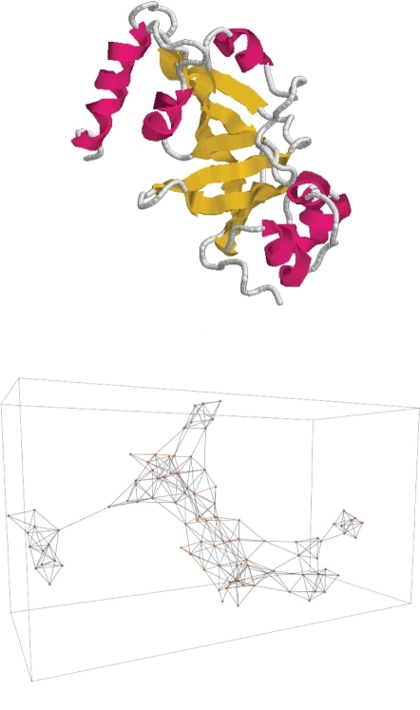
Problem Formulation (5/5)
Figure 8: 1DTP protein and its expected SSE-IN network

Slide 25
Proposed Algorithm
Two problem two solution
Multi-objective Evolutionary Optimization Algorithm to predict SSE-IN
Ant Colony Optimization to predict the intra SSE interactions as well as inter SSE interactions

Slide 26

Multi-objective Optimization (1/2)
Have more than one objective functions to be optimized
Individual X and Y has n objectives x₁, x₂, … , x_{n} and y₁, y₂, … , y_{n} and the fitness functions are z₁, z₂, … , z_{n}
Domination:
if and only if z_{i}(X) ≥ z_{j} (Y) for i,j = 1, 2, … , n

Slide 27
Multi-objective Optimization (2/2)
Objectives for SSE-IN prediction
Distance between amino acids
Nearer the better
Torsion Angles between amino acids
Have to be inside a thershold
Hydrophobicity
Hydrophobic or hydrophilic

Slide 28
Multi-objective Genetic Algorithm (1/4)
Evolutionary algorithm as multi-objective optimization
Genetic Algorithm
An improved and combined version of NSGA-II and SPEA2
Three operators
Crossover operator
Mutation operator
Topological operator

Slide 29
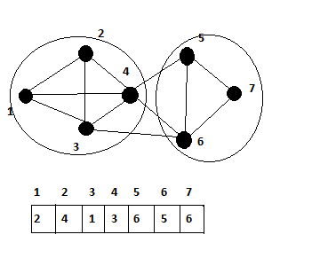
Multi-objective Genetic Algorithm (2/4)
SSE1
SSE2
Genetic Representation
Figure 9: Network of 7 nodes clustered into {1,2,3,4} and {5,6,7}

Slide 30
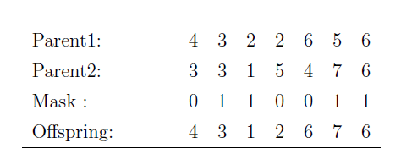
Multi-objective Genetic Algorithm (3/4)
Crossover
Table 2: Example of Uniform Crossover

Slide 31
Multi-objective Genetic Algorithm (4/4)
Fitness function

Slide 32
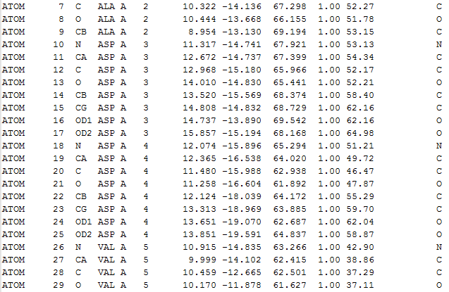
Input file of 1DTP protein

Slide 33
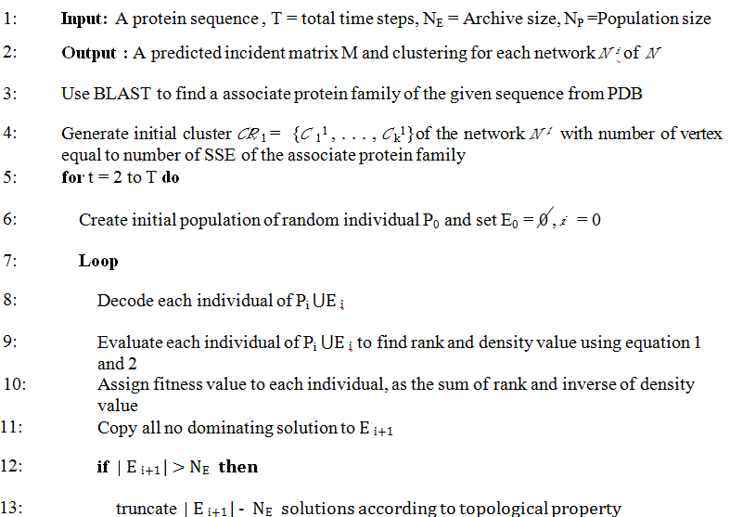
Proposed Algorithm for SSE-IN Prediction (1/2)

Slide 34
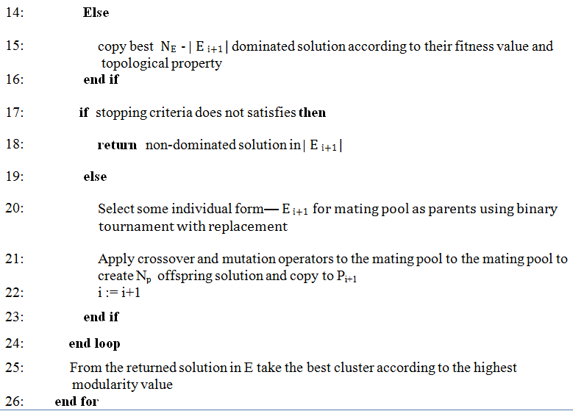
Proposed Algorithm for SSE-IN Prediction (2/2)

Slide 35
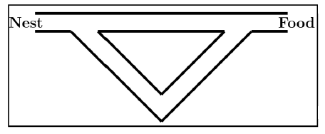
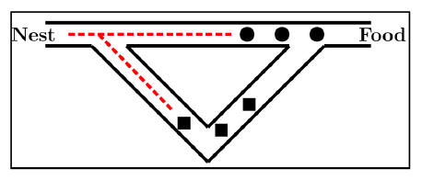
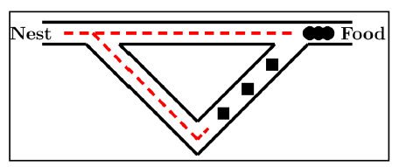
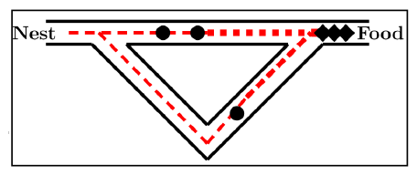
Ant Colony Optimization (1/6)
(a)
(b)
(c)
(d)
Figure 10: An example of shortest path finding capability of ant colony optimization

Slide 36
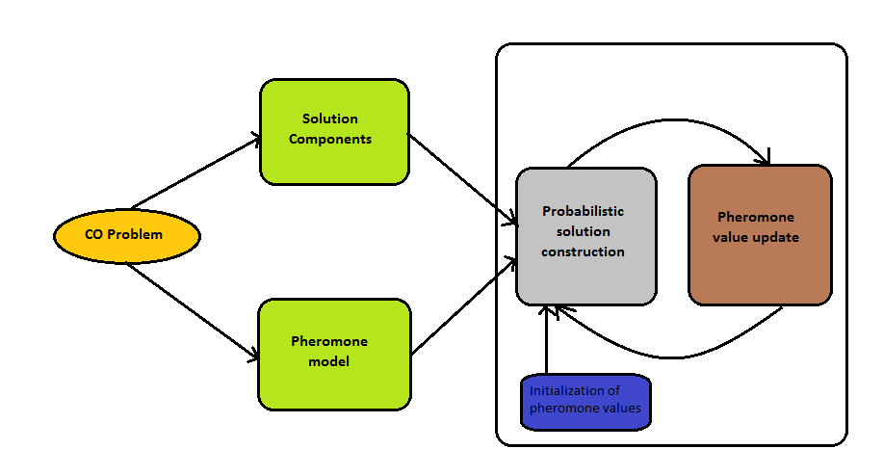
Ant Colony Optimization (2/6)
Figure 11: Working Procedure of Ant Colony Optimization

Slide 37
Ant Colony Optimization (3/6)
Candidate solutions are constructed using a pheromone model, that is, a parameterized probability distribution over the solution space
The candidate solutions are used to modify the pheromone values in a way that is deemed to bias future sampling toward high quality solutions

Slide 38
Ant Colony Optimization (4/6)
Have to know how many edges or interactions to be added
Need a protein as reference from the associated protein family of same number of SSE
To chose the reference protein family we had to calculate average distance of the reference protein and the base protein and chose the best one

Slide 39
Ant Colony Optimization (5/6)
Two step algorithm
Local Algorithm: In interaction, consider each pair of SSE's separately. This is the local step. We use an ant colony algorithm to identify the suitable interactions between amino acids belonging to these SSE's
Global Algorithm: A global ant colony algorithm is run to predict the interaction between amino acids from different SSE-IN

Slide 40
Ant Colony Optimization (6/6)

Slide 41
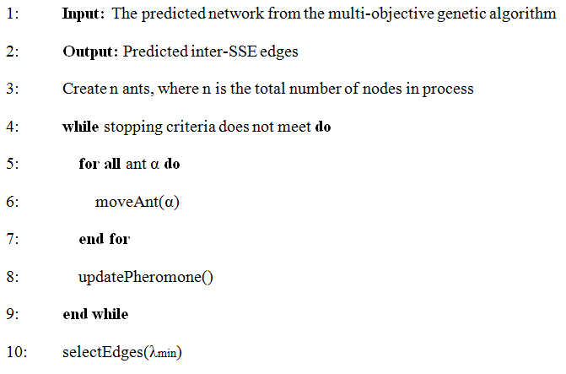
Local Algorithm - ACO

Slide 42
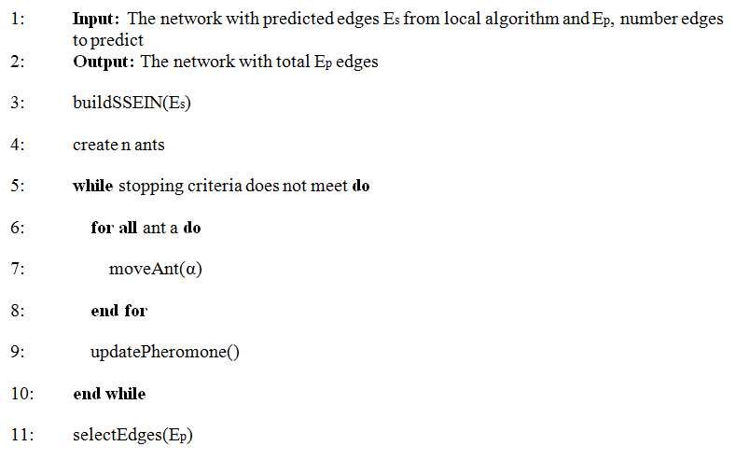
Global Algorithm - ACO

Slide 43
Performance Analysis (1/6)
Multi-objective Evolutionary Algorithm
Accuracy

Slide 44
Performance Analysis (2/6)
Average Accuracy (%)
Figure 11: Comparison between proposed algorithm for SSE-IN prediction with respect to proposed by Gaci et al. with 698 All alpha proteins and 413 All beta proteins and number of population in GA is restricted to 15

Slide 45
Performance Analysis (3/6)
Average Accuracy (%)
Figure 12: Comparison between proposed algorithm for SSE-IN prediction with respect to proposed by Gaci et al. with 698 All alpha proteins and 413 All beta proteins and number of population in GA is at least 15

Slide 46
Performance Analysis (4/6)
Ant colony optimization
Proportion of edges
Precision (%)
Figure 13: Precision in number of edges to be added in all alpha protein

Slide 47
Performance Analysis (5/6)
Ant colony optimization
Proportion of edges
Precision (%)
Figure 14: Precision in number of edges to be added in all beta protein

Slide 48
Class | SCOP Family | Number of Proteins | Protein Size | Score of Proposed Method | Average Deviation of Proposed method | Score of Gaci et al. Method | Average Deviation of Gaci et al. method
All Alpha | 46688 | 17 | 27-46 | 83.973 | 3.277 | 79.136 | 8.114
 | 47472 | 10 | 98-125 | 73.973 | 12.635 | 70.692 | 15.53
 | 46457 | 25 | 129-135 | 76.125 | 7.849 | 74.567 | 9.047
 | 48112 | 11 | 194-200 | 69.234 | 14.008 | 68.3 | 14.942
 | 48507 | 18 | 203-214 | 66.826 | 5.504 | 64.488 | 7.842
 | 46457 | 16 | 241-281 | 63.281 | 17.025 | 63.375 | 16.931
 | 48507 | 20 | 387-422 | 62.072 | 9.304 | 61.947 | 9.429
All Beta | 50629 | 6 | 54-66 | 79.635 | 2.892 | 76.136 | 6.391
 | 50813 | 11 | 90-111 | 74.006 | 4.428 | 72.567 | 5.867
 | 48725 | 24 | 120-124 | 80.881 | 7.775 | 76.692 | 11.964
 | 50629 | 13 | 124-128 | 76.379 | 9.361 | 71.3 | 14.44
 | 50875 | 14 | 133-224 | 77.959 | 10.67 | 74.488 | 14.141
Table 3: Predicting a SSE-IN by ant colony approach. The algorithm parameters are: α = 25, β = 12, ρ = 0.7, Δτ = 4000, e = 2, λ_{min} = 0.8

Slide 49
Performance Analysis (6/6)
Algorithm Complexity
Independent of specific time bound
Running time can be controlled
More time it runs better it performs

Slide 50
Conclusion
Computational solution to an biological problem and described how to formulate a biological problem like folding protein into optimization and graph theory problem. The formulation consists of finding the interactions between SSE network and interaction between amino acids of the protein. The first problem was solving by an multi-objective genetic algorithm and the second one solve by ant colony optimization approach.

Slide 51
References
O. Gaci. How to fold amino acid interaction networks by computational intelligence methods. In BioInformatics and BioEngineering (BIBE), 2010 IEEE International Conference on, pages 150 - 155, 2010.
Deepayan Chakrabarti, Ravi Kumar, and Andrew Tomkins. Evolutionary clustering. In Tina Eliassi-Rad, Lyle H. Ungar, Mark Craven, and Dimitrios Gunopulos, editors, KDD, pages 554 - 560. ACM, 2006.
L. Li N. V. Dokholyan, F. Ding, and E. I. Shakhnovich. Topological determinants of protein folding. In Proceedings of the National Academy of Sciences of the United States of America, volume 99, pages 8637 - 8641, 2002.
Helen M Berman, John Westbrook, Zukang Feng, Gary Gilliland, TN Bhat, Helge Weissig, Ilya N Shindyalov, and Philip E Bourne. The protein data bank. Nucleic acids research, 28(1):235 - 242, 2000.
Debnath Pal and Pinak Chakrabarti. On residues in the disallowed region of the ramachandran map. Biopolymers, 63(3):195 - 206, 2002.
Carl Branden, John Tooze, et al. Introduction to protein structure, volume 2. Garland New York, 1991.

Slide 52
References
Mark EJ Newman. The structure and function of networks. Computer Physics Communications, 147(1):40-45, 2002
Omar Gaci, Stefan Balev, et al. Proteins: From structural classication to amino acid interaction networks. Proceedings of the BIOCOMP 08, 2(1):728-734, 2008.
Omar Gaci and Stefan Balev. The small-world model for amino acid interaction networks. In Advanced Information Networking and Applications Workshops, 2009. WAINA'09. International Conference on, pages 902 - 907. IEEE, 2009.
Christian Blum. Ant colony optimization: Introduction and recent trends. Physics of Life reviews, 2(4):353-373, 2005.
Omar Gaci. Building a topological inference exploiting qualitative criteria. Evolutionary Bioinformatics, 2010.
Deb K, Agrawal S, Pratap A, and Meyarivan T. A fast elitist non-dominated sorting genetic algorithm for multi-objective optimization: Nsga-ii. In Proc. Of 6th international conference on parallel problem solving on nature, Paris,France, September 2000. Springer
Marco Laumanns Eckart Zitzler and Lothar Thiele. SPEA2: Improving the Strength Pareto Evolutionary Algorithm. Zurich, Switzerland, 2001
Y.J. Park and M.S. Song. A genetic algorithm for clustering problems. In Proc.
of 3rd Annual Conference on Genetic Algorithm, pages 2-9, 1989

Slide 53
Question
?

