Slide 1
Choosing & Evaluating UI/UX Guidelines
Based on UX Design Institute & UNICEF Guidelines

Slide 2
Agenda
Why I chose these guidelines
Evaluation of guidelines
Strengths & Weaknesses
Key Takeaways & Recommendations

Slide 3
Context & Purpose
UI/UX guidelines are crucial for consistent, user-friendly design.
They provide rules, principles, and best practices for teams.
Our focus: UX Design Institute’s 10 UI Guidelines + UNICEF Design Guidelines.

Slide 4
Why UX Design Institute’s Guideline
Credible source based on usability heuristics.
Concise and easy to understand (10 rules).
Good foundation for general UI design projects.

Slide 5
Why UNICEF’s Design Guideline
Developed for large-scale, multi-platform applications.
Focuses on accessibility, consistency, and usability.
Provides actionable component-level guidance.
Mainly for our Government we don’t have any specific guideline to make any website. As Unicef is worldly recognized so we are following this guideline.

Slide 6
Comparison of the Two Guidelines
Both emphasize usability and consistency.
UX Design Institute: high-level, theory-focused.
UNICEF: practical, component-driven, technical details.

Slide 7
Overview: UX Design Institute
10 UI guidelines covering:
Visibility of system status
Match with real world
User control & freedom
Consistency, error prevention, recognition over recall

Slide 8
Overview: UNICEF Design Guidelines
Covers design principles, components, and accessibility.
Provides technical specs for developers.
Ensures cross-platform and organizational consistency.

Slide 9
Evaluation Criteria
Clarity & Understandability
Applicability & Scalability
Completeness & Flexibility
Ease of Adoption
Support with Examples

Slide 10
Evaluation: UX Design Institute
Strengths: clear, simple, memorable.
Widely applicable across domains.
Weakness: abstract, lacks technical depth.
Not specific for accessibility or complex systems.

Slide 11
Evaluation: UNICEF Guidelines
Strengths: concrete, developer-friendly, accessible.
Covers both UX and UI aspects.
Weakness: heavy for small projects, less flexible.
More rigid for innovation.

Slide 12
Strengths: UX Design Institute
Simple rules for fast adoption.
Grounded in Nielsen’s heuristics.
Improves usability at a conceptual level.

Slide 13
Strengths: UNICEF Guidelines
Detailed component-level guidance.
Focus on accessibility and inclusivity.
Scalable for large, multi-team projects.

Slide 14
Weaknesses: UX Design Institute
Too high-level, lacks examples.
Not directly actionable for developers.
Limited coverage of accessibility.

Slide 15
Weaknesses: UNICEF Guidelines
Can be overwhelming for smaller projects.
Rigid structure may reduce creativity.
Requires training for adoption.

Slide 16
Example: Applying the Guidelines
Form design example:
UXDI: Reduce cognitive load, clear error prevention.
UNICEF: Component spacing, label placement, accessibility rules.

Slide 17
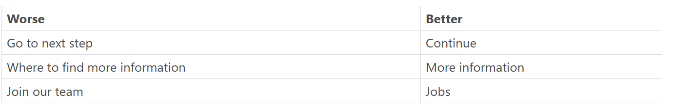
Details about Guidelines
Brand colors
Traffic light colors: traffic light colors metaphor for indicating status or result.
Font Size: Large text is defined as 14 point (typically 18.66px) and bold or larger, or 18 point (typically 24px) or larger.
Typography: For keeping the weight of the HTML low, we haven’t defined a default typography other than the default font of the operating system the user is running. For example, in Windows 10 is Segoe.
Headings: Headings h1 to h6. Do not jump hierarchies. After h1 there should be h2, but not h3 or h4. This is important for text readers, as users can navigate through headings.
Text and labelling:

Slide 18
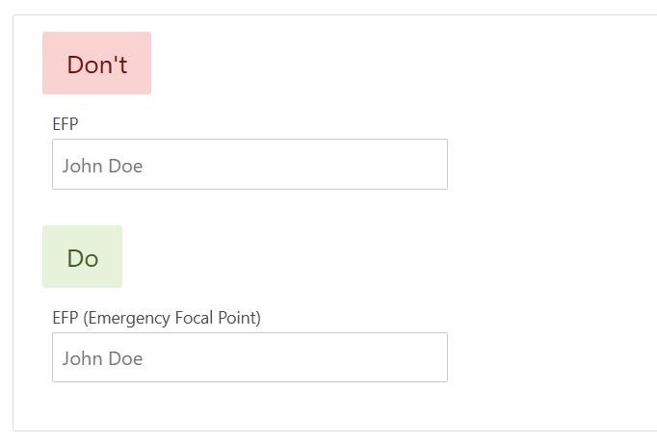
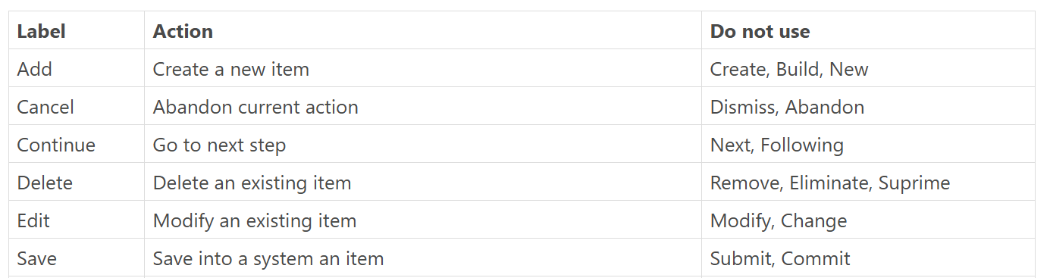
Don’t just write short form
Buttons perform actions

Slide 19
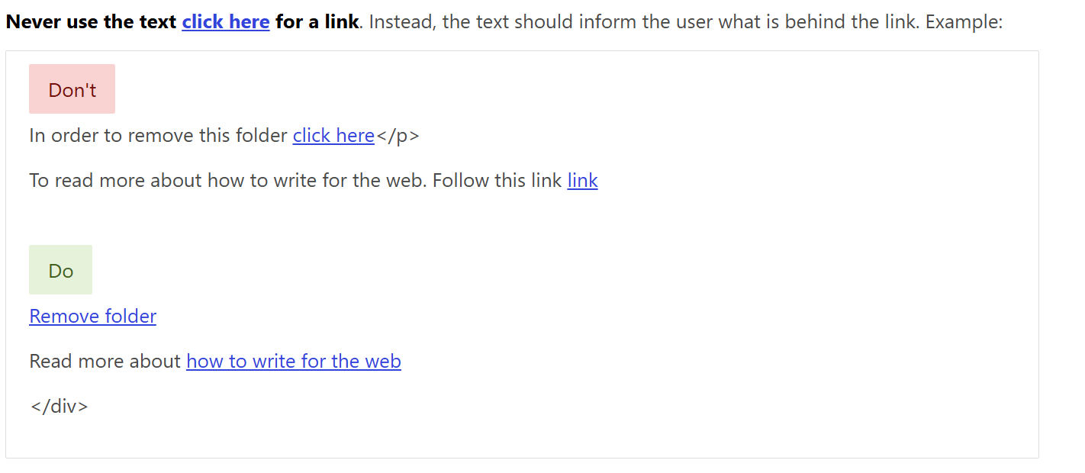

Slide 20
Alerts
Sometimes you need to recall user attention. Use alerts for that.
Alerts shall be used ONLY to display information that is extremely important for the user to to be aware of.
Success alerts. Use these alerts to indicate a positive, successfull outcome
Warning alerts. use them to notify the user about situations that is not blocking but that may affect the outcome or he needs to be aware of.
Danger alert. Use these alerts for errors and in situations in which the user cannot continue.

Slide 21
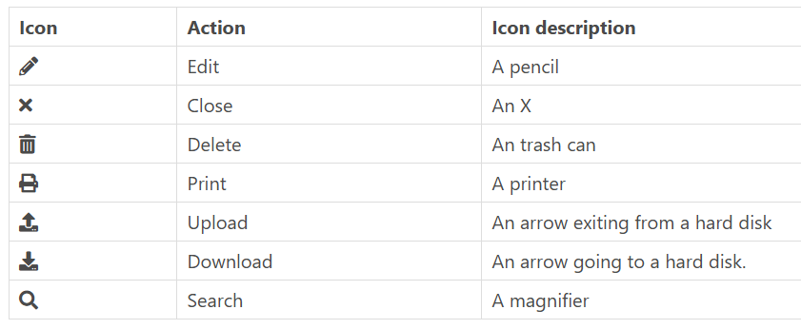
Icons
In general, icons shall always be accompanied with a label. Exceptionally, a tooltip is allowed.

Slide 22
Date format
In UNICEF Style Guidelines (internal document) the recommended format is 3 February 2019. We also recommend this format if space is necessary dd-MMM-YYYY. For instance: 01-Feb-2018 or 10-Mar-2020.
Time formats
Time shall be displayed in current user timezone and in 12-hour format. Example: Add the title attribute with the 24-hour time.
Numbers and currencies format
By default, we stick to English numbers. Separate thousands, millions, etc. with , and decimals with .. Example: 3.14159, 1,200,000. For currencies prepend the currency symbol to the number and use always two decimals. Example: $123,456,789.00, €1,200.00.
Images
Images should weight the least amount possible. We work on environments on which the Internet is still not reliable. So, minimizing the use and size of images is a must.

Slide 23
Recommendations
Combine high-level heuristics with component guidance.
Add accessibility & mobile responsiveness focus.
Create a hybrid internal design guide.

Slide 24
Implementation & Adoption
Distribute summarized cheat sheets.
Provide training workshops for team members.
Regular reviews and updates of guidelines.

Slide 25
Summary & Takeaways
UXDI: strong conceptual foundation.
UNICEF: detailed, practical, scalable.
Together: balanced design system for teams.

Slide 26
Q&A / Discussion
Questions?
Feedback on evaluation and recommendations?

