Slide 1


Dash: Efficient Genomic Set Operations Using HyperLogLogs
Daniel N. Baker, Ben Langmead
Department of Computer Science
Johns Hopkins University

Slide 2
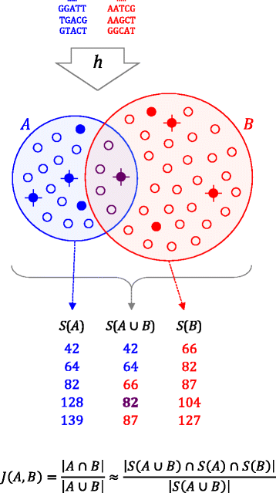
Mash: MinHash-based distance estimation
For a given sketch size n, k-mers from each genome are hashed, and the n smallest hashes are retained as a sketch.
This provides an unbiased estimator of the Jaccard index between two sets.
Sketch complexity: O(m log(n)) Jaccard index complexity: O(n)
Deterministic, pseudorandom subsets
“Bolt Thrower”
Brian D. Ondov, et al. Genome Biology 2016 17:132. Mash: fast genome and metagenome distance estimation using MinHash
https://doi.org/10.1186/s13059-016-0997-x

Slide 3
K-mer: exact subsequence of DNA
We abuse notation by counting “spaced seeds” as kmers.
k <= 32 can be encoded as 64-bit integers and efficiently manipulated

Slide 4
Applications
1. Genome comparisons
Clustering
2. Classification of sets of reads
Characterization
Contamination
‘mash screen’
3. Indexing
By providing an efficient estimate of the overlap of sets, this similarly facilitates genomic database creation and querying.

Slide 5
Motivation
Mash was wildly successful
Clustering all of RefSeq overnight
Facilitated rapid comparison of genomes
mashmap
Using minhash for fast seeding for alignment of noisy reads
Other uses
The Sequence Bloom Tree facilitates large-scale indexing using Bloom filters

Slide 6


Approximate Counting and HyperLogLogs
Approximate Counting
Trades an exact solution for log(log(n)) space.
HyperLogLog
Partitions approximate counting into subsets and uses the harmonic mean to reduce variance.
Same asymptotic performance as MinHash:

Slide 7
Accuracy: E. coli genomes
40 genomes
Compared across:
Sketch sizes
Kmer length
All dash values use Ertl’s Joint MLE estimator.
JMLE consistently had the lowest SSE and bias.

Slide 8
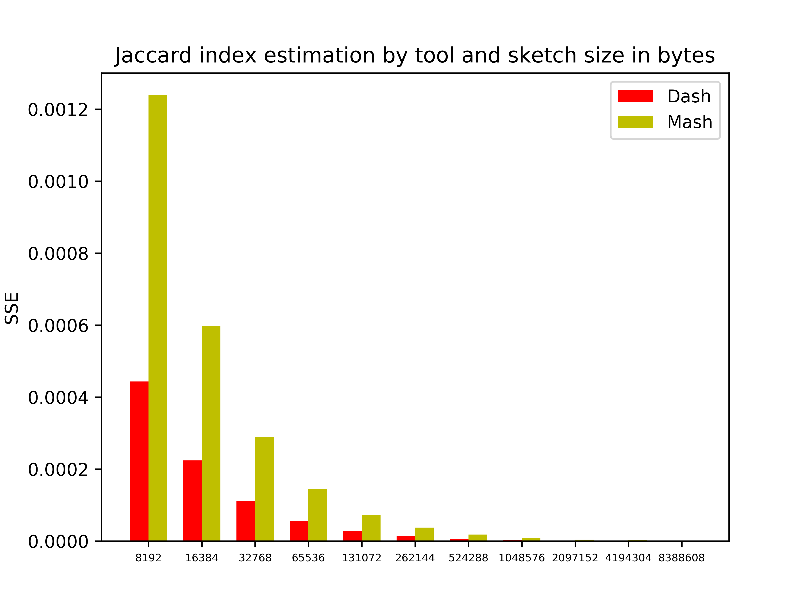

Slide 9
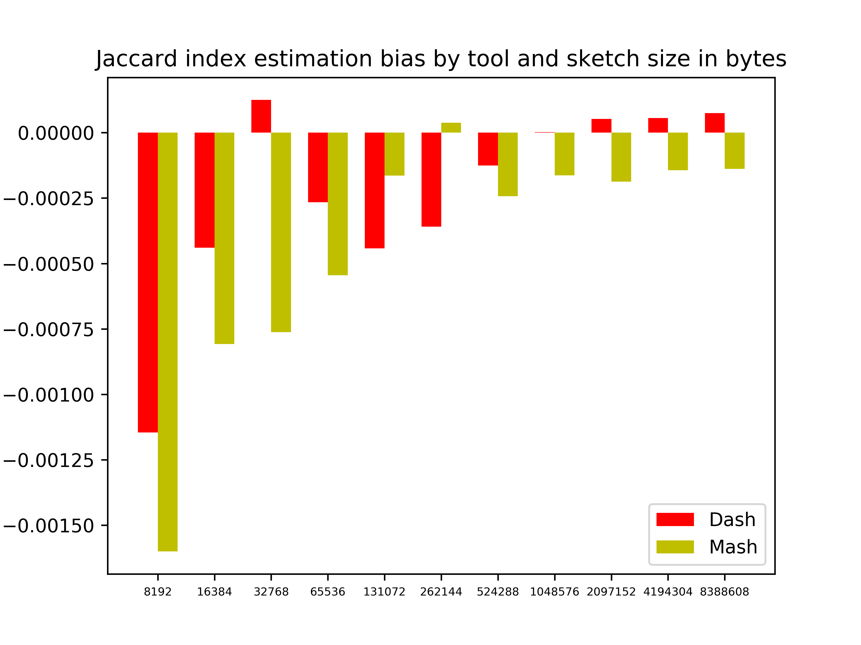

Slide 10
Performance: Omnium Contra Omnes
Bulk RefSeq
Our experiment
153670 genomes:
11,807,157,615 comparisons
Mash
54,118 genomes
1,464,351,903 comparisons
Comparison dominates dash

Slide 11
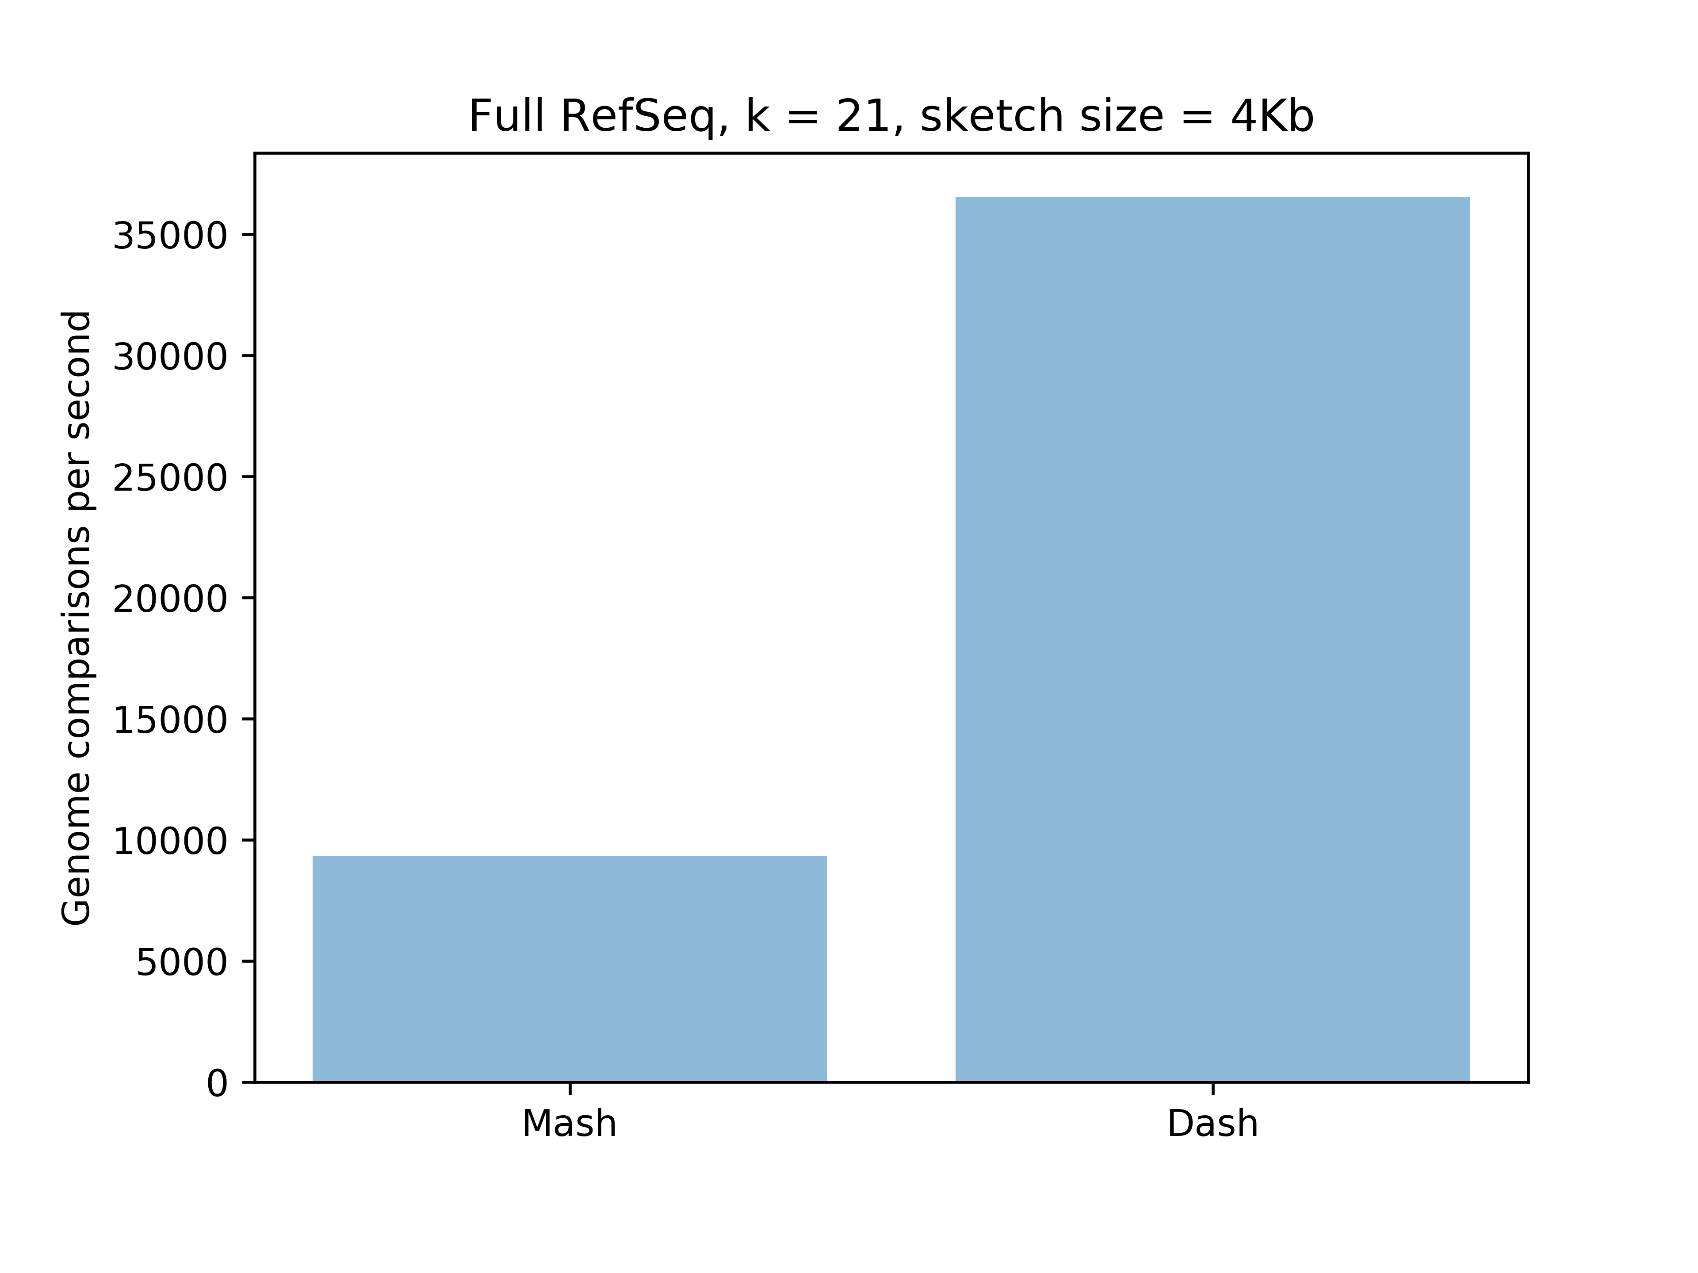

Slide 12
Performance Methods
Threadscaling
Memory pooling by thread
Minimizing memory allocations
Staggered I/O
Vectorization
Generically generate optimal code for given platform.
Supports and SSE, AVX2, AVX512
Nearly linear speedup with vector width
Accelerated hash functions
Encoding
Lookup tables
Circular buffer

Slide 13
Features
Transparently supports uncompressed, zlib, and zstd-compressed files.
Arbitrarily spaced seeds.
Optional windowing for minimizers.
Exact distance calculation using hash sets.
Canonicalized and uncanonicalized encoding.
Supports fastq data using approximate data structures to remove rare events.
Scalable: both sketching and comparisons scale to hundreds of processors
Supports vectorization through generic vector library
Supports 4 HLL cardinality estimation algorithms¹
[1] Ertl, Omar. New cardinality estimation algorithms for HyperLogLog sketches. https://arxiv.org/abs/1702.01284

Slide 14
Dash
Fast.
Accurate.
Scales to hundreds of threads.
Generic.
Spaced kmers
Minimizers

Slide 15


Acknowledgements
Ben Langmead
Florian Breitwieser
Code:
Dash: https://github.com/dnbaker/dash
Related/dependent work:
Bonsai (encoding):https://github.com/dnbaker/bonsai
Vectorization: https://github.com/dnbaker/vec
Sketch Data Structures: https://github.com/dnbaker/hll
HyperLogLog (& variants)
Bloom Filters (& variants)
Count Sketch/Count-Min Sketch
HyperMinHash
HyperLogFilter

Slide 16
Commands
dash sketch
Creates HyperLogLog sketches
dash dist
Performs all pairwise comparisons between sequence files
dash setdist
Performs all pairwise comparisons exactly using khash
dash hll
Estimates the cardinality of the set of files provided.
This can facilitate using larger hash tables by preallocating necessary space rather than growing dynamically.

Slide 17
Hash Function Selection
Hash Function | Mean abs error | Mean bias
clhash | 0.8205943% | -0.00026603
Murmur3 Finalizer | 0.8271393% | -0.000238526
Thomas Wang, 64-bit (reversible) | 0.8201395% | -0.000213554
#Path | Mean abs error | Mean bias
hlf_250trials.clhash.out | 0.008205943 | -0.00026603
hlf_250trials.mur.out | 0.008271393 | -0.000238526
hlf_250trials.wang.out | 0.008201395 | -0.000213554

