Slide 1


Department Of Computer Science

Slide 2
Final Report
Podcraft Agentic - AI Podcast Episode Planning System
Muhammad Awais Ashraf
FA23-BDS-053
Asna Hammad
FA23-BDS-051
Supervisor:
Dr. Tehseen Riaz Abbasi
Department Of Computer Science
Submission Date: 21-May-2026

Slide 3
Scope

Slide 4
Project Category
A- Desktop Application/Information System
B- Web Application/Web Application based Information System
C- Problem Solving and Artificial Intelligence
D- Simulation and Modeling
E- Smartphone Application
F- Smartphone Game
G- Networks
H- Image Processing
I- Other (specify category) ______________________

Slide 5
Abstract
PodCraft is a smart platform that automates podcast episode planning using intelligent autonomous agents.It reduces the need for manual research and unstructured planning that often slows down podcasters.Many creators struggle with organizing episode flow, questions, and introductions, leading to inconsistent content quality.PodCraft generates structured outlines, engaging hooks, and research-based questions automatically.It also improves workflow efficiency with organized, timestamped segments and guided episode structure.Overall, it helps podcasters focus more on creativity and delivery while improving production quality.

Slide 6
Introduction
Purpose:
  To develop a smart platform that assists podcasters in preparing structured episodes with minimal manual effort.
Key Goals:
  Modernize podcast planning by combining AI automation with creative assistance.
  Provide intelligent research, content planning, and episode structuring support.
Impact:
  Supports creators in educational, entertainment, and professional fields globally.

Slide 7
Problem Statement
Problems Solved
Disorganized research & topic discovery
Weak guest analysis & question generation
Poor episode structuring & time management
No intelligent automation for creators
Why Develop This System
Reduce manual prep time, improve episode quality & consistency, help solo creators & small teams work efficiently
Similar Systems?
Yes, but only basic script/note tools exist. No integrated system automates research, trending topics, guest analysis & structuring. Re-implementation helps me learn gap analysis, integration of multiple features, and real-world user-centered design.
Skills to Learn
NLP, web scraping/APIs, recommendation algorithms, full-stack development, system design, project management

Slide 8
Problem Solution
PodCraft is an intelligent agent-based platform that automates podcast episode planning. Users input their podcast niche or guest details. Four agents work together: User Intent & Guest Analyzer (interprets content direction), Topic Research Agent (gathers trends and background info), Question & Timestamp Generator (creates structured questions with time allocation), and Hook & Intro Suggestion Agent (produces engaging openings). An Episode Outline Planner organizes everything into a logical flow. The system reduces manual effort, ensures professional structure, and improves consistency. Available on web and mobile with a user-friendly interface, PodCraft helps creators focus on creativity while AI handles planning.

Slide 9
Advantages/Benefits of Proposed System
Time Efficiency
Automates research and planning tasks.
Improved Content Quality
Ensures logical flow and professional presentation.
Consistency
Maintains uniform structure for all productions.
Accessibility
Supports both web and smartphone platforms.
Audience Engagement
Generates compelling hooks and organized segments.

Slide 10
Related System Analysis/Literature Review
Application Name | Weakness | Proposed Project Solution
Descript: | no research or planning support. | Provides automated topic research, structured planning, and complete episode outlines before recording begins
Buzzsprout | Only supports hosting and distribution; lacks content preparation tools. | Assists in pre-production through intelligent agents that generate interview questions, hooks, and timestamps.
Notion | Manual planning tool with no intelligent automation. | Uses autonomous AI agents to automatically convert raw ideas into structured, actionable episode plans.
ChatGPT | General-purpose AI requiring repeated prompts; no specialized or structured workflow. | Provides a dedicated, one-stop podcast planning workflow with specialized agents for each sub-task.

Slide 11
Scope
Includes: Web and smartphone platforms, autonomous agents for research, trend analysis, question generation, and timestamp allocation.
Functionalities: Secure user authentication, cloud storage, and editable/exportable episode plans.
Exclusions: Does not include audio recording, editing, or direct publishing.

Slide 12
Modules
Module 1: User Authentication & Profile Management
Module 2: User Intent & Guest Analyzer
Module 3: Topic Research Agent
Module 4: Question and Timestamp Generator
Module 5: Hook & Intro Suggestion Agent
Module 6: Episode Outline Planner

Slide 13
Module 1: User Authentication & Profile Management
What the user does: Registers an account, logs in, and sets up their podcast profile.
Logical flow:
User signs up using email/password or Google OAuth.
User verifies email (if applicable) and logs in.
User creates a podcast profile (podcast name, niche, default tone).
User can add guest profiles, view episode history, and manage account settings.
Major Features:
Secure registration & login (JWT + OAuth)
Password recovery with reset link
Podcast profile creation & switching
Guest profile management
Episode history and saved plan management

Slide 14
Module 2: User Intent & Guest Analyzer
What the user does: Provides episode direction and guest details for AI analysis.
Logical flow:
User starts a new episode and selects a podcast niche from predefined categories.
User enters episode topic or guest name.
User optionally adds guest details (name, profession, LinkedIn/website).
AI analyzes input and generates content direction and guest summary.
Major Features:
Podcast niche selection (20+ categories)
Episode topic / guest name input
Guest profile submission (manual or URL-based)
AI-generated guest background summary
Episode tone selection (Casual, Professional, Humorous, Serious)

Slide 15
Module 3: Topic Research Agent
What the user does: Triggers and reviews AI-researched topics for the episode.
Logical flow:
User clicks "Generate Topics" or research starts automatically after intent submission.
AI agent scans news, social media, academic sources, and industry blogs.
System displays topics with title, summary, source, and date.
User bookmarks preferred topics (up to 10) and rejects irrelevant ones.
User can export research summary as PDF.
Major Features:
Automated topic research (30-second delivery)
Filter by relevance and recency (30 days / 6 months / all time)
Bookmark up to 10 topics per episode
View source references
Tier-based research depth (premium: 5 sources, free: 2 sources)

Slide 16
Module 4: Question & Timestamp Generator
What the user does: Generates structured interview questions with time allocations.
Logical flow:
User clicks "Generate Questions" (requires at least 1 bookmarked topic).
AI creates 10–20 questions organized into Opening, Main, and Closing segments.
User can edit, reorder (drag-and-drop), or add custom questions.
User specifies total episode duration.
System auto-generates timestamps (HH:MM:SS) for each segment.
User can manually adjust timestamps or export to PDF/DOCX.
Major Features:
Structured question generation (Opening / Main / Closing)
Question count customization (5–30 for premium, max 8 for free)
Drag-and-drop reordering
Auto-timestamp allocation based on episode duration
Shareable question sheet link for guest

Slide 17
Module 5: Hook & Intro Suggestion Agent
What the user does: Generates and selects an engaging episode opening hook.
Logical flow:
User navigates to Hook & Intro screen.
User selects preferred tone (Dramatic, Curious, Humorous, Inspirational).
User clicks "Generate Hooks" — AI produces 3–5 distinct hook variants.
User reviews each variant (word count and style displayed).
User selects one hook to save to episode draft.
User can preview hook read-aloud or export as standalone script.
Major Features:
Generate 3–5 hook variants per request
Tone customization (4 options)
Hook length compliance (30–120 words)
Individual hook regeneration
Read-aloud preview feature
Export as plain-text script

Slide 18
Module 6: Episode Outline Planner
What the user does: Combines all outputs into a complete, exportable episode plan.
Logical flow:
User clicks "Build Outline" after completing questions, timestamps, and hook selection.
AI synthesizes research topics, questions, timestamps, and selected hook into structured outline.
Outline is organized into Intro → Main Segments → Outro.
User can edit sections, reorder, add custom sections, or apply a template (Interview / Solo / Panel).
User approves outline and exports as PDF, DOCX, or Markdown (Notion-compatible).
Major Features:
Full outline synthesis from all prior modules
Section editing & reordering (drag-and-drop)
Custom section addition
3 outline templates (Interview, Solo Episode, Panel Discussion)
Multi-format export (PDF, DOCX, Markdown)
Team sharing (production team users)
Auto-save every 30 seconds

Slide 19
System Limitations/Constraints
LI-1
Depends on active internet connectivity.
LI-2
AI content may require manual review for accuracy.
LI-3
No support for audio recording or editing.
LI-4
Performance varies based on device and network speed.

Slide 20
Software Process Methodology
Process Methodology: Incremental Development Model
Reason: Since PodCraft involves complex AI agent interactions, an incremental approach allows us to develop and test one agent (e.g., the Researcher) before moving to the next (e.g., the Scriptwriter). This ensures core functionality is stable before adding complexity.
Design Methodology: Object-Oriented Design (OOD)
Reason: We are using an Agentic framework where each AI Agent is treated as an autonomous "Object" with its own properties (tools, memory, role). OOD allows us to manage these interactions cleanly and scale the system easily.

Slide 21
Tools and Technologies
Tools | Versions | Rationale
Python | 3.11 | Backend development and AI processing
JavaScript | ES6 | Frontend and backend scripting
Typescript | 5.3 | Type-safe frontend development
React JS | 18.2 | Web frontend framework
React Native | 0.72 | Cross-platform mobile app development
Node JS | 20.10 | Server-side runtime environment
Express JS | 4.18 | Backend web framework
OpenAI API | Latest | AI content generation and intelligent agents
REST API | V1 | Communication between frontend and backend

Slide 22
Team Members Individual Tasks/Work Division
Student Name | Student Registration Number | Responsibility / Modules
Awais Ashraf | FA23-BDS-053 | Full-stack development for Mobile App (React Native, backend APIs, database integration, AI agent integration for mobile platform, testing and deployment on mobile)
Asna Hammad | FA23-BDS-051 | Full-stack development for Web App (React JS frontend, Node JS backend, database management, AI agent integration for web platform, testing and deployment on web)

Slide 23
Data Gathering Approach
Interviews: Conducted with podcast creators to understand their specific workflows and challenges.
Questionnaires: Distributed to creators to gather quantitative data on preparation difficulties.
Observation: Studying how podcasters currently use existing tools like Notion or Descript for planning.
Online Research: Analyzing current podcast production trends and user expectations.
Reasoning: To ensure PodCraft aligns with real-world user needs and solves actual planning bottlenecks.

Slide 24
Core AI & Backend Concepts
Concept-1 Agentic AI Architecture: Multiple AI agents work together to plan episodes.
Concept-2 Natural Language Processing (NLP): GPT-4 understands input and generates content.
Concept-3 Prompt Engineering: Designing prompts for structured AI outputs.
Concept-4 Web Scraping: Fetching trending topics from external APIs.
Concept-5 RESTful API Development: Building secure Node.js/Express APIs.
Concept-6 JWT Authentication & OAuth 2.0: Secure login with email or Google.
Concept-7 NoSQL Database (MongoDB): Flexible schemas for users and episodes.

Slide 25
Slide 2: Frontend & Mobile Concepts
Concept-1 Cross-Platform Mobile (React Native): One codebase for Android & iOS.
Concept-2 State Management (Redux/Context API): Managing app-wide episode data across screens.
Concept-3 Responsive UI Design (Tailwind CSS): Building adaptive layouts for all screen sizes.
Concept-4 Component-Based Architecture (React JS): Reusable UI components for faster development.
Concept-5 Form Handling & Validation: Managing user inputs for niche, guest details, and episode settings.
Concept-6 API Integration (Axios/Fetch): Connecting frontend to backend REST APIs.
Concept-7 Navigation (React Router / React Navigation): Screen-to-screen navigation in web and mobile apps.
Concept-8 Full-Stack Integration: Connecting frontend, backend APIs, and MongoDB database seamlessly.

Slide 26
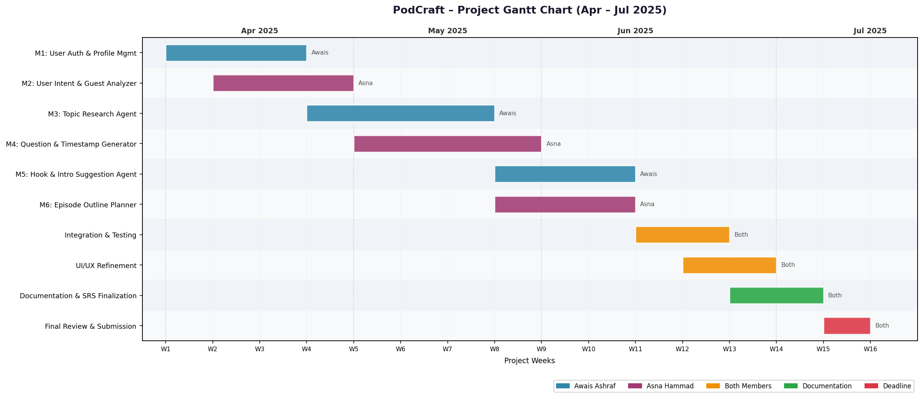
Gantt Chart

Slide 27
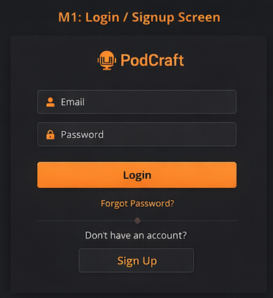
Mockups
Interface-01: Login/Sign-up Screen

Slide 28
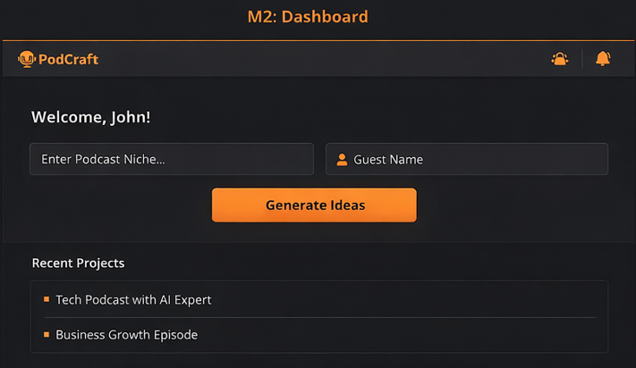
Mockups
Interface-02: User Dashboard

Slide 29
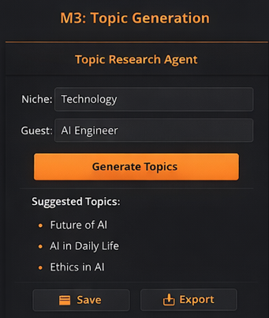
Mockups
Interface-03: Topic Research Agent

Slide 30
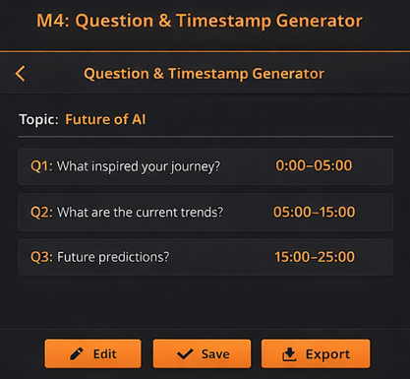
Mockups
Interface-04 Question and Timestamp Generator

Slide 31
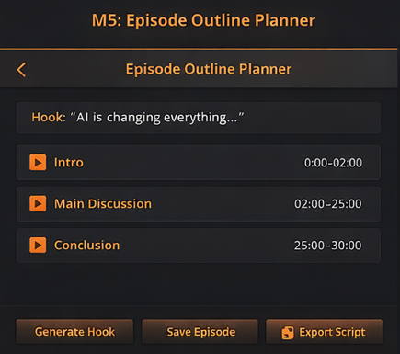
Mockups
Interface-05: Episode Outline Planner

Slide 32
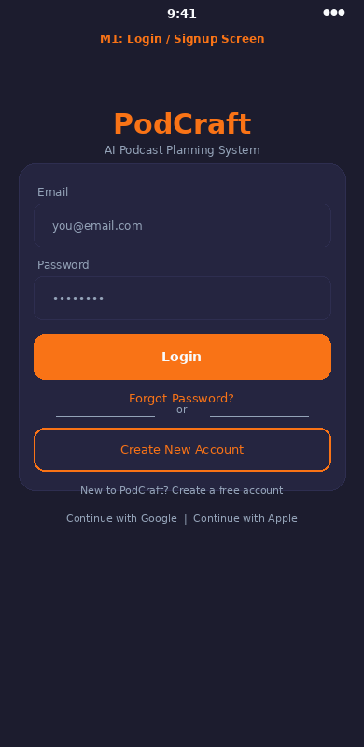
Mockups
Interface-06: User Authentication Screen (Mobile)

Slide 33
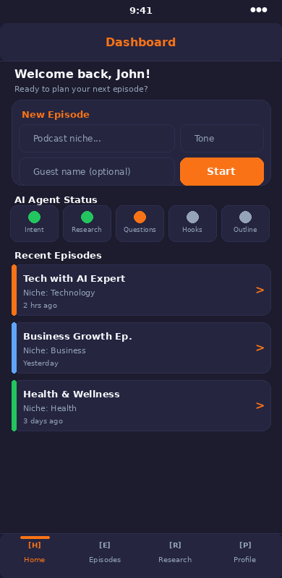
Mockups
Interface-07: User Dashboard (Mobile)

Slide 34
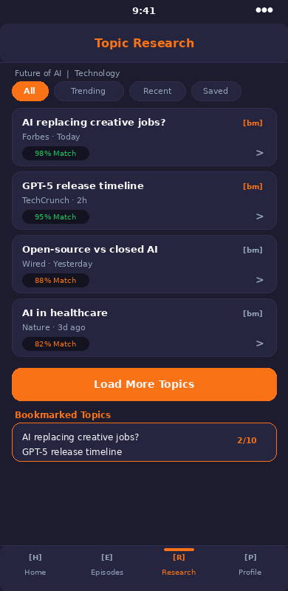
Mockups
Interface-08: Topic Research (Mobile)

Slide 35
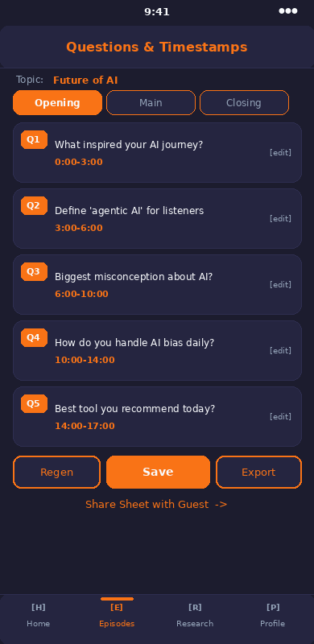
Mockups
Interface-09: Questions and Timestamp Generator (Mobile)

Slide 36
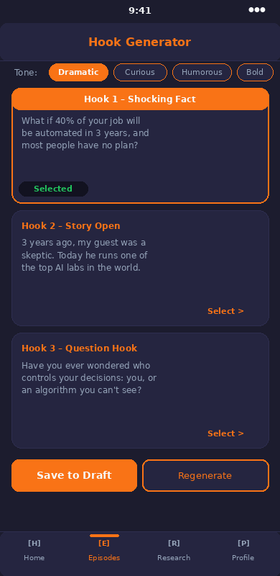
Mockups
Interface-10: Hook and Intro Suggestion (Mobile)

Slide 37
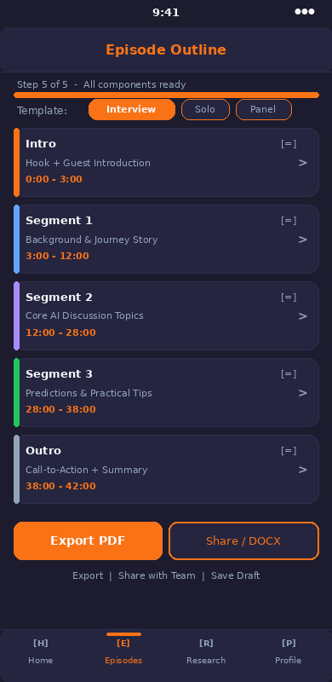
Mockups
Interface-11: Episode Outline Planner (Mobile)

Slide 38
SRS

Slide 39
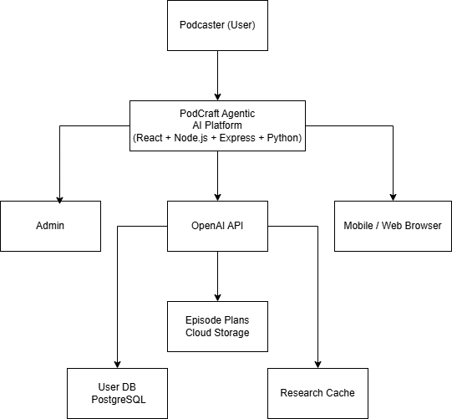
Context / Block Diagram

Slide 40
Requirement Elicitation Techniques
Technique: Observation
Reason: By watching podcast creators manually plan episodes using existing tools (Notion, ChatGPT, Google Docs, sticky notes), we identified unspoken inefficiencies such as scattered research, unstructured question preparation, and inconsistent episode flow, issues that users themselves may not articulate clearly in interviews or surveys.
Reference: Wiegers, K. E., & Beatty, J. (2013). Software Requirements (3rd ed.). Microsoft Press, pp. 89-91.

Slide 41
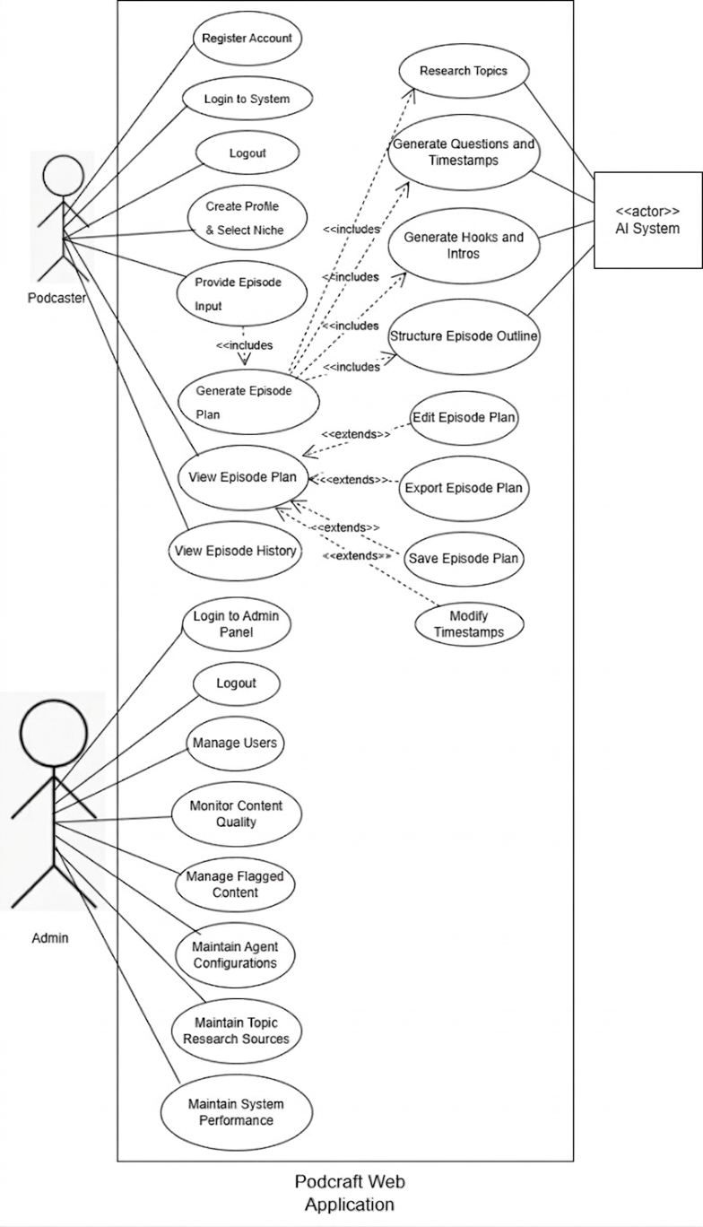
Use Case Diagram

Slide 42
Usecase Lists (module wise)
Module 1: User Authentication & Profile Management (Web)
Use Case Id | Use Case Title | Use Case Description | Functional Requirement
UC-Web-1.1 | Signup | User creates an account using email/password or Google OAuth. | FR1.1
UC-Web-1.2 | Login | User provides credentials to authenticate and access dashboard. | FR1.3
UC-Web-1.3 | Change Password | User changes account password after providing old password. | FR1.7
UC-Web-1.4 | Recover Password | User requests password reset link via registered email. | FR1.5
UC-Web-1.5 | Edit Profile Details | User updates podcast name, niche, and notification preferences. | FR1.6
UC-Web-1.6 | Logout | User terminates active session and redirects to login screen. | FR1.8
UC-Web-1.7 | Delete Account | User permanently deletes account and all associated data. | FR1.7

Slide 43
Module 2: User Intent & Guest Analyzer
Use Case Id | Use Case Title | Use Case Description | Functional Requirement
UC-Web-2.1 | Select Podcast Niche | User selects a niche from predefined categories (20+ options). | FR2.1
UC-Web-2.2 | Submit Episode Topic | User enters episode topic or guest name (max 200 chars). | FR2.2
UC-Web-2.3 | Analyze Intent | System interprets input and determines content direction. | FR2.3
UC-Web-2.4 | Save Podcast Profile | User saves current settings as a named profile for reuse. | FR2.4
UC-Web-2.5 | Select Episode Tone | User chooses tone (Casual, Professional, Humorous, Serious). | FR2.5
UC-Web-2.6 | Add Guest Profile | User submits guest name, profession, and URL for analysis. | FR2.7
UC-Web-2.7 | Enter Manual Guest Bio | User manually types guest biography instead of URL. | FR2.8

Slide 44
Module 3: Topic Research Agent
Use Case Id | Use Case Title | Use Case Description | Functional Requirement
UC-Web-3.1 | Initiate Topic Research | System automatically or manually triggers research agent. | FR3.1
UC-Web-3.2 | View Research Results | System displays topics with title, summary, source, and date. | FR3.2
UC-Web-3.3 | Filter Topics | User filters results by relevance and recency (30 days/6 months/all). | FR3.3
UC-Web-3.4 | Bookmark Topic | User bookmarks preferred topic (max 10 per episode). | FR3.4
UC-Web-3.5 | Reject Topic | User rejects irrelevant topic; it won't appear again. | FR3.5
UC-Web-3.6 | View Source Reference | User clicks to view original source URL in new tab. | FR3.6
UC-Web-3.7 | Export Research Summary | User exports full research as PDF document. | FR3.8

Slide 45
Module 4: Question & Timestamp Generator
Use Case Id | Use Case Title | Use Case Description | Functional Requirement
UC-Web-4.1 | Generate Questions | AI generates 10–20 questions organized into Opening/Main/Closing. | FR4.1
UC-Web-4.2 | Customize Question Count | User specifies desired number of questions (5–30 for premium). | FR4.2
UC-Web-4.3 | Edit Question | User edits any generated question text inline. | FR4.3
UC-Web-4.4 | Reorder Questions | User drags and drops questions within/across segments. | FR4.4
UC-Web-4.5 | Auto-Generate Timestamps | System allocates timestamps based on episode duration. | FR4.5
UC-Web-4.6 | Edit Timestamp Manually | User overrides auto-generated timestamps; system recalculates. | FR4.6
UC-Web-4.7 | Share Question Sheet | User generates shareable link for guest (no account needed). | FR4.7

Slide 46
Module 5: Hook & Intro Suggestion Agent
Use Case Id | Use Case Title | Use Case Description | Functional Requirement
UC-Web-5.1 | Generate Hook Variants | AI generates 3–5 distinct hook variants with style tags. | FR5.1
UC-Web-5.2 | Select Hook Tone | User selects tone (Dramatic, Curious, Humorous, Inspirational). | FR5.2
UC-Web-5.3 | Regenerate Single Hook | User regenerates one hook variant without affecting others. | FR5.4
UC-Web-5.4 | Select Preferred Hook | User selects one hook to save as episode intro. | FR5.5
UC-Web-5.5 | Preview Hook | User listens to read-aloud preview of selected hook. | FR5.6
UC-Web-5.6 | Export Hook | User exports selected hook as plain-text script file. | FR5.7
Use Case Id | Use Case Title | Use Case Description | Functional Requirement

Slide 47
Module 6: Episode Outline Planner
Use Case Id | Use Case Title | Use Case Description | Functional Requirement
UC-Web-6.1 | Generate Full Outline | AI synthesizes all outputs into structured episode outline. | FR6.1
UC-Web-6.2 | Edit Section | User edits title, description, or content of any section. | FR6.2
UC-Web-6.3 | Reorder Sections | User drags and drops sections to reorganize flow. | FR6.3
UC-Web-6.4 | Add Custom Section | User inserts new section with custom title and notes. | FR6.4
UC-Web-6.5 | Apply Template | User applies Interview, Solo, or Panel Discussion template. | FR6.5
UC-Web-6.6 | Export Outline | User exports outline as PDF, DOCX, or Markdown. | FR6.6
UC-Web-6.7 | Share with Team | User shares outline via in-app notification and link. | FR6.7

Slide 48
Non-Functional Requirement
PodCraft - Non-Functional Requirements
Title | Performance Requirements
NFR-1 | The system shall respond to user requests within 3 seconds under normal load. AI agent research tasks shall complete within 15 seconds for a given niche or guest. The platform shall support up to 500 concurrent users with no degradation in response time. API throughput shall handle at least 100 requests per minute.
Title | Reliability
NFR-2 | PodCraft shall maintain 99.5% uptime monthly. The system shall implement automatic failover for critical AI agent services. All episode plans shall be auto-saved every 60 seconds to prevent data loss. Recovery time objective (RTO) shall not exceed 30 minutes in the event of system failure.
Title | Usability
NFR-3 | A new user shall be able to generate their first episode plan within 10 minutes of registration without assistance. The interface shall comply with WCAG 2.1 Level AA accessibility standards. The mobile app UI shall support one-handed use for core features. User satisfaction rating shall target a minimum of 4.0/5.0 in usability surveys.
Title | Supportability
NFR-4 | All backend code shall follow PEP 8 (Python) and Airbnb (JavaScript/TypeScript) coding standards. The system shall include comprehensive API documentation using Swagger/OpenAPI. Module-level unit tests shall achieve a minimum of 80% code coverage. Log levels (INFO, WARN, ERROR) shall be consistently applied to support debugging and monitoring.
Title | Design Constraints
NFR-5 | The system must be built using React JS (web) and React Native (mobile) as mandated by the project scope. All AI agent functionality must utilize the OpenAI API. The backend must follow RESTful API design principles. The system must be deployable on cloud infrastructure (AWS or equivalent) and use PostgreSQL as the primary relational database.
Title | Security
Nfr-6 | The system shall use secure authentication (JWT/OAuth 2.0) and encrypt data using HTTPS (TLS). Role-based access control (RBAC) shall restrict unauthorized access. The system shall protect against common vulnerabilities (SQL injection, XSS, CSRF) and store passwords using secure hashing.

Slide 49
SDS

Slide 50
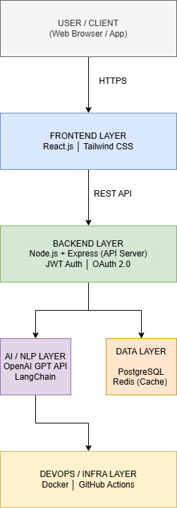
Architecture Diagram of Proposed Project
Figure-2: Layered Architecture Diagram

Slide 51
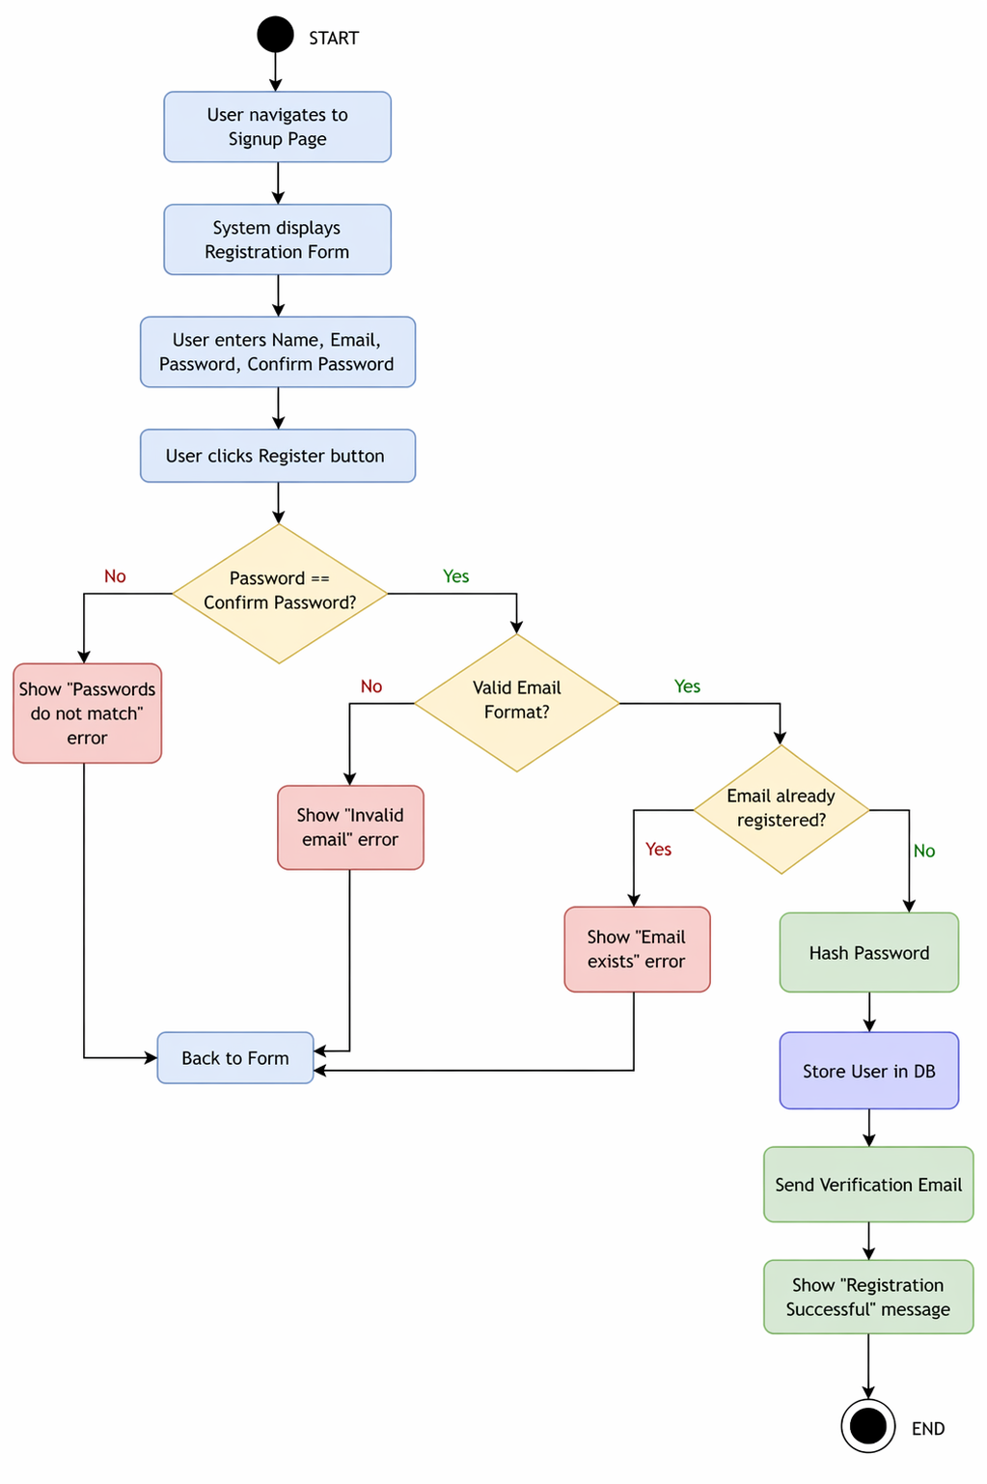
Activity Diagram of Podcraft
Module-1: User Authentication & Profile Management
Activity Diagram For UC1 User Registration:

Slide 52
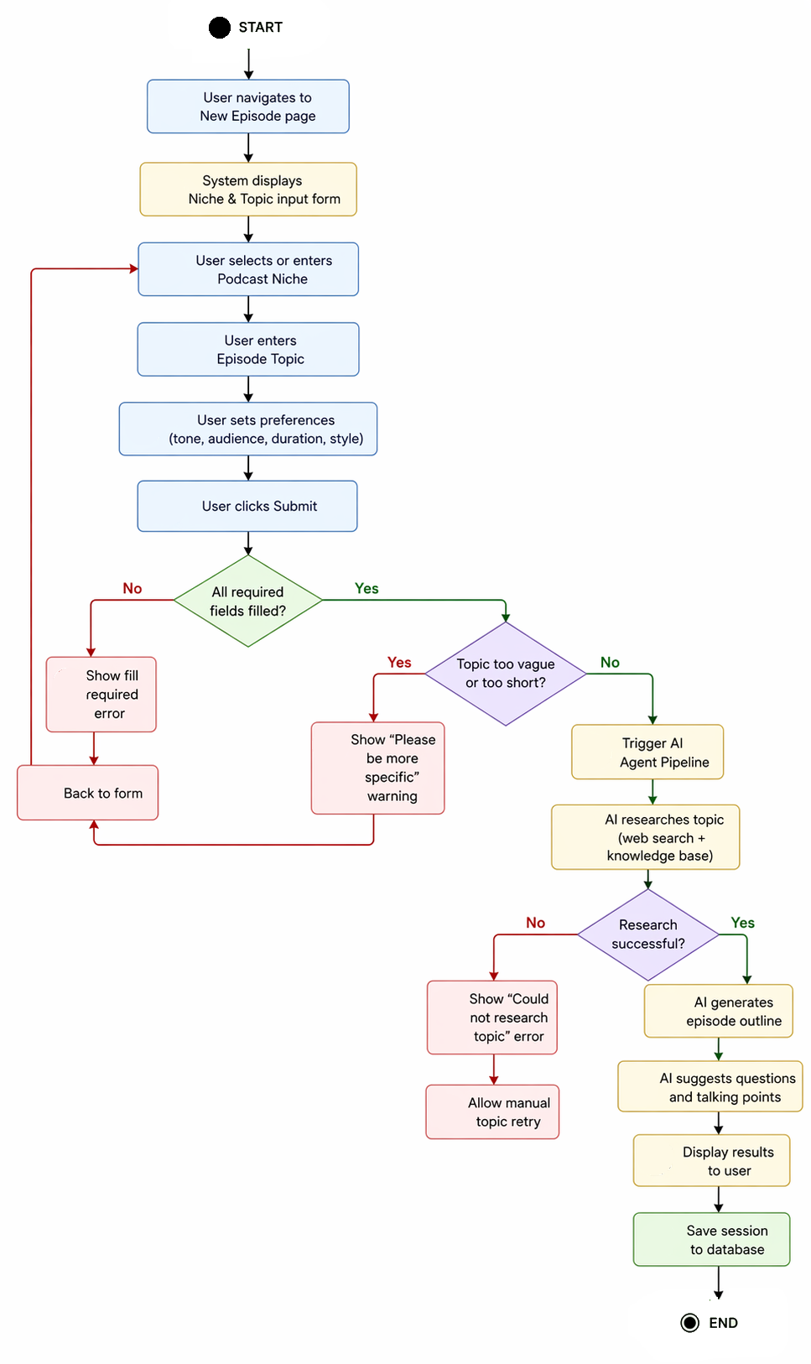
Module 2: User Intent & Guest Analyzer
Activity Diagram For UC1 Provide Podcast Niche and Topic:

Slide 53
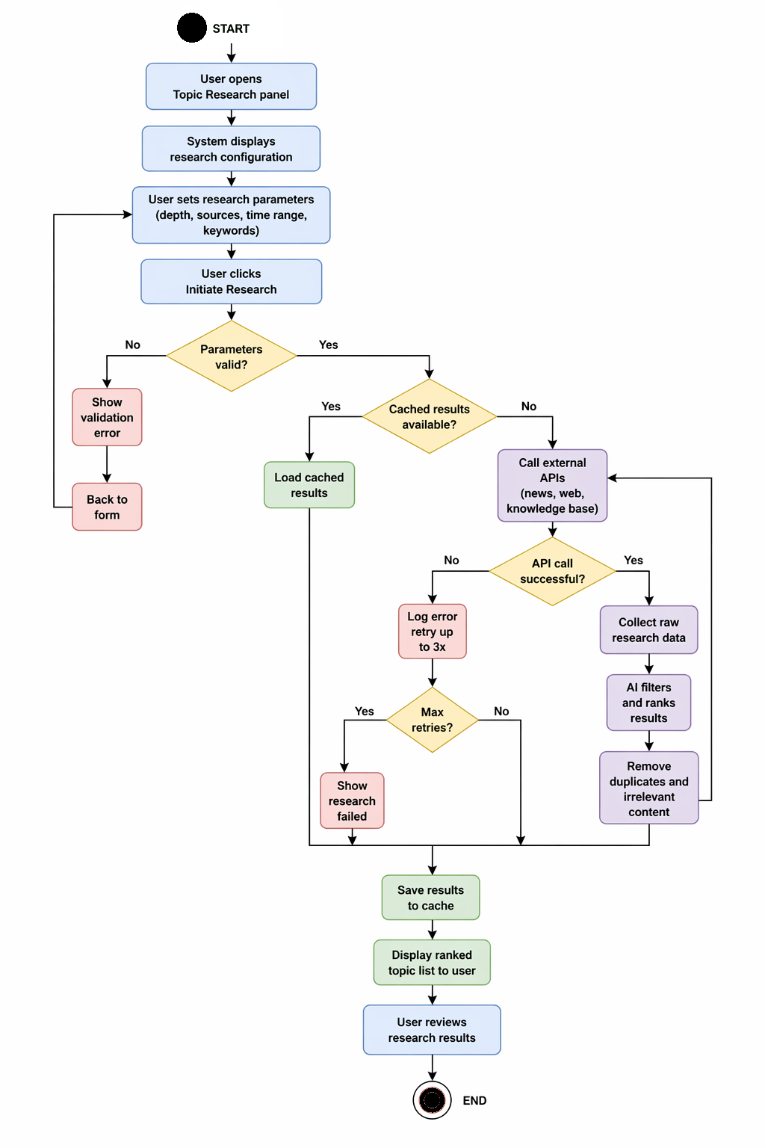
Module 3: Topic Research Agent
Activity Diagram For UC1 Initiate Topic Research:

Slide 54
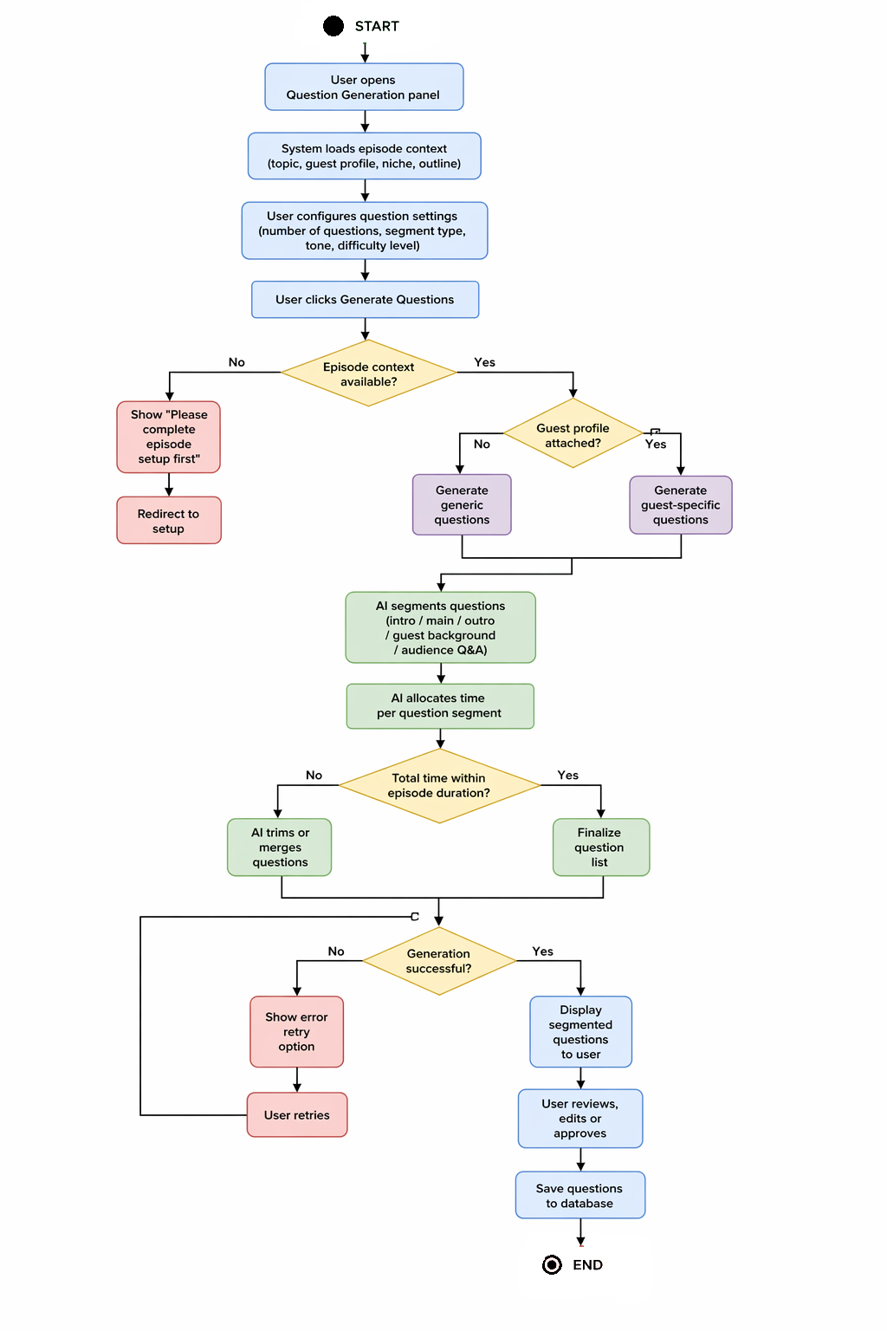
Module 4: Question & Timestamp Generator
Activity Diagram For UC1 Generate Episode Questions

Slide 55
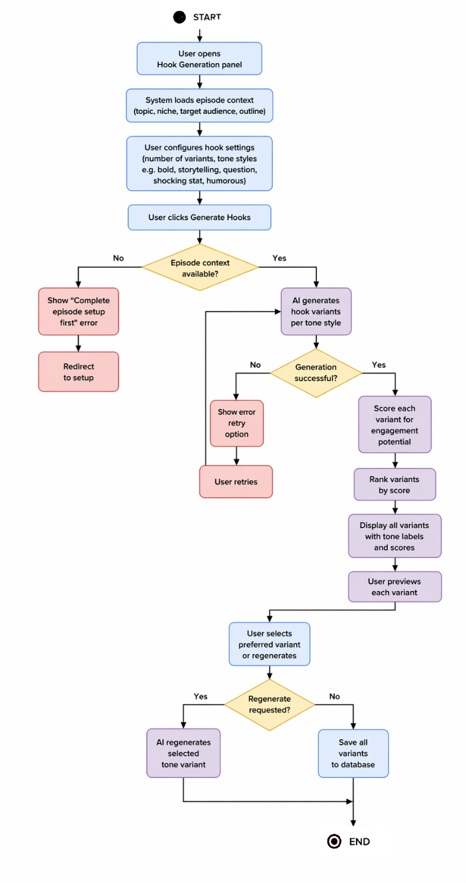
Module 5: Hook and Intro Suggestion Agent
Activity Diagram For UC1 Generate Multiple Hook Variants:

Slide 56
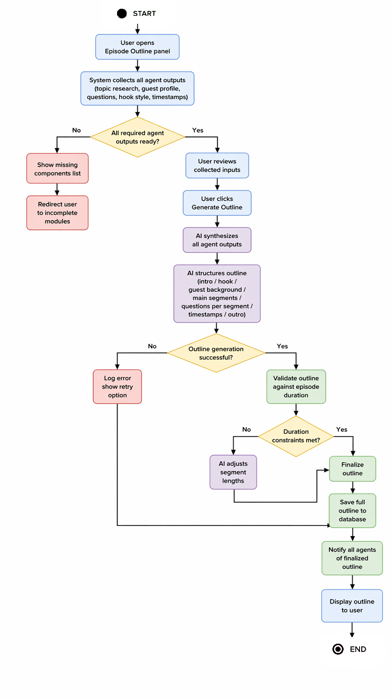
Module 6: Episode Outline Planner
Activity Diagram For UC1 Generate Full Episode Outline:

Slide 57
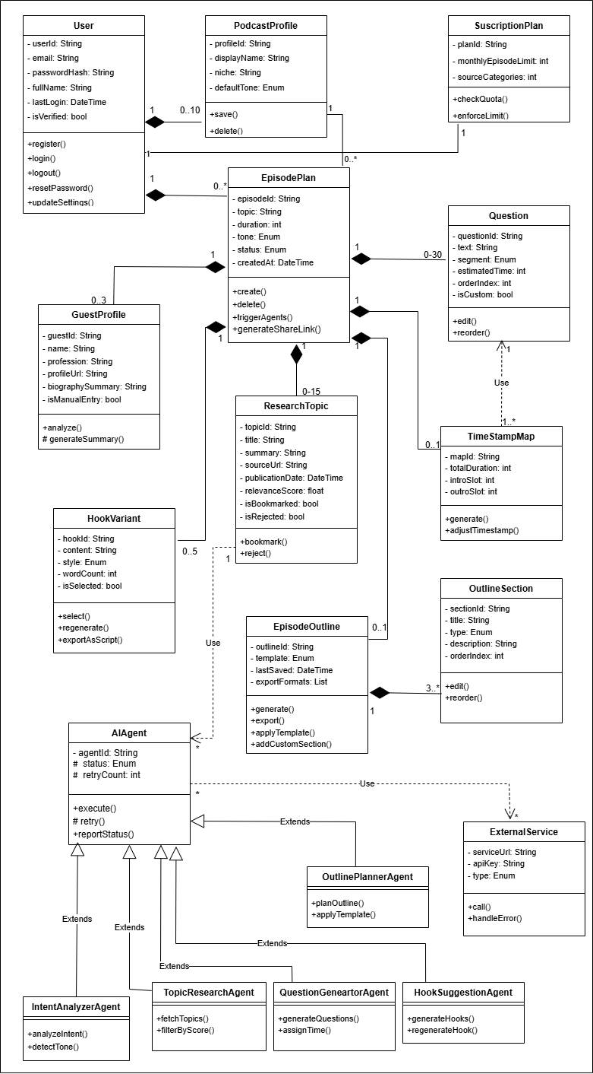
Class Diagram
Class Diagram – PodCraft Agentic AI Podcast Planning System (MVC Architecture)

Slide 58
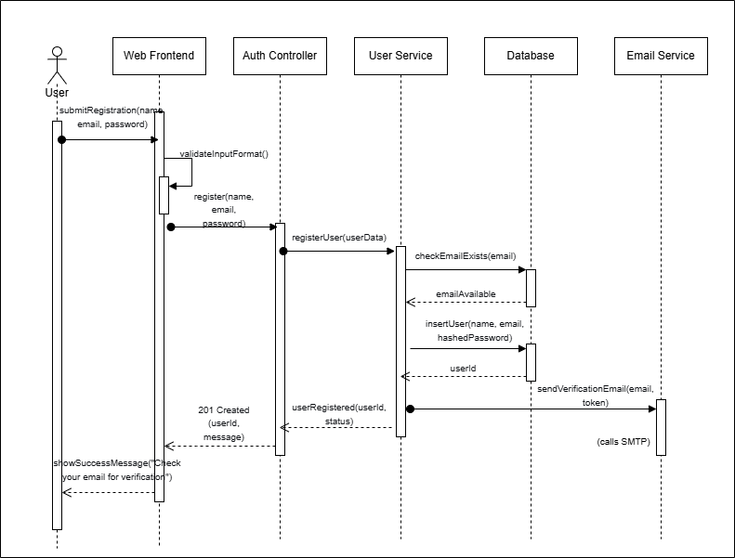
Sequence Diagrams of Podcraft
Module 1: User Authentication & Profile Management
Sequence Diagram For UC1 User Registration

Slide 59
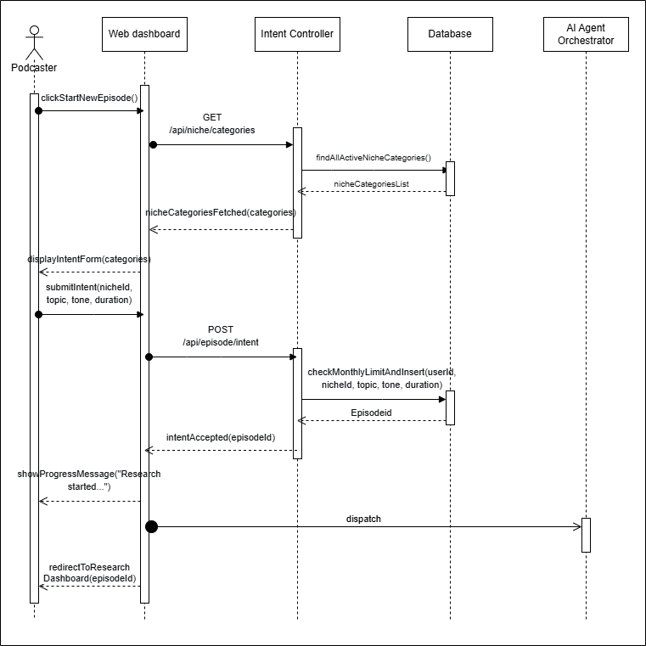
Module 2: User Intent & Guest Analyzer
Sequence Diagram For UC1 Provide Podcast Niche and Topic:

Slide 60
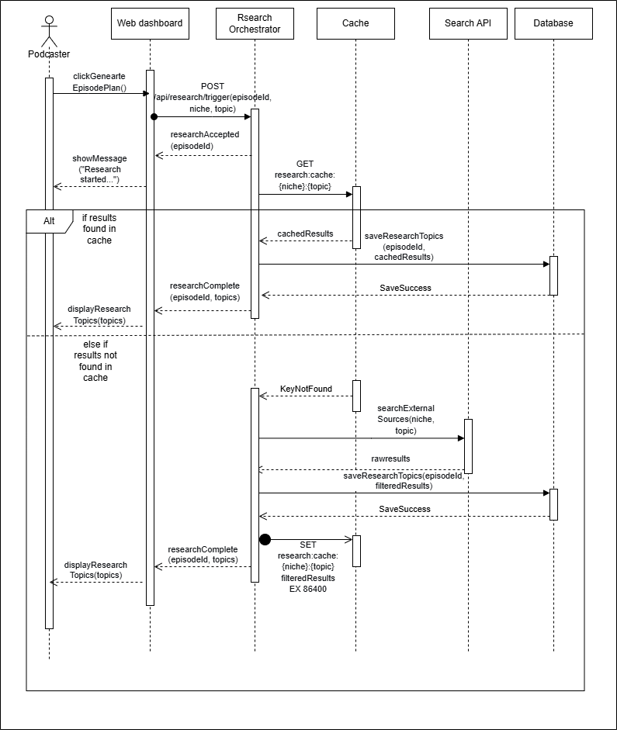
Module 3: Topic Research Agent
Sequence Diagram For UC1 Initiate Topic Research

Slide 61
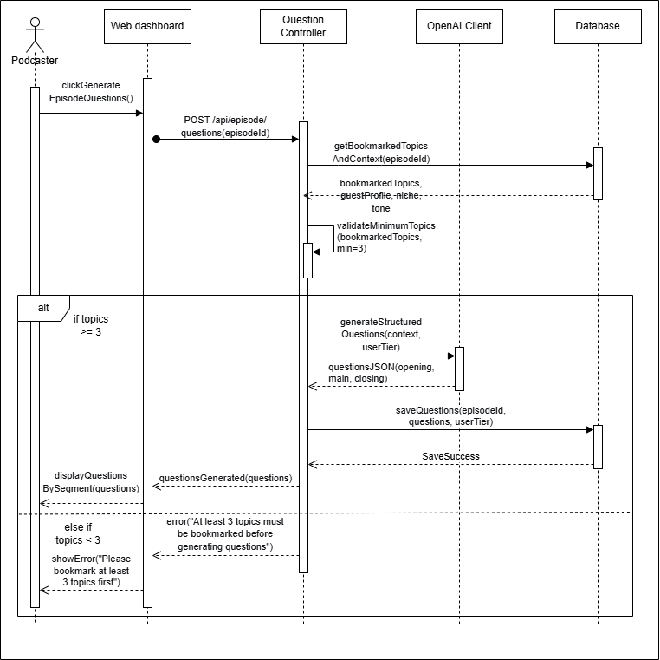
Module 4: Question & Timestamp Generator
Sequence Diagram For UC1 Generate Episode Questions

Slide 62
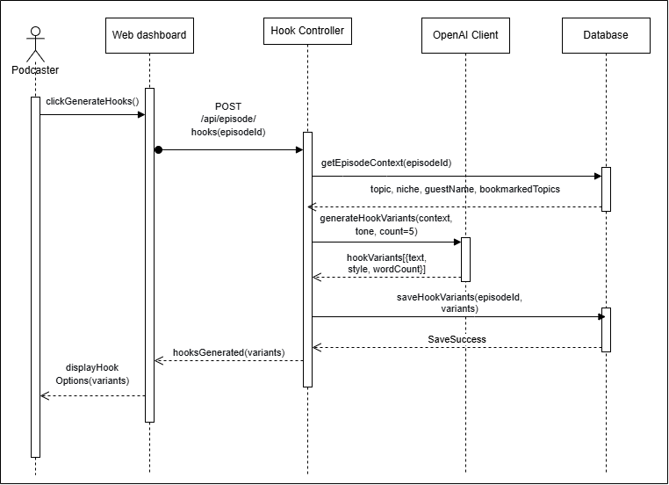
Module 5: Hook and Intro Suggestion Agent
Sequence Diagram For UC1 Generate Multiple Hook Variants:

Slide 63
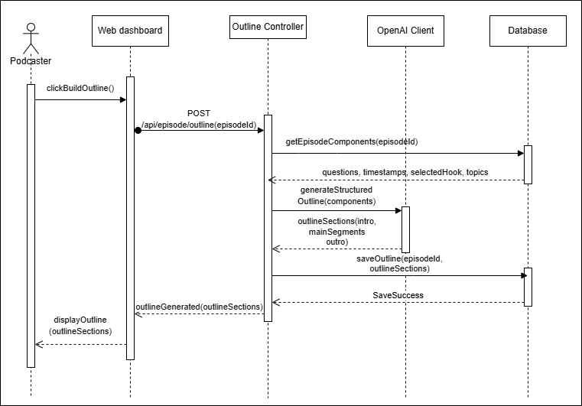
Module 6: Episode Outline Planner
Sequence Diagram For UC1 Generate Full Episode Outline:

Slide 64
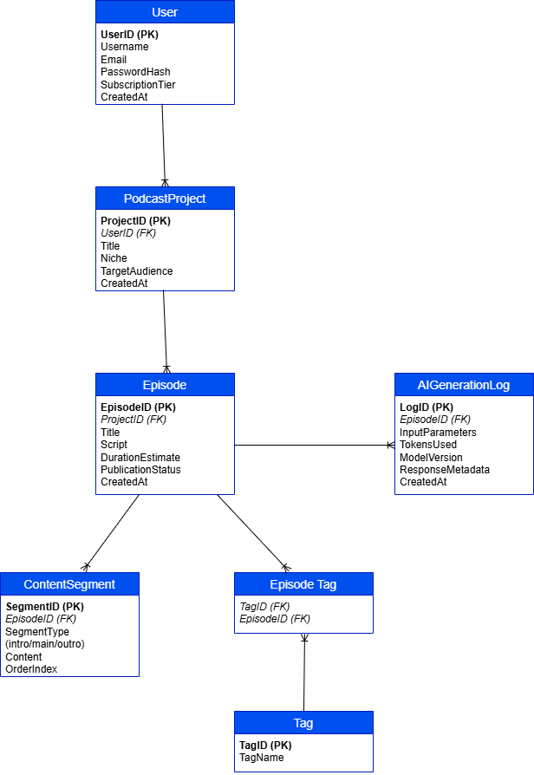
Entity Relationship Diagram
Entity Relationship Diagram (ERD) – PodCraft Database Schema

Slide 65
Algorithms

Slide 66
Algorithm & Implementation
Topic Research Agent – Research Generation Algorithm
Module: Topic Research Agent (Module 3)
Actual Implementation: My ResearchController.js uses a template-based approach (not external APIs) with predefined research data per niche, relevance scoring, and subscription-based result limiting.
Pseudocode:
Algorithm: generateResearchData
Input: podcastNiche, episodeTopic, userSubscription
Output: Saved research documents with relevance scores
1. episode ← findEpisodeById(episodeId)
2. if episode.user !== currentUser then
3. return "Not authorized"
4. end if
5.
6. episode.researchStatus ← "processing"
7. saveEpisode(episode)
8.
9. // Delete existing research
10. deleteMany({ episode: episodeId })
11.
12. // Get template data based on niche
13. if researchTemplates[nich

Slide 67
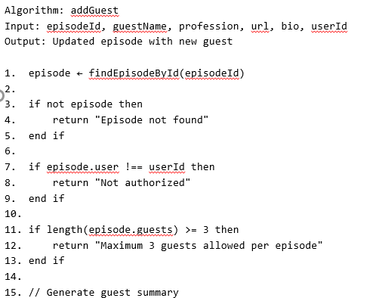
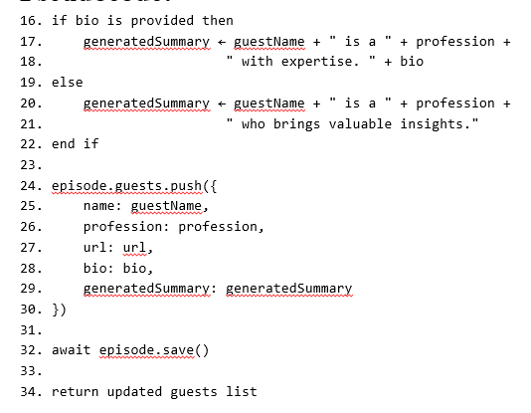
Episode Management - Guest Addition with Summary Generation
Module: User Intent & Guest Analyzer (Module 2)
Actual Implementation: My EpisodeController.js allows adding guests to episodes with automatic summary generation and enforces a maximum of 3 guests per episode.
Pseudocode:

Slide 68
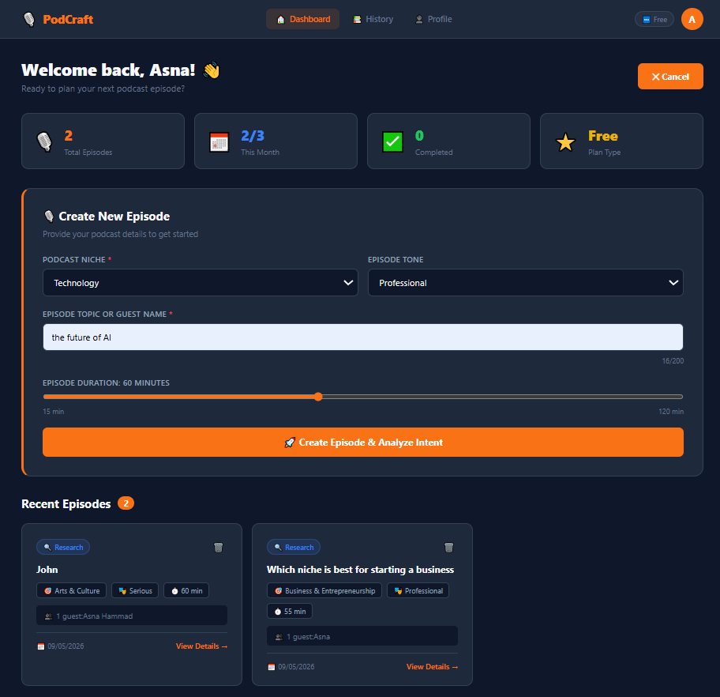
User Interfaces
Interface-1: Create Episode Intent Screen (Web)

Slide 69
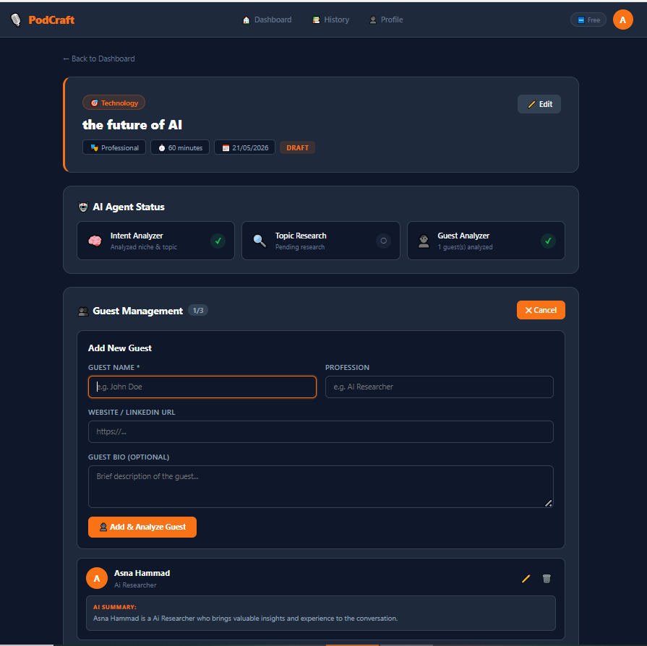
User Interfaces
Interface-2: Add Guest Profile Screen (Web)

Slide 70
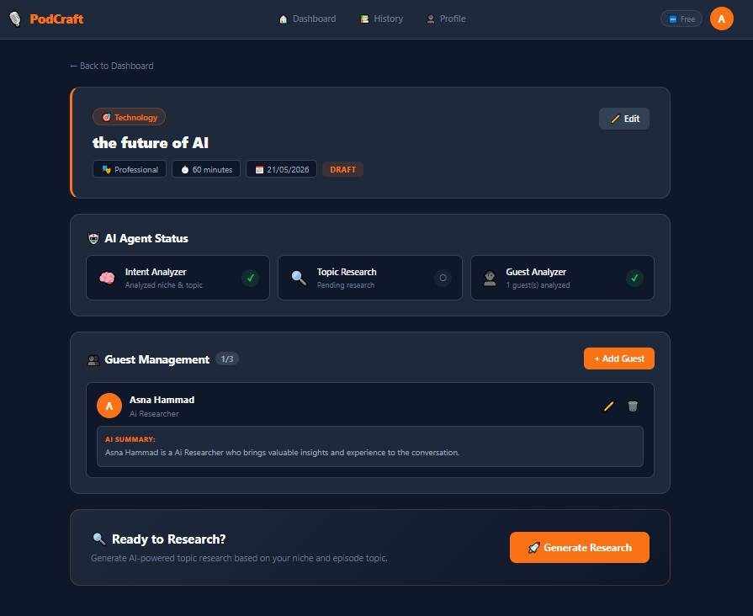
User Interfaces
Interface-3: Guest Summary Generated Screen (Web)

Slide 71
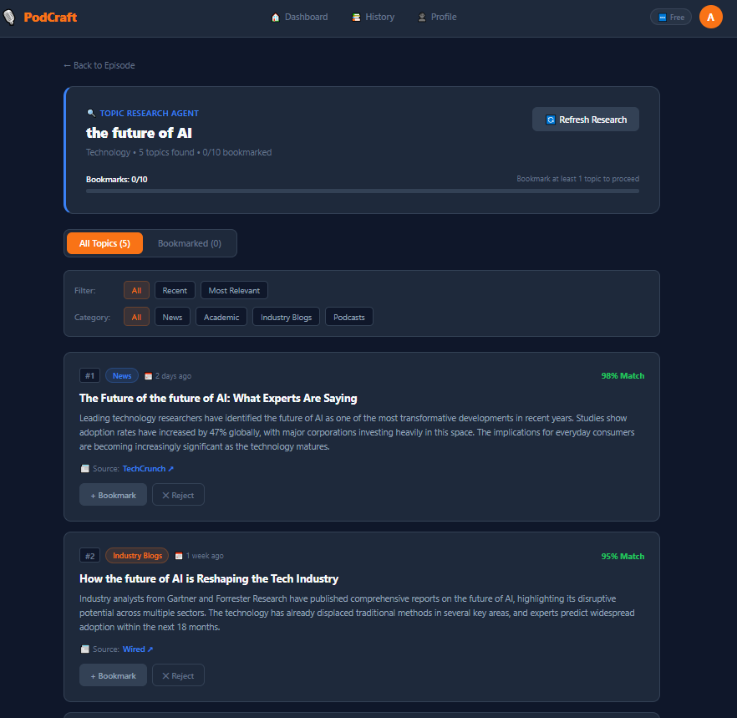
User Interfaces
Interface-4: Research Results Dashboard (Web)

Slide 72
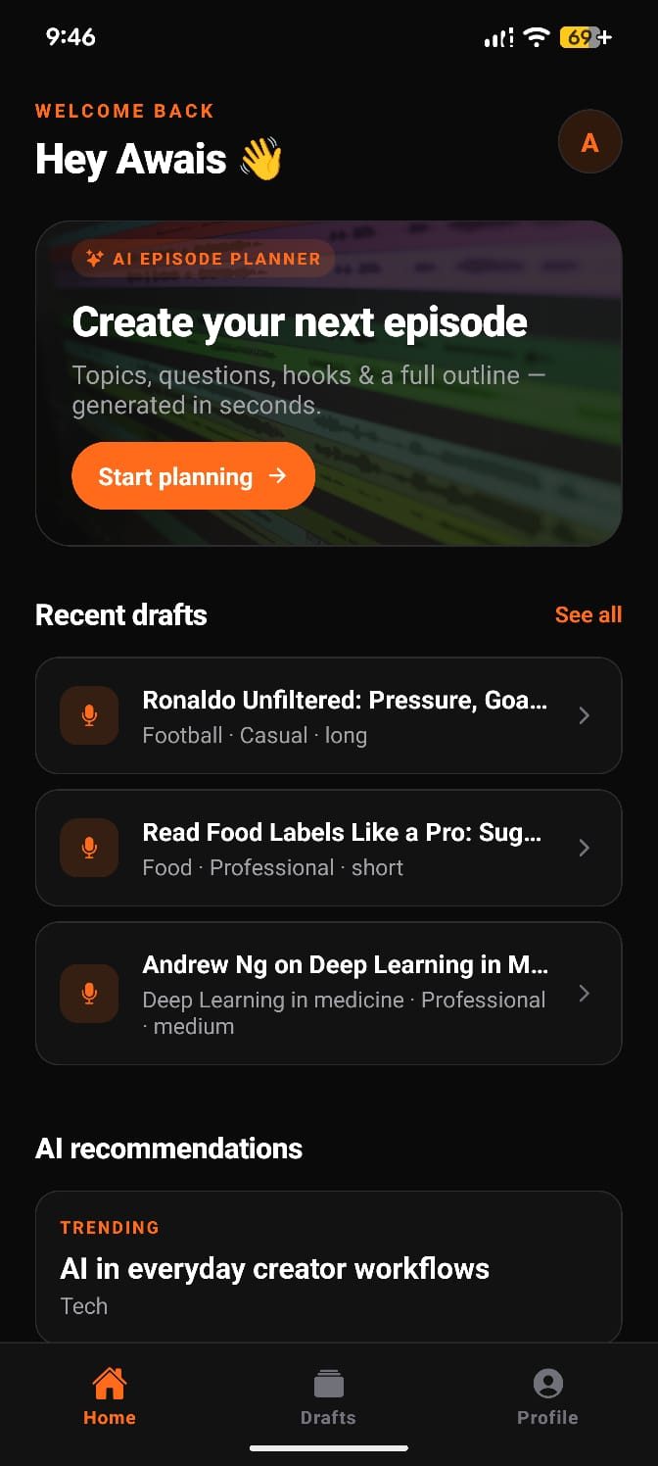
User Interfaces
Interface-1: Home Screen (Mobile)

Slide 73
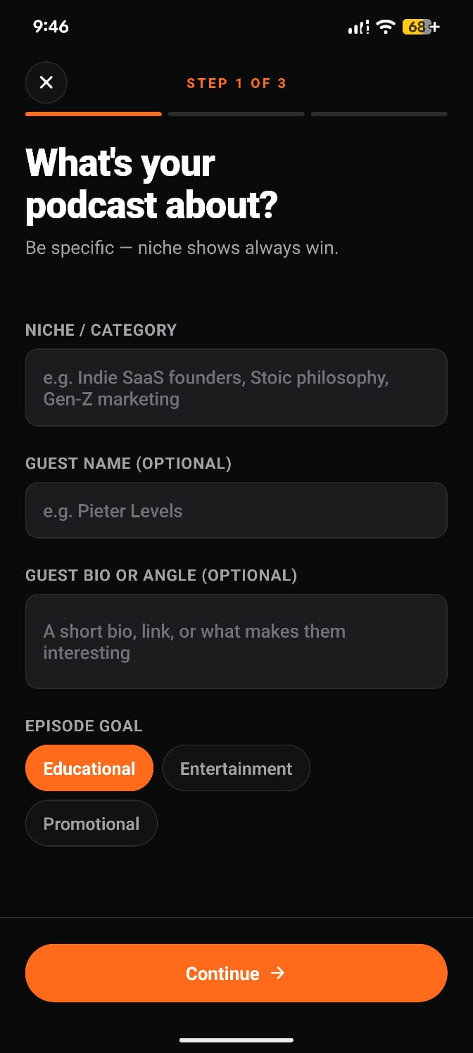
User Interfaces
Interface-2: Create Podcast (Mobile)

Slide 74
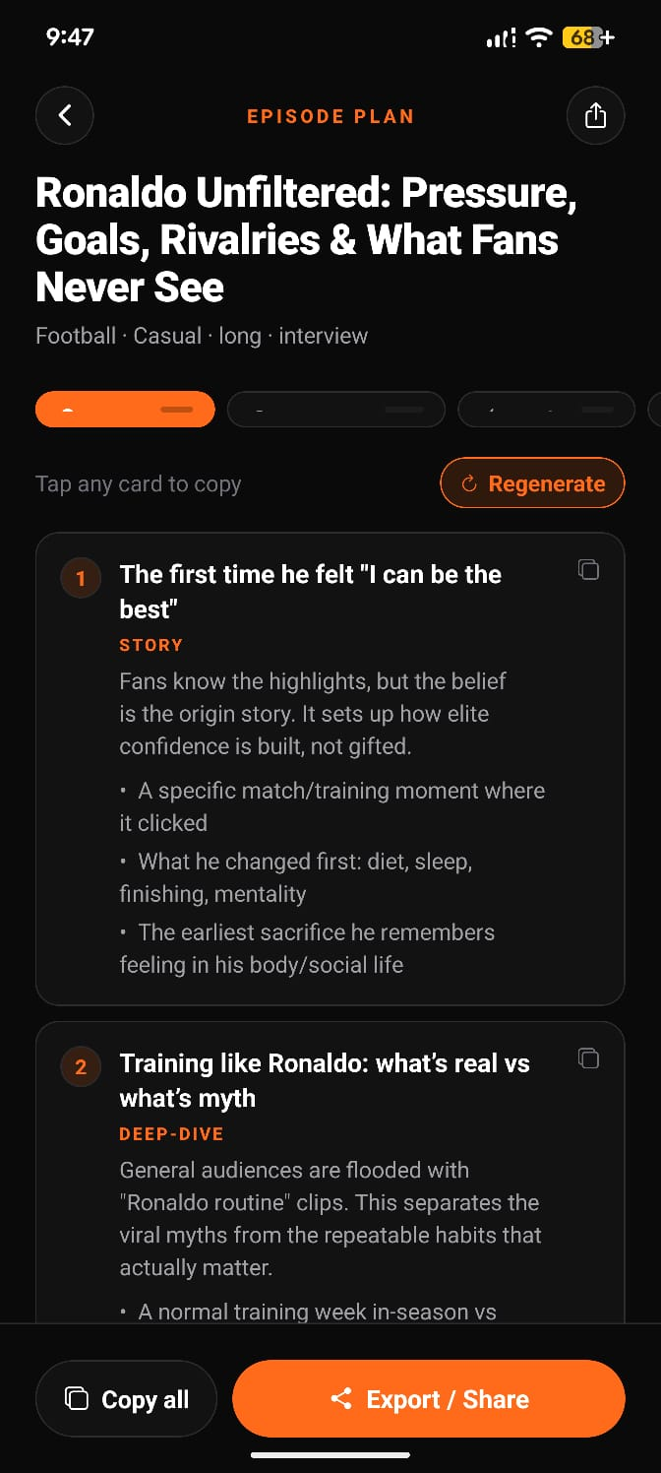
User Interfaces
Interface-3: Result of Podcast Creation (Mobile)

Slide 75
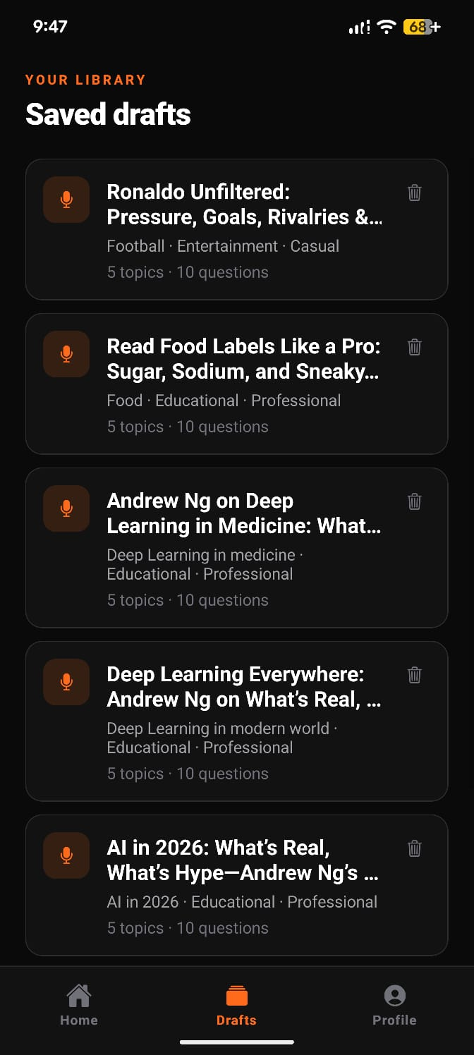
User Interfaces
Interface-4: Research Result Dashboard (Mobile)

Slide 76
Testing

Slide 77
Testing Methodology
Methodology | Purpose in PodCraft | Reason for Selection
Unit Testing | Verify individual functions (validateEmail, matchPassword, generateJWT, hashPassword, extractJSON, distributeTimestamps, rankHooks, exportOutlineTXT) | Ensures each small component works correctly in isolation before integration; catches bugs early in development lifecycle
Functional Testing | Validate end-to-end features (User Registration, Login, Episode Creation Wizard, Results Screen Tabs, Drafts Library, Profile & Sign Out) | Tests system from user's perspective; ensures features meet requirements as specified in SRS
Decision Table Testing | Test business rules (BR-1 Signup Validity, BR-2 Episode Length Duration, BR-3 User-Scoped Access, BR-4 Regenerate Section Scope) | Business rules have multiple conditions; decision tables provide systematic coverage of all input combinations
Integration Testing | Test module interfaces (Auth ↔ Episode Creation, Episode Service ↔ GPT-5.2 API, Episode Service ↔ MongoDB, Frontend ↔ Backend over HTTPS) | Verifies that modules developed by different team members work together correctly; catches interface-level defects

Slide 78
List of Test Case Cases Module Wise
Module 1: User Authentication & Profile Management (Web Dashboard)
Test Case Id | Test Case Title | Test Case Description | Test Case Detail
TC-Web-1.1 | Verify Email Validation | User enters email in different formats; system validates correctly. | UT_1_1_001
TC-Web-1.2 | Verify Password Match | User enters password and confirm password; system checks exact equality. | UT_1_2_001
TC-Web-1.3 | Verify JWT Generation | System generates three-part token that decodes to correct user ID. | UT_1_3_001
TC-Web-1.4 | Verify Password Hashing | System hashes password using bcrypt with 2b2b prefix. | UT_1_4_001
TC-Web-1.5 | Verify Login Endpoint | User logs in with valid/invalid credentials; system returns 200/401. | UT_1_5_001
TC-Web-1.6 | Verify Signup Endpoint | User signs up with unique email; system rejects duplicates and malformed emails. | UT_1_6_001
TC-Web-1.7 | Verify User Registration | User registers with valid data; account created and JWT returned. | FT-1 (Case 1)
TC-Web-1.8 | Verify Registration with Existing Email | User registers with already registered email; system shows error. | FT-1 (Case 2)
TC-Web-1.9 | Verify Login with Valid Credentials | User logs in with seeded account; dashboard loads successfully. | FT-2 (Case 1)
TC-Web-1.10 | Verify Login with Wrong Password | User enters incorrect password; system shows invalid credentials error. | FT-2 (Case 2)

Slide 79
Module 2: Episode Setup & Guest Management (Web Dashboard)
Time | Test Case Title | Test Case Description | Test Case Detail
TC-Web-2.1 | Verify Niche Validation | User enters niche/topic; system rejects empty or whitespace-only input. | UT_2_1_001
TC-Web-2.2 | Verify AI Prompt Builder | System builds prompt embedding all wizard fields (niche, guest, goal, tone, length, format). | UT_2_2_001
TC-Web-2.3 | Verify Episode Creation Step 1 | User enters niche and selects goal; system advances to step 2. | FT-3 (Case 1)
TC-Web-2.4 | Verify Episode Creation with Empty Niche | User leaves niche empty; system shows validation alert. | FT-3 (Case 2)
TC-Web-2.5 | Verify Episode Creation Step 2 | User picks tone, length, format; system advances to step 3. | FT-3 (Case 3)
TC-Web-2.6 | Verify Full Episode Generation | User reviews summary and taps Generate; system displays results with all tabs. | FT-3 (Case 4)
TC-Web-2.7 | Verify Drafts Library | User opens Drafts tab; saved episodes listed by creation date descending. | FT-5 (Case 1)
TC-Web-2.8 | Verify Delete Draft | User long-presses draft card; system shows confirmation and removes draft. | FT-5 (Case 2)
TC-Web-2.9 | Verify Refresh Drafts | User pulls down to refresh; list refreshes from API. | FT-5 (Case 3)

Slide 80
Module 3: Topic Research, Question, Hook & Outline Generation (AI Agent Pipeline)
Test Case Id | Test Case Title | Test Case Description | Test Case Detail
TC-Web-3.1 | Verify JSON Extraction | System strips Markdown fences and parses JSON from LLM response. | UT_3_1_001
TC-Web-3.2 | Verify Timestamp Distribution | System produces N ascending mm:00 markers across episode duration. | UT_3_2_001
TC-Web-3.3 | Verify Hook Ranking | System orders hook objects by descending text length. | UT_3_3_001
TC-Web-3.4 | Verify TXT Export | System renders episode title and outline sections with duration and purpose. | UT_3_4_001
TC-Web-3.5 | Verify Results Screen Tabs | User taps each pill tab (Topics, Questions, Hooks, Outline, Timestamps); content swaps correctly. | FT-4 (Case 1)
TC-Web-3.6 | Verify Regenerate Hooks | User taps Regenerate on Hooks tab; only hooks array changes; other sections preserved. | FT-4 (Case 2)
TC-Web-3.7 | Verify Copy Single Item | User taps any card; system shows "Copied to clipboard" toast. | FT-4 (Case 3)
TC-Web-3.8 | Verify Copy All | User taps "Copy all" button; full Markdown plan copied to clipboard. | FT-4 (Case 4)
TC-Web-3.9 | Verify Export/Share | User taps "Export/Share" button; native OS share sheet opens with plan text. | FT-4 (Case 5)
TC-Web-3.10 | Verify Profile and Sign Out | User opens Profile tab; shows user details; tap Sign out; token cleared; redirect to login. | FT-6 (Case 1-2)

Slide 81
List of Test Case Cases Module Wise
Module 1: User Authentication & Profile Management (Mobille Dashboard)
Test Case Id | Test Case Title | Test Case Description | Test Case Detail
TC-Mobile-1.1 | validateEmail() | Verifies that email validation correctly identifies valid and invalid email formats. | UT_1_1_001
TC-Mobile-1.2 | matchPassword() | Verifies that password and confirm-password matching enforces exact, case-sensitive equality before submission. | UT_1_2_001
TC-Mobile-1.3 | generateJWT() | Verifies that the JWT generator produces a well-formed three-part token and decodes back to the same user identifier. | UT_1_3_001
TC-Mobile-1.4 | hashPassword() / verifyPassword() | Verifies bcrypt hashing produces a $2b$ prefixed hash and verification returns True/False correctly. | UT_1_4_001
TC-Mobile-1.5 | POST /api/auth/login | Verifies the login endpoint returns 200 with token for valid credentials and 401 for invalid credentials. | UT_1_5_001
TC-Mobile-1.6 | POST /api/auth/signup | Verifies the signup endpoint creates new account, rejects duplicate emails, and rejects malformed emails. | UT_1_6_001

Slide 82
Module 2: Episode Setup & Guest Management (Mobile Dashboard)
Test Case Id | Test Case Title | Test Case Description | Test Case Detail
TC-Mobile-2.1 | validateNiche() | Verifies that the niche/topic input passes validation when non-empty and rejects empty or whitespace-only input. | UT_2_1_001
TC-Mobile-2.2 | buildEpisodePrompt() | Verifies that the AI prompt builder embeds every wizard input (niche, guest, goal, tone, length, format) into the final prompt sent to GPT-5.2. | UT_2_2_001

Slide 83
Module 3: Topic Research, Question, Hook & Outline Generation (AI Agent Pipeline)
Test Case Id | Test Case Title | Test Case Description | Test Case Detail
TC-Mobile-3.1 | extractJSON() | Verifies the LLM response parser strips Markdown code fences and parses valid JSON from a wrapped response. | UT_3_1_001
TC-Mobile-3.2 | distributeTimestamps() | Verifies the timestamp distributor produces N ascending mm:00 markers beginning at 00:00 across a target episode duration. | UT_3_2_001
TC-Mobile-3.3 | rankHooks() | Verifies the hook ranker orders hook objects by descending text length (used as a proxy for development depth). | UT_3_3_001
TC-Mobile-3.4 | exportOutlineTXT() | Verifies the TXT exporter renders the episode title and each outline section with its duration and purpose. | UT_3_4_001

Slide 84
Lesson Learnt
Student Name and Registration # | Lesson Learned
Muhammad Awais Ashraf: FA23-BDS-053 | Technical: Mobile App Development with React Native & Expo, Backend API Integration with FastAPI, NoSQL Database Management with MongoDB, AI API Integration using LLM (GPT-5.2), Unit & Integration Testing, JWT Authentication & AsyncStorage session handling. Non-technical: Learned how to manage a full development cycle under academic deadlines; improved problem-solving skills as I debugged real environment issues like bcrypt truncation and iOS Expo Go flex rendering bugs, strengthened team collaboration by dividing responsibilities clearly between web and mobile, and gained confidence in building and deploying a production-ready AI-powered application from scratch.
Asna Hammad FA23-BDS-051 | Technical: Full-Stack Web Integration, Building an app in react, Testing Methodologies, JWT Authentication, Error Handling, How a systematic software development works. Non-technical: Learned that strong determination and focus can overcome even the tightest deadlines, time management; as I prioritized tasks effectively and worked beyond comfort zones to meet semester milestones, team collaboration, Problem Solving as I faced challenges like bcrypt 72-byte limitation.

Slide 85
Work Break Down
Milestones | Asna Hammad (FA23-BDS-051) | Awais Ashraf (FA23-BDS-053)
SCOPE Document and SCOPE presentation | Document: Software Process & Methodology, Problem Solution, Stakeholders, Mobile Modules, Mobile Mockups, Presentation Formatting. Presentation: All slides except Web Modules and Web Mockups (Title, Abstract, Research, Introduction, Problem Statement, Solution, Motivation, Existing Systems, Skills, Advantages, Scope, Limitations, Methodology, Tools, Stakeholders, Work Division, Requirements, Concepts, Gantt Chart, Mobile Mockups, Conclusion, References, Plagiarism, and overall presentation formatting). | Scope Document: Introduction, Objectives, Literature Review (with comparison table), Advantages, Abstract, Problem Statement, Vision Statement, Scope, Limitations, Data Gathering, Tools & Technologies, WBS & Gantt Chart, References, Web Modules (Client Web & Admin Web), Web Mockups, Document Formatting. Presentation: Web Modules Slides, Web Mockups Slides.
SRS Document and SRS Presentation | Word Doc: Whole chapter 1(1.1-1.11), 2.4 mockups for mobile app, Use case diagram, 2.5.1: Use case lists + 2.5.2: tables + 2.6: functional requirements for first 2 modules, plagiarism report for word. Word doc formatting Presentation: Slides 1-5, 15, 16, 19-29, 31 | Word doc: Chapter 2(2.1- 2.4), mockups for web, 2.5: use case description, 2.5.1/2 (use case lists and tables for remaining 4 modules), 2.6 (Functional Requirements tables for remaining 4 modules), 2.7, 2.8, references, plagiarism report for pptx. pptx formatting Presentation: slides 9-14, 17, 18, 30, 32, 33
SDS Document and SDS Presentation | Section 3.2, Architecture Pattern (whole) Section 3.3.1 Sequence diagrams (all) Section 3.3.2 class diagram Section 3.3.5 usecase diagram document formatting | Section 3.1 System architecture overview (whole) Section 3.3.3 Activity diagrams (all) Section 3.3.4 State Diagrams (all) Section 3.4 (whole)
Project Design (Figma and Implementation) | Web prototype + Implementation | Mobile App prototype + implementation
Project Test Plan and Presentation | All web app testcases | All mobile app testcases
Project Final Report and Presentation | Slides 7-25, 41-47, 55-59, 62-67, 73-76 | Slides 1-6,26-39, 48-54, 60, 68-72, 77-79

Slide 86
Reviews Details
Milestones | Reviewer-1 Comments (Asna Hammad FA23-BDS-051) | Reviewer-2 Comments (Awais Ashraf FA23-BDS-053)
SCOPE Document and SCOPE Presentation | Scope well-defined; modules clearly listed. Suggested adding more detail to limitations section. Accepted and added LI-1 to LI-7. | Good problem statement and objectives. Recommended adding WBS and Gantt chart. Accepted and added.
SRS Document and SRS Presentation | Functional requirements complete. Suggested adding more use case descriptions. Accepted and added 2.5.2 tables. | Non-functional requirements well quantified. Recommended adding mockup-based requirement analysis technique. Accepted and added in section 2.4.
SDS Document and SDS Presentation | Sequence diagrams well drawn for all modules. Suggested adding state diagrams for AI agents. Accepted and added in section 3.3.4. | Class diagram follows MVC pattern correctly. Recommended adding data design section. Accepted and added section 3.4.
Project Design (Figma and Implementation) | UI mockups align with requirements. Suggested improving mobile navigation. Accepted and updated bottom nav bar. | Backend controllers well structured. Recommended adding research templates for more niches. Accepted and added Technology, Business, Health, Personal Development.
Project Test Plan and Presentation | Unit test cases detailed. Suggested adding business rules testing. Accepted and added decision tables for BR-1 to BR-4. | Integration testing covers all modules. Recommended adding functional testing for drafts library. Accepted and added FT-5.
Project Final Report and Presentation | Overall report well organized. Suggested adding lessons learned section. Accepted and added. | Testing summary shows 98.77% pass rate. Recommended adding bcrypt limitation mitigation. Accepted and added password length validation.

Slide 87
Conclusion
PodCraft bridges the pre-production gap by automating the most time-consuming parts of podcasting.
By using collaborative AI agents, it ensures high-quality content structure and increased audience engagement.
It serves as a professional "Digital Producer" for both independent and professional creators.

Slide 88
References
R. S. Pressman and B. R. Maxim, Software Engineering: A Practitioner’s Approach, 2019.
S. B. Roy and A. Das, "Artificial Intelligence in Content Generation," Journal of Intelligent Systems, 2021.
L. Zhang and M. Lee, "NLP in Digital Media," IJCSIT, 2022.
OpenAI, "GPT Technology Overview," https://openai.com/research, 2024.
MongoDB Inc., "Documentation," https://www.mongodb.com/docs, 2024.

Slide 89
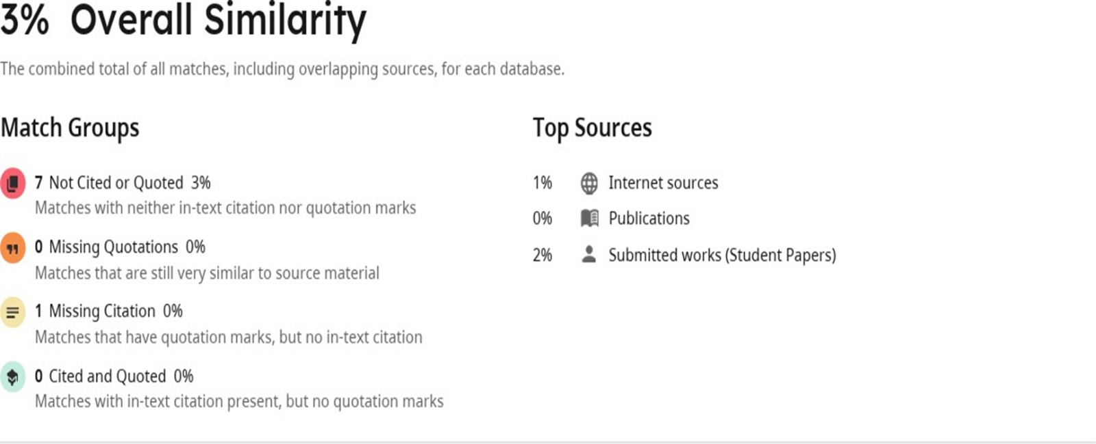
Plagiarism Report

Slide 90

Questions and Answers

