Slide 1

Department Of Computer Science

Slide 2
Software Requirement Specification
PodCraft: Agentic AI Podcast Episode Planning System
Asna Hammad
FA23-BDS-051
Awais Ashraf
FA23-BDS-053
Supervisor:
Dr. Tehseen Raza Abbassi
Department Of Computer Science
Submission Date: 3rd April 2026

Slide 3
Project Category
B- Web Application/Web Application based Information System
E- Smartphone Application
J- Artificial Intelligence
M- Database & Cloud Services

Slide 4
Research Based Project
Yes,
Papers to be Studied:
  Software Engineering: A Practitioner's Approach (R. S. Pressman & B. R. Maxim)
  Artificial Intelligence in Content Generation (S. B. Roy & A. Das)
  Applications of Natural Language Processing in Digital Media (L. Zhang & M. Lee)
  Automated Content Structuring Using Intelligent Agents (J. Kim & P. Robinson)
  AI-Based Conversational Systems for Creative Industries (T. Williams)

Slide 5
Introduction
Purpose:
  To develop a smart platform that assists podcasters in preparing structured episodes with minimal manual effort.
Key Goals:
  Modernize podcast planning by combining AI automation with creative assistance.
  Provide intelligent research, content planning, and episode structuring support.
Impact:
  Supports creators in educational, entertainment, and professional fields globally.

Slide 6
Tools and Technologies
Tools | Versions | Rationale
Python | 3.11 | Backend development and AI processing
JavaScript | ES6 | Frontend and backend scripting
Typescript | 5.3 | Type-safe frontend development
React JS | 18.2 | Web frontend framework
React Native | 0.72 | Cross-platform mobile app development
Node JS | 20.10 | Server-side runtime environment
Express JS | 4.18 | Backend web framework
OpenAI API | Latest | AI content generation and intelligent agents
REST API | V1 | Communication between frontend and backend

Slide 7
Scope
Includes:
  Web and smartphone platforms, autonomous agents for research, trend analysis, question generation, and timestamp allocation.
Functionalities:
  Secure user authentication, cloud storage, and editable/exportable episode plans.
Exclusions:
  Does not include audio recording, editing, or direct publishing.

Slide 8
Modules
Module 1: User Authentication & Profile Management
Module 2: User Intent & Guest Analyzer
Module 3: Topic Research Agent
Module 4: Question and Timestamp Generator
Module 5: Hook & Intro Suggestion Agent
Module 6: Episode Outline Planner

Slide 9
Module 1: User Authentication & Profile Management
Use Case Id | Use Case Title | Use Case Description | Functional Requirement
M1-UC1 | User Registration | User Registration functionality will be available to users of the application. | The system shall allow users to register via email and password.
M1-UC2 | User Login | User Login functionality will be available to users of the application. | The system shall authenticate users and establish a secure session.
M1-UC3 | Password Recovery | Password Recovery functionality will be available to users of the application. | The system shall send a password reset link via email.
M1-UC4 | Create Podcast Profile | Create Podcast Profile functionality will be available to users of the application. | The system shall allow users to create a named podcast profile.
M1-UC5 | Select Podcast Niche | Select Podcast Niche functionality will be available to users of the application. | The system shall allow users to select a podcast niche category.
M1-UC6 | View Episode History | View Episode History functionality will be available to users of the application. | The system shall display all previously generated episodes.
M1-UC7 | Add Guest Profile | Add Guest Profile functionality will be available to users of the application. | The system shall allow users to add guest details and bio.
M1-UC8 | Edit Guest Profile | Edit Guest Profile functionality will be available to users of the application. | The system shall allow users to update any guest profile field.
M1-UC9 | Delete Saved Plan | Delete Saved Plan functionality will be available to users of the application. | The system shall delete a saved plan after user confirmation.
M1-UC10 | Update Account Settings | Update Account Settings functionality will be available to users of the application. | The system shall allow users to update their account information.
M1-UC11 | Logout | Logout functionality will be available to users of the application. | The system shall terminate the session and redirect to login.
M1-UC12 | Delete Account | Delete Account functionality will be available to users of the application. | The system shall permanently delete account after confirming.

Slide 10
Module 2: User Intent & Guest Analyzer
Use Case Id | Use Case Title | Use Case Description | Functional Requirement
M1-UC1 | Provide Podcast Niche and Topic | Users will provide the podcast niche and topic to guide content generation. | The system shall allow users to input niche and topic for AI.
M1-UC2 | Submit Guest Profile | Users will submit guest profile details for intent analysis. | The system shall allow users to submit guest details for analysis.
M1-UC3 | Specify Episode Goals and Format | The system shall allow users to define episode goals and format. | The system shall allow users to define episode goals and format.
M1-UC4 | Review Analyzed Intent Summary | Users will review the AI-generated intent summary before proceeding. | The system shall display an AI-generated intent summary for review.
M1-UC5 | Edit and Refine Intent Inputs | Users will edit and refine intent inputs to improve accuracy. | The system shall allow users to edit and resubmit intent inputs.
M1-UC6 | Save Podcast Profile for Reuse | Users will save their podcast profile for use in future sessions. | The system shall allow saving intent config as a reusable profile.
M1-UC7 | Switch Between Existing Podcast Profiles | Users will switch between previously saved podcast profiles. | The system shall allow users to switch between saved profiles.
M1-UC8 | Delete Podcast Profile | Users will delete unwanted podcast profiles from the system. | The system shall delete a profile permanently after confirmation.

Slide 11
Module 3: Topic Research Agent
Use Case Id | Use Case Title | Use Case Description | Functional Requirement
M2-UC1 | Initiate Topic Research | Users will initiate the topic research process for their episode. | The system shall trigger AI to research topics based on user inputs.
M2-UC2 | View Researched Topics List | Users will view a list of topics generated by the research agent. | The system shall display AI-generated topics with relevance scores.
M2-UC3 | Filter Topics by Relevance or Recency | Users will filter researched topics by relevance or recency. | The system shall allow filtering topics by relevance or recency.
M2-UC4 | Bookmark Preferred Topics | Users will bookmark preferred topics for quick reference. | The system shall allow users to bookmark preferred topics.
M2-UC5 | Reject Irrelevant Topics | Users will reject topics that are not relevant to their episode. | The system shall allow users to reject and remove irrelevant topics.
M2-UC6 | Request Additional Research Depth | Users will request deeper research on selected topics. | The system shall return deeper insights for a selected topic.
M2-UC7 | View Source References for Topics | Users will view the source references behind researched topics. | The system shall display source references per researched topic.
M2-UC8 | Export Research Summary | Users will export the research summary in a downloadable format. | The system shall export the research summary as PDF or DOCX.

Slide 12
Module 4: Question & Timestamp Generator
Use Case Id | Use Case Title | Use Case Description | Functional Requirement
M3-UC1 | Generate Episode Questions | Users will generate a list of episode questions automatically. | The system shall auto-generate episode questions using the AI agent.
M3-UC2 | Customize Question Count and Type | Users will customize the count and type of questions generated. | The system shall allow users to set question count and type.
M3-UC3 | Edit Individual Questions | Users will edit individual questions to better fit their episode. | The system shall allow inline editing of any generated question.
M3-UC4 | Reorder Questions via Drag-and-Drop | Users will reorder questions using a drag-and-drop interface. | The system shall support drag-and-drop question reordering.
M3-UC5 | Assign Time Allocations to Segments | Users will assign time allocations to each episode segment. | The system shall allow time duration assignment per segment.
M3-UC6 | Auto-Generate Timestamp Structure | The system will auto-generate a timestamp structure for the episode. | The system shall auto-generate timestamps from questions and durations.
M3-UC7 | Preview Full Q&A Timeline | Users will preview the full Q&A timeline before finalizing. | The system shall display a full interactive Q&A timeline preview.
M3-UC8 | Export Questions and Timestamps as PDF/DOCX | Users will export questions and timestamps as PDF or DOCX. | The system shall export questions and timestamps as PDF or DOCX.
M3-UC9 | Share Question Sheet with Guest | Users will share the question sheet directly with their guest. | The system shall generate a shareable link for the question sheet.

Slide 13
Module 5: Hook & Intro Suggestion Agent
Use Case Id | Use Case Title | Use Case Description | Functional Requirement
M4-UC1 | Generate Multiple Hook Variants | The system will generate multiple hook variants for the episode intro. | The system shall generate at least three AI hook variants.
M4-UC2 | Select Preferred Hook Style | Users will select their preferred hook style from generated options. | The system shall allow users to choose a preferred hook style.
M4-UC3 | Customize Hook Tone (e.g., dramatic, curious, humorous) | Users will customize the hook tone to match episode mood. | The system shall allow tone selection as an AI generation parameter.
M4-UC4 | Regenerate Hooks with New Parameters | Users will regenerate hooks by adjusting the generation parameters. | The system shall regenerate hooks without discarding prior results.
M4-UC5 | Preview Hook with Episode Context | Users will preview the hook in the context of the full episode. | The system shall display the hook within full episode intro context.
M4-UC6 | Save Hook to Episode Draft | Users will save their chosen hook to the episode draft. | The system shall save the selected hook to the episode draft.
M4-UC7 | View Hook Performance Suggestions | Users will view AI suggestions on improving hook performance. | The system shall provide AI suggestions to improve hook effectiveness.
M4-UC8 | Export Hook as Standalone Script | Users will export the hook as a standalone script file. | The system shall export the hook as a PDF or DOCX script.

Slide 14
Module 6: Episode Outline Planner
Use Case Id | Use Case Title | Use Case Description | Functional Requirement
M5-UC1 | Generate Full Episode Outline | The system will generate a complete outline for the episode. | The system shall generate a full outline combining all episode components.
M5-UC2 | View Outline in Structured Format | Users will view the outline in a clear, structured format. | The system shall display the outline with sections and timestamps.
M5-UC3 | Edit Outline Sections | Users will edit individual sections of the generated outline. | The system shall allow inline editing of any outline section.
M5-UC4 | Reorder Outline Segments | Users will reorder outline segments to fit their episode flow. | The system shall support drag-and-drop outline segment reordering.
M5-UC5 | Add Custom Sections to Outline | Users will add custom sections to personalize the outline. | The system shall allow users to insert custom outline sections.
M5-UC6 | Apply Outline Templates | Users will apply pre-built outline templates to their episode. | The system shall provide pre-built templates to populate the outline.
M5-UC7 | Export Outline as PDF / DOCX / Notion | Users will export the outline as PDF, DOCX, or Notion format. | The system shall export the outline in PDF, DOCX, or Notion format.
M5-UC8 | Share Outline with Team Members | Users will share the episode outline with their team members. | The system shall generate a shareable link with access permissions.
M5-UC9 | Save Outline as Episode Draft | Users will save the outline as an episode draft for later use. | The system shall auto-save and allow manual saving of the outline.

Slide 15
Requirement Elicitation Techniques
Interviews: Conducted with podcast creators to understand their specific workflows and challenges.
Questionnaires: Distributed to creators to gather quantitative data on preparation difficulties.
Observation: Studying how podcasters currently use existing tools like Notion or Descript for planning.
Online Research: Analyzing current podcast production trends and user expectations.
Reasoning: To ensure PodCraft aligns with real-world user needs and solves actual planning bottlenecks.

Slide 16
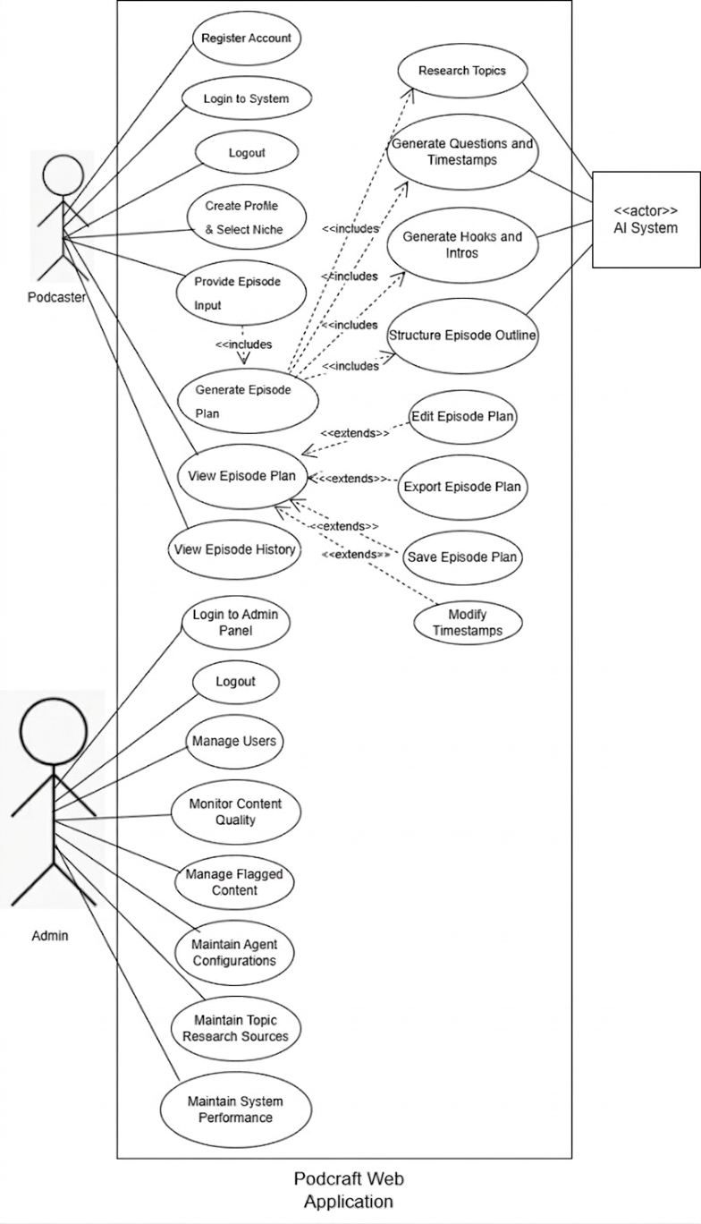
Use Case Diagram

Slide 17
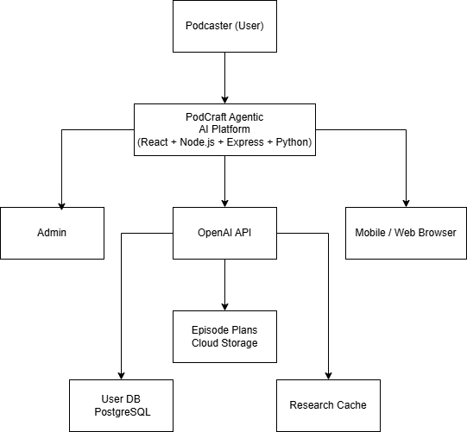
Context / Block Diagram

Slide 18
Non-Functional Requirement
PodCraft - Non-Functional Requirements
Title | Performance Requirements
NFR-1 | The system shall respond to user requests within 3 seconds under normal load. AI agent research tasks shall complete within 15 seconds for a given niche or guest. The platform shall support up to 500 concurrent users with no degradation in response time. API throughput shall handle at least 100 requests per minute.
Title | Reliability
NFR-2 | PodCraft shall maintain 99.5% uptime monthly. The system shall implement automatic failover for critical AI agent services. All episode plans shall be auto-saved every 60 seconds to prevent data loss. Recovery time objective (RTO) shall not exceed 30 minutes in the event of system failure.
Title | Usability
NFR-3 | A new user shall be able to generate their first episode plan within 10 minutes of registration without assistance. The interface shall comply with WCAG 2.1 Level AA accessibility standards. The mobile app UI shall support one-handed use for core features. User satisfaction rating shall target a minimum of 4.0/5.0 in usability surveys.
Title | Supportability
NFR-4 | All backend code shall follow PEP 8 (Python) and Airbnb (JavaScript/TypeScript) coding standards. The system shall include comprehensive API documentation using Swagger/OpenAPI. Module-level unit tests shall achieve a minimum of 80% code coverage. Log levels (INFO, WARN, ERROR) shall be consistently applied to support debugging and monitoring.
Title | Design Constraints
NFR-5 | The system must be built using React JS (web) and React Native (mobile) as mandated by the project scope. All AI agent functionality must utilize the OpenAI API. The backend must follow RESTful API design principles. The system must be deployable on cloud infrastructure (AWS or equivalent) and use PostgreSQL as the primary relational database.
Title | Security
Nfr-6 | The system shall use secure authentication (JWT/OAuth 2.0) and encrypt data using HTTPS (TLS). Role-based access control (RBAC) shall restrict unauthorized access. The system shall protect against common vulnerabilities (SQL injection, XSS, CSRF) and store passwords using secure hashing.

Slide 19
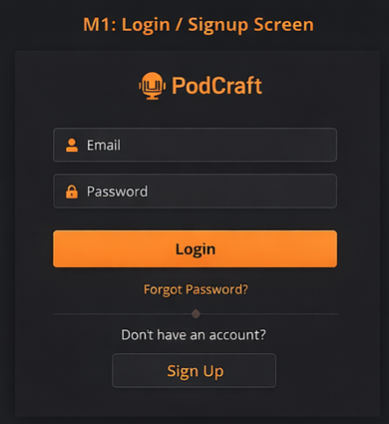
User Interfaces
Interface-01: Login/Sign-up Screen

Slide 20
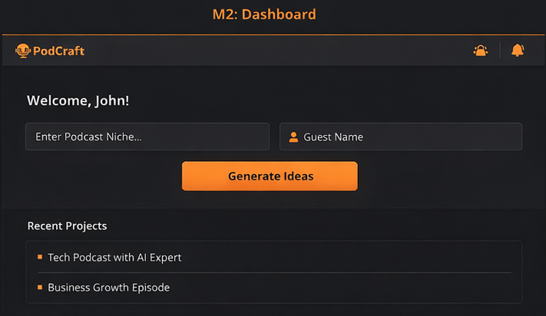
User Interfaces
Interface-02: User Dashboard

Slide 21
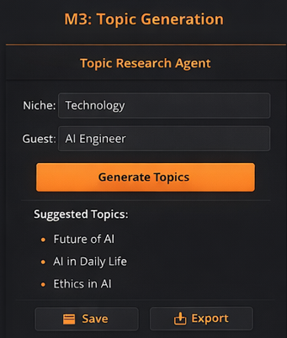
User Interfaces
Interface-03: Topic Research Agent

Slide 22
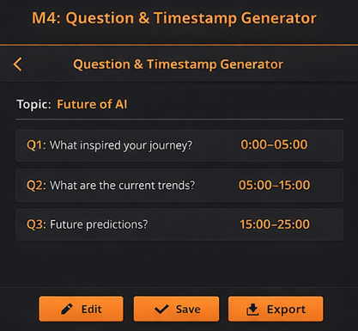
User Interfaces
Interface-04 Question and Timestamp Generator

Slide 23
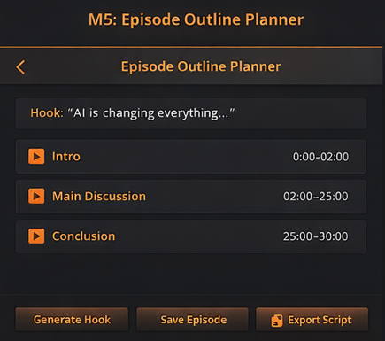
User Interfaces
Interface-05: Episode Outline Planner

Slide 24
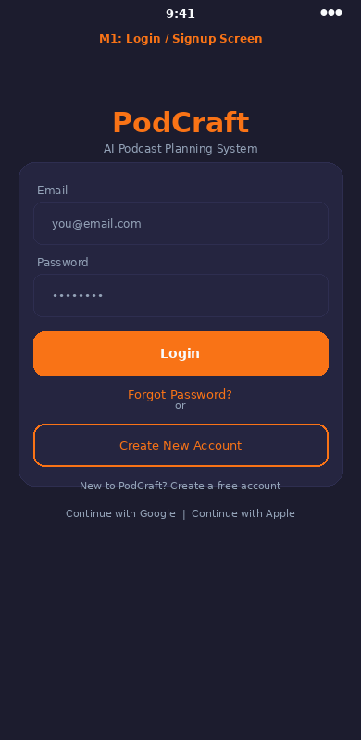
User Interfaces
Interface-06: User Authentication Screen (Mobile)

Slide 25
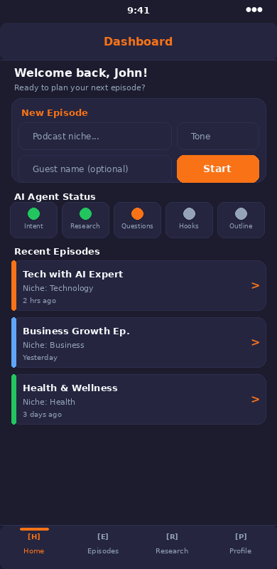
User Interfaces
Interface-07: User Dashboard (Mobile)

Slide 26
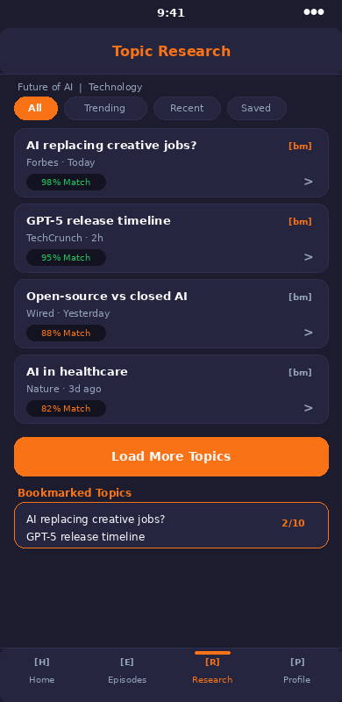
User Interfaces
Interface-08: Topic Research (Mobile)

Slide 27
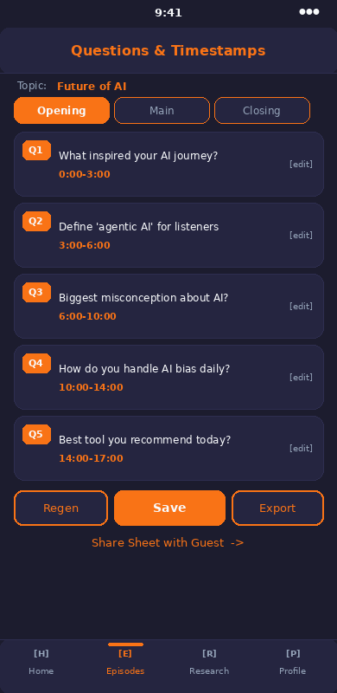
User Interfaces
Interface-09: Questions and Timestamp Generator (Mobile)

Slide 28
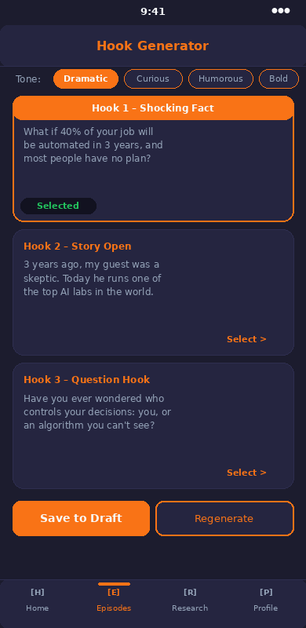
User Interfaces
Interface-10: Hook and Intro Suggestion (Mobile)

Slide 29
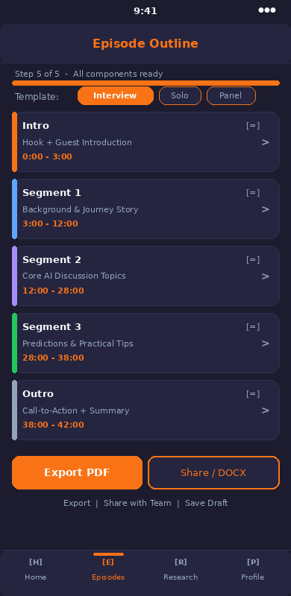
User Interfaces
Interface-11: Episode Outline Planner (Mobile)

Slide 30
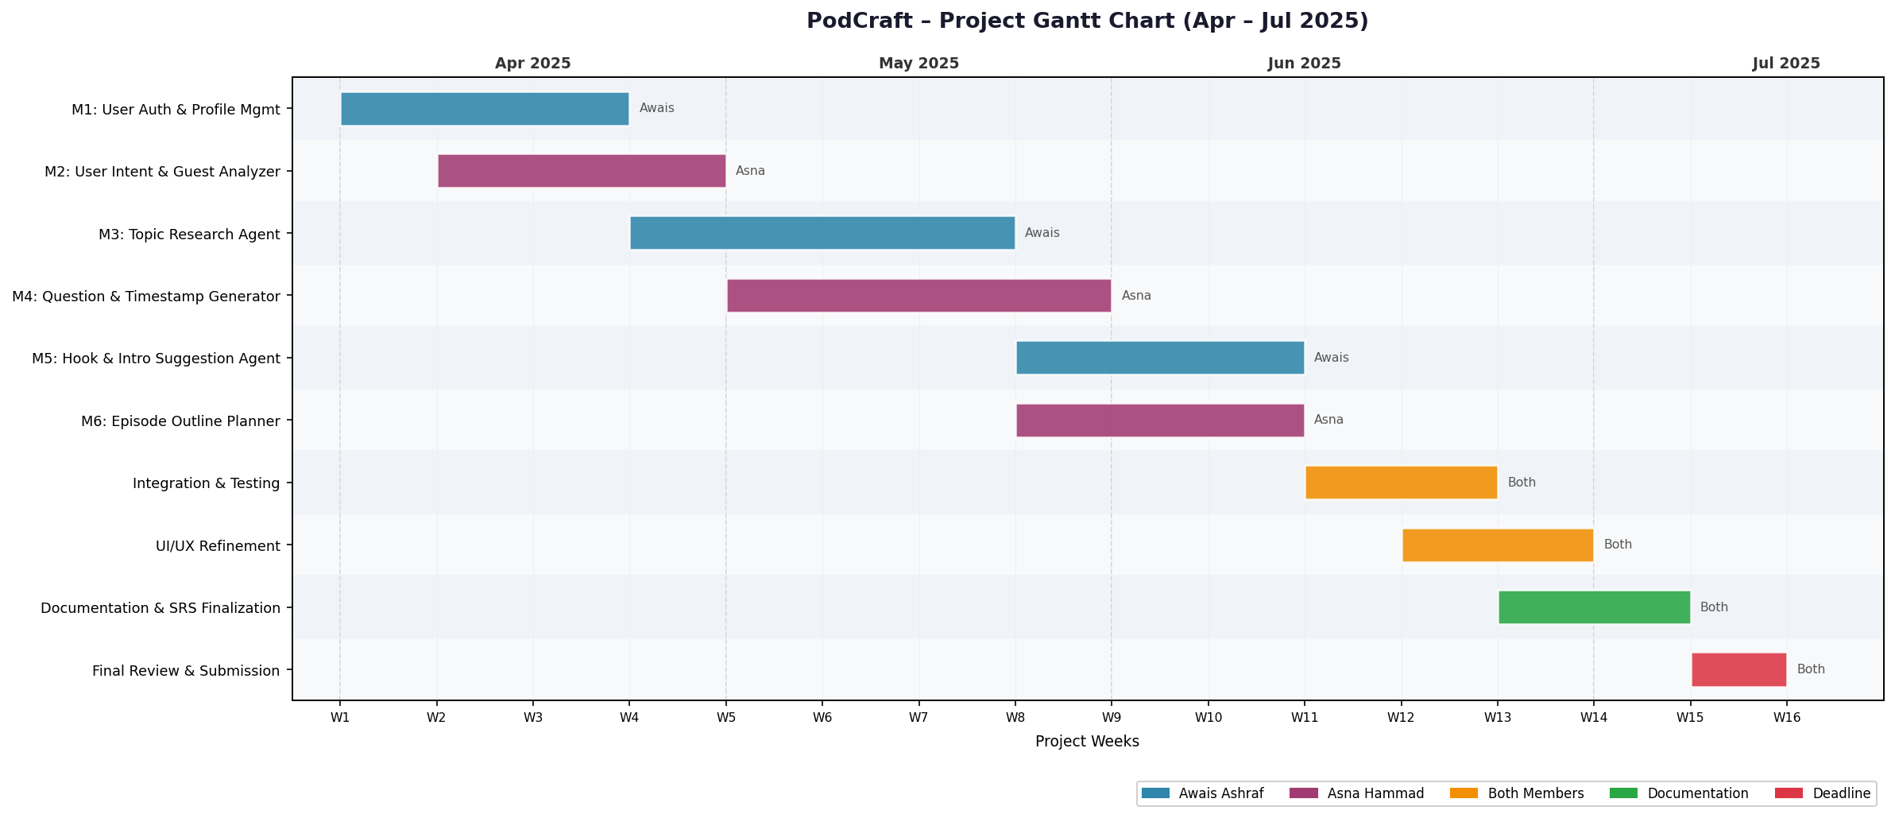
Gantt Chart

Slide 31
Conclusion
PodCraft bridges the pre-production gap by automating the most time-consuming parts of podcasting.
By using collaborative AI agents, it ensures high-quality content structure and increased audience engagement.
It serves as a professional "Digital Producer" for both independent and professional creators

Slide 32
References
[1] Pressman, R. S., & Maxim, B. R. (2019). Software Engineering: A Practitioner's Approach (9th ed.). McGraw-Hill Education.
[2] Roy, S. B., & Das, A. (2022). Artificial Intelligence in Content Generation: Challenges and Opportunities. Journal of AI Research, 45(3), 112-134.
[3] Zhang, L., & Lee, M. (2021). Applications of Natural Language Processing in Digital Media. IEEE Transactions on Multimedia, 23(8), 2987-3001.
[4] Kim, J., & Robinson, P. (2023). Automated Content Structuring Using Intelligent Agents. ACM Computing Surveys, 56(2), 1-28.
[5] Williams, T. (2022). AI-Based Conversational Systems for Creative Industries. International Journal of Human-Computer Studies, 158, 102734.
[6] OpenAI. (2024). GPT-4 Technical Report. Retrieved from https://openai.com/research/gpt-4
[7] React Documentation. (2024). React JS Official Guide. Retrieved from https://react.dev
[8] Meta Platforms. (2024). React Native Documentation. Retrieved from https://reactnative.dev

Slide 33
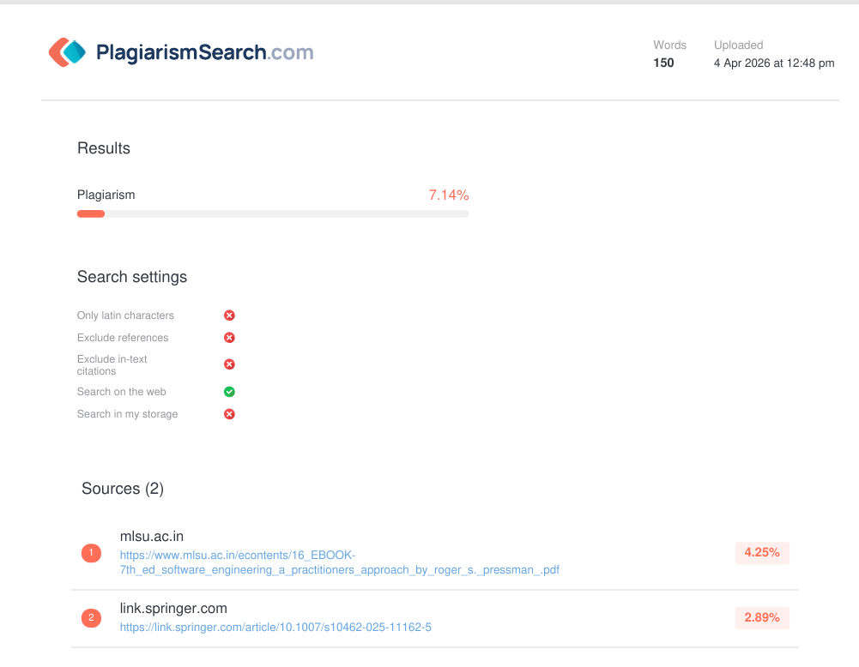
Plagiarism Report

Slide 34

Questions and Answers

